Slide 1
Internet Technology, Economics and Policy
Henning Schulzrinne
http://www.cs.columbia.edu/~hgs/teaching/itep/
Spring 2019

Slide 2
Class overview

Slide 3
Big questions
How does money make the Internet go ‘round?
How does the Internet work, technically?
How come your Internet bill is so high (or low)?
What’s hard about extending the Internet to rural areas?
Is the Internet local, national or international?
What does it mean for the Internet to be “open” or “neutral”?
Do Google and Facebook differ from Comcast and AT&T? Should any of them be able to ban offensive speech on their platform?
How can we make the Internet useful for public safety & people with disabilities?
Why do carriers pay billions of dollars for spectrum?
What exactly is privacy?
What makes “cyber security” hard?

Slide 4
What’s on the syllabus?
Introduction
  Economics of the Internet
Technology
  Overview of Internet technology (how does the Internet work)
  Protocol and architecture standardization (IETF, 3GPP, OMA, ...)
  Wireless communications
    From AM radio to cellular
    Spectrum: properties, allocation and co-existence
Economics
  Review of basic principles of micro-economics
  The economics of networks
    building networks, natural monopolies, …
Law & policy
  How does the law work?
  A bit of communication history
  The role of communication policy and regulation
    Telecom Act, FCC overview
  Common carriage, public utilities, significant market power and other regulatory frameworks

Slide 5
What’s on the syllabus?
Network neutrality and the Open Internet
Peering, transit and traffic exchange
Names, numbers and addresses
Internet security challenges
  Basic principles of network security
  “Cybersecurity”
  Unwanted communication
  Privacy and surveillance
Communication for all
  Enabling technologies for people with disabilities (relay services, accessibility, CVAA, ...)
Internet governance
  ICANN, ITU and other actors

Slide 6
What should you be able to do after taking the class?
Elevator pitch
  “What is spectrum and why is it hard to find” – in 2 minutes
In-depth survey
  “The economics of Internet adoption in rural and urban areas”
Research
  Know sources and approaches
    engineering models vs. economic models vs. legal analysis
  Appreciate need to consider
    technical feasibility
    economic factors
    policy enablers and constraints
    different approaches in different countries

Slide 7
Materials
No formal text book, but draws from
  “Telecommunications Law & Policy” (S. Benjamin, Shelanski, Speta, Weiser), 2012.
  “The Master Switch” (T. Wu).
  “Computer Networking: A Top-Down Approach” (J. Kurose, K. Ross), 7th edition, Pearson, 2017.
Other materials:
  Technical papers (IEEE, ACM, tech reports, …)
  Law review articles (Federal Communications Law Journal)
  SSRN (online paper archive) → TPRC conference
  White papers
  Industry analysis reports (analysts, OECD, Census, …)
  Regulatory filings (FCC, Ofcom, BEREC, …)
  Laws & regulations (US, mostly)

Slide 8
How to benefit from this class
Be prepared (e.g., read assigned materials)
Expand your mental horizon beyond your discipline
Understand positions you may not “like”
Participate in class discussion
Pick an interesting project
  “big data”
  summary of work in an area (“law review for non-lawyers”)
  apps & software for public-good applications
  system modeling

Slide 9
How not to benefit
Catch up on Facebook & Instagram
Cat videos!
Transcribe the class into your notebook
Flip through the slides
Voice only popular opinions
  or opinions you read in the NY Times, WSJ or Breitbart
Believe that the instructor is always right
  on facts or interpretation

Slide 10
Mechanics
Homework assignments
  may allow options to accommodate different backgrounds
  no programming required
Semester (group) paper
  start early – may need to be defined & refined by iteration
  outcome: research paper
  may be review, quantitative analysis or experiment (not just software)
Guest (video) lectures
  colleagues from Washington, DC
Possibly, field trip

Slide 11
Semester project
Pick topic and team by Feb. 8
  including goals and tools
  responsibilities (who will do what)
  observable milestones (every two weeks)
  create project page
  submit via CourseWorks
Bi-weekly progress reports for each team
End-of-semester presentation
Report suitable as technical report, i.e.,
  proper citations (IEEE format, etc.)
  useful abstract
  standard paper conventions, including format and style
  not just a bunch of bullet points or graphs

Slide 12
Semester project
See ITEP project page
Student chosen, with guidance
  encourage cross-disciplinary teams
  teams of 1-3 students
Data analysis
  Measuring Broadband America, ATLAS
  other data sources (FCC, Ofcom, OECD, ITU)
  own data gathering
Measurements
  Open Internet measurements
  911 services: (indoor) location accuracy, non-traditional emergency coordination (Harvey)
  Services for people with disabilities: closed captioning; speech-to-text
  Spectrum measurements
Analysis
  Network economics (e.g., spectrum usage, pricing or universal service)
  In-depth literature review (e.g., privacy, spectrum, rural broadband)

Slide 13
Field trip?
Possible field trip to Washington, DC
  FCC
  NTIA
Interest & logistics

Slide 14
People & Money

Slide 15
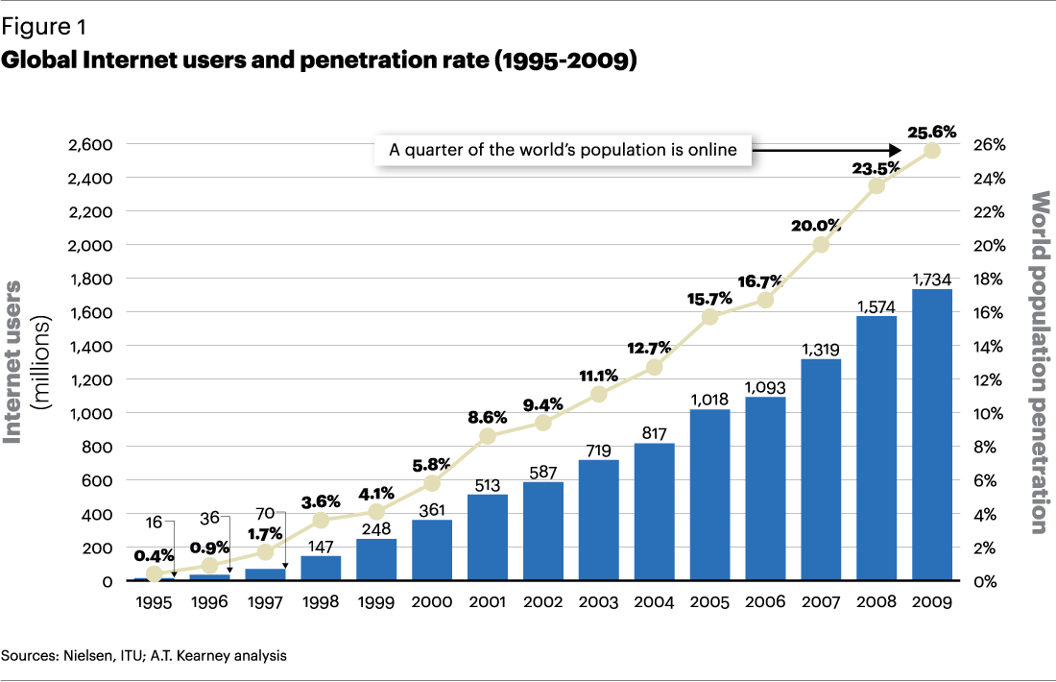
Internet growth – classical view (1995-2009)

Slide 16
Internet growth – 2009–2016

Slide 17
Global Internet users

Slide 18
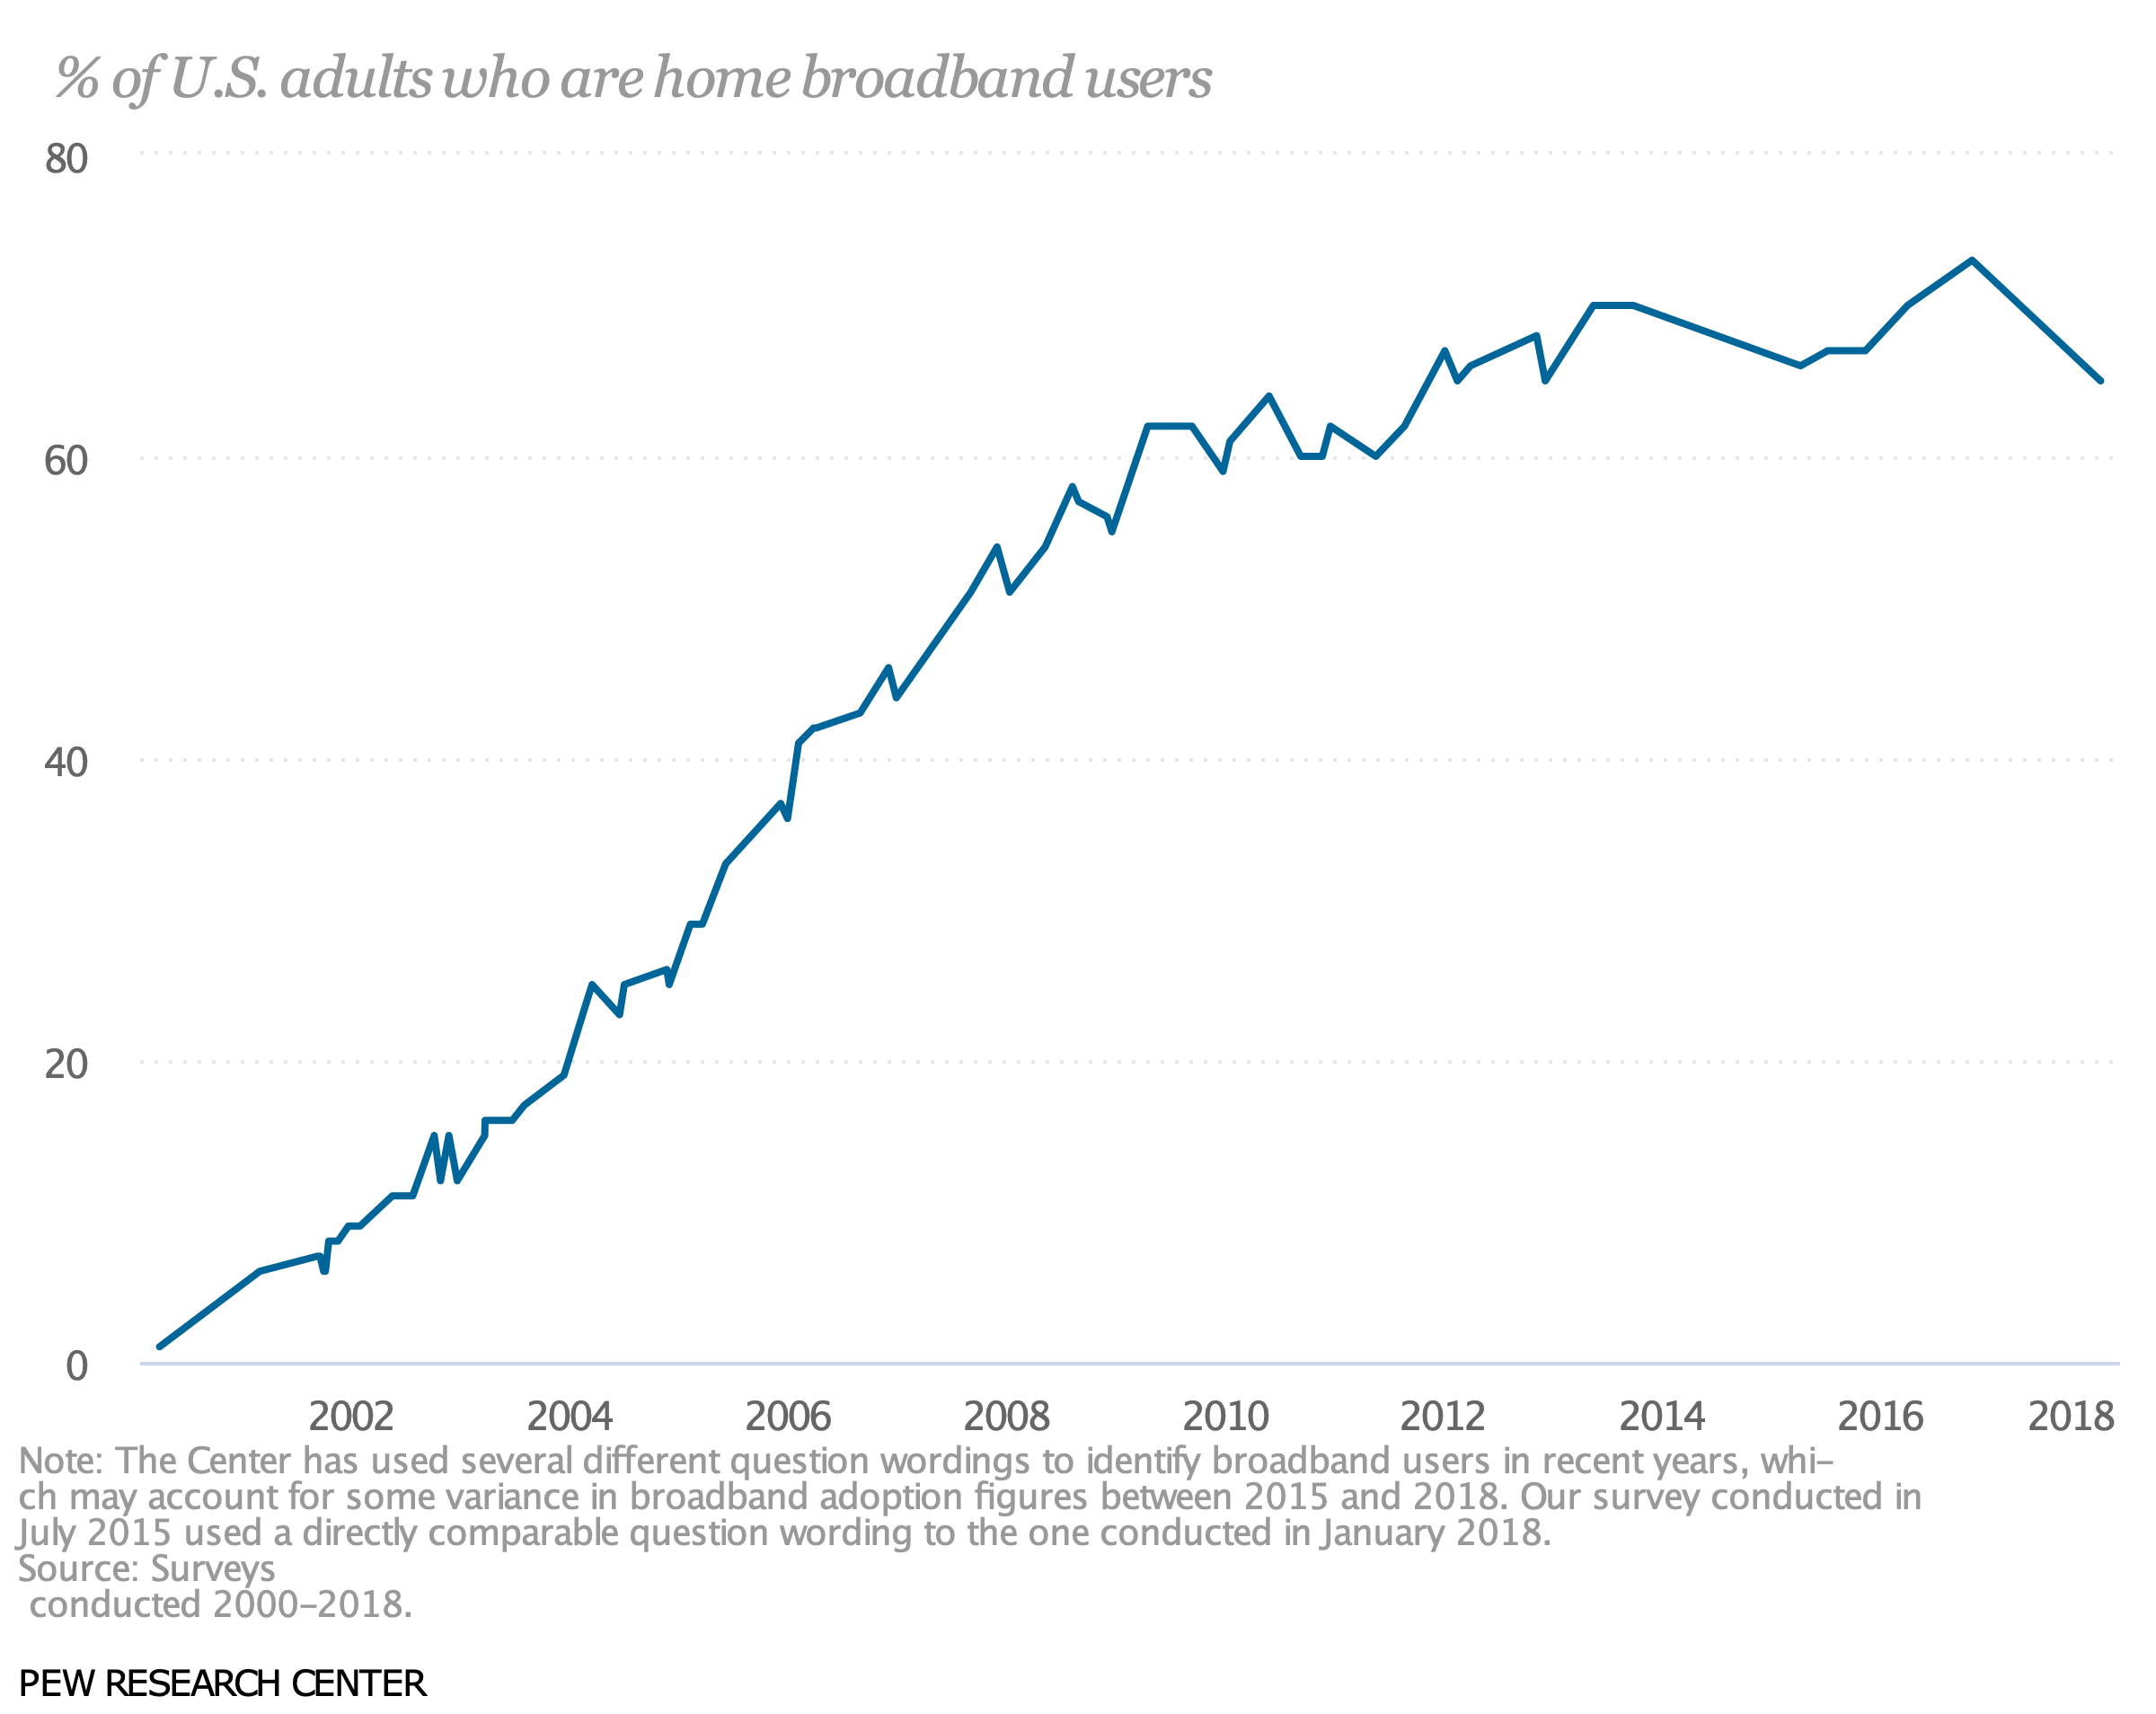
% of US adults who are home broadband users

Slide 19
Dial-up still mattered 10 years ago
56 kb/s

Slide 20
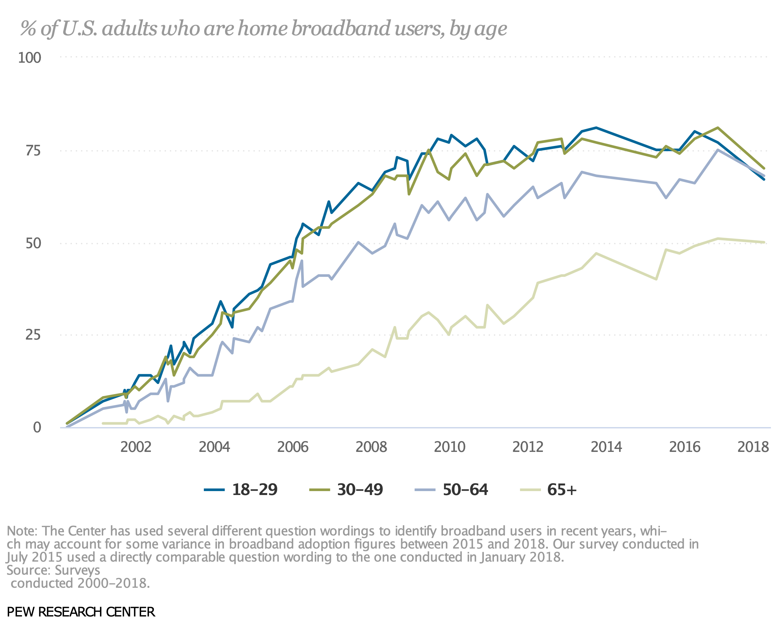
US Internet access
Pew
Notes:
http://www.pewinternet.org/2013/08/26/home-broadband-2013/
http://www.pewinternet.org/three-technology-revolutions/

Slide 21
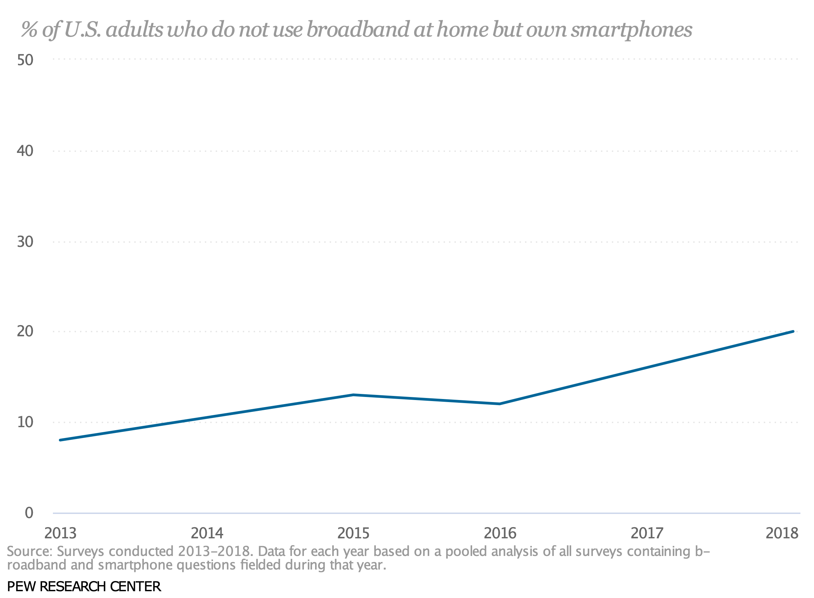
% of U.S. adults who do not use broadband at home but own smartphones

Slide 22
Digital media usage (US)

Slide 23
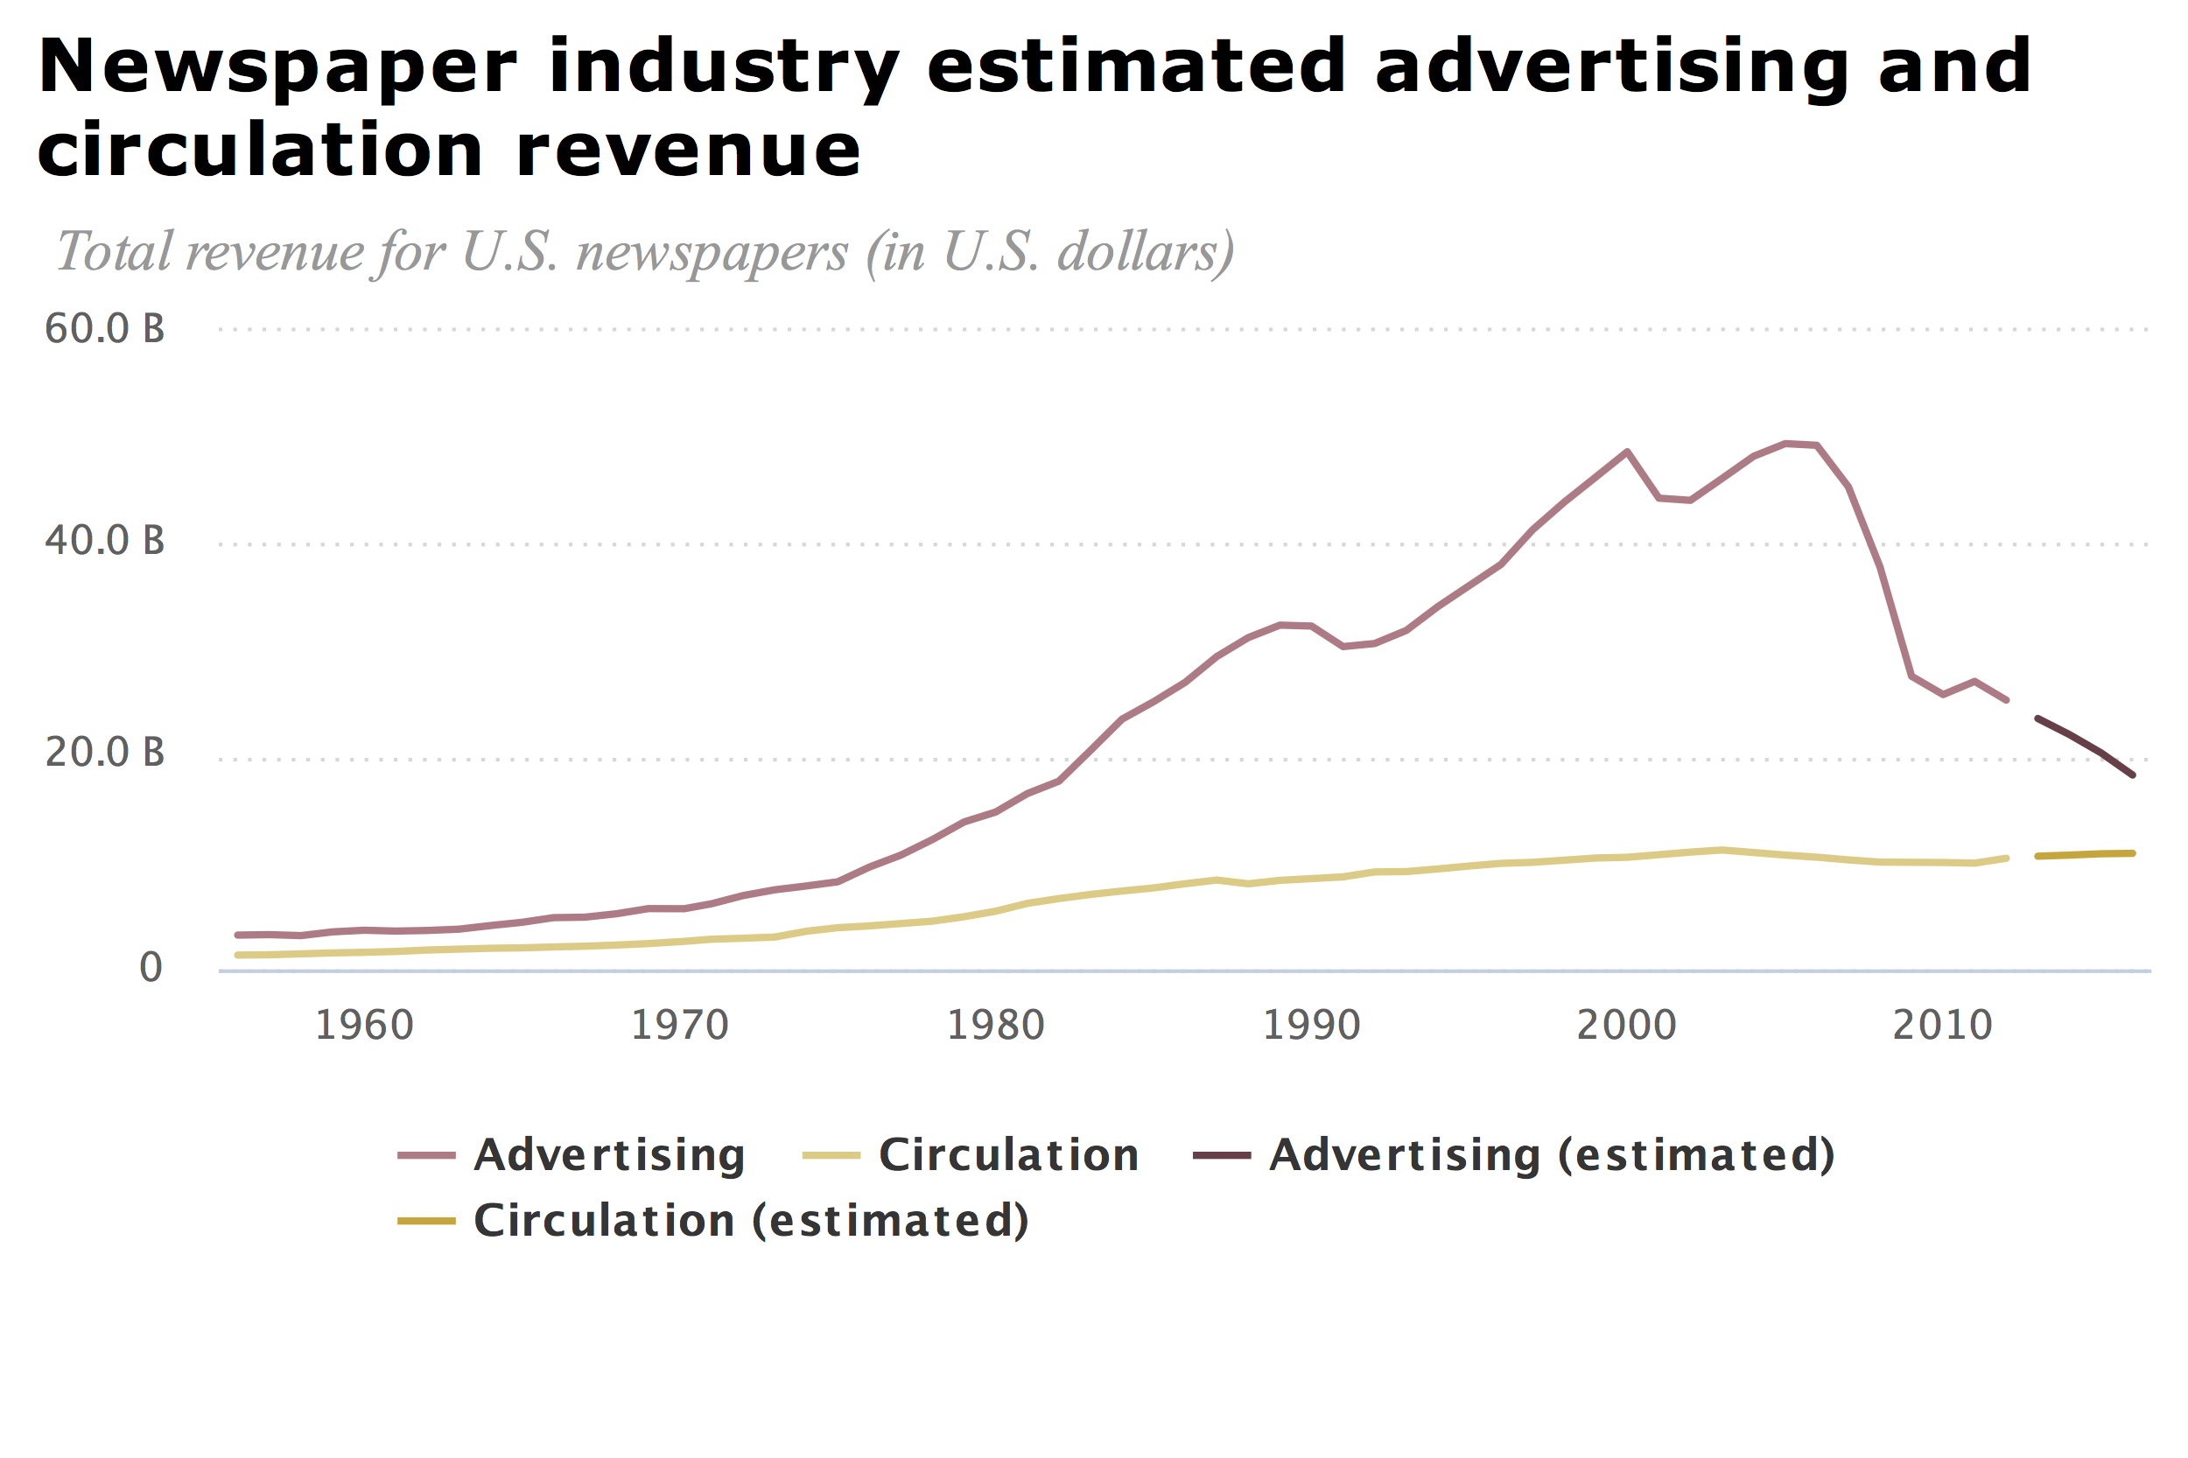
But not all are happy about this…
Notes:
http://www.journalism.org/fact-sheet/newspapers/

Slide 24
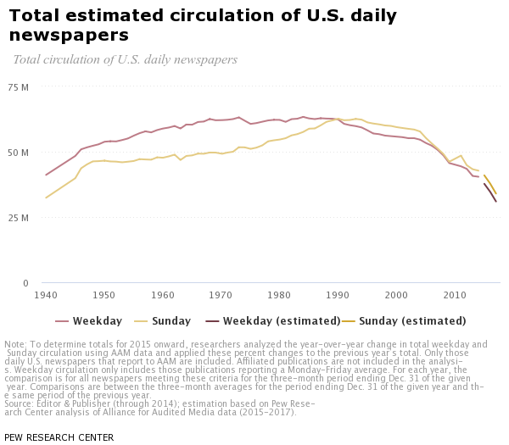
Newspaper circulation

Slide 25
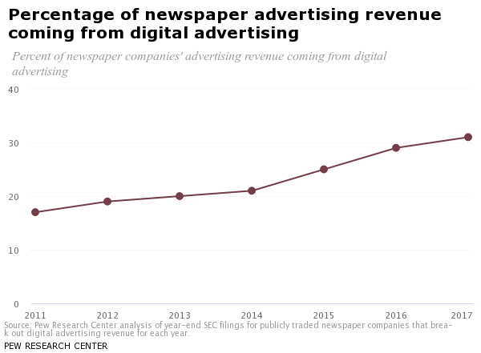
Newspaper revenue

Slide 26
Cord cutting - video

Slide 27
Cord cutting - phone

Slide 28

Media advertising spending
Media advertising spending in the United States from 2015 to 2021 (in billion U.S. dollars)
Advertising spending in the U.S. 2015-2021
Note: United States; 2015 to 2016; includes digital (desktop/laptop, mobile and other internet-connected devices), directories, magazines, newspapers, out-of-home, radio and TV
Further information regarding this statistic can be found on page 107.
Source(s): eMarketer; ID 272314
12
Overview

Slide 29
Advertising as fraction of GDP

Slide 30
Advertising is changing

Slide 31
Print still has room to fall
Advertising spending vs. consumer time spent in the United States in 2017, by medium
Media ad spend vs. time spent in the U.S. in 2017
Note: United States; 2017
Further information regarding this statistic can be found on page 110.
Source(s): IAB; PwC; Kleiner Perkins Caufield & Byers; ID 237288
15
Overview

Slide 32

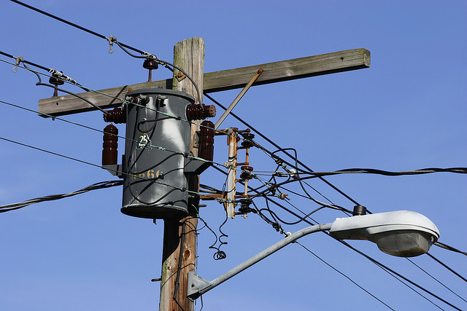









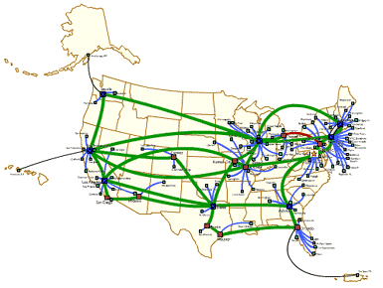
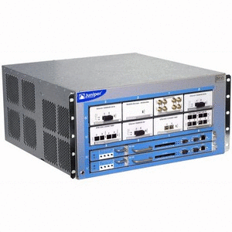
Basic Internet money routing
ISP
Internet
$56B fixed
$141B mobile
$285B (NA, 2016)
consumer spending
($14.2T)
content & service aggregators
OTT
(over-the-top)
$219B
Notes:
http://www.tradingeconomics.com/united-states/consumer-spending
https://tradingeconomics.com/united-states/consumer-spending
$56B total wireline revenue is estimated by taking FCC 477 estimate of 104M connections, at $45/month ARPU. Those are estimated from AT&T, Comcast & Charter data.

Slide 33
Largest advertisers
Largest advertisers in the United States in 2017 (in billion U.S. dollars)
Largest advertisers in the U.S. 2017
Note: United States; 2017; includes measured and unmeasured spending
Further information regarding this statistic can be found on page 111.
Source(s): Kantar Media; Advertising Age; ID 275446
16
Overview

Slide 34
U.S. wireless telecommunication providers
Total revenue of major U.S. wireless telecommunication providers in 2017 (in billion U.S. dollars)
U.S. mobile telecommunications providers ranked by revenue 2017
advertising $104B
Note: United States; 2017
Further information regarding this statistic can be found on page 8.
Source(s): Deutsche Telekom; AT&T; Verizon; US Cellular; Sprint Corporation; ID 201048
2

Slide 35
More industry revenues
Company or sector | US domestic revenue, 2017
Netflix (US) | $6.1B
Cisco (Americas) | $28.4B
US subscription TV (cable, satellite) | $83.3B
US film (box office gross) | $11.07B
US music (incl. concerts) | $17.2B ($8.7B retail, 2/3 streaming)
US games (software & ads) | $17.6B
US wireless telecom (services) | $188.5B
Google (worldwide) | $109.65B (56% international, $67B advertising)
Notes:
http://files.shareholder.com/downloads/NFLX/5135776168x0x938338/FB0485BA-48EF-4457-ABED-CF26A5B21523/10K_Final.PDF
http://clients1.ibisworld.com/reports/us/bed/default.aspx?bedid=4625
http://www.statista.com/statistics/293486/revenue-of-cable-networks-in-the-us/
http://selectusa.commerce.gov/industry-snapshots/media-entertainment-industry-united-states.html
http://www.techtimes.com/articles/9270/20140627/america-china-japan-video-games-revenue.htm
http://www.statista.com/statistics/293490/revenue-of-wireless-telecommunication-carriers-in-the-us/
https://apps.fcc.gov/edocs_public/attachmatch/FCC-15-41A1.pdf
https://www.statista.com/statistics/266206/googles-annual-global-revenue/
https://investor.cisco.com/investor-relations/financial-information/Financial-Results/default.aspx
http://www.businessofapps.com/data/netflix-statistics/#3
https://www.statista.com/statistics/185214/revenue-breakdown-of-us-cable-and-pay-tv-providers/
http://www.riaa.com/wp-content/uploads/2018/03/RIAA-Year-End-2017-News-and-Notes.pdf

Slide 36
Internet service providers (by age)
”phone companies”
  1880s
  (incumbent) Local Exchange Carrier (LEC) & Rural LEC
  large ILECs: AT&T, Verizon
  large RLECs (“independents”): CenturyLink, Frontier, Windstream
  thousands of small RLECs
“cable companies”
  1960s
  all are MVPDs, but phone companies can also be MVPDs
  Comcast, Charter, Cox, Altice, Mediacom
“cellular providers”
  1980s
  AT&T, Verizon, T-Mobile, Sprint
Internet backbone & “dark fiber”
  1990s
  Level3, Cogent, Zayo

Slide 37
The industry is complicated
MVPD (affects video rights & obligations)
cable
(CATV)
satellite
(SAT)
ILEC
RLEC
CLEC
LEC
owns
all entities can serve as a Broadband Internet Access Service (BIAS), commonly known as ISP
almost all ”TV” distributors are MVPDs, but not all MVPDs are ISPs (e.g., satellite)
AT&T, as an ILEC, owns a satellite MVPD (DirecTV)
Same company can be ILEC in one state & CLEC in another (rare)

Slide 38
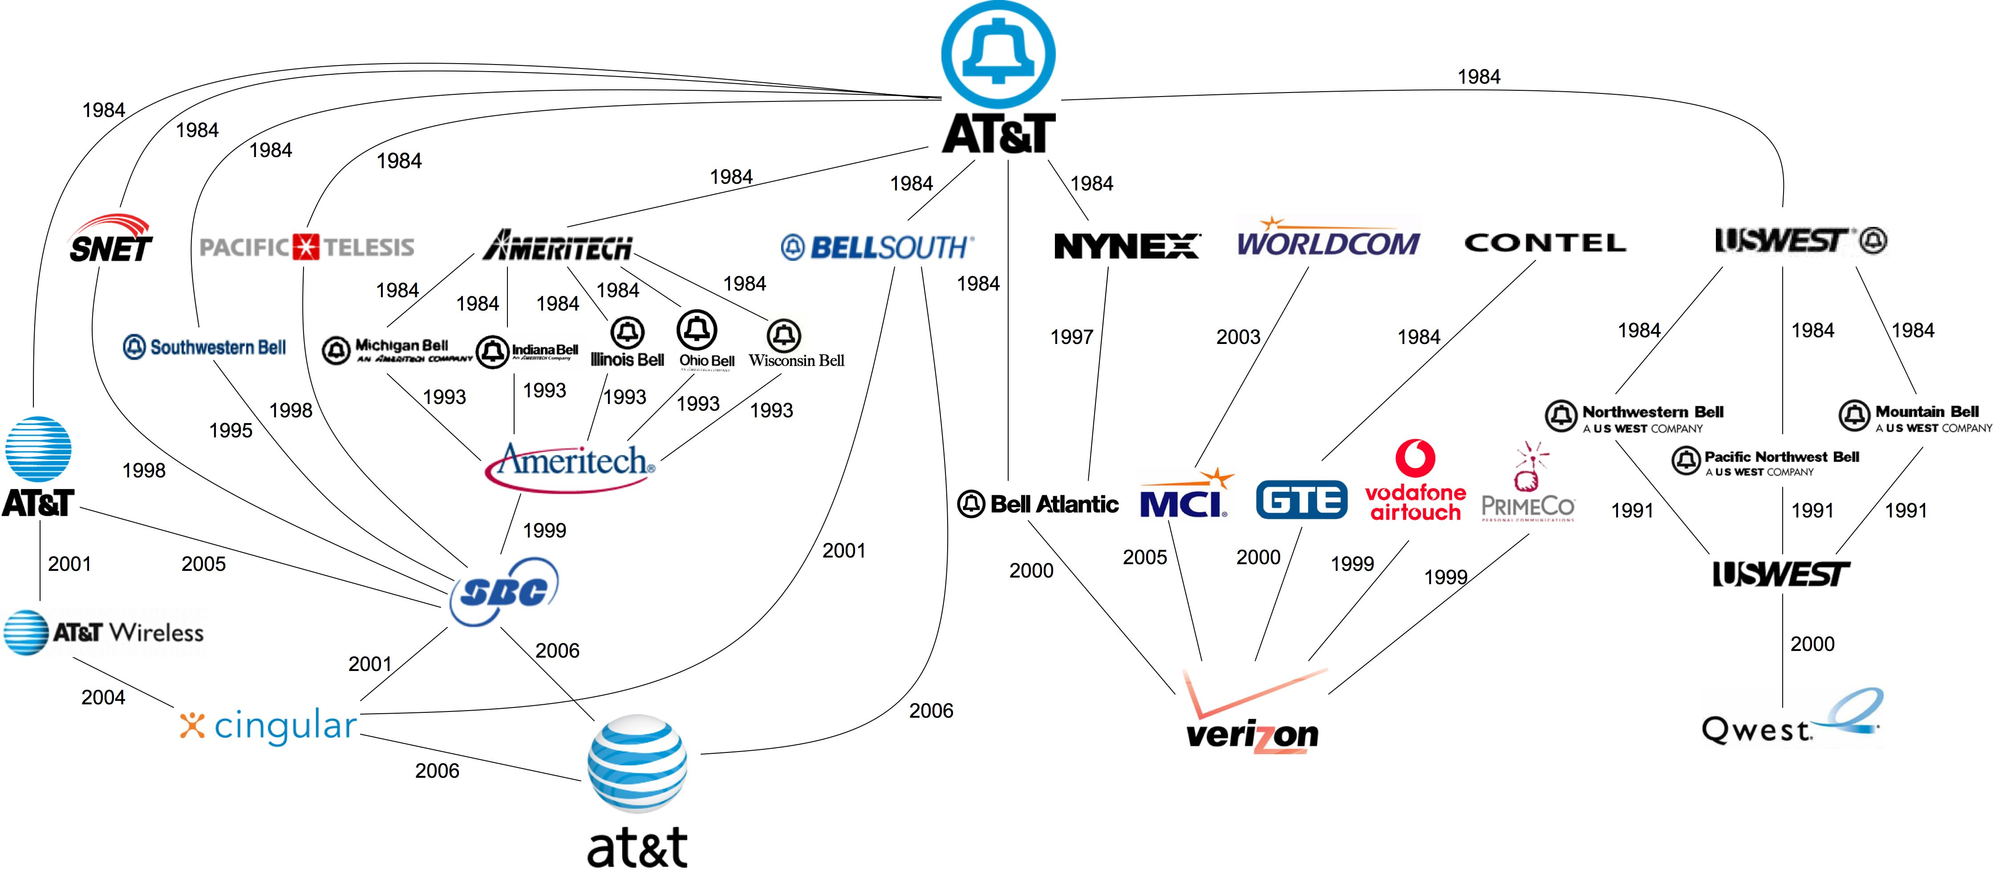
FreePress, 2008
Notes:
http://i.imgur.com/Tvh6teU.jpg
http://subjunctive.net/klog/2008/12/graphical_history_of/

Slide 39
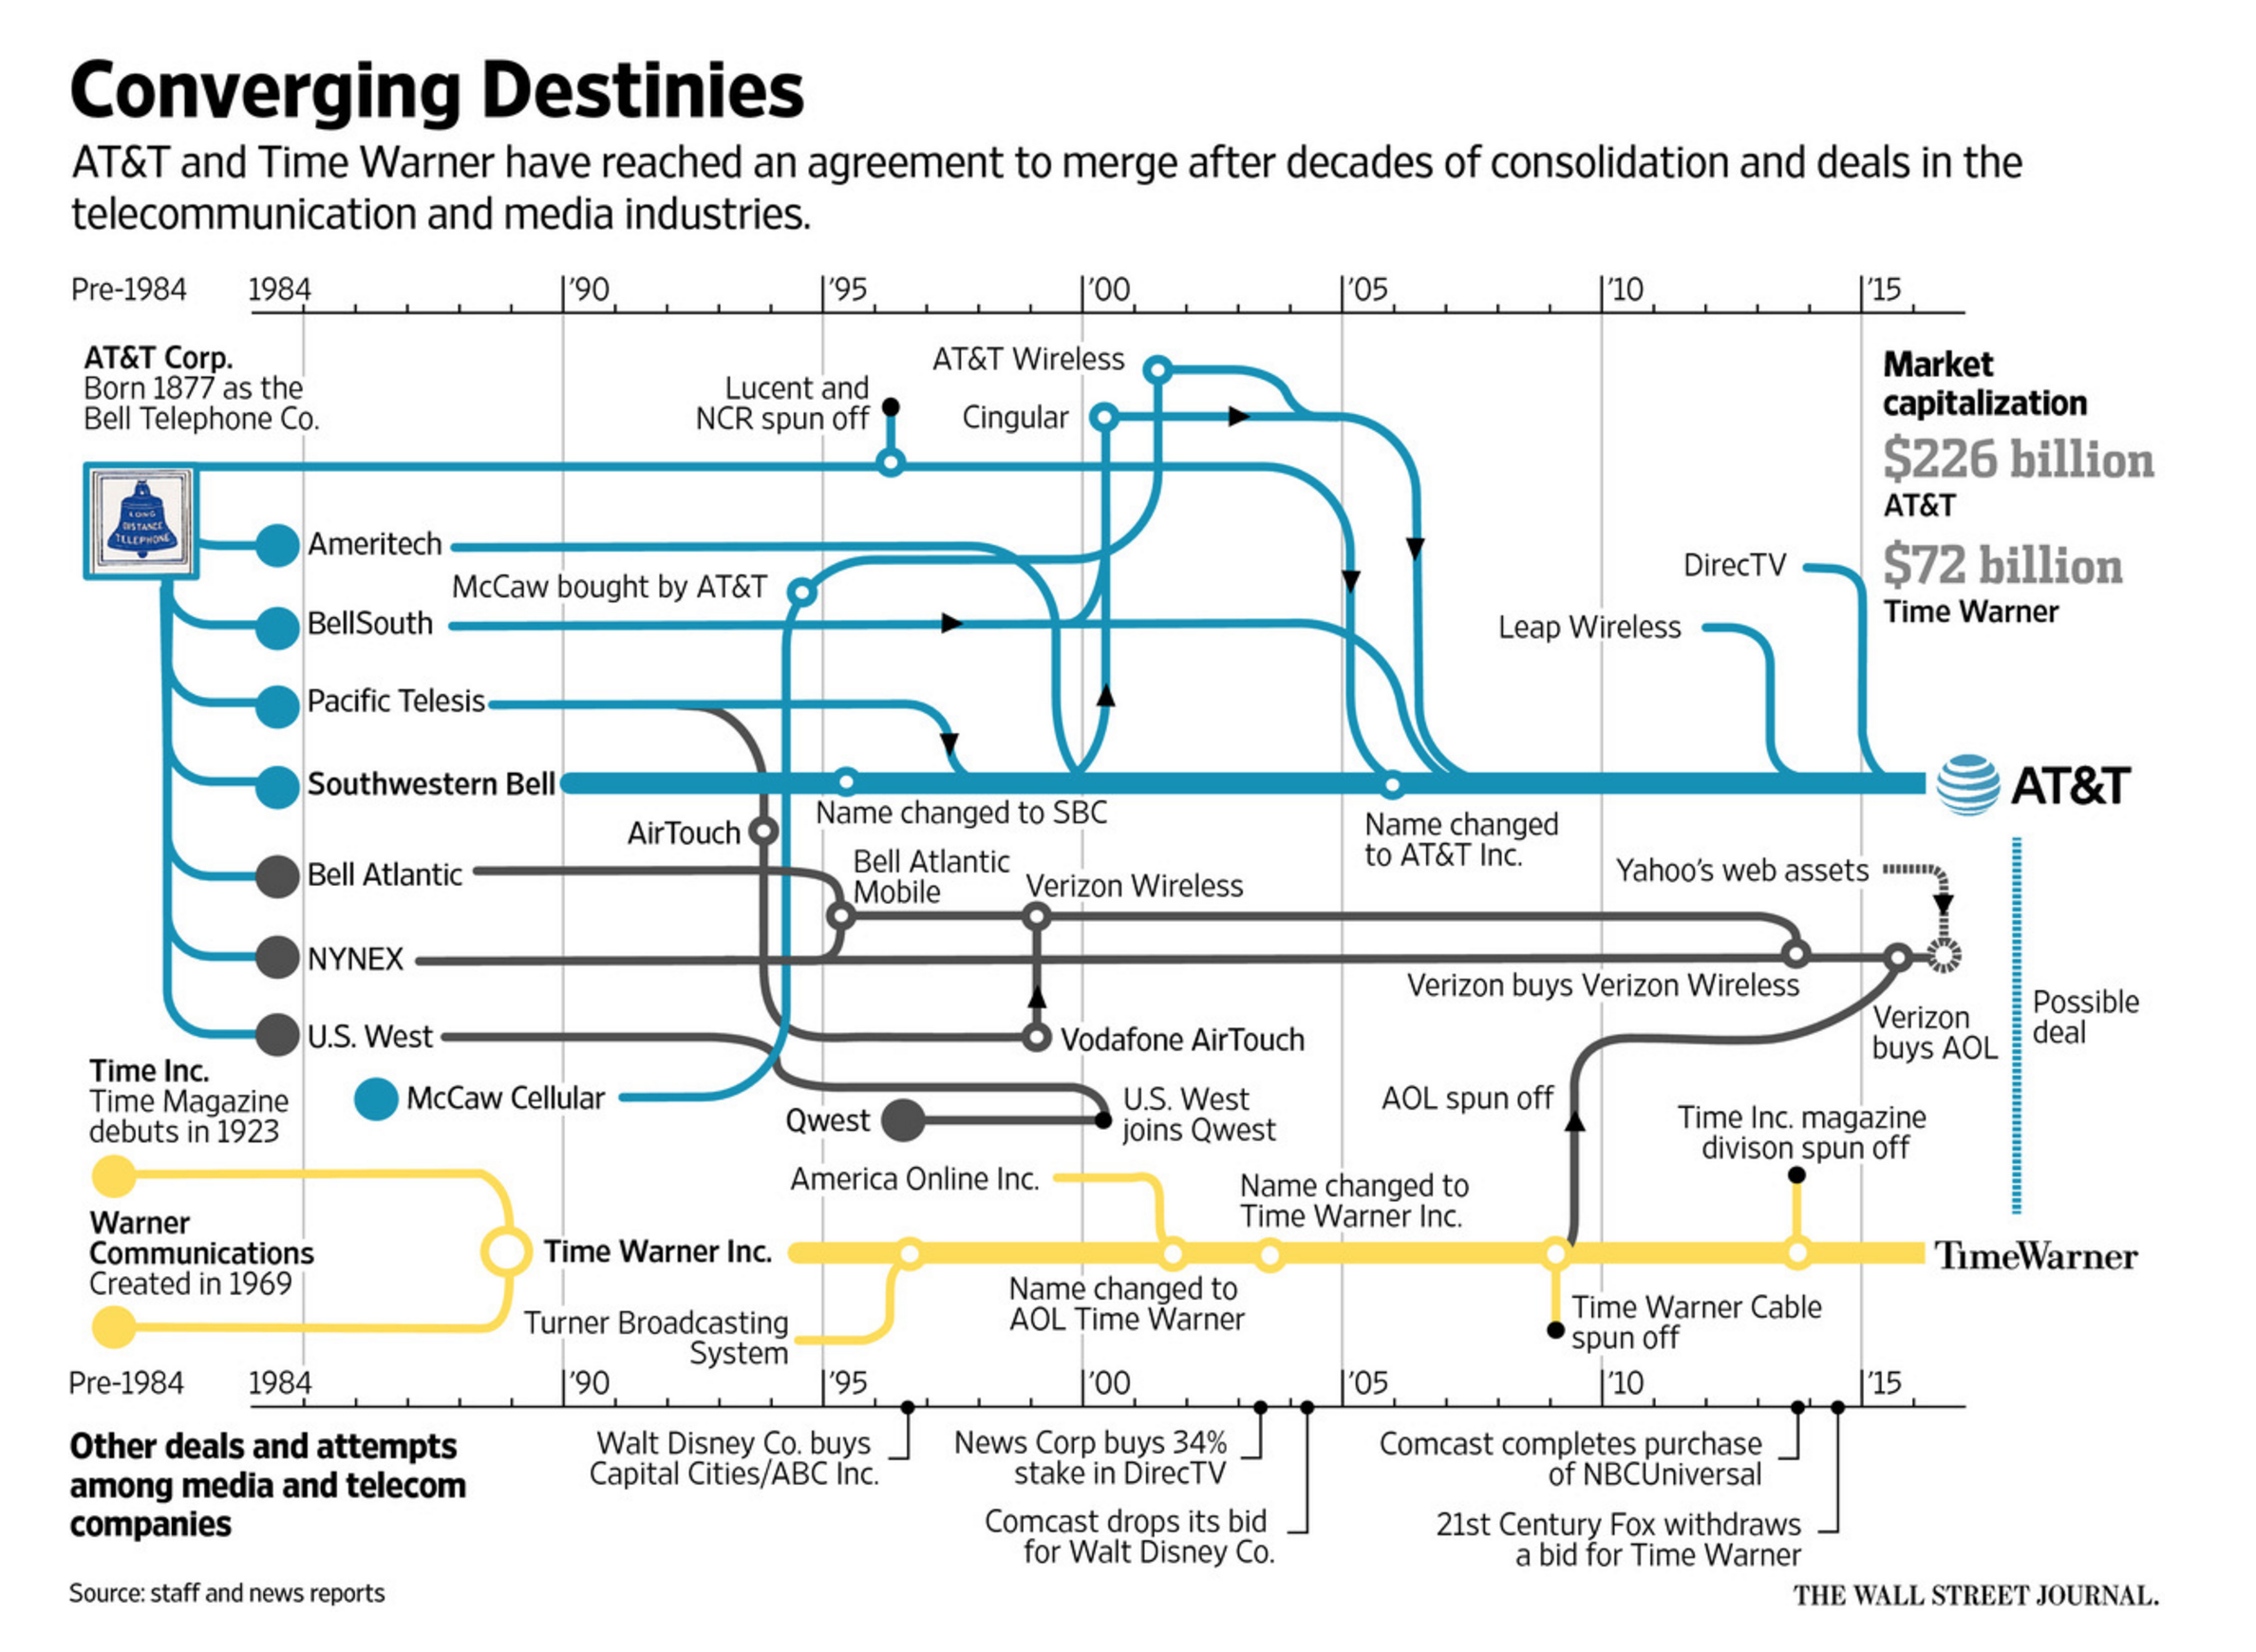
Notes:
https://www.theverge.com/2016/10/24/13389592/att-time-warner-merger-breakup-bell-system-chart

Slide 40
Cable TV subscriptions

Slide 41
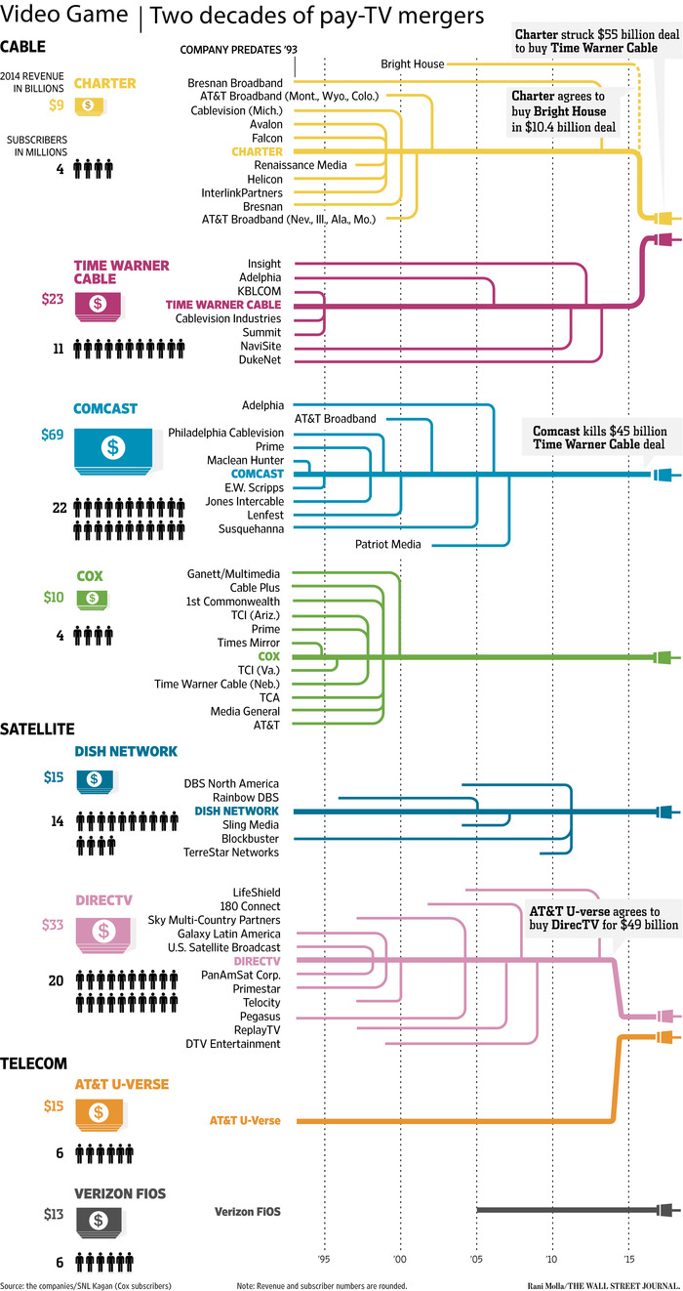
Cable companies

Slide 42
It used to be simple (ca. 1990)
MVPD
cable
(CATV)
satellite
(SAT)
ISP
ILEC
RLEC
CLEC
LEC

Slide 43
OTT, VOD, SVOD, …
OTT = delivery of services (interactive voice, entertainment video) over the Internet without subscribing to traditional cable or telephone service
  Video: Netflix, Hulu, HBO Go, YouTube, Vimeo, Go90
  Voice: Skype, Vonage, FaceTime, …
OVD = online video distribution (linear, scheduled [not VOD])
SVOD = streaming/subscription video on demand
AVOD = ad-supported video-on-demand
TVOD = transactional; “pay TV”
MVPD = multi-channel video programming distributor
  typically, linear = “live TV”→ can be cable (all cable systems are MVPDs), satellite (also) or fiber!
TV Everywhere = cable service over IP (same bundle)
Notes:
http://digiday.com/platforms/what-is-over-the-top-ott/
http://www.lightreading.com/video/ott/to-be-or-not-to-be-an-mvpd/d/d-id/714880

Slide 44
OTT, SVOD, …
Service | Linear vs. on-demand | bundle or individual | payment | example
OVD | both | any | any
MVPD | linear (may offer VOD) | bundles | monthly | cable TV, satellite
TV Everywhere | linear | subset of TV bundle | monthly | Comcast, TWC
SVOD | on demand | bundle | monthly | Netlfix, HBO Go, Hulu Plus
TVOD |  | movie | movie | Amazon Instant Video
AVOD |  | short form content, movie | ad-supported | YouTube, Vimeo, Hulu

Slide 45
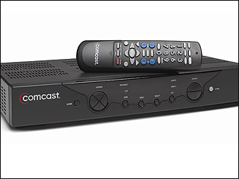






Basic video money routing
MSO/MVPD
retransmission consent fees
cable
$30B (2018)
$52B ⁽²⁰¹⁷⁾
consumer spending
($14.2T 2018)
cable channels
reverse compensation
Notes:
http://variety.com/2016/voices/columns/retransmission-fees-on-rise-1201785968/

Slide 46
Video markets – MVPD and vMVPD

Slide 47
New video models

Slide 48
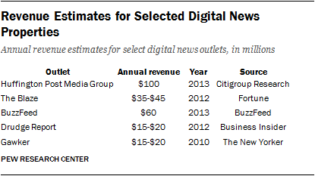
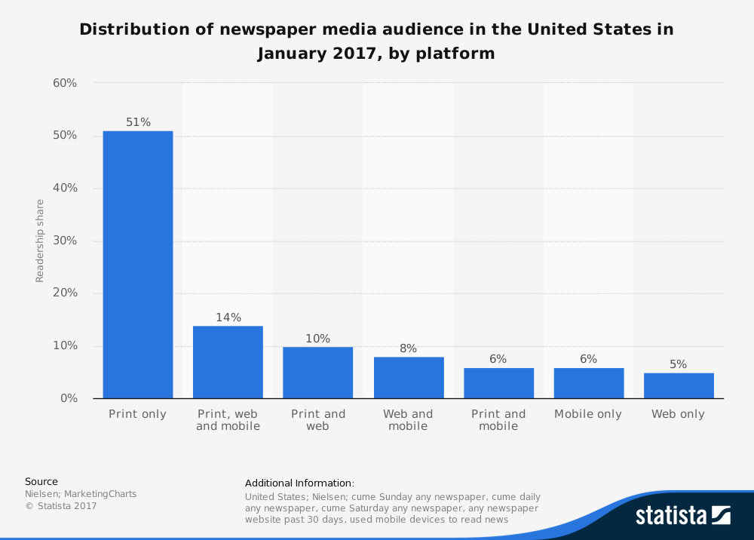
News revenue
2016: $29B for 1,331 US dailies
  62% ($18B) from advertising
  ¼ ($11B) digital & print circulation
  rest: events, commercial printing, e-commerce, …
12 cable news channels, 3 broadcast networks news, 800 news-producing local TV stations
  $16.4B revenue
  total of about 2,192 TV stations
  3 news networks: $691M average
Non-commercial sector: $1.9B
  includes 1,000 local public radio stations
  393 public TV stations (PBS)
Notes:
http://www.journalism.org/2015/04/29/newspapers-fact-sheet/
http://www.journalism.org/2014/03/26/industry-breakdown-newspapers-still-largest-revenue-segment/
https://www.statista.com/statistics/183408/number-of-us-daily-newspapers-since-1975/
https://apps.fcc.gov/edocs_public/attachmatch/DOC-345720A1.pdf

Slide 49
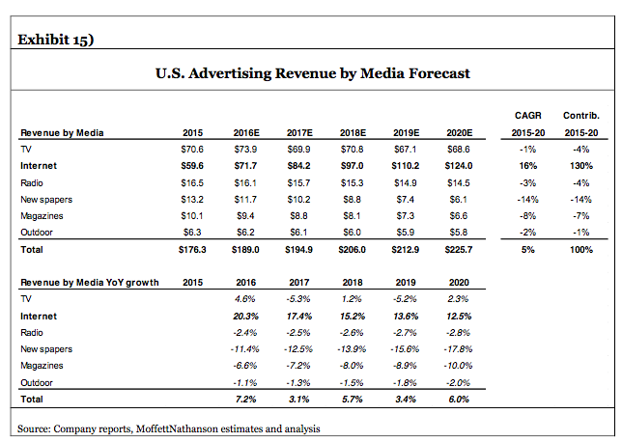
2015-2020 U.S. Advertising
The Digital Duopoly, MoffettNathansan, 2016

Slide 50
Newspaper advertising
Twenty years ago classifieds provided more than a third of the revenue of The Washington Post. Craigslist has destroyed that business for the Post and every major paper in the country. (Brookings, 2014)
Notes:
http://www.businessinsider.com/chart-of-the-day-newspapers-classified-ads-revenue-2011-3

Slide 51

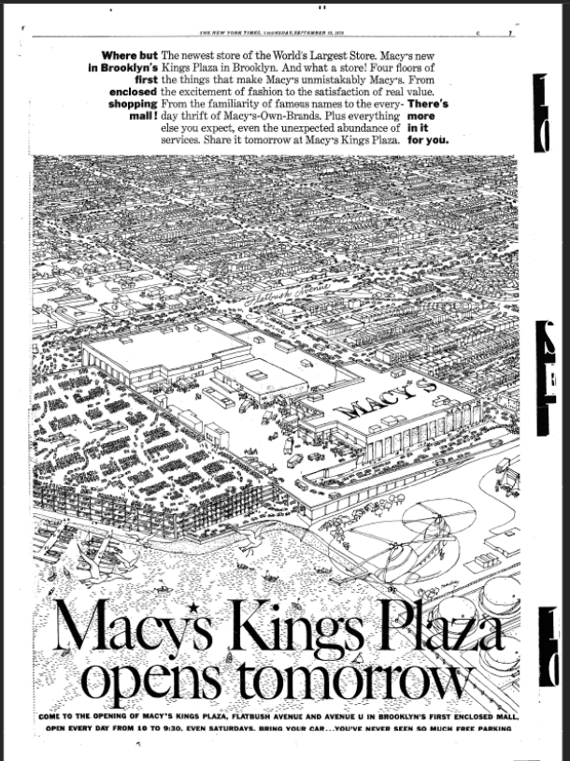
NY Times, 09/10/1970

Slide 52
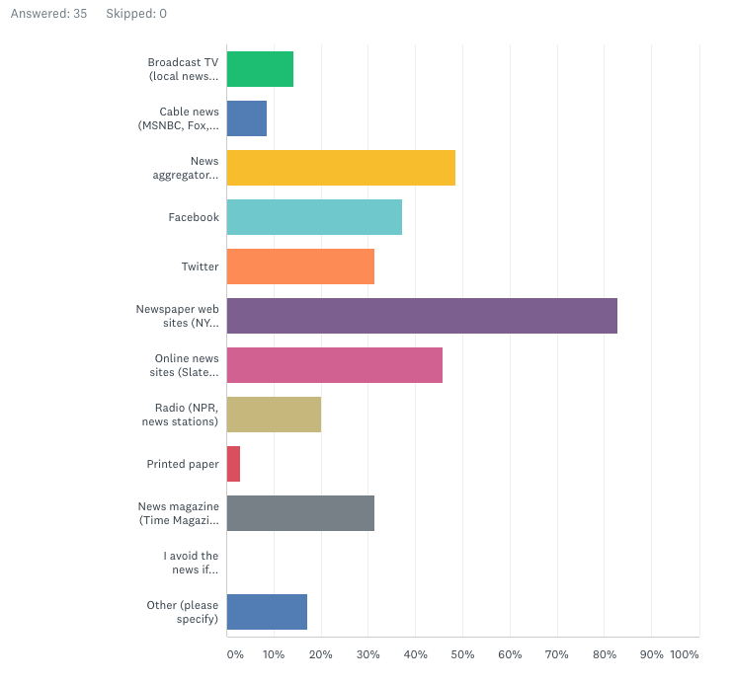
Class survey: Where do you get your news?
+ podcasts

Slide 53
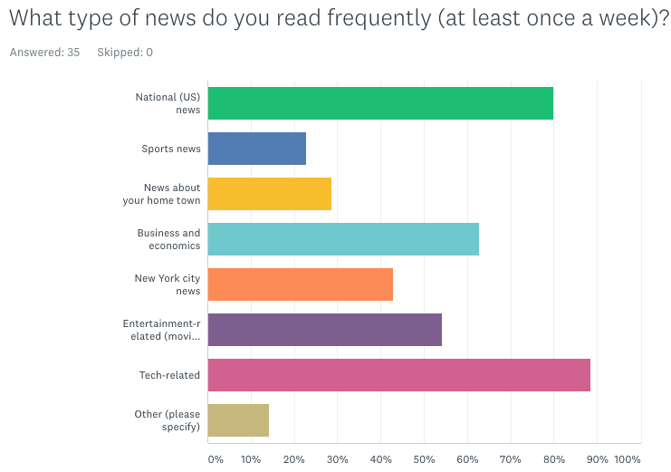
Class survey: What type of news do you read?

Slide 54
How does this compare?
asymmetric dependency

Slide 55
Why are newspapers dying?
Typically, TV and Internet news comments on or builds on newspaper reporting
  TV exception: “if it bleeds, it leads”
Local family ownership → chains (Gannett – USA Today) → private equity & hedge funds
  loans on cash flow
Non-news business lost
  classified advertising, help wanted → Craig’s List, Yelp, Indeed, …
  obituaries
  event calendars, movie listings, stock quotes, public notices, weather, sports scores, …
Political sorting, dominance of national issues → national news sources
More supply of advertising space, better targeting
Google and FB dominance of digital advertising
High cost for print: Boston Globe $25.90/week ($1,347/year)
  “Print is becoming a niche product for people willing to pay for it.”
Notes:
http://www.whoneedsnewspapers.org/pdfs/njtr_backgrounder.pdf
According to data from the Bureau of Labor Statistics’ Occupational Employment Statistics, 39,210 people worked as reporters, editors, photographers, or film and video editors in the newspaper industry in 2017. That is down 15% from 2014 and 45% from 2004. Median wages for editors in 2017 were about $49,000, while for reporters the figure was about $34,000.
https://www.bizjournals.com/boston/news/2018/03/06/the-boston-globe-to-hike-home-delivery-rates.html

Slide 56
The newspaper death spiral
Expect high returns
Reduce staff
Reduce quality
Reduce readership
Ad-rate drops
No R&D
Increase subscription cost

Slide 57
Winner take most market

Slide 58
New: retailer as advertiser

Slide 59
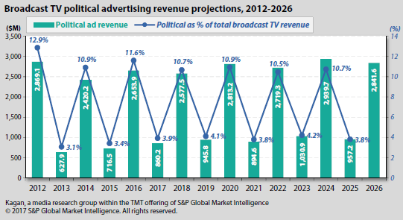
Aside: political advertising on TV

Slide 60
Digital advertising revenue
Notes:
https://www.iab.com/wp-content/uploads/2018/11/REPORT-IAB-Internet-Advertising-Revenue-Report-HY-2018.pdf

Slide 61
US dominates marketing
Notes:
https://www.zenithmedia.com/wp-content/uploads/2017/03/Adspend-forecasts-June-2017-executive-summary.pdf

Slide 62
What kind of advertising?
Real-time brokered (programmatic): ~80%
Notes:
http://www.iab.net/media/file/PwC_IAB_Webinar_Presentation_FY2014_PWC.pdf
https://www.emarketer.com/Article/eMarketer-Releases-New-Programmatic-Advertising-Estimates/1015682

Slide 63
Social media advertising

Slide 64
Performance vs. CPM

Slide 65
 | Top 10 Ad Markets - 2016 (sorted by ad$/capita)
 | adspend($M) | pop. (M) | ad$/capita ($) | gdp/capita ($) | ad$/gdp (%)
US | 190778 | 323.1 | $590.46 | $57,466.79 | 1.027
Aus | 10930 | 24.13 | $452.96 | $49,927.82 | 0.907
UK | 24160 | 65.64 | $368.07 | $39,899.39 | 0.922
Japan | 41924 | 127 | $330.11 | $38,894.47 | 0.849
Germany | 21951 | 82.67 | $265.53 | $41,936.06 | 0.633
Canada | 8739 | 36.29 | $240.81 | $42,157.93 | 0.571
SK | 11271 | 51.25 | $219.92 | $27,538.81 | 0.799
France | 11381 | 66.9 | $170.12 | $36,854.97 | 0.462
Brazil | 13047 | 207.7 | $62.82 | $8,649.95 | 0.726
China | 74961 | 1379 | $54.36 | $8,123.18 | 0.669
Diana Yin

Slide 66
Global ad spending by medium

Slide 67


What kind of advertising?
Display (banner) ads
  brand awareness, mostly
  fixed cost or bidding for pages
  pop-ups, inline, interstitial (before & after)
Search ads
  bidding for key words
Location-based (push) advertising
Email-based
Sponsored content
Video and audio (podcast, streaming) ads
  Pre-roll & mid-roll, insert
Classifieds (e.g., Craigslist)
Referral revenue (not quite advertising)
  NYT Wirecutter, airline credit cards, …

Slide 68
Programmatic advertising
DSP = demand-side platforms: advertisers offer their ads for placement
SSP = supply-side platform: publishers offer inventory for sale
Notes:
http://blog.xapads.com/programmatic-advertising-how-it-works/

Slide 69
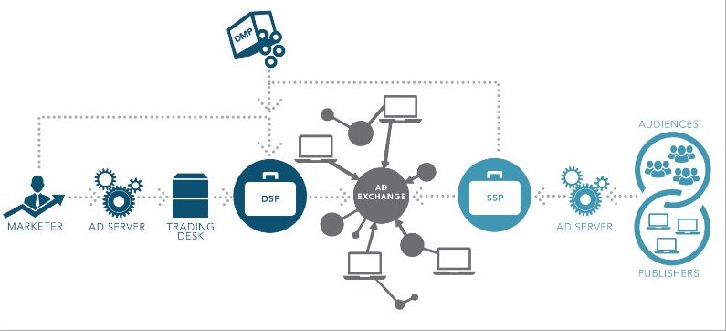
Buying media programmatically
(source: DNB)
Notes:
https://www.linkedin.com/pulse/definitive-guide-programmatic-advertising-gdn-vs-dsp-rtb-ankush-gupta

Slide 70
1993

Slide 71
2015

Slide 72

Sharing – behavior - inferences

Slide 73
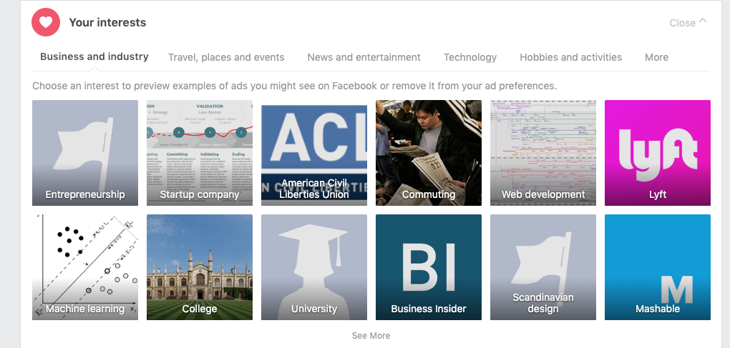

Derived data: Facebook interests
https://www.facebook.com/ads/preferences/

Slide 74
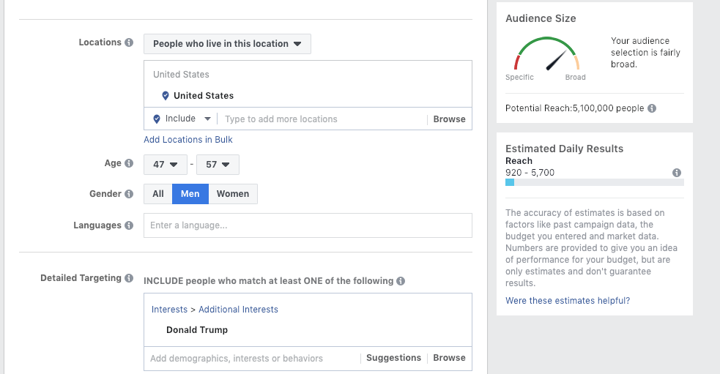
Facebook ad targeting

Slide 75
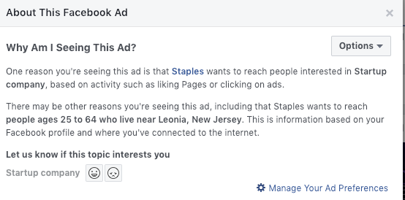
Facebook ad targeting

Slide 76

Facebook looks like advertising

Slide 77
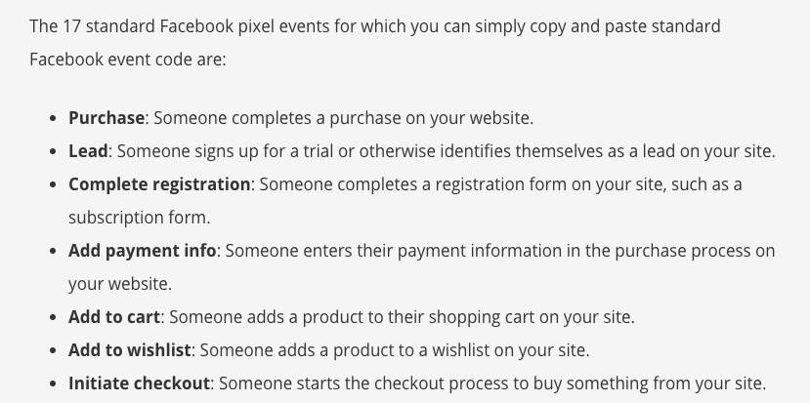
Facebook pixel: track conversion & show FB ads
Show FB ads to web page visitors.
Notes:
https://blog.hootsuite.com/facebook-pixel/

Slide 78
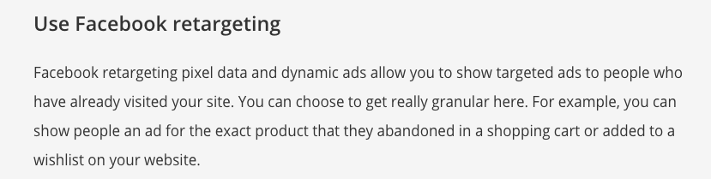
FB retargeting
Notes:
https://blog.hootsuite.com/facebook-pixel/

Slide 79
The eco system

Slide 80
Types of banner advertising (& video?) inventory
also: sponsored content

Slide 81
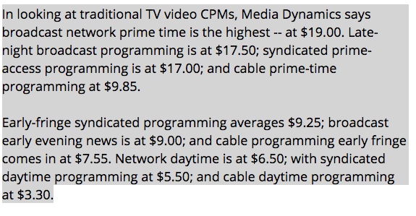
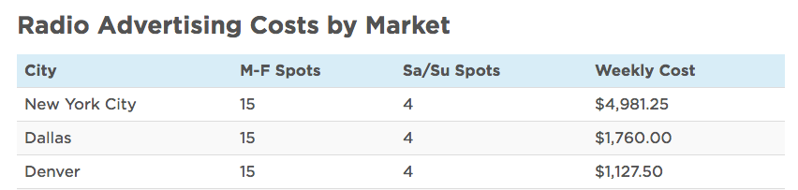
Advertising reach
Classical
  TV, radio: rating points – 1% of TV households (116.3 M in 2014)
    particular A18-49 (adults 18 to 49)
    Live, Live+SD, Live+7
  Newspaper: circulation
Digital
  CPM: thousand impressions
    $2.80 display ads; $5 email; $3 video
  CPC: thousand clicks
    → CTR: click-through rate (relevance for mobile?)
  Google AdSense: 68% to publisher, 32% to Google
TV CPM
Radio CPM: ~$20
Notes:
http://www.statista.com/statistics/243789/number-of-tv-households-in-the-us/
http://www.allbusiness.com/web-advertising-and-cpm-a-quick-guide-for-small-businesses-2646-1.html
http://monetizepros.com/display-advertising/average-cpm-rates/
http://webgilde.com/en/how-much-does-adsense-pay/
http://fitsmallbusiness.com/radio-advertising-costs/

Slide 82
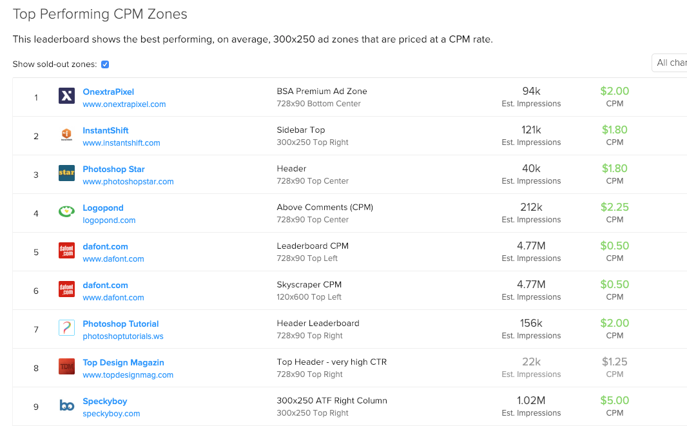
How much can you make on web ads?
https://www.buysellads.com/buy/leaderboard/id/17/soldout/1/ch/-1

Slide 83
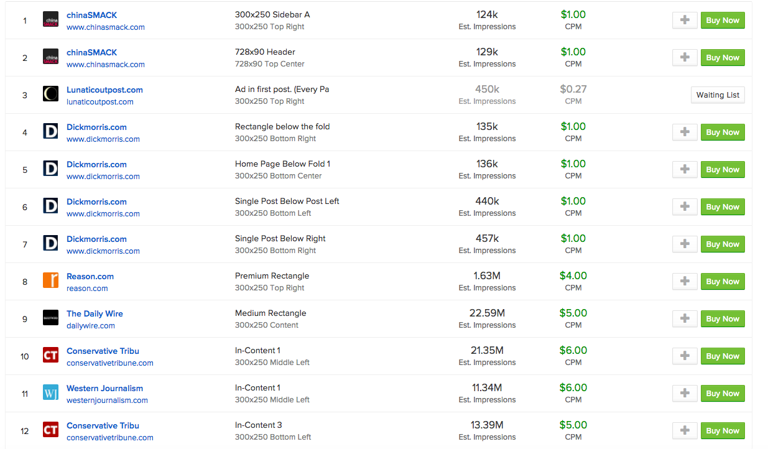
Fake news (mostly)

Slide 84

Web and mobile advertising
Not just CPM – multiple ads per page
  “$48/1000 visits”
  $0.25-$3 for generic sites
  $1-$10 for content rich sites
  $10 for product-related sites
Ad tracking
  cross-site cookies – embedded frames or images
    or track by IP address, browser characteristics, etc.
  effectiveness?
Impact of ad blocking?
  IOS9
  Europe: 20-30%
Notes:
http://webgilde.com/en/how-much-does-adsense-pay/
https://www.eff.org/privacybadger
https://digiday.com/uk/europe-ad-blocking-rates/

Slide 85
Cookie: client storage
HTTP response
HTTP/2.0 200 OK
Content-Type: text/html; charset=utf-8
Set-Cookie: dwf_contrib_beta=False; Path=/; secure
Set-Cookie: dwf_sg_task_completion=False; expires=Sun, 03-Mar-2019 05:03:06 GMT
HTTP request (later)
Host: developer.mozilla.org
Cookie: dwf_contrib_beta=False; dwf_sg_task_completion=False
…
The user agent will reject cookies unless the Domain attribute specifies a scope for the cookie that would include the origin server. For example, the user agent will accept a cookie with a Domain attribute of "example.com" or of "foo.example.com" from foo.example.com, but the user agent will not accept a cookie with a Domain attribute of "bar.example.com" or of "baz.foo.example.com". (RFC 6265)

Slide 86
Example trackers (New York Times)

Slide 87
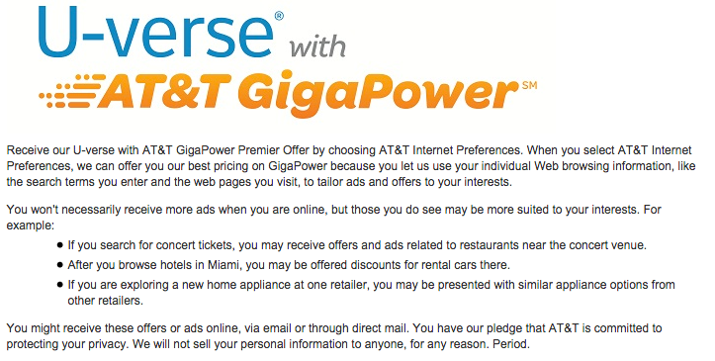
Tracking users and households
Cookies (“same origin policy”)
IP address
Browser characteristics
  e.g., user agent, links visited, fonts installed
“Super cookies”
ISP-based tracking
Notes:
https://edu.gcfglobal.org/en/internetsafety/understanding-browser-tracking/1/

Slide 88
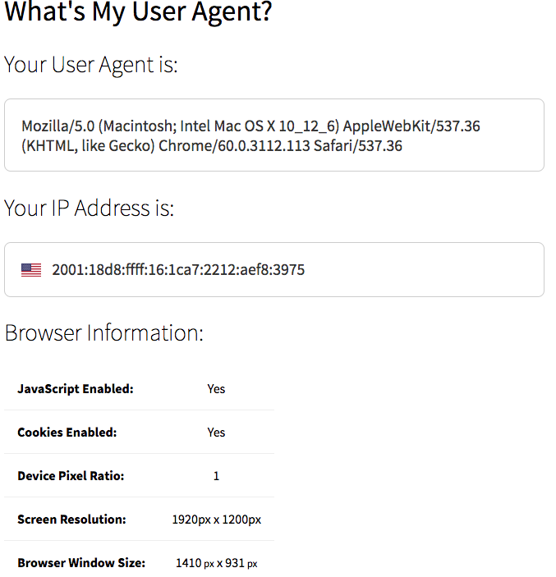
Browser strings
http://www.whoishostingthis.com/tools/user-agent/
Notes:
http://whatsmyuseragent.com/

Slide 89

Tracking – test your browser

Slide 90
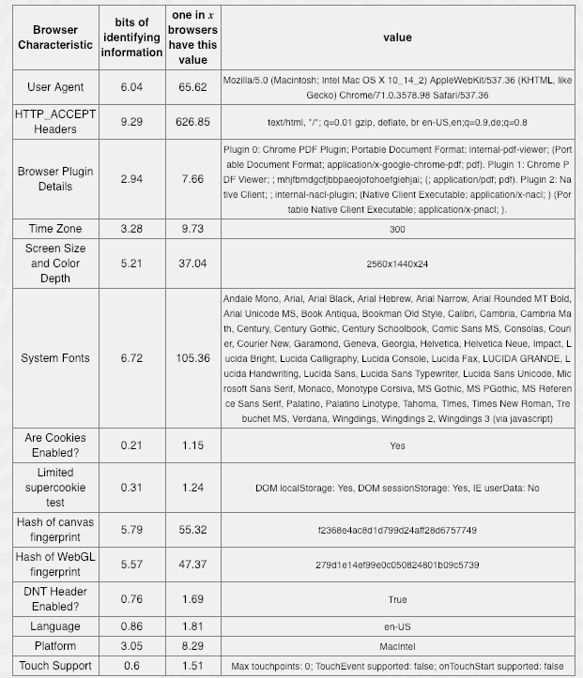
Browser tracking

Slide 91
A bit of technology

Slide 92

Converging communities
since 1900: separate networks, companies, professions
machine → machine
machine → human
human → human
1960s
1896
1915
1876
data
broadcast
(radio, TV)
voice
(telephone)
IM
generality
data integrity
access control
low cost
scalability
copyright prot. (DRM)
ease of use
universality
reliability
privacy
Internet

Slide 93
Lifecycle of technologies
traditional technology propagation:
military
corporate
consumer
opex/capex doesn’t matter;
expert support
capex/opex sensitive, but amortized;
expert support
capex sensitive;
amateur
Can it be done?
Can I afford it?
Can my mother use it?

Slide 94
Internet and networks timeline
university
prototypes
production
use
in research
commercial
early residential
broadband
home
Internet
everywhere
theory
1960
1970
1980
1990
2000
2010
2020
port
speeds
100 kb/s
1 Mb/s
10 Mb/s
100 Mb/s
1 Gb/s
10 Gb/s
DNS
RIP
UDP
TCP
SMTP
SNMP
finger
ATM
BGP, OSPF
Mbone
IPsec
HTTP
HTML
RTP
Internet
protocols
XML
OWL
SIP
Jabber
email
ftp
SDN
JSON
blockchain
DQDB, ATM
QoS
VoD
p2p
ad-hoc
sensor
technical
issues
queuing
architecture
routing
cong. control
cybersecurity
data centers

Slide 95
What has changed?
1980s through 1990s | 2000s+
Rapid technology evolution in network core | Relatively stable core technology
Internet exceptionalism (no distance! no borders! no social hierarchy!) | National laws & customs
Internet utopianism | “Big Switch”, harms & limitations
Performance! | Reliability? Usability!
Cost-insensitive (and “free” phone access) | Deployment cost barriers
Separated from commercial media (newspapers, magazines, radio, TV) | Affects all media
Self-revealed data (email, BBS) | Intimate data (information access, behavioral, sensors)
Little economic impact | One of the largest US exports

Slide 96
What’s different?
What | Classical utilities (gas, water, electricity) | Internet | Consumer electronics
Geographic scope | regional | local, national, international | mostly international
Economics | enabler | entry, competition, enabler | Trade, patents
Impact on culture | minimal | foundational | rarely (Walkman, iPhone)
Impact on domestic politics | in LDCs | jobs, education, health, transportation, copyright, income inequality | health & education (smartphones)
Impact on international politics | water rights? | trade, espionage, propaganda, cyberattacks, copyright, … | trade

