Slide 1
Network technology review
Henning Schulzrinne
Spring 2019
material drawn from various online sources, reports & author

Slide 2



Slide 3
Dividing the problem

Slide 4

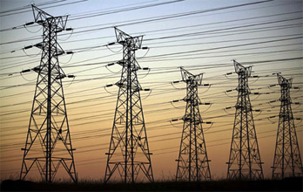
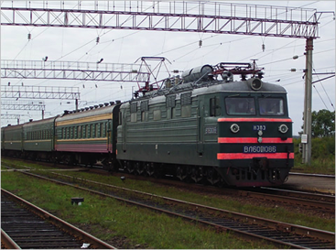
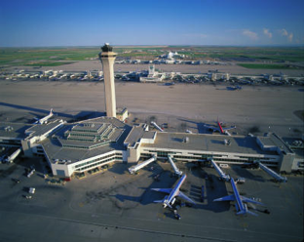
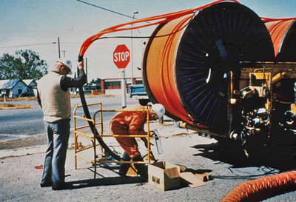
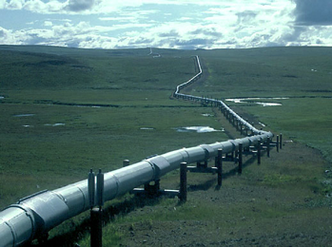
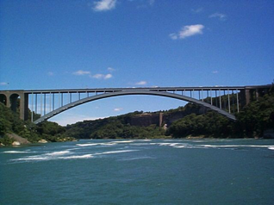
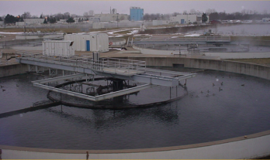
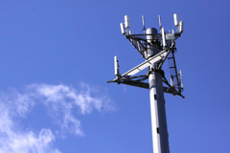
The great infrastructure
Technical structures that support a society → “civil infrastructure”
  Large
  Constructed over generations
  Not often replaced as a whole system
  Continual refurbishment of components
  Interdependent components with well-defined interfaces
  High initial cost
water
energy
transportation
communication

Slide 5
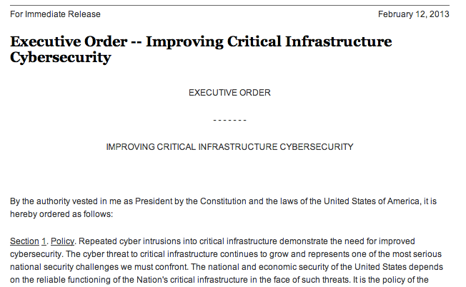
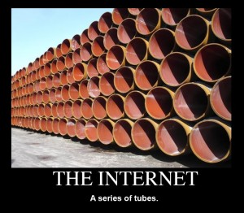
The Internet as core civil infrastructure

Slide 6
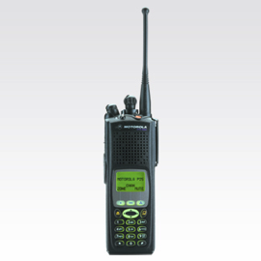

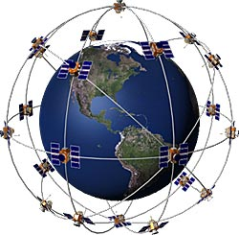


Broadband, Internet, communications
LMR
dial-up
Broadband (Internet, EU NGA)
LEO, MEO, GEO

Slide 7
Interdependencies with other lifelines
outside plant
Trans
recovery coordination
control
Water
CO & data centers
flooding
shared
RoW
Telecom
shared
poles
towers & antennas
fuel
parts
Power
Pipelines

Slide 8













Who runs communication systems and networks?
incumbent local exchange carriers
(“ILEC”)
competitive local exchange carriers
(“CLEC”)
cable companies
(“MVPD”)
cellular providers (3-4)
~6
rural local exchange carriers
(“RLEC”)
wholesaler providers
(“carriers’ carrier”)
satellite providers
~1,000
communities & cooperatives (“muni networks”, REC)
radio & TV stations
(1,784 TV, 15,470 radio)
private land mobile radio (public safety, transit, taxis, …)
~2
# with ~90% marketshare

Slide 9
US pay TV providers (2018)

Slide 10
US broadband providers (2018)

Slide 11
What do communications networks do that’s different?
Any-to-any: multiparty, coordination & cooperation, conflict
  less of a concern in (say) civil engineering
Economics: network effect, scale effects
Challenges:
  geographic distribution
  long-lived
  different industries participating
  remote attacks through infrastructure itself

Slide 12
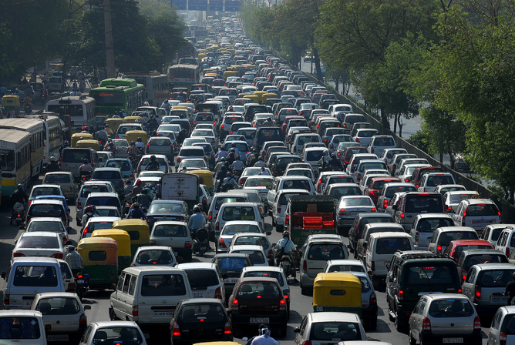
What problems do networks solve?
Diversity in technologies
  wired vs. terrestrial wireless vs. satellite
  trade-off capacity vs. cost vs. distance
Variation in load
  intermittent demand → shared networks
  cannot design capacity for top 5 minutes of load
“Noise”
  electric noise
  radio interference
Human adversaries
  denial-of-service attacks
  information theft
  impersonation

Slide 13
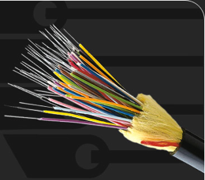
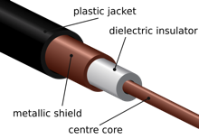
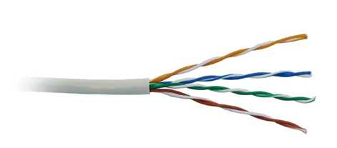
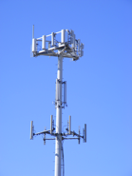
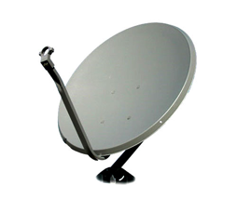
Network trade-offs
cost per user
* incremental cost assuming legacy networks;
“green field” cost is roughly the same
capacity per user

Slide 14
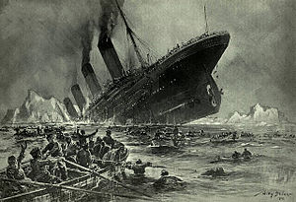


A bit of (US) history
1895-1901: G. Marconi demonstrates wireless communications
1912: Titanic
Radio Act of 1912
  all radio stations licensed
  monitor distress channel (500 kHz)
Radio Act of 1927
  deal with AM (“medium wave”) chaos → licensing “in the public interest”

Slide 15
Communications as a regulated industry
free-market economies, subject to government regulation
  “why” (and objections) later
telephony: federally regulated since 1910
broadcasting: 1927
telecommunications: 1934
  but dates back to Interstate Commerce Act of 1887 (railroads)
  cousins: railroads, electricity, air service, …
  specialized administrative agency for sector-specific regulation
    vs. general regulation (environmental, safety, employment, contracts, consumer protection, …)
Notes:
Benjamin

Slide 16
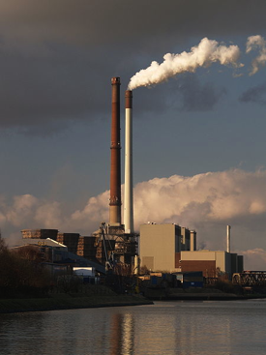

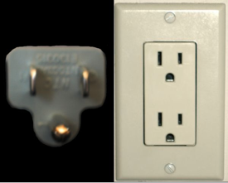
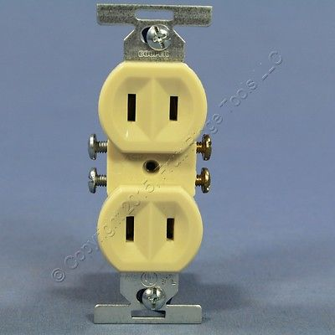
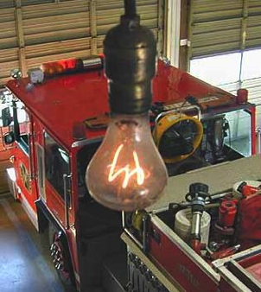
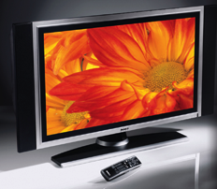
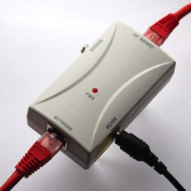
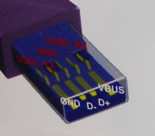
Interfaces: Energy
110/220V
NEMA 1-15R
~1915 (2 prong)
Lots of other (niche) interfaces
Replaced in a few applications
1901
http://www.centennialbulb.org/cam.htm
Notes:
http://www.iec.ch/worldplugs/history.htm
https://rustbeltanthro.wordpress.com/2015/04/02/mapping-electrical-sockets-and-plugs-a-history-of-colonialism-war-and-non-globalization/
http://www.mosaicshades.com/antique2005/sockets/

Slide 17
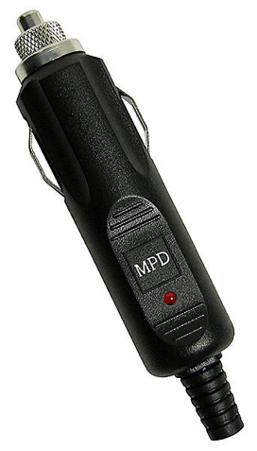
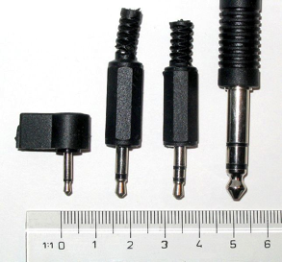


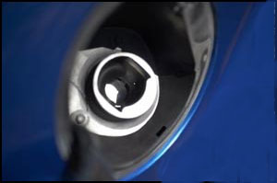

Other long-lived interfaces
1993
1878
Cigarette lighter
(1956)
fuel nozzle
1982
1992
SQL
1974

Slide 18
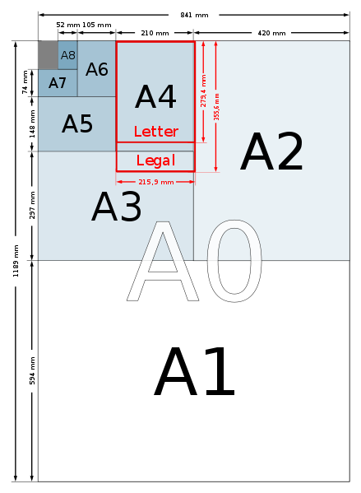
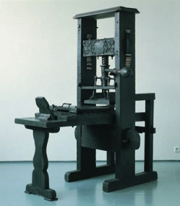
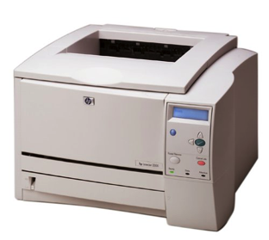


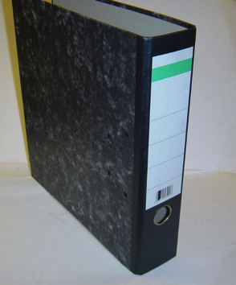

Interfaces: Paper-based information
1798, 1922 (DIN)

Slide 19
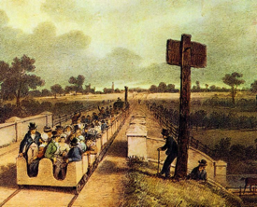
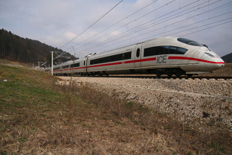
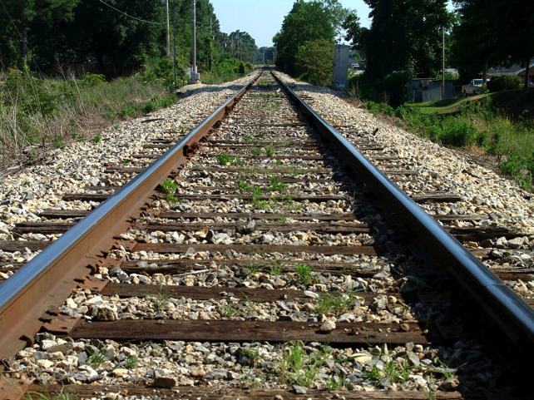

Interfaces: Transportation
About 60% of world railroad mileage
1435 mm
1830 (Stephenson)
1846 UK Gauge Act
12’

Slide 20
The two-layer model
content
apps & software
services
copyright
data privacy
data theft
disability access
IP
patents
resource scarcity
investment
technology innovation
“Lower layers”
infrastructure
“the network”
disruption
location privacy
universal service

Slide 21
Why layering?
Perform functions once
  upper layers rely on lower layers
  in theory (see: “end-to-end principle”)
Common in engineering and society
  postal system, operating systems & other APIs, buildings, …
  but not always formal or deep
  model of a (legal) contract
Change implementation without affecting relying parties
  minimize communications, “information hiding”, “isolation”
  “black box”
Topological and administrative scoping
  single physical connection technology
  single vs. multiple administrative domains

Slide 22
OSI model background
Introduced in 1978 and revised in 1984
  first formal attempt to codify engineering practice
  slice big problem into manageable areas of concern
Formulates the communication process into structured layers
There are seven layers in the model → the 7-Layer model

Slide 23
The function of a layer
Each layer deals with a subset of aspects of networking
  e.g., Layer 1 deals with the communication media
Each layer communicates with the adjacent layers
  In both directions
  Example: Network layer communicates with:
    transport layer
    data link layer
Each layer formats the data packet
  Example: adds or deletes addresses

Slide 24
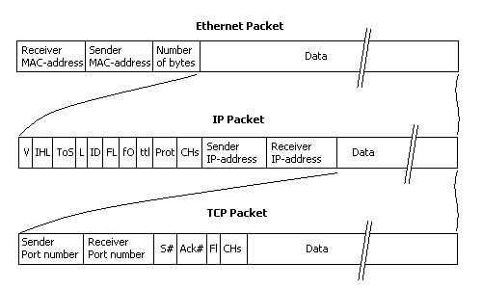
Layers → wrapping
applies to other “networks” – FireWire, USB, SCSI, SS7 (telecom), …
Notes:
http://www.laneye.com/network/ethernet-network-packet-holding-an-ip-packet.gif

Slide 25
The (theoretical) layered approach to communication
7. Application
message format, human-machine interface
structured content
“OSI model”
6. Presentation
serialization, encryption, compression
messages
byte stream
5. Session
authentication, permissions, restoration, state
4. Transport
end-to-end reliability, flow & congestion control
3. Network
network addressing, end-to-end routing
packets
(“frames”)
2. Data Link
link flow control, error detection, framing
Physical
analog-digital (bit stream)
bit stream

Slide 26
Layering
secure, reliable, world-wide
email
functionality
L7
generality
PHY (L1)
any digital
communications
unreliable bits
over one link

Slide 27

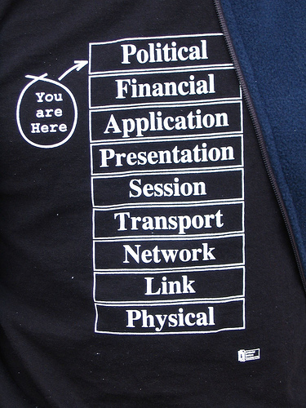
The real model

Slide 28
The real model, xkcd
https://xkcd.com/2105/

Slide 29

The Internet Protocol Hourglass
email WWW phone...
SMTP HTTP RTP...
TCP UDP…
IP
ethernet PPP…
CSMA async sonet...
copper fiber radio...
small number of long-term stable interfaces
S. Deering

Slide 30
Why four (core) layers?
Layer | Colloquial name | Function
1 | PHY | photons & electrons → bits
2 | MAC | bits → packets on one technology
3 | L3 | packets end-to-end, on heterogeneous technologies, to interface
4 | L4 | unreliable → reliable host/interface → application
(5) | Presentation, data | application data structure encoding
7 | Application | Application behavior (email, web)

Slide 31
Internet layer functions
Layer | Key protocols | Control protocol | Transmission technologies | Administrative domains | Main function | Addresses
PHY | Ethernet, 4G |  | single, but may be diverse (fiber, copper) | 1 | analog-to-digital | none
MAC | Ethernet | 3GPP | same | 1 | framing | MAC address
network | IPv4, IPv6 | DHCP, OSPF, BGP | agnostic | many | end-to-end delivery | IP addresses
transport | UDP, TCP | built-in | agnostic | 2 (ends) | reliability, congestion control | ports
application | HTTP, RTP | SIP | agnostic (except for properties) | 2 (ends) | framing, description, sessions | URLs, email addresses

Slide 32

The problems with layering
Doesn’t capture whole story
  control protocols
Information hiding
  inefficiency: more than needed
Information and implementation leakage
Ossification
Duplication
  “If you want it done right, you have to do it yourself”
Notes:
Charles-Guillaume Étienne

Slide 33
Node functions
Error detection
  bit errors are detected with high probability
Error correction
  bit errors are repaired via redundancy (“forward error correction”)
ARQ
  lost or corrupted packets are re-transmitted
Flow control
  prevent fast sender overwhelming slow receiver
Congestion control
  prevent fast sender overwhelming slower network

Slide 34
Network building blocks
Network addresses
  and mapping
Data serialization
Protocols
  Cooperation algorithms

Slide 35

“Algorithms + Data Structures = Programs”
Protocols + serialization = networking
human protocols:
“what’s the time?”
“I have a question”
air traffic control
introductions
… specific messages sent
… specific actions taken when message received, or other events
1976
network protocols:
machines rather than humans
all communication activity in Internet governed by protocols

Slide 36
Protocols
Protocols define format & order of messages sent and received among network entities
  and actions taken on message transmission or receipt
Often includes notions of time
  what happens if there is no response?
Similar to Application Programming Interfaces (APIs)
  size_t fwrite(const void *ptr, size_t size, size_t count, FILE *stream);
  differences?
Can also consider a “contract”
  “if I provide you X, you will provide Y”

Slide 37



What’s a protocol?
a human protocol and a computer network protocol:
Hi
TCP connection
request
Hi
TCP connection
response
Got the
time?
Get http://www.awl.com/kurose-ross
2:00
<file>
time
Q: other human protocols?

Slide 38
Names, identifiers and addresses
Any large system needs to be able to identify its components
  Societal examples?
Names, identifier
  unique label for something
    DOI: doi:10.1038/nphys1170
  may be function, not device
  often unchanged when “thing” moves or changes providers
Address
  how do I get to that identifier?
  geography, routing ➔ typically changes when the ”thing” (person) moves
Reality is less clearly divided

Slide 39
Names & addresses in the Internet
URL: https://example.com ➔
email: jane@example.com
domain name
(example.com)
DNS
IPv4 address(es)
93.184.216.34
IPv6 address(es)
2606:2800:220:1:248:1893:25c8:1946
ARP
MAC address
14:02:ec:35:02:8c

Slide 40
Domain names

Slide 41
Internet addresses

Slide 42
Serialization: turning data structures into bytes
Internal data structures (data bases, arrays, lists, dictionaries, …) need to be transported across network or stored in a file
  efficiently, without too much empty space
  without memory references
  without depending on computer architecture of sender
Networks and files are sequences of bytes (“byte stream”)
→ convert internal structure into nested text elements
  references (“pointers”) by name or identifier, not memory location

Slide 43
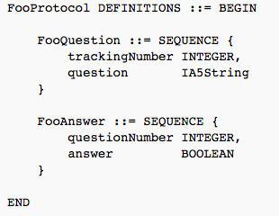

Serialization: ASN.1
serialization = convert data structure into
(linear) byte stream
like C, without pointers…
30 13 02 01 05 16 0e 41 6e 79 62 6f 64 79 20 74 68 65 72 65 3f

Slide 44
Serialization: RFC 822
Delivered-To: hgs10@lionmailmx.cc.columbia.edu
Received: by 10.140.158.132 with SMTP id e126csp131562qhe;
Thu, 28 Aug 2014 14:01:48 -0700 (PDT)
Return-Path: etickets@amtrak.com
Return-Path: etickets@amtrak.com
Received: from unknown (HELO etvswas01p) ([10.14.128.202])
by phlsmtprelay01.amtrak.com with ESMTP; 28 Aug 2014 16:55:42 -0400
Date: Thu, 28 Aug 2014 17:01:30 -0400 (EDT)
From: etickets@amtrak.com
To: HGS@cs.columbia.edu, HENNING.SCHULZRINNE@FCC.GOV
Message-ID: <633700356.JavaMail.TDDServerProd@amtrak.com>
Subject: Amtrak: eTicket and Receipt for Your 09/10/2014 Trip
MIME-Version: 1.0
Content-Type: multipart/mixed;
boundary="----=_Part.1409259690306”
MIME-Version: 1.0
Content-Type: multipart/mixed;

Slide 45
Serialization: XML
<note>
<id>1</id>
<name>A green door</name>
<price>12.50</price>
<tags>
<tag>home</tag>
<tag>green</tag>
</tags>
</note>

Slide 46
Serialization: JSON
{
"id": 1,
"name": "A green door",
"price": 12.50,
"tags": ["home", "green"]
}

Slide 47
Internet architecture

Slide 48
What’s the Internet: “nuts and bolts” view
millions of connected computing devices: hosts
  running network apps
  end point = origination and destination of Internet traffic
communication links
  fiber, copper, radio, satellite, light, sound, …
  characterized by bandwidth and delay
routers
  forward packets (chunks of data)
  typically, lots of interfaces
“middleboxes”
  lots of devices that are technically hosts, but part of the infrastructure
  firewalls, web proxies (caches)
J. Kurose (Ch. 1)
Notes:
48
Kurose, Ch. 1

Slide 49
















Internet: “Nuts & bolts” view
protocols control sending, receiving of messages
  e.g., TCP, IP, HTTP, Skype, Ethernet
Internet: “network of networks”
  loosely hierarchical
  public Internet versus private intranet
Internet standards
  RFC: Request for comments
  IETF: Internet Engineering Task Force
mobile network
global ISP
home
network
regional ISP
institutional
network
J. Kurose (Ch. 1)

Slide 50


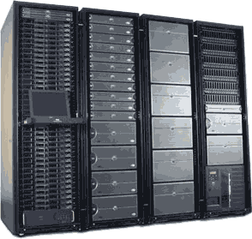
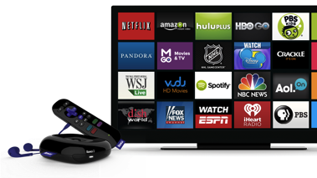
Internet traffic flows today
CDN
content
access network
(data center provider)
backbone (transit)
eyeball ISP
Google
Facebook
YouTube
Yahoo
Live
Baidu
Comcast
comm.
CDN
Level3
Cogent
Akamai
content CDN
video
conferencing
Netflix
server farm
50

Slide 51
Network types
Access
  “last mile”
Regional or metro
  “metro fiber”, “metro Ethernet”
Wholesale
  connect points-of-presence across
  may also provide access to commercial buildings & data centers
Trans-oceanic
  often, owned separately (consortium), but integrated into wholesale networks

Slide 52
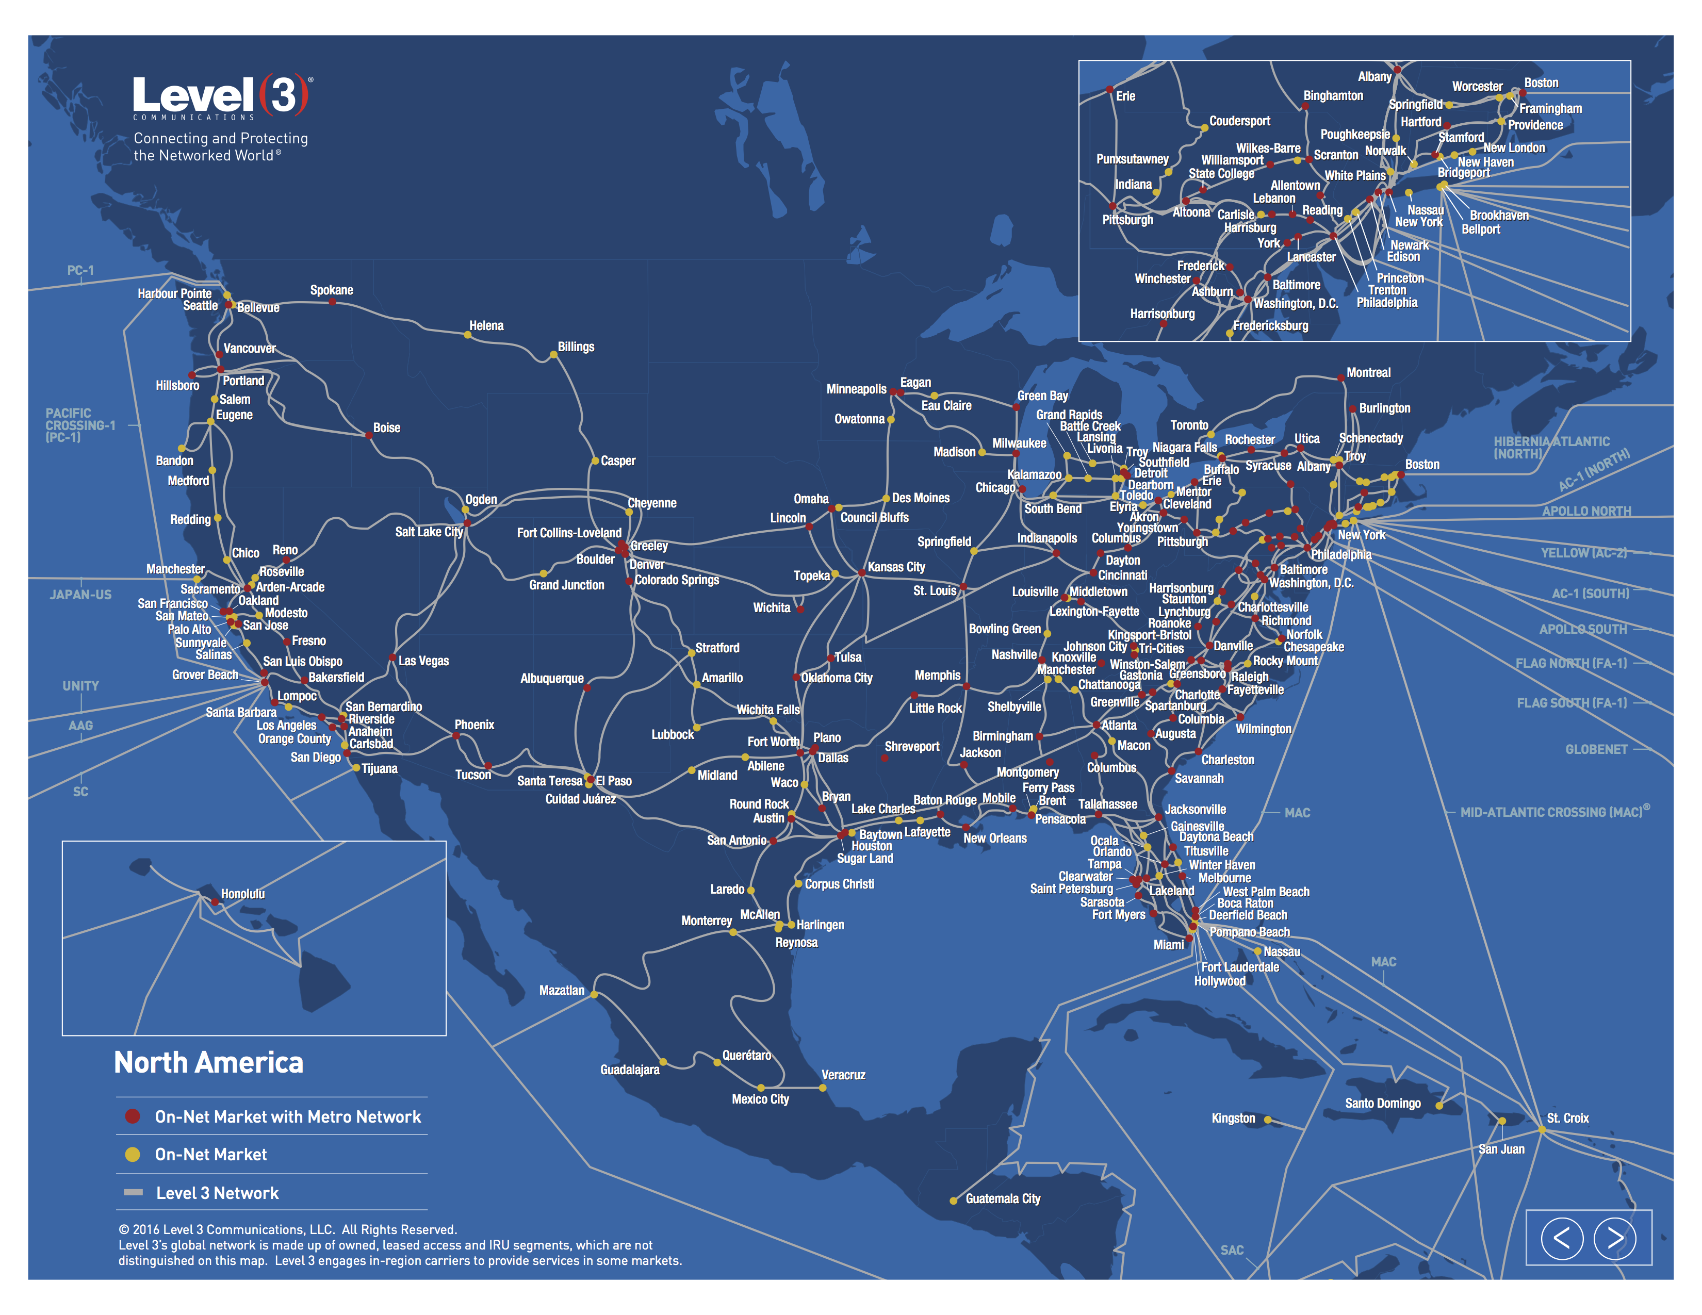
A backbone network

Slide 53
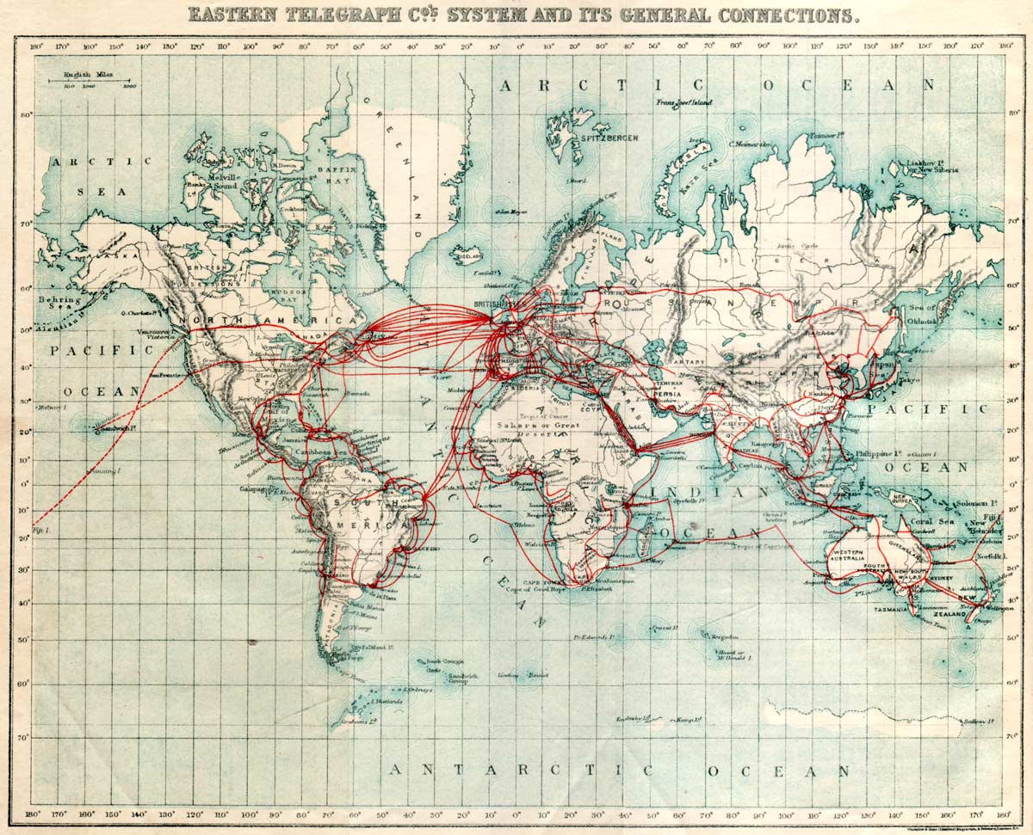
1901 “data” backbone

Slide 54
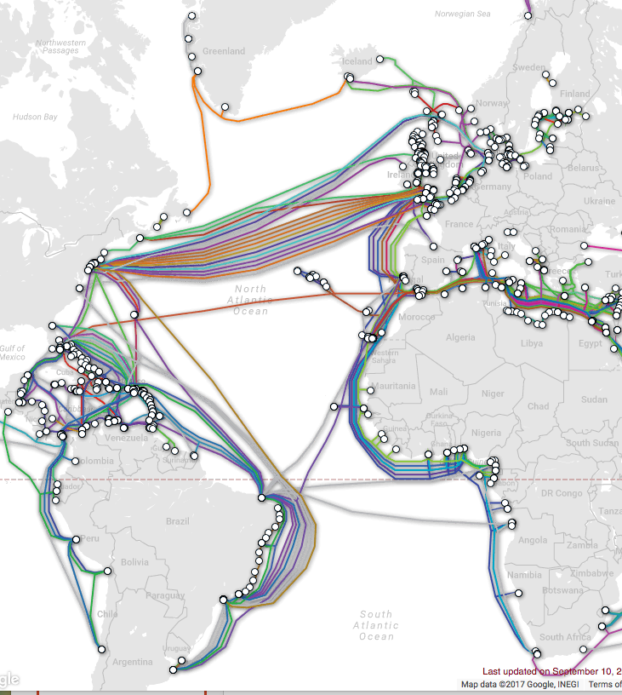
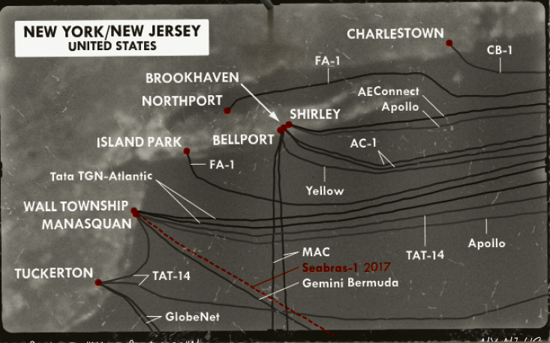
Submarine cable map
http://www.telegeography.com/
Notes:
http://www.telegeography.com/

Slide 55
The usage of cables is changing
Notes:
Optical Illusions: Content Providers and the Impending Transformation of International Transport
Tim Stronge TeleGeography, NANOG 71

Slide 56
But content providers aren’t building

Slide 57
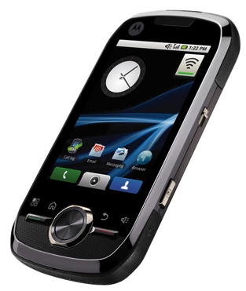

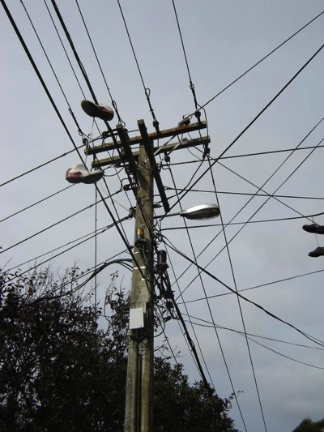
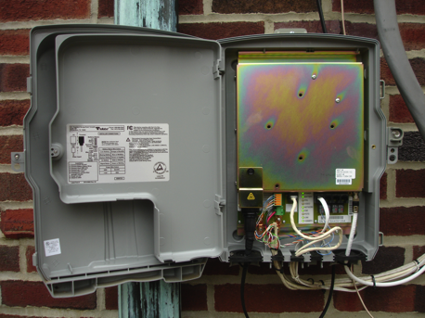
Wireline & wireless
100’ to ~3 miles
fiber or copper
(rarely, microwave)
“almost all networks are 99% wired”
exceptions?

Slide 58
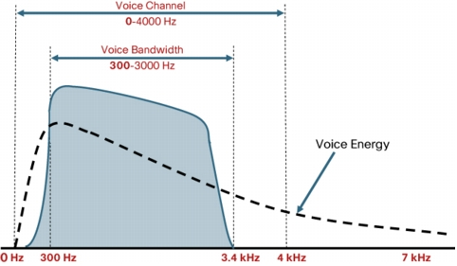
It’s all spectrum - phone
Notes:
http://www.voipsupply.com/images/voice_freq_range.jpg

Slide 59
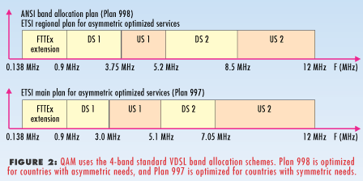




It’s all spectrum - wires
4 kHz
copper
10 MHz
1 GHz
200 - 347 THz

Slide 60
Classical division of spectrum
Band | range | commonly called | sample current usage
VLF | 3-30 kHz |  | navigation, submarine
LF | 30-300 kHz |  | WWVB (clock 60 kHz)
MF | 300-3 MHz |  | AM radio
HF | 3-30 MHz |  | short wave radio
VHF | 30-300 MHz |  | TV 2-6, 7-13, FM radio, CB, LMR
UHF | 0.3-3 GHz |  | LMR, TV 14-50, cellular, Wi-Fi
SHF | 3-30 GHz | microwave | radars, Wi-Fi
EHF | 30-300 GHz | mmWave | radars, satellite, p2p links

Slide 62
Commercial wireless spectrum (US)
LTE band class | frequency | origin | usage
71 | 617-698 MHz | incentive auction (TV) | TMo, AT&T, Dish
12 & 13 (A, B, C) | 700 MHz | digital dividend (TV) | AT&T, TMo, VZ
14 (D) | 700 MHz | digital dividend (TV) | FirstNet
5 | 850 MHz | cellular | AT&T, US Cellular
4 | 1700 MHz | AWS | many
25 | 1900 MHz | PCS | many
30 | 2300 MHz | WCS | AT&T
41 | 2500 MHz | EBS | Sprint

Slide 63

It’s all spectrum - radio
FM radio: 100 kHz
AM radio: 9 or 10 kHz
typical cell channel:
5-10 MHz
TV: 5 or 6 MHz

Slide 64




Slide 65
Spectrum for wireless broadband
Wells-Fargo
2017

Slide 66
LTE holdings

Slide 67
Spectrum per user

Slide 68
Geographic sizing: CMA

Slide 69
Spectrum geography: EA
Notes:
http://wireless.fcc.gov/auctions/data/maps/ea.pdf

Slide 70

It’s all spectrum - modem
Notes:
http://hackadaycom.files.wordpress.com/2013/01/dial-up-handshake-infographic.png

Slide 71

Fundamental limit to channel capacity
channel capacity
(bits/second)
bandwidth
(Hz)
signal-to-noise ratio
(typically, dB)
Shannon-Hartley limit

Slide 72

Amplitude, frequency & phase modulation
Wikipedia

Slide 73

Phase modulation
Wikipedia

Slide 74

Quadrature amplitude modulation (QAM)
Wikipedia

Slide 75
Shannon examples
SNR (dB) = 10 log₁₀ (S/N)
Telephone modem
  SNR = 20 dB (1:100)
  frequency range ~3 kHz → 3,000 log₂ (101) = 19.97 kb/s
Noise can be larger than signal!
  → negative SNR
Less noise → higher signal power
Only true for simple channel models
  “additive Gaussian white noise” (AWGN)
Spectral efficiency: bits per second per Hz
  often, around 1-2 b/s/Hz, but can be much higher
Notes:
See ITU Q.552

Slide 76
Circuit switching: FDM versus TDM
Example:
FDM
4 users
frequency
time
TDM
frequency
time
Notes:
Two simple multiple access control techniques.
Each mobile’s share of the bandwidth is divided into portions for the uplink and the downlink. Also, possibly, out of band signaling.
As we will see, used in AMPS, GSM, IS-54/136

Slide 77
All networks are similar
packets
time-division multiplexing
packets
modulation
frequency division
medium = spectrum

Slide 78










Reference architecture
Other
Communications
Networks
Internet
Peering
OTT
Interconnected Networks
Users
ISP
Comm Complex
Video Complex
Access Network
Regional Broadband
Network
Transport Core
Service Core
Interconnected Networks
Local Video
Feeds
Video Feeds
and 3rd Party
CDNs
Other Cores
Within the
Network
L3 Router
SBC and
L3 Router
Set top box
command&control
Video
Cache

Slide 79

Broadband Access Technologies
FBWA or 4G
FTTHome
FTTCurb
BPL
DSL
4G
Fiber PON
HFC
Digital
Subscriber Line
Telco or ILEC
10s of Mbps
Entertainment, data, voice
Fiber -- Passive
Optical Network
Telco or ILEC
~75 Mb/s
Futureproof?
Fixed Broadband Wireless Access
Wireless ISP
WiMAX or LTE:
  -10s of Mbps
Satellite: few Mbps
4G/LTE
Cellular operators
5-10 Mbps (100 kph)
Hybrid Fiber Coax
CableCo (MSO)
Entertainment, data, voice
10s of Mbps
Broadband Power Line
PowerCo
Data, voice
~few Mbps
Paul Henry (AT&T), FCC 2009
Notes:
http://www.broadband.gov/ws_fixed_bb.html

Slide 80

Local loop

Slide 81
Physical architecture
Feeder Cables
  Carries traffic serving multiple endpoints form an “office” to a neighborhood
  (local convergence point, LCP, or serving area interface, SAI)
Distribution Cables
  Carry traffic for one or more households from LCP to the curb (network access point)
Drop Cables (above ground) or service wire (underground)
  Carry traffic from curb to dwelling unit
Depending upon the architecture
  Cables may be fiber, twisted pair or coax
  Local convergence point and/or network access point could host a patch panel, a DSLAM, an optical splitter, an Ethernet switch, or a fiber/coax interface.

Slide 82


Broadband access
-48v

Slide 83

Logical architecture
Access network extends from Residential Gateway (RG) to Broadband Network Gateway (BNG)
Flow management between AN and RG depends upon the architecture
Flow management in the Ethernet Aggregation Network similar across architectures but may differ from how flows are managed between the AN and the RG
In Metro Network flows are typically distinguished by layer 3 QoS tags and/or separate VPNs
http://www.broadband-forum.org/technical/download/TR-101_Issue-2.pdf

Slide 84

xDSL logical architecture
http://www.broadband-forum.org/technical/download/TR-101_Issue-2.pdf

Slide 85
ADSL (ITU G.992.1)
ADSL spectral power repartition (PSTN)
Power
DATA
DATA
POTS
DATA
POTS
POTS
Upstream
Upstream
Upstream
Downstream
Downstream
Downstream
300 Hz
300 Hz
300 Hz
3,4 kHz
3,4 kHz
3.4 kHz
22 kHz
22 kHz
22 kHz
133kHz
133kHz
203 kHz
203 kHz
203 kHz
1.1 MHz
1.1 MHz
1.1 MHz
Frequency
FDD: Frequency Division Duplexing
➔ no interference between up and down

Slide 86



Access: cable network
cable headend
…
cable
modem
splitter
CMTS
cable modem
termination system
data, TV transmitted at different
frequencies over shared cable
distribution network
ISP
HFC: hybrid fiber coax
  asymmetric: up to 30Mbps downstream transmission rate, 2 Mbps upstream transmission rate
network of cable, fiber attaches homes to ISP router
  homes share access network to cable headend
  unlike DSL, which has dedicated access to central office

Slide 87
Cable architecture

Slide 88
Cable spectrum
Notes:
Telecom & Networking Equipment The Cable Equipment Playbook – Opportunity for Investors, Oct. 4, 2017, Jefferies

Slide 89

Simplified access network diagram
Jason Livingood (Comcast) FCC 2009
Notes:
89
http://www.broadband.gov/ws_fixed_bb.html

Slide 90
DOCSIS 3.0 channel bonding
152 Mbps
Logical Channel Bonding Technology
38 Mbps
38 Mbps
38 Mbps
38 Mbps
6 MHz
6 MHz
6 MHz
6 MHz
DOCSIS 2.0 is limited to single channel’s capacity
DOCSIS 3.0 employs packet bonding across multiple channels
  Initially will bond 4 channels
  8 channel-capable silicon coming soon
  Upstream bonding in 2010
  Increased speeds 100Mbps+
Notes:
90

Slide 91



Verizon’s FTTP architecture
customer premise
OLT
Optical Line Terminal
Voice & Data Downstream 1490 nm
Voice, Data & Video 1490 nm, 1310 nm, 1550 nm
ONT
Optical Network Terminal
Optical Couplers (WDM)
Optical Splitter
Upstream 1310 nm
Video 1550 nm
1x32
CENTRAL OFFICE
EDFA
Erbium Doped Fiber Amplifier
Bandwidth & Services
Upstream
Downstream
1310 nm
1490 nm
1550 nm
Voice & Data at 155 to 622 Mbps
Voice, Data & VOD at 622 Mbps
Broadcast Video
54 MHz
864 MHz
Brian Whitton, Verizon
Analog TV
Digital TV and HDTV
Notes:
by Brian Whitton, Verizon Networks

Slide 92

Communication satellites
Communication satellites, some properties, including: altitude above earth, round-trip delay time, number of satellites for global coverage.

Slide 93

Satellite frequency bands

Slide 94

Geostationary satellites (2)
“bent pipe”
VSATs using a hub.

Slide 95
HTS launches per year
Dedicated HTS | Hybrid Payload HTS
Thaicom 4 | Anik F2
WildBlue 1 | AMC-15
Spaceway 3 | AMC-16
Ka-Sat | Ciel-2
ViaSat-1 | Hylas 1
Jupiter-1 | Arabsat 5C
Inmarsat 5F2 | YahSat 1B
Inmarsat 5F1 | Hylas 2
Inmarsat 5F3 | Hispasat AG1
NBN Co 1A | Express AM5
GSAT-11 | Astra 2F
NBN Co 1B | Express AM6
 | Amazonas 3
 | Astra 2E
 | Thor 7
 | Astra 2G
 | Jabiru-1
David Hartshorn, 2014

Slide 97


Low-Earth orbit satellites
The Iridium satellites form six necklaces
around the earth.

Slide 98
OneWeb (2018+)
LEO – 1,200 km orbit
648 satellites in 18 orbital planes
  50-70 gateway sites
Ku & Ka-band spectrum
Service area: 1,080 by 1,080 km per satellite
  7.5 Gb/s
OneWeb presentation at International Satellite Symposium 2016
Notes:
https://www.itu.int/en/ITU-R/space/workshops/SISS-2016/Documents/OneWeb%20.pdf

Slide 99
GSO protection
OneWeb presentation at International Satellite Symposium 2016
Notes:
https://www.itu.int/en/ITU-R/space/workshops/SISS-2016/Documents/OneWeb%20.pdf

Slide 100

Exede beam map
http://www.wildbluetools.com/content/dealer/email/Beam_map-high-mid-low.html

Slide 101
Satellite
Advantages
Disadvantages
Near-universal geographic availability
  low incremental cost
    satellite terminal + installation
Resilient after natural disasters
  often used as backup
Latency
  MBA 2014: RTT 671 ms
Temporary disruptions
  sun alignment
  rain fade
Capacity
  Viasat-1: 140 Gb/s (for 300,000 customers)
  usually, usage-capped

Slide 102

Example: Exede satellite plans
Oklahoma County, OK

Slide 103

Project Loon
LTE at 850 MHz
solar powered
wind layers
< 20 km altitude

Slide 104
The cost of networks

Slide 105



Network economics, (over)simplified
70%
30%
traditional: 12-15 staff/10k customers
Iliad, FR: 3-4 staff/10k
Notes:
opex ratios: Deloitte

Slide 106





Fiber deployment
wastewater pipe
(3-5 km/week)

Slide 107
Broadband network cost - FTTP
Category | Details | Outside plant
FTTP in existing right-of-way | All underground, not including drops or electronics | $1,200…$1,300 per passing
 | 40% aerial, 60% underground, not including drops or electronics | $1,000…$1,100 per passing
FTTP drops | Range of distances and complexity | $300…$700 per connected home
Crown Fibre Holdings (Govt. of New Zealand); provided by CTC

Slide 108

Broadband network cost – Fiber middle mile
Category | Details | Outside plant | Source
aerial, new attachment | Northeastern city municipal utility; 96% aerial, 4% underground; 87.6 miles | $30,000/mile | Public utility (actual cost)
aerial overlash | Major metropolitan area (U.S. east coast) | $15,000/mile
buried | Mixed suburban/urban locations and pot/bore construction | $89,000/mile | Washington, D.C.-area BTOP project (actual cost)
Data provided by CTC

Slide 109
Middle mile cost example
CTC, 2009 (“Brief Engineering Assessment: Efficiencies available through simultaneous construction and co-location of communications conduit and fiber”)

Slide 110
More fiber observations
Fiber middle-mile cost: $50-70k/mile
Fiber cost: 144 strands = $10k/mile, 48 strands = $4.7k/mile
Common characteristics:
  avoid active elements in network → power, maintenance → PON
  recently: avoid anything except fiber (including splitters)
    cf. wireless last mile approach
  fiber home run, even if PON (Google Fiber, Stockholm)
Fiber cost higher for buried, but cheaper if conduit or aerial
Recent FTTH:
  avoid indoor installation (cf. Verizon FiOS)
  one box in home (ONT + 802.11ac), not ONT + MoCa STB

Slide 111
FTTH estimates
Bell Alliant in Western Canada has now passed over half a million homes with fiber home, the largest deployment in North America after Verizon. Their latest financial report showed capex of less than $500 per home passed.
Verizon reported costs fell below $700/home passed several years ago and headed to $600. Add the cost of actually installing a large fraction of those homes, and your cost per home passed by the network comes closer to $1,000.
Installing each home at Verizon added $500-600. Digging lawns and drilling holes into the homes is labor intensive.
Includes equipment whose price is rapidly dropping. Early Verizon gear cost $300-400/home, but today they are probably paying half that.
  Very large fiber builds in China are paying less than $100/home.

Slide 112

FTTx cost vs. DSL
Alcatel-Lucent, 2013

Slide 113
Capital investment
Company | Revenue | Capital expenditures | %
Comcast (US) [3Q14] | $11.04B | $1.644B | 14.9
Telekom (DE) [3Q14] | €15.6B | $2.58B | 16.5
Safaricom (KE) [H1FY15] | Ksh 79.34B | Ksh 12.37 | 15.5

Slide 114
Accidental broadband
94.2% of US
households have
phone service
G.992.2
ADSL
DSL patents
1988-1991
1993
1999
62.1 million US
households have
cable TV
“peak CATV”:
82% of HH
DOCSIS 3.1
(10G/1G)
DOCSIS 1.0
(40M/1M)
1995
1997
2008
2016
Notes:
file:///Users/hgs/Downloads/1997_Mar_Trends.pdf

Slide 115
Network competition models
single provider
(any technology)
cable
copper, fiber
IP
“bit stream”
MAC
(Ethernet)
shared copper, fiber
PHY
poles & conduits
regulated: pricing? behavior?
how many entrants? where?
margin squeeze

Slide 116
Sharing models: US
sharing (incumbent + new entrant) vs. neutral third party
+ WISP & satellite
DSL
(ILEC)
fiber
(ILEC, CATV, overbuilder)
HFC
PHY (LTE)
spectrum
ducts & poles
(electric utilities or ILEC)
towers

Slide 117
Sharing models: Canada, Europe, Australia
usually
unbundled
unbundling
varies
mostly not unbundled
DSL
fiber
HFC
PHY (LTE)
spectrum
ducts & poles
(electric utilities or ILEC)
towers
Notes:
http://dx.doi.org/10.1787/20716826
http://www.oecd.org/sti/broadband/2-7.pdf

Slide 118
Broadband competition challenges

Slide 119
The difficulty of competition
Static vs. dynamic (new entrants)
  existing, converging infrastructures
    coax cable + copper + wireless
Difficulties for new entrants (“overbuilder”)
  capital investment vs. amortized network
  legal barriers
  customer acquisition (“sticky” customers)
  incumbent pricing
Notes:
https://aws.amazon.com/blogs/aws/aws-importexport-snowball-transfer-1-petabyte-per-week-using-amazon-owned-storage-appliances/

Slide 120

Google Fiber

Slide 121
Network costs
yes, but mostly
electronics
middle mile
last mile
backbone
CDN
largely unaffected
by video
ISP-owned
vs. leased!
DSL | no
HFC | homes/service node
fiber | no
cellular | densification
lack of IXPs in LDCs!

Slide 122
Transit prices
http://drpeering.net/white-papers/Internet-Transit-Pricing-Historical-And-Projected.php

Slide 123




Bandwidth costs
Amazon EC2
  $50 - $120/TB out, $0/TB in
CDN (Internet radio)
  $600/TB (2007)
  $7-20/TB (Q1 2014 – CDNpricing.com)
NetFlix (7 GB DVD)
  postage $0.70 round-trip → $100/TB
FedEx – 2 lb disk
  5 business days: $6.55
  Standard overnight: $43.68
  Barracuda disk: $91 - $116/TB
DVD-R (7 GB)
  $0.25/disk → $35/TB
Notes:
FedEx and EC2 prices as of 09/15/09
CDN: http://www.mindbranch.com/listing/product/R678-29.html
http://www.cdnpricing.com/

Slide 124
rural broadband

Slide 125
What is rural?
Census:
  Urban = Urbanized Areas (UAs) of 50,000 or more people
    OR Urban Clusters (UCs) of 2,500 to 50,000 people.
    core of population density of 1000 people/mi²
      all of NJ: 1210 / mi²
  Rural = everywhere else
OMB:
  Metropolitan Statistical Areas (MSAs): >= one urbanized area of >= 50,000 population, plus adjacent territory that has a high degree of social and economic integration with the core as measured by commuting ties.
  Micropolitan Statistical Areas: >= one urban cluster of at least 10,000 but less than 50,000 population, plus adjacent territory that has a high degree of social and economic integration.
USDA
  based on counties

Slide 126
Rural areas (USDA)
Notes:
https://www.ers.usda.gov/topics/rural-economy-population/rural-classifications/what-is-rural.aspx

Slide 127
Broadband access by speed & geography
15% of US population

Slide 128
Rural broadband US
Notes:
https://fivethirtyeight.com/features/the-worst-internet-in-america/

Slide 129


Slide 130
Rural electrification
Early 1920s, between 2 and 3% (likely less)
  1921: DC had 98.2%, MA 97.8%
“In 1935, only 10.9% of American farms (744,000) enjoyed central station power, compared with Germany and Japan at 90%, France between 90 and 95%, and New Zealand at 60%.”
“In 1940, just four and a half years after Roosevelt signed Executive Order No. 7037 (followed by 1936 ”Rural Electrification Act”), 25% of American farms had been electrified.”
1950: 90% had been electrified nationally
Today: 850 distribution coops serving 14 M homes
Notes:
http://remagazine.coop/flashbacks-rural-electrification-cartogram-numbers/

Slide 131
Rural electrification
“In 1935, Morris Llewellyn Cooke, a mechanical engineer who had devised efficient rural distribution systems for power companies in New York and Pennsylvania, had written a report that detailed a plan for electrifying the nation's rural regions. Appointed by Roosevelt as the REA's first administrator, Cooke applied an engineer's approach to the problem, instituting what was known at the time as "scientific management"—essentially systems engineering. Rural electrification became one of the most successful government programs ever enacted. Within 2 years it helped bring electricity to some 1.5 million farms through 350 rural cooperatives in 45 of the 48 states. By 1939 the cost of a mile of rural line had dropped from $2,000 to $600. Almost half of all farms were wired by 1942 and virtually all of them by the 1950s.”
Cost of aerial fiber installation: $14k/mile material, $39k/mile installation ^{(Singer, 2017)}
USDA loans at 5% (hardship rate) for telecom
  but currently Treasure rate is lower (2.81% for 30 years)
  others at rates equivalent to municipal bonds
$10,958 in 2017
Notes:
“Assessing the Impact of Removing Regulatory Barriers on Next Generation Wireless and Wireline Broadband Infrastructure Investment”, 2017
http://www.greatachievements.org/?id=2990 (rural electric)
https://fas.org/sgp/crs/misc/RL33816.pdf

Slide 132
Density determines network choices
cable
satellite
REC
DSL (common)
FTTH
WISP
HH/road mile
1454
1
7
10
20
50
100
1000
Alaska roadmiles
Notes:
Manhattan: 508 road miles - http://venus.fcny.org/cmgp/streets/pages/2001PDF/Report/DFMN.pdf ; Wikipedia: 738,644 households in Manhattan
Alaska: 15,178 miles; 741,894 population

Slide 133
Rural deployment options
Technology | Capacity in rural areas (typical) | Advantage | Disadvantage
DSL | < 5 Mb/s | mostly deployed | speed increase requires active components deep in network
4G LTE | ~ 5 Mb/s | existing deployment, MF II | limited capacity (current avg.: 2.1 GB/month)
5G (3.5 GHz, not mmWave) | depends on deployment model | saves fiber drop | spectrum OpEx
satellite (current geo) | 12 Mb/s nominal | no incremental deployment cost | expensive, capacity-limited, latency
HFC (“cable”) | 25-100 Mb/s | low upgrade cost to 1 Gb/s+ | 85% of households
FTTH & FTTC | 100 Mb/s – 1 Gb/s | 20 year life time passive outside plant | cost to deploy

Slide 134
cost recovery

Slide 135

Consumer expenditures
“Americans spent $116 more a year on telephone services in 2011 than they did in 2007, according to the Labor Department, even as total household expenditures increased by just $67.
Meanwhile, spending on food away from home fell by $48, apparel spending declined by $141, and entertainment spending dropped by $126. The figures aren't adjusted for inflation.” (WSJ 2012)
Notes:
Morgan Stanley, Macro Meets Micro: A Five- Year View of the Telecom Services Industry, July 2014.
http://online.wsj.com/articles/SB10000872396390444083304578018731890309450
http://www.bls.gov/opub/btn/archive/consumer-spending-in-2010-pdf.pdf

Slide 136
The value of bits
Technologist: A bit is a bit is a bit
Economist: Some bits are more valuable than other bits
  e.g., $(email) >> $(video)
Application | Volume | Cost per unit | Cost / MB | Cost / TB
Voice (13 kb/s GSM) | 97.5 kB/minute | 10c | $1.02 | $1M
Mobile data | 5 GB | $40 | $0.008 | $8,000
MMS (pictures) | < 300 KB, avg. 50 kB | 25c | $5.00 | $5M
SMS | 160 B | 10c | $625 | $625M
Notes:
T-Mobile 2010
AT&T data
http://www.nowsms.com/discus/messages/12/8500.html

Slide 137

Problem likely capacity, not speed
June 2017: 100 GB

Slide 138
The challenges of service differentiation
Method | Used by | Advantage | Drawbacks | Customer dislike estimate
Speed tiers | C, DSL | Differentiates basic usage modes | Less effective above 10 Mb/s | 😦
Usage-based charging (caps, metered) | M, (C, DSL), LD | heavy vs. light users encourages Wi-Fi use | complaints about meter accuracy adaptive applications (4G bill shock) pay for ads hard to predict | 😦😦😦
Application-based charging | M | Easier to predict Business model | Affects content competition barriers to entry | 😦😦😦
Differentiated privacy | AT&T, NetZero | Full functionality | Low-income users may not be attractive to advertisers | 😦 or 😦😦😦

Slide 139
The challenges of service differentiation
Method | Used by | Advantage | Drawbacks | Customer dislike estimate
Priority | ? | Better experience for VoIP | Other experience must be bad → economy class in airline | ?
Time-of-day | LD, Sat | Approximates congestion Easy to understand | Not optimally efficient Possible bill shock | 😦😦
Congestion-based | ? | Encourages time shifting | Limited shift Unpredictability | 😦😦😦😦
The words you won't say on your deathbed are, "If only I had spent more time watching the bandwidth meter (or phone bill)."

Slide 140
Cable TV vs. Internet
Lots of advocates of “fairness” for metering
Very few advocate scaling the monthly TV fee (Europe) or the cable TV fee by hours watched
  eminently feasible with STBs
  content tiers but not viewing tiers
“but cost of cable TV does not depend on viewers”
not really: content cost to MVPD is based on popularity

