Slide 1
Experimentally-Driven Mapping of QoS-to-QoE for Mission-Critical Voice
Henning Schulzrinne (PI), Dan Rubenstein
Charles Jennings, Norm Groner
v1.3

Slide 2
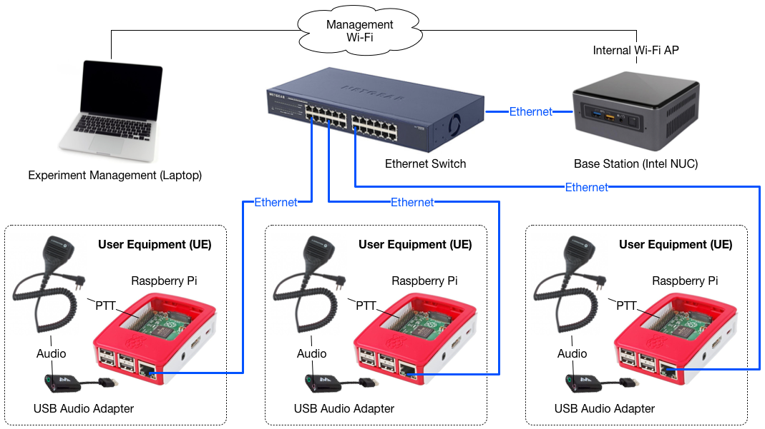
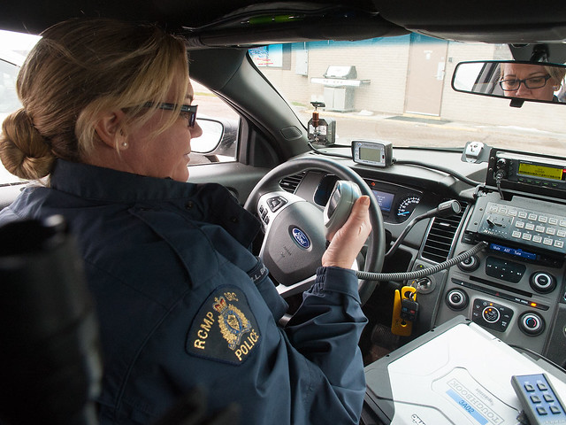
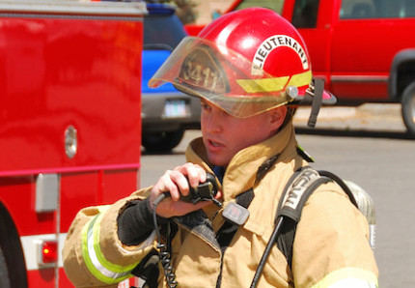
Project objectives
How does the quality of the communication channel affect first responder communications?
Four phase approach:
Build communication testbed with tunable parameters that emulates realistic (poor) LMR communication channel conditions
Experiment using trained first responders to communicate across communication infrastructure
Measure communication performance (delay, accuracy)
Build mathematical models: channel conditions → performance measures

Slide 3
QoE measures
Comprehension errors
e.g., repeat transmitted messages
Task errors
e.g., wrong information recorded
Usage errors
e.g., pressing talk to speak button too early or too late
Length and latency of responses
e.g., pauses between requests and start of transmission
Subjective ratings of user experience
e.g., rated frustration with ratios

Slide 4
Year 1: Testbed development
Intel NUC will manage all services
End-user communication gear connected to Android or RPi Devices
Centralized control to adjust communication quality parameters
mouth-to-ear and PTT delay
noise level
packet loss (outage bursts)

Slide 5
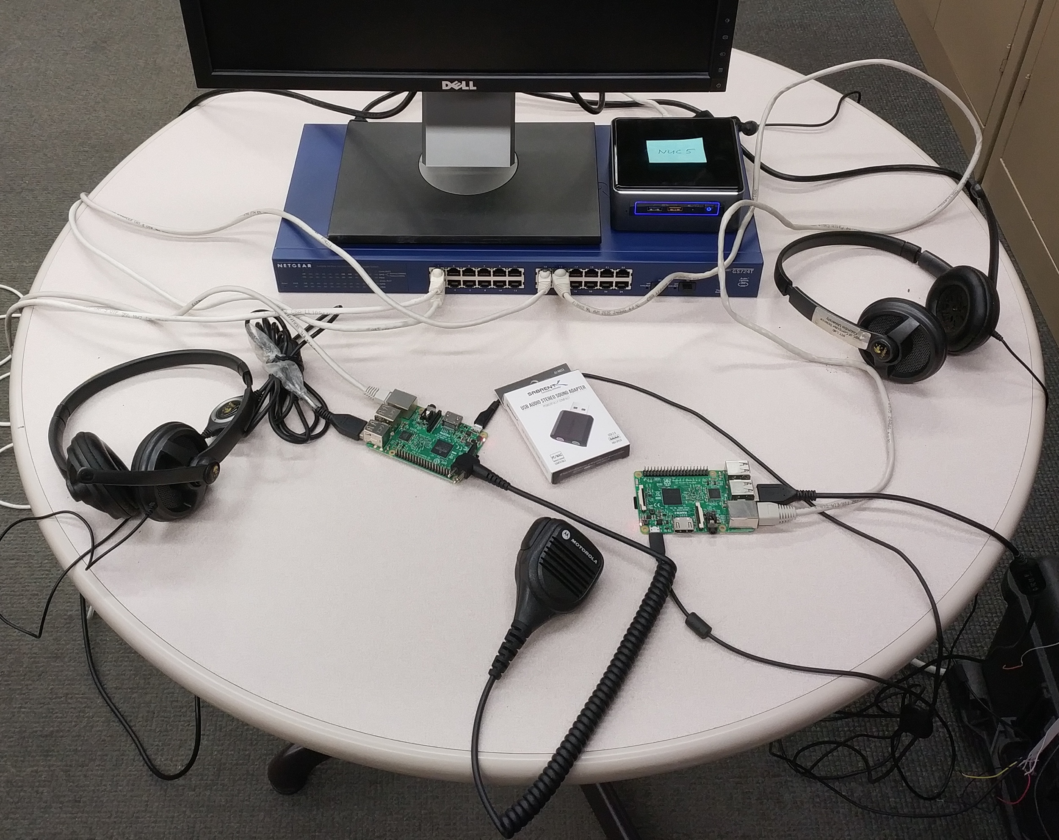
First (early) prototype

Slide 6
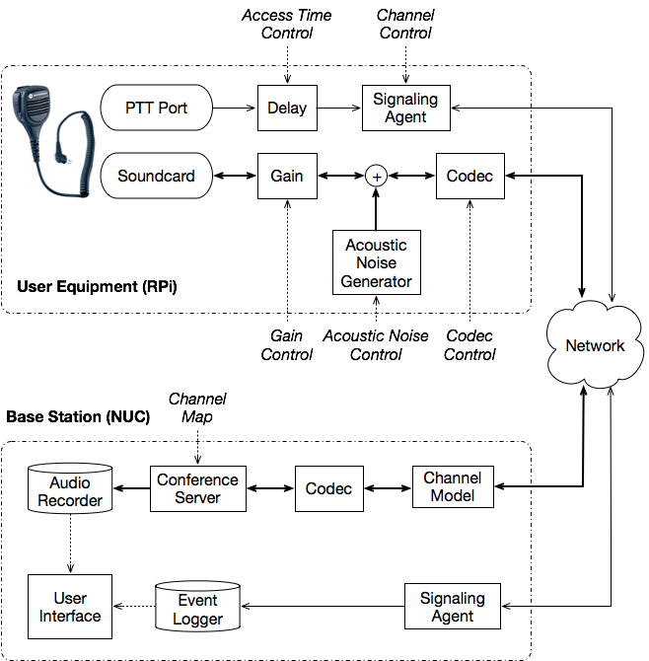
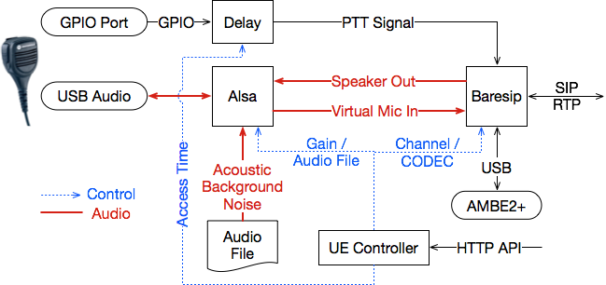
More detailed system architecture
UE

Slide 7
Year 2: Testing
Generate scenarios that first responders will describe
First responder officer volunteers will help design appropriate scenarios
First responders “in-the-field” will test in the scenario (in a lab)
QoE: measure communication time and accuracy

Slide 8
Year 3: Modeling
Produce mappings from input parameters (delay, noise, loss) to output parameters (communication time and accuracy)
Input Parameters
Multi-Dimensional Curve Fitting
Performance
Experimental Results
Input parameters

Slide 9
Accomplishments to date
Testing platform development
Initial design of network-based general voice quality platform
portable, replicable, building on standard software
Demo: initial prototype using Raspberry Pi (Linux) + VoIP clients
Engagement with local first responder organizations
Actively engaged with Columbia University’s Office of Public Safety
James McShane, VP Public Safety
Jeannine Jennette, Executive Director, Public Safety
Empress EMS (major private EMS provider)
Teaneck, NJ fire department
your name here - inviting additional scenario input & test participants

