Slide 1
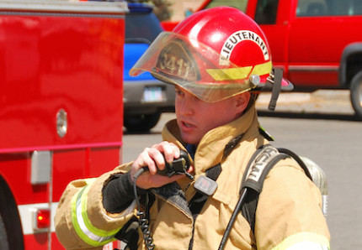
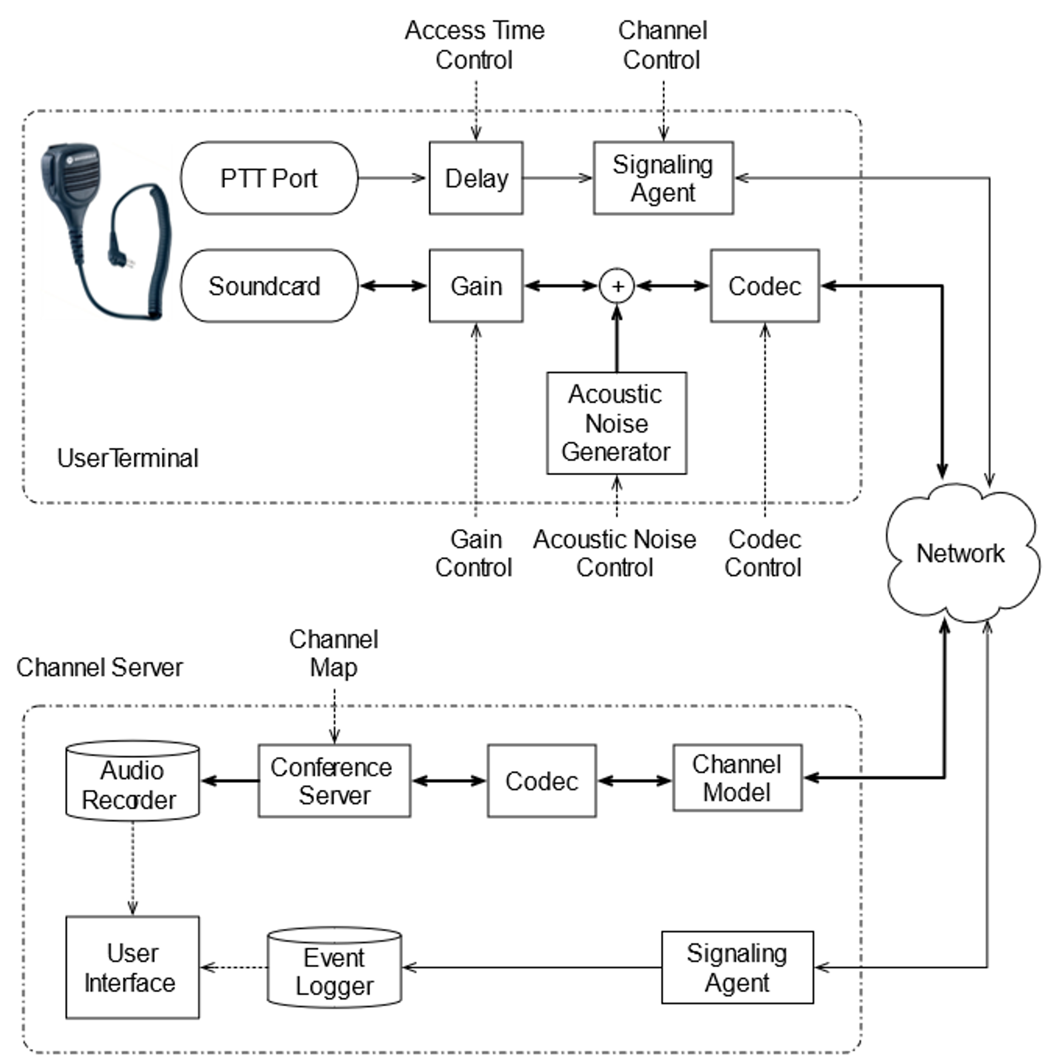
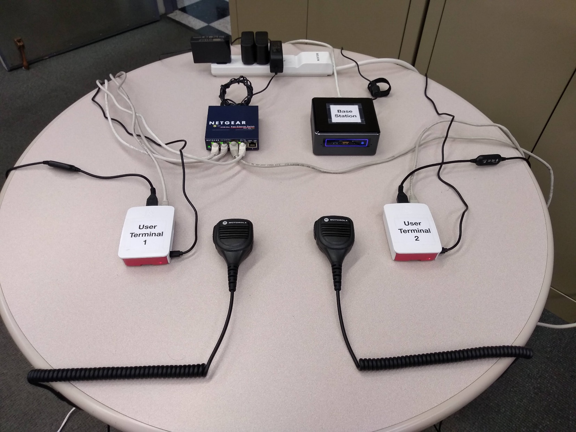
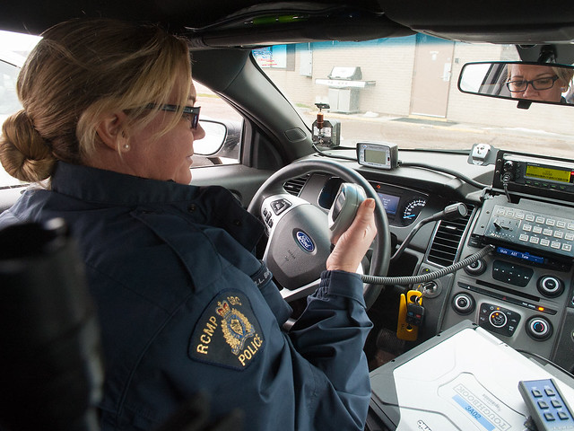
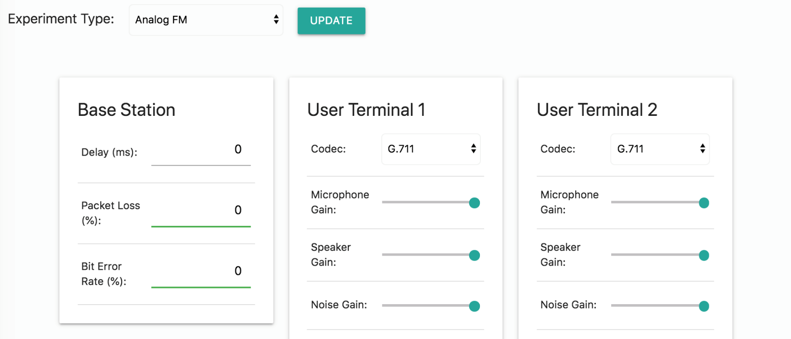
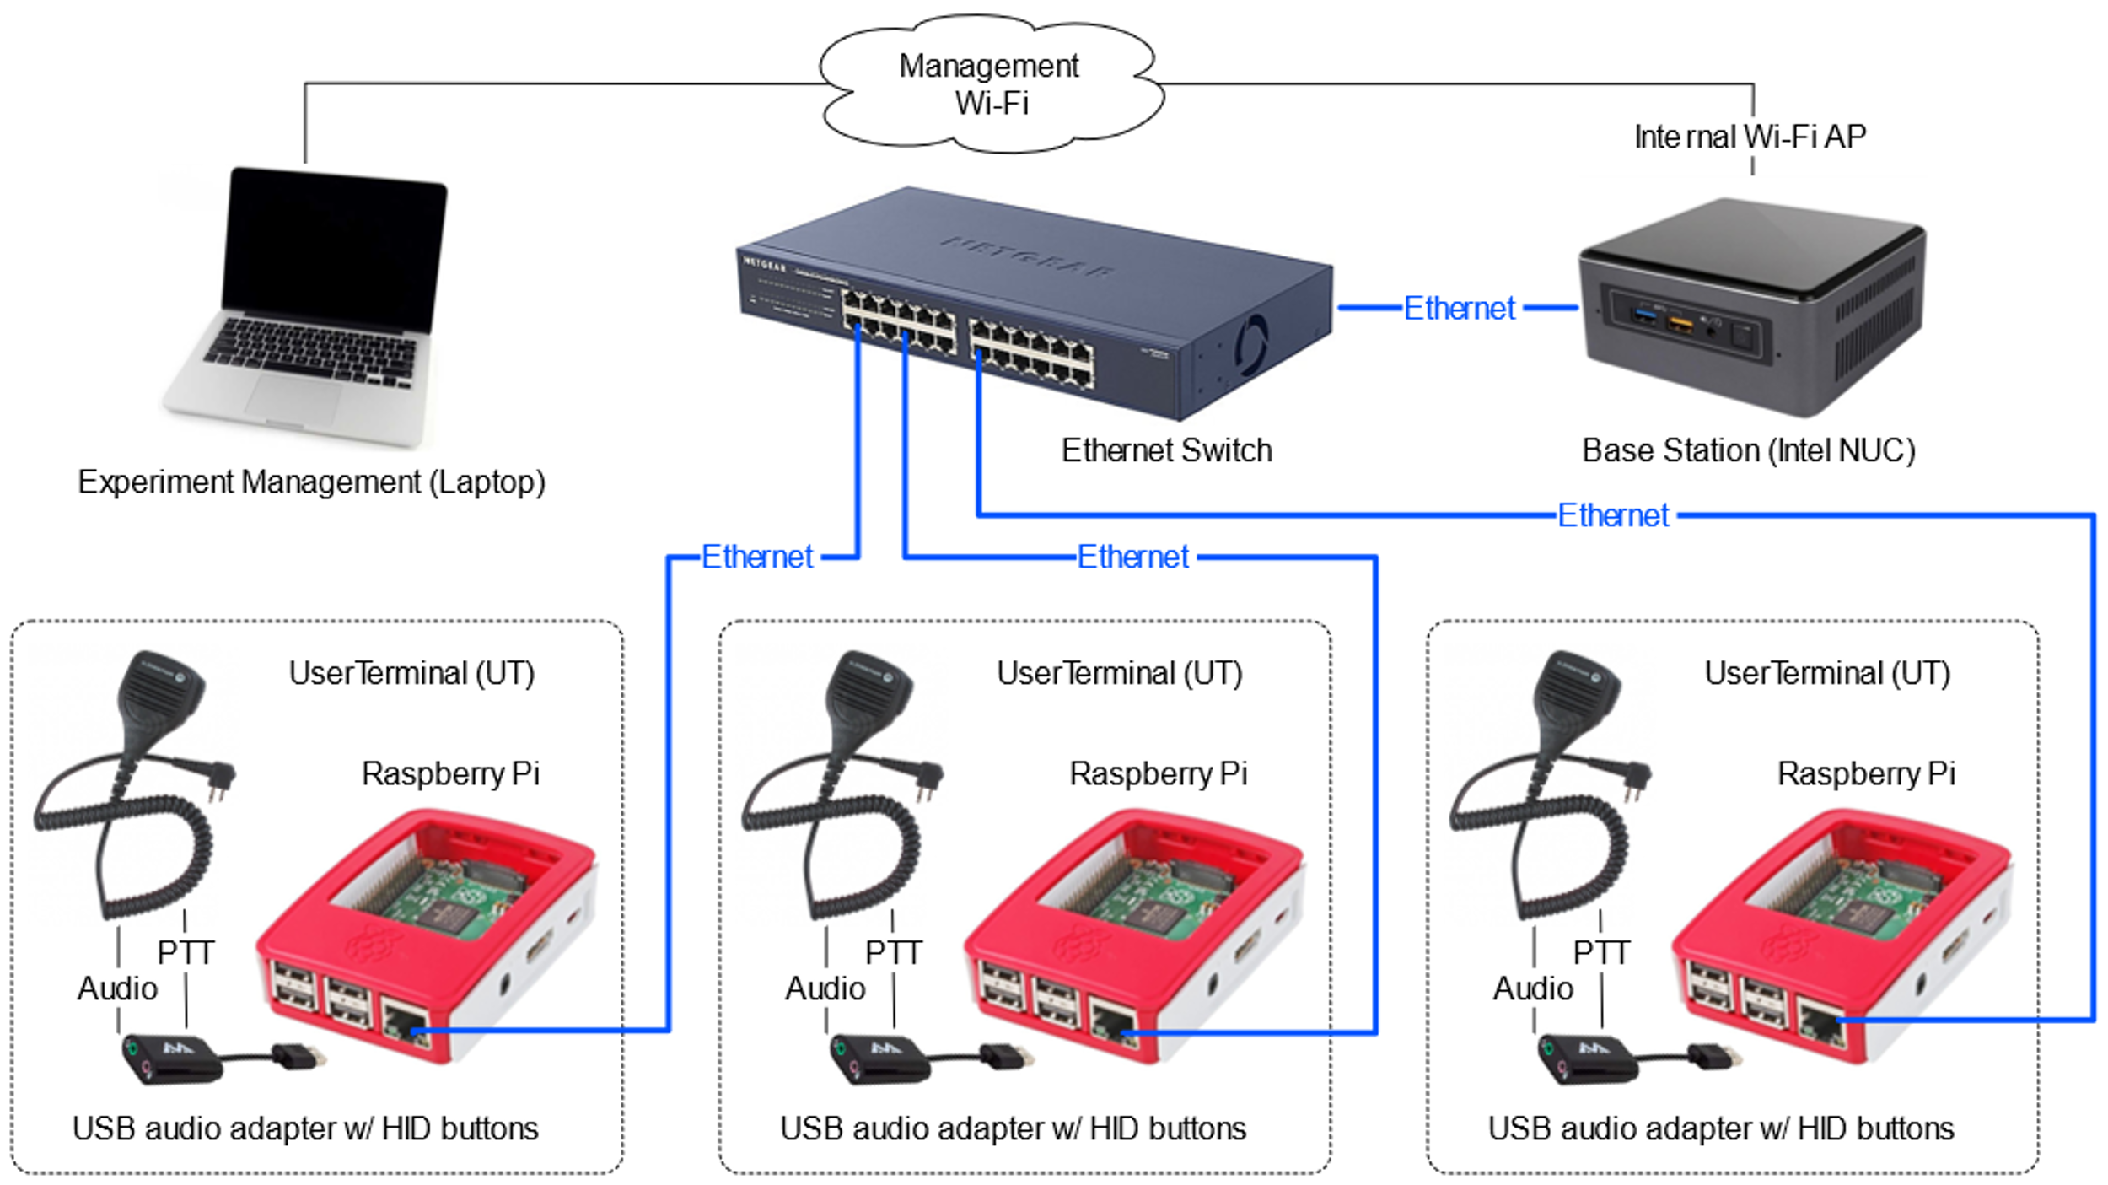
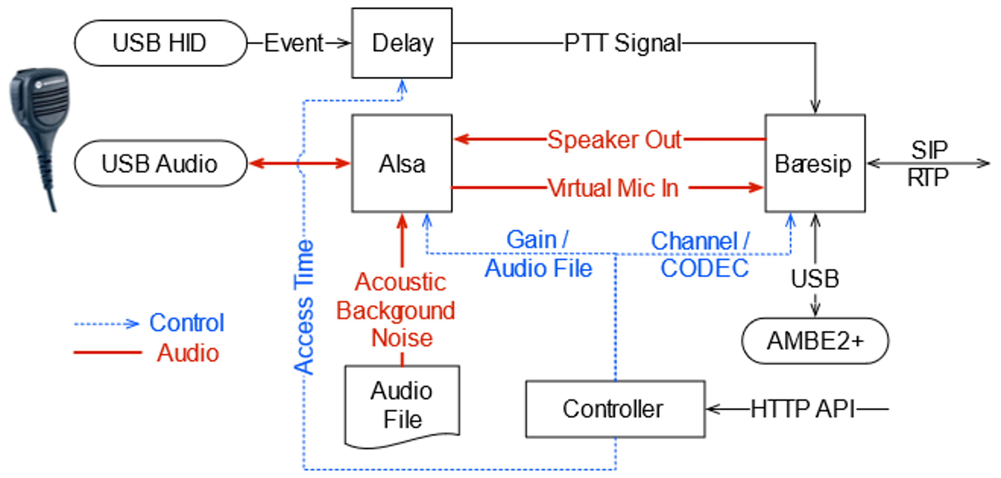
Experimentally-Driven Mapping of QoS-to-QoE for Mission-Critical Voice
Henning Schulzrinne¹, Dan Rubenstein¹, Charles Jennings², and Norm Groner²
Columbia University¹, John Jay College²
Email: hgs@cs.columbia.edu
Introduction
Software Architecture
First Testbed Prototype
Jan Janak
Luoyao Hao
Artiom Baloian
Ian Loeb
Shaun Maher
Kunal Mahajan
Goals & motivations
Establish relationship between QoS and QoE in mission-critical voice
initially, mainly FM and P.25
Improve QoE for public safety responders
Guide future MCV designs
QoE Measures (tentative)
Comprehension errors
Task errors
Usage errors
Length and latency of responses
Subjective rating of user experience (impact on other tasks)
Based on standardized VoIP protocols (SIP and RTP) and open source software
Support both user-to-user and group communication scenarios
Key experiment parameters controllable in real-time via HTTP APIs
Self-contained, easy to assemble, extend, and transport
Designed for experiments with human subjects
Emulation profiles for analog FM, P.25, and next-gen LMR systems
Mapping of QoS-to-QoE
Map from input parameters (delay, PTT delay, noise, bit errors, packet loss) to output parameters (communication time and accuracy).
A simplified version of the testbed with two UTs and one Base Station
Approach
Build communication testbed with tunable parameters that emulates realistic (poor) LMR communication channel conditions
Experiment using trained first responders to communicate across communication infrastructure
Measure communication performance
Build mathematical models: channel conditions → performance measures
Hardware Architecture
Internal Building Blocks of UT Subsystem
Intel Next Unit of Computing (NUC) for experiment and testbed management
LMR equipment emulated with Raspberry Pi
Fast Ethernet network with programmable channel emulator (based on NISTnet)
Custom acoustic noise generator can be mixed with microphone input
Manually control audio input & output gain
Planning to support AMBE2+ codec used in P.25 systems
Testbed & Experiment Management Interface
Future Work
Second Year: Testing
Generate interactive scenarios for first responders
Obtain IRB approval
First responders “in-the-field” will test the scenario (in a lab)
QoE: measure communication time, accuracy, impact on other tasks
Third Year: Modeling
Produce mappings from input parameters (delay, noise, loss) to output parameters (communication time and accuracy)
References
David J. Atkinson and Andrew A. Catellier, Intelligibility of Analog FM and Updated P25 Radio Systems in the Presence of Fireground Noise: Test Plan and Results, NTIA Report 13-495, May 2013.
Jesse Frey, Jaden Pieper and Tim Thompson, Mission Critical Voice QoE Mouth-to-Ear Latency Measurement Methods, NIST, Feb 2018.
Wenyu Jiang, K. Koguchi and H. Schulzrinne, "QoS evaluation of VoIP end-points“, IEEE International Conference on Communications, 2003, pp. 1917-1921 vol. 3.

