Slide 1
5G: Making networks slower
Non-traditional commercial wireless
Henning Schulzrinne
Columbia University

Slide 2
Design principles & lessons
Keep applications independent of lower layers
  in particular, PHY
  = fundamental design principle of the Internet, even if 50 years old…
Allow island deployments that can merge to backbone when available
  may only be intermittent – but information needs may also be less urgent
Simplify authorization
  mediated trust (add nodes) rather than passwords
Require no specialized resources
  no special spectrum licenses
  no carrier technicians or vehicles
  minimal training (IT technician level)
Network difficulties
  VLAN support
  QoS and admission control
  external management support
  packet header overhead (can do 2 kb/s VoIP codec → ROHC needed)

Slide 3
Need local computation
Mobile devices don’t have the battery or continuity
Remote cloud is too unreliable
→ good application of fog computing
Applications:
  local VoIP and text service
  message store-and-forward
  IoT data gathering and aggregation
  local GIS system
  video processing
  higher-level data compression
  informational and transactional resources for public (e.g., check-in)

Slide 4
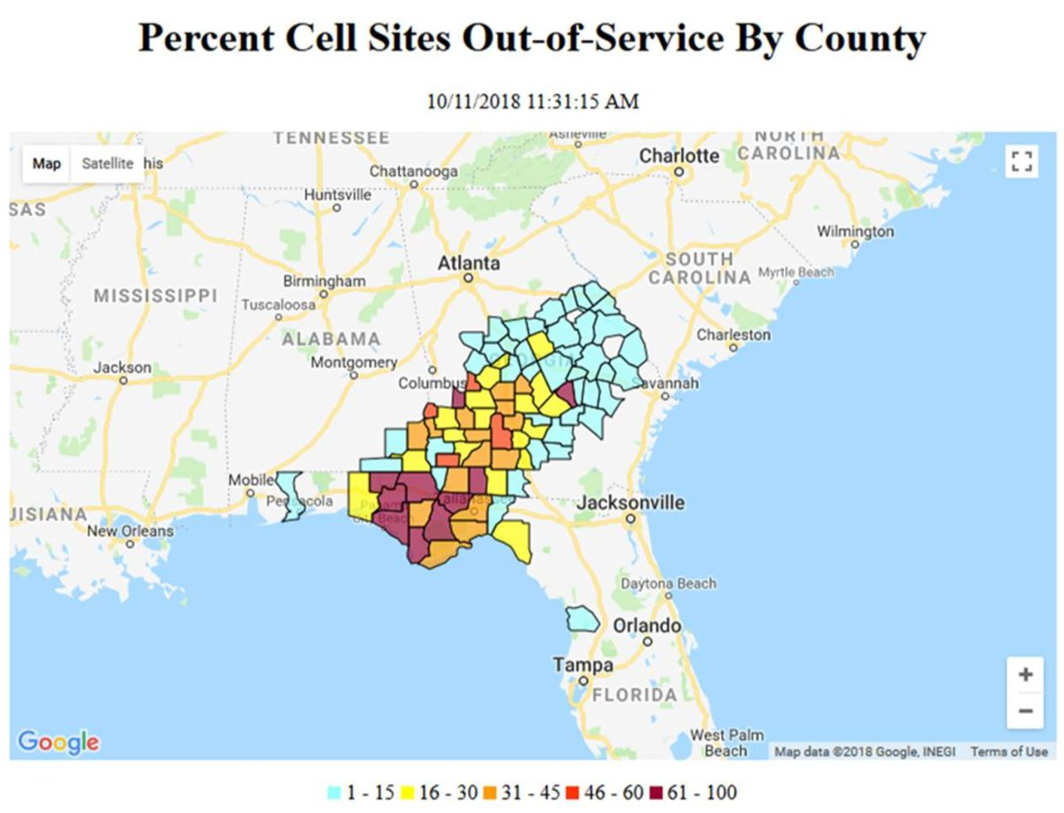
Cell networks may not be available
“She explained that in some cases even after service is restored, it quickly goes out again. New fiber cuts arise as recovery workers begin clearing roads and removing debris from residential properties, and as electric poles get replaced.
  "Our fiber crews are working around the clock to make repairs," Schultz said Monday. "While they are making good progress, we are still experiencing new fiber cuts as soon as repairs are made."
Notes:
https://www.cnet.com/news/fiber-outages-slow-cell-recovery-after-hurricane-michael/

Slide 5
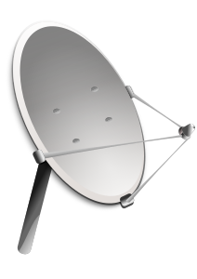


”Whatever it takes” communication
+
opportunistic
networks
Notes:
FirstNet
satellite
Wi-Fi peer-to-peer
SMS
store-and-forward

Slide 6

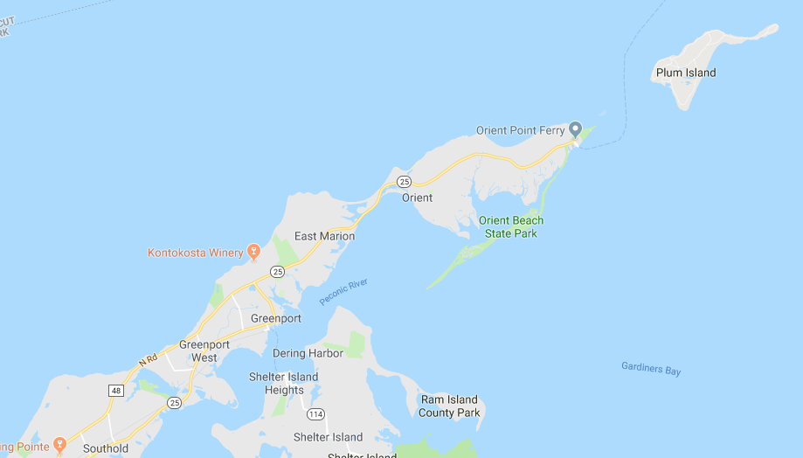
DARPA RADICS

Slide 7
Example: DARPA PHOENIX nodes
DECT
DARPA RADICS: support blackstart for electric utilities
802.11af
(TVWS)
mesh
high-bandwidth
VHF
mesh network (OLSR) with multiple VLANs (VoIP, SCADA, …)
goal: self-configuring – just turn on
network-technology agnostic (not just 4G)
local services (VoIP, messaging, edge cloud)
with diagnostics and traffic isolation
SDR: P.25
over VHF + Codec2 + data
Notes:
https://saankhyalabs.com/rural-broadband/meghdoot-base-station-slb802odu/
https://mimomax.com/product_category/radios/
http://www.persistentsystems.com/mpu5/

Slide 8
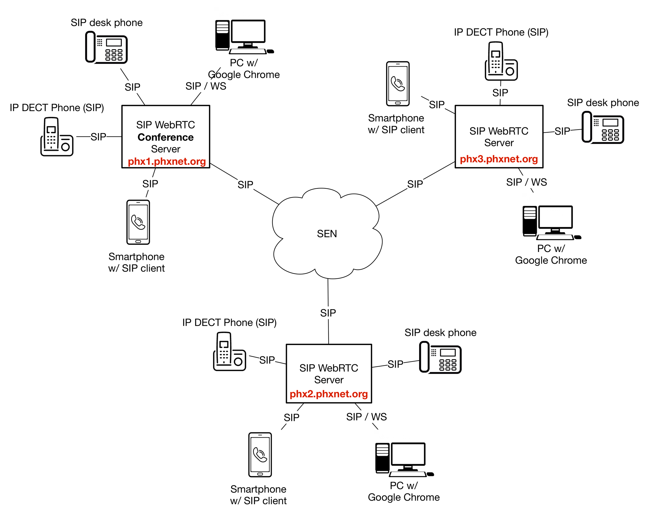
Example: distributed VoIP implementation
Every node can function by itself
Local capability, “global” dial plan

Slide 10
Special case of IoT: Ultra-Reliable Low Latency Communication
NB-IOT (Rel 13)
LTE CAT1
Rapeepat Ratasuk, Nokia

Slide 11
Trading bandwidth – coverage - cost
Notes:
Keysight 2017: https://www.keysight.com/upload/cmc_upload/All/20170612-A4-JianHuaWu-updated.pdf

Slide 12
Cellular narrowband IoT
 | LTE Cat 1 | LTE Cat 0 | LTE Cat M1 (eMTC) | LTE Cat NB1 (NB-IoT)
3GPP Release | Release 8 | Release 12 | Release 13 | Release 13
Mobility | Full | Full | Full | Only idle mode reselection
DL peak | 10 Mb/s | 1 Mb/s | 1 Mb/s | 50 kb/s
UL peak | 5 Mb/s | 5 Mb/s | 375 kb/s (HD) 1 Mb/s | 250 kb/s (multi tone) 20 kb/s (single tone)
Latency | 50-100 ms | Not deployed | 10-15 ms | 1.6-10 s
Duplex mode | Full | Full & half | Full & half | Half
Device receive bandwidth | 1.4 – 20 MHz | 1.4 – 20 MHz | 375 kHz 1.4 MHz | 180 kHz
MCL (path loss) | 142 dB | 142 dB | 156 dB 164 dB (claimed) | 164 dB (but)
Notes:
https://www.iot-now.com/2016/06/21/48833-cat-m1-vs-nb-iot-examining-the-real-differences/
https://altair-semi.com/wp-content/uploads/2017/02/Coverage-Analysis-of-LTE-CAT-M1-White-Paper.pdf
https://www.keysight.com/upload/cmc_upload/All/20170612-A4-JianHuaWu-updated.pdf

Slide 13
Non-standard commercial options - examples
rural broadband deployment → mmWave backhaul
electric distribution networks → long-range VHF
performance (obviously) depends on antenna gain and placement
  very few reliable comparisons of systems under similar or standardized conditions
Technology | band | bandwidth | reach (estimate)
LoRa | 902-928 MHz UL | 0.3 – 27 kb/s | 2-3 km urban, 5-7 km rural
VHF MIMO | 136-174 MHz, 400-470 MHz 806-960 MHz | < 1.2 Mb/s @ 50 kHz | < 100 km (LOS)
Carlson TVWS | 600 MHz | < 24 Mb/s | < 40 km
MPU5 mesh | L, S, C bands | < 100 Mb/s | < 20 km (6 W)
Ubiquiti RP-5AC | 5 GHz | < 500 Mb/s @ 80 MHz | < 10 km
Siklu Etherhaul | 70-80 GHz | < 10 Gb/s | < 5 km
Notes:
https://www.thethingsnetwork.org/
https://mimomax.com/wp-content/uploads/2018/07/MiMOMax_SRP-Case-Study_201811.pdf
http://www.persistentsystems.com/pdf/mpu5/5-17-live-event.pdf

Slide 14

Tethered drones
200 Mb/s tether
Notes:
https://elistair.com/orion-tethered-drone/

