Slide 1
Block chains: miracle cure or snake oil?
Henning Schulzrinne (Columbia University)
February 2019
Federal Reserve New York

Slide 2
”ML is programmed in
Python, AI in PowerPoint.”
Blockchain in exclamation marks!

Slide 3
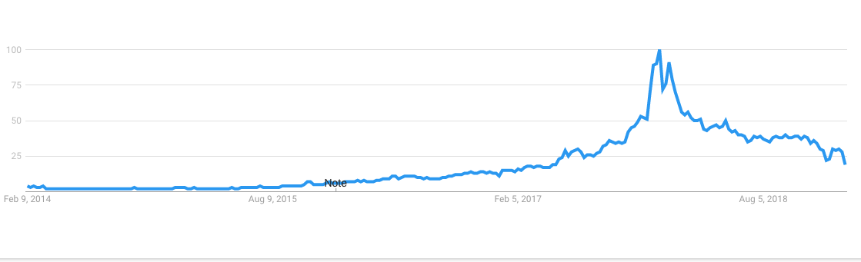
Google searches: blockchain
Dec. 2017: $17,132

Slide 4
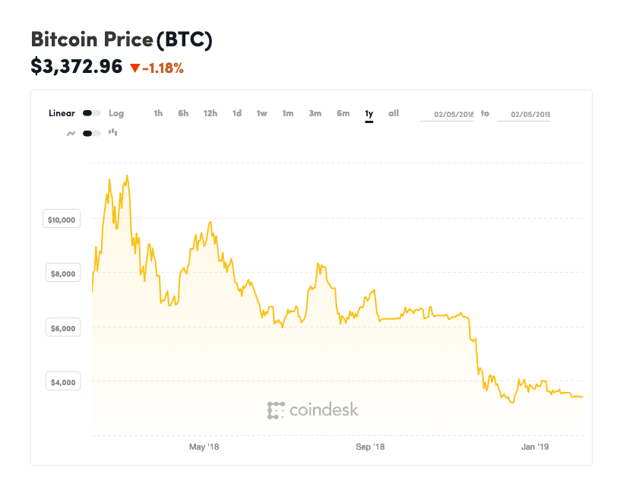
Bitcoin (1 year)
store of value?
unit of account?

Slide 5
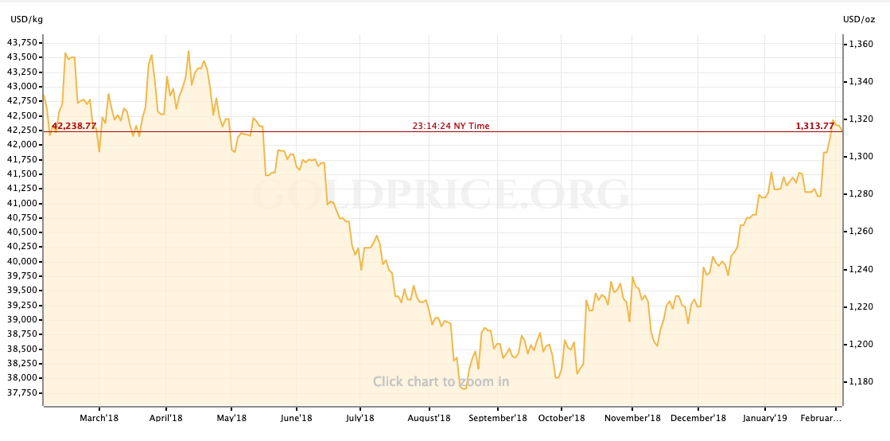
Bitcoin is the new gold – is it?

Slide 6
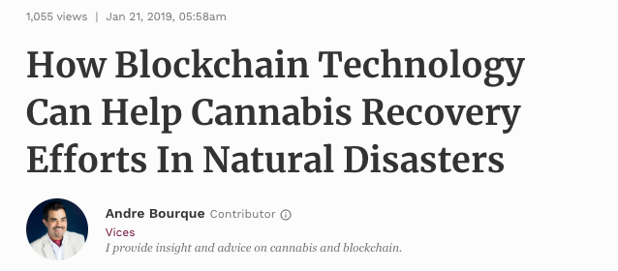
High on blockchain

Slide 7
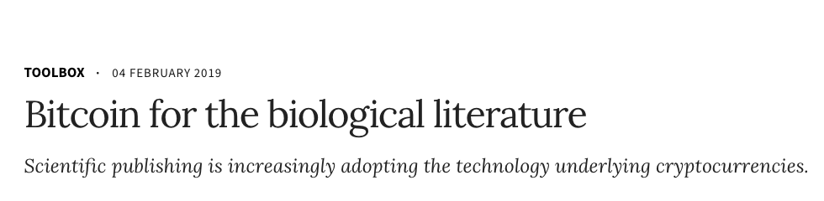
Recording research precedence

Slide 8
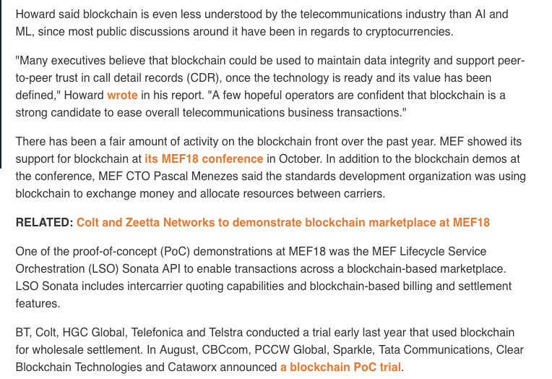
Telecom

Slide 9
An early analog blockchain
Nottingham, 1790
Notes:
1494 Luca Pacioli in his Summa de Arithmetica, Geometria, Proportione et Proportionalita
https://www.nottingham.ac.uk/manuscriptsandspecialcollections/researchguidance/accounting/business.aspx

Slide 10
Key idea: linkage

Slide 11
What does a database do?
INSERT INTO ledger (customer, amount)
VALUES (1234, $543)
SELECT sum(amount) FROM ledger
WHERE customer = 1234
trusted, reliable data store
may be operated by third party (AWS, Azure, GC, …)
transaction may be signed by originator
content may be encrypted

Slide 12
Modern datastore architecture (simplified)
SELECT person, amount FROM payment JOIN person USING (person) WHERE …
stored
procedure
authorization
validation
transaction
(all or nothing)
disk
(permanency)
backup
log (DB or files)

Slide 13
Centralized → distributed

Slide 14
Concept: non-repudiation
“A statement's author cannot successfully dispute its authorship or the validity of an associated contract (or signature).”
Traditional grounds (McCullagh):
  The signature is a forgery;
  The signature is not a forgery, but was obtained via:
    Unconscionable conduct by a party to a transaction;
    Fraud instigated by a third party;
    Undue influence exerted by a third party.
Crypto:
  A service that provides proof of the integrity and origin of data, both in an unforgeable relationship, which can be verified by any third party at any time; or,
  In authentication, an authentication that with high assurance can be asserted to be genuine, and that can not subsequently be refuted.
  Typically, uses public-private key pair for validation and signing.
  Refutation: author has to make plausible case that somebody stole their key.
Notes:
https://firstmonday.org/ojs/index.php/fm/article/view/778/687

Slide 15
BAR actors: Byzantine, altruistic, rational
Byzantine: may deviate from protocol for any reason
technical failure
deliberate harm
gratuitous maliciousness
Rational: self interested
maximize short-term or long-term benefit
including any penalties or rewards
general
attack!
retreat!
Altruistic: follow protocol exactly
extrinsic or intrinsic motivation
general
general
attack!

Slide 16
What is a blockchain?
Distributed ledger
Indelible, append-only log of transactions between parties
Which transactions happened?
  "Alice transferred 10 coins to Bob”
Order of transactions
  "Alice transferred 10 coins to Bob, and then Bob transferred title to his car to Alice”
Public (mostly) & accessible to all parties
Tamper-proof: no party can add, delete, or modify ledger entries once they have been recorded
➔ Ledgers must be immune to attack, ensuring the ledger remains secure even if some parties misbehave, whether accidentally or maliciously.
M. Herlihy, CACM 2/2019

Slide 17
Public blockchain architecture
distributed ledger
+ consensus
+ currency
currencies (ERC-20)
swaps
….
Bitcoin
Ethereum
(digital contracts)
block chain
(distributed ledger)
block chain
(distributed ledger)
ILP

Slide 18
What kind of ledger?

Slide 19
Block chaining
Stallings, 2017
Notes:
W. Stallings, IPJ 20(3)

Slide 20
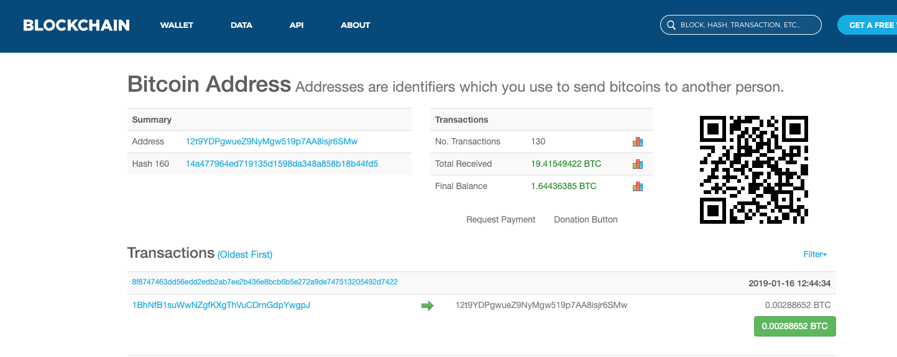
Concept: identifier
Bitcoin addresses are tokens
May (should) use unique address for each transaction
Examples
  P2PKH: 1BvBMSEYstWetqTFn5Au4m4GFg7xJaNVN2
  Bech32: bc1qar0srrr7xfkvy5l643lydnw9re59gtzzwf5mdq

Slide 21
Adding transactions
Stallings, 2017

Slide 22
What’s in a block?

Slide 23
Consensus algorithms
Goal: make it difficult for (cheating) participants to collude – 51% problem
  may also provide incentive to participate in validation – e.g., 12.5 BTC reward
Idea: make it expensive to cheat
  preferably more than you can gain
Encourage distribution of block approver → decentralization
  assumes implicitly linear cost → no or limited efficiencies of scale or scope
  only needed if identities are easily forged and no external recourse (e.g., criminal prosecution)
Variations, among many:
  Proof of Work (PoW): solve “hard” problem that requires computation → hardware + energy cost
    reward given to first miner who solves cryptopuzzle
    scale: mining farms (human labor, ASICs)
    scope: own or access to cheap electricity or specialized circuits (ASICs)
  Proof of Stake (PoS): validator chosen based on wealth

Slide 24

PoW ingredient: hash
Hash (SHA-256 for Bitcoin
ethash for Ethereum)
hash('sha256', 'The quick brown fox jumped over the lazy dog.');
68b1282b91de2c054c36629cb8dd447f12f096d3e3c587978dc2248444633483
Transforms any text or bit string into 32-byte (256 bit) number.
256 bit = 1.15 10⁷⁷ = ~0.1% of number of atoms in visible universe.
Need exhaustive search to construct string that creates same hash.
Difficulty can be calibrated (number of matching digits).

Slide 25

Mine bitcoins at home!
Shark Mini, $2,590
Notes:
https://sharkmining.com/us/shark-mini.html/#506:1699

Slide 26
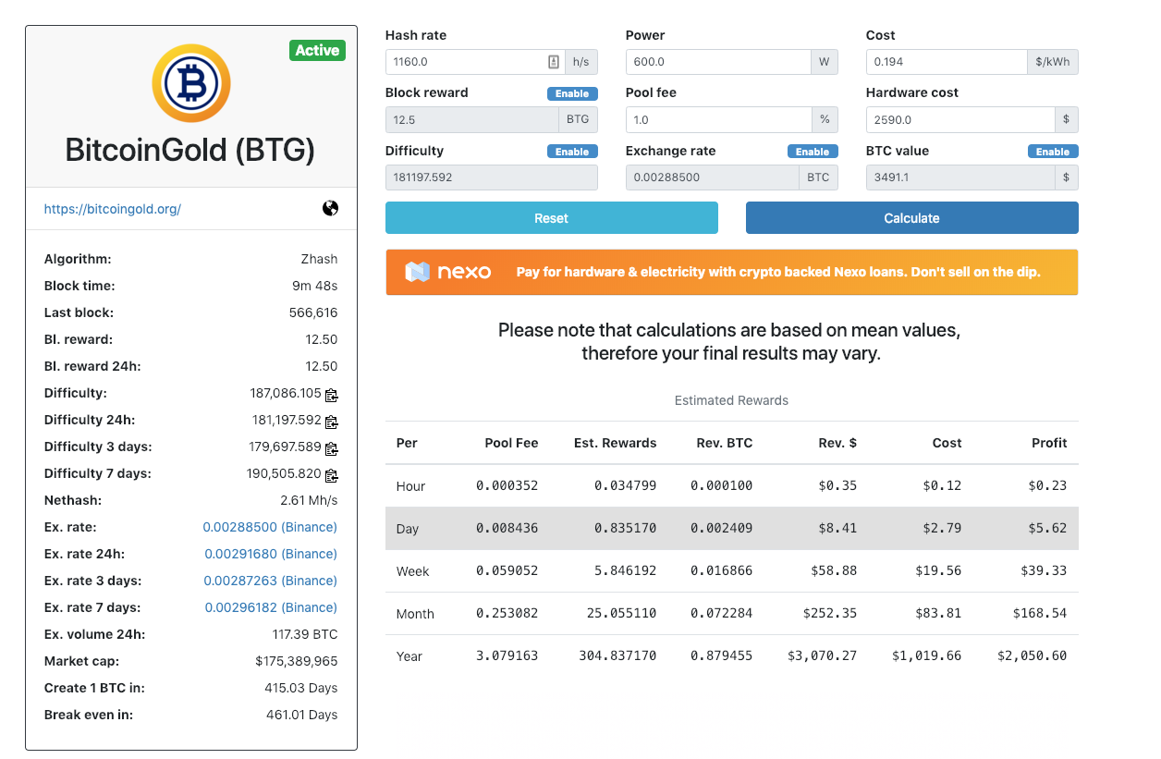
This is not investment advice
Notes:
https://whattomine.com/coins/214-btg-equihash

Slide 27
Bitmain Ordos facility, Inner Mongolia
Notes:
https://spectrum.ieee.org/computing/networks/why-the-biggest-bitcoin-mines-are-in-china

Slide 28
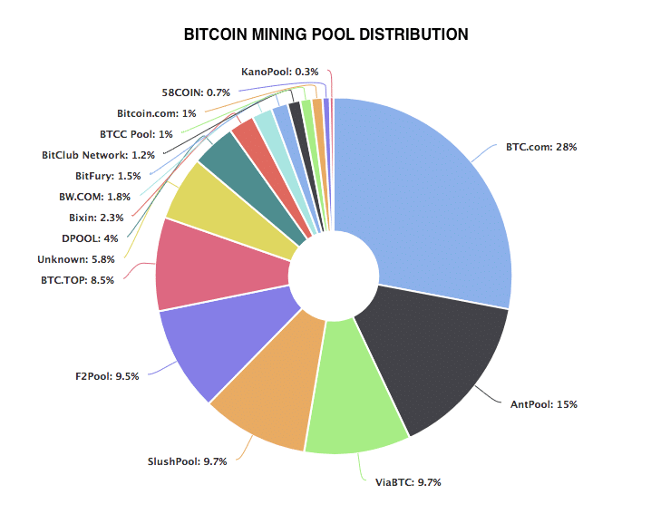
Bitcoin mining pool distribution

Slide 29
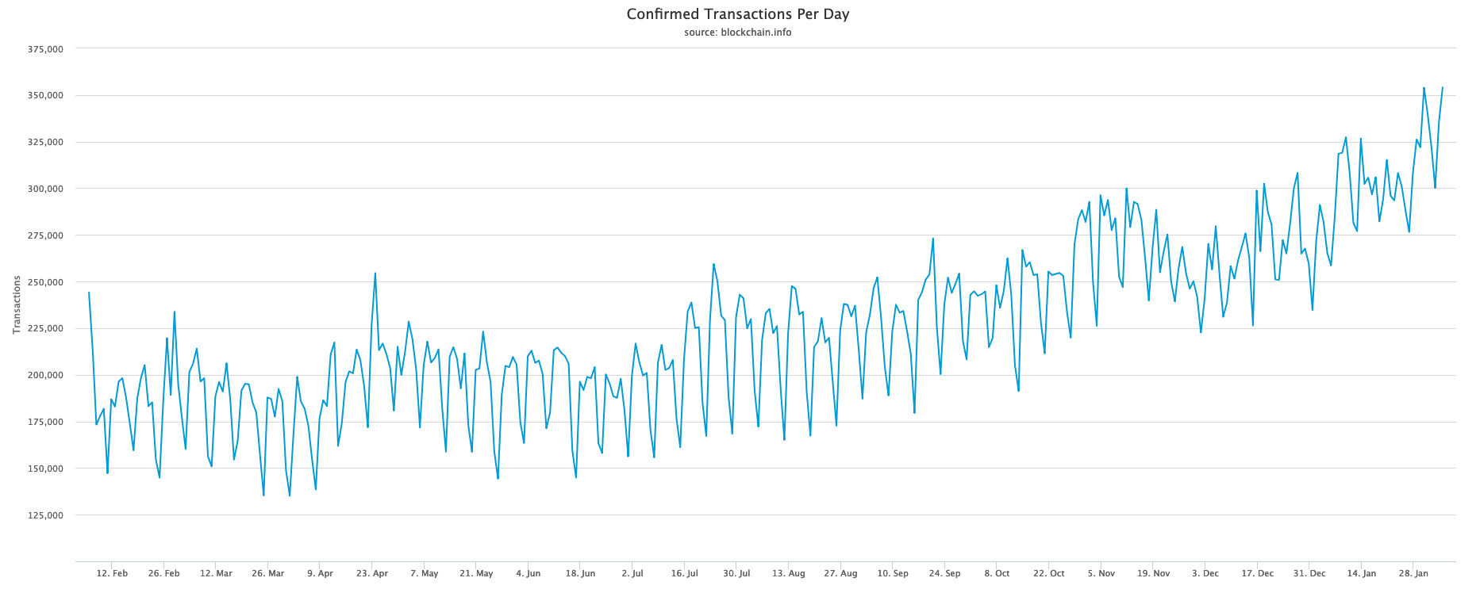
Bitcoin transactions
medium of exchange?

Slide 30
Smart contracts
Most financial service applications will need more than key-value storage
Most blockchains (BTC, ETH) include a programming language
  functions get executed on ”commit” by nodes
Example asset transfer (Alice wants to trade share coupons for bitcoins):
  hashlock h prevents an asset from being transferred until the contract receives a matching secret s, where h = H(s)
  Alice creates a secret s, h = H(s), and publishes a contract on the coupon blockchain with hashlock h and timelock 48 hours in the future, ensuring the contract will transfer the coupons to Bob if Bob can produce s within 48 hours. If he cannot, the coupons will be refunded to Alice.
  When Bob confirms that Alice's contract has been published on the coupon blockchain, he publishes a contract on the Bitcoin blockchain with the same hashlock h but with timelock 24 hours in the future, ensuring the contract will transfer the bitcoins to Alice if Alice can produce s within 24 hours. If she cannot, the bitcoins will be refunded to Bob.
  When Alice confirms that Bob's contract has been published on the Bitcoin blockchain, she sends the secret s to Bob's contract, taking possession of the bitcoins, and revealing s to Bob.
  Bob sends s to Alice's contract, acquiring the coupons and completing the swap.
M. Herlihy, CACM 2/2019

Slide 31
AWS SQL server vs. bitcoin
AWS RDS server (m4.2xlarge)
Bitcoin
2,100 SQL transactions/second
$3,521/year
Intel Xeon E5-2676 v3: 120 W
3-7 transactions/second
$6,800 ‘all-in’ cost per BTC
12.5 BTC per block reward
10 minutes per block
➔ 657k blocks/year → $4.46B
3.4 GW

Slide 32
Notes:
https://medium.com/@sbmeunier/when-do-you-need-blockchain-decision-models-a5c40e7c9ba1

Slide 33
Miracle cure vs. snake oil – public & private blockchain
Miracle cure (or at least good fit)
(all private)
Not FDA approved
(mostly public)
Distributed, semi-trusting users
Limited ability to fund and administer common infrastructure
Supply chain records
Notary (time-stamped) services
  non-repudiability (but limited time resolution)
Bitcoin, most digital currencies
ICOs
Consumer payments
High-volume & low latency transactions (< minutes)
Complex business logic

Slide 34
The blockchain conundrum
Public blockchains don’t work all that well in practice
  high cost
  high risk
  low performance
  difficult governance (forks, ossification)
  hard to balance privacy vs. prevention of illegal uses
Private blockchains work
  can avoid expensive consensus algorithms (no 51% problem)
  can share computational resources (instead of paying a fee)
  but if you have a trusted entity running the blockchain, why not run a database + cryptographically signed records?

Slide 35
What makes systems hard in practice?
Adversarial environment
  attacker almost always has the advantage
    has to find one flaw, you have to find all of them
  particularly, if one cannot back out mistakes
Near-100% uptime
Unknown scaling
Versioning and backward compatibility
  no clear ability to upgrade
  unknown dependencies
  unclear governance (who gets to decide)
Leslie Lamport (1987): A distributed system is one in which the failure of a computer you didn’t even know existed can render your own computer unusable.

Slide 36


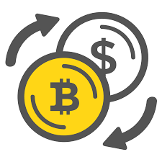
Cryptography is (relatively) easy, security is hard
smart contracts
oracle
programming language
(e.g., EVM + Solidity)
exchange
Bitcoin, Ethereum
cyber attack
fraud
phishing

Slide 37
Security problems
Same as all software systems
Specific to public blockchains
Specification flaws
  protocol timing, bid down, man-in-the-middle, …
Implementation flaws
  in underlying system software
  in application software
  in configuration
Credential theft or exposure
Insider attacks
  and other non-technical issues
Little legal recourse
International
No “backup”
No “undo” (fund reversal)
No intermediary (e.g., credit card charge-back)
May not be able to recover credentials

Slide 38
Limitations of computer science
We do not know how to prove (most) specifications correct
  People routinely find problems in security protocols years later
Programming languages themselves are often buggy
Distributed systems are much harder than centralized systems
  “concurrency” – things can happen in various orderings
  many more failure possibilities → impossibility results
We depend on assumptions on the underlying system that may not be true
  see Spectre & Meltdown
Maintaining and configuring software is not well understood
  dependencies
Cryptographic key management is logistically hard

Slide 39
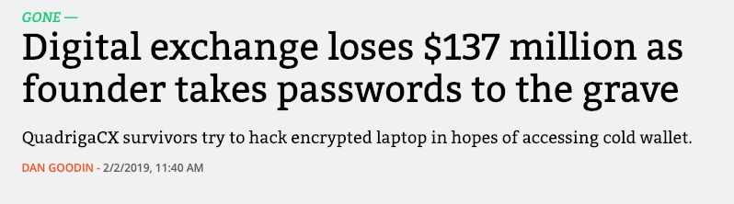
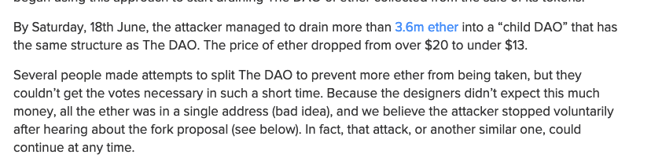
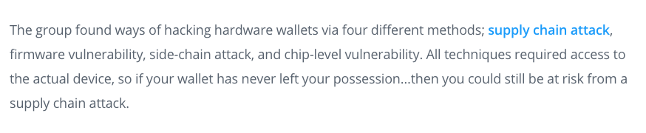
Random examples
Notes:
https://www.coindesk.com/understanding-dao-hack-journalists
https://coinsutra.com/biggest-bitcoin-hacks/
https://news.bitcoin.com/crypto-exchanges-wallets-hacked-korea/
https://bitcoinist.com/trezor-hardware-wallet-hack-passphrase/

Slide 40
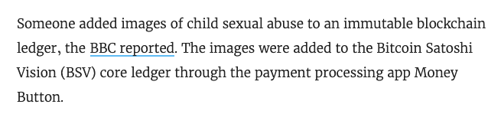
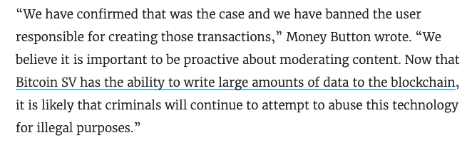
Unalterable is maybe not that great an idea
Notes:
https://gizmodo.com/someone-uploaded-child-pornography-to-a-blockchain-ledg-1832398480

Slide 41
My tentative questions & recommendations
Can a simpler (less general) system do the same thing?
  E.g., a digital notary service
What other systems are connected to the blockchain and what effects can they have?
  Eco system, not blockchain (e.g., exchanges, wallets, mining pools, …)
Governance and sustainability is more important than technical details
  Who gets to do overrides when things go wrong?
  Who decides and how when there are conflicts between stake holders?
Speed kills – slow down execution and allow reversals
  see Bangladesh Bank cyber heist
What are the emergency brakes?
  see autonomous cars (remote control) – autonomous driving is easy; it’s the lack of braking that causes accidents
What are the data privacy and accountability trade-offs?

Slide 42

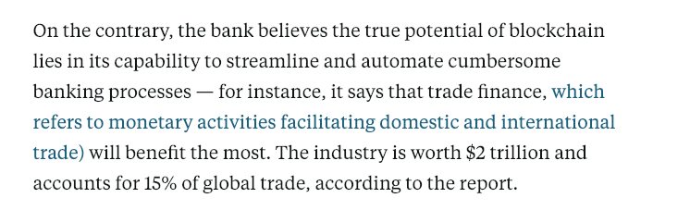
JPMorgan report 2019

Slide 43
Conclusion
Blockchain offers a variation of an old computing abstraction (database)
Important to distinguish public vs. private blockchains
Useful general-purpose service for mid-to-low trust interaction
Distributed, decentralized, limited trust → at cost of energy, privacy
But many of the permissioned blockchain problems can be solved with less effort and complexity
  Does not ensure truth, but may ensure non-repudiation
  But may offer convenient standard and infrastructure (”BaaS”)
May assume more maturity of computer science than realistic
  More potential security issues, not fewer

Slide 44
Useful not-too-technical tutorials and opinions
NIST, ”Blockchain Technology Overview”, NISTIR 8202, Oct. 2018
https://doi.org/10.6028/NIST.IR.8202
W. Stallings, “A Blockchain Tutorial”, Cisco Internet Protocol Journal, Nov. 2017.
Maurice Herlihy, “Blockchains From a Distributed Computing Perspective,” Communications of the ACM (CACM), Feb. 2019.
Bruce Schneier, “There’s no good reason to trust blockchain technology,” Wired, Feb. 6, 2019.

Slide 46
DHS model
Notes:
https://nvlpubs.nist.gov/nistpubs/ir/2018/NIST.IR.8202.pdf

Slide 48
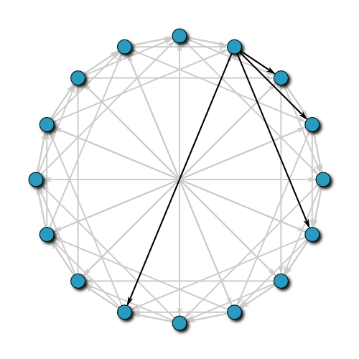
Predecessor: peer-to-peer systems
key – value mapping
(“noSQL”)
distributed storage
but: no inherent protection against
Notes:
By Seth Terashima (Tetra7 (talk)) - Own work, CC BY-SA 3.0, https://commons.wikimedia.org/w/index.php?curid=10089321

Slide 49
Bruce Schneier on private blockchains
Private blockchains are completely uninteresting. (By this, I mean systems that use the blockchain data structure but don’t have the above three elements.) In general, they have some external limitation on who can interact with the blockchain and its features. These are not anything new; they’re distributed append-only data structures with a list of individuals authorized to add to it. Consensus protocols have been studied in distributed systems for more than 60 years. Append-only data structures have been similarly well covered. They’re blockchains in name only, and—as far as I can tell—the only reason to operate one is to ride on the blockchain hype.
Wired, 2019
Notes:
https://www.wired.com/story/theres-no-good-reason-to-trust-blockchain-technology/

Slide 50
Trust models
Liars and Outliers (Schneier, 2012):
  morals
  reputation
  institutions → ”laws formalize reputation” + sanctions + incentives (credit score)
  security systems (locks, fences, alarm systems, audit systems, …)
Blockchain and the New Architecture of Trust (Werbach, 2018):
  peer-to-peer trust
  leviathan trust (institutional)
    contracts
  intermediary trust
    credit cards, escrow, …
  distributed trust
    blockchain (maybe also online review systems)
Notes:
https://www.wired.com/story/theres-no-good-reason-to-trust-blockchain-technology/

Slide 51
Practical CS: The power of a few service abstractions
Key-value store → noSQL, file system, AWS S3
Database → linked tables with predicates
Process → protection domain → containers (Docker, Kubernetes)
Virtual machine
Queue → AWS SQS, work queues
Messaging → email, SMS, EDI
Query-Response (API) → HTTP
Serialization: data structures → portable objects (ASN.1, XML, JSON, …)
Pattern matching
Public key systems

