Slide 1
IoT: The Internet of Things that shouldn’t be on the Internet
Henning Schulzrinne (Columbia University)
January 25, 2019
CITI State of Telecom
This material is based upon work supported by the National Science Foundation under Grant No. (CNS-1218977). Any opinions, findings, and conclusions or recommendations expressed in this material are those of the author(s) and do not necessarily reflect the views of the National Science Foundation.

Slide 2
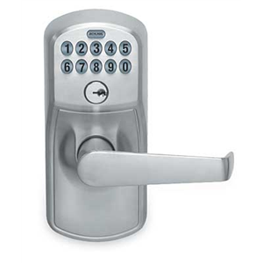
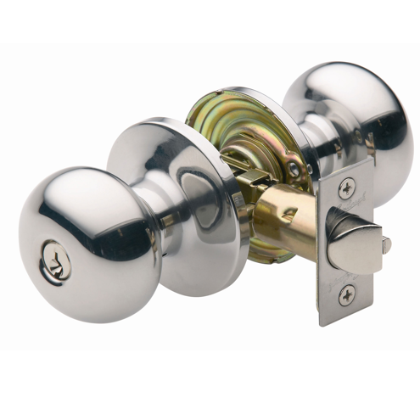
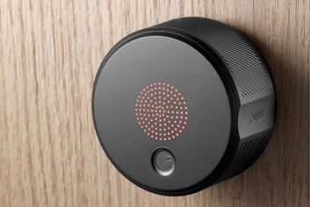
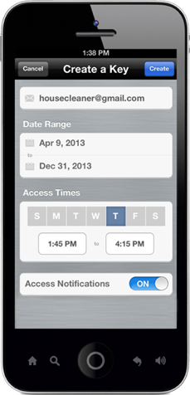
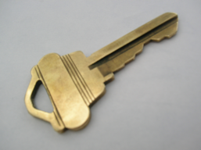
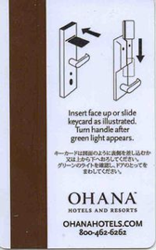
Natural evolution

Slide 3
IoT is not exactly new (1978)

Slide 4
IoT – an idea older than the web (1985)
Peter Lewis (panel discussion 1985)
From Chetan Sharma Consulting 2016

Slide 5
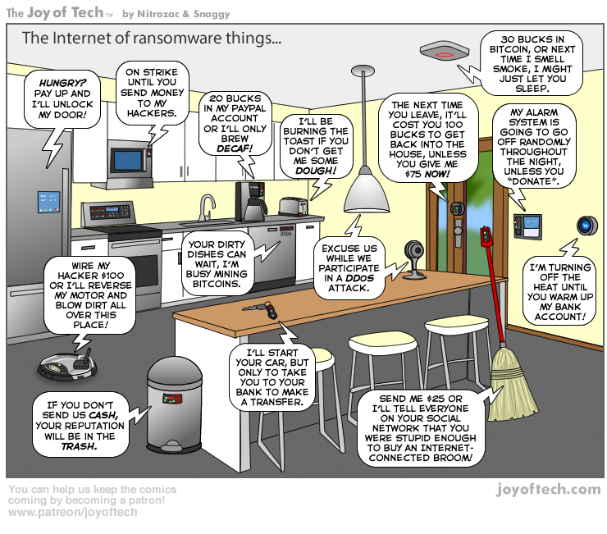

Slide 6
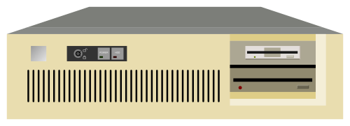
Old home & office architecture
Wired LAN
(10-100 Mb/s)
1-5 Mb/s
< 1 Mb/s
1995 – 2010: most communications was local, with web browsing as main Internet activity

Slide 7

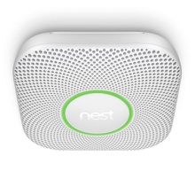
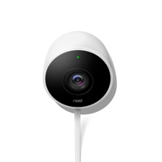
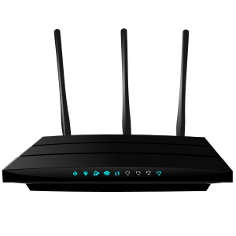
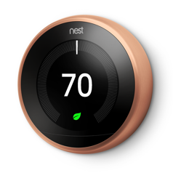
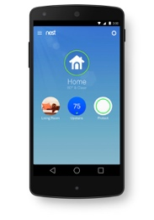
IoT and home architecture
Wireless LAN
(0.1 - 1 Gb/s)
relatively little intra-LAN
mostly LAN-to-cloud
upload-download ratio may change

Slide 8
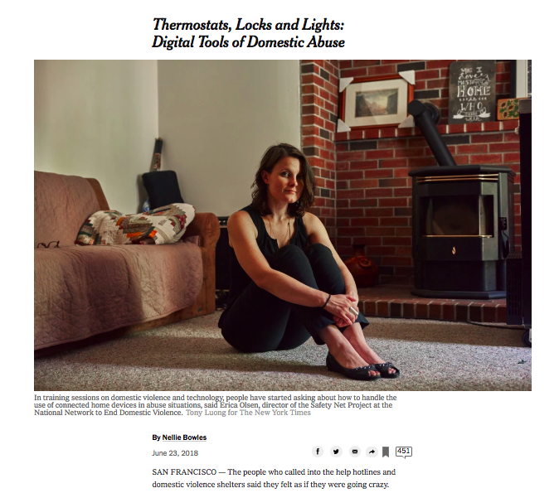
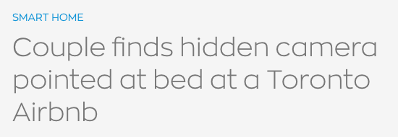

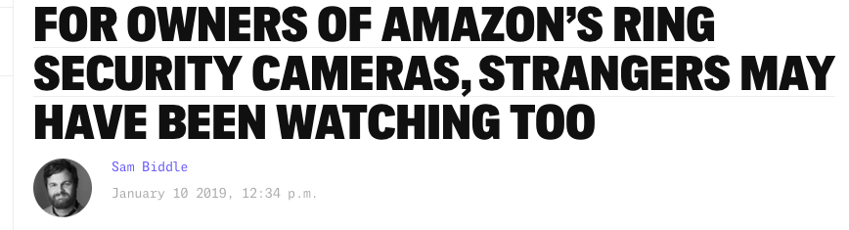
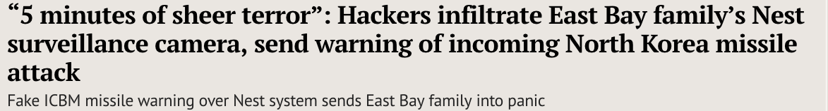
IoT combines risks
https://youtu.be/TIhW61FMNIc
IoT risks
Privacy
DDoS
Ransomware
Physical harm
Enable crime
We-Vibe Class Action Says Vibrator App Collects Sensitive Data
doxing++
Notes:
https://www.mercurynews.com/2019/01/21/it-was-five-minutes-of-sheer-terror-hackers-infiltrate-east-bay-familys-nest-surveillance-camera-send-warning-of-incoming-north-korea-missile-attack/
https://nordic.businessinsider.com/smart-tv-data-collection-advertising-2019-1
https://theintercept.com/2019/01/10/amazon-ring-security-camera/
https://www.digitaltrends.com/home/couple-finds-hidden-camera-in-toronto-airbnb/
https://topclassactions.com/lawsuit-settlements/lawsuit-news/344267-we-vibe-class-action-says-vibrator-app-collects-sensitive-data/

Slide 9
IoT DDOS economics
Schneier
Oct. 2016
Cohan
Apr. 2013
DDOS as externality
  device owners don’t care:
    barely slows down their Internet service
    device still functions normally
    don’t know victims, generally
  vendors don’t care (enough)
    not liable for damage (right now) – public nuisance?
    only marginally affects their business reputation
  ISP don’t care (much)
    individually, not much load – in lightly-loaded direction (outbound)
    hard to combat
    haven’t adopted BCP38 (egress address filtering)
Notes:
https://www.schneier.com/blog/archives/2016/10/security_econom_1.html

Slide 10
IoT security confluence
IoT insecurity
long supply chain
long-lived device
one-time purchase
mostly hardware expertise
millions of them
no liability
dog’s breakfast of software
no UI
no BCP38
sue vendor in China?
whose consent?

Slide 11
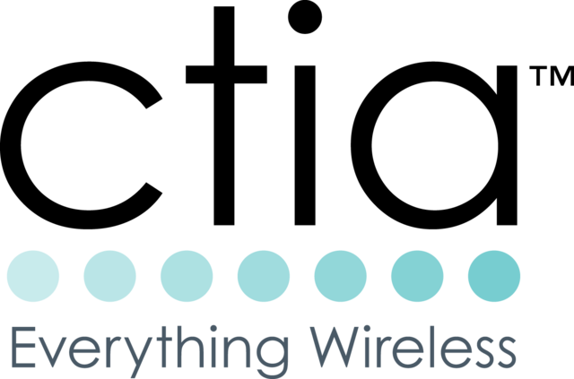
Every industry organization has guidelines
2018
Nov. 2016
Summer 2017
Feb. 2016
Nov. 2016
Dec. 2015
Notes:
https://www.bitag.org/report-internet-of-things-security-privacy-recommendations.php
https://otalliance.org/resources/iot-industry-resources
https://www.schneier.com/blog/archives/2017/02/security_and_pr.html
https://www.cablelabs.com/vision-secure-iot
https://transition.fcc.gov/oet/tac/tacdocs/reports/2015/FCC-TAC-Cyber-IoT-White-Paper-Rel1.1-2015.pdf
https://iot.cityofnewyork.us/
https://www.dhs.gov/sites/default/files/publications/Strategic_Principles_for_Securing_the_Internet_of_Things-2016-1115-FINAL....pdf
https://www.gsma.com/iot/wp-content/uploads/2016/02/CLP.11-v1.1.pdf
https://iotsecurityfoundation.org/wp-content/uploads/2015/09/IoTSF-Establishing-Principles-for-IoT-Security-Download.pdf
https://www.thedigitalstandard.org/

Slide 12
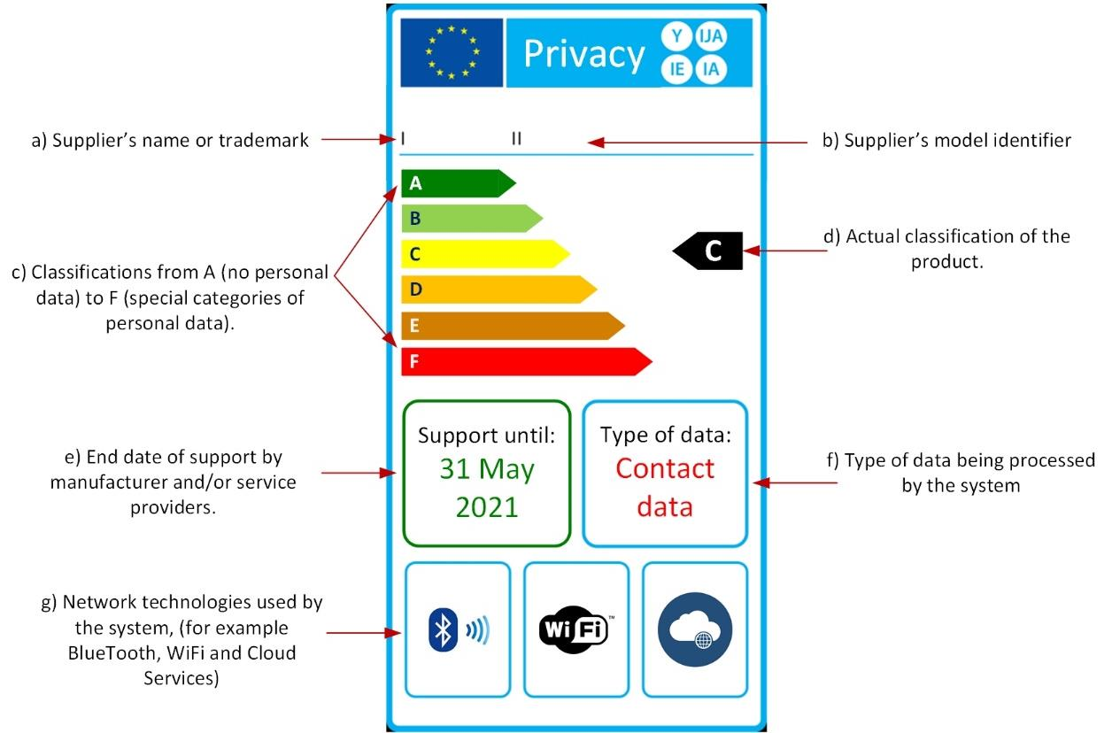
Privacy and security label?
NaraSec
(9/2017)
P. Kelley et al.
SIGCHI 2010
Rob van Diermen (2018)
Notes:
https://cups.cs.cmu.edu/privacyLabel/
http://www.narasec.com/post/iot-security-labels/
“The Internet of Things: a privacy label for IoT products in a consumer market”, 2018

Slide 13
This is not that hard!
More research needed?
More action needed!
No factory-default passwords
  long-term, no human-setable passwords at all → client certs
No telnet, ssh, SNMP (typically)
Only configure from local subset
Automated, signed updates within reasonable time of vulnerability
Web interfaces use non-root accounts
Automated testing
  XSS and SQL injection
  use of unencrypted protocols

Slide 14
If people actually wanted to solve the problem…
Consumer Reports and others don’t see this as within their qualifications
Regulatory: certification for devices
  see ”Textile and Wool Act” (1939)
  NRTL; UL (city fire codes, insurance)
  UL is not required, but liability ensures use
Large retailers: require labeling and standards
Are there types of IoT devices that are particularly high-risk?
  personal behavioral data
  minors
  risk of harm (security products, faucets, …)
Notes:
https://www.practicalmachinist.com/vb/general/ot-when-does-product-need-certification-ul-such-231394/

