Slide 1
Robocalls – An illustrated guide to origin, mechanisms and prevention
Remedies
Henning Schulzrinne
Columbia University
August 2019

Slide 2
Why not use email spam filtering techniques?
 | Email | Phone calls
Name space | infinite | relatively small
Content inspection | common | not possible
Addresses | IP address – non-spoofable for TCP Email address – easily spoofable | Phone number -- spoofable
Delivery | filtered by provider: block lists (e.g., Spamhaus) SPF, DKIM | interconnection and delivery obligations
Delivery trace | Received-by headers | Via headers – only for end-to-end VoIP calls
Limited-use address | easy (e.g., web mail) | not feasible
Consent-based | CAPTCHA systems (not common) | likely too annoying
see also RFC 5039

Slide 3

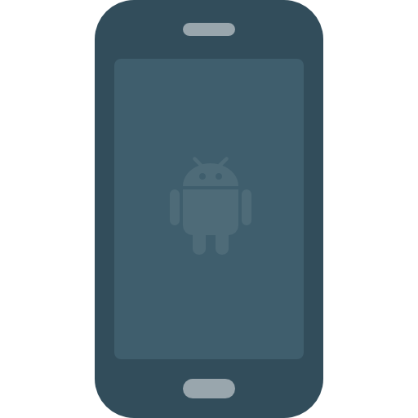
Prevent robocalls at every stage
aggregate user feedback
auto-response
local filtering
originating carrier
terminating
carrier
track reassigned numbers
check DNC
sign calls
KYC
sign calls
track behavior
traceback
validate caller ID
analytics

Slide 4
Not everybody likes call blocking
August 2018
October 8, 2018
Notes:
https://ecfsapi.fcc.gov/file/1008117346409/ACA%20Reply%20Comment%20Letter%20Call%20Blocking%20and%20Labeling.pdf
https://www.fcc.gov/ecfs/filing/1008117346409

Slide 5

Who can do what?
Carriers by themselves
  Work with third parties (Nomorobo, FirstOrion, TNS, …)
  Modify CNAM to show reputation of calling party (→ Verizon)
    But limited display capability
Carriers in cooperation
  STIR/SHAKEN
  Industry-wide blacklist
  Common white list
  Do-not-originate
First Orion

Slide 6
Blacklist & whitelist problems
Blacklist
  Not too useful without authentication
  Most useful: invalid, unassigned numbers & area codes
  Do Not Originate (DNO) – numbers known not to make outbound calls
    E.g., IRS, 555
  Complaint about over-blocking (e.g., PACE, SiriusXM, Securus for inmate calls) → illegal vs. unwanted in FCC 17-59
Whitelist
  No industry-wide effort
  Likely hard for accidental inclusions to find appropriate organization
  See CNAM caller ID problems
  How do validate legitimate robocallers?
    No (FCC) license for medical notification services
    But bonding may be an option
Re-assigned number database
  Who will pay?
Notes:
SiriusXM: https://www.fcc.gov/ecfs/filing/10222944628403
Securus: https://www.fcc.gov/ecfs/filing/10507303086058

Slide 7

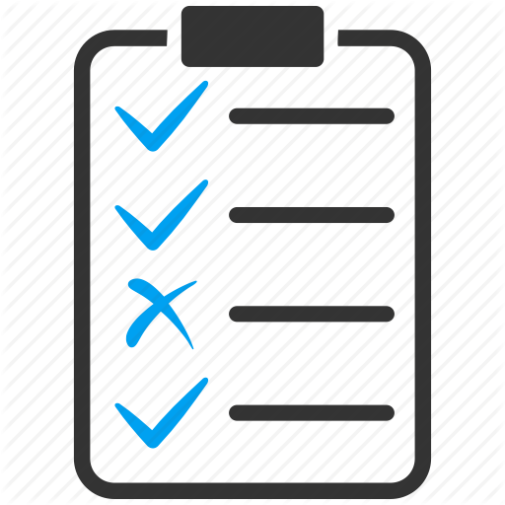
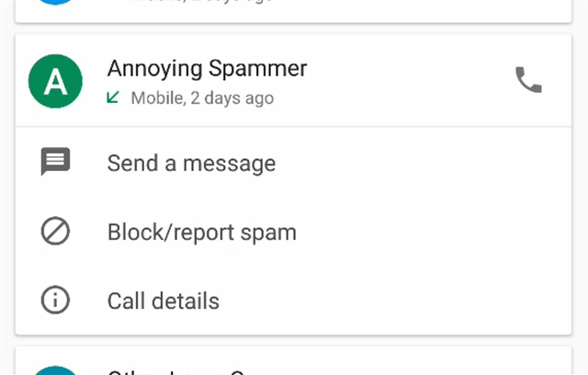
Populating blacklists
Consumer complaints
app feedback

Slide 8
Solution set
remove invalid & unassigned #s
improved traceback
caller authentication
(identity assertion)
do not originate
(e.g., block IRS)
block unauthenticated calls
user feedback → black lists
strong white lists
simultaneous ringing (e.g., Nomorobo)
strong black & white lists
no authentication
partial authentication
all authenticated

Slide 9
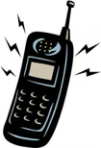

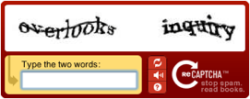

Incremental deployment
signed?
N
Y
should be signed?
validates?
N
Y
N
Y
known caller?
N
Y
N
Y

Slide 10
WSJ: “Small Carriers Stymie Robocall Fight”
“Relatively few calls flagged as high risk of being illegal robocalls — 13% — originate from numbers owned by major telecom carriers, including AT&T, Verizon and T-Mobile, according to TNS, which provides network and data services to the telecommunications industry.”
“R Squared Telecom LLC, based in Akron, Ohio. The company was launched in 2014 as an intermediary connecting Philippines-based call centers to the U.S. telephone system.”
“The FCC has asserted limited jurisdiction over VoIP providers, an agency spokesman said. For example, one-way carriers -- those that place calls but don't receive them -- aren't subject to certain requirements. Many internet-based phone companies are set up this way.”
The FTC has broad authority to go after deceptive business practices, but the agency believes some robocall intermediaries, including VoIP providers, fall outside its jurisdiction. … the FTC cites a May 2018 enforcement action related to scam callers where it declined to sue an internet-based phone company "for its knowing participation in the illegal robocalls."
The FTC memo pointed the finger at the FCC, saying the company in question was likely a "common carrier" exclusively under the jurisdiction of the FCC.
WSJ, 8/19/2019

Slide 11
Frankel proposal
All originating providers should do three things:
  Permit volume calling only by vetted originators
  Include a Billing Telephone Number linked to the Originating Provider
    BTN is distinguished when:
      Commercial caller uses an alternative provider for outbound traffic (call termination)
      Calls are placed “on behalf of” another number, or incoming calls are forwarded
      Calls are originated from outside USA
      Wireless subscriber roams off-network
  Cooperate with industry traceback efforts
Exception for vetted customers
  Legitimate volume call originators subscribe to published best practices
  Third-party auditing and compliance
  Referenceable by providers, analytics companies, regulatory enforcement
Notes:
https://ecfsapi.fcc.gov/file/1040682300200/Robo-ExParte-2018-Apr-ZipDX.pdf

Slide 12
STIR/SHAKEN

Slide 13
Architecture for robocall prevention
Check STIR signature
look up category based on number (optional)
indicate probability(spam)
“analytics”
“big data”
carrier
SIP
proxy
SIP
proxy
”survey”
external
service
607 Unwanted
RFC 8197
STIR signing
RFC 8224

Slide 14
The role of STIR/SHAKEN
Ensure that caller is authorized to use calling number
  Identify originating carrier (or close to it)
  Prevent impersonation and randomization
STIR: protocol additions to VoIP call signaling protocol (SIP) → IETF
SHAKEN: guidelines for using STIR in carrier networks → ATIS & SIPForum

Slide 15
STIR + SHAKEN
Chris Wendt, SIPNOC 2016

Slide 16
SHAKEN reference architecture

Slide 17
SHAKEN attestation
A: full attestation | Is responsible for the origination of the call onto the IP based service provider voice network. Has a direct authenticated relationship with the customer and can identify the customer. Has established a verified association with the telephone number used for the call.
B: partial attestation | Is responsible for the origination of the call onto its IP-based voice network. Has a direct authenticated relationship with the customer and can identify the customer. Has NOT established a verified association with the telephone number being used for the call.
C: gateway attestation | Is the entry point of the call into its VoIP network. Has no relationship with the initiator of the call (e.g., international gateways).

Slide 18
STIR/SHAKEN organizational model

Slide 19
STIR / SHAKEN governance
Notes:
ATIS SHAKEN governance authority, May 4, 2017 ex-parte

Slide 20
STI-GA, STI-PA, STI-CA
STI-GA (governance)
  Defining the policies and procedures governing which entities can acquire STI certificates.
  Establishing policies governing which entities can manage the PKI and issue STI certificates.
  Established 2018 via ATIS, but still finalizing board.
STI-PA (policy)
  Policy enforcement role
  Keeps list of CAs
  Digitally signs service provider tokens
STI-CA (certificate)
  Issues certificates to carriers (and other entities)

Slide 21
SIP INVITE example
INVITE sip:+12155551213@tel.example1.net SIP/2.0
Via: SIP/2.0/UDP
10.36.78.177:60012;branch=z9hG4bK-524287-1---77ba17085d60f141;rport
Max-Forwards: 69
Contact: <sip:+12155551212@69.241.19.12:50207;rinstance=9da3088f36cc528e>
To: <sip:+12155551213@tel.example1.net>
From: "Alice"<sip:+12155551212@tel.example2.net>;tag=614bdb40
Call-ID: 79048YzkxNDA5NTI1MzA0OWFjOTFkMmFlODhiNTI2OWQ1ZTI
P-Asserted-Identity: "Alice"<sip:+12155551212@tel.example2.net>,tel:+12155551212
CSeq: 2 INVITE
Allow: SUBSCRIBE, NOTIFY, INVITE, ACK, CANCEL, …, MESSAGE, OPTIONS
Content-Type: application/sdp
Date: Tue, 16 Aug 2016 19:23:38 GMT
Identity: eyJhbG…doDtCA; info=<http://cert.example2.net/example.cert>;alg=ES256
BASE64URL(UTF8(JWS Protected Header))
. BASE64URL(JWS Payload)
. BASE64URL(JWS Signature)

Slide 22
SHAKEN PASSporT = JWS token
ECDSA elliptic curve
PASSPorT type
Protected Header
{
"alg":"ES256", "typ":"passport", "ppt":"shaken”,
"x5u":"https://cert.example.org/passport.crt"
}
Payload
{
"attest":"A",
"dest": {"tn":["12125551213"]},
"iat": 1443208345,
"orig": {"tn":"12155551212"},
"origid":"123e4567-e89b-12d3-a456-426655440000"
}
X.509 certificate URL
timestamp (Unix)
UUID (opaque)
e.g., traceback, class of service
Notes:
ATIS-1000074

Slide 23

Non-VoIP termination
VoIP
TDM
Telephone network
Caller ID
Invalid → e.g., set to 000-000-0000
Validated → screening indicator
SPAM?
Notes:
https://www.verizon.com/support/residential/homephone/calling-features/stop-unwanted-calls
Q.763
https://adamdoupe.com/publications/toward-authenticated-caller-id-transmission-itu2016.pdf

Slide 24

PSTN: draft-ietf-stir-oob
212-555-1234
VoIP
TDM
Telephone network
Caller ID
CPS
Query CPS
Valid → !CHARLIE
Invalid → INVALID
Unknown → ?CHARLIE
Key(212-555-1234)

Slide 25
STIR/SHAKEN issues
Network issues
  Works best with IP interconnection
    But can work for VoIP-VoIP-…-VoIP-PSTN (trusted)-PSTN (terminating)
Attestation level
  May need additional operational support – is this line authorized to use number X?
  Harder for VoIP gateways
Call forwarding
  Sign original caller or forwarding caller?
  Work in progress in ATIS
Legitimate spoofing
Call signaling equipment
  Diversity of providers
  Some are no longer in business or have been acquired

Slide 26
Timelines
Verizon (as of May 7, 2018): “Verizon is committed to deploying the STIR/SHAKEN authentication standard in our networks. We described the investments Verizon is making and the work streams underway to update multiple network elements. We expect to achieve initial operational capability later this year, with the bulk of production anticipated for 2019.”
No other (known) public commitments
CATA report:
Notes:
https://www.fcc.gov/ecfs/filing/105072444807124

Slide 27
draft-sipcore-callinfo-spam
Conveys information from carrier (SBC, CSCF) to UA
Parameters:
  spam: estimated likelihood of spam (0-100%), i.e., measure of uncertainty
    could be related to what fraction of called parties label this number as spam
  type: type of caller
    for VoIP home gateways, could be displayed via caller ID (CNAM)
  reason: source of data
    mostly, for debugging; similar to some email headers
  source: domain of entity inserting data
Example:
Call-Info: <http://wwww.example.com/5974c8d942f120351143> ;source=carrier.example.com ;purpose=info ;spam=85 ;type=fraud ;reason="FTC list"

Slide 28
Call categories
Category | Description
business | placed by businesses, i.e., an entity or enterprise entered into for profit. This type is used if no other, more precise, category fits.
debt-collection | collecting of debt owed or alleged to be owed by the called party
emergency-alert | provide the recipient warnings and alerts regarding a pending or on-going emergency. (unrelated to emergency calls to 9-1-1 or 1-1-2. Includes alerts related to weather-related school closings.)
fraud | considered to be fraudulent.
government | government entity, if no more specific label such as "health" or "debt-collection" is known or applies.
health | informational calls by health plans, … health care provider, …
informational | information about a transaction: package delivery, appointment reminder, order confirmation
not-for-profit | not-for-profit organization, including for soliciting donations or providing information

Slide 29
Call categories
Category | Description
personal | A non-business, person-to-person, call, e.g., from a residential line or personal mobile number
political | elections or other political purposes
prison | Calls from jails, prisons and other correctional facilities
public-service | Calls that provide the recipient information regarding public services, e.g., school closings
spam | likely unwanted, if not otherwise classified
spoofed | calling number for this call has been spoofed
survey | solicits the opinions or data of the called party
telemarketing | placed in order to induce the purchase of a product or service to the called party
trusted | The call is being placed by a trusted entity and falls outside the other categories listed. This may include call backs, e.g., from a conferencing service, or messages from telecommunication carriers and utilities.

Slide 30
Do Not Originate (DNO)

Slide 31
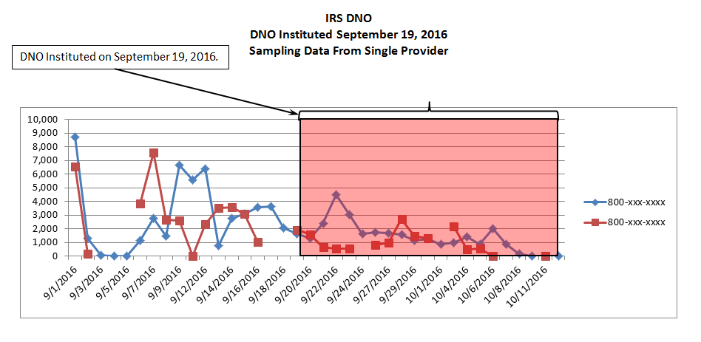
Do not originate (DNO)
Candidate number(s) for DNO must be inbound-only (e.g., 1-800-XXX-1040
DNO: TNs are identified at VoIP gateways or interconnection points, and prevented from terminating to the end user based upon the caller ID information (Call-ING #).
DNO is instituted by some or many carriers. Calls from TNs on a DNO list are rejected by first service provider in the call path that has implemented DNO.
US Telecom, 2017

Slide 32
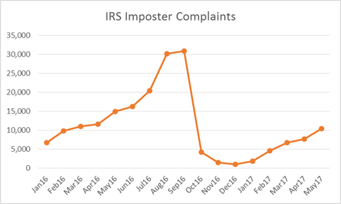
Do not originate impact

Slide 33
Consumer tools

Slide 34
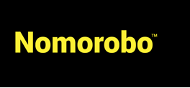
Consumer solutions
Apps
  Don’t work well for iOS (need to download blacklist)
  Some “leakage” due to new number spoofing
  Likely to increase if they get more effective
Nomorobo
  Relies on SIP parallel forking (aka simultaneous ringing) feature → VoIP only
    Robocall will ring once
    second number is an 800# at Nomorobo
  Confusing: FiOS Verizon Freedom Essentials (no) vs. Digital Voice (yes)
TNS CallGuardian
Notes:
https://tnsi.com/product/robocall-protection/

Slide 35
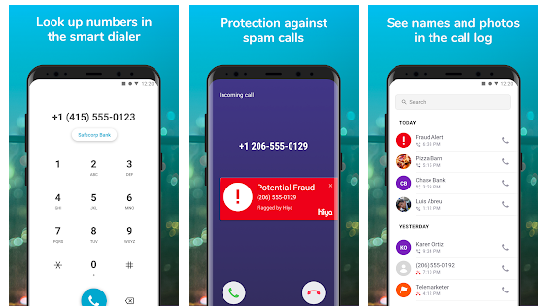
Example: Hiya

Slide 36
YouMail voice mail
“Q: How does the Call Blocker actually work?
A: When you ignore a call on your iPhone or Android, the call goes to YouMail. YouMail determines whether or not this particular caller is one you don't want to hear from – either because you told YouMail explicitly, or because it's on our blacklist of known spammers. Those callers get to hear an 'out of service' greeting. When robocalls and telemarketers hear that greeting, they take you off the list and don't call again. Since many spammers share that list, YouMail gets you off many different lists at one time. Effectively, you are call blocking at the source, preventing the unwanted calls from ever being made.”

Slide 37
Verizon call marking (2018)

Slide 38
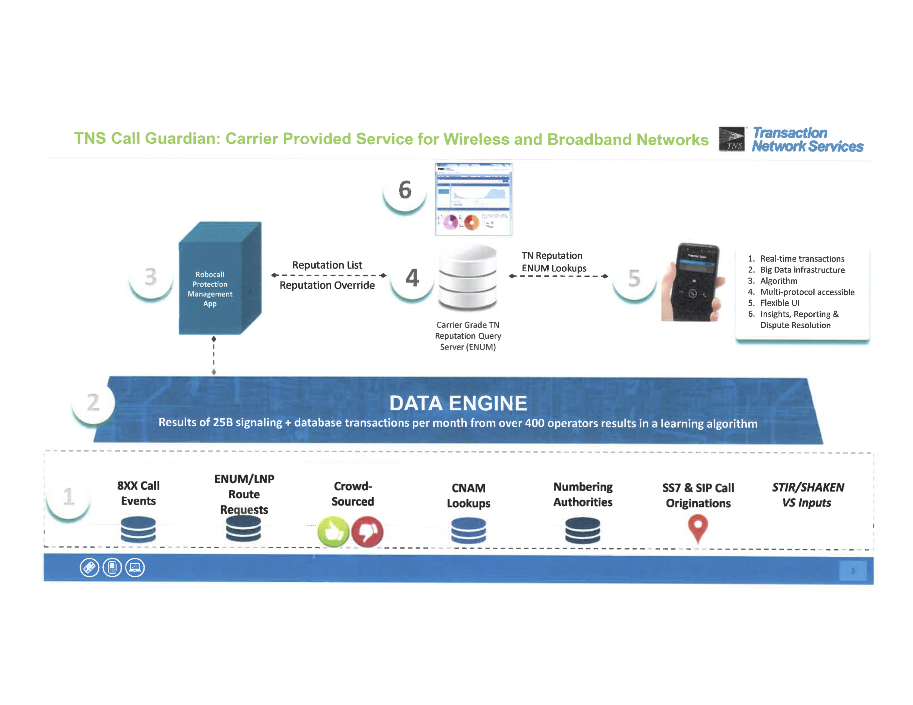
Example: TNS Call Guardian
Notes:
https://www.fcc.gov/ecfs/filing/1020878019865

Slide 39
Does the brand of smartphone matter?
YouMail claim: “Our data shows that iPhone users get 22% more scam calls, 32% more payment reminders calls, and 25% more telemarketing calls.”

Slide 40
Google call screening (Pixel only)

Slide 41
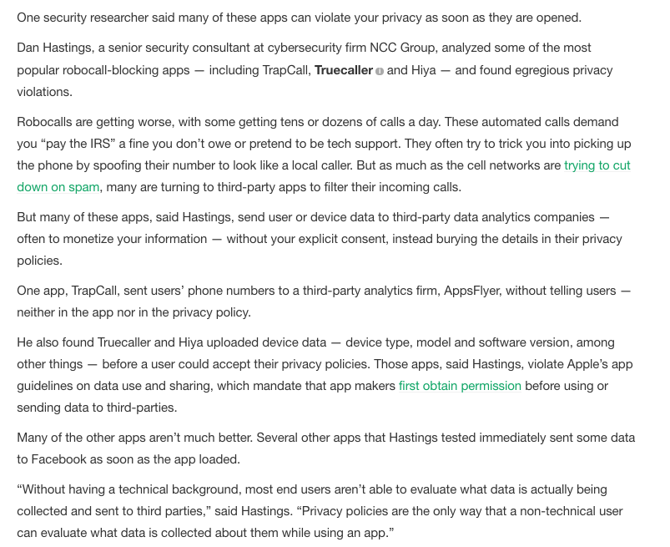
"If you are not paying for it, you're not the customer; you're the product being sold”
TechCrunch,
August 9, 2019

Slide 42
Tracking & tracing

Slide 43
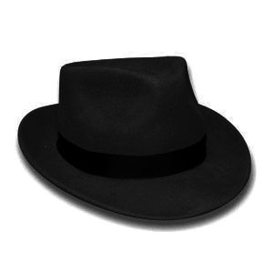
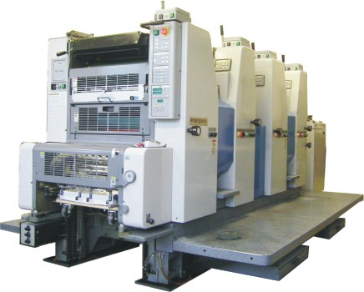


Law enforcement vs. robocallers
Agile numbering
Automated customer acquisition
Transnational
One faxed subpoena at a time
Manual trace-back
Largely domestic

Slide 44
It’s not just on the Caller ID……
It’s in the Call Billing Records
Hexadecimal Identifier (-1) = aa Structure Code (-2) = 41202c Call Code (1) = 006c Sensor Type (2) = 008c Sensor ID (Identification) (3) = 0212721c Recording Office Type (4) = 032c Recording Office ID (5) = 0480501c Date (6) = 30519c Timing Indicator (7) = 00000c Study Indicator (8) = 0000000c Answer Indicator (9) = 0c Service Observed, Traffic Sampled (10) = 2c Operator Action (11) = 2c Service Feature (12) = 000c Originating NPA (13) = 202c Originating Number (14) = 4561414c Overseas Indicator (15) = 0c Terminating NPA (16) = 00800c Terminating Number (17) = 4444444c
Hexadecimal Identifier (-1) = aa Structure Code (-2) = 41211c Call Code (1) = 015c Sensor Type (2) = 008c Sensor ID (Identification) (3) = 0212721c Recording Office Type (4) = 032c Recording Office ID (5) = 0480501c Date (6) = 30519c Timing Indicator (7) = 00000c Study Indicator (8) = 0000000c Answer Indicator (9) = 0c Service Observed, Traffic Sampled (10) = 2c Operator Action (11) = 3c Service Feature (12) = 000c Originating NPA (13) = 202c Originating Number (14) = 4561414c Overseas Indicator (15) = 0c Terminating NPA (16) = 00908c Terminating Number (17) = 6856777c

Slide 45
Traceback
With spoofing, has to do with
US Telecom traceback group (Kevin Rupy – ITB Group)
  22 carriers
  ATIS’ Service Provider Contact Directory (SPCD)
April 2017
Strike force report
Notes:
https://www.ustelecom.org/sites/default/files/documents/Senate-Commerce-Testimony-Rupy-April-18-2018.pdf

Slide 46
Traceback – US Telecom

Slide 47

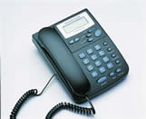
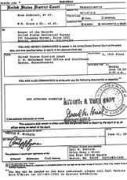
Via: SIP/2.0/TLS client.biloxi.example.com:5061;branch=z9hG4bKnashds7
;received=192.0.2.201
trace call route
VoIP provider A
VoIP provider B
§
§
§
automatically route subpoena

Slide 48
Federal & state actions

Slide 49
Robocall Strike Force – Oct. 2016

Slide 50
Robocall Strike Force – Oct. 2016

Slide 51
FCC blocking rules
2015 Order: carriers may offers customers tools to block unwanted robocalls
  Requires informed consumer opt-in
  Blocking permitted regardless of whether legal or illegal
November 2017: non-opt-in blocking for
  calls from invalid/unassigned numbers or
  if the subscriber assigned the number authorizes the blocking (e.g., IRS) → do not originate
June 2019: opt-out blocking
  voice service providers may offer consumers call blocking through an opt-out process
  “may offer opt-out call-blocking programs based on any reasonable analytics designed to identify unwanted calls”
  suggest “including a point of contact for legitimate callers to report what they believe to be erroneous blocking as well as a mechanism for such complaints to be resolved”
  “offering an opt-in white list program using the consumer’s contact list”
Notes:
https://www.fcc.gov/document/fcc-affirms-robocall-blocking-default-protect-consumers-0

Slide 52
FCC analytics (June 2019)
large bursts of calls in a short timeframe
low average call duration
low call completion ratios
invalid numbers placing a large volume of calls
common Caller ID Name (CNAM) values across voice service providers
a large volume of complaints related to a suspect line
sequential dialing patterns
neighbor spoofing patterns
patterns that indicate TCPA or other contract violations
correlation of network data with data from regulators, consumers, and other carriers
and comparison of dialed numbers to the National Do Not Call Registry

Slide 53
State AG anti-robocall principles (August 2019)
#1: Offer Free Call Blocking and Labeling. For smartphone mobile and VoIP residential customers, make available free, easy-to-use call blocking and labeling tools and regularly engage in easily understandable outreach efforts to notify them about these tools. For all types of customers, implement network-level call blocking at no charge. Use best efforts to ensure that all tools offered safeguard customers’ personal, proprietary, and location information.
#2: Implement STIR/SHAKEN. Implement STIR/SHAKEN call authentication.
#3: Analyze and Monitor Network Traffic. Analyze high-volume voice network traffic to identify and monitor patterns consistent with robocalls.

Slide 54
State AG anti-robocall principles
#4: Investigate Suspicious Calls and Calling Patterns. If a provider detects a pattern consistent with illegal robocalls, or if a provider otherwise has reason to suspect illegal robocalling or spoofing is taking place over its network, seek to identify the party that is using its network to originate, route, or terminate these calls and take appropriate action. Taking appropriate action may include, but is not limited to, initiating a traceback investigation, verifying that the originating commercial customer owns or is authorized to use the Caller ID number, determining whether the Caller ID name sent to a receiving party matches the customer’s corporate name, trademark, or d/b/a name, terminating the party’s ability to originate, route, or terminate calls on its network, and notifying law enforcement authorities.
#5: Confirm the Identity of Commercial Customers. Confirm the identity of new commercial VoIP customers by collecting information such as physical business location, contact person(s), state or country of incorporation, federal tax ID, and the nature of the customer’s business.

Slide 55
State AG Anti-Robocall Principles
#6: Require Traceback Cooperation in Contracts. For all new and renegotiated contracts governing the transport of voice calls, use best efforts to require cooperation in traceback investigations by identifying the upstream provider from which the suspected illegal robocall entered its network or by identifying its own customer if the call originated in its network.
#7: Cooperate in Traceback Investigations. To allow for timely and comprehensive law enforcement efforts against illegal robocallers, dedicate sufficient resources to provide prompt and complete responses to traceback requests from law enforcement and from USTelecom’s Industry Traceback Group. Identify a single point of contact in charge of responding to these traceback requests, and respond to traceback requests as soon as possible.
#8: Communicate with State Attorneys General. Communicate and cooperate with state Attorneys General about recognized scams and trends in illegal robocalling. Due to the ever-changing nature of technology, update the state Attorneys General about potential additional solutions for combatting illegal robocalls.

Slide 56
State AG anti-robocall principles
AT&T
CenturyLink
Comcast
Frontier
T-Mobile
Verizon
Bandwidth
Charter
Consolidated
Sprint
U.S. Cellular
Windstream Services
Will smaller VoIP providers sign?

Slide 57
TRACED Act (S.151 – passed 05/2019)
Implements a forfeiture penalty for violations (with or without intent) of the prohibition on certain robocalls.
Requires voice service providers to develop call authentication technologies.
The Federal Communications Commission (FCC) shall promulgate rules establishing when a provider may block a voice call based on information provided by the call authentication framework, but also must establish a process to permit a calling party adversely affected by the framework to verify the authenticity of their calls. The FCC shall also initiate a rulemaking to help protect a subscriber from receiving unwanted calls or texts from a caller using an unauthenticated number.
Notes:
https://www.congress.gov/bill/116th-congress/senate-bill/151

Slide 58
TRACED Act – new definitions & authentication
VOICE SERVICE.—The term “voice service”—
  (A) means any service that is interconnected with the public switched telephone network and that furnishes voice communications to an end user using resources from the North American Numbering Plan
  (B) includes—
    (i) transmissions from a telephone facsimile machine, computer, or other device to a telephone facsimile machine; and
    (ii) …, any service that enables real-time, two-way voice communications, … and permits out-bound calling, whether or not the service is one-way or two-way voice over internet protocol.
…, not later than 18 months after the date of enactment of this Act, the [FCC] shall require a provider of voice service to implement the STIR/SHAKEN authentication framework…

Slide 59
TRACED Act
Requires DOJ and the FCC to assemble an interagency working group to study and report to Congress on the enforcement of the prohibition of certain robocalls. Specifically, the working group will look into how to better enforce against robocalls by examining issues like the types of laws, policies, or constraints that could be inhibiting enforcement.
Requires the FCC to initiate a proceeding to determine whether its policies regarding access to number resources could be modified to help reduce access to numbers by potential robocall violators.

Slide 60
H.R. 3375 - Stopping Bad Robocalls Act
Passed House July 24, 2019
“the establishment of a database of telephone numbers that have been disconnected”
no citation required to seek forfeiture penalty
four year statute of limitations (47 USC 227b)
annual robocall report

Slide 61
H.R. 3375 - Stopping Bad Robocalls Act
call authentication regulations within one year, effective within 6 months
no line item charge for call authentication
blocking service “are provided with no additional line item charge to consumers and no additional charge to callers for resolving complaints related to erroneously blocked calls”
require contact information for VoIP providers
  “would be an interconnected VoIP service (as so defined) except that the service permits users to terminate calls to the public switched telephone network but does not permit users to receive calls that originate on the public switched telephone network”

Slide 62
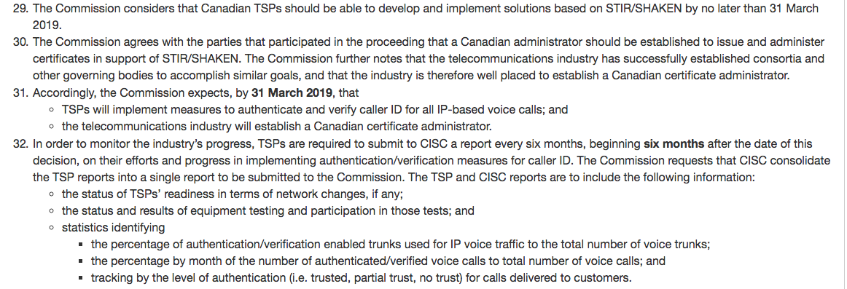
Canada – January 2018
Measures to reduce caller identification spoofing and to determine the origins of nuisance calls
https://crtc.gc.ca/eng/archive/2018/2018-32.htm

Slide 63
Make numbers valuable
If spoofing stops, robocallers will find number resellers
Robocallers will “burn” numbers – use until number gets blocked
  number exhaust problem – many numbers become “tainted”
  may still be sufficiently cheap to make calls → e.g., at 1,000 calls, only $0.001
Create consumer (low-volume) and high-volume numbers
  e.g., $10/year for low-volume outbound numbers (e.g., 10 calls/day)
  $1,000/year for high-volume number (> 10 calls per day)
Also helps solve USF problems

