Slide 1
Robocalls – An illustrated guide to origin, mechanisms and prevention Telephone numbers
Henning Schulzrinne
Columbia University

Slide 2
What are telephone numbers?
Generally, assigned by each country
e.g., +49 = Germany
But +1 “North American Numbering Plan” = US, Canada, Carribean (Bermuda, Anguilla, Antigua & Barbuda, the Bahamas, Barbados, the British Virgin Islands, the Cayman Islands, Dominica, the Dominican Republic, Grenada, Jamaica, Montserrat, Sint Maarten, St. Kitts and Nevis, St. Lucia, St. Vincent and the Grenadines, Trinidad and Tobago, and Turks & Caicos)
but not Mexico

Slide 3
Who can get numbers?
Traditional telephone carriers
Carriers do not pay for numbers
carriers contribute based on revenues
exceptions: 800 numbers
have to file NRUF
Providers “resell” numbers
Since Feb. 2016, interconnected VoIP providers can get numbers
Roughly, 40 providers have been granted access
Notes:
https://nationalnanpa.com/nruf/index.html

Slide 4
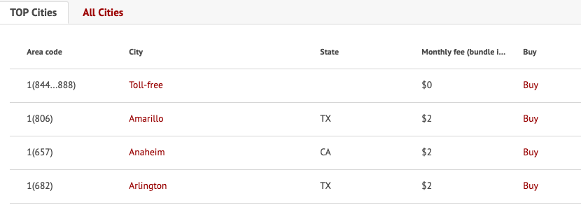
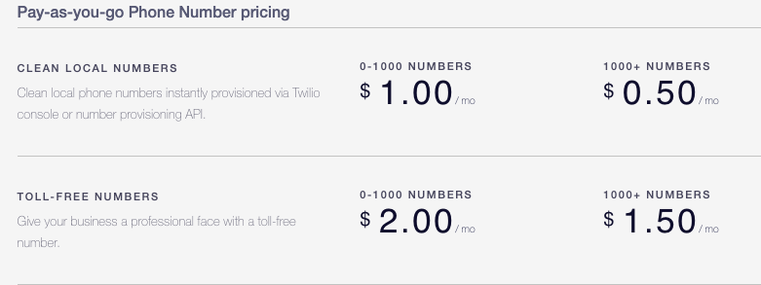
You can buy numbers, too

Slide 5
How many numbers are there?
10 digits (NPA-NXX-XXXX) → 10 billion numbers in theory
672 NPAs usable (317 geographic, 18 non-geographic in the US + 42 Canada + others) → 390 total
Each NPA 1.7 M numbers
→ roughly 5.3 B numbers in theory, 3.1 B in potential use
(most) robocallers love illegal and unused numbers

Slide 6
CNAM – caller name
delivered as modem
tones after first ring
1200 baud modem
no more than 15 characters

Slide 7
CNAM
Subscriber names are entered by service provider
May not be available for wireless callers
Typically only shows business name
Multiple database providers
Example pricing: $0.005/dip (bulkvs.com)
May have incorrect database entries (caching)
Neustar – probably largest provider
ListYourself.net
Examples: TrueCNAM.com (TrueSpam), https://www.calleridtest.com/

Slide 8
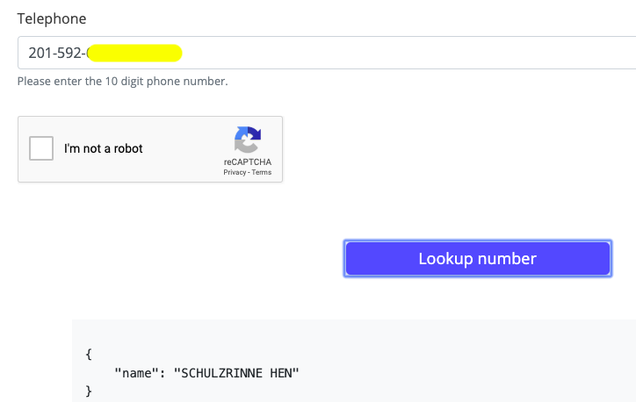
https://apeiron.io/cnam

Slide 9
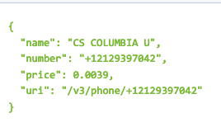
OpenCNAM

Slide 10
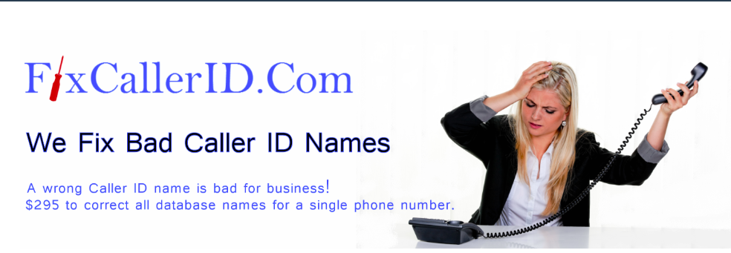
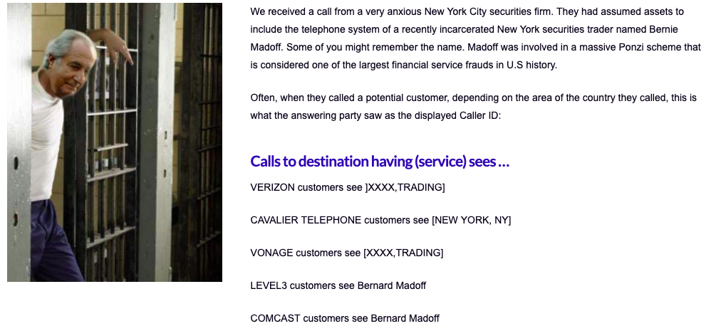
Bad CNAM: bad system design = business opportunity

Slide 11
Reassigned numbers cause unwanted calls
Numbers are often reassigned after about 90 days if subscription lapses
most common for pre-pay mobile services
for new subscriber for same carrier
But legitimate callers don’t know that subscriber has changed
Debt collection calls particularly problematic
December 2018: FCC authorizes reassigned numbers database
”Has this number changed subscriber since [my last recorded opt-in]?”

Slide 12
FCC re-assigned numbers best practices
Interactive Opt-out. Include an interactive opt-out mechanism in all artificial or prerecorded voice calls so that recipients may easily report a reassigned or wrong number.
Wrong Number Reports. Implement procedures for recording wrong number reports received by customer service representatives placing outbound calls.
New Phone Number Recordings. Implement processes for allowing customer service agents to record new phone numbers when receiving calls from customers.
Request Information Updates. Periodically send an email or mail request to the consumer to update his or her contact information.
Recognize Triple Tones. Utilize an autodialer’s and/or a live caller’s ability to recognize “triple-tones” that identify and record disconnected numbers.
Reassigned Number Policy. Establish policies for determining whether a number has been reassigned if there has been no response to a “two-way” call after a period of attempting to contact a consumer.
Texting Information Updates. Enable customers to update contact information by responding to any text message they receive, which may increase a customer’s likelihood of reporting phone number changes and reduce the likelihood of a caller dialing a reassigned number.

Slide 13
Number spoofing

Slide 14
Two modes of caller ID spoofing
Impersonation
Anonymization
spoof target number
personal or 800 number
Helpful for
vishing
stolen credit card validation
retrieving voicemail messages
SWATting
disconnect utilities
unwanted pizza deliveries
retrieving display name (CNAM)
pick more-or-less random number
including unassigned numbers
“neighbor spoofing”
Helpful for
robocalling
intercarrier compensation fraud
TDOS

Slide 15
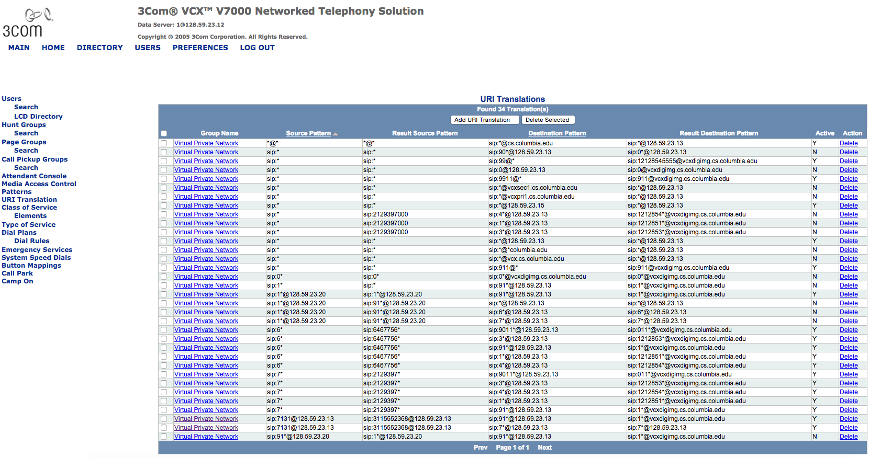

Slide 16
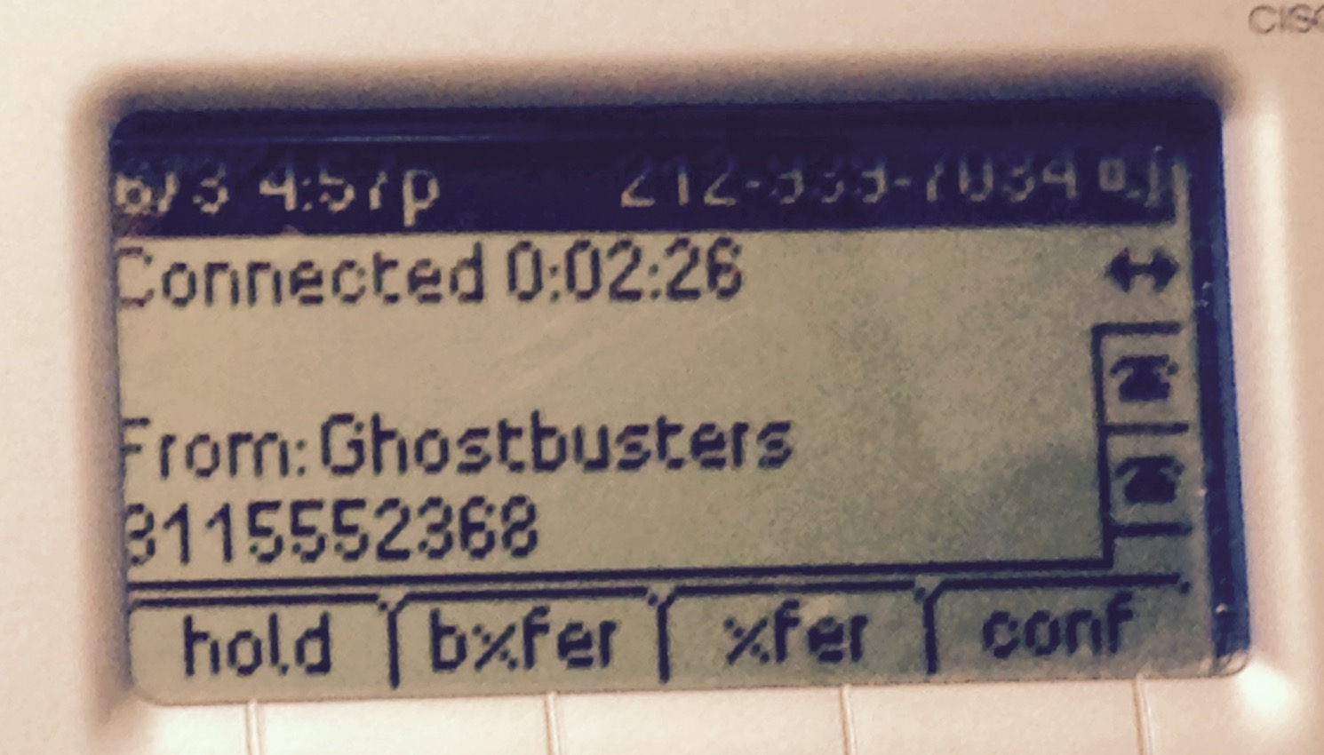

Slide 17
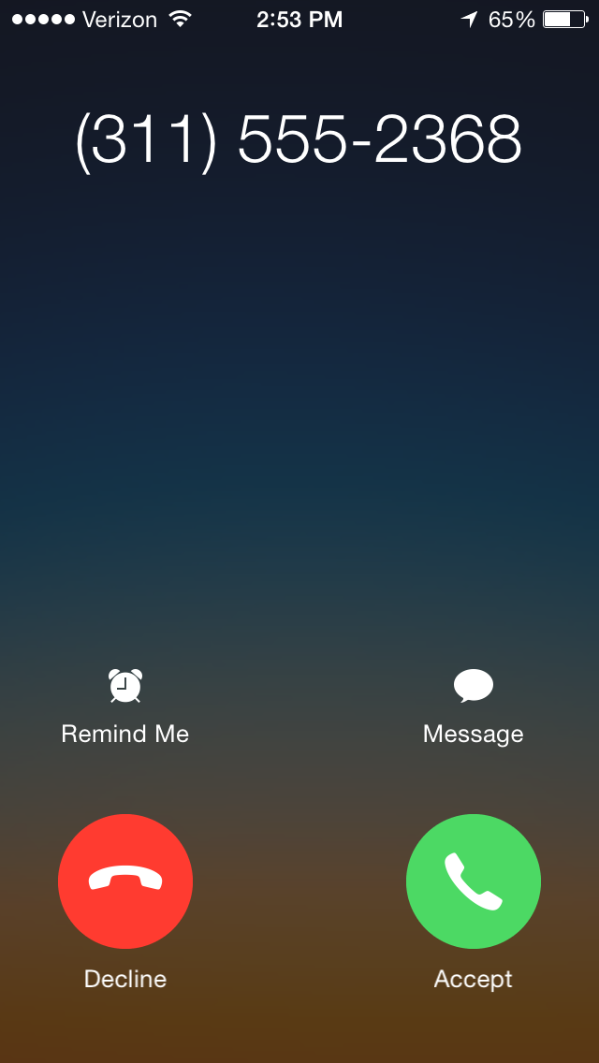
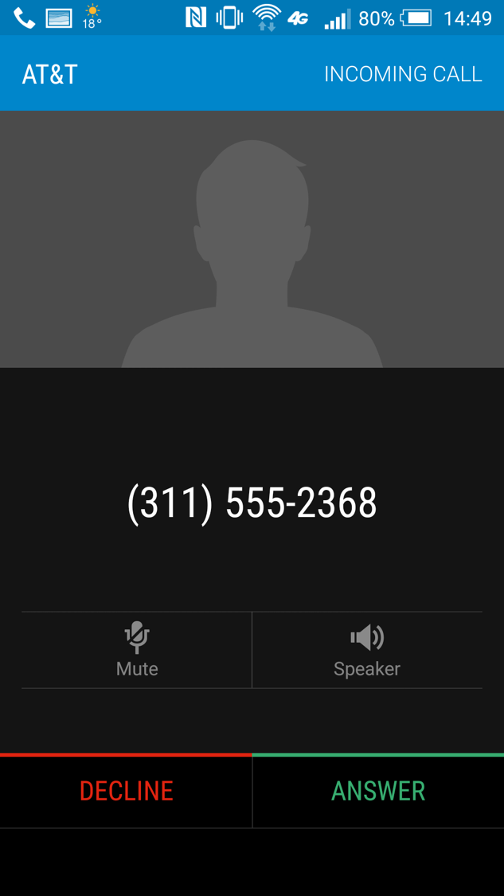

Slide 18
Legitimate caller ID spoofing
Doctor’s office
call from personal physician cell phone should show doctor’s office number
Call center
airline outbound contract call center should show airline main number, not call center
Multiple devices, one number
provide single call-back number (e.g., Google Voice) from all devices
anonymity is distinct problem (caller ID suppression)

Slide 19
Two modes of caller ID spoofing
Impersonation
Anonymization
spoof target number
personal or 800 number
Helpful for
vishing
stolen credit card validation
retrieving voicemail messages
SWATting
disconnect utilities
unwanted pizza deliveries
retrieving display name (CNAM)
pick more-or-less random number
including unassigned numbers
“neighbor spoofing”
Helpful for
robocalling
intercarrier compensation fraud
TDOS

Slide 20
Spoofing
Feb. 2018
Notes:
https://www.fcc.gov/ecfs/filing/1020878019865

Slide 21
Spoofing & unwanted calls
10,000 victims
$54M losts
VM retrieval
spoof
specific
kidnapping
impersonation
spoof
random
telemarketing without callback
scams
bomb threats
can’t
spoof
(or unlikely)
international toll
telemarketing with callback
unwanted
surveys &
charity calls
telemarketing
real goods
(energy plans)
telemarketing
scams
(vacation, lucky
winner)
extortion
(pay or
arrest/deport)
individualized
threats

