Slide 1
Robocalls – An illustrated guide to origin, mechanisms and prevention
Introduction
Henning Schulzrinne
Columbia University

Slide 2
Questions
All open communication systems suffer from unwanted communication
Magnitude, nature and history of robocalls
What is a robocall and why (when) is it illegal?
Types of robocalls
How does the phone system work (today)?
How to be a successful robocaller
Defending against robocalls
  core strategies
  number validation: STIR/SHAKEN, CAs
  short-term and long-term issues and options
  consumer strategies

Slide 3
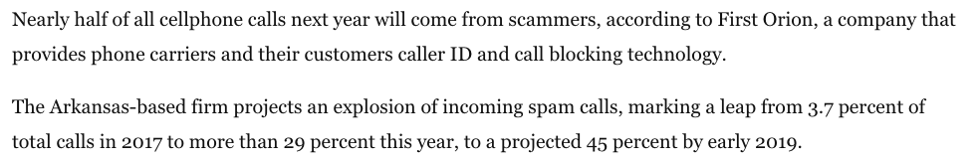
“You won the Nobel prize. You just have to wire some money.”
When the Swedish Royal Academy of Sciences called New York University professor Paul Romer early this morning to inform him that he was co-recipient of this year's Nobel Prize in Economics, the veteran professor let the call go to voicemail, thinking that only a telemarketing call could be coming in at such an early hour.
“I didn't answer the phone because I've been getting so many spam calls," Romer told ABC News. "I just assumed it was more spam."
Notes:
https://abcnews.go.com/US/economist-won-nobel-prize-thought-early-morning-call/story?id=58358633

Slide 4
Two types of communication systems
open communication systems:
anybody can join
hard to keep people out
closed systems:
by invitation only
can be kicked out (“blocked”)
closed communication systems often have open introduction
mechanism (Facebook, LinkedIn, Skype)

Slide 5
Spam is not a new problem

Slide 6
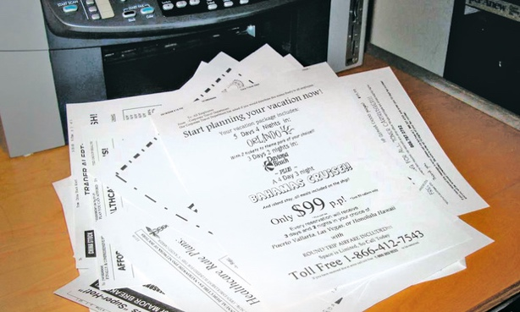
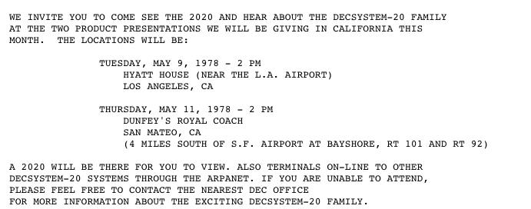
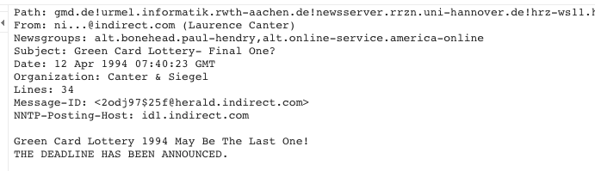
All open communications media attract spam
1996: US Standard Mail (bulk mail) created
2005: Standard Mail volume outpaces First-Class Mail volume
1985: invention of computer-based fax board
2005: Junk Fax Prevention Act (47 USC 227)
1971: first email
1978: email spam (DEC-20)
Jan 1994: “Global Alert For all: Jesus is Coming Soon:
April 1994: Canter & Siegel green card lottery
1994: MAKE MONEY FAST!
Notes:
https://groups.google.com/forum/#!original/alt.online-service.america-online/-F9L_Y2YvHM/9mg3paxBqAUJ

Slide 7
Spam
CACM 8/2019

Slide 8
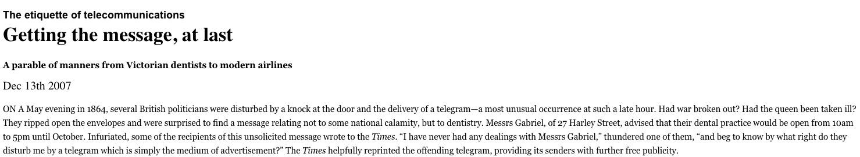
Telegraph spam - 1864
Economist
Notes:
https://www.economist.com/node/10286400/print?story_id=10286400

Slide 9
Spanish Prisoner Scam
1898

Slide 10
Greed, fear, charity, marketing & loans
Greed: money mules, “you won a cruise”
Fear: “you will lose your social security benefits”, “your PC has a virus”, “your grandson is in prison”
Charity: ”Please support our police officers”
Impersonation: “Hi, I’m Trusted Contractor. Call me back at my fake number”
Debt collection

Slide 11
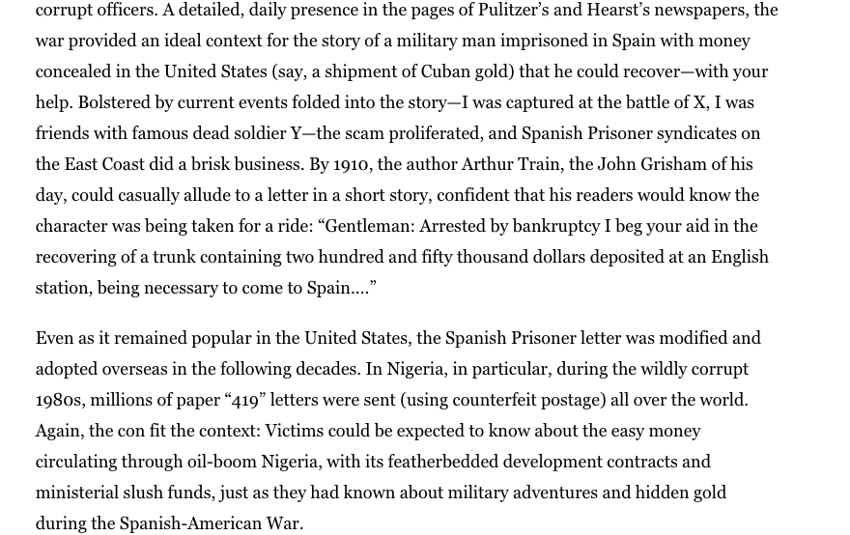
Nigerian “advance fee” scam
Notes:
https://www.bostonglobe.com/ideas/2013/05/18/the-long-weird-history-nigerian-mail-scam/C8bIhwQSVoygYtrlxsJTlJ/story.html

Slide 12
Common scams
Tech support scams
  Problem with Apple ID, Microsoft account, or cable company account information.
  number is spoofed from the company’s 800 number
  caller may have name and an old password
  send you to a fake website to steal your money or collect your personal information,
  ask their target to pay using a gift card, which victims will often purchase at a drugstore
Family emergency scams
  Scammers pose as relatives or friends calling in an emergency.
  From social media account: family relationships, pet names, latest travels, ….
  A grandchild who may be traveling abroad, is in a faraway jail or in the hospital and in urgent need of emergency funds.
  Urgency can trick you into sending money before you realize it’s a scam.
  Ask the victim to keep it secret, preventing victims from checking with other family members about the supposed crisis.
Consumer Report, 8/19

Slide 13
More common scams
Government imposter scams
  Criminals use phone number spoofing technology
  IRS or Social Security Administration is calling seeking payment
  Crooks often have your name, Social Security number, or other personal information.
  IRS may threaten to arrest or deport you, or revoke your license if you don’t pay right away.
  With the Social Security scam, “your benefits are blocked and can be reactivated for a fee”
Medicare scams
  Scammers pretend to be Medicare representatives or from a medical supply company
  Looking for your personal information and will say they need your Medicare number so that you can get a back or neck brace.
  Need your information or money so that you can get a new Medicare card and that if you don’t act quickly, you’ll be hit with fees.

Slide 14
Other scams that wax & wane
Immigration scams
  Targeting immigrant communities
  Send money using IM or deported
International call-back scams
  “We have important information for you – call back at 1-869-555-1234”
  aka Wangiri scam (“you won the lottery”)
  looks like an 800 or new area code
  actually in Saint Kitts and Nevis Island
  International call - $0.48/minute (Verizon landline)
  robocaller gets kickback from local phone company
    not unknown in the US (free conference calling lines)

Slide 15
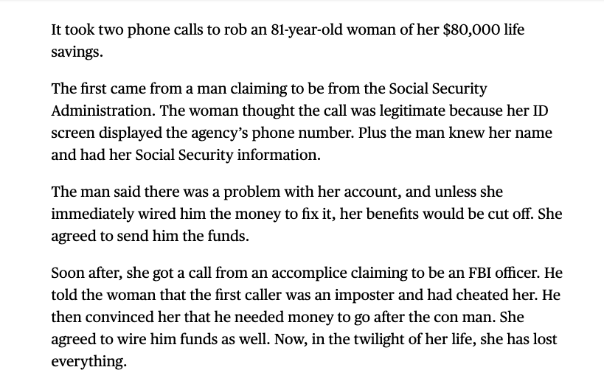
More sophisticated scams
Consumer Reports, August 2019

Slide 16
More targeted scams
“reported losses of $285.2 million so far this year, with a median loss of $700, according to FTC data. At this point in 2018, consumers had reported losses of $239 million with a median loss of $500.”
“While less and less people are getting scammed overall, the few who are are seeing much bigger losses,” says Ian Barlow, the Do Not Call program coordinator at the FTC. “And there are lots of individual consumers who lose everything.”
Older people are particularly vulnerable to scams.

Slide 17
Leveraging more information
Easily available personal information, whether stolen in a data breach or from poorly secured social media accounts, helps criminals add credibility to their cons.
“Robocall scammers know more about you, so they’re targeting you specifically,” says Al Pascual, chief operating officer and co-founder at Breach Clarity, a firm that helps consumers to understand the threat level of a data breach and what steps they need to take to be protected. “They pretend to be a family member in need of money or use other creative ways to get you to pay up.”

Slide 18
Telemarketing vs. robocalls
telemarketing
robocalls
Telemarketing = “a plan, program, or campaign . . . to induce the purchase of goods or services or a charitable contribution”
  Telemarketing means the initiation of a telephone call or message for the purpose of encouraging the purchase or rental of, or investment in, property, goods, or services, which is transmitted to any person. (47 USC 227)
Robocalls
  colloquially: anything automated (dialing & recorded voice) & high volume
  legally: it’s complicated (later)
FTC: interstate telemarketing calls
FCC: intrastate and interstate calls: TCPA
State laws: intrastate telemarketing
https://www.ftc.gov/tips-advice/business-center/guidance/complying-telemarketing-sales-rule#Introduction
Notes:
https://tcpaworld.com/tcpaworlds-rolling-atds-review/

Slide 19
Terms of art
ATDS = automatic telephone dialing system
predictive dialer
  use call metrics to predict the moment when human agents will be available to make the next call
  dial multiple numbers at the same time.
  ensure maximum agent utilization
  avoid dead air when called party picks up and no agent available
    TCPA: no more than 3% “dead air” or abandoned calls
ringdna.com

Slide 20
Wanted, unwanted, illegal & criminal robocalls
Wanted
(school closing)
Illegal
(civil violation; TCPA)
Criminal
(wire fraud)
Unwanted
(annoying, but legal)

Slide 21
Robocalls – from unwanted to criminal
traditional telemarketing
real (possibly sub-par) product
TCPA violation
dubious products
(credit repair, timeshares)
false debt collection
loans that are no longer owed
(or wrong person)
B2B telemarketing
wrong number calls
(reassigned numbers)
financial scams
using greed
aggressive debt
collection
surveys
financial scams
using threats
political calls
dubious charities
“good” charities

Slide 22
Spoofed
caller ID
robocalls
Voicemail impersonation
illegal
wanted
vishing
debt collectors
(traditional +
unregulated)
TDOS
swatting
toll fraud
unwanted
Spoofed
Caller ID or CNAM
robocalls

Slide 23
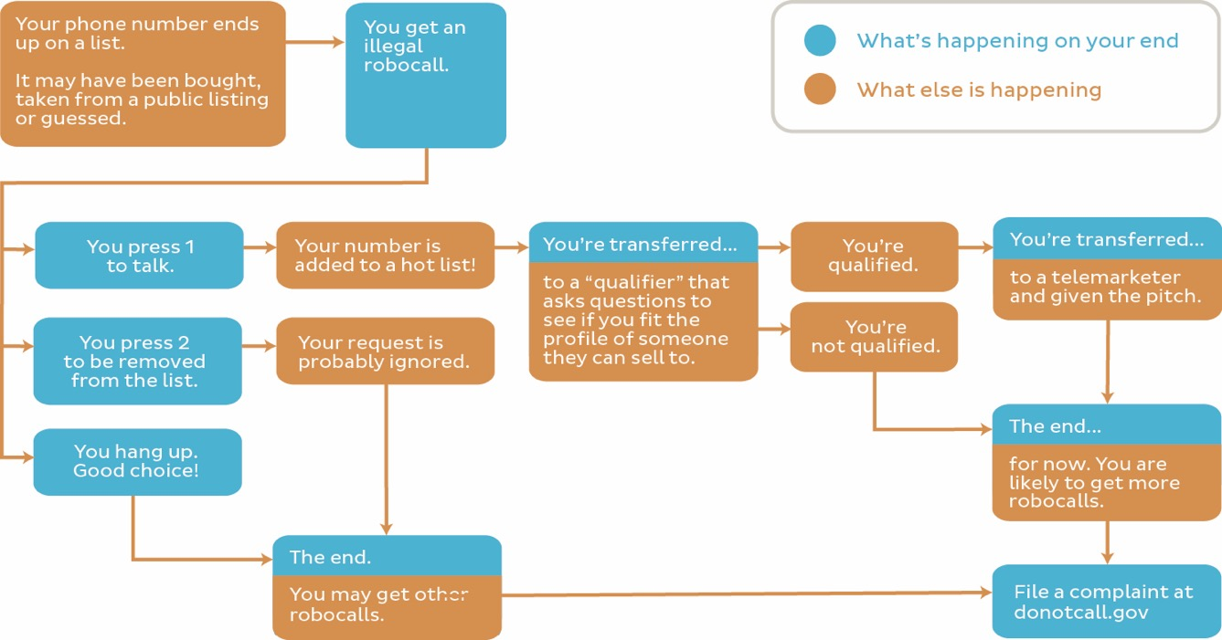

Slide 24
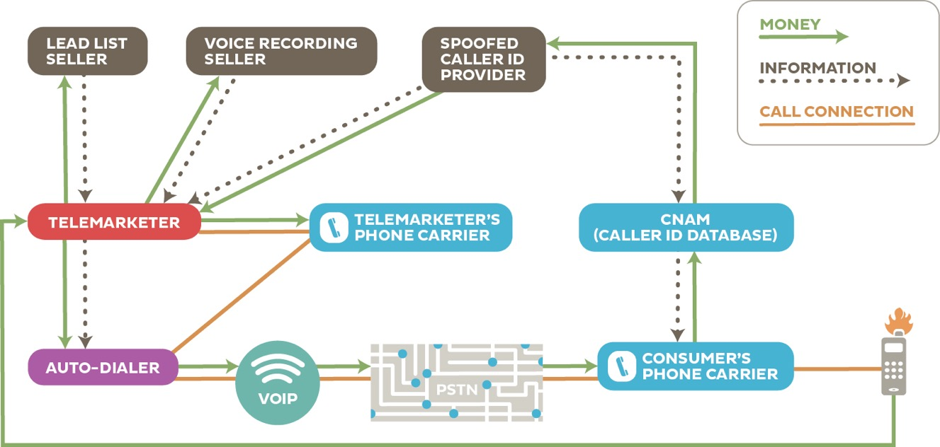

Slide 25
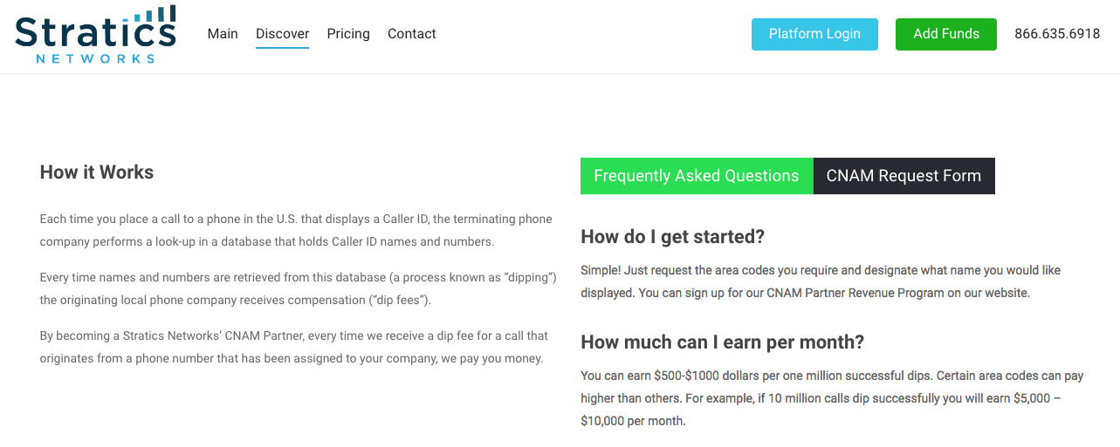
CNAM revenue sharing

Slide 26
Another view
Robocalling
Cheap VoIP
Number spoofing
Cheap labor
English-language countries
Or recent Chinese visa fraud

Slide 27
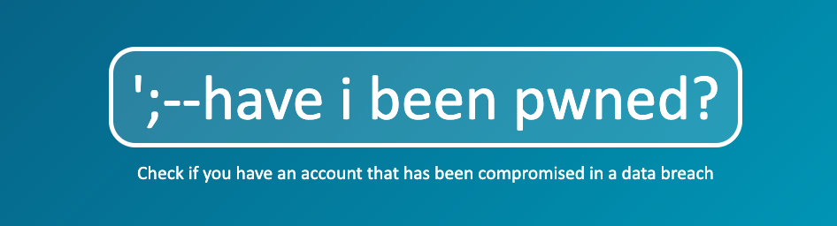
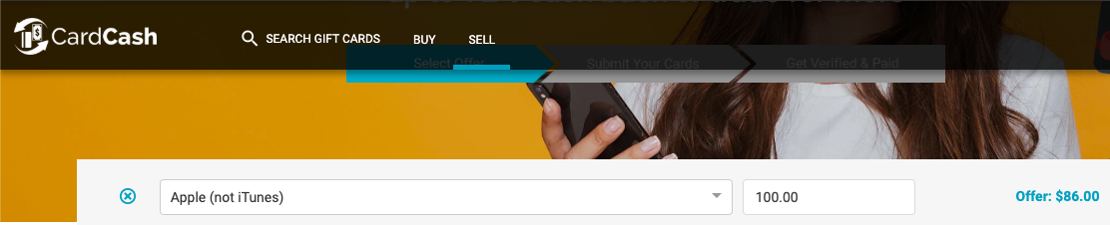
Why now?
TaaS → RaaS*
* Robocalls as a service
Notes:
https://www.tripwire.com/state-of-security/risk-based-security-for-executives/risk-management/gift-card-fraud-how-its-committed-and-why-its-so-lucrative/

Slide 28
Is this a US problem only?
Four ingredients:
  relatively cheap call termination rates
  infrastructure suppliers
  means of payment (gift cards!) – many countries don’t have those
  English/Spanish/French-speaking or ex-pat community
Most common (source: Hiya, 2019)
  Spain (24%)
  UK (22%)
  Italy (21%)
  France (20%)
  Argentina (10%)
  US (10%) – seems low
  Mexico (9%)
  Brazil (9%)
  Chile (9%)
  Australia (6%)

Slide 29
Where are the callers and victims?
Florida & California
  human eco system → boiler room agents striking out on their own
Travel scams in Guatemela, Mexico & Costa Rica
Medical brace scams in Philippines, Latin America
IRS, social security, tech support: India
Targets: 53 Southern cities in top-100, 5 southern states in top-10
  older population
  economic conditions → loan scams & get-rich schemes
  “Southerners are more polite and answer the phone more” (YouMail)
  “The more you answer the phone, the more calls you get” (YouMail)

Slide 30
Selected Federal Robocall Rules
Law/rules |  | Agency enforcing | Calls covered
Telephone Consumer Protection Act (TCPA) and FCC Rules (1991) | 47 U.S.C. § 227 47 CFR 64.1200 | FCC | Restricts certain calls made using an artificial or prerecorded voice to residential lines; certain calls made using an artificial or prerecorded voice or an automatic telephone dialing system to wireless telephone numbers; and certain telemarketing calls.
2009 Truth in Caller ID Act (TICIDA) | 47 U.S.C. § 227(e) | FCC | Prohibition on the knowing transmission of misleading or inaccurate Caller ID information “with the intent to defraud, cause harm, or wrongfully obtain anything of value.”
Do Not Call Implementation Act (DNCIA) | 15 U.S.C. § 6101 | FTC, FCC | Authorizes the FTC to collect fees for the implementation and enforcement of a Do Not Call Registry. Telemarketers must consult the National Do Not Call Registry before calling.10 Requires that “the Federal Communications Commission shall consult and coordinate with the Federal Trade Commission to maximize consistency with the rule promulgated by the Federal Trade Commission.”
FCC Report on Robocalls, CGB 17-59, Feb. 2019

Slide 31
Selected federal robocall laws & rules
Law/rules |  | Agency enforcing | Calls covered
Telemarketing Consumer Fraud and Abuse Prevention Act (Telemarketing Act) and Telemarketing Sales Rule | 15 U.S.C. §§ 6101-6108 16 CFR § 310 | FTC | Prohibits deceptive and abusive telemarketing acts or practices.
Fair Debt Collection Practices Act | 15 U.S.C. §§ 1692-1692p |  | Restricts debt-collection hours and frequency.

Slide 32
How to prevent…
Content | Method | Wireline residential | Wireline business | Wireless (mobile) including business
Telemarketing | Manual | DNC | Can’t prevent | DNC
 | Auto-dialed | DNC | Can’t prevent | ❌
 | Pre-recorded | ❌ | Can’t prevent | ❌
Informational (including political, charity, polling) | Manual | can’t prevent | can’t prevent | can’t prevent
 | Auto-dialed or pre-recorded | opt-out | opt-out | ❌
Emergency | Any | permissible | permissible | permissible
Note: DNC does not cover calls from companies with which the customer has an existing
business relationship.

Slide 33
Do Not Call (DNC) List
Established June 2003
1st Amendment challenge rejected by 10th Circuit in Feb. 2004
Companies must search list at least every 31 days
DNC includes wireless and toll-free numbers
Sellers, Telemarketer, Service Providers
Exempt Organization ("EO")— exempt from both the FTC's and FCC's requirements, but chooses to access the registry. Exempt Organizations include charities or certain non-profit organizations, organizations engaged in political solicitations or surveys, or Sellers or Telemarketers that call ONLY consumers with EBR or PEC.
Annual fees: 5 area codes free; area code $59 up to a maximum of $16,228

Slide 34
You are not allowed to…
 | Wireline residential | Wireline business | Wireless (mobile)
not on do-not-call list | pre-recorded TM | no restriction | pre-recorded or auto-dialed non-emergency
on DNC | any telemarketing | does not apply | any telemarketing pre-recorded or auto-dialed non-emergency
Charity & political | ok | ok | not ok

Slide 35
Prior Express Written Consent (PEWC)
Required for ATDS and prerecorded telemarketing calls
PEWC means an agreement, in writing, bearing the signature of the person called that clearly and conspicuously discloses that the person authorizes the seller to deliver or cause to be delivered telemarketing calls using an automatic telephone dialing system or an artificial or prerecorded voice to a specified telephone number. Furthermore, the person must be informed they are not required to sign the agreement, or agree to enter into such an agreement, as a condition of purchasing any property, goods, or services.

Slide 36
Prior Express Consent (PEC)
ATDS for non-sales calls require PEC
(1) the call recipient must have provided the number to the business directly or via an intermediary (i.e. capturing it via caller ID or from a third party is not sufficient);
(2) there is no express consent if the call recipient provided “instructions to the contrary” (i.e., indicated that he/she doesn’t want to be contacted at that number);
(3) the call must be for “normal business communications;”
(4) the call must be closely related to the purpose for which consent was given.
https://www.jornaya.com/tcpa-requirements-faq/

Slide 37
Established business relationship (EBR)
DNC numbers require EBR
Either:
  transaction with the seller within the previous 18 months (“Transactional EBR”)
  inquired about the seller’s goods/services within the previous 3 months (“Inquiry EBR”).
Federal DNC laws do not apply to business-to-business calls (except the sale of non durable office or cleaning supplies).
Individual states may have more restrictive requirements.
https://www.jornaya.com/tcpa-requirements-faq/

Slide 38
TCPA requirements (16 CFR § 310.4)
Mainly affects (semi-)legitimate businesses
Calls only between 8 am and 9 pm local time.
Must let the phone ring at least 15 seconds or four rings.
Bans ending unsolicited advertisements by auto-dialer, prerecorded voice
message, or fax to anyone without prior express consent.
Bans auto-dialers and artificial or prerecorded voice messages programmed to call any emergency phone lines (including 911 numbers, PSAPs, hospital emergency lines, physicians or medical service lines, health care facilities, poison control centers, fire protection or law enforcement agencies), pagers or cellular phones, or a call for which a charge is made to the calling party.
Prohibits use of an auto-dialer to engage 2+ lines of a multi-line business.
Requires that anyone using an auto-dialer or an artificial or prerecorded voice message to call any number state the identity of the caller at the beginning of the message and give the address and phone number of the caller during the call.
Customers must be able to opt-out of future robocalls during a robocall. If there is an opt out requested, the call must be disconnected immediately and no future calls can be made to that consumer by that organization.
https://thedma.org/resources/compliance-resources/tcpa/

Slide 39
TCPA – it’s a definitional mess
47 U.S. Code § 227
  The term “automatic telephone dialing system” means equipment which has the capacity—(A) to store or produce telephone numbers to be called, using a random or sequential number generator; and
  (B) to dial such numbers.
47 CFR § 64.1200
ACA International vs. FCC
Dominguez vs. Yahoo – 3rd Circuit (June 26, 2018)
“Corporate defendants and telemarketers should take advantage of the Dominguez decision to try to eliminate lawsuit based on dialing systems that cannot generate random or sequential numbers.”
Marks vs. Crunch San Diego (Sept. 18, 2018) – 9th Circuit
  does “using a random…” modify ”store or produce” or just “produce”?
  court: can automatically dial stored numbers

Slide 40
The smartphone “question”
FCC PN
DA 18-1014
… how to interpret and apply the statutory definition of automatic telephone dialing system, including the phrase “using a random or sequential number generator,” in light of the recent decision in Marks, as well as how that decision might bear on the analysis set forth in ACA International. To the extent the statutory definition is ambiguous, how should the Commission exercise its discretion to interpret such ambiguities here? Does the interpretation of the Marks court mean that any device with the capacity to dial stored numbers automatically is an automatic telephone dialing system? What devices have the capacity to store numbers? Do smartphones have such capacity? What devices that can store numbers also have the capacity to automatically dial such numbers? Do smartphones have such capacity?

Slide 41
TCPA private right of action
FCC can seek penalties up to $16,000
TCPA allows a plaintiff to recover actual monetary damages, or alternatively, $500 in damages for each violation, whichever is greater, and up to $1,500 if the court finds that such violation is “willful or knowing”
Also applies to text messages
  can withdraw consent using “any reasonable means”, not just STOP
Often, as class actions – settlements up to $75M
Notes:
https://www.mccarter.com/TCPA-The-Next-Wave-of-Class-Action-Lawsuits-Asserts-Consumers-Right-to-Withdraw-Consent-to-Receive-Text-Messages-02-14-2017/

Slide 42
How bad is it out there?

Slide 43
How many robocalls are there?
Nobody knows, really
Three sources of data
  FCC complaint data
    not as well known as FTC → lower numbers
    172,000 complaints in calendar year 2015, 150,000 complaints in 2016, 185,000 complaints in 2017, and 232,000 complaints in 2018.
  FTC complaint data
    only small fraction report
  Estimates by robocall prevention tools
    extrapolate from blocked calls
General unknowns
  FCC & FTC depends on consumer awareness (media coverage)
    and “does it matter” perception

Slide 44
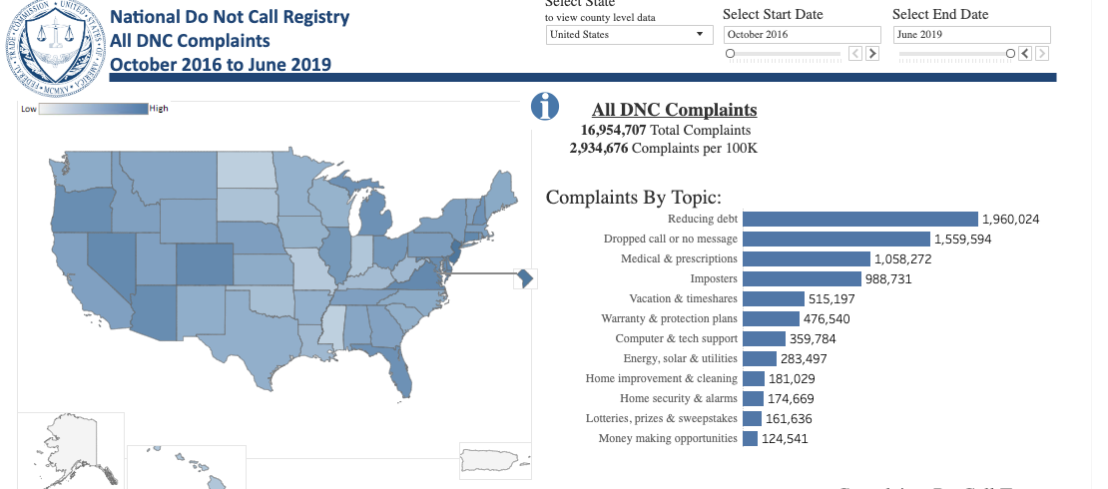
FTC complaints
https://www.ftc.gov/news-events/press-releases/2019/07/ftc-announces-new-public-web-page-interactive-do-not-call

Slide 45
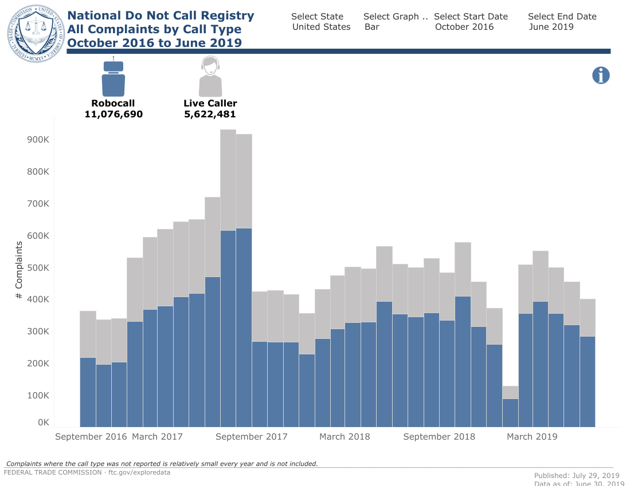
FTC complaint statistics

Slide 46
Volume estimates
YouMail: 29B in 2016 to 30B in 2017, and to 47B in 2018.
Hiya: 26.3 billion robocalls were made to mobile phones in the United States in 2018
First Orion: 44.6% of calls to mobile in 2019 will be scams
Hiya: over 30% of the calls “general spam”, not fraud or other illegal activity
  approximately 20% “telemarketing”

Slide 47
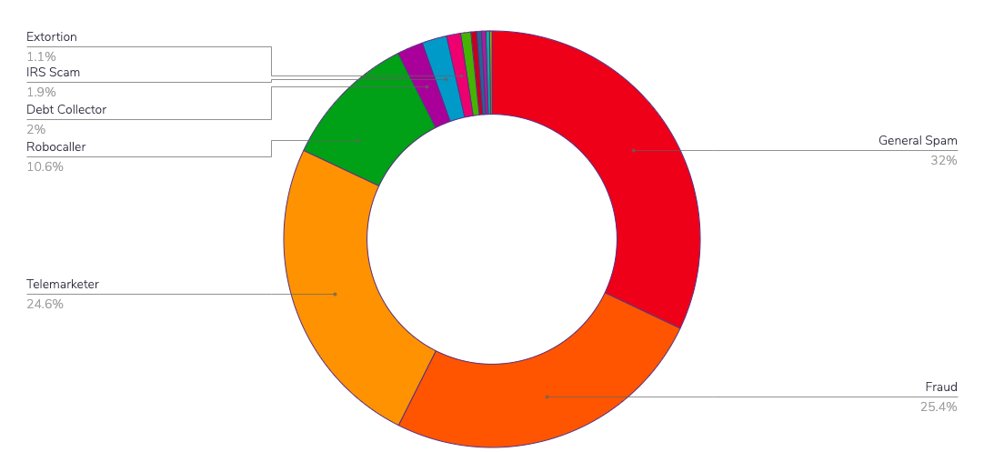
The flavors of annoyance and worse
Hiya 2018 robocall radar

Slide 48
Hiya Q1 2018

Slide 49
Hiya Q2 2018

Slide 50
Hiya Q2

Slide 51
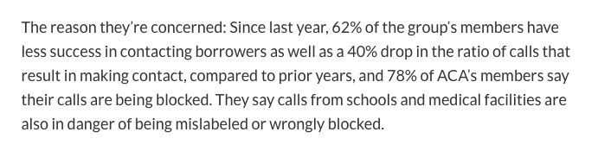
Notes:
https://www.marketwatch.com/story/flexing-their-muscles-debt-collectors-see-an-opportunity-to-fend-off-robocall-rules-2018-10-12

Slide 53
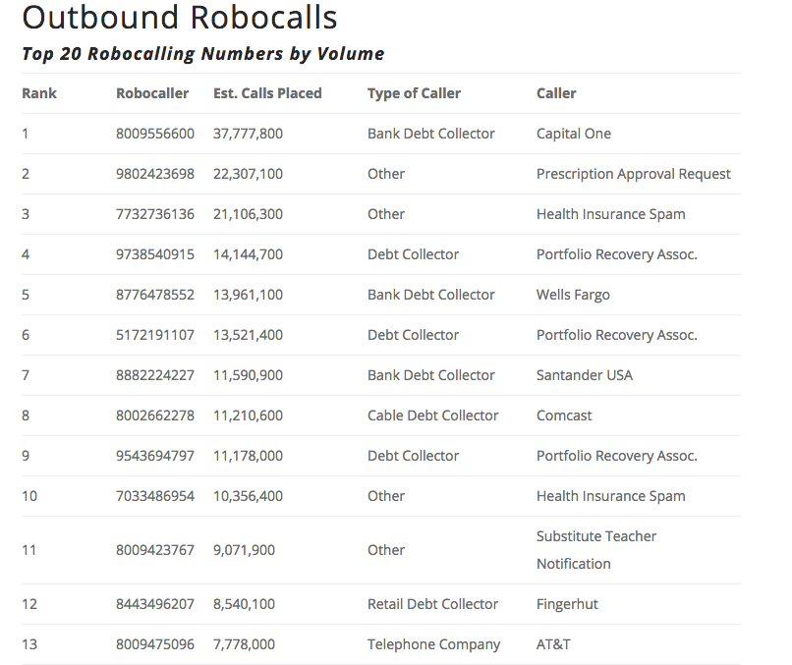
Notes:
YouMail - https://blog.youmail.com/2018/05/robocall-index-snapshot-april-2018/

Slide 54
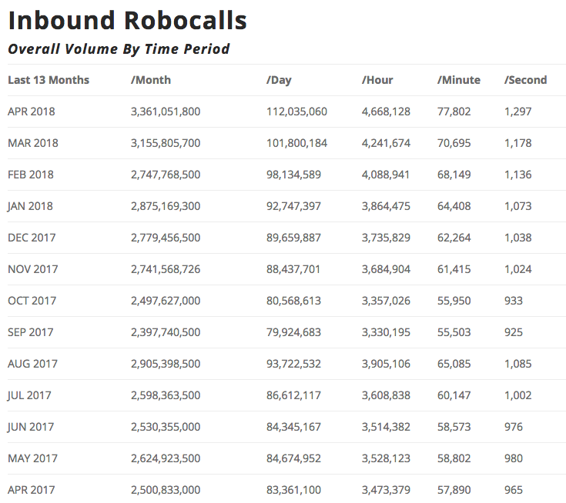
Notes:
YouMail - https://blog.youmail.com/2018/05/robocall-index-snapshot-april-2018/

Slide 55
What makes this difficult? (FCC, Feb. 2019)
Many illegal robocallers are operating in foreign countries. Although Congress recently gave the Commission express jurisdiction over foreign Caller ID spoofers, in practice the Commission may also need cooperation from foreign governments.
Vast majority of service providers that originate calls from illegal robocallers appear to be VoIP providers. Many of these providers do not keep updated contact information with the Commission or do not keep accurate records of all calls made across their networks.
The statute of limitations for TCPA violations is one year, which too often is not enough time to complete investigations involving complex robocalling cases.
In many instances, the TCPA requires notice via a citation before the Commission can launch forfeiture proceedings, allowing a cited offender the chance to incorporate under a new name to evade further detection and begin illegal activity anew.

Slide 56
How to be a robocaller
Apprentice with an existing robocaller
Use existing robocalls-as-a-service providers, preferably many different ones
Hire cheap labor in India or Philippines
Register company, if needed, in Florida or other discovery-unfriendly jurisdiction
  get mailbox or suite address
Do not keep any assets with the company
Transfer assets abroad or to relatives
Laugh when you get the forfeiture letter and claim poverty
When caught by state AG, try again in another state

Slide 57
FTC enforcement
“The FTC has brought 140 enforcement actions against companies and telemarketers for abandoned call, robocall and Do Not Call Registry violations. As of December 2018, 121 of these FTC enforcement actions have been resolved, and in those cases the agency has recovered over $50 million in civil penalties and $71 million in redress or disgorgement. In 2017, a federal court found satellite television provider Dish Network liable for millions of calls that violated the FTC’s Telemarketing Sales Rule—including Do Not Call, entity-specific, and abandoned-call violations—the TCPA, and state law.The $168 million judgment is the largest civil penalty ever obtained for a violation of the FTC Act.”

Slide 58
FCC enforcement
but do they pay?

Slide 59
Outlook
We’re at an inflection point – the robocall business is likely to change
Robocallers will likely use real numbers or compromised systems
Will likely try to spoof the CNAM information

