Slide 1
Robocalls – An illustrated guide to origin, mechanisms and prevention
Introduction to VoIP
Henning Schulzrinne
Columbia University

Slide 2
Legal background
PSTN – public switched telephone network
  traditional telephone regulation (PUC for local & intrastate, FCC for interstate & international)
  largely abandoned
Interconnected VoIP defined in 47 CFR 9.3:
  Interconnected VoIP service. An interconnected Voice over Internet protocol (VoIP) service is a service that:
  (1) Enables real-time, two-way voice communications;
  (2) Requires a broadband connection from the user's location;
  (3) Requires Internet protocol-compatible customer premises equipment (CPE); and
  (4) Permits users generally to receive calls that originate on the public switched telephone network and to terminate calls to the public switched telephone network.

Slide 3
Background: telecommunications (47 USC 153)
… “telecommunications” means the transmission, between or among points specified by the user, of information of the user’s choosing, without change in the form or content of the information as sent and received.
… “telecommunications carrier” means any provider of telecommunications services, except that such term does not include aggregators of telecommunications services (as defined in section 226 of this title). A telecommunications carrier shall be treated as a common carrier under this chapter only to the extent that it is engaged in providing telecommunications services, except that the Commission shall determine whether the provision of fixed and mobile satellite service shall be treated as common carriage.
… “telecommunications service” means the offering of telecommunications for a fee directly to the public, or to such classes of users as to be effectively available directly to the public, regardless of the facilities used.

Slide 4
More definitions
Information service = users of telecommunication services
  “capability for generating, acquiring, storing, transforming, processing, retrieving, utilizing, or making available information via telecommunications, and includes electronic publishing, but does not include any use of any such capability for the management, control, or operation of a telecommunications system or the management of a telecommunications service.”
cf. Basic vs. enhanced service (CI)
  Basic telecommunications: "the offering of a pure transmission capability over a communications path that is virtually transparent in terms of its interaction with customer supplied information.”
  Enhanced: everything else
Adjunct services: directory services

Slide 5
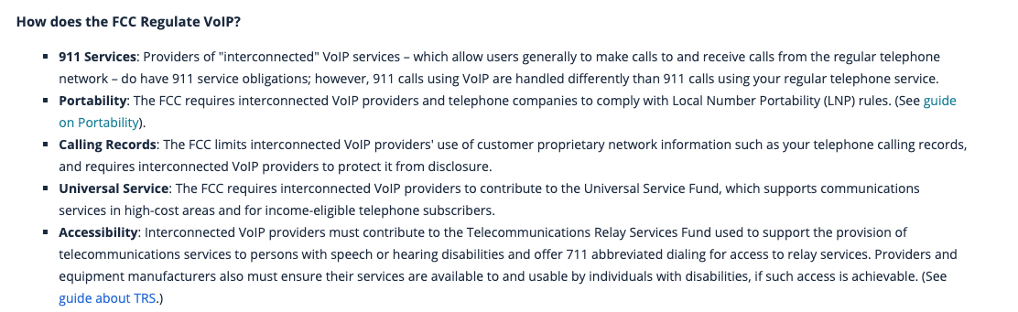
FCC rules for VoIP
https://www.fcc.gov/consumers/guides/voice-over-internet-protocol-voip

Slide 6
Name confusion
Commonly used interchangeably:
  Voice-over-IP (VoIP) – but includes video
  Internet telephony – but may not run over Internet
  IP telephony (IPtel)
Some reserve Internet telephony for transmission across the (public) Internet
  but much of it is not – reserved capacity, separate leased capacity
Transmission of telephone services over IP-based packet switched networks
Also includes video and other media, not just voice

Slide 7
A bit of history
1876 invention of telephone
1915 first transcontinental telephone (NY–SF)
1920’s first automatic switches
1956 TAT-1 transatlantic cable (35 lines)
1962 digital transmission (T1)
1965 1ESS analog switch
1974 Internet packet voice (2.4 kb/s LPC)
1977 4ESS digital switch
1980s Signaling System #7 (out-of-band)
1990s Advanced Intelligent Network (AIN)
1992 Mbone packet audio (RTP)
1996 early commercial VoIP implementations (Vocaltec); PC-to-PC calling

Slide 8
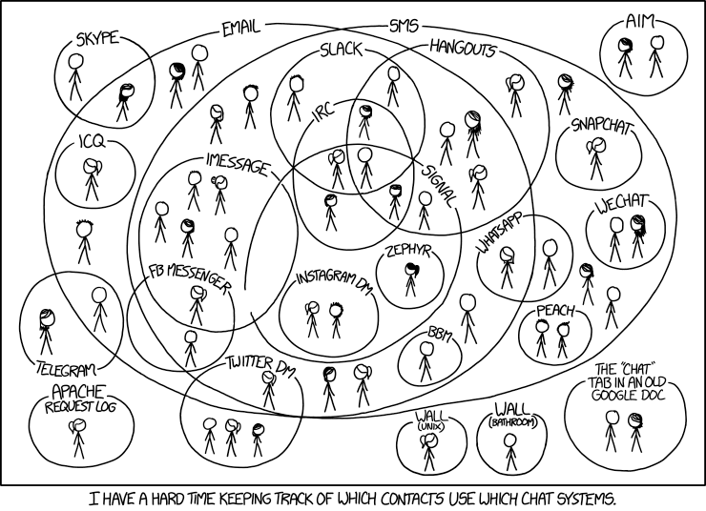

Slide 9
Classical phone system aka PSTN aka TDM
Public Switched Telephone Network (PSTN)
TDM = time-division multiplexing
Digital circuits are time-shared between multiple calls
Voice is sampled 8,000 times a second (125 µs)
Each call is 64 kb/s
Classical PBX: 24 voice circuits “T1”

Slide 10
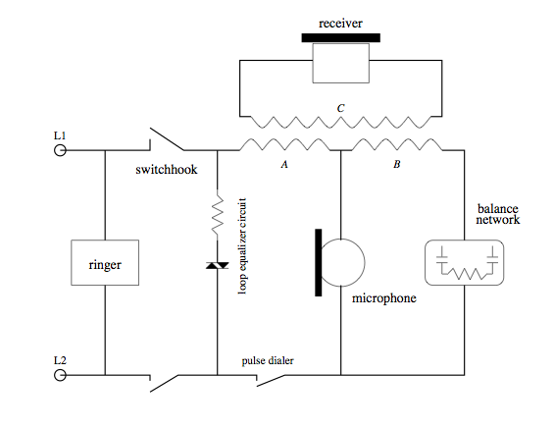
Circuit diagram
ringing: 25 Hz, 50 V AC

Slide 11
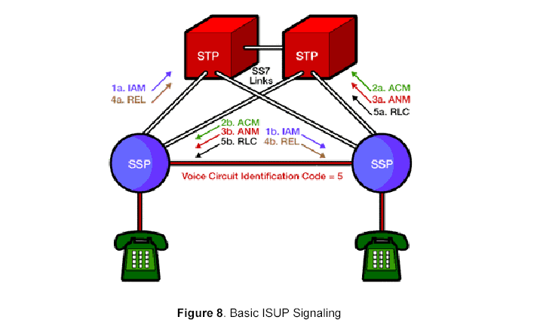
Signaling System #7

Slide 12
Example: BellSouth
32 Analog 1AESS COs (SSPs)
856 Lucent 5ESS COs
  355 5ESS “Hosts’ and 501 Remotes
581 Nortel DMS COs
  285 DMS “Hosts” and 283 Remotes and 10 DMS-10
138 Siemens COs (includes 85 Remotes)
1607 Total COs with approx. 20.3 million NALs
  hosts ~ 24,000 lines
  remotes ~ 3,500 lines
109 tandems
D. Finn (BellSouth 2006)

Slide 13
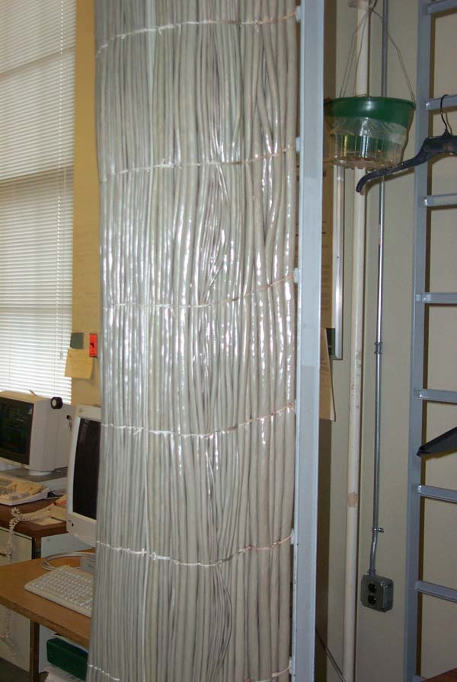
CO picture
copper wires: home → cable vault → distribution frame
D. Finn (BellSouth 2006)

Slide 14
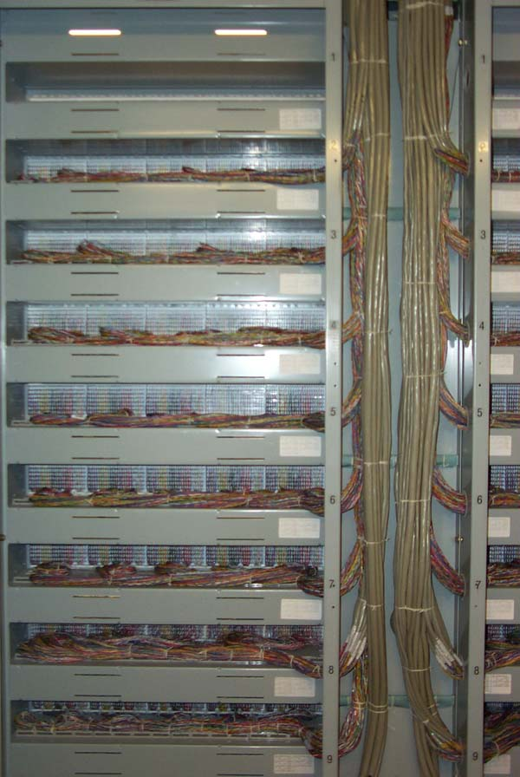
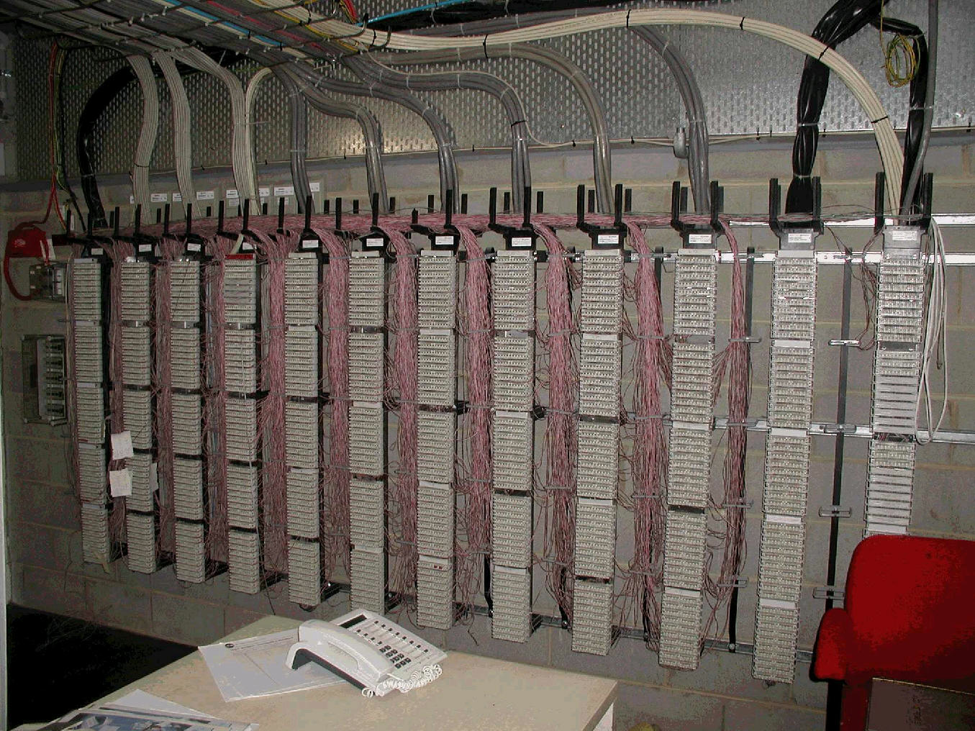
CO picture
distribution frame
Notes:
http://www.acma.gov.au/webwr/aca_home/registers/cabling_licences/networ1.jpg

Slide 15
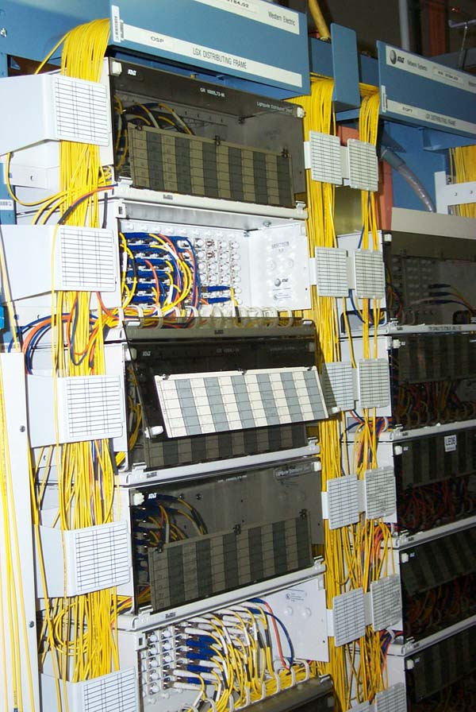
CO pictures
fiber cross connect point: fiber leaves CO
D. Finn (BellSouth 2006)

Slide 16


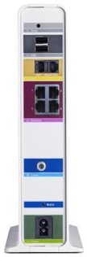
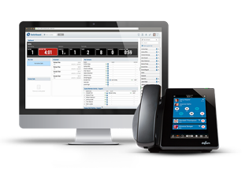


The flavors of VoIP
Local
ISP
The Phone Company
”over-the-top” (OTT)
Local
ISP
“triple play”
using DOCSIS
Enterprise VoIP
business
ISP
CMRS
(cell) using
IMS
SIP trunking

Slide 17
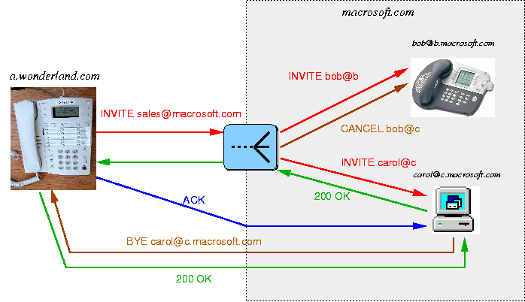
Basic SIP message flow

Slide 18
SIP message format
request
response
request line
INVITE sip:bob@there.com SIP/2.0
SIP/2.0 200 OK
Via: SIP/2.0/UDP here.com:5060
From: Alice <sip:alice@here.com>
To: Bob <sip:bob@there.com>
Call-ID: 1234@here.com
CSeq: 1 INVITE
Subject: just testing
Contact: sip:alice@pc.here.com
Content-Type: application/sdp
Content-Length: 147
Via: SIP/2.0/UDP here.com:5060
From: Alice <sip:alice@here.com>
To: Bob <sip:bob@there.com>
Call-ID: 1234@here.com
CSeq: 1 INVITE
Subject: just testing
Contact: sip:alice@pc.here.com
Content-Type: application/sdp
Content-Length: 134
header fields
v=0
o=alice 2890844526 2890844526 IN IP4 here.com
s=Session SDP
c=IN IP4 100.101.102.103
t=0 0
m=audio 49172 RTP/AVP 0
a=rtpmap:0 PCMU/8000
v=0
o=bob 2890844527 2890844527 IN IP4 there.com
s=Session SDP
c=IN IP4 110.111.112.113
t=0 0
m=audio 3456 RTP/AVP 0
a=rtpmap:0 PCMU/8000
message body
SDP

Slide 19
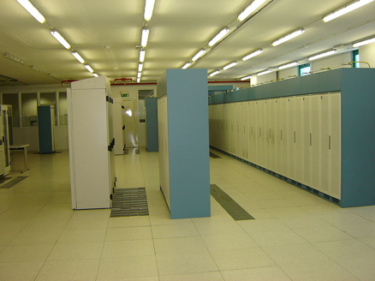
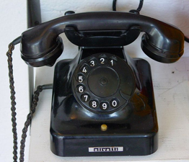
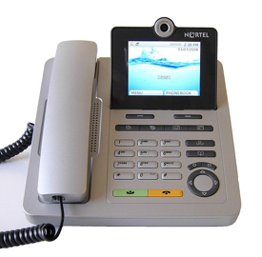

What has changed?
one assigned
number
customer
local exchange carrier
can’t tell end user from provider → can use any number

Slide 20
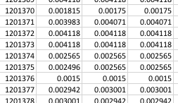
What makes VoIP different?
International ~ national calls
  Internet transport to domestic gateways
Low cost
  0.2 to 0.4 c/minute
Programmability
  E.g., Asterisk

Slide 22
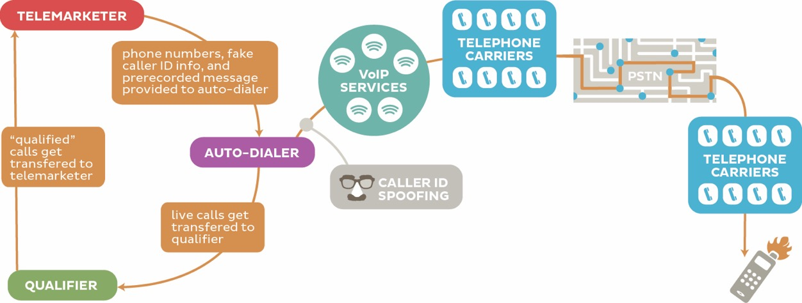

Slide 23
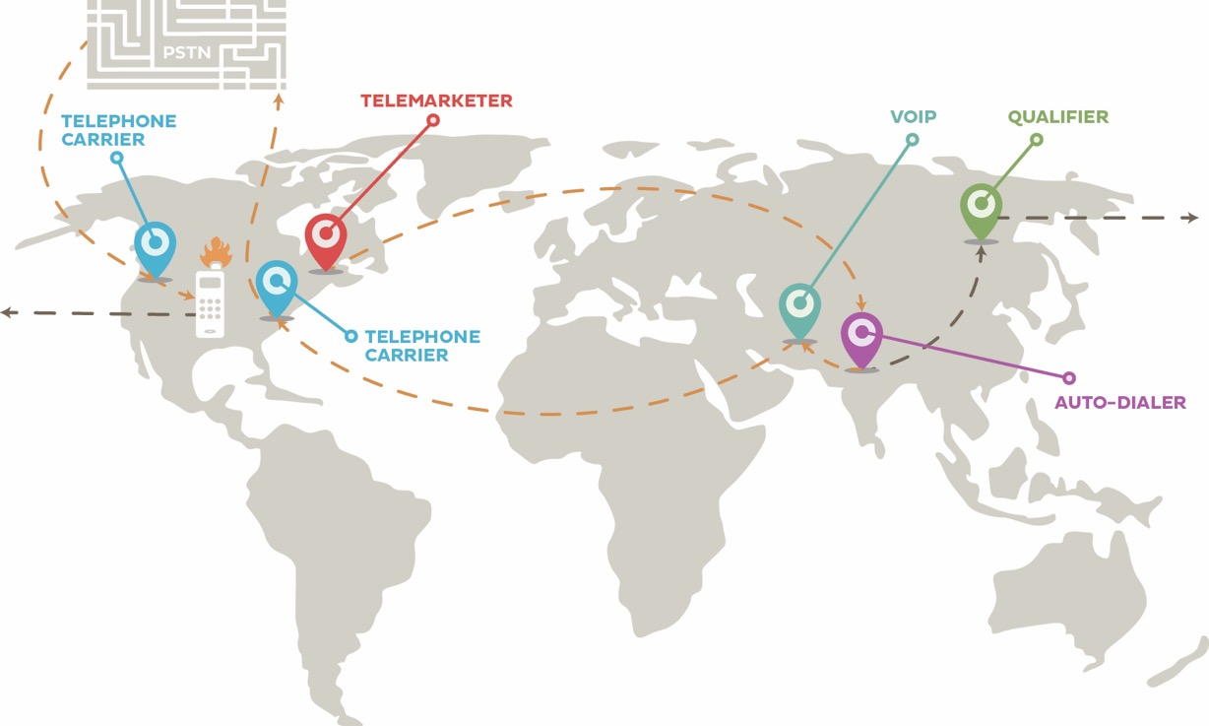

Slide 24
Why not use email spam filtering techniques?
 | Email | Phone calls
Name space | infinite | relatively small
Content inspection | common | not possible
Addresses | IP address – non-spoofable for TCP Email address – easily spoofable | Phone number -- spoofable
Delivery | filtered by provider: block lists (e.g., Spamhaus) SPF, DKIM | interconnection and delivery obligations
Delivery trace | Received-by headers | Via headers – only for end-to-end VoIP calls
Limited-use address | easy (e.g., web mail) | not feasible
Consent-based | CAPTCHA systems (not common) | likely too annoying
see also RFC 5039

