Slide 1
5G is the greatest technology ever
This material is based upon work supported by the National Science Foundation under Grant No. 1702967. Any opinions, findings, and conclusions or recommendations expressed in this material are those of the author(s) and do not necessarily reflect the views of the National Science Foundation.
Henning Schulzrinne
Columbia University
typical keynote
closer to this one
Notes:
https://www.hindustantimes.com/football/fifa-world-cup-2018-germany-football-team-apologises-for-poor-showing-thank-fans/story-cugMnf6P56DPrCvgxpBEkN.html

Slide 2
I know how you feel…
H2020
NSF
AI
blockchain
networking

Slide 3
4G vs. 5G
aka early mid-life crisis car
(millennials – born 1983)
reliable people hauler
capacity not latency (~acceleration)

Slide 4
5G – the next moonshot
“5G could be one of the great moonshots of this generation” (FCC Chairman Pai, July 2019)
“And because many of the game-changing applications of 5G have not yet been invented or even imagined, we will certainly run into skeptics who think this will be useful for nothing more than faster downloads of movies or cat videos to our phones.” (same)
”Secure 5G networks will absolutely be a vital link to America’s prosperity and national security in the 21st century. 5G will be as much as 100 times faster than the current 4G cellular networks. It will transform the way our citizens work, learn, communicate, and travel. It will make American farms more productive, American manufacturing more competitive, and American healthcare better and more accessible. Basically, it covers almost everything, when you get right down to it. Pretty amazing.” (your guess)
Notes:
https://www.whitehouse.gov/briefings-statements/remarks-president-trump-united-states-5g-deployment/

Slide 5
5G Germany
”Für die Industrie und andere Wirtschaftsbereiche ist 5G enorm wichtig, da aus ihrer Sicht die ultraschnelle Datenübertragung für den Standort Deutschland im globalen Wettbewerb eine entscheidende Rolle spielt. Bisher ist Deutschland in Sachen schnelles Internet hinten dran, mit dem neuen Standard soll das anders werden – die Bundesrepublik solle zum „Leitmarkt“ für 5G werden, heißt es im Koalitionsvertrag der Bundesregierung.”
short: “plays a decisive role in global competition for German as [industrial] location”; “Germany as leading market for 5G [applications]”

Slide 6
Former FCC chairman: “Time to move beyond 5G hype”
5G is “wireless cable”
5G is the transformational technology … autonomous vehicles and remote surgery.
To Sprint and T-Mobile, the cost of building out 5G is the justification for a merger, reducing consumer choice from four national wireless carriers to three.
To AT&T, a faster 4G network has been rebranded “5G-E” although it is not “real 5G.”
To satellite companies currently licensed to use potential 5G spectrum, it is the opportunity to sell something for which they paid nothing at a windfall profit.
To Donald Trump, 5G is a political talking point to gin up nationalistic furor over a “race” with China.
To the Trump Federal Communications Commission (FCC), 5G is an excuse to preempt the antenna siting decisions of local governments.
To the wireless industry, 5G is the chance to promote something new that may open up needed new revenue streams.

Slide 7
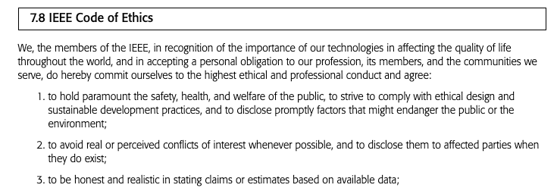
We are not driven by the marketer’s code of ethics
Engineering
Marketing
The Ninth Circuit “exaggerated advertising, blustering and boasting upon which no reasonable buyer would rely.” … “a general claim of superiority over comparable products that is so vague that it can be understood as nothing more than a mere expression of opinion.”
Notes:
https://www.venable.com/insights/publications/2017/08/the-best-article-on-puffery-ever-the-ftcs-fight-ag

Slide 8
5G: all the credit, none of the blame
Typical argument:
  we have a problem ∈ {competitiveness, aging society, traffic accidents, climate change}
  IT can play some role in ameliorating the problem
  IT needs networks
  5G is a new network technology
  thus, 5G fixes problem!
But
  is 5G critical for the particular application?
  or is it just connectivity – Wi-Fi, fiber, LoRa, satellite?
  how large is the impact – broadband impact studies often inconclusive
5G as innocent technology: somehow doesn’t facilitate all the connectivity-related problems
  privacy, online crime, IoT attacks, election manipulation, …
  all the credit, none of the blame

Slide 9
Caveat 1: Economics

Slide 10
The 5G economics are shaky
Jefferies, May 2019
Based on our analysis, we believe that the conditions for an acceptable Return on Investment (ROI) on 5G infrastructure are poor. Moreover, the 5G investment ROI looks drastically lower than the ROI associated with prior wireless investment cycles – specifically 3G and 4G. The major difference is that the Wireless Service market is now a mature business.
Notes:
Jefferies, May 2019

Slide 11
Industry dynamics – 5G is not 3G or 4G
Jefferies, May 2019
 | 3G (2001) | 4G (2009) | 5G (2019)
Wireless industry | rapid growth | growth | mature
Subscribers | +111 M sub adds (US) | +50 M sub adds | flat?
Smartphones | 0% | ~15% | ~93%
Handset technology | 35 SMS/m U.S. (2000) camera (2002) touch screen (2002) Blackberry (2003) Motorola Razor (2004) | Apple iPhone (June 2007) Apple iPad (April 2010) | foldable phones?
ARPU 5 years | +$5 / sub | +$5/sub | down?
Net leverage | 2.1x (YE’02) | 1.8x (YE’09) | 2.6x (YE’18)
Likely ROI | Very high | high | very low

Slide 12
Mature industry

Slide 13
5G and FTTH: The Value of Convergence Raf Meersman, CEO Comsof
Notes:
5G and FTTH: The Value of Convergence Raf Meersman, CEO Comsof

Slide 14
FTTH operators have the advantage
“5G and FTTH: The Value of Convergence,” Raf Meersman, CEO Comsof
Notes:
5G and FTTH: The Value of Convergence Raf Meersman, CEO Comsof

Slide 15
5G = FTTL (fiber to the lamppost)
4G competition model: rent towers → similar density for all carriers
  small carriers might add roaming for rural areas
  many towers still with non-fiber backhaul, e.g., P2P microwave
5G competitive advantage: fiber in urban areas
  about 20% of 5-year TCO (Felten, Diffraction Analysis)
  incumbent carriers (e.g., old European PTT)
  US: no national FTTH carriers: local cable + AT&T + Verizon + enterprise (Cogent, Zayo)
Likely options
  fewer competitors (4 → 3 → 2) → only carriers with fiber assets left
  force open FTTH or FTTC networks
  city-owned neutral fiber (or at least ducts) or national neutral 5G anyhaul (Colombia)
  commodity (enterprise, retail) Internet service rather than specialty dark fiber
Notes:
https://www.ftthcouncil.eu/documents/COM-190313-FibreFor5G-ConvergenceStudy-Presentation-RafMeersman%20-%20v4%20-%20publish.pdf

Slide 16

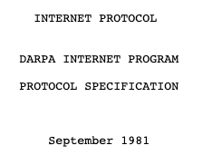
Equipment vendors & operators
commodity
(rarely loved, only hated less)
Boeing 737
designed 1967
770-800
livery
advertising
pricing
800 GSM operators

Slide 17


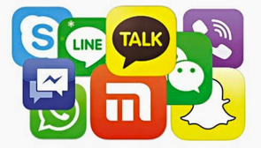

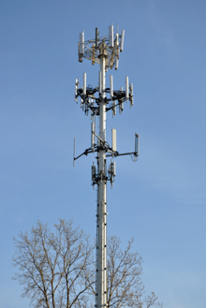
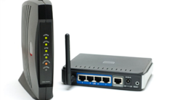
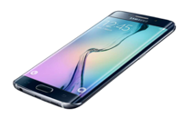

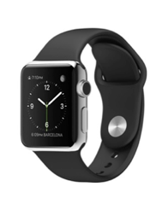
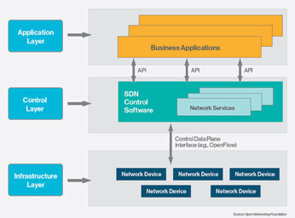


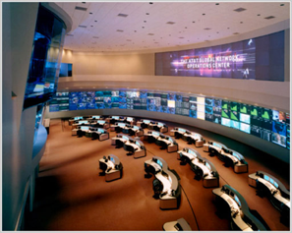


Carriers as system aggregators
Spectrum DB
Spectrum DB
40k towers each (US)
Level3
Cogent
LTE-U
802.11n
LTE

Slide 18
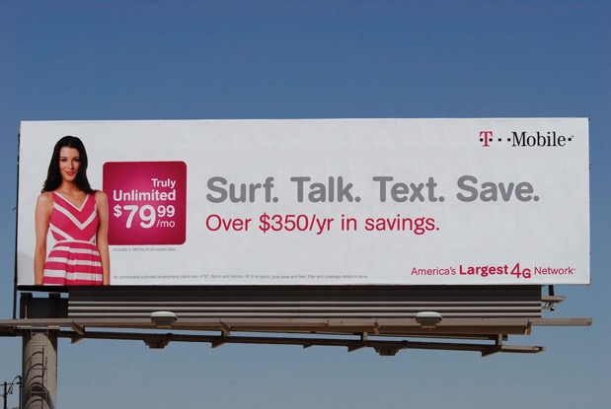
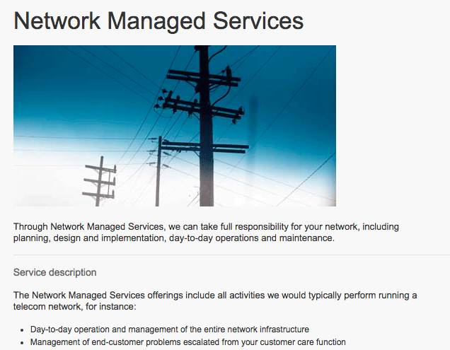
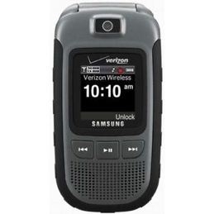
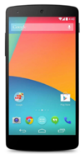
5G: Carriers as consumer brand
Outside
Inside

Slide 19
Caveat 2: Applications

Slide 20
Remote surgery via 5G?
Mash

Slide 21
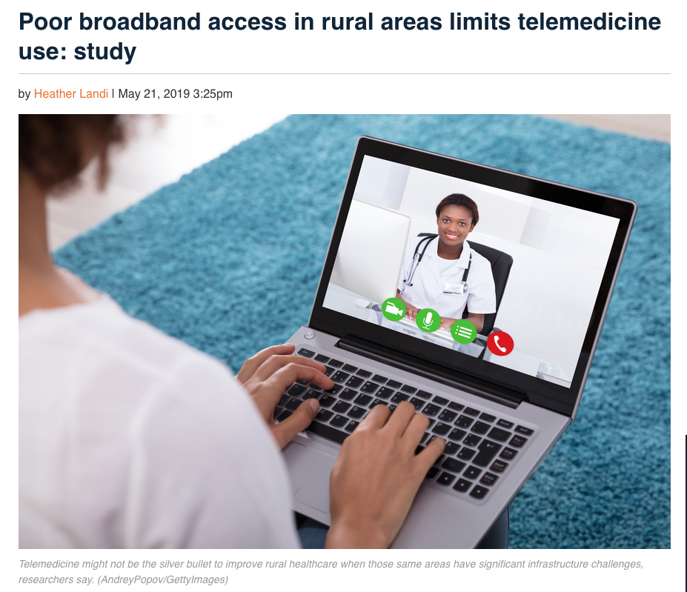

Slide 22
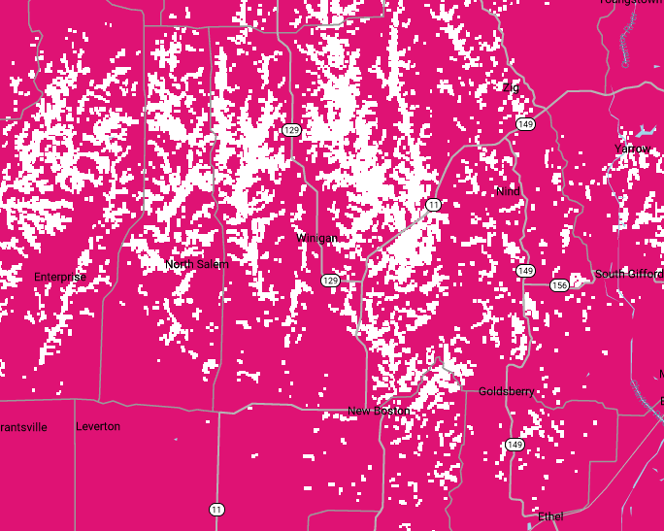
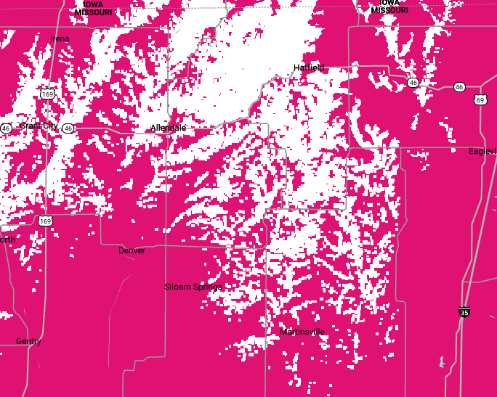
You better hold on to that steering wheel

Slide 23
Mobile users need RR, not VR or AR
“In London, … some lamp posts have been padded in order to protect the large numbers of people using their mobile devices while walking.” (safety.com, 2019)
Since 2009, pedestrian fatalities have risen 46%, with nearly 6,000 people struck and killed in 2016.
both smartphones and marijuana can impair the attention and judgment
Notes:
https://www.safety.com/distracted-walking-a-major-pedestrian-safety-concern/
https://www.ghsa.org/resources/news-releases/pedestrians18
https://www.paynterlaw.com/blog/distraction-major-cause-pedestrian-accidents

Slide 24
Fully new (scale) applications are extremely rare
Application | First demonstrated (on Internet)
Video | 1992: mbone (multicast audio & video)
Augmented reality | 1968: Ivan Sutherland invents the head-mounted display and positions it as a window into a virtual world
Virtual reality | 1979: Eric Howlett developed the Large Expanse, Extra Perspective (LEEP) optical system
IoT | 1985: term ”Internet of Things” used
Connected cars | 2001: OnStar remote diagnostics
Games | 1984: “Islands of Kismai” (first commercial online game)
mobile
fewer wires (last hop)
better
faster
cheaper

Slide 25
US Senator correctly predicts Internet future
US Senator
Ted Stevens (2006)
Notes:
https://en.wikipedia.org/wiki/Series_of_tubes

Slide 26
Caveat 3: Edge/fog computing

Slide 27
(Dubious) economics of fog computing
hyperscale
cloud providers
free
known to OEM
”free”
privacy assurances
save access BW
low latency
save backhaul
low cost (scale, mux.)
well-known interfaces
Paas, SaaS, serverless, bare metal
limited
capacity
limited
capacity
limited capacity
business model?
heterogeneity
programming model?
> 20 ms latency
privacy concerns

Slide 28
Edge computing is an edge case
P. Mendes (2019)

Slide 29
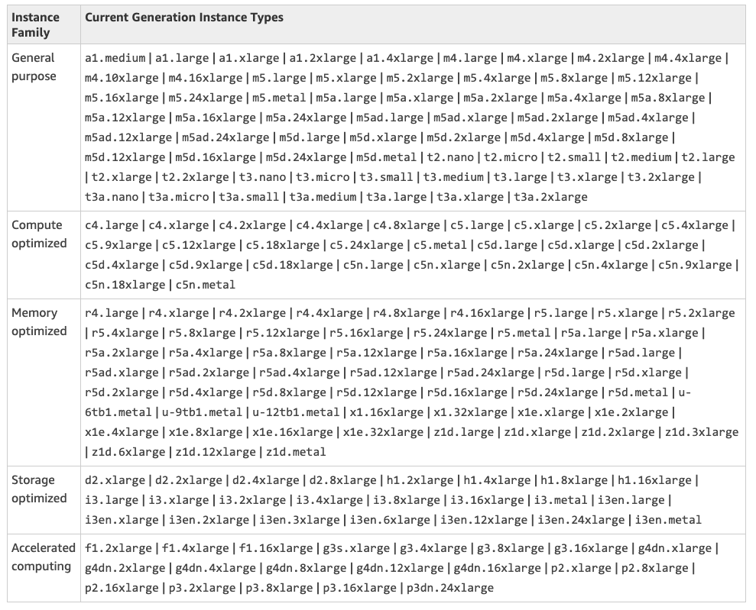
Hyper-scale cloud providers offer more (integrated) choices

Slide 30
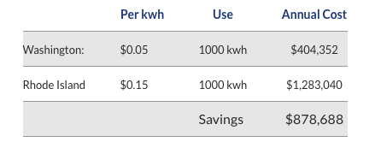
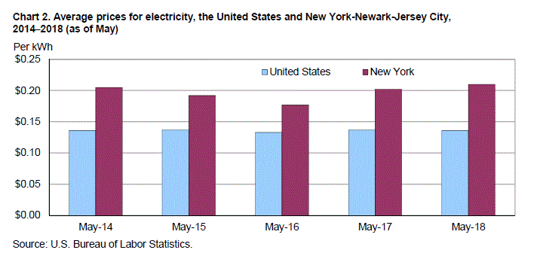
Hyper-scale cloud providers pay less for energy
Notes:
https://info.siteselectiongroup.com/blog/power-in-the-data-center-and-its-costs-across-the-united-states

Slide 31
Even in the US, data centers are not that far
0.4 ms RTT
1.4 ms RTT

Slide 32
If not edge computing & URLCC, what then?

Slide 33
What does matter to users?
€/GB & $/GB | $10/GB mobile vs. $0.25/GB fixed; 20 GB/month caps | Effective mobile GB pricing needs to decrease by 50%/year
coverage – international | restricted + expensive roaming country-specific bands | like Wi-Fi, needs to work the same everywhere
security – applications | unencrypted voice & text | end—to-end encryption, with clear indications
security – account & CPNI | SIM swaps fraudulent port-outs SS7 attacks | mandatory MFA for accounts decommission SS7

Slide 34
What does matter to developers?
API - available | proprietary, hard to use | services (voice, text), subscriber management, billing
API – ease of use | complex, little support, tepid commitment | see: cloud, Twilio, Stripe APIs
Global scope | need to custom-develop applications for each country | compare: AWS, Google, Azure
Reliability | “T-Mobile customers across the country couldn’t make calls or send text messages for about four hours yesterday, confirms the carrier. ” | reliability, transparent post-mortems

Slide 35
Cellular data costs at least 10x Wi-Fi

Slide 36
Comcast median household usage

Slide 37
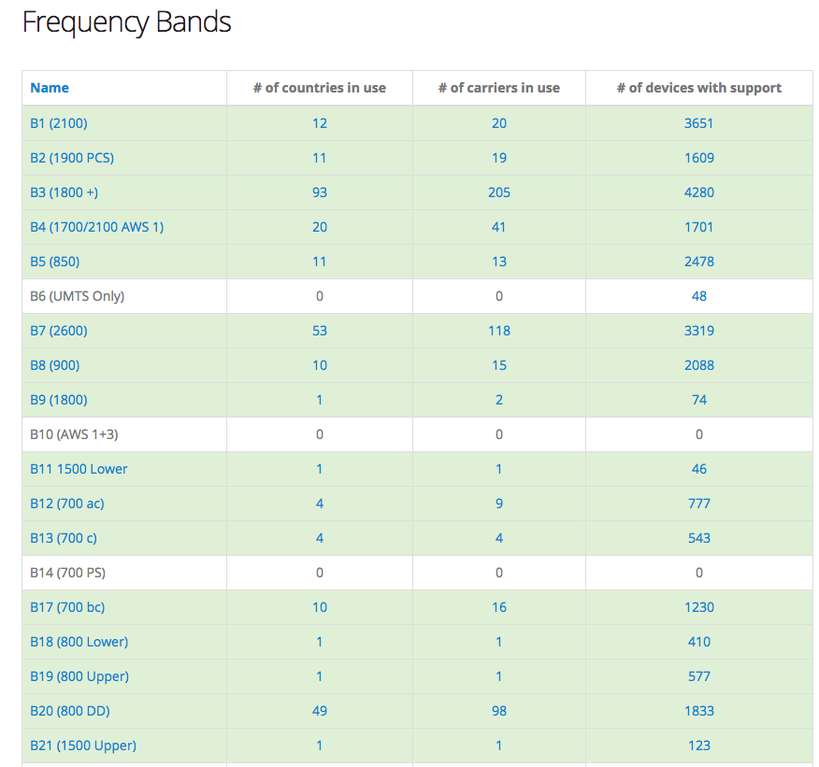
International roaming will get even more difficult
https://www.frequencycheck.com/interfaces/lte

Slide 38
Summary
5G – as usual, nG will deliver what (n-1)G promised
5G is needed primarily for additional capacity to keep up with data usage
  5G new applications are needed for political and regulatory reasons
  NB-IoT (not 5G) useful for sparse IoT applications
The 5G economics don’t look good (for carriers & equipment vendors)
  but if RAN gets cheap enough, might make good enterprise network
  carriers not attractive suppliers of vertical expertise
No indication that 5G will drive new applications, except by cheaper bandwidth
IoT will be dominated by Wi-Fi, some low-rent cellular, maybe satellite

Slide 39
Backup

Slide 40
Generational surprises
Generation | Expectation | Surprise | Cost per GB
0G (landline) | voice | fax & modem
1G | corporate limousine | eavesdropping
2G | better voice quality (“digital!”) | SMS | $1000
3G | WAP | web | $100
4G | IMS | YouTube, WhatsApp, notifications | $10
5G | IoT (low latency) | ? | $1?
underestimated cost and fixed-equivalence as drivers
are the even generations the successful ones?

Slide 41
IoT is not exactly new (1978)

Slide 42
The IoT killer app
http://www.traptec.eu/

Slide 43

20 billion devices ≠ 20 billion device 5G connections
hybrid connectivity: cheap +
ubiquitous
cheap connectivity
managed connectivity

Slide 44
IoT requirements
Wide-area Wireless Communication Challenges for the Internet of Things
Harpreet S. Dhillon, Howard Huang, Harish Viswanathan

Slide 45
IoT is not a helpful term
The only common thread is what doesn’t matter: absence of a human
Otherwise, spans every dimension of networking
mobility
high-speed train
aeronautical
fixed infrastructure
message/week
bandwidth
4K video
minutes
or hours
latency
10 ms protective
relay
easy
hard
indoors or urban
geography
remote pipeline
cost constraints
$1/year
$5/device
1% of $1B bridge

Slide 46
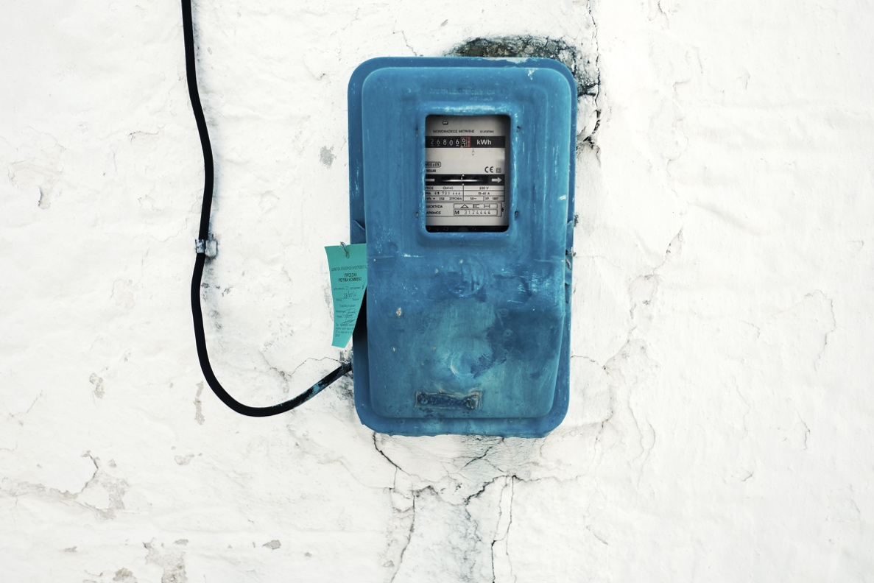
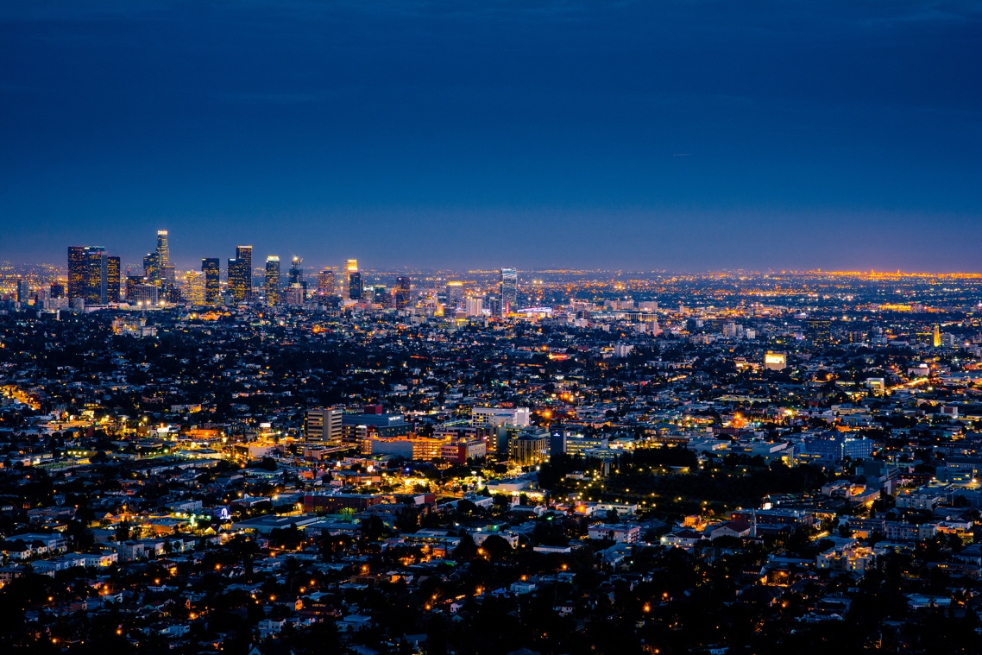
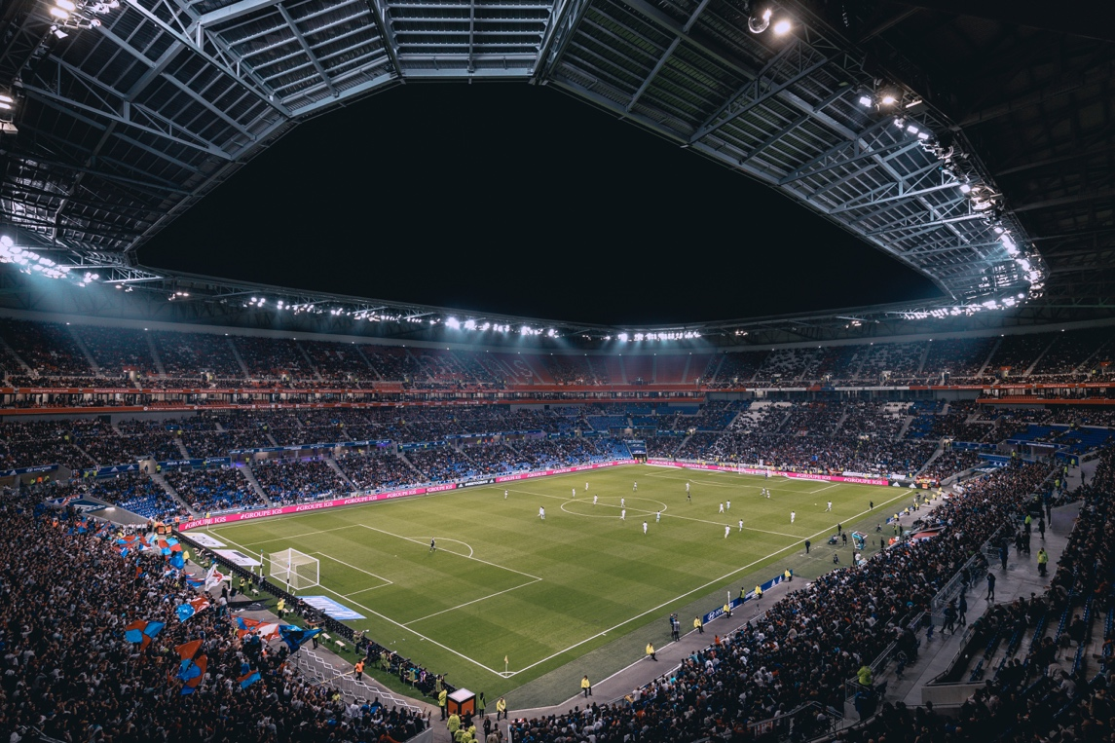
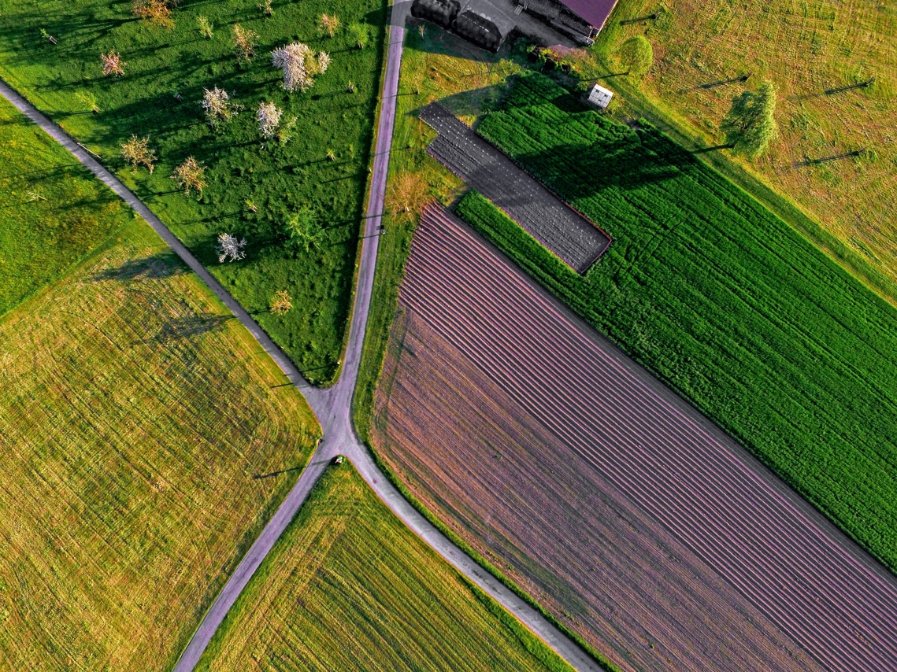
What are likely cellular IoT applications?
single provider
no reliance on local Wi-Fi
but: license-free and regional only
nodes / km²
security cameras
(high BW density)
100% coverage

Slide 47
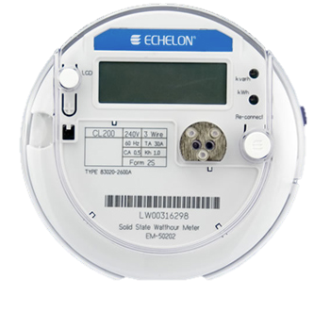
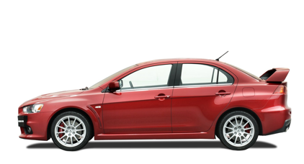

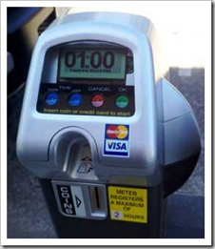
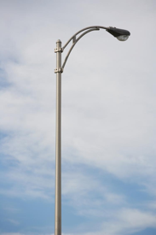
What is the scale of outdoor and distributed applications?
one per household or business (e.g., 136M housing units in US)
31,100 in US
but often connected to city fiber network
268.8M (US) cars, trucks, …
26.5M (44M) in US
$2B energy cost / year
Boston: 64k street lights
but: often connected to fiber (5G!)
5 million (US)
62,000 in NYC
Notes:
http://64.27.51.222/media/overview-of-the-us-parking-industry.aspx parking meters
https://www1.eere.energy.gov/buildings/publications/pdfs/ssl/nlc-streetlight2013_smalley.pdf

Slide 48
What kind of communication networks?
Dominant challenge | Example | solution
Low monthly cost | Residential | Wi-Fi
High bandwidth outdoors | Stadium (spectators, cameras) | 5G mmWave
High bandwidth indoors | University lecture hall | Wi-Fi
Outdoor, but regional | Public transit, metering, traffic signage | NB-IoT, LoRAWAN
Outdoor, on major roads | Connected vehicles | DSRC + LTE?
Outdoor (including marine), 100% coverage, small antenna | Agriculture sensors | Iridium NEXT?
Outdoor (including marine), 100% coverage, antenna size not limited | Agriculture machinery, construction, pipelines, shipping, logistics | LEO satellites?

Slide 50
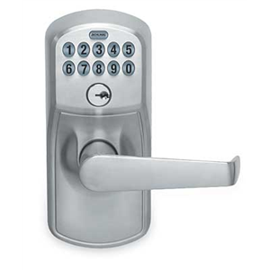
5G low latency
X
X
X
one-to-many!
X
V2I2V
LAN
EEW
(< 5 s)
protective
relay
tight control loop → near-100% availability in time & space

Slide 51
Challenge for non-carrier IoT networks
Need international and near-universal (road) coverage
  LoRaWAN as competitor to NB-IoT
  compete with cellular aggregators
  need to be everywhere before customers interested anywhere
Challenging pricing model
  per month?
  per message (e.g., for lost items & problem reporting)?
Notes:
http://www.lightreading.com/iot/iot-strategies/sigfox-said-to-face-customer-backlash/d/d-id/724292?page_number=3

Slide 52
Example: gas meter using LoRAWAN
→ works well for IoT applications that are inherently regional
(utilities, public transit signage)

Slide 53
Short & long-range IoT networks
Notes:
Bernstein, Sept. 2017
Asian Semis & Semicap & APAC Telecom
The Long View: The Dawn of the IoT Era (Part 2): NB-IoT & Other Wide-area Technologies

Slide 54
Verizon telematics + IoT revenue
VZ: $31.8B revenue (Q118)

Slide 55
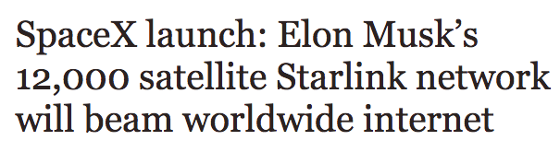
Alternative: satellite communication
NEXT
Iridium
two-way
GlobalStar
GPS fix every 10 minutes
LEO
Notes:
http://www.oneweb.world
https://www.iridiumnext.com/2016/09/22/new-platform-new-possibilities/

Slide 56
“We don’t want to be bit pipes”
France Telecom
Minitel era (~2000)
→ Avoid commoditization (competition on price only)
Two mechanisms: provide better services vs. withhold services (”APIs”) or price-differentiate
2008
WAP
IMS
Linear
video
Cloud
Content
Which prevents them from being good bit pipes
→ unusual, but inherent, conflict of interest between provider and customer
Notes:
https://mondaynote.com/verizon-no-we-cant-become-dumb-pipes-ddab2b41a2d8

Slide 57
What are carriers good at?
Research?
Software development?
  Who is going to develop those 5G SDN applications?
OTT applications?
API-based services?
  Why did Twilio and Tropo offer voice service APIs and not the ILECs?

Slide 58
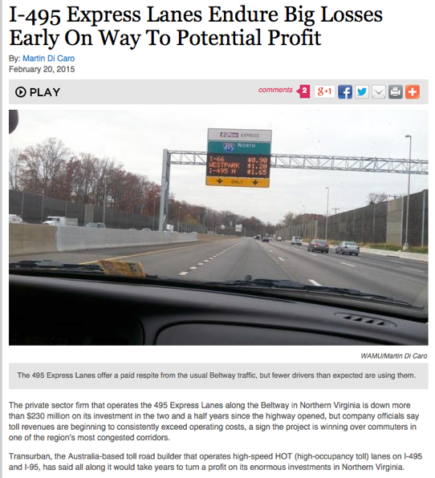
The law of new networks
“Any new network technology will be justified on (finally) providing QoS”
To succeed, they have to provide good-enough QoS for best effort
  at least with competition
The business model for QoS is difficult
  see bypass toll roads
QoS is usually not accessible to applications
  or not end-to-end
  even with slicing (since few applications are mobile-only)

