Slide 1
WiFiUS: Collaborative project
Massive-IoT: Massive and Automated Heterogeneous IoT networks
http://www.oulu.fi/cwc/massiveiot
Belongs to WiFiUS program（ NSF award # 1702967 ）: “Wireless Innovation between Finland and U.S. (WiFiUS) provides a platform for building long-term research and education collaboration between the two world leaders in the field of wireless networking.”
http://www.wifius.org/
MEETING AT NYU WIRELESS 24th April 2018

Slide 2
WiFiUS Massive-IoT Project consortium:
Finland
University of Oulu, CWC http://www.oulu.fi/cwc/
PI prof. Mika Ylianttila, Dr. Erkki Harjula
VTT Technical Research Centre of Finland http://www.vttresearch.com/
PI Dr. Jukka Mäkelä, Pekka Karhula, Olli Mämmelä
USA
Columbia University, http://www.cs.columbia.edu/irt/
PI prof. Henning Schulzrinne, Jan Janak
New York University (NYU), http://wireless.engineering.nyu.edu/
PI prof. Ted Rappaport, Yunchou Xing, Ojas Kanhere, Shihao Ju
MEETING AT NYU WIRELESS 24th April 2018

Slide 3
Massive-IoT Research topics
Edge computing using distributed IoT processing and storage to make IoT networks substantially more efficient and robust
Secure exchange of user IoT data when using edge computing
Simulation-to-deployment enabling automated deployment of large scale IoT networks (up to millions of nodes)
Indoor positioning based on collective intelligence of IoT nodes
System Architecture Design
Simulation and tesbeds
Auto-deployment and analysis
Management and orchestration
MEETING AT NYU WIRELESS 24th April 2018

Slide 4
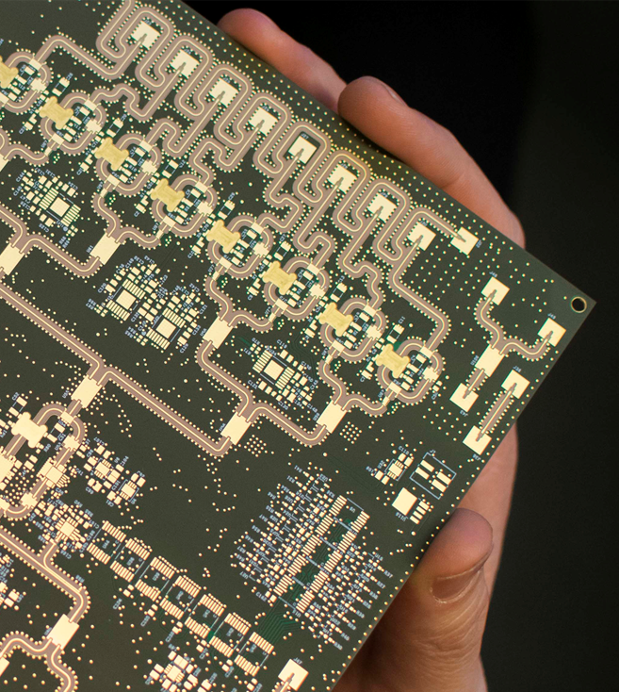
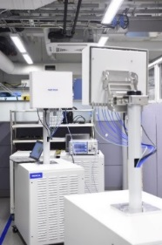
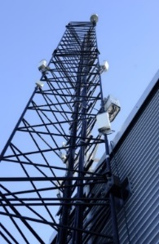
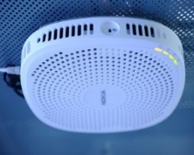
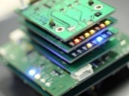
5G Test Network Finland
Open test network for co-creation (https://5gtn.fi/co-creation/).
Main parts located in Oulu & Helsinki regions.
Was used in EU-Korea demos at 2018 Winter Olympic Games.
Operator grade live network with plugged in 5G prototype radios.
Near future targets: become the first operational local micro-operator during 2019 at University of Oulu campus once 100MHz bandwidth becomes available at 3.5GHz band later this year.
800 MHz @26/28 GHz
10 Gbps
Hybrid beamformer
LTE small cell
IoT sensors
5G PoC
LTE Macros with NB IoT
MEETING AT NYU WIRELESS 24th April 2018

Slide 5
National Flagship on Wireless Communications
www.6genesis.org
Wireless Connectivity
Ultra-reliable low-latency communications
National Flagship proposal for 2018-2026
programme initiated by Government and funded by Academy of Finland; 3 initiatives approved.
6G Enabled Wireless Smart Society & Ecosystem (6Genesis); volume 251M€.
Operated by Uoulu, PI Prof. Latva-aho
in collaboration with: Nokia, VTT, Aalto University, City Of Oulu, Oulu Univesity of Applied Sciences.
Unmanned
processes
Devices & Circuit Technology
THz communications materials & circuits
Unlimited
connectivity
Distiributed Computing
Mobile edge intelligence
Time critical
& trusted
applications
Services and Applications
Multidisciplinary research accross verticals
Disruptive
value networks
MEETING AT NYU WIRELESS 24th April 2018

Slide 6
WifiUS - WiFi Usable Security
Scalability Challenges
Current “one app per manufacturer” model does not scale
Transition of device ownership not well supported
Advanced installation scenarios not supported
Approach
Securely manage credentials for an entire network of IoT devices
Network (Wi-FI passwords) & Application (cloud authorization) level
Advanced scenarios: rental, shared, managed IoT devices, large-scale heterogeneous IoT networks, physically inaccessible infrastructure
Complete IoT device lifecycle management (ownership transfer)
Zero-touch device authentication (QR, visible light, manufacturer CA)

Slide 7
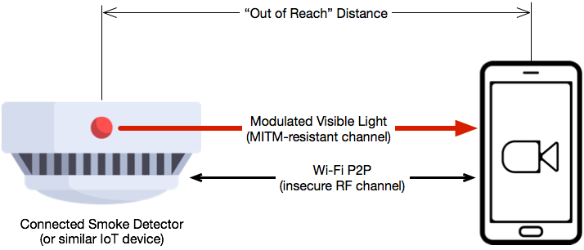
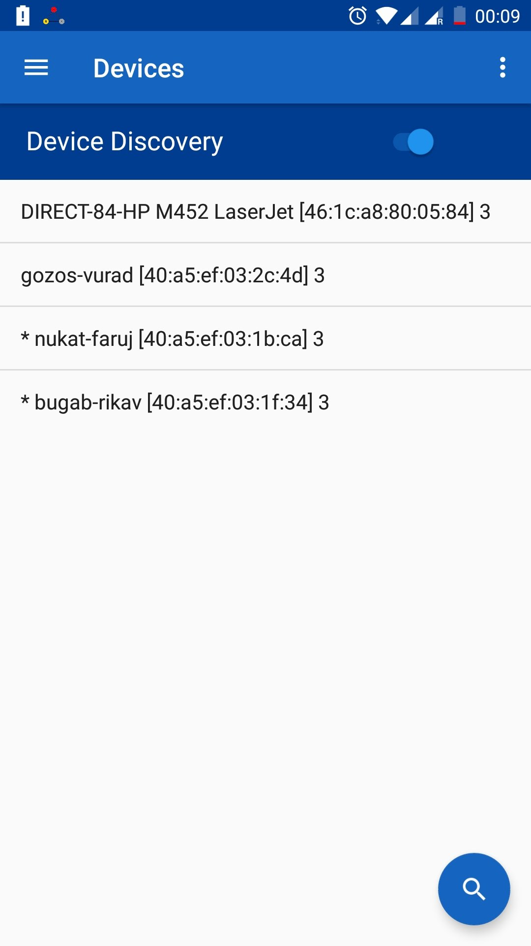
WifiUS - WiFi Usable Security
Open Android Commissioning App
Prototype IoT Device with
Visible Light Authentication

Slide 8
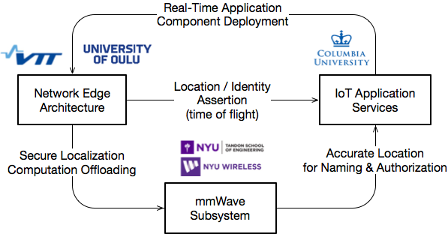
Integrated WifiUS Architecture
An ongoing effort to integrate the work of all WifiUS project partners into a coherent unified system architecture
Focus on cross-layer interaction & subsystem integration
Inter-domain applicability (vehicular systems, 5G networks, large-scale industrial IoT)

