Slide 1







WiFiUS: Collaborative project
Massive-IoT: Massive and Automated Heterogeneous IoT networks
http://www.oulu.fi/cwc/massiveiot
Belongs to WiFiUS program（ NSF award # 1702967 ）: “Wireless Innovation between Finland and U.S. (WiFiUS) provides a platform for building long-term research and education collaboration between the two world leaders in the field of wireless networking.”
http://www.wifius.org/

Slide 2
WiFiUS Massive-IoT Project consortium:
Finland
  University of Oulu, CWC http://www.oulu.fi/cwc/
    PI prof. Mika Ylianttila, Dr. Erkki Harjula, Pawani Porambage, Tenager Mekonnen
  VTT Technical Research Centre of Finland http://www.vttresearch.com/
    PI prof. Heikki Ailisto, Dr. Jukka Mäkelä, Pekka Karhula, Olli Mämmelä
USA
  Columbia University, http://www.cs.columbia.edu/irt/
    PI prof. Henning Schulzrinne, Jan Janak
  New York University (NYU), http://wireless.engineering.nyu.edu/
    PI prof. Ted Rappaport, Yunchou Xing, Ojas Kanhere, Shihao Ju

Slide 3
Massive-IoT Research topics
Edge computing using distributed IoT processing and storage to make IoT networks substantially more efficient and robust
Secure exchange of user IoT data when using edge computing
Simulation-to-deployment enabling automated deployment of large scale IoT networks (up to millions of nodes)
Indoor positioning based on collective intelligence of IoT nodes
System Architecture Design
Simulation and tesbeds
Auto-deployment and analysis
Management and orchestration

Slide 4

Intelligent Next Generation Edge IoT Systems
Studies for the integration of IoT and edge computing to achieve high resource-efficiency while maintaining sufficient level of security and privacy
  A three-level architecture for Edge-IoT communication and security has been defined

Slide 5



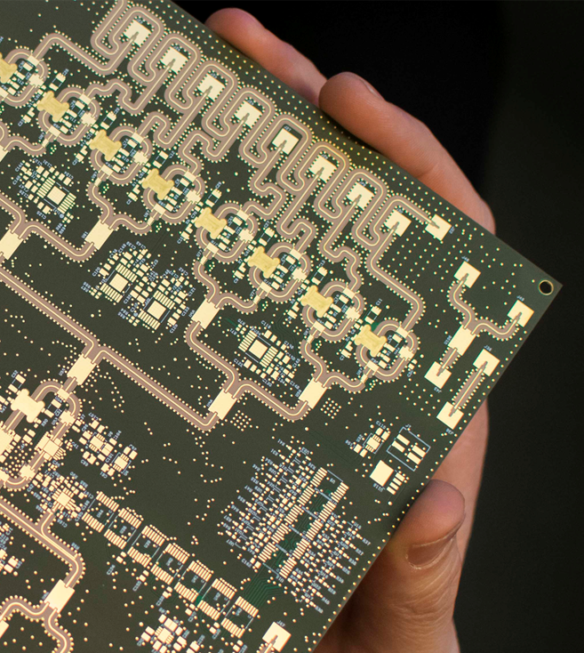
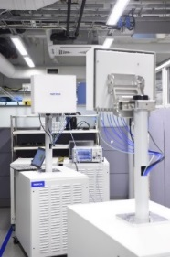
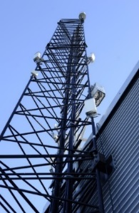
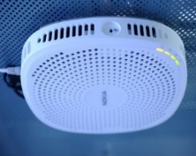
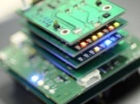
5G Test Network Finland
Open test network for co-creation (https://5gtn.fi/co-creation/).
Main parts located in Oulu & Helsinki regions.
Was used in EU-Korea demos at 2018 Winter Olympic Games.
Operator grade live network with plugged in 5G prototype radios.
Near future targets: become the first operational local micro-operator during 2019 at University of Oulu campus once 100MHz bandwidth becomes available at 3.5GHz band later this year.
vMEC (virtualized Multi-Access Edge Computing)
800 MHz @26/28 GHz
10 Gbps
Hybrid beamformer
LTE small cell
IoT sensors
5G PoC
LTE Macros with NB IoT

Slide 6
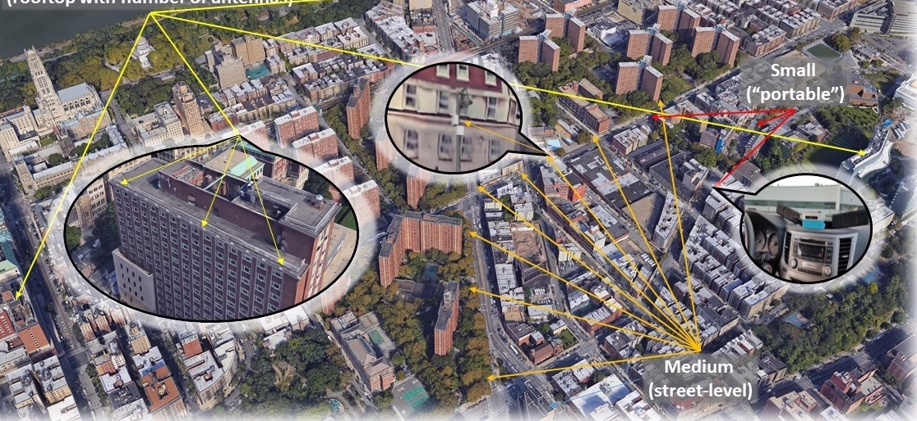
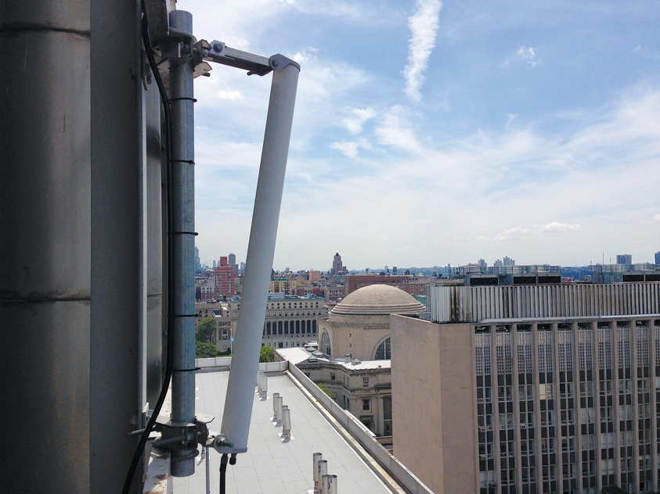

Planned Deployment
West Harlem
Area: ~1 sq. mile
~9 Large Sites ~40 Medium sites
Fiber optic connection from most sites
~200 Small nodes
  Including vehicular and hand-held
Fiber connection to NYU Data Center, Rutgers, GENI/I2
Interaction with smart community & innovation initiatives (Gigabit center, etc.)

Slide 7
COSMOS Planned Deployment
West Harlem
Area: ~1 sq. mile
~9 Large Sites ~40 Medium sites
Fiber optic connection from most sites
~200 Small nodes
  Including vehicular and hand-held
Fiber connection to NYU Data Center, Rutgers, GENI/I2
Interaction with smart community & innovation initiatives (Gigabit center, etc.)

Slide 8
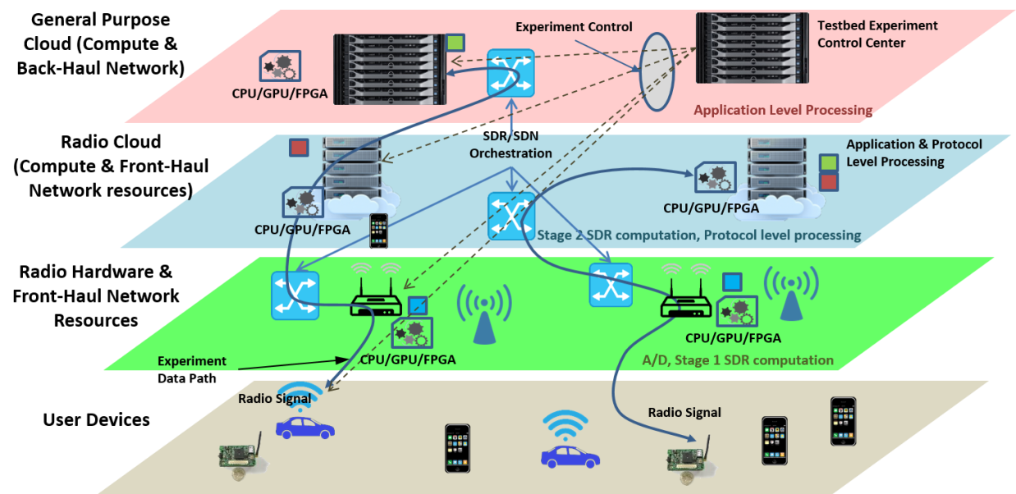
System Architecture
COSMOS architecture has been developed to realize ultra-high BW, low latency and tightly coupled edge computing
Key design challenge: Gbps performance + full programmability at the radio level
Developed a fully programmable multi-layered (i.e. radio, network and cloud) system architecture for flexible experimentation

Slide 9
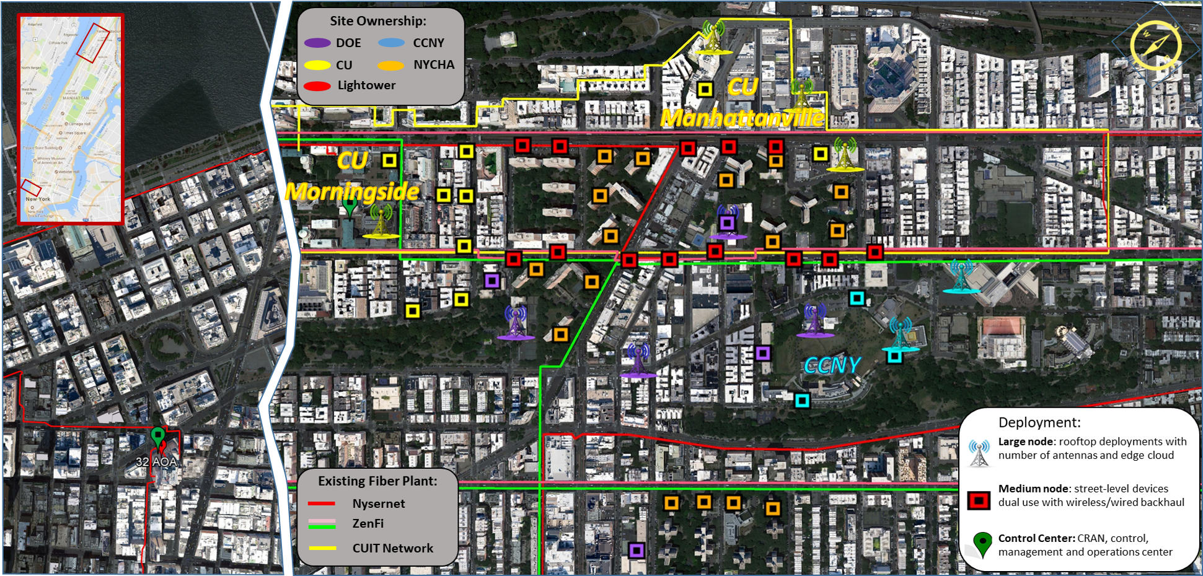
Tentative Deployment Plan

Slide 13
WifiUS - WiFi Usable Security
Scalability Challenges
Current “one app per manufacturer” model does not scale
Transition of device ownership not well supported
Advanced installation scenarios not supported
Approach
Securely manage credentials for an entire network of IoT devices
Network (Wi-FI passwords) & Application (cloud authorization) level
Advanced scenarios: rental, shared, managed IoT devices, large-scale heterogeneous IoT networks, physically inaccessible infrastructure
Complete IoT device lifecycle management (ownership transfer)
Zero-touch device authentication (QR, visible light, manufacturer CA)

Slide 14
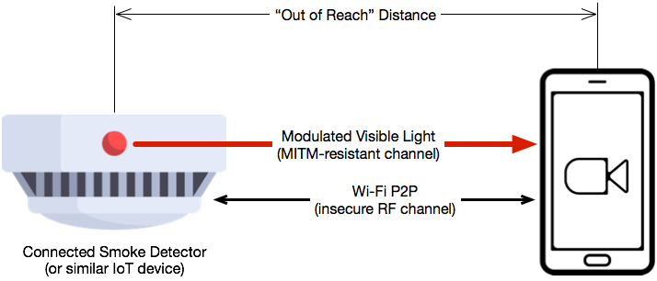
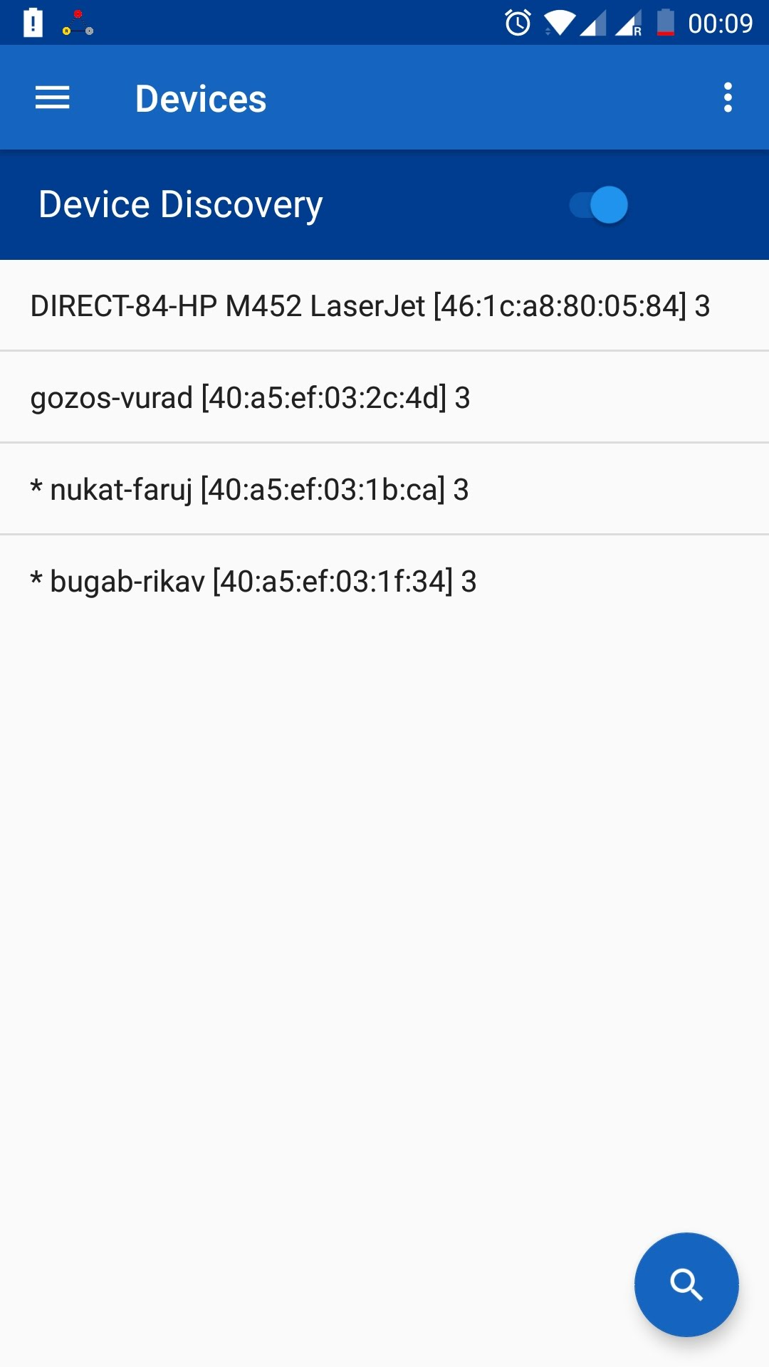
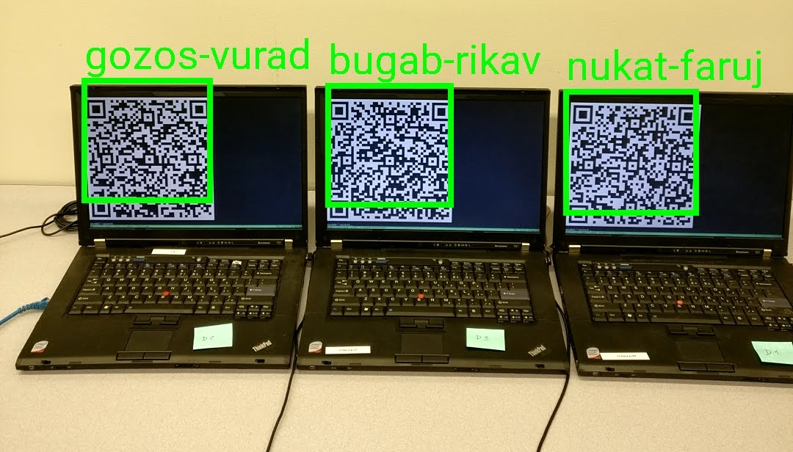
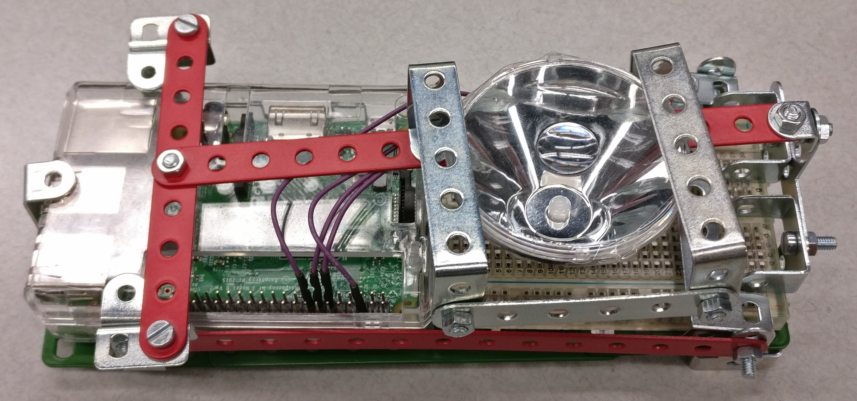
WifiUS - WiFi Usable Security
Open Android Commissioning App
Prototype IoT Device with
Visible Light Authentication

Slide 15
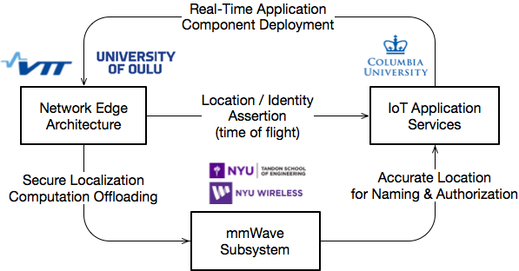
Integrated WifiUS Architecture
An ongoing effort to integrate the work of all WifiUS project partners into a coherent unified system architecture
Focus on cross-layer interaction & subsystem integration
Inter-domain applicability (vehicular systems, 5G networks, large-scale industrial IoT)

Slide 16
Publications and related work
Edited Books (1)
  M. Liyanage, I. Ahmad, A. Abro, A. Gurtov, M. Ylianttila,(eds). ”A comprehensive Guide to 5G Security”, Wiley and Sons, 2018.
Book chapters (1)
  E. Harjula, T. Mekonnen, M. Komu, P. Porambage, T. Kauppinen, J. Kjällman, M. Ylianttila. ”Energy Efficiency in Wireless Multimedia Sensor Networking: Architecture, Management and Security”. In, A Popescu (eds) Greening Video Distribution Networks: Energy-Efficient Internet Video Delivery, Springer, Heidelberg, 2018.
Journal Articles (4)
  P. Porambage, J. Okwuibe, M. Liyanage, M. Ylianttila, T. Taleb. ”Survey on Multi-Access Edge Computing for Internet of Things Realization”. to appear in IEEE Communications Surveys & Tutorials, 2018.
  T. Kumar, P. Porambage, I. Ahmad, M. Liyanage, E. Harjula, M. Ylianttila. "Securing the Gadget-Free Digital Services", to appear IEEE Computer, 2018.
  I. Ahmad, T. Kumar, M. Liyanage, J. Okwuibe, M. Ylianttila and A. Gurtov, "Overview of 5G Security Challenges and Solutions," in IEEE Communications Standards Magazine, vol. 2, no. 1, pp. 36-43, 2018.
  T. Mekonnen, M. Komu, R. Morabito, R., T. Kauppinen, E. Harjula, T. Koskela and M. Ylianttila. "Energy Consumption Analysis of Edge Orchestrated Virtualized Wireless Multimedia Sensor Networks". IEEE Access, Vol.6, pp. 5090 – 5100, 2017.
Conference Papers (3)
  T. Mekonnen, E. Harjula, A. Heikkinen, T. Koskela and M. Ylianttila, "Energy Efficient Event Driven Video Streaming Surveillance Using SleepyCAM," 2017 IEEE International Conference on Computer and Information Technology (CIT), pp. 107-113. Helsinki, August 2017.
  I. Ahmad, T. Kumar, M. Liyanage, J. Okwuibe, M. Ylianttila, A. Gurtov, "5G Security: Analysis of Threats and Solutions", the 2017 IEEE Conference on Standards for Communications and Networking (CSCN), Helsinki, Finland, September 2017 (Best paper award).
  M. Liyanage, M. Dananjaya, J. Okwuibe, M. Ylianttila, "SDN based Operator Assisted Offloading Platform for Multi-Controller 5G Networks" , in 23th IEEE International Symposium on Local and Metropolitan Area Networks (LANMAN), Osaka, Japan, 2017.

