Slide 1
COSMOS Project Overview
May 2018
D. Raychaudhuri¹ (PI), Ivan Seskar¹ (PD), Gil Zussman² (co-PI), Sundeep Rangan³ (co-PI)
¹Rutgers University
²Columbia University
³NYU
Partners: New York City, Silicon Harlem, City College of New York, University of Arizona
COSMOS is part of the NSF PAWR program, and is funded in part by NSF award CNS-1827923, and by the PAWR Industry Consortium

Slide 2
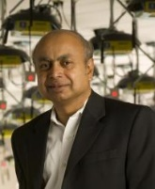
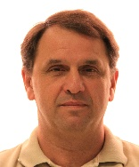
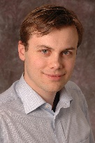
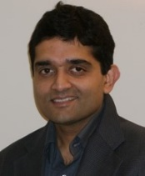
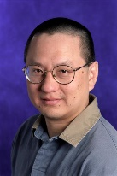
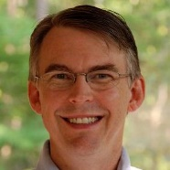
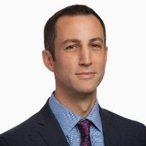
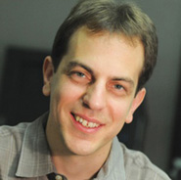
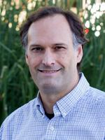
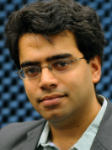
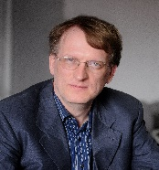
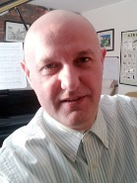
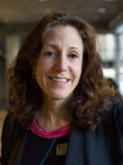

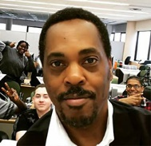
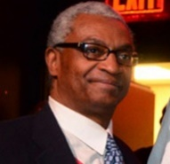
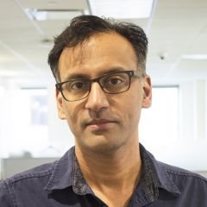
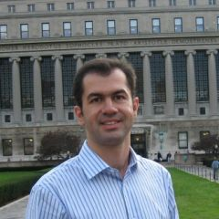
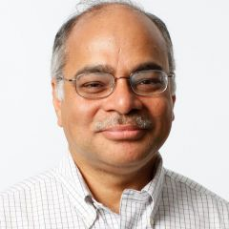
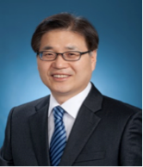

Project Team
Core Team: Rutgers, Columbia, NYU
Partners: New York City, Silicon Harlem, CCNY, U Arizona
Dipankar Raychaudhuri Director, WINLAB Professor, ECE, Rutgers U. | Ivan Seskar Associate Director, WINLAB Rutgers U. | Marco Gruteser Professor, ECE & CS, Rutgers U. ACM Sigmobile Chair | Narayan Mandayam Associate Director, WINLAB Professor & Chair, ECE, Rutgers U. | Thu D. Nguyen Professor and Chair, CS, Rutgers U. | James Von Oehsen Associate VP, OARC, Rutgers U. | Joshua Breitbart Deputy CTO, NYC
Gil Zussman Associate Professor, EE and CS, Columbia U. | Daniel Kilper Administrative Director, CIAN Adjunct Professor, Columbia U. Research Professor, UA | Harish Krishnaswamy Associate Professor, EE, Columbia U. | Henning Schulzrinne Professor, CS, Columbia U. | Zoran Kostic Associate Professor, EE, Columbia U | Sharon Sputz Director, Strategic Programs, Data Science Institute, Columbia U. | Alan Crosswell Associate VP and Chief Technologist, Columbia U. IT
Clayton Banks Co-Founder and CEO, Silicon Harlem | Bruce Lincoln Co-Founder, Silicon Harlem | Sundeep Rangan Associate Professor, ECE, NYU Director, NYU Wireless | Thanasis Korakis Research Assistant Professor, ECE, NYU | Shivendra Panwar Director, CATT Professor & Chair, ECE, NYU | Myung Lee Professor ECE, CCNY | Rosemarie Wesson Professor and Associate Dean, CCNY

Slide 3
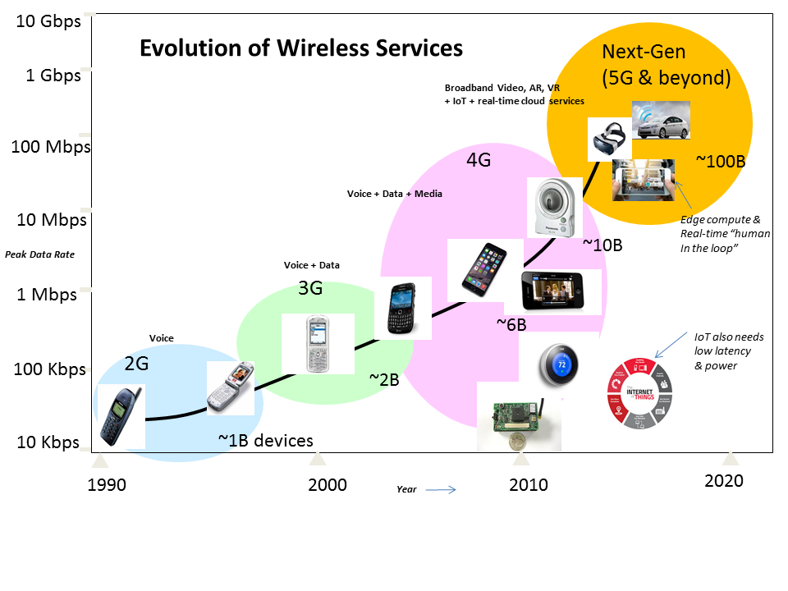
Motivation
Wireless - unparalleled growth in data rates, devices, and traffic
Services evolving from
high-speed data and video towards AR, VR and IoT with real-time “human-in-the-loop”
Fast changes in technology and services motivate city-scale next-gen wireless testbed for use by both academic and industry researchers → PAWR

Slide 4
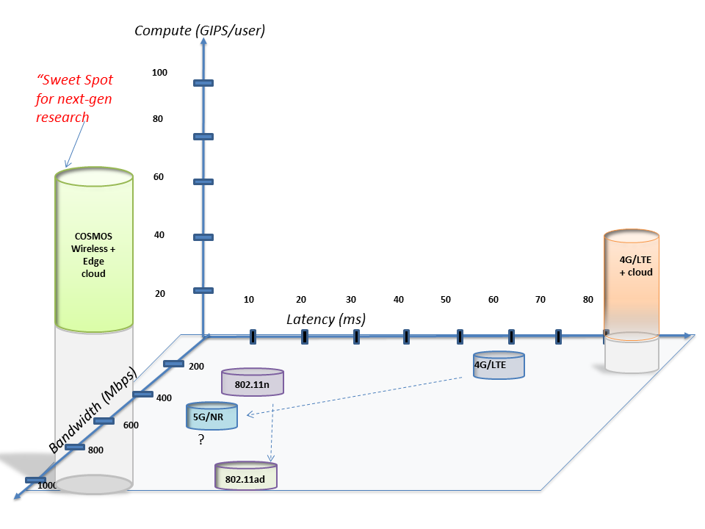
Project Vision
Latency and compute power are the two new dimensions for characterizing wireless access
Latency for 4G cellular > 50 ms, while targets for 5G are <10 ms
Edge computing is an enabler for real-time services
COSMOS will enable researchers to investigate ultra-high speed (~Gbps), low latency (<5ms), and edge computing (~10-100 GIPS)
COSMOS = Cloud Enhanced Open Software Defined Mobile Wireless Testbed for City-Scale Deployment

Slide 5
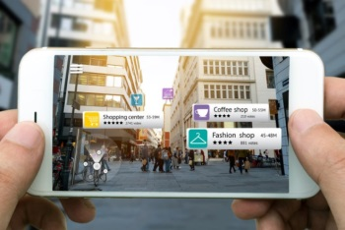
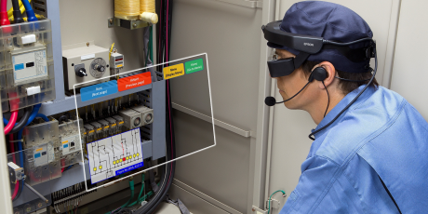




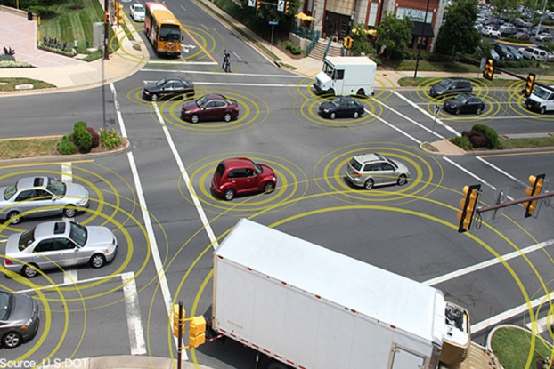

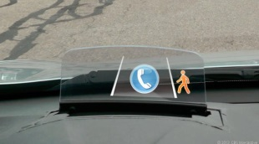
Project Vision
Ultra-high bandwidth, low latency, and powerful edge computing will enable important new classes of real time applications
Application domains include AR, VR, connected car, smart city (with high-bandwidth sensing), industrial control, …
Augmented Reality
Smart City + Connected Car
Image/
Video
Cloud
Infrastructure
Roadside
AP
Roadway sensors & lighting
In-car guidance display
Industrial Control

Slide 6
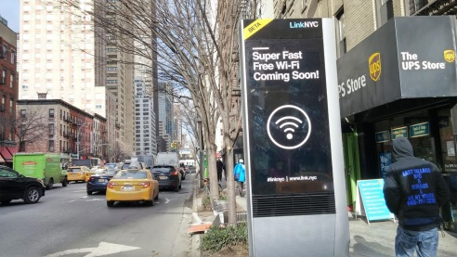
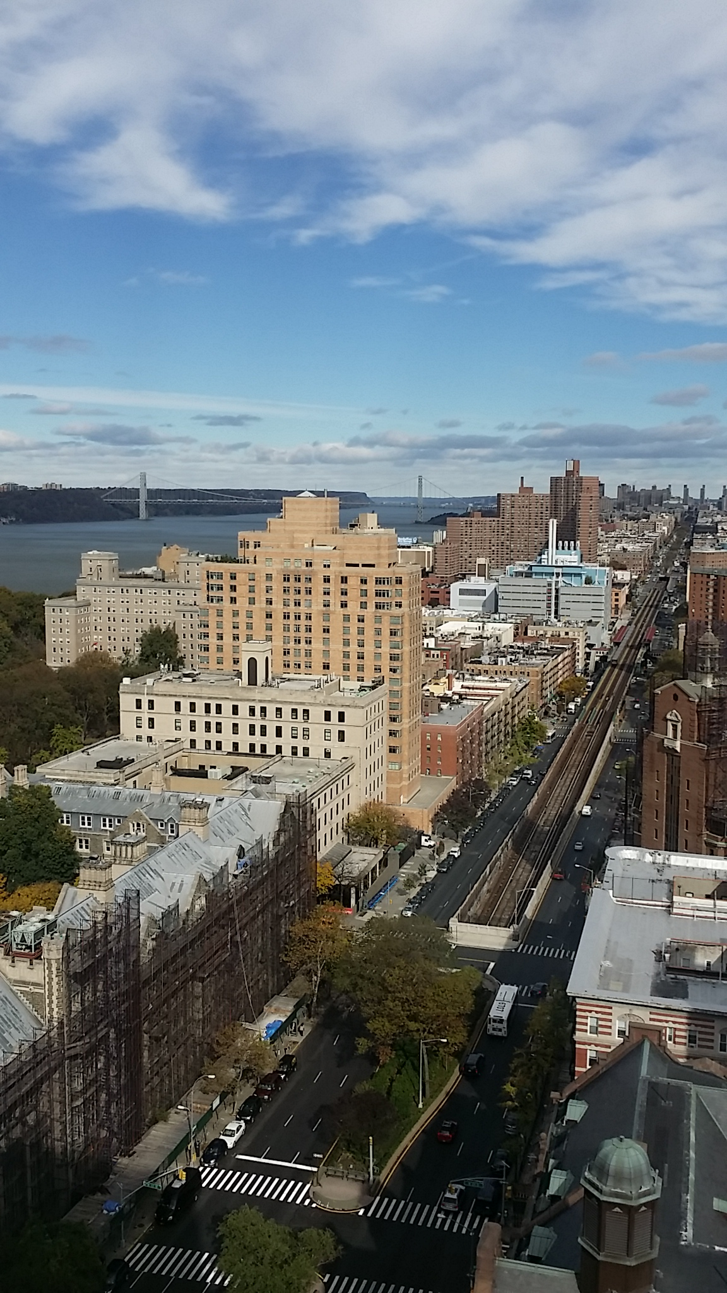
Project Vision
Living lab research platform
  Bring together research addressing critical technological, social, and civic challenges facing the world’s mega-cities
Research & innovation engine of NYC ecosystem
  Smart city projects
  Broadband community initiatives
  Applications-focused startups
NYC location enables experiments and stress testing at scales and conditions that are unavailable elsewhere

Slide 7
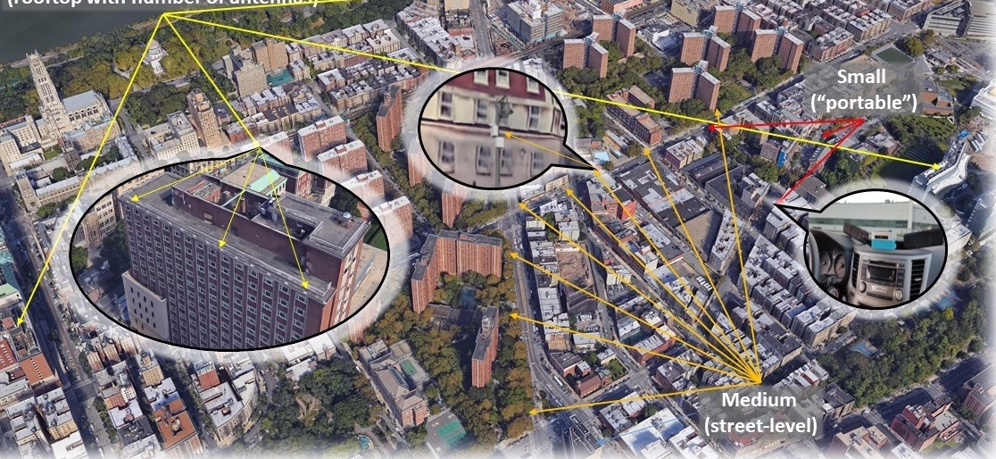
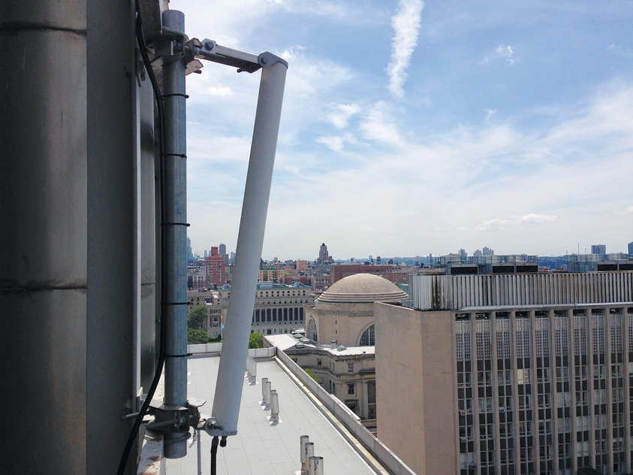
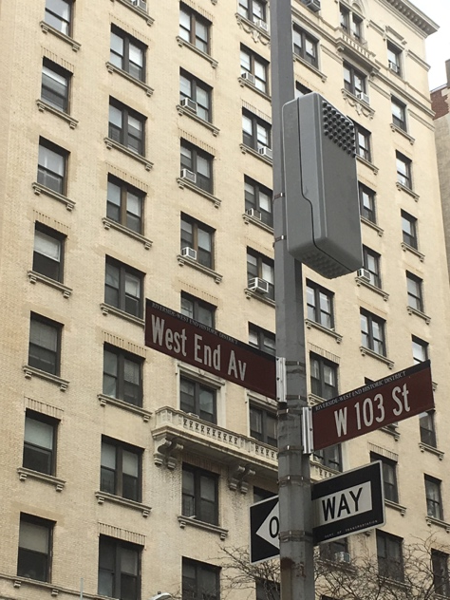
Planned Deployment
West Harlem
Area: ~1 sq. mile
~9 Large Sites ~40 Medium sites
Fiber optic connection from most sites
~200 Small nodes
  Including vehicular and hand-held
Fiber connection to NYU Data Center, Rutgers, GENI/I2
Interaction with smart community & innovation initiatives (Gigabit center, etc.)

Slide 8
COSMOS - Architecture and Technology

Slide 9
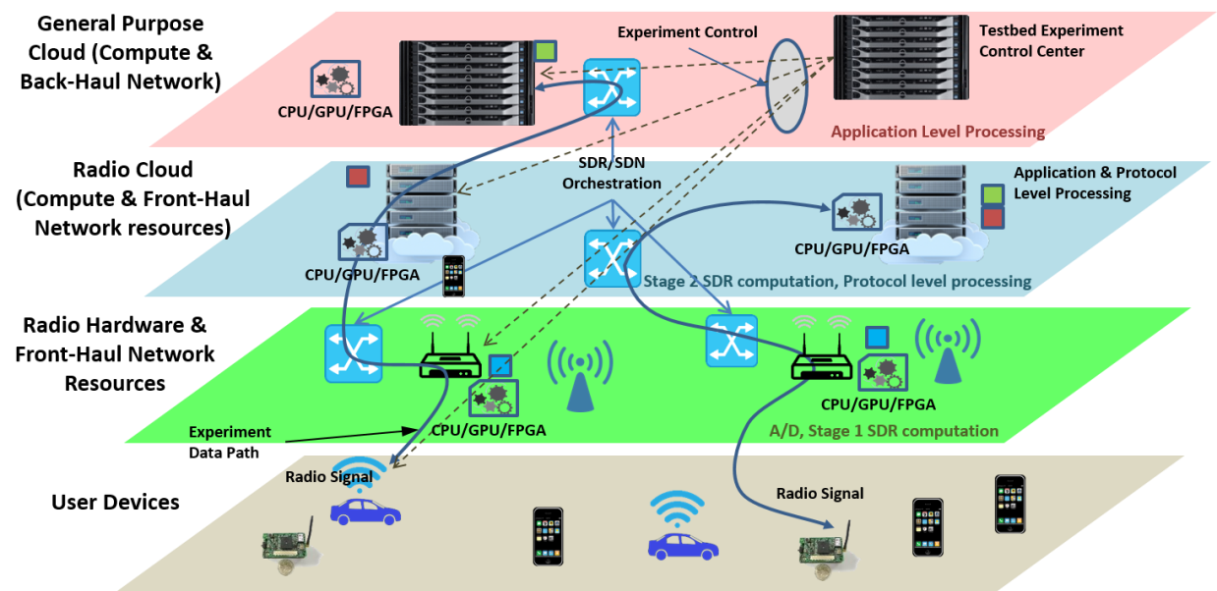
System Architecture
COSMOS architecture has been developed to realize ultra-high BW, low latency and tightly coupled edge computing
Key design challenge: Gbps performance + full programmability at the radio level
Developed a fully programmable multi-layered (i.e. radio, network and cloud) system architecture for flexible experimentation

Slide 10
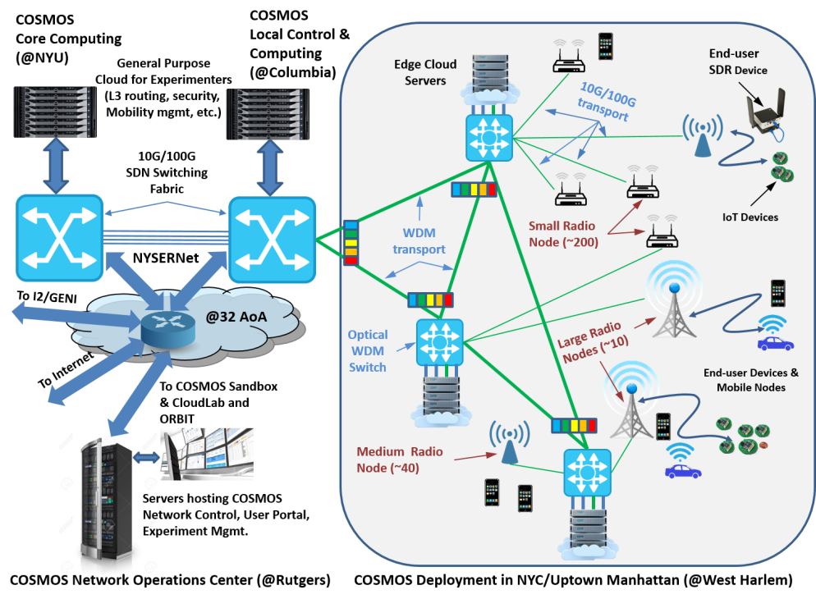
System Architecture
System design based on three levels of SDR radio node (S,M,L) with M,L connected via fiber to optical WDM transport
SDN-based backhaul and compute services, with access to ORBIT, GENI…
COSMOS control center and general purpose cloud at Rutgers via 32 AoA PoP

Slide 11
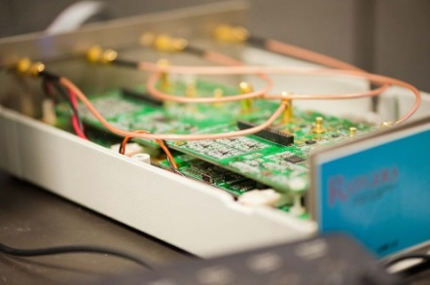
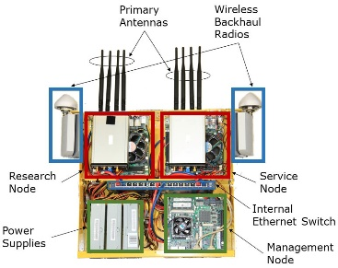
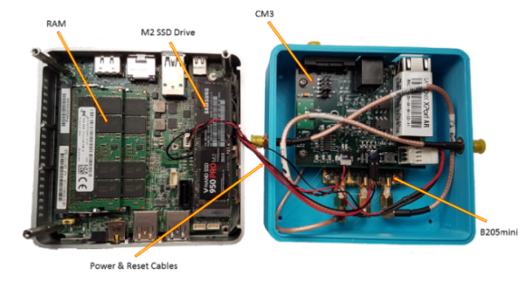
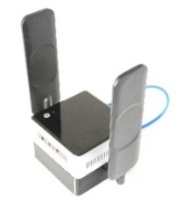
Key Technologies - SDR
All-software solution adopted for radio technology
Advanced SDR Radio Nodes at various performance levels and form factors
Design goal: 400 Mhz – 6 Ghz + 28 Ghz and 60 Ghz bands, ~500 Mhz BW, Gbps
Signal processing can be spread between radio node & edge cloud RAN
Team has extensive prior experience with SDR technology (…currently over 50 nodes in ORBIT running DSA, LTE, etc.)
WINLAB SDR circa 2010
Mobile SDR Node (Small)
Prototype COSMOS SDR
Node (Medium)

Slide 12
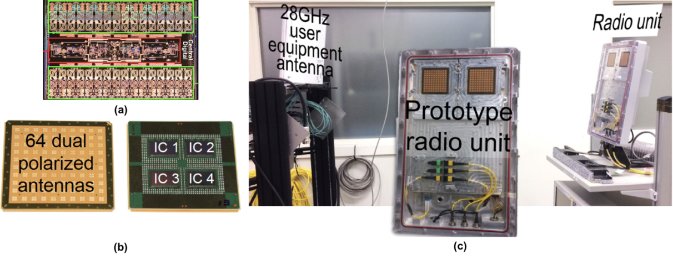
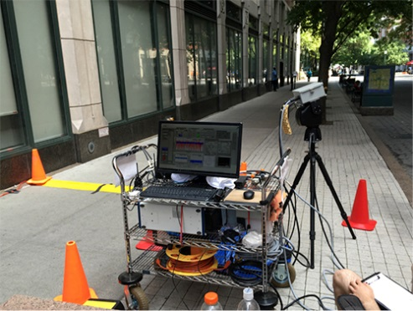
Key Technologies -mmWave
mmWave a key new technology for the testbed, with limited availability of components
Leveraging ongoing CU collaboration with IBM to provide mmWave phased arrays (64 antennas, 8 beams) for 28 Ghz
Extensive mmWave systems expertise at NYU, including prototype systems and channel measurements
mmWave components from IBM
NYU Channel Measurements

Slide 13
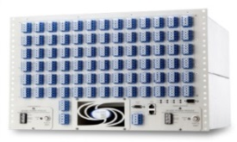
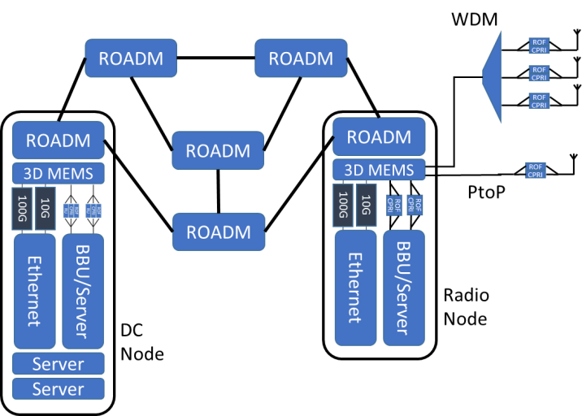
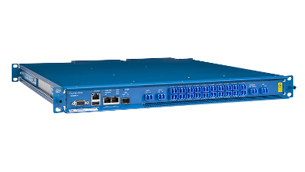

Key Technologies – Optical Net
MEMS Switch
Fast and low latency optical x-haul network using 3D MEMS switch and WDM ROADM
  Configure wide range of topologies
  Experiment on converged fiber/wireless networks
Enables fast front-haul/mid-haul/back-haul connectivity between radio nodes and edge cloud
SDN control plane for both optical and Ethernet switching
Leverages results from CIAN NSF ERC, EAGER dark fiber project at Columbia
ROADM (whitebox)

Slide 14
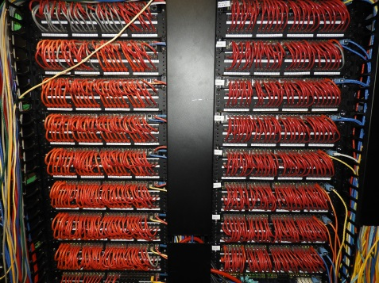
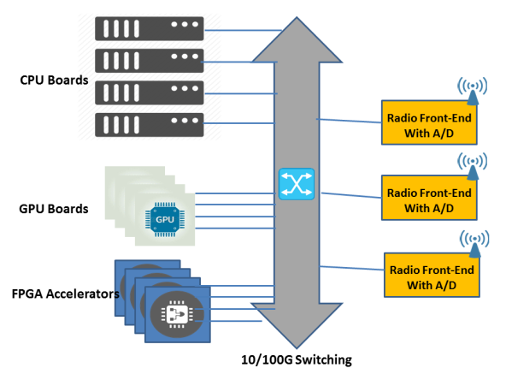
Key Technologies – SDN & Cloud
SDN control plane used to control x-haul and cloud server connectivity
Open Network Operating System (ONOS) with radio API extensions
Compute clusters collocated with radio nodes (M,L) with choice of CPU, GPU and FPGA accelerators
Also, users have access to regular cloud racks for L3→ applications (GENI & CloudLab clusters at WINLAB)
SDN Switching Rack

Slide 15
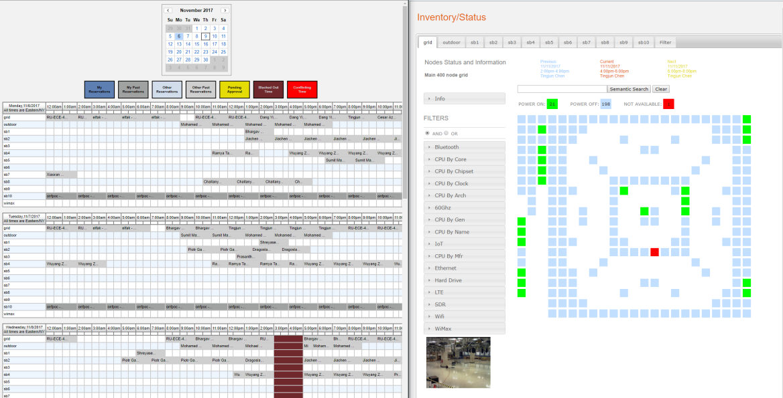
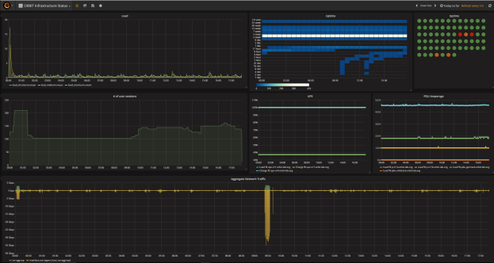
Key Technologies - OMF
Testbed software is a critical component
OMF control & management software leveraged from ORBIT
Provides tools for experiment scripting, execution, measurements and data collection
Supports high-level experiment scripts for ease of use
Mature open-source technology, proven in multiple research testbeds worldwide

Slide 16
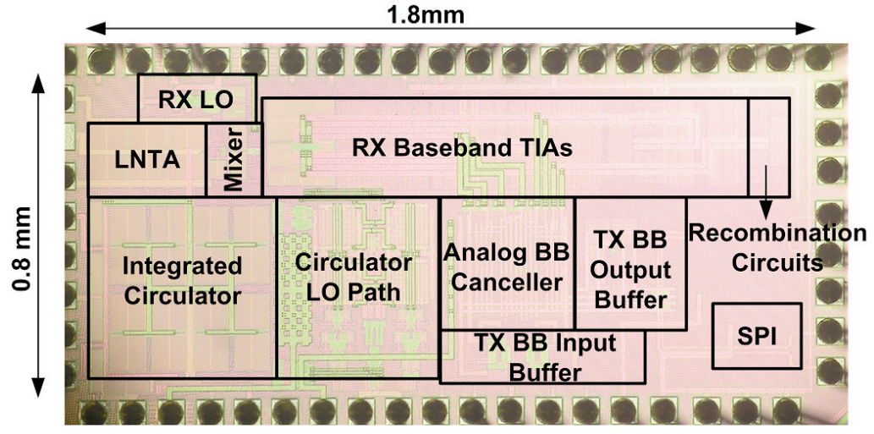
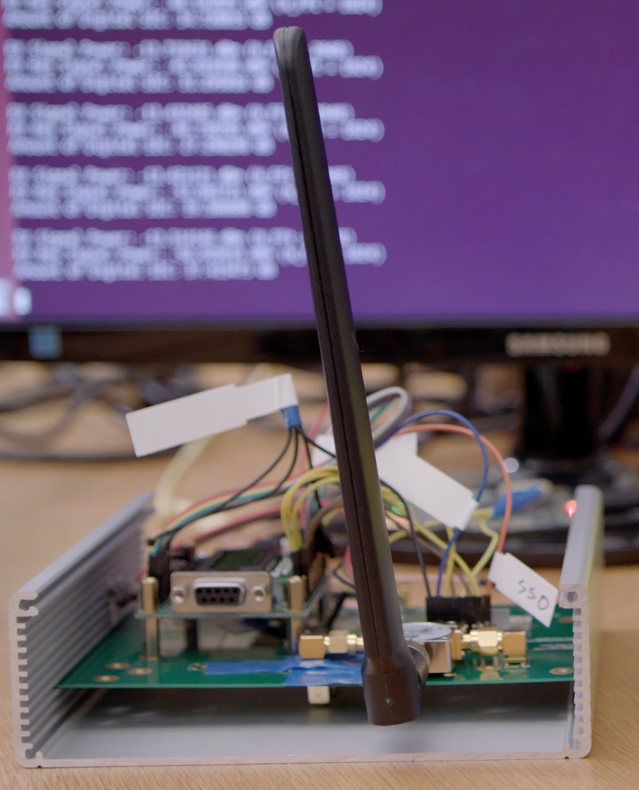
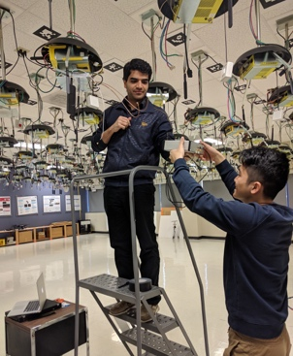



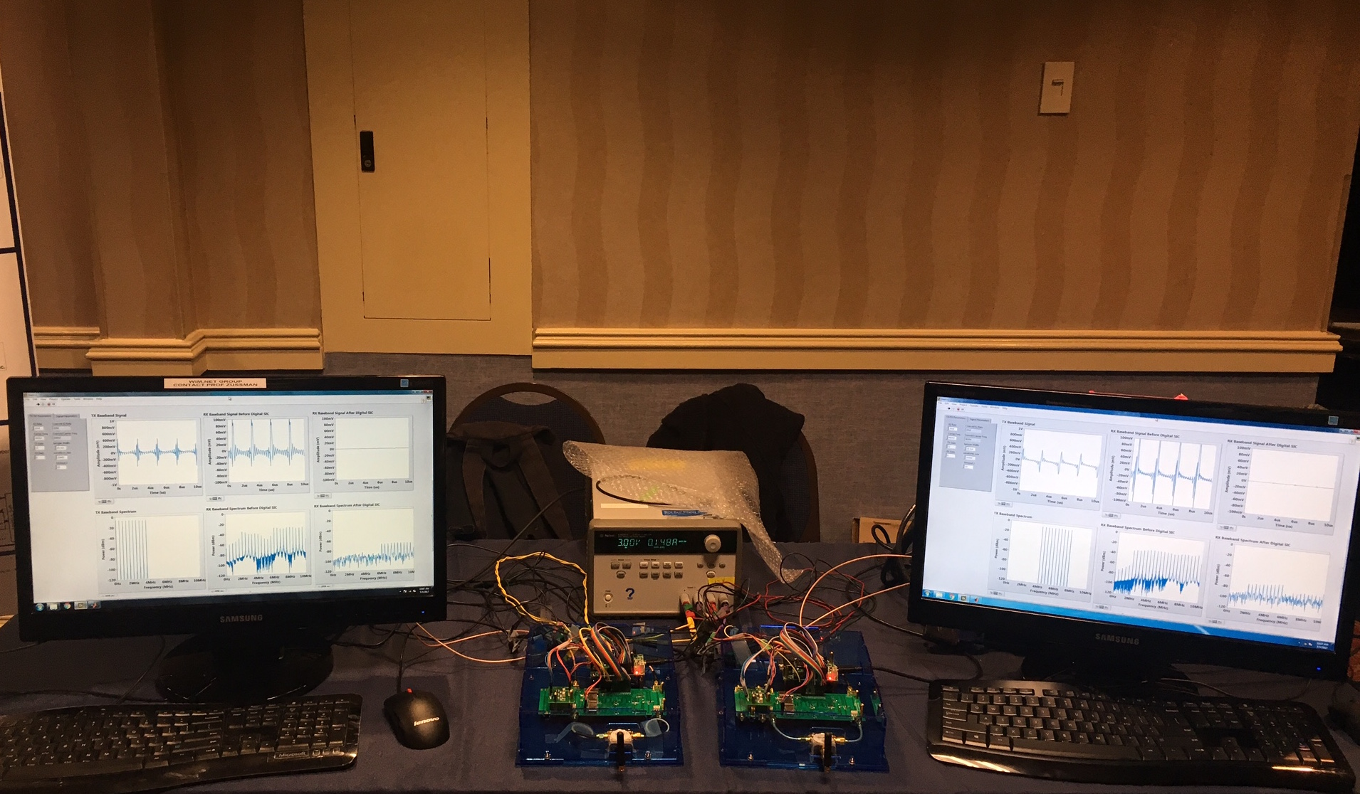

Experimental Research (1)
Project includes eight internal “Test Experiments” (TE) to help drive design requirements
TE on Full-Duplex Wireless:
  Goal: design and evaluate network protocols designed for IC-based full-duplex nodes
  Gen-1 node w/ frequency-flat RC canceller, supporting 90dB SIC imparted to 5MHz 0dBm TX signal
  Gen-2 node w/ wideband FDE-based RF canceller, supporting 95dB SIC imparted to 10MHz 5dBm TX signal
  Gen-1 node already deployed in ORBIT to provide the community full-duplex SDRs
  Gen-2 to be deployed in COSMOS
  Real-world experimental evaluation of higher-layer algorithms in heterogeneous networks with both legacy half-duplex nodes and full-duplex nodes
Programmable Gen-1 full-duplex
node installed in ORBIT
Gen-2 full-duplex link

Slide 17

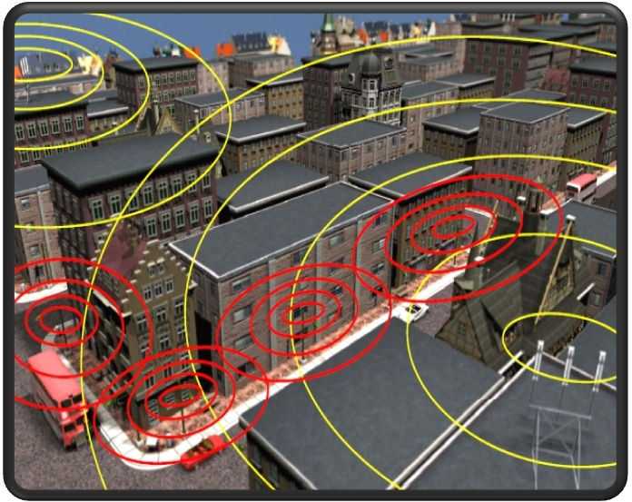





Experimental Research (2)
TE on Dynamic Spectrum
Goal is to evaluate cooperative spectrum coordination algorithms in dense city environment
Multiple technologies (such as WiFi and LTE/5G) in the same unlicensed band
Experimental evaluation of both distributed and centralized (cloud-based) protocols and algorithms
Selectable set of radio nodes in COSMOS, with real-world propagation effects
Applications/Services
PAWR Backhaul
REST API
SD-WN
controller
Control API
Spectrum Control Plane
5G/LTE Unlicensed
Control API
Wi-Fi
Control API
PAWR Wireless
Access
Software based 5G/LTE on PAWR USRP nodes
Wireless
Element
Wireless
Element
Avoid
Starvation
Better channel estimation
with and without feedback

Slide 18




Experimental Research (3)
TE on Vehicular Sensor Sharing and automated driving
Experiment involves multiple mobile nodes, high BW/low latency wireless access and multiple levels of cloud processing
Real world traffic and network conditions
Outcomes include evaluation of system performance and application demo
Automotive Research: Rich Sensor Sharing and Orchestration for Robust Automated Driving
Collection and Analysis of Near -Accidents
Cloud analytics
Months
Live Merged
Point Cloud
and Guidance
Edge computing
resources
Minutes
mmWave
access network
and direct
communications
Milliseconds

Slide 19
COSMOS - Deployment and Outreach

Slide 20


Objective: Take it Outside

Slide 21
Objective: Take it Outside

Slide 22




Large Node
Equipment Dimensions (L*W*H) | Multiple 24in x 24in x 12in
Weight (lbs) | 100+
Power Draw | 1000-2000W electronics and 2000W cooling per enclosure
Cabling Requirements | Fiber and 110V/220V AC
Access Requirements | Roof-edge mounted
Other Requirements | ~$700K
Small Node
Equipment Dimensions (L*W*H) | 9in x 9in x 3.75in
Weight (lbs) | 8
Power Draw | 120W
Cabling Requirements | 2 x Gigabit Ethernet and 110V/220V AC or 12V/19V DC
Access Requirements | Portable
Other Requirements
Medium Node
Equipment Dimensions (L*W*H) | 24in x 24in x 12in
Weight (lbs) | 50
Power Draw | 350W electronics and 1000-2000W cooling
Cabling Requirements | Fiber and 110V/220V AC
Access Requirements | Pole mounted
Other Requirements | ~$50K
Small Node (Ultra-portable)
Equipment Dimensions (L*W*H) | 4.5in x 4.5in x 2.75in
Weight (lbs) | 2
Power Draw | 40W
Cabling Requirements | Gigabit Ethernet and 110V AC or 12V/19V DC
Access Requirements | Portable
Other Requirements

Slide 23


Deployment:
Large node: rooftop deployments with number of antennas and edge cloud
Medium node: street-level devices dual use with wireless/wired backhaul

Slide 24




COSMOS: Deployment
Site Ownership:
DOE
CCNY
CU
NYCHA
Deployment:
Lightower
Large node: rooftop deployments with number of antennas and edge cloud
Existing Fiber Plant:
Nysernet
Medium node: street-level devices dual use with wireless/wired backhaul
ZenFi
CUIT Network
Control Center: CRAN, control, management and operations center

Slide 25


Phase 0: NSF EAGER - Lighting Dark Fiber Ring in Harlem
Fiber facilitated by the city and ZenFi (U. Arizona, Columbia, City College, Silicon Harlem)
Next phase: PAWR consortium fiber (Crown Castle)

Slide 26
Planned Deployment

Slide 27



Users and Mobile Devices (~200)
Columbia Public Safety cars
Columbia Facilities trucks and vehicles
Columbia Shuttles
Students in Columbia, CCNY, Manhattan School of Music, Barnard, JTS, UTS, Teacher’s College
Potentially high school students

Slide 28













Partnerships and Users
67 Letters: Industry, Tech and Venture partners shown, Government Local, City and State, Community Boards, School Districts, Local Community and experimenters from the research community
Additional Companies and Community partners are expressing interest in participation

Slide 29



Community Outreach
Silicon Harlem, a COSMOS partner, is a social venture, designed to transform Harlem into a technology and innovation hub
Silicon Harlem will operate as one of the interfaces between the COSMOS partners and the local community aiming to integrate the testbed elements within the community and various relevant smart city programs
Significant ongoing local tech-projects (Gigabit Center, New America Project)

Slide 30


K12 Education
NYU, Columbia, and Rutgers have been running K12 STEM education programs exposing students to experimental driven research, hands-on experience and research activities applied to the real world
Columbia: ENG Program
NYU: Arise Program

Slide 31
Testbed-based - Educational Labs
Phase 1 (1 year): Define and develop labs along with teachers:
  Define scientific areas/existing curriculum that can be supported by labs run remotely on the testbed
  Build the labs collaboratively (teachers, undergrad/graduate students and faculty)
  Recruiting ~10 teachers for upcoming summer (at Columbia and NYU)
Phase 2 (2 years): Bring the labs from year 1 to schools in District 5
  Run the labs developed in schools, get feedback from teachers and K12 students
  Redesign the curriculum and create more labs
Phase 3 (2 years): Run the web-based labs at scale across NYC schools
  Mature set of labs can run online by schools all over NYC

Slide 32


Project Tasks & Schedule
Project is organized into testbed arch and design tasks (T1-T7), system integration deployment (S1-S7) and outreach (R1-R5)
Some milestones: System level lab test 1QY2, Phase 1 community release 3QY2, Phase 2 community release 3QY3, ….
Schedule Graphic

Slide 33
Summary
Focus on ultra high bandwidth, low latency, edge cloud
Open platform (building on ORBIT) integrating mmWave, SDR, and optical x-haul
1 sq mile densely populated area in West Harlem
Local community outreach
Research community:
  Develop future experiments, provide input
  (short term) get involved in the educational outreach
ray@winlab.rutgers.edu, seskar@winlab.rutgers.edu, gil@ee.columbia.edu

