Slide 1
CS at Regulatory agencies
Henning Schulzrinne

Slide 2
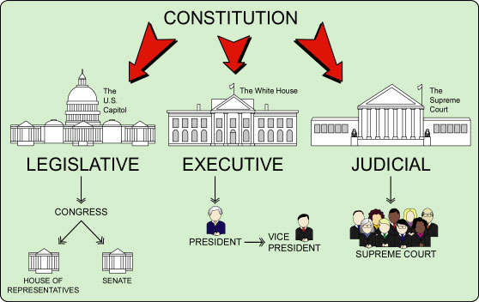
Civics was a bit too simple…

Slide 3
The US hierarchy of laws
Constitution
Commerce clause
Law
Telecom Act 1934 & 1996
47 CFR
Narrative
reasonable network management
Article I, Section 8: To regulate Commerce with foreign Nations, and among the several States, and with the Indian Tribes (1787)
SEC. 706. ADVANCED TELECOMMUNICATIONS INCENTIVES. (a) IN GENERAL- The Commission … shall encourage the deployment on a reasonable and timely basis of advanced telecommunications capability to all Americans (including, in particular, elementary and secondary schools and classrooms) by utilizing, in a manner consistent with the public interest, convenience, and necessity, …, or other regulating methods that remove barriers to infrastructure investment.

Slide 4
FTC & FCC (and others)
FCC: digital inclusion, spectrum, emergency services, cyber security, robocalls
FTC: consumers, privacy
enforcement, not regulations
FAA (DOT)
NIST
Some fund research, most don’t

Slide 5
Code of Federal Regulations
Title 3: The President
Title 7: Agriculture
Title 33: Navigation and Navigable Waters
Title 39: Postal Service
Title 47: Telecommunications
Title 49: Transportation
Title 50: Wildlife and Fisheries
http://www.ecfr.gov/

Slide 6
FCC
Chairman (R) – Ajit Pai
4 Commissioners (2 D, 2 R)
Consumer and Governmental Affairs
Enforcement
International
Media
Public Safety & Homeland Security
Wireless Telecommunications
Wireline Competition
President nominates
Senate confirms
Independent federal agency
About 1,688 employees (60 economists, 300 engineers, 600 lawyers + support staff)

Slide 7
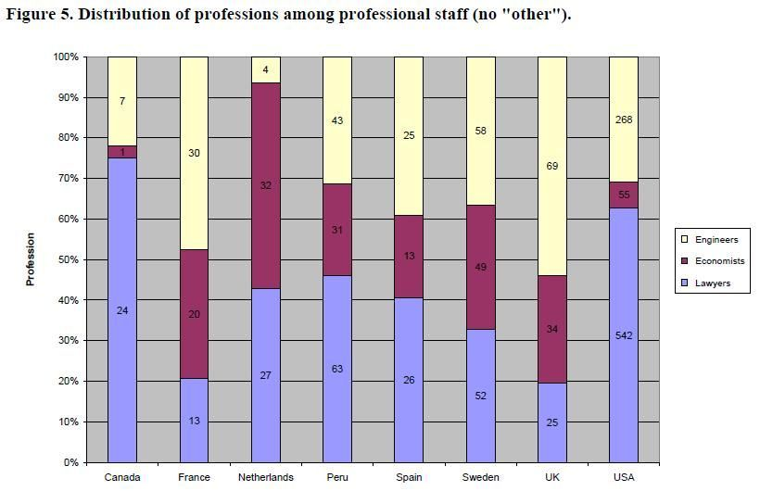
Staffing at National Regulatory Agencies

Slide 8
Notice and Comment rulemaking
Unless an exception applies, Commission must use notice and comment procedures to adopt rule
Commission adopts Notice of Proposed Rulemaking (NPRM) either at monthly Open Meeting or on circulation
Bureaus and offices generally lack delegated rulemaking authority
NPRM must include statement of legal authority
terms or substance of the proposed rule, or a description of the subjects and issues involved
NPRM must be sufficient to expose the proposal to public comment, and give affected parties an opportunity to develop evidence for their position
May issue more general Notice of Inquiry (NOI) if not ready to go to NPRM
Notes:
http://www.cybertelecom.org/notes/fcc.htm

Slide 9
Engagement
Comment on regulatory proceedings
Present your research (if relevant)
Workshops
Advisory committees
Sabbatical
IPA assignment

Slide 10
Advantages
Better appreciation of law & economics
Teaching impact (me: “Internet Technology, Economics & Policy”)
Research impact (“broader impact”)
Research topics (emergency services, data analysis)

