Slide 1
Possible, probable and perilous paths – the Internet in 25 years
Henning Schulzrinne
Columbia University

Slide 2

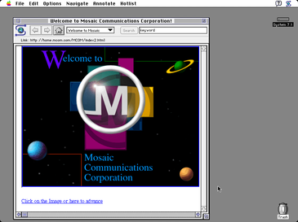
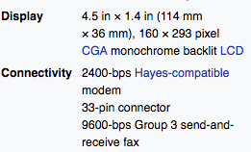
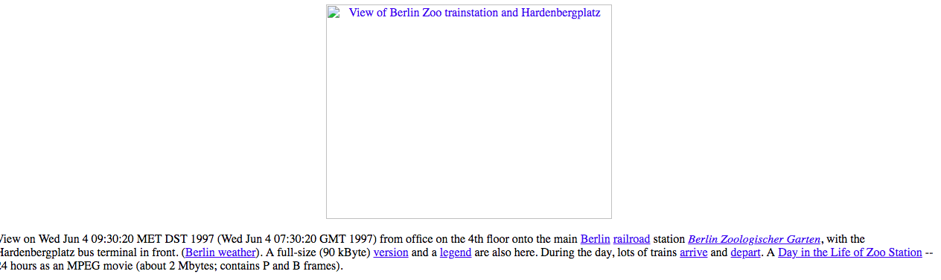
25 years ago
August 1993
IBM Simon (announced 11/1993)
Mosaic 1.0: November 1993
Euro-ISDN: 1994
DSL patent: 1990
DOCSIS started 1995
DSL in Germany: 7/1999
GMD webcam (1997)

Slide 3
Transit prices
http://drpeering.net/white-papers/Internet-Transit-Pricing-Historical-And-Projected.php

Slide 4
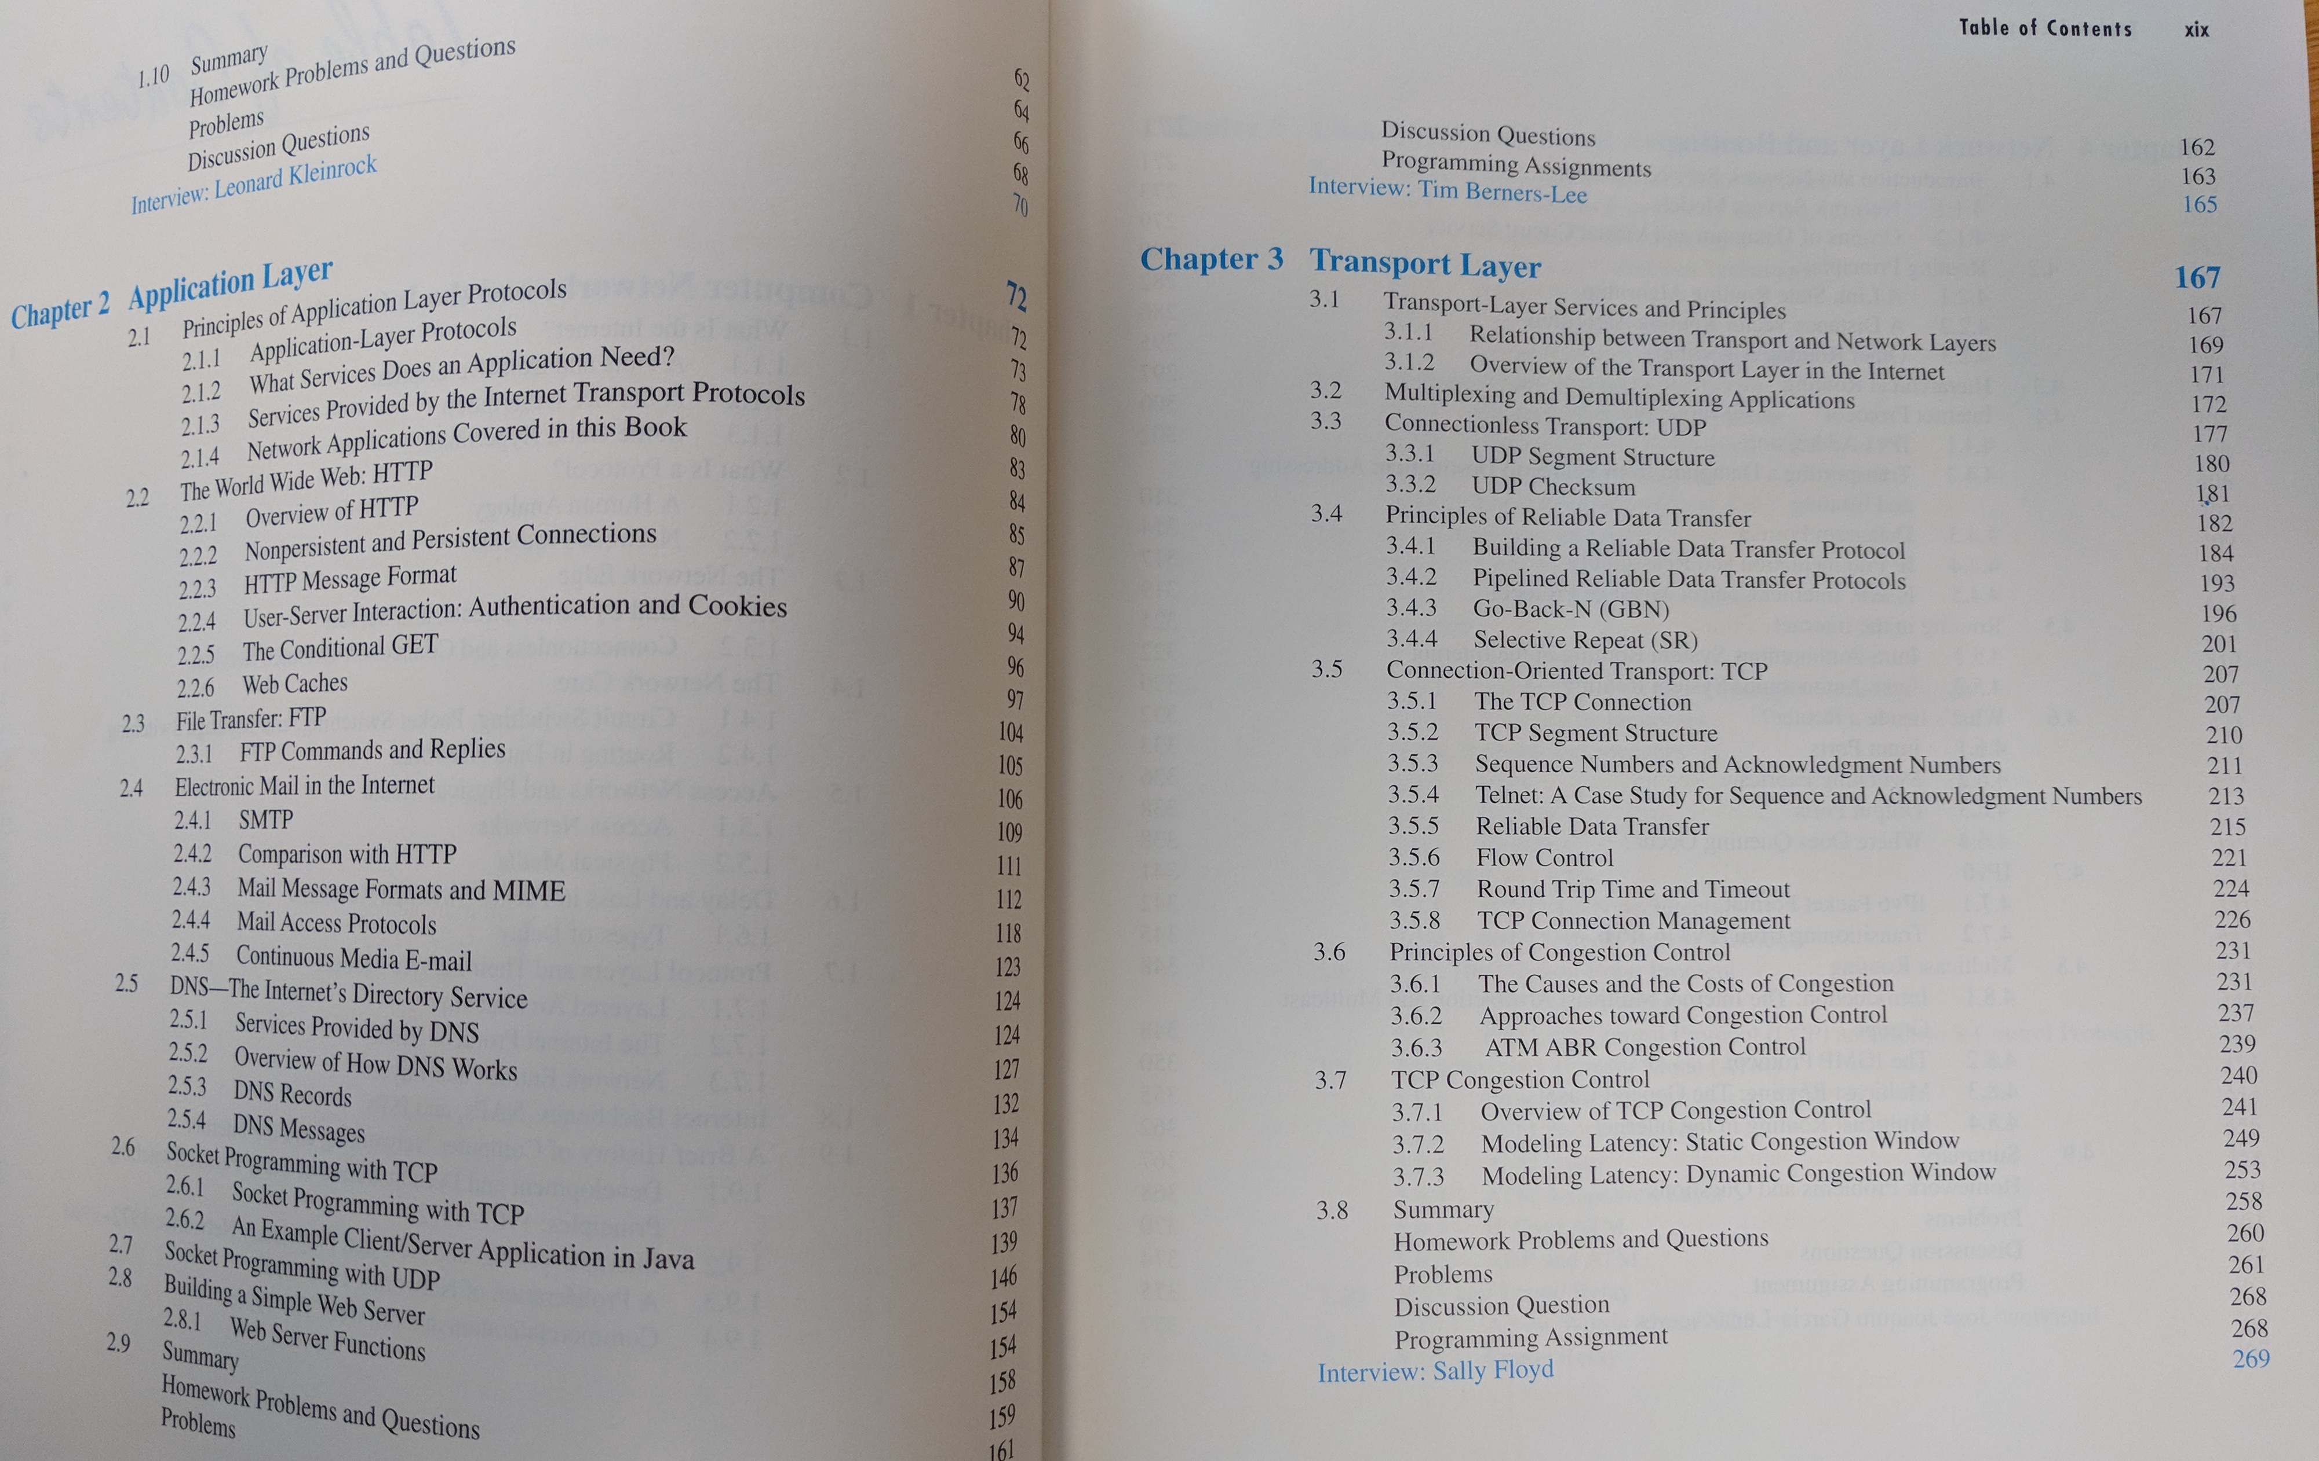
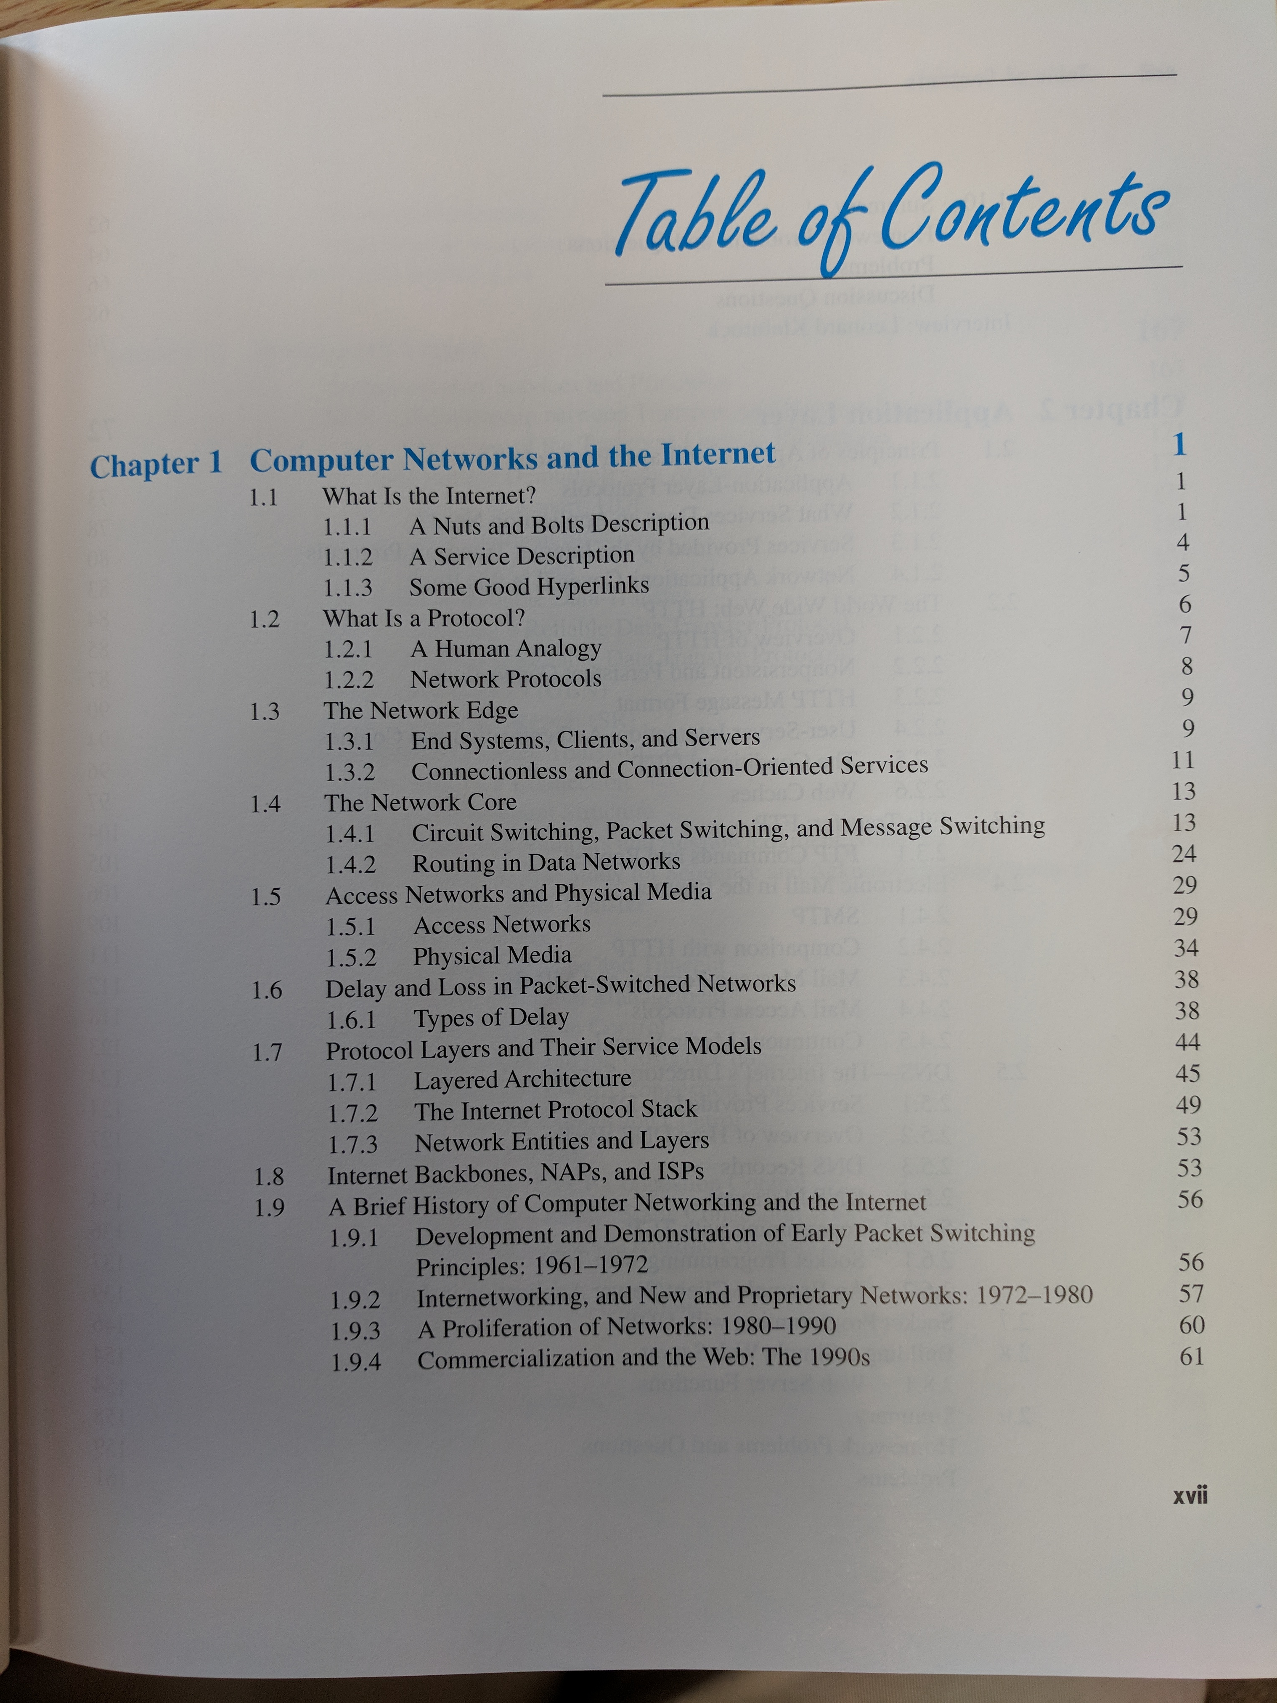
Kurose/Ross, 2000

Slide 5
IETF25 (1992) looks familiar

Slide 6
Why so little change in the Internet?
 | Browser | Data center | Access networks | Internet
Major changes in last decade | WebRTC, HTML5, WebSocket, CSS3, … | SDN, heterogeneous computing, rack-scale, accelerators | 5G, DOCSIS 3.x | QUIC
Major players | 3 | 4 (or 7) | Major wireless Comcast | Hundreds to thousands
Backward compatible | Easy | Local | Separate frequencies | Minimum feature set
Incentive | Competition | Revenue | Spectral efficiency | Limited (OpEx?)

Slide 7
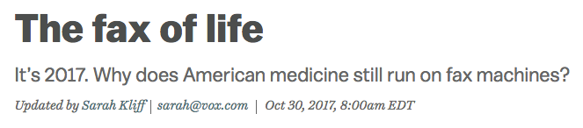
Networks never die, they just drop nodes
* 1982
➔ We’ll still have phone numbers and IPv4 addresses in 2043…

Slide 8
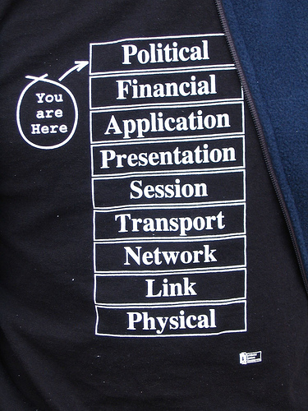
Moving up (and down)
privacy → data usage
cyber security
network neutrality
news, real & fake
5G, 6G, …
quantum communications

Slide 9
“We don’t want to be bit pipes”
France Telecom
Minitel era (~2000)
→ Avoid commoditization (competition on price only)
Two mechanisms: provide better services vs. withhold services (”APIs”) or price-differentiate
2008
WAP
IMS
Linear
video
Cloud
Content
Which prevents them from being good bit pipes
→ unusual, but inherent, conflict of interest between provider and customer
Notes:
https://mondaynote.com/verizon-no-we-cant-become-dumb-pipes-ddab2b41a2d8

Slide 10
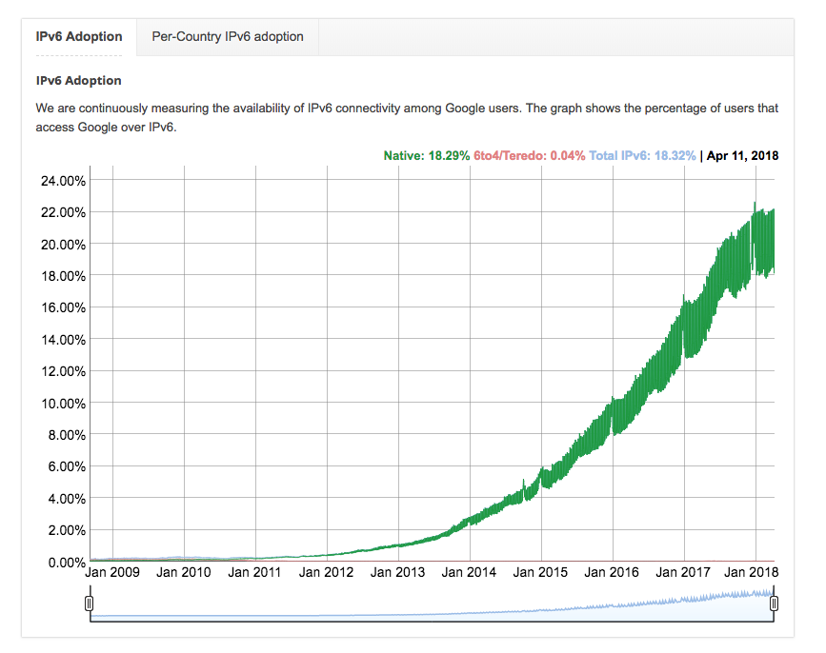
“The future has arrived — it’s just not evenly distributed yet.” (Gibson, 1992)
IPng WG: July 1994
RFC 2460: December 1998

Slide 11
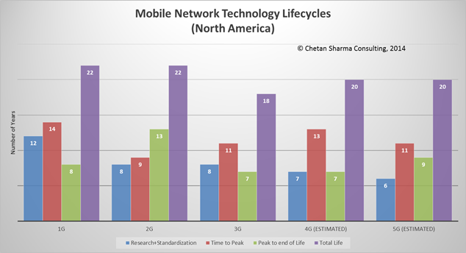
Design networks for 20 years
10 years per G
get your 7G proposals ready
ever smaller differences to Wi-Fi

Slide 12
Generational surprises
Generation | Expectation | Surprise | Cost per GB
0G (landline) | voice | fax & modem
1G | corporate limousine | eavesdropping
2G | better voice quality (“digital!”) | SMS | $1000
3G | WAP | web | $100
4G | IMS | YouTube, WhatsApp, notifications | $10
5G | IoT (low latency) | ? | $1?
underestimated cost and fixed-equivalence as drivers
are the even generations the successful ones?

Slide 13
Internet structure: network of networks
Tier 1 ISP
Tier 1 ISP
Google
No longer good
representation of
revenue structure
traditional money flow
IXP
IXP
IXP
Regional ISP
Regional ISP
large eyeball
ISPs may charge
long-haul and CDN
for access
access
ISP
access
ISP
access
ISP
access
ISP
access
ISP
access
ISP
access
ISP
access
ISP

Slide 14
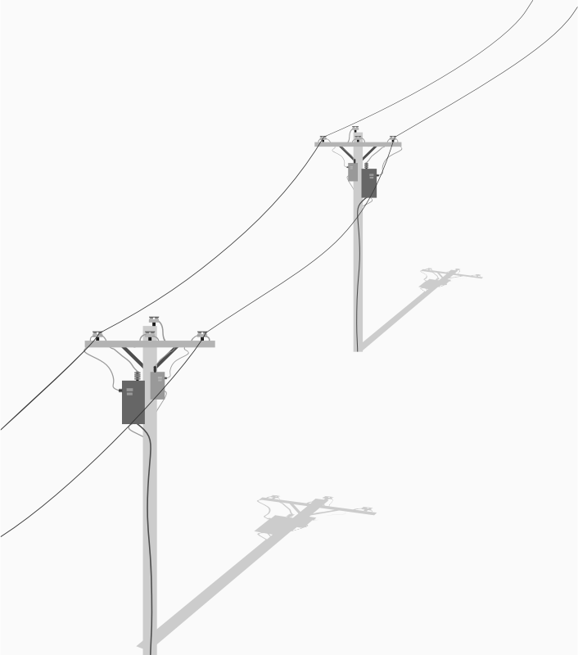

Internet 2043: largely invisible
Google
Amazon +
FB
China +
Russia +
illiberal democracies
Internet

Slide 15
We’re not done yet
Internet = electricity or Bahn: only discussed if unreliable
Limited increase in user-visible speeds – variable, instead of fixed
Finally self-managing networks?
  but ping + reboot have survived 40 years…
End of Moore’s Law → specialized hardware for most functions
Increasing system and component complexity → ever harder for researchers to contribute (except measure)
New upper-layer services: P2P storage → block chain → ?
Data privacy (data minimization) → data usage protections (hopefully) – data fiduciary
Networks as enablers for everything, not necessarily as object itself
One of the most powerful amplification tools, but limited influence on use
We will still be reviewing QoS papers

