Slide 1
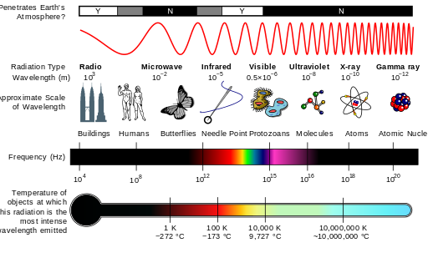

Through a new prism: spectrum in the 5G age
This material is based upon work supported by the National Science Foundation under Grant No. CNS-1702952. Any opinions, findings, and conclusions or recommendations expressed in this material are those of the author(s) and do not necessarily reflect the views of the National Science Foundation.
Henning Schulzrinne
Columbia University

Slide 2
Spectrum is a lot more colorful
How does spectrum “work”?
What is it worth?
Three case studies:
  TV bands
  3.5 GHz
  mmWave
What can we do differently?

Slide 3
Quick background

Slide 4
Classical division of spectrum
Band | range | commonly called | sample current usage
VLF | 3-30 kHz |  | navigation, submarine
LF | 30-300 kHz |  | WWVB (clock 60 kHz)
MF | 300-3 MHz |  | AM radio
HF | 3-30 MHz |  | short wave radio
VHF | 30-300 MHz |  | TV 2-6, 7-13, FM radio, CB, LMR
UHF | 0.3-3 GHz |  | LMR, TV 14-50, cellular, Wi-Fi
SHF | 3-30 GHz | microwave | radars, Wi-Fi
EHF | 30-300 GHz | mmWave | radars, satellite, p2p links

Slide 6
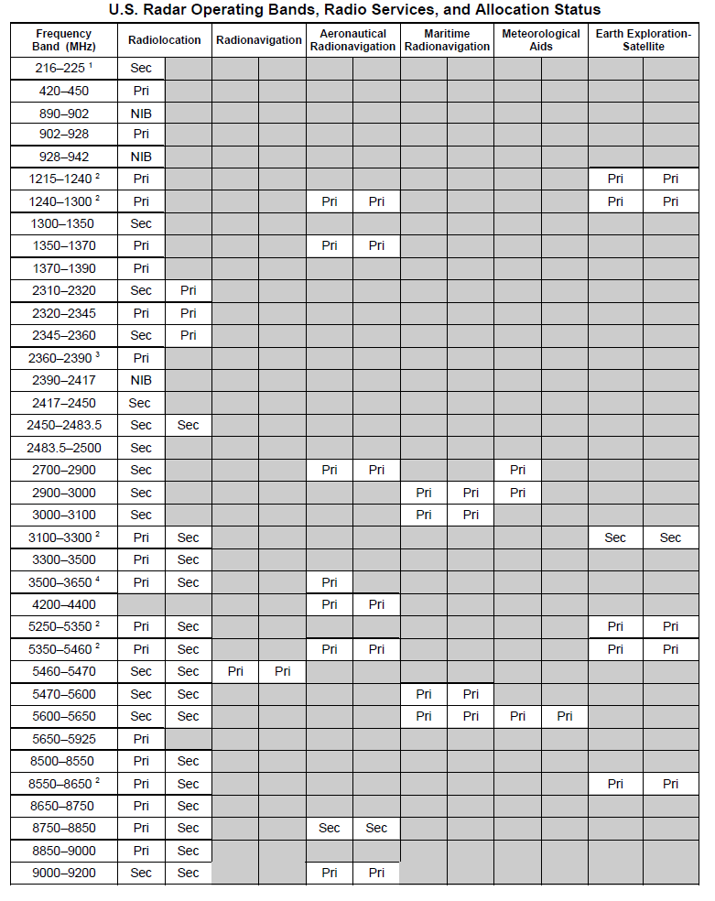
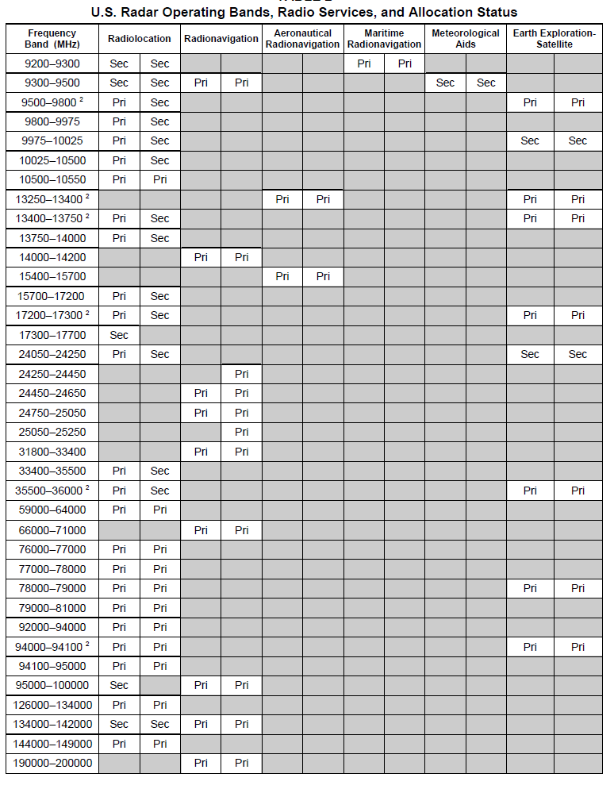

Slide 7
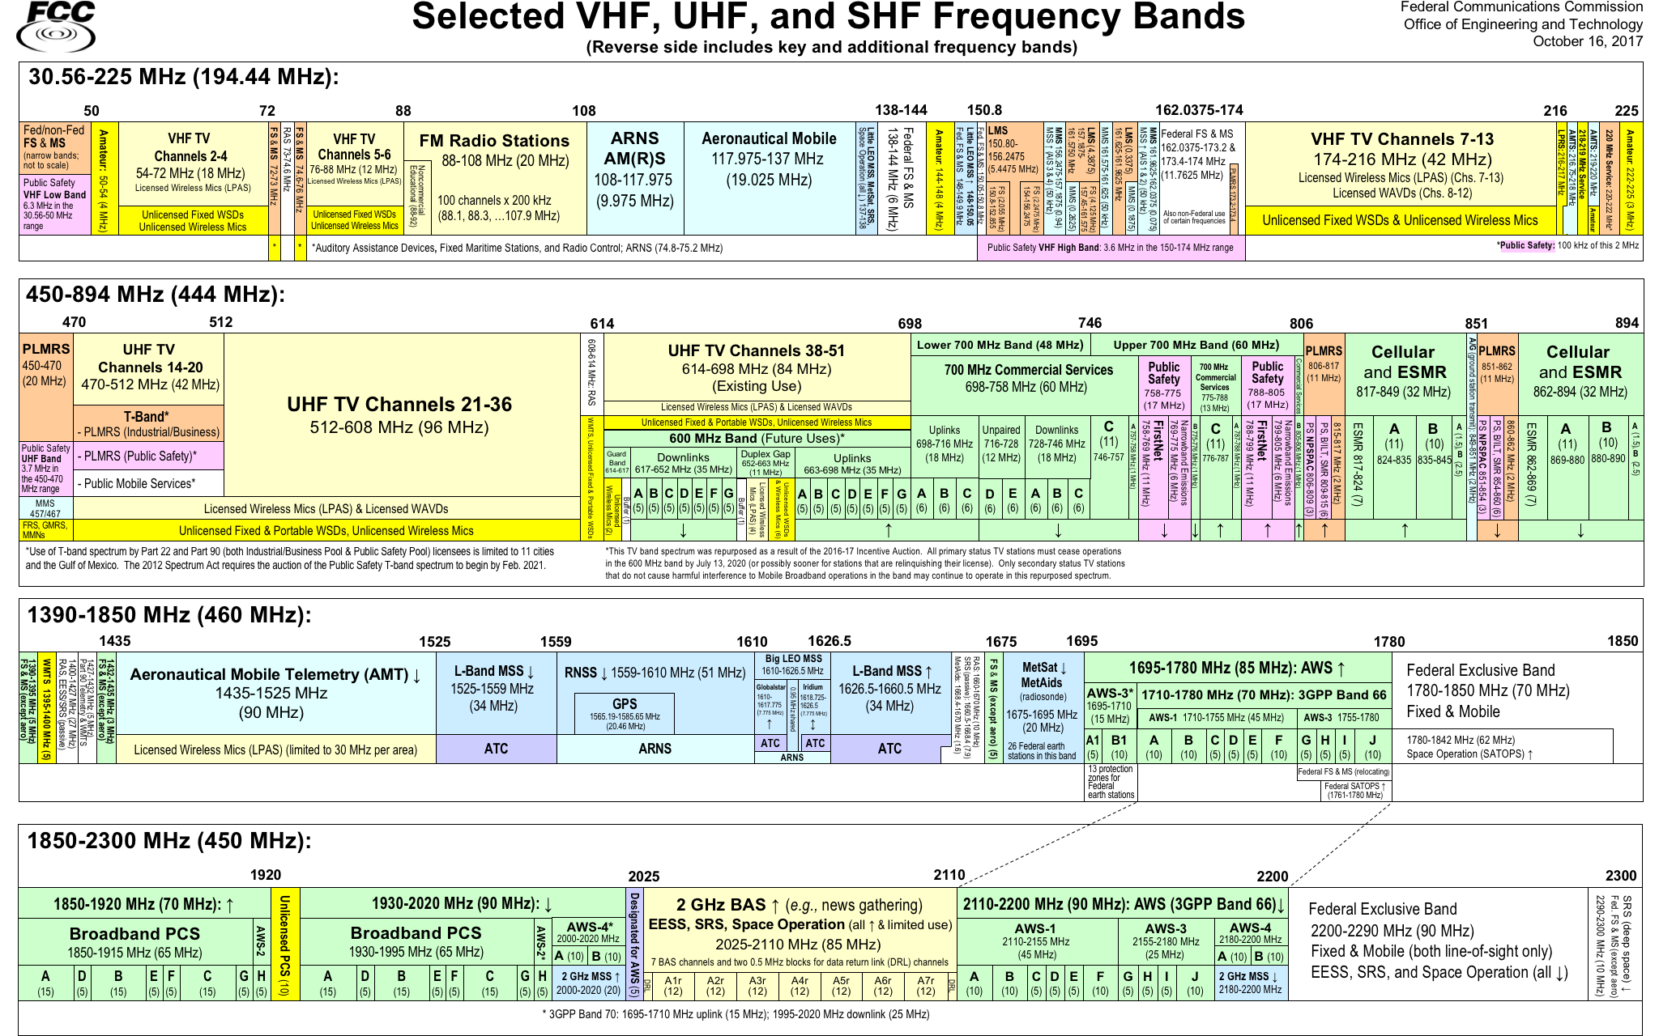

Slide 8
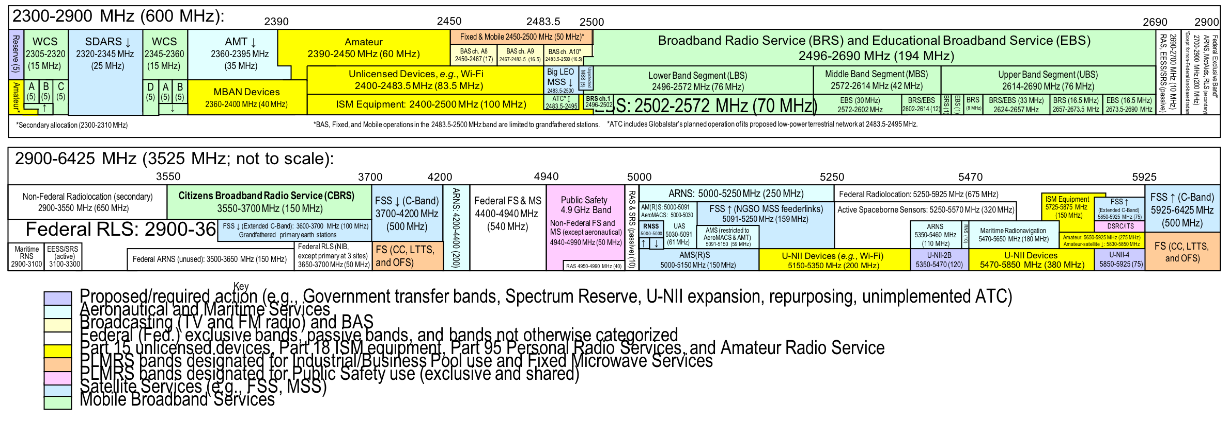

Slide 9
Commercial wireless spectrum (US)

Slide 10
Unlicensed & lightly-licensed bands (US)
UHF (476-700 MHz) – incentive auctions (licensed) + some unlicensed + TV white spaces
ISM (902-908 MHz) – BlueTooth
1920-1930 MHz – cordless phones (DECT)
2.4 GHz (73 MHz) – 802.11b/g
3.550 GHz (150 MHz) – shared, database
3.6 GHz (100 MHz) – for backhaul & WISPs
4.9 GHz (50 MHz) – public safety; under reconsideration
5.8 GHz (400 MHz) – 802.11 a/n

Slide 11
5.8 GHz band is complex
DFS
DFS
Notes:
https://www.connect802.com/802-11-channel-frequency-allocation

Slide 12
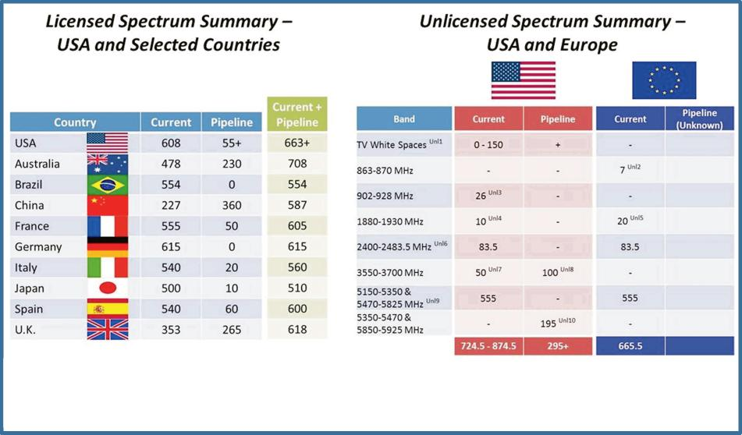
Feb. 2013
Notes:
http://hraunfoss.fcc.gov/edocs_public/attachmatch/DOC-318485A1.pdf

Slide 13
Notes:
The Mobile Broadband Spectrum Challenge: International Comparisons
Wireless Telecommunications Bureau Office of Engineering & Technology
February 26, 2013

Slide 14
Licensed spectrum is paired
Unpaired → TDD
FDD is easier – power level management

Slide 15
Ideal spectrum
Unused or cheap
Available globally (→ important for consumer goods & market size)
  preferably under similar licensing conditions
No noisy or sensitive neighbors
Propagates indoors through walls and glass
Not affected by rain or leaves outdoors
Wide bands (≥ 5 MHz, preferably 20 MHz+)
Is paired (uplink & downlink)
Can be processed with cheap electronics (Si, not GaAs)
Allows small antennas🦄🦄

Slide 16
Spectrum band trade-offs
Band | Antenna | Capacity (typical channel width) | In-building penetration | Rural
LF (below 400 MHz) | e.g., FM: 80 cm | 5-100 kHz per band | very good | very good
Low (400 MHz – 1 GHz) | small (1/4 λ = 7.5 cm) | 5-10 MHz | good | good
Mid-band (1 – 2.5 GHz) | small | 5-20 MHz | ok | ok
High-band (2.5 – 24 GHz) | small | 5-100 MHz | poor | poor
Millimeter wave (> 24 GHz) | small, but array antenna needed | 100 MHz+ | poor | poor
“1900 MHz takes somewhere between 2 to 4 times as many sites as 850 MHz”

Slide 17
Antennas
iPhone 4S
Yagi-Uda TV antenna (UHF)
Roughly 90” long
𝜆/2 = 25 cm

Slide 18
Spectrum roles
400 – 800 MHz
1 – 3 GHz
3-6 GHz
> 10 GHz
base-level coverage
(particularly rural)
urban capacity
indoor & capacity
directional
capacity
Digital dividend
TV incentive auction
AWS-3
3.5 GHz
mmWave

Slide 19
Attenuation by frequency

Slide 20
28 GHz attenuation & reflection
multipath reflections
highly directional antennas
Rappaport, 2013

Slide 21
Who is in charge?
Notes:
Wells Fargo Wireless Spectrum Primer, 2017

Slide 22
Spectrum management
Until the 2000s
“Modern”
Single purpose
Fixed technology (modulation)
Exclusive use
Narrow bands (except TV)
Assume single radio per device
Worry mostly about OOB to like
Spectral efficiency secondary
Single-country
Flexible use
Flexible technology
Shared, over/underlay
At least 5 MHz, preferably 100
Multiple (> 4) radios, from 0.6 to 6 GHz
Receiver requirements?
Spectral efficiency matters
International coordination

Slide 23
Spectrum sharing
How much politeness & fairness is required?
→ LTE-U & LTE-LAA (license-assisted, listen-before-talk)
through
1990s
Wi-Fi
radio, TV,
early mobile
US: since 1994
Notes:
“Priority-Based Classification of Spectrum Access Models”, August 2013

Slide 24
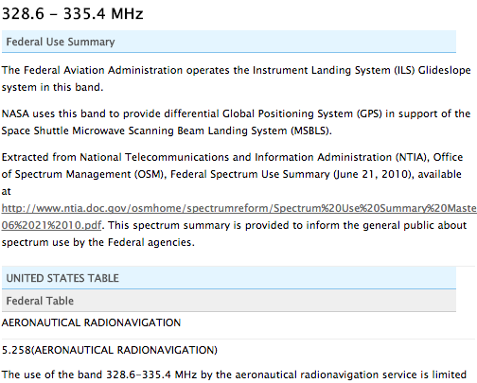
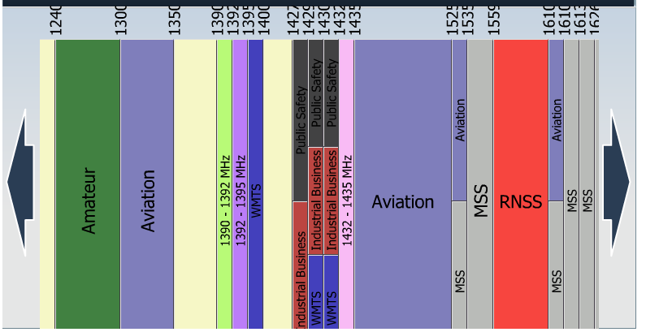
FCC spectrum dash board
(stale as of June 2014)
http://reboot.fcc.gov/reform/systems/spectrum-dashboard

Slide 25
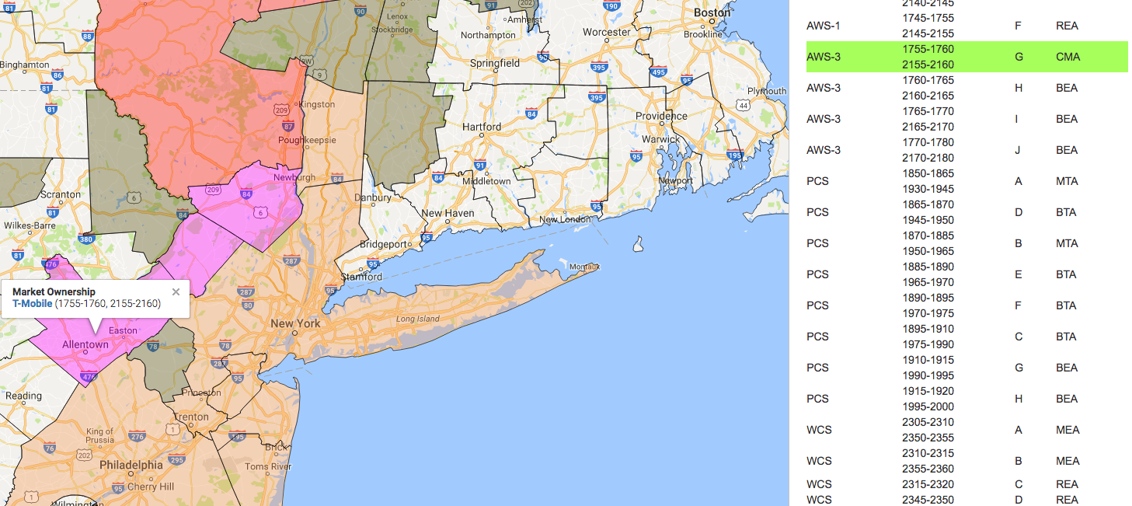
Spectrum map – carrier holdings
http://specmap.sequence-omega.net/

Slide 26
Challenges for spectrum sharing
Unlicensed ~2000
Unlicensed now
Unlicensed emerging
indoor home
indoor enterprise
campus
--> natural separation
secondary public SSID
re-use HFC/FTTH backhaul
LTE-U, LAA
what are the “kindergarten” rules?
only power rules (no listen-before-talk (CS) required)
e.g., CableWiFi
One band, one channel

Slide 27


Spectrum co-existence
vs.
“high tower, high power”
(TV, cellular downlink, radar transmitter)
cellular downlink receiver
radar receiver
GPS receiver
UL TX: 24 dBm
DL TX: 43-48 dBm
acquisition -138 dBm
tracking: -146 dBm
-105 dBm
TV: 90 dBm (1 MW UHF)
how do I quickly identify sources of interference?

Slide 28
The filter problem
guard band
(wasted)
filter
(input or output)
licensed band
user 1
licensed band
user 2
Power imbalance:
cell downlink: 100 W ERP
cell uplink: 0.05 – 2 W
Notes:
http://oem.bmj.com/content/61/9/769/T2.expansion.html

Slide 29
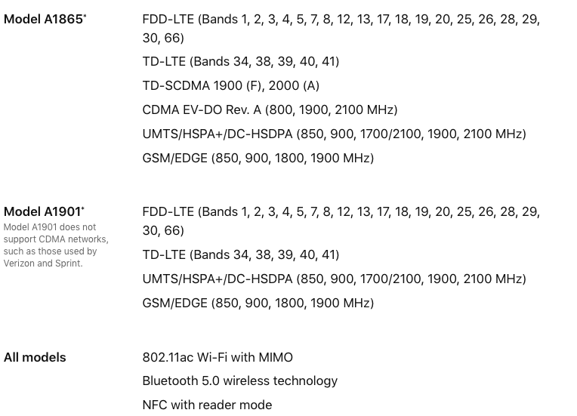
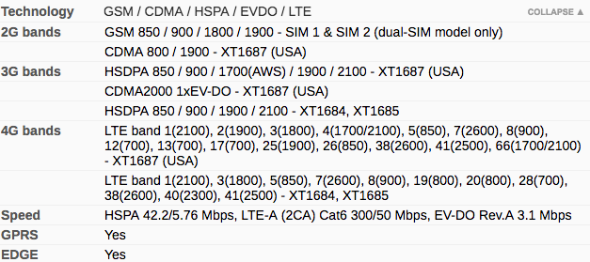
Lots of radios
iPhone X
$999+
Moto G5 Plus
$220

Slide 30
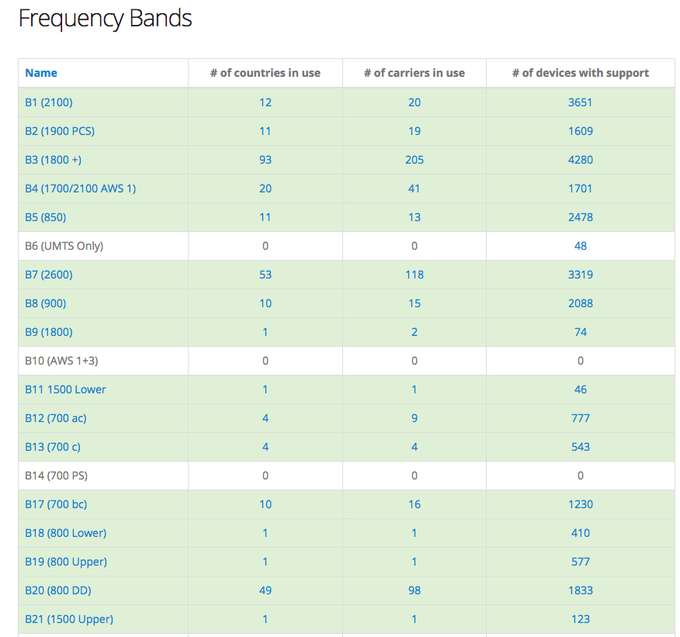
LTE band support varies
https://www.frequencycheck.com/interfaces/lte

Slide 31
Spectrum holdings

Slide 32
Spectrum holdings

Slide 33
LTE holdings

Slide 35
What is it worth to you?

Slide 36
The value of bits
Technologist: A bit is a bit is a bit
Economist: Some bits are more valuable than other bits
  e.g., $/bit(email) >> $/bit(video)
  no-QoS bits dominate in volume
Application | Volume | Cost per unit | Cost / MB | Cost / TB
Cable video | 660 GB |  | $0.06 | $60
Voice (13 kb/s GSM) | 97.5 kB/minute | 10c | $1.02 | $1M
Mobile data | 5 GB | $40 | $0.008 | $8,000
MMS (pictures) | < 300 KB, avg. 50 kB | 25c | $5.00 | $5M
SMS | 160 B | 10c | $625 | $625M
Notes:
T-Mobile 2010
AT&T data
http://www.nowsms.com/discus/messages/12/8500.html

Slide 37
“Best and highest value use”
Metric: $ per MHz and population covered → $/MHz/POP
How do you estimate the value of spectrum, beyond auction price?
  What about public safety usage?
No good estimate of value for unlicensed spectrum
How do you encourage more efficient usage of existing spectrum?
  b/s/Hz → b/s/Hz/sq mi
Example: TV spectrum value is largely indirect
  10-15% watch over-the-air
  but TV stations get must-carry right and network exclusivity
Avoid spectrum hoarding & speculation
  foreclosure value
  build-out & service requirements (“use it or lose it”)
  but can create minimal networks that serve few real customers (e.g., NB-IoT)

Slide 38
More variables: space & time
For every FCC auction, there’s been disagreement over spatial granularity
  Regional usage (rural carriers, local usage) or mall number of nationwide carriers?
Can you lose your license?
  Preferential bidding (sham entities)
  Build-out requirements → prevent warehousing, foreclosure
What is the duration?
  US: indefinite, mostly
    In theory, FCC could revoke license (license, not property)
  Europe: up to 20 years
  UK: indefinite, with 5 years notice
Spectrum license fees (“rent”)?
  Encourages efficient usage, but raises cost (“spectrum tax”)

Slide 39
Proposal: Depreciating licenses
Milgrom, et al., 2017
From one perspective, the depreciating license is a perpetual license that carries an annual license fee equal to 10% of its “value,” as declared by the licensee. What disciplines the declared value is that it doubles as an offer: the licensee must be prepared to sell her license to any party who is willing to pay the declared value.
From a second perspective, the licensee is granted a depreciating stake in a perpetual license, with 10% of the right reverting annually to the FCC. To continue to use the license, the incumbent licensee purchase the missing 10% each year at a price of X, which the incumbent licensee herself determines. However, when she declares X, she commits to sell her license to any buyer during the next year at a price of 10X, which becomes an upper bound on the licensee’s “ask price” for that year. These rules create a tension – a licensee can pay a reduced license fee by declaring a lower value X, but must then be willing to sell the license for the corresponding lower price.
Alternative: auction with bidding credits
Notes:
Redesigning Spectrum Licenses to Encourage Innovation and Investment By Paul Milgrom, E. Glen Weyl and Anthony Lee Zhang

Slide 40
FCC license areas
3,007
“DMA”
TV
734
491
176
52
12

Slide 41
It takes a long time to convert spectrum
Notes:
Wells-Fargo Research June 2017

Slide 42




Why does it take so long?
Decide auction modes, regions, band plan, preferences, …
auction
clearing
Who are we going to pick on?
ITU, 3GPP
coordination
(“this is my SAT band”)
build-out
end-user devices

Slide 43
Build-out deadlines
Notes:
GAO: Spectrum Management - FCC’s Use and Enforcement of Buildout Requirements

Slide 45
Spectrum valuations
Notes:
Wells Fargo

Slide 46
Spectrum per user

Slide 47
Spectrum requires civil engineering investment
Tower owner | Number of towers
Crown Castle | 39,739
American Tower | 40,000 (with VZW)
SBA Communications | 15,151
United Cellular Co. | 4,802
Verizon Wireless | 1,400
T-Mobile Towers | 1,003
Time Warner | 950
Mediacom Communications | 750
Charter Communications | 650
Diamond Communications | 637
Trillion Partners | 635
cost/tower: $150k
total US: 205k
Notes:
http://www.statisticbrain.com/cell-phone-tower-statistics/
http://ir.sbasite.com/releasedetail.cfm?ReleaseID=908348

Slide 48
Cell sites by carrier

Slide 49
Spectrum economics trade-off
Two choices: buy spectrum or buy towers (access points, …)
“Densification”
Spectral capacity – b/s/Hz/km²
Capacity often mostly needed in constrained environments
  Home, office
  Stadiums
  Public transit hubs & airports

Slide 50
Spectrum vs. small cells

Slide 51
Technology changes value

Slide 52
Same spectrum, different capacity

Slide 53
TV spectrum

Slide 54
TV spectrum
VHF (54-88 MHz, 174-216 MHz) + UHF (470-606 MHz)
Only about 10% of viewers use over-the-air (OTA) in the US
  → could replace with 18 Mb/s stream via broadband
But broadcasting conveys important rights on cable:
  Must carry for small stations & retransmission consent for network stations
  Territorial exclusivity (one network station per DMA)
ATSC 3.0 will provide IP-over-TV (with Internet backchannel)
Limited interest in freeing more spectrum

Slide 55
TV white spaces (US)
First large-scale spectrum database
But limited use in the US
  number of channels
  power levels
  equipment
  available mostly in rural areas, not urban
  change after incentive auction
Leonia, NJ
Amherst, MA

Slide 56
Broadcast Incentive Auction: From Idea to Law
National Broadband Plan (Mar. 2010)
“Congress should consider expressly expanding the FCC’s authority to enable it to conduct incentive auctions in which incumbent licensees may relinquish rights in spectrum assignments to other parties or to the FCC.”
President’s Nat’l Wireless Initiative (Feb. 2011)
“As recommended in the FCC’s National Broadband Plan, legislation is needed to allow the FCC to conduct “voluntary incentive auctions” that enable current spectrum holders to realize a portion of auction revenues if they choose to participate.”
“…the Commission may encourage a licensee to relinquish voluntarily some or all of its licensed spectrum usage rights in order to permit the assignment of new initial licenses subject to flexible-use service rules by sharing with such licensee a portion…of the proceeds…from the use of a competitive bidding system...”
Spectrum Act
(Feb. 2012)
Notice of Proposed Rulemaking
(Oct. 2012)
“The FCC issued a Notice of Proposed Rulemaking on October 2, 2012, which launches the process which will leverage the collective expertise of the leading authorities in telecommunications, computer science, engineering, economics and law, as well as members of the public at large, to craft the best possible incentive auction.”

Slide 57
TV incentive auction
go off-air (6 MHz)
multiplex (share)
VHF
descending clock auction
→ reduce until clearing target met
TV station participated & got bid?
April 2017 ✅
initial
clearing goal
reverse
auction
(TV stations)
forward
auction
(carriers)
144 MHz
(May 2016)
forward bids
insufficient →
reduce clearing goal
repack
(39 months)
2012: Section 6403 of the Middle Class Tax Relief and Job Creation Act of 2012
go dark
July 2020

Slide 58
600 MHz spectrum
FirstNet
spectrum
radio astronomy, medical monitoring
5 MHz downlink blocks
5 MHz uplink blocks

Slide 59
Incentive auction facts

Slide 60
Reverse auction: TV stations
175 stations
  30 move to VHF
  133 channel-share or disappear
  12 no sharing plans → go dark
WWTO-TV (Chicago): $304M
2 NJ public TV stations: $332M
987 stations will change channels

Slide 61
Forward auction: T-Mobile & others
$8B
$6.2B
486 licenses
$1.7B
145M POPS
$1B
18 PEAs
(has 700 MHz spectrum)
FirstNet spectrum
Notes:
http://www.fiercewireless.com/wireless/mapping-t-mobile-dish-comcast-and-at-t-who-got-how-much-600-mhz-spectrum-and-where

Slide 62
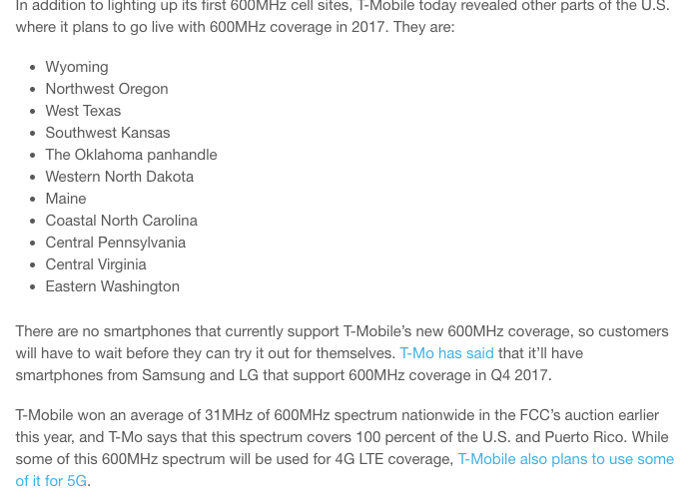
T-Mobile 600 MHz spectrum
Band class 71

Slide 63
3.5 GHz CBRS

Slide 64
3.5 GHz user classes
must not interfere
1
Federal users
Fixed satellite users (FCC)
census tract
≤ 70 MHz
3-year licenses
assigned via SAS
2
Priority licenses (PAL)
10 MHz channels in 3550-3650
3
General authorized use (GAL)
ESC (environmental sensing capability) allows commercial use in coastal and Great Lakes region

Slide 65
3.5 GHz band
FSS: C Band (3.625–4.200)

Slide 67
mmWave

Slide 68
mmWave bands
Notes:
Wells Fargo Wireless Spectrum Primer, 2017

Slide 69
mmWave bands for mobile systems (non-satellite)
Band | Available | Currently used
12.2-12.7 GHz | 500 MHz | Licensed to DISH (2004 & 2012)
24 GHz | 400 MHz | FiberTower, AT&T
28 GHz (LMDS) | 1.3 GHz | Verizon (via XO)
37 GHz | 1.6 GHz | greenfield
39 GHz | 1.4 GHz | FSS (unused), 14 blocks of 50+50; StraightPath (VZ)
57-71 GHz (V-band) | 14 GHz | unlicensed (WiGig)
71-76 + 81-86 GHz (E-band) | 10 GHz | light license
Notes:
https://docs.fcc.gov/public/attachments/DOC-347449A1.pdf

Slide 70
Atmospheric absorption
Notes:
Wikipedia

Slide 71
mmWave problems
Largely line-of-sight, but sometimes usable reflections by buildings
Absorbed by walls, rain, leaves, human body
Need very directional antennas → hard to make work for mobile devices
  Better for fixed wireless access
Absorption by hands holding device → external antenna (again)
→ most 5G mobile likely to use 3.5 GHz band initially

Slide 72
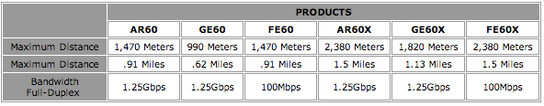
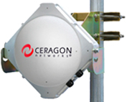
60 GHz+
60 GHz
unlicensed
Combine 5 + 60 GHz
“Up to 10Gbps full duplex throughput over ranges as far as 4.3 miles (6.9km)”
71-76 GHz + 81-86 GHz (FDD)
2 GHz channel

Slide 73
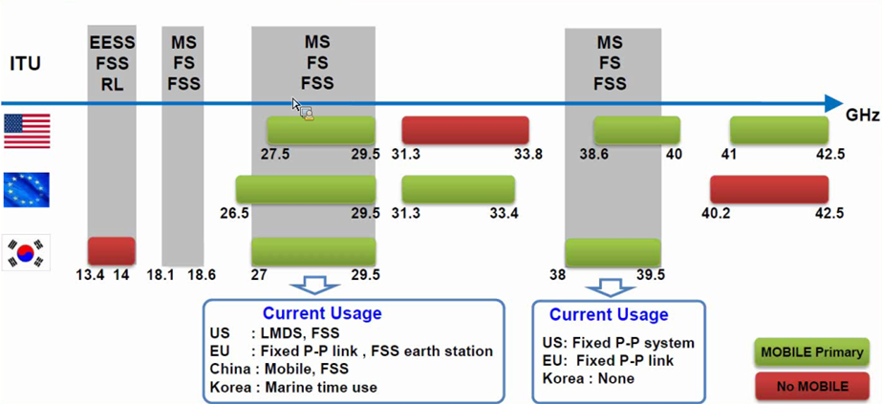
30-40GHz mmW – Spectrum Overview
Source : Samsung Communications Research Team
Note: The Commission’s Fixed Microwave (Part 101) and Satellite Communications (Part 25) service rules govern most of US Mobile allocations shown above
73

Slide 74
MMW: Spectrum Frontiers R&O
Core Principles
  Identify substantial spectrum in MMW bands for new services
  Protect incumbent services against interference
  Flexible use: enable market to determine highest valued use
  Overlay auctions where no existing assignments
  Provide spectrum for both licensed and unlicensed use
R&O – 10.85 GHz added for mobile service (July 2016)
  Licensed bands (3.85 GHz): 27.5-28.35 GHz; 37-38.6 GHz; 38.6-40 GHz
  Unlicensed bands (7 GHz): 64-71 GHz
FNPRM – seeks comment on another 18 GHz & above 95 GHz
  24.25-24.45 GHz; 24.75-25.25 GHz; 31.8-33.4 GHz; 42-42.5 GHz; 47.2-50.2 GHz; 50.4-52.6 GHz; 71-76 GHz; 81-86 GHz; bands above 95 GHz
Licensing, operating and regulatory rules
  Part 30: Upper Microwave Flexible Use Service (UMFUS)
  Geographic area licensing, area size, band plan, license term

Slide 75
MMW final technical rules
Flexible Duplexing (TDD or FDD)
TX Power
  Max EIRP of 75dBm/100MHz for BS; 43 dBm for MS; 55 dBm for transportable stations
Out of Band Emissions (OOBE)
  -13dBm/MHz in conducted or radiated equivalent (i.e. includes TRP measurement)
  -5dBm/MHz within the 10% of the occupied bandwidth from the channel edge
Field strength at market borders
  -76dBm/m²/MHz (measured at 1.5 meters above ground)
Same Part 15 rules for 57-71GHz band
  Average EIRP ≤ 40 dBm and Peak EIRP ≤ 43 dBm
  On-board aircraft service is not allowed
  Short-range mobile field disturbance sensors are permitted at reduced power level (less than 10dBm of output power)
Existing Part 101 limits for fixed point-to-point and point-to-multipoint service

Slide 76
Exploring alternatives

Slide 77
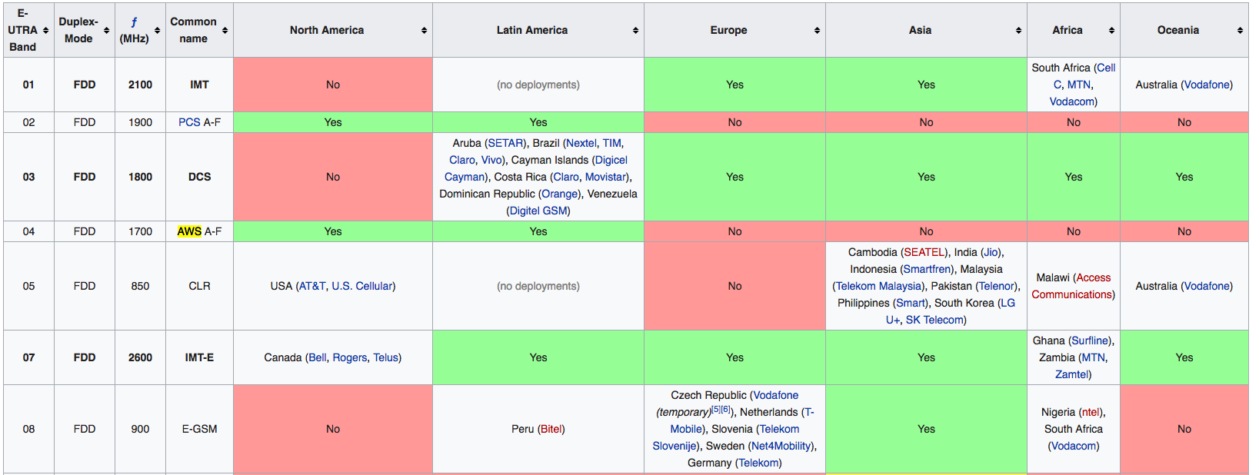
The world is not converging
https://en.wikipedia.org/wiki/LTE_frequency_bands
Notes:
https://www.frequencycheck.com/interfaces/umts-hspa

Slide 78
Do more with more or less
Action | Advantage | Drawback
Buy more spectrum (auction or private) | scales linearly investment property | scales linearly expensive timing & location unpredictable rely on competitors
Better technology (modulation, power, bidirectional, massive MIMO) | cheap | mostly played out requires densification
More cell sites | scales adaptive | costly monthly rent for sites

Slide 79
Auctions have limitations
One-time estimate of value
  most spectrum is licensed indefinitely
  technology may change value – up or down
    e.g., small cells, MIMO
  new neighbors may change value
May encourage speculation
  build-out requirements help (and common), but can be 3-10 years
Relies on small (3-4) number of carriers
  only subscription model
  how do you aggregate the value of 5.8 GHz spectrum?
Likely necessary where spectrum requires nationwide multi-$B investment

Slide 80
Alternative models
Sharing by usage modes
  indoor vs. outdoor
  satellite vs. terrestrial (directional antennas!)
  multiple bands → rendezvous band → spectrum database
Unlicensed initially only home and enterprise
  and limited rural wireless ISPs (WISPs)
Or: private transactions only (like most real estate)
  has been difficult for government holders (incentives unclear – huge auction == 1 aircraft carrier)
But CableWiFi and FON show other models
  cheap infrastructure
  existing high-capacity fiber/coax deployment (backhaul)
  emphasis on nomadic, not mobile, use
  emphasis on data, not voice → tolerate quality variability
  easily shareable among providers (just authentication)
→ neutral spectrum provider
  cf. shared infrastructure models (Europe)

Slide 81
Make the network location-aware
2G/3G/4G are location-ignorant: “I only know your cell sector”
All mobile devices will be location-aware to the ~5 m
Some know where they will likely be in the near future
  public transit
  road navigation systems
  ➔ predict access and hand-off
All devices will have multiple radios
  use macro cell network to query for local access

Slide 82
Outlook
Move from purpose-specific to generic spectrum
Spectrum rules tend to evolve (slowly)
  e.g., sharing conservative → liberal
Consider setting expectations for receivers (“no right to complain”)
  currently, implicit by original occupancy
Simple spectrum database models
  but increasingly dynamic data in space & time (e.g., mobile primary users)
  start with either licensed or generic “rendezvous” channel
  ask database for channels available across many bands (e.g., IETF PAWS)
Need for more constrained unlicensed bands?
  long range, low duty cycle networks – rendezvous, low-bandwidth IoT
  rent short-term

Slide 83
Backup

