Slide 1
Scalable enforcement
Henning Schulzrinne
Columbia University

Slide 2
New Jersey Man
Notes:
https://www.fcc.gov/document/32k-penalty-proposed-use-gps-jammer-individual

Slide 3
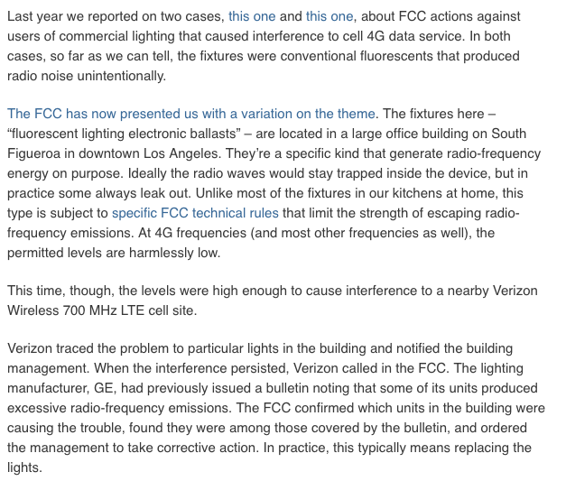
LED lighting
https://www.commlawblog.com/2014/02/articles/enforcement-activities-fines-forfeitures-etc/bulbs-behind-bars-iii-more-lighting-fixtures-mess-up-mobile-data-service/

Slide 4
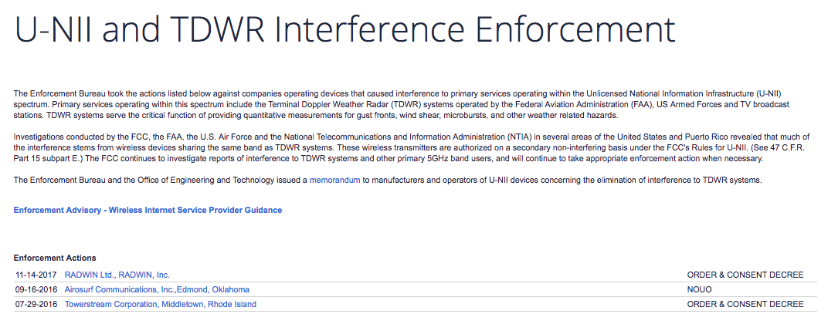
U-NII
Notes:
https://www.fcc.gov/general/u-nii-and-tdwr-interference-enforcement

Slide 5
Interference - means, motive & opportunity
intentional
malicious
active evasion
unintentional
non-malicious
intentional
non-malicious
“nobody is harmed”
local GPS jamming
no FCC equipment
authorization
GPS jamming
LED lighting
UNI DFS disabling
WISP power amplifiers
Stingray (foreign intelligence)

Slide 6
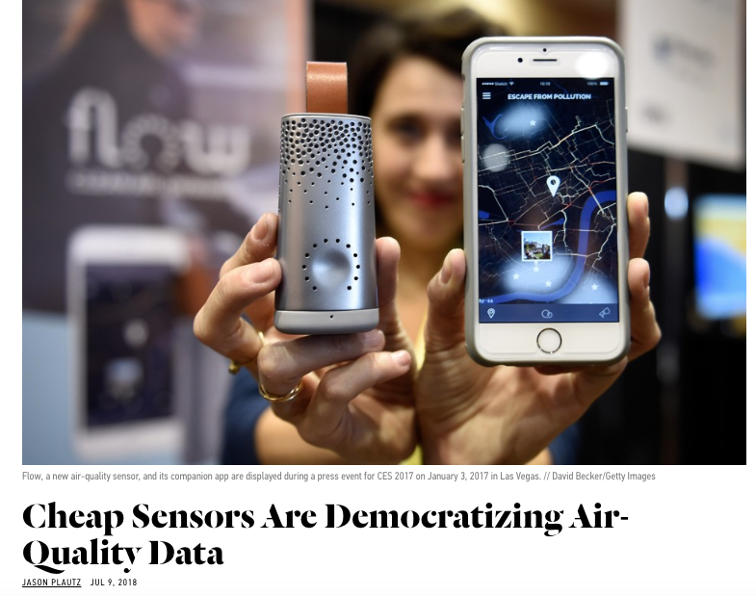
Scalable enforcement
➔ network of spectrum sensors – but are they legal?
Automatic station identification ➔ may work for Wi-Fi and other intentional transmitters, but not noisy LEDs and GPS jammers
FCC field offices: 3 regions (Columbia, MD; Atlanta, GA; Los Angeles, CA) + Boston, MA; Chicago, IL; Columbia, MD; Dallas, TX; Denver, CO; Honolulu, HI; Miami, FL; New Orleans, LA; New York, NY; Portland, OR; and San Francisco, CA)
54 staff (GAO, 2017)
Notes:
https://www.gao.gov/products/GAO-17-727

Slide 7
Intercept: 18 U.S. Code § 2511
(1) Except as otherwise specifically provided in this chapter any person who—(a) intentionally intercepts, endeavors to intercept, or procures any other person to intercept or endeavor to intercept, any wire, oral, or electronic communication;
  (ii) such device transmits communications by radio, or interferes with the transmission of such communication; …
(g) It shall not be unlawful under this chapter or chapter 121 of this title for any person—
  (i) to intercept or access an electronic communication made through an electronic communication system that is configured so that such electronic communication is readily accessible to the general public;
  (iv) to intercept any wire or electronic communication the transmission of which is causing harmful interference to any lawfully operating station or consumer electronic equipment, to the extent necessary to identify the source of such interference; or
  (v) for other users of the same frequency to intercept any radio communication made through a system that utilizes frequencies monitored by individuals engaged in the provision or the use of such system, if such communication is not scrambled or encrypted.
Notes:
https://www.law.cornell.edu/uscode/text/18/2511
https://www.justice.gov/usam/criminal-resource-manual-1066-interception-radio-communications-47-usc-605

Slide 8
18 U.S. Code § 2510 - Definitions
(16)“readily accessible to the general public” means, with respect to a radio communication, that such communication is not—
  (A) scrambled or encrypted;
  (B) transmitted using modulation techniques whose essential parameters have been withheld from the public with the intention of preserving the privacy of such communication;
  (C) carried on a subcarrier or other signal subsidiary to a radio transmission;
  (D) transmitted over a communication system provided by a common carrier, unless the communication is a tone only paging system communication; or
  (E) transmitted on frequencies allocated under part 25, subpart D, E, or F of part 74, or part 94 of the Rules of the Federal Communications Commission, unless, in the case of a communication transmitted on a frequency allocated under part 74 that is not exclusively allocated to broadcast auxiliary services, the communication is a two-way voice communication by radio;

Slide 9
47 U.S. Code § 705
No person not being authorized by the sender shall intercept any radio communication and divulge or publish the existence, contents, substance, purport, effect, or meaning of such intercepted communication to any person. No person not being entitled thereto shall receive or assist in receiving any interstate or foreign communication by radio and use such communication (or any information therein contained) for his own benefit or for the benefit of another not entitled thereto. No person having received any intercepted radio communication or having become acquainted with the contents, substance, purport, effect, or meaning of such communication (or any part thereof) knowing that such communication was intercepted, shall divulge or publish the existence, contents, substance, purport, effect, or meaning of such communication (or any part thereof) or use such communication (or any information therein contained) for his own benefit or for the benefit of another not entitled thereto.
Notes:
https://www.fcc.gov/consumers/guides/interception-and-divulgence-radio-communications
https://www.law.cornell.edu/uscode/text/47/605

Slide 10
Google StreetView (2010-2012)
Notes:
FCC DA 15-592

Slide 11
Google StreetView

Slide 12
Conclusion
FCC enforcement is driven by complaints and prioritization
  life safety, commercial TV & radio, cellular
Direction finder model does not scale
  particularly with reduced field staff
Automating enforcement has been discussed, but difficult
  mobile, short range, intermittent
  non-traditional emitters (LEDs, BitCoin mining)
Wireless intercept rules lack clarity
  intent, encryption, usage, bands (satellite, cellular)
  but relatively clear for interference mitigation

