Slide 1
Nobody answers their phone anymore! How to prevent death-by-robocall for phone calls
Henning Schulzrinne
October 2018

Slide 2
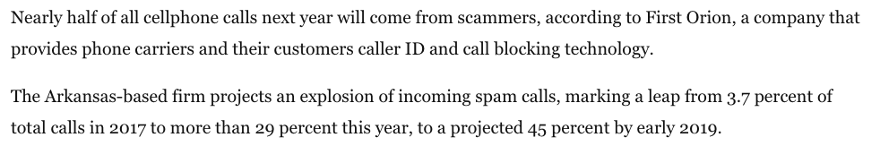
“You won the Nobel prize. You just have to wire some money.”
When the Swedish Royal Academy of Sciences called New York University professor Paul Romer early this morning to inform him that he was co-recipient of this year's Nobel Prize in Economics, the veteran professor let the call go to voicemail, thinking that only a telemarketing call could be coming in at such an early hour.
“I didn't answer the phone because I've been getting so many spam calls," Romer told ABC News. "I just assumed it was more spam."
Notes:
https://abcnews.go.com/US/economist-won-nobel-prize-thought-early-morning-call/story?id=58358633

Slide 3
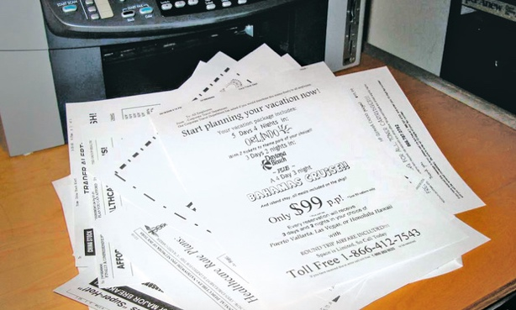
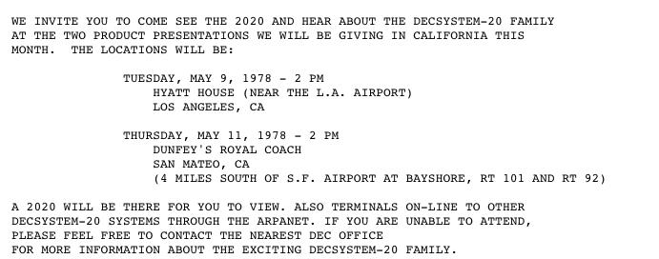
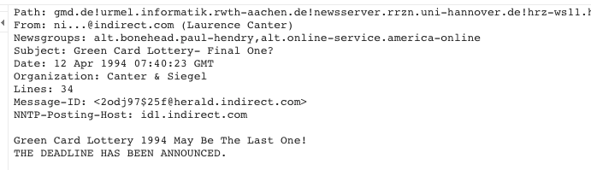
All open communications media attract spam
1996: US Standard Mail (bulk mail) created
2005: Standard Mail volume outpaces First-Class Mail volume
1985: invention of computer-based fax board
2005: Junk Fax Prevention Act (47 USC 227)
1978: email spam (DEC-20)
Jan 1994: “Global Alert For all: Jesus is Coming Soon:
April 1994: Canter & Siegel green card lottery
1994: MAKE MONEY FAST!
Notes:
https://groups.google.com/forum/#!original/alt.online-service.america-online/-F9L_Y2YvHM/9mg3paxBqAUJ

Slide 4
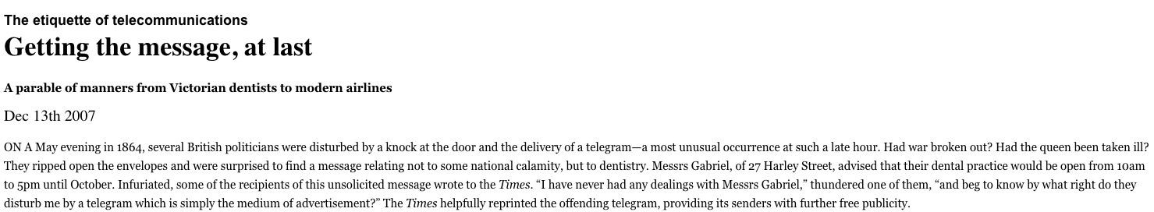
Telegraph spam - 1864
Economist
Notes:
https://www.economist.com/node/10286400/print?story_id=10286400

Slide 5
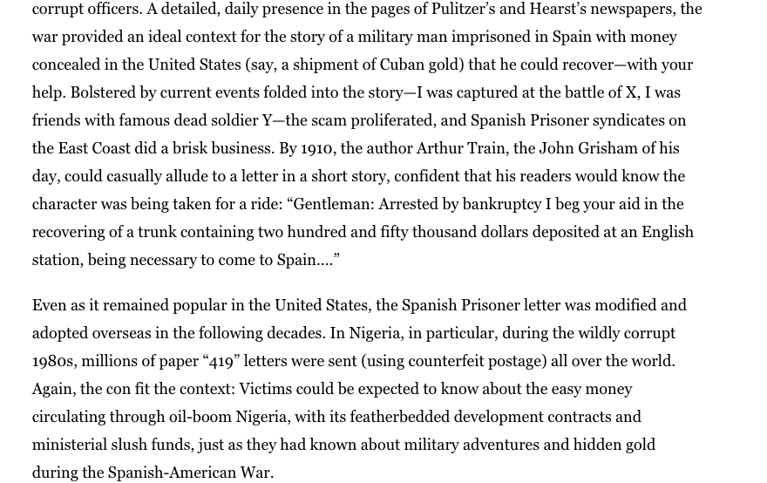
Nigerian “advance fee” scam
Notes:
https://www.bostonglobe.com/ideas/2013/05/18/the-long-weird-history-nigerian-mail-scam/C8bIhwQSVoygYtrlxsJTlJ/story.html

Slide 6
VoIP & Robocalling background

Slide 7


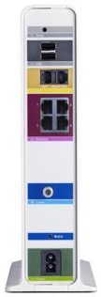
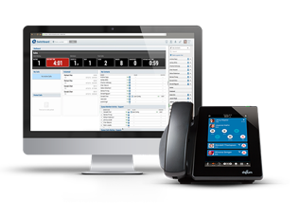
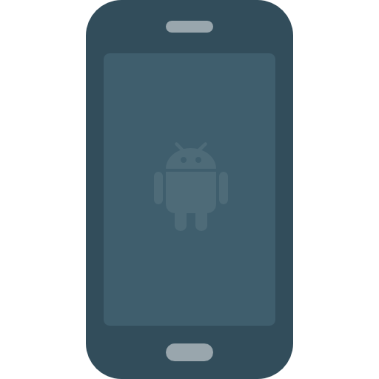

The flavors of VoIP
Local
ISP
The Phone Company
”over-the-top” (OTT)
Local
ISP
“triple play”
Using DOCSIS
Enterprise VoIP
business
ISP
CMRS
(cell) using
IMS
SIP trunking

Slide 8
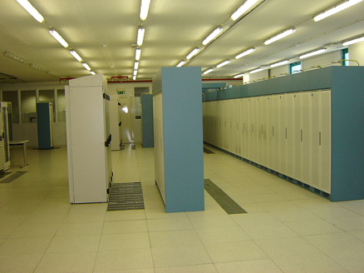
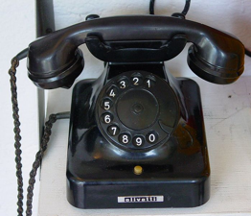
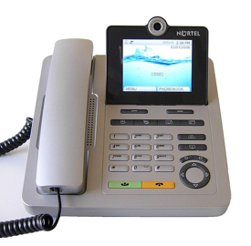

What has changed?
one assigned
number
customer
local exchange carrier
can’t tell end user from provider → can use any number

Slide 9
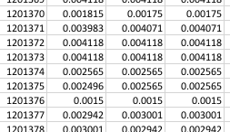
What makes VoIP different?
International ~ national calls
  Internet transport to domestic gateways
Low cost
  0.2 to 0.4 c/minute
Programmability
  E.g., Asterisk

Slide 10
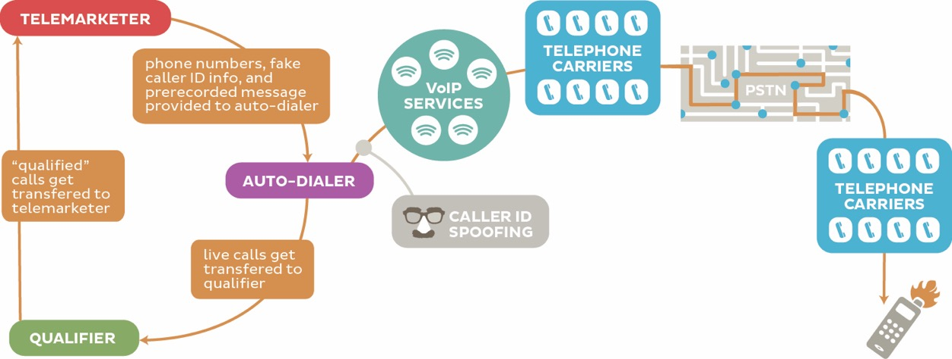

Slide 11
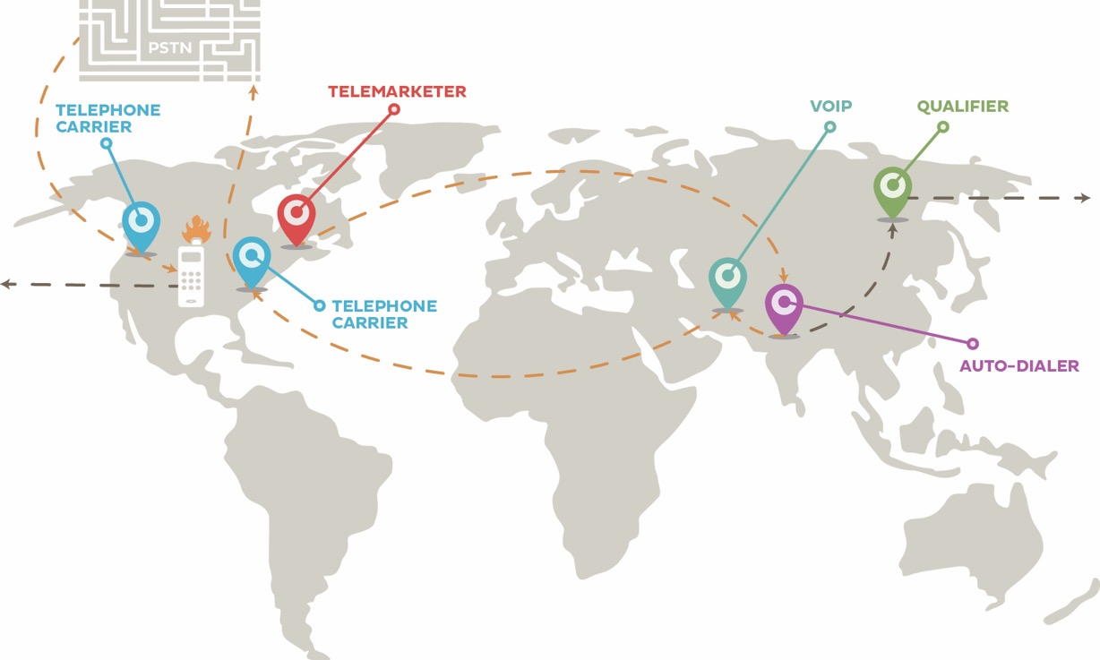

Slide 13
Robocalling
Cheap VoIP
Number spoofing
Cheap labor
English-language countries
Or recent Chinese visa fraud

Slide 14
Robocall prohibitions
 | Wireline residential | Wireline business | Wireless (mobile)
not on DNC | pre-recorded TM | no restriction | pre-recorded non-emergency auto-dialed non-emergency
on DNC | any telemarketing | any telemarketing | Any telemarketing pre-recorded non-emergency auto-dialed non-emergency

Slide 15
How to prevent…
Content | Method | Wireline residential | Wireline business | Wireless (mobile)
Telemarketing | Manual | DNC | DNC | DNC
 | Auto-dialed | DNC | DNC | ❌
 | Pre-recorded | ❌ | DNC | ❌
Informational (including political, charity, polling) | Manual | can’t prevent | can’t prevent | can’t prevent
 | Auto-dialed or pre-recorded | opt-out | opt-out | ❌
Emergency | Any | permissible | permissible | permissible
Note: DNC does not cover calls from companies with which the customer has an existing
business relationship.

Slide 16
FCC blocking rules
2015 Order: carriers may offers customers tools to block unwanted robocalls
  Requires informed consumer opt-in
  Blocking permitted regardless of whether legal or illegal
November 2017: non-opt-in blocking for
  calls from invalid/unassigned numbers or
  if the subscriber assigned the number authorizes the blocking (e.g., IRS) → do not originate
Current debate: debt collectors
  33 state AGs:

Slide 17
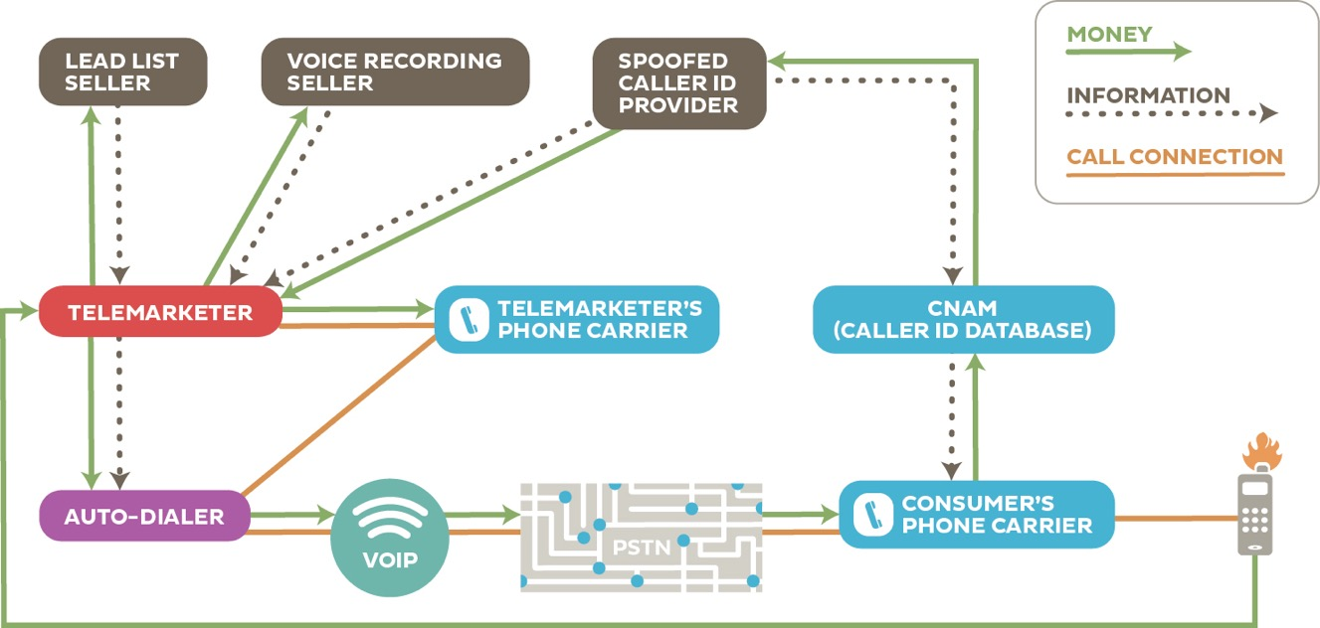

Slide 18
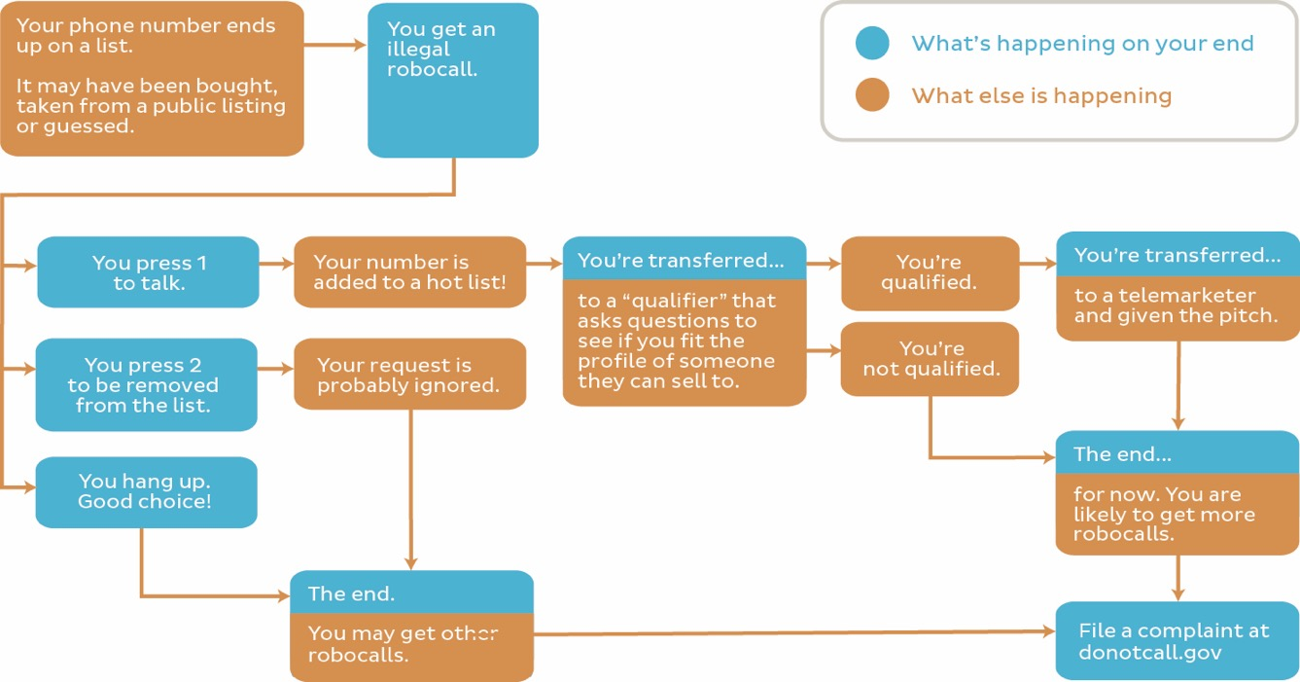

Slide 19
Spoofed
caller ID
robocalls
Voicemail impersonation
illegal
wanted
vishing
debt collectors
(traditional +
unregulated)
TDOS
swatting
toll fraud
unwanted
Spoofed
Caller ID or CNAM
robocalls

Slide 20
Hiya Q1 2018

Slide 21
Hiya Q2 2018

Slide 22
Hiya Q2

Slide 23
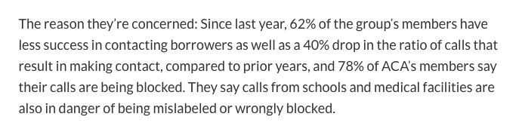
Notes:
https://www.marketwatch.com/story/flexing-their-muscles-debt-collectors-see-an-opportunity-to-fend-off-robocall-rules-2018-10-12

Slide 25
Not everybody likes call blocking
August 2018
October 8, 2018
Notes:
https://ecfsapi.fcc.gov/file/1008117346409/ACA%20Reply%20Comment%20Letter%20Call%20Blocking%20and%20Labeling.pdf
https://www.fcc.gov/ecfs/filing/1008117346409

Slide 26
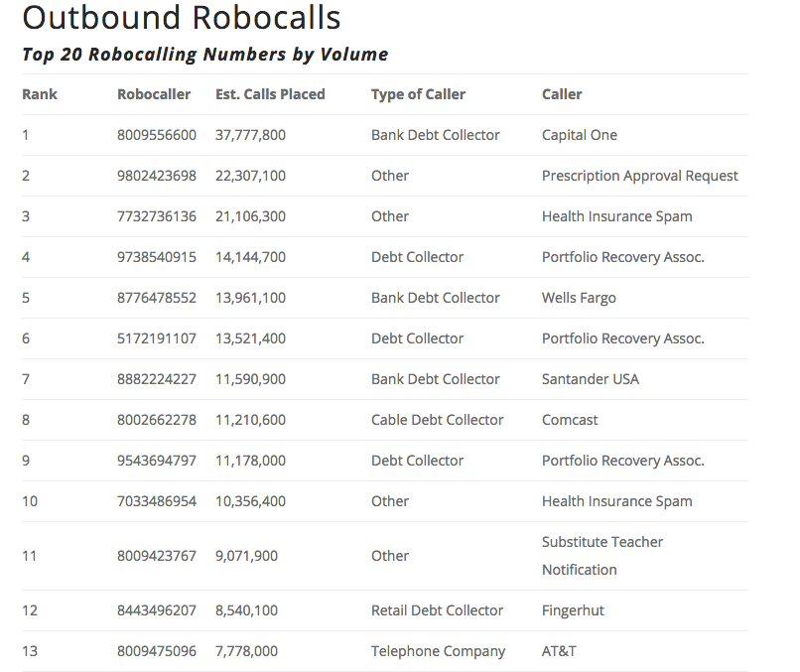
Notes:
YouMail - https://blog.youmail.com/2018/05/robocall-index-snapshot-april-2018/

Slide 27
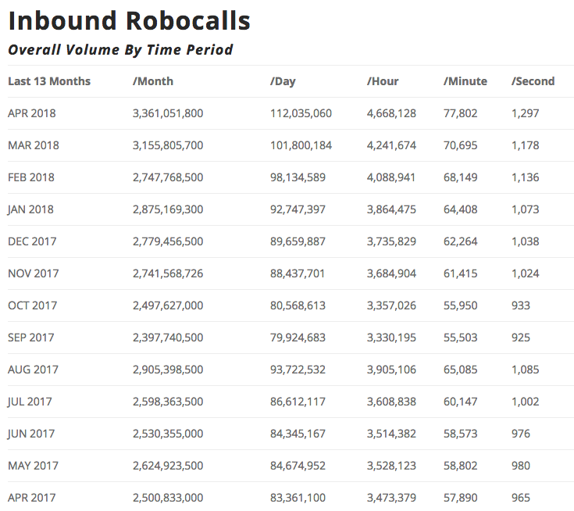
Notes:
YouMail - https://blog.youmail.com/2018/05/robocall-index-snapshot-april-2018/

Slide 28
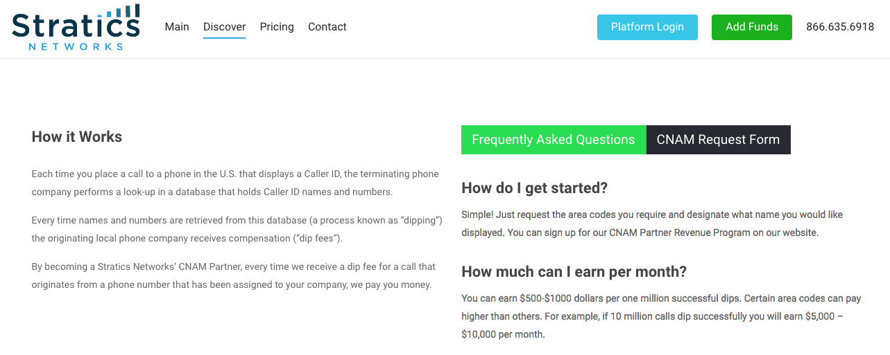
CNAM revenue sharing

Slide 29
Number spoofing

Slide 30
Two modes of caller ID spoofing
Impersonation
Anonymization
spoof target number
  personal or 800 number
Helpful for
  vishing
  stolen credit card validation
  retrieving voicemail messages
  SWATting
  disconnect utilities
  unwanted pizza deliveries
  retrieving display name (CNAM)
pick more-or-less random number
  including unassigned numbers
  “neighbor spoofing”
Helpful for
  robocalling
  intercarrier compensation fraud
  TDOS

Slide 31
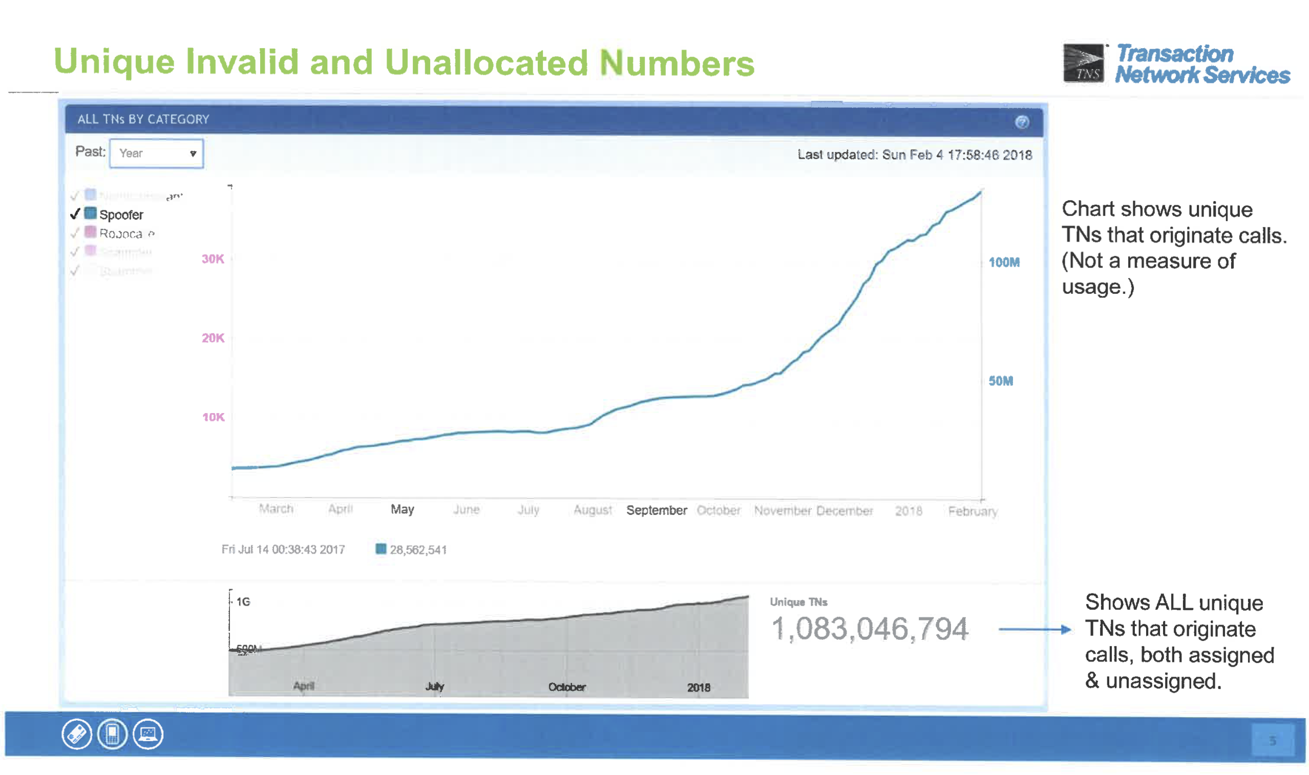
Spoofing
Feb. 2018
Notes:
https://www.fcc.gov/ecfs/filing/1020878019865

Slide 32
Spoofing & unwanted calls
10,000 victims
$54M losts
VM retrieval
spoof
specific
kidnapping
impersonation
spoof
random
telemarketing without callback
scams
bomb threats
can’t
spoof
(or unlikely)
international toll
telemarketing with callback
unwanted
surveys &
charity calls
telemarketing
real goods
(energy plans)
telemarketing
scams
(vacation, lucky
winner)
extortion
(pay or
arrest/deport)
individualized
threats

Slide 33
Legitimate caller ID spoofing
Doctor’s office
  call from personal physician cell phone should show doctor’s office number
Call center
  airline outbound contract call center should show airline main number, not call center
Multiple devices, one number
  provide single call-back number (e.g., Google Voice) from all devices
anonymity is distinct problem (caller ID suppression)

Slide 34
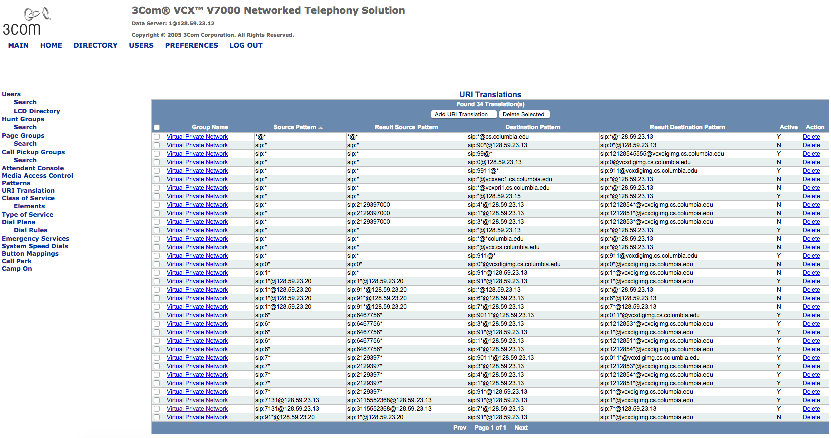


Slide 35
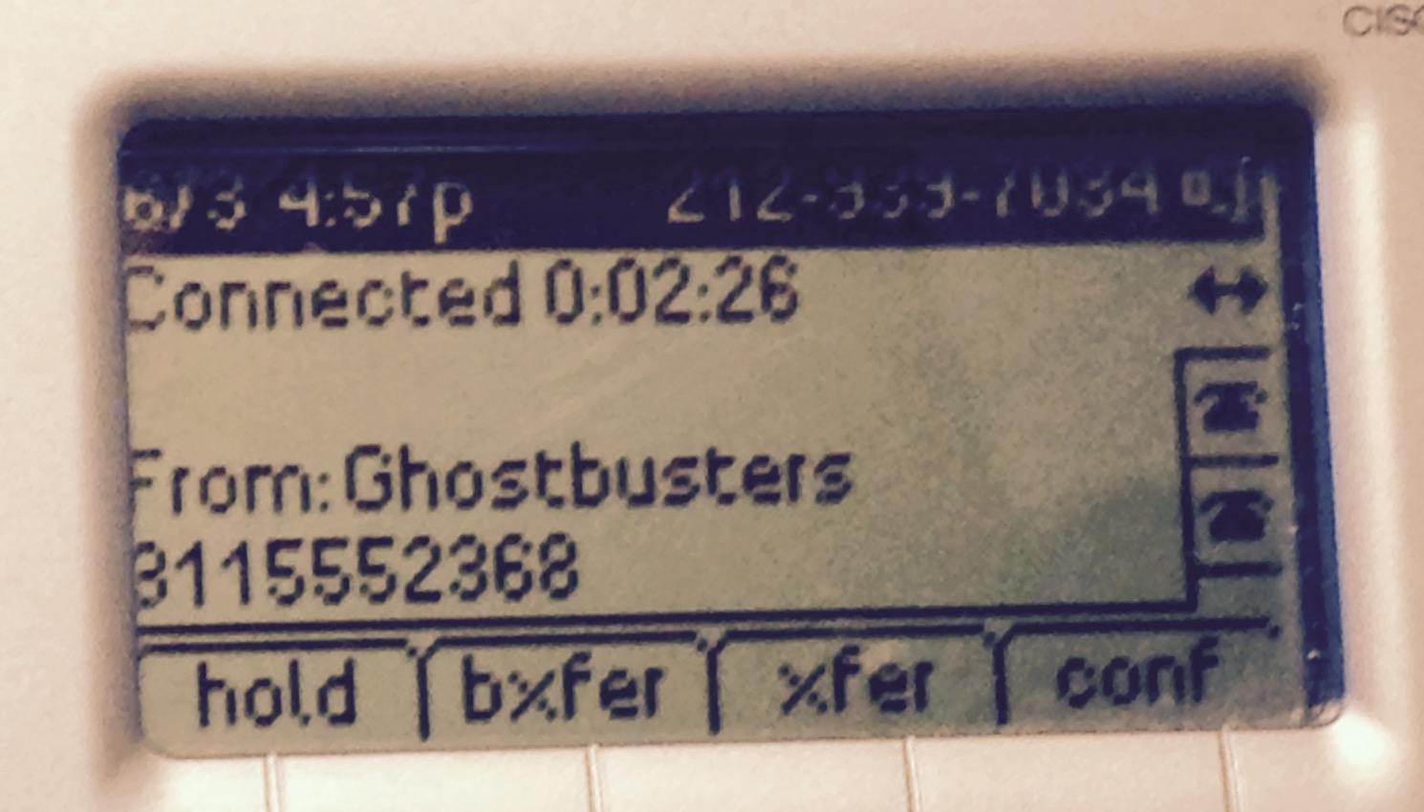

Slide 36
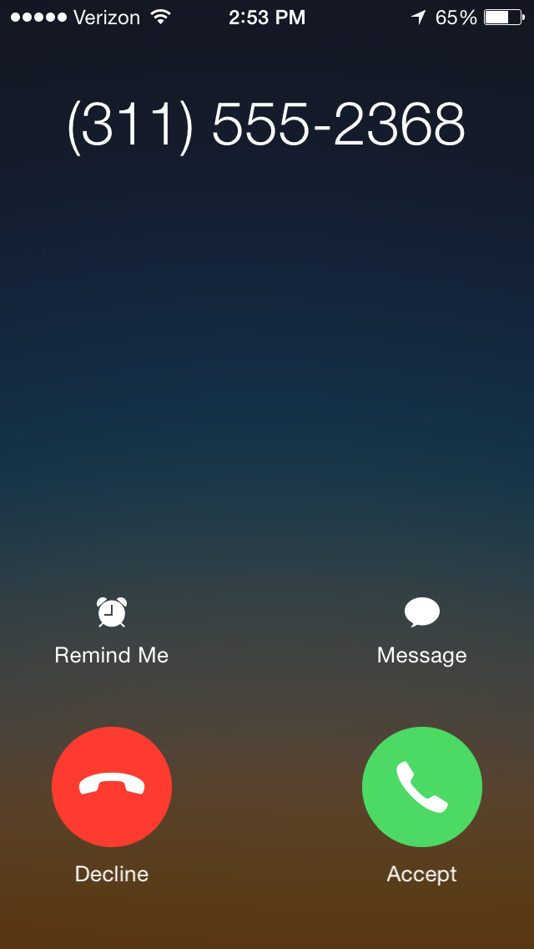
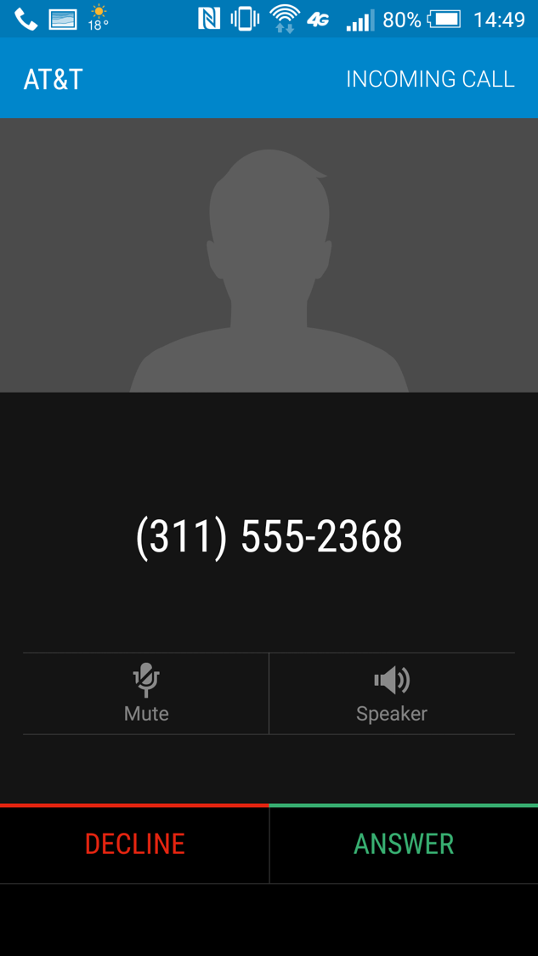

Slide 37
Robocall mitigation

Slide 38
Why not use email spam filtering techniques?
 | Email | Phone calls
Name space | infinite | relatively small
Content inspection | common | not possible
Addresses | IP address – non-spoofable for TCP Email address – easily spoofable | Phone number -- spoofable
Delivery | filtered by provider: block lists (e.g., Spamhaus) SPF, DKIM | interconnection and delivery obligations
Delivery trace | Received-by headers | Via headers – only for end-to-end VoIP calls
Limited-use address | easy (e.g., web mail) | not feasible
Consent-based | CAPTCHA systems (not common) | likely too annoying
see also RFC 5039

Slide 39

Who can do what?
Carriers by themselves
  Work with third parties (Nomorobo, FirstOrion, TNS, …)
  Modify CNAM to show reputation of calling party (→ Verizon)
    But limited display capability
Carriers in cooperation
  STIR/SHAKEN
  Industry-wide blacklist
  Common white list
  Do-not-originate
First Orion

Slide 40
Solution set
remove invalid & unassigned #s
improved traceback
caller authentication
(identity assertion)
do not originate
(e.g., block IRS)
block unauthenticated calls
user feedback → black lists
strong white lists
simultaneous ringing (e.g., Nomorobo)
strong black & white lists
no authentication
partial authentication
all authenticated

Slide 41
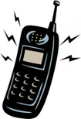

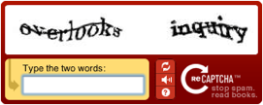

Incremental deployment
signed?
N
Y
should be signed?
validates?
N
Y
N
Y
known caller?
N
Y
N
Y

Slide 42


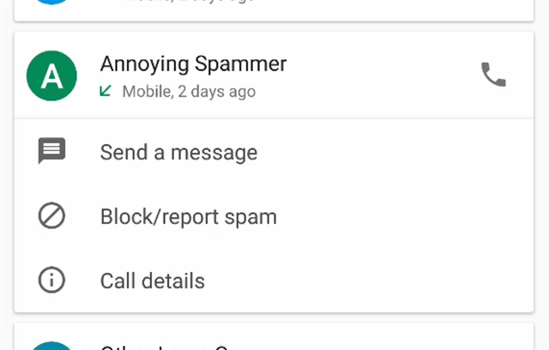
Populating blacklists
Consumer complaints
app feedback

Slide 43
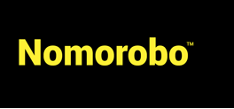
Consumer solutions
Apps
  Don’t work well for iOS (need to download blacklist)
  Some “leakage” due to new number spoofing
  Likely to increase if they get more effective
Nomorobo
  Relies on SIP parallel forking (aka simultaneous ringing) feature → VoIP only
    Robocall will ring once
    second number is an 800# at Nomorobo
  Confusing: FiOS Verizon Freedom Essentials (no) vs. Digital Voice (yes)
TNS CallGuardian
Notes:
https://tnsi.com/product/robocall-protection/

Slide 44
Verizon call marking (2018)

Slide 45
Blacklist & whitelist problems
Blacklist
  Not too useful without authentication
  Most useful: invalid, unassigned numbers & area codes
  Do Not Originate (DNO) – numbers known not to make outbound calls
    E.g., IRS, 555
  Complaint about over-blocking (e.g., PACE, SiriusXM, Securus for inmate calls) → illegal vs. unwanted in FCC 17-59
Whitelist
  No industry-wide effort
  Likely hard for accidental inclusions to find appropriate organization
  See CNAM caller ID problems
  How do validate legitimate robocallers?
    No (FCC) license for medical notification services
    But bonding may be an option
Re-assigned number database
  Who will pay?
Notes:
SiriusXM: https://www.fcc.gov/ecfs/filing/10222944628403
Securus: https://www.fcc.gov/ecfs/filing/10507303086058

Slide 46
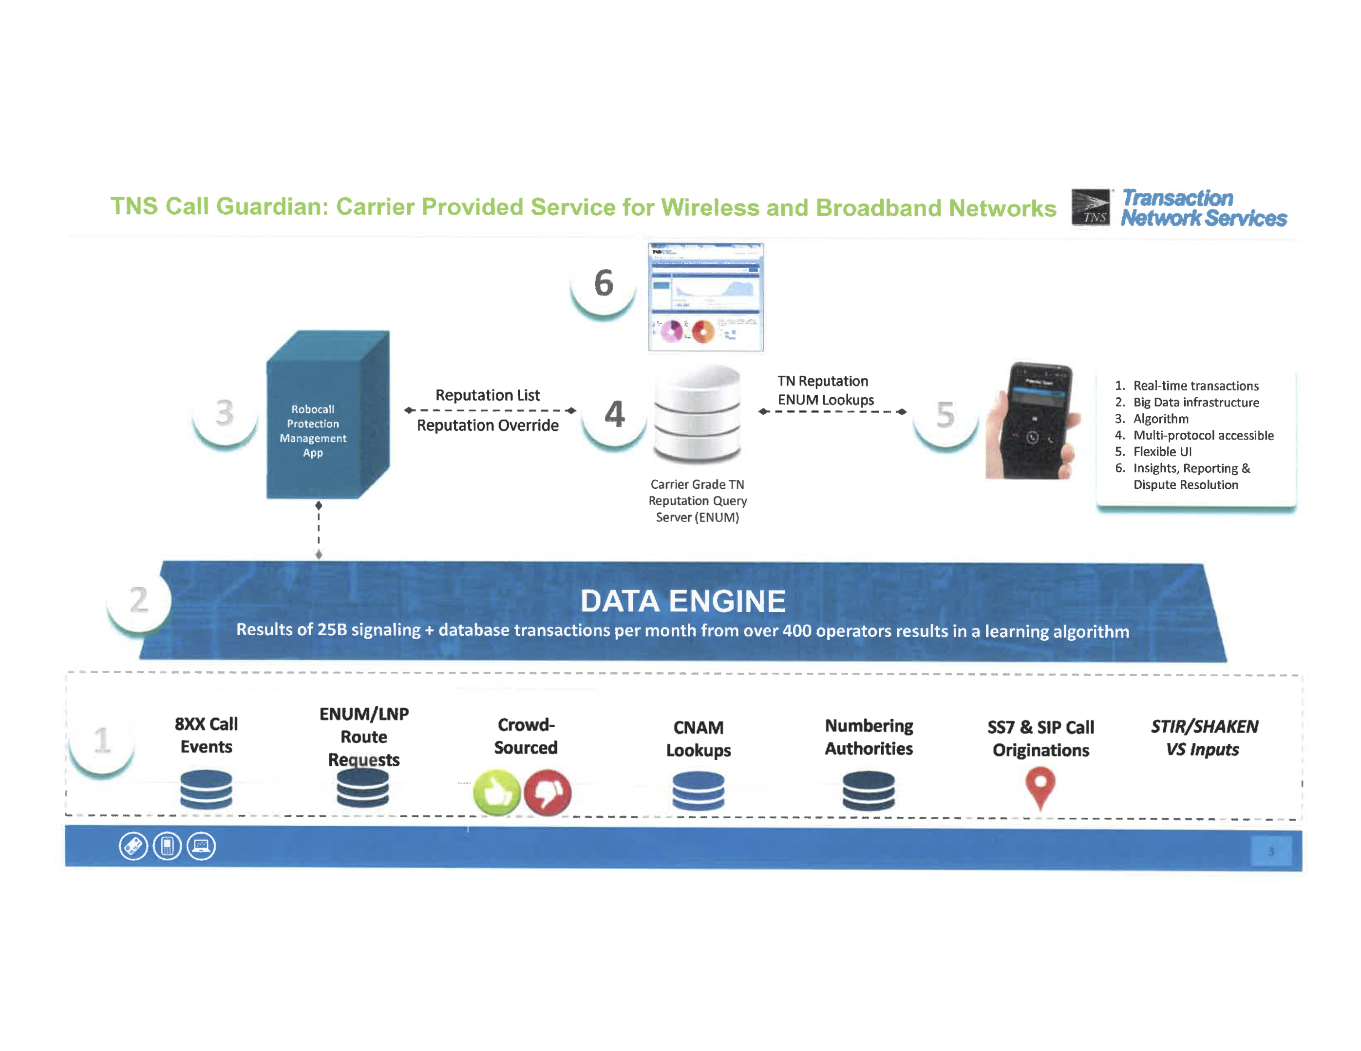
Example: TNS Call Guardian
Notes:
https://www.fcc.gov/ecfs/filing/1020878019865

Slide 47
Frankel proposal
All originating providers should do three things:
  Permit volume calling only by vetted originators
  Include a Billing Telephone Number linked to the Originating Provider
    BTN is distinguished when:
      Commercial caller uses an alternative provider for outbound traffic (call termination)
      Calls are placed “on behalf of” another number, or incoming calls are forwarded
      Calls are originated from outside USA
      Wireless subscriber roams off-network
  Cooperate with industry traceback efforts
Exception for vetted customers
  Legitimate volume call originators subscribe to published best practices
  Third-party auditing and compliance
  Referenceable by providers, analytics companies, regulatory enforcement
Notes:
https://ecfsapi.fcc.gov/file/1040682300200/Robo-ExParte-2018-Apr-ZipDX.pdf

Slide 48
STIR/SHAKEN

Slide 49
The role of STIR/SHAKEN
Ensure that caller is authorized to use calling number
  Identify originating carrier (or close to it)
  Prevent impersonation and randomization
STIR: protocol additions to VoIP call signaling protocol (SIP) → IETF
SHAKEN: guidelines for using STIR in carrier networks → ATIS & SIPForum

Slide 50
Architecture for robocall prevention
Check STIR signature
look up category based on number (optional)
indicate probability(spam)
“analytics”
“big data”
carrier
SIP
proxy
SIP
proxy
”survey”
external
service
607 Unwanted
RFC 8197
STIR signing
RFC 8224

Slide 51
STIR + SHAKEN
Chris Wendt, SIPNOC 2016

Slide 52
SHAKEN reference architecture

Slide 53
STIR/SHAKEN organizational model

Slide 54
STIR / SHAKEN governance
Notes:
ATIS SHAKEN governance authority, May 4, 2017 ex-parte

Slide 55
STI-GA, STI-PA, STI-CA
STI-GA (governance)
  Defining the policies and procedures governing which entities can acquire STI certificates.
  Establishing policies governing which entities can manage the PKI and issue STI certificates.
  Established 2018 via ATIS, but still finalizing board.
STI-PA (policy)
  Policy enforcement role
  Keeps list of CAs
  Digitally signs service provider tokens
STI-CA (certificate)
  Issues certificates to carriers (and other entities)

Slide 56
SHAKEN attestation
A: full attestation | Is responsible for the origination of the call onto the IP based service provider voice network. Has a direct authenticated relationship with the customer and can identify the customer. Has established a verified association with the telephone number used for the call.
B: partial attestation | Is responsible for the origination of the call onto its IP-based voice network. Has a direct authenticated relationship with the customer and can identify the customer. Has NOT established a verified association with the telephone number being used for the call.
C: gateway attestation | Is the entry point of the call into its VoIP network. Has no relationship with the initiator of the call (e.g., international gateways).

Slide 57
SHAKEN PASSporT = JWS token
ECDSA elliptic curve
PASSPorT type
Protected Header
{
"alg":"ES256", "typ":"passport", "ppt":"shaken”,
"x5u":"https://cert.example.org/passport.crt"
}
Payload
{
"attest":"A",
"dest": {"tn":["12125551213"]},
"iat": 1443208345,
"orig": {"tn":"12155551212"},
"origid":"123e4567-e89b-12d3-a456-426655440000"
}
X.509 certificate URL
timestamp (Unix)
UUID (opaque)
e.g., traceback, class of service
Notes:
ATIS-1000074

Slide 58
Non-VoIP termination
VoIP
TDM
Telephone network
Caller ID
Invalid → e.g., set to 000-000-0000
Validated → screening indicator
SPAM?
Notes:
https://www.verizon.com/support/residential/homephone/calling-features/stop-unwanted-calls
Q.763
https://adamdoupe.com/publications/toward-authenticated-caller-id-transmission-itu2016.pdf

Slide 59

PSTN: draft-ietf-stir-oob
212-555-1234
VoIP
TDM
Telephone network
Caller ID
CPS
Query CPS
Valid → !CHARLIE
Invalid → INVALID
Unknown → ?CHARLIE
Key(212-555-1234)

Slide 60
STIR/SHAKEN issues
Network issues
  Works best with IP interconnection
    But can work for VoIP-VoIP-…-VoIP-PSTN (trusted)-PSTN (terminating)
Attestation level
  May need additional operational support – is this line authorized to use number X?
  Harder for VoIP gateways
Call forwarding
  Sign original caller or forwarding caller?
  Work in progress in ATIS
Legitimate spoofing
Call signaling equipment
  Diversity of providers
  Some are no longer in business or have been acquired

Slide 61
SIP INVITE example
INVITE sip:+12155551213@tel.example1.net SIP/2.0
Via: SIP/2.0/UDP
10.36.78.177:60012;branch=z9hG4bK-524287-1---77ba17085d60f141;rport
Max-Forwards: 69
Contact: <sip:+12155551212@69.241.19.12:50207;rinstance=9da3088f36cc528e>
To: <sip:+12155551213@tel.example1.net>
From: "Alice"<sip:+12155551212@tel.example2.net>;tag=614bdb40
Call-ID: 79048YzkxNDA5NTI1MzA0OWFjOTFkMmFlODhiNTI2OWQ1ZTI
P-Asserted-Identity: "Alice"<sip:+12155551212@tel.example2.net>,tel:+12155551212
CSeq: 2 INVITE
Allow: SUBSCRIBE, NOTIFY, INVITE, ACK, CANCEL, …, MESSAGE, OPTIONS
Content-Type: application/sdp
Date: Tue, 16 Aug 2016 19:23:38 GMT
Identity: eyJhbG…doDtCA; info=<http://cert.example2.net/example.cert>;alg=ES256
BASE64URL(UTF8(JWS Protected Header))
. BASE64URL(JWS Payload)
. BASE64URL(JWS Signature)

Slide 62
draft-sipcore-callinfo-spam
Conveys information from carrier (SBC, CSCF) to UA
Parameters:
  spam: estimated likelihood of spam (0-100%), i.e., measure of uncertainty
    could be related to what fraction of called parties label this number as spam
  type: type of caller
    for VoIP home gateways, could be displayed via caller ID (CNAM)
  reason: source of data
    mostly, for debugging; similar to some email headers
  source: domain of entity inserting data
Example:
Call-Info: <http://wwww.example.com/5974c8d942f120351143> ;source=carrier.example.com ;purpose=info ;spam=85 ;type=fraud ;reason="FTC list"

Slide 63
Call categories
Category | Description
business | placed by businesses, i.e., an entity or enterprise entered into for profit. This type is used if no other, more precise, category fits.
debt-collection | collecting of debt owed or alleged to be owed by the called party
emergency-alert | provide the recipient warnings and alerts regarding a pending or on-going emergency. (unrelated to emergency calls to 9-1-1 or 1-1-2. Includes alerts related to weather-related school closings.)
fraud | considered to be fraudulent.
government | government entity, if no more specific label such as "health" or "debt-collection" is known or applies.
health | informational calls by health plans, … health care provider, …
informational | information about a transaction: package delivery, appointment reminder, order confirmation
not-for-profit | not-for-profit organization, including for soliciting donations or providing information

Slide 64
Call categories
Category | Description
personal | A non-business, person-to-person, call, e.g., from a residential line or personal mobile number
political | elections or other political purposes
prison | Calls from jails, prisons and other correctional facilities
public-service | Calls that provide the recipient information regarding public services, e.g., school closings
spam | likely unwanted, if not otherwise classified
spoofed | calling number for this call has been spoofed
survey | solicits the opinions or data of the called party
telemarketing | placed in order to induce the purchase of a product or service to the called party
trusted | The call is being placed by a trusted entity and falls outside the other categories listed. This may include call backs, e.g., from a conferencing service, or messages from telecommunication carriers and utilities.

Slide 65
Robocall Strike Force – Oct. 2016

Slide 66
Robocall Strike Force – Oct. 2016

Slide 67
Timelines
Verizon (as of May 7, 2018): “Verizon is committed to deploying the STIR/SHAKEN authentication standard in our networks. We described the investments Verizon is making and the work streams underway to update multiple network elements. We expect to achieve initial operational capability later this year, with the bulk of production anticipated for 2019.”
No other (known) public commitments
CATA report:
Notes:
https://www.fcc.gov/ecfs/filing/105072444807124

Slide 68
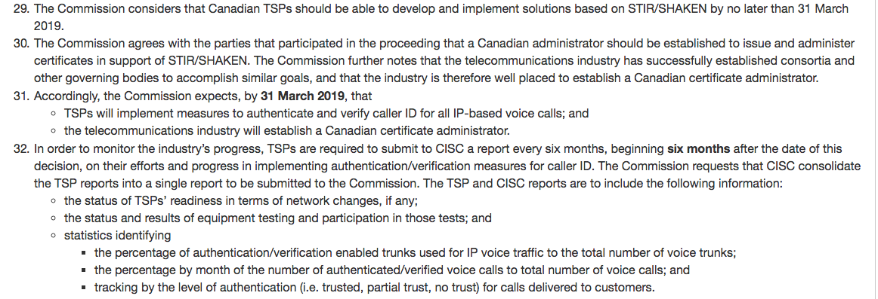
Canada – January 2018
Measures to reduce caller identification spoofing and to determine the origins of nuisance calls
https://crtc.gc.ca/eng/archive/2018/2018-32.htm

Slide 69
Tracking & tracing

Slide 70
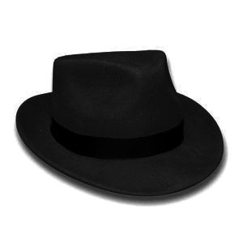
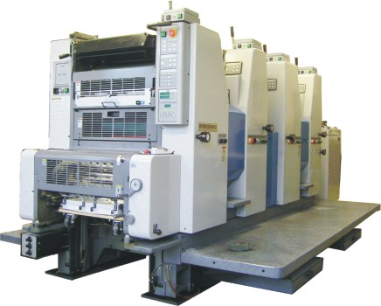


Law enforcement vs. robocallers
Agile numbering
Automated customer acquisition
Transnational
One faxed subpoena at a time
Manual trace-back
Largely domestic

Slide 71
It’s not just on the Caller ID……
It’s in the Call Billing Records
Hexadecimal Identifier (-1) = aa Structure Code (-2) = 41202c Call Code (1) = 006c Sensor Type (2) = 008c Sensor ID (Identification) (3) = 0212721c Recording Office Type (4) = 032c Recording Office ID (5) = 0480501c Date (6) = 30519c Timing Indicator (7) = 00000c Study Indicator (8) = 0000000c Answer Indicator (9) = 0c Service Observed, Traffic Sampled (10) = 2c Operator Action (11) = 2c Service Feature (12) = 000c Originating NPA (13) = 202c Originating Number (14) = 4561414c Overseas Indicator (15) = 0c Terminating NPA (16) = 00800c Terminating Number (17) = 4444444c
Hexadecimal Identifier (-1) = aa Structure Code (-2) = 41211c Call Code (1) = 015c Sensor Type (2) = 008c Sensor ID (Identification) (3) = 0212721c Recording Office Type (4) = 032c Recording Office ID (5) = 0480501c Date (6) = 30519c Timing Indicator (7) = 00000c Study Indicator (8) = 0000000c Answer Indicator (9) = 0c Service Observed, Traffic Sampled (10) = 2c Operator Action (11) = 3c Service Feature (12) = 000c Originating NPA (13) = 202c Originating Number (14) = 4561414c Overseas Indicator (15) = 0c Terminating NPA (16) = 00908c Terminating Number (17) = 6856777c

Slide 72
Traceback
With spoofing, has to do with
US Telecom traceback group (Kevin Rupy – ITB Group)
  22 carriers
  ATIS’ Service Provider Contact Directory (SPCD)
April 2017
Strike force report
Notes:
https://www.ustelecom.org/sites/default/files/documents/Senate-Commerce-Testimony-Rupy-April-18-2018.pdf

Slide 73
Traceback – US Telecom

Slide 74
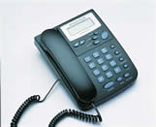
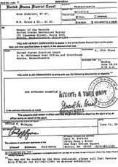
Via: SIP/2.0/TLS client.biloxi.example.com:5061;branch=z9hG4bKnashds7
;received=192.0.2.201
trace call route
VoIP provider A
VoIP provider B
§
§
§
automatically route subpoena

Slide 75
Conclusion
Predictable – automation + permissionless sending → unwanted communication
Robocalls threaten to make voice calls unusable
  and also enable other identity-related fraud
Preventing unwanted communication = strong identity + black lists + white lists + FCC rules + enforcement
STIR/SHAKEN as strong identity model
  requires PKI infrastructure
Solvable, but being implemented at telecom speed

