Slide 1
Making networks slower: 5G and IoT
Henning Schulzrinne (Columbia University)
NAE 5G Colloquium
November 2018
This material is based upon work supported by the National Science Foundation under Grant No. (CNS-1218977). Any opinions, findings, and conclusions or recommendations expressed in this material are those of the author(s) and do not necessarily reflect the views of the National Science Foundation.

Slide 3
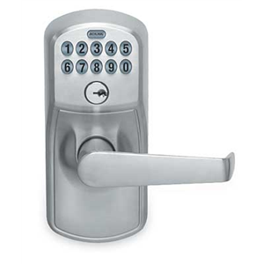
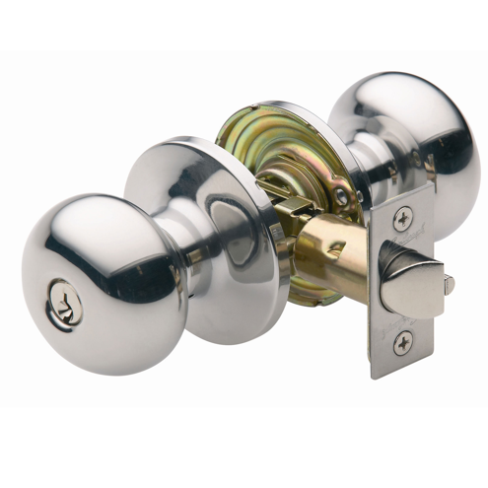
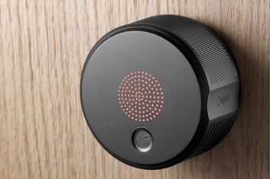
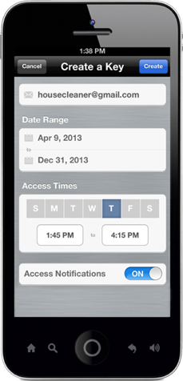
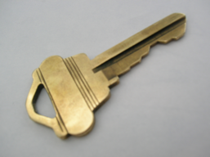

Natural evolution

Slide 4
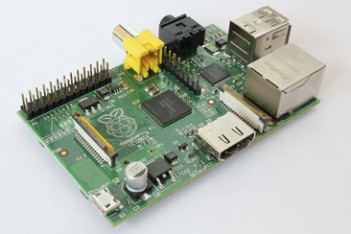
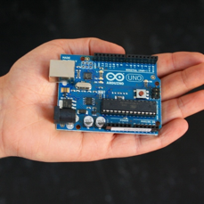
Key enablers
IoT
Cheap SOCs
Mature Internet protocols
Cellular connectivity
Unlicensed
Analytics
(“big data”)
Applications
Cloud-hosted applications & data

Slide 5

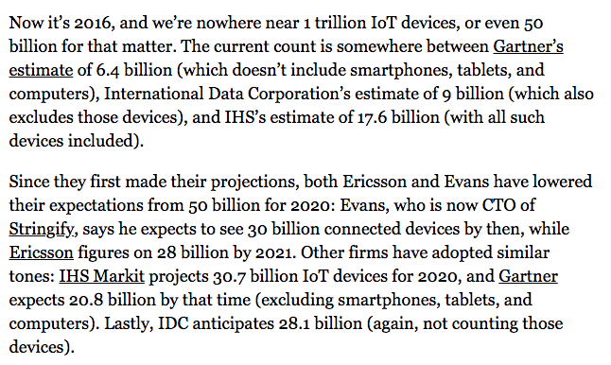

Pick your number
IEEE
Spectrum
8/2016
➔ the keynote estimator: the higher, the more likely to be cited in a keynote
Notes:
https://www.cisco.com/c/dam/en/us/products/collateral/se/internet-of-things/at-a-glance-c45-731471.pdf

Slide 6
IoT is not exactly new (1978)

Slide 7
IoT – an idea older than the web (1985)
Peter Lewis (panel discussion 1985)
From Chetan Sharma Consulting 2016

Slide 8
The IoT killer app
http://www.traptec.eu/

Slide 9
For public safety, plan for surprises
Generation | Expectation | Surprise | Cost per GB
0G (landline) | voice | fax & modem
1G | corporate limousine | eavesdropping
2G | better voice quality (“digital!”) | SMS | $1000
3G | WAP | web | $100
4G | IMS | YouTube, WhatsApp, notifications | $10
5G | IoT (low latency) | ? | $1?
underestimated cost and WiFi-equivalence as drivers
are the even generations the successful ones?

Slide 10

20 billion devices ≠ 20 billion device 5G connections
hybrid connectivity: cheap +
ubiquitous
cheap connectivity
managed connectivity

Slide 11
IoT is not a helpful term
The only common thread is what doesn’t matter: absence of a human
Otherwise, spans every dimension of networking
mobility
high-speed train
aeronautical
fixed infrastructure
message/week
bandwidth
4K video
minutes
or hours
latency
10 ms protective relay
industrial control
easy
hard
indoors or urban
geography
remote pipeline
cost constraints
$1/year
$5/device
1% of $1B bridge

Slide 12
Special case of IoT: Ultra-Reliable Low Latency Communication
NB-IOT (Rel 13)
LTE CAT1
Rapeepat Ratasuk, Nokia

Slide 13
URLLC use cases
competing
with fiber
and proprietary
networks
Rapeepat Ratasuk, Nokia

Slide 14
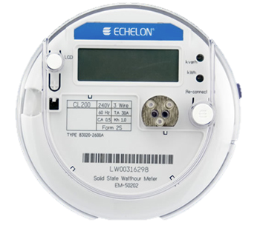


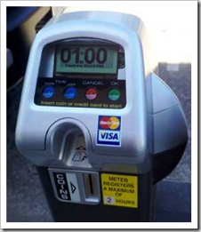
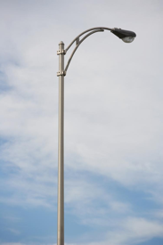
What is the scale of outdoor and distributed applications?
one per household or business (e.g., 136M housing units in US)
31,100 in US
but often connected to city fiber network
268.8M (US) cars, trucks, …
26.5M (44M) in US
$2B energy cost / year
Boston: 64k street lights
but: often connected to fiber (5G!)
5 million (US)
62,000 in NYC
Notes:
http://64.27.51.222/media/overview-of-the-us-parking-industry.aspx parking meters
https://www1.eere.energy.gov/buildings/publications/pdfs/ssl/nlc-streetlight2013_smalley.pdf

Slide 16
Trading bandwidth – coverage - cost
Notes:
Keysight 2017: https://www.keysight.com/upload/cmc_upload/All/20170612-A4-JianHuaWu-updated.pdf

Slide 17
Cellular narrowband IoT
 | LTE Cat 1 | LTE Cat 0 | LTE Cat M1 (eMTC) | LTE Cat NB1 (NB-IoT)
3GPP Release | Release 8 | Release 12 | Release 13 | Release 13
Mobility | Full | Full | Full | Only idle mode reselection
DL peak | 10 Mb/s | 1 Mb/s | 1 Mb/s | 50 kb/s
UL peak | 5 Mb/s | 5 Mb/s | 375 kb/s (HD) 1 Mb/s | 250 kb/s (multi tone) 20 kb/s (single tone)
Latency | 50-100 ms | Not deployed | 10-15 ms | 1.6-10 s
Duplex mode | Full | Full & half | Full & half | Half
Device receive bandwidth | 1.4 – 20 MHz | 1.4 – 20 MHz | 375 kHz 1.4 MHz | 180 kHz
MCL (path loss) | 142 dB | 142 dB | 156 dB 164 dB (claimed) | 164 dB (but)
Notes:
https://www.iot-now.com/2016/06/21/48833-cat-m1-vs-nb-iot-examining-the-real-differences/
https://altair-semi.com/wp-content/uploads/2017/02/Coverage-Analysis-of-LTE-CAT-M1-White-Paper.pdf
https://www.keysight.com/upload/cmc_upload/All/20170612-A4-JianHuaWu-updated.pdf

Slide 18
5G low latency
X
X
X
one-to-many!
X
V2I2V
LAN
EEW
(< 5 s)
protective
relay
tight control loop → near-100% availability in time & space

Slide 19
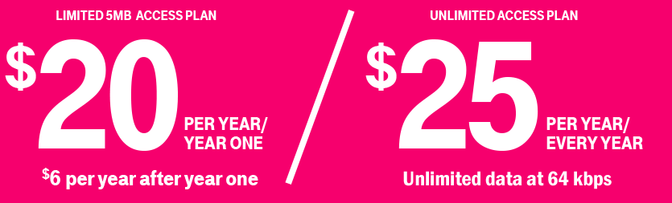
T-Mobile (US) example
NB-IoT
u-blox SARA-N410-02B (20k+ at $5 ea.)
Notes:
https://iot.t-mobile.com/pricing/#annual-plans

Slide 20
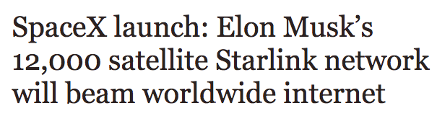
Alternative: satellite communication
NEXT
Iridium
two-way
GlobalStar
GPS fix every 10 minutes
LEO
Notes:
http://www.oneweb.world
https://www.iridiumnext.com/2016/09/22/new-platform-new-possibilities/

Slide 21
Conclusion
There is no IoT – there are lots of them and very different
  low-bandwidth, infrequent, resilient → URLLC
  outdoor vs. factory (replace Ethernet, Wi-Fi) vs. home
  business models: “free” Wi-Fi vs. paid, licensed spectrum
Economic model changes
  Traditional applications: capacity + cost per GB
    $50/month/device
  Many IoT applications: annual cost per device
    $6/year/device
Application areas for URLLC are still speculative
  change in factory model (wireless) + business model (external)

