Slide 1
Gigabit measurements – quality, not (just) quantity
Henning Schulzrinne
Columbia University

Slide 2
Bottlenecks move
fewer end points (greater HHI…)
1990-2010: last mile
2015: interconnection
2010-2018ish: home Wi-Fi
2012-5G: mobility
2016-2020: servers
also, bottlenecks less predictable

Slide 3
What are we trying to achieve?
Compare actual to advertised performance?
Speed metrics may fade in visibility (see 4G)
Determine application QoE?
Determine consumer satisfaction?
What about network reliability?
Determine average speed of Internet in country X and “X faster than Y”?
Estimate contributions of Internet bottlenecks (over time)?
Evaluate changes in metrics over time?
What if bandwidth changes over time (down-grading in mobile)?
➔ gather enough data to allow reasoned discussion for all of these

Slide 4
Two audiences
Research, consumer protection agencies, journalists?
Consumers
Advertised vs. actual
Which version of TCP or QUIC?
Changes over time
Performance inputs: latency, packet loss, loss bursts
DNS and interconnect performance
Reliability at different timescales (500 ms and up)
What broadband service should I choose? Which provider?
Is something wrong with my service?
Will I get 8K video?
Without stalls?
For all video services I care about?
Can I count on doing that video conference from home?

Slide 5
What should we measure?
Single-server performance – but capture destination and path
with TCP changes (e.g., BBR and QUIC), fairness may be more unpredictable
Multi-server parallel performance (diverse data centers & CDNs)
Real world video (see next)
End-to-end & component reliability
partial reachability
temporary performance degradation (vs. discarding worst samples)
carrier DNS resolver
CDNs
probably now more critical than raw performance

Slide 6
The goal is invisibility
No longer raw speed, but “invisibility” → the Internet should not get in the way of what people want to do
Comparison: no longer indicate FLOPS, CPU clock speeds
What is the threshold?

Slide 7
Adaptive bitrate comparison chart
Feature | Adobe HDS | Apple HLS | Microsoft SS | MPEG- DASH
Deployment on ordinary HTTP servers
Flexible DRM support
HTML5 support
Agnostic to video and audio codecs
HEVC Ready (UHD/4K)
Typical segment duration | 2-4s | 10s | 2-4s | Flexible
[2] Bitmovin - MPEG-DASH vs. Apple HLS vs. Microsoft Smooth Streaming vs. Adobe HDS

Slide 8
QoS and QoE in video streaming
End-user
Viewing experience
Service
VoD, video conference and IPTV
QoE
domain
Application
frame rate, resolution, color, video and audio codec type
QoS domain
Network
delay, throughput and packet loss

Slide 9
Common QoE metrics in video streaming
Start-up delay
Time from the instant a play button is clicked to when the player actually starts to play the main video
Rebuffering
Video stalling or buffer underrun
Occurs when the playback rate is higher than what the network can handle
Avg. bitrate
Average played bitrate during playback
Bitrate change
Bitrate increases or decreases while a video is being played

Slide 10
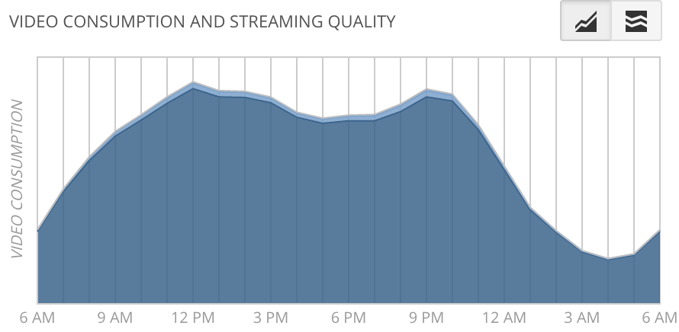
Video quality report by OTT service providers
Google Video Quality Report – A friendly, consumer focused report card [4]
Netflix ISP Speed Index – Focused on ISP QoE rankings [5]

Slide 11
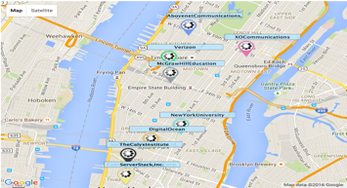
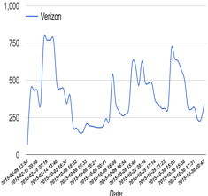
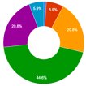
YouSlow platform
End-user device
User-friendly QoE report
https://dyswis.cs. columbia.edu/youslow/
Chrome plug-in
YouSlow app.
Monitor playback events from within video players
Video QoE analysis metrics
QoE report metrics
Initial buffering
Pre-roll ads length
Bitrate change
Rebuffering
Video buffering status
ISP and location info.*
Initial buffering
Video ads
Bitrate change
Rebuffering
Abandonment
Avg. played bitrate
Avg. rebuffering ratio
Avg. HTTP latency
Others
* MaxMind: IP Geolocation

Slide 12
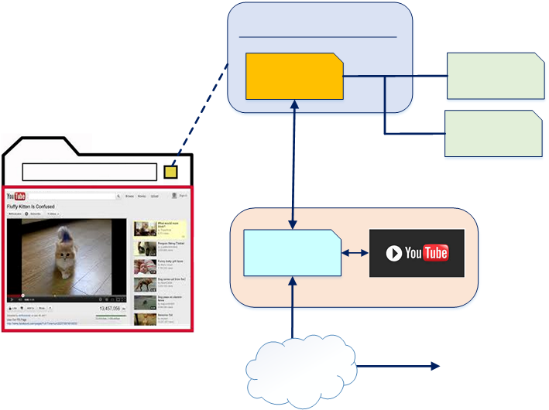
YouSlow Chrome extension
Obtain various playback status directly from the video players e.g., start-up latency, quality changes, rebuffering status, location and ISP info.
YouSlow extension
Background scripts
Chrome local storage
Chrome Web request
Inject a script when a viewer watches video at www.youtube.com
YouSlow core content scripts
Access YouTube player
via YouTube Player API [17]
End-user’s Chrome browser
Internet
YouSlow server

Slide 13
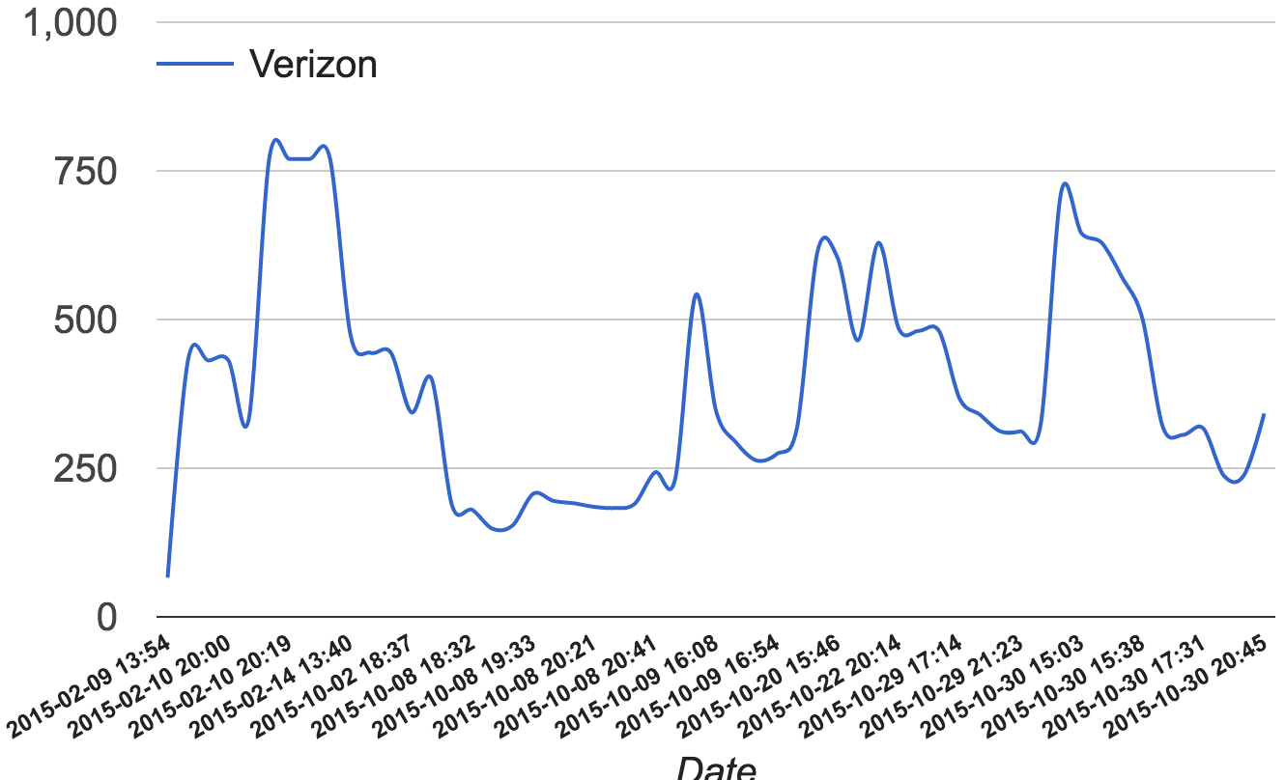
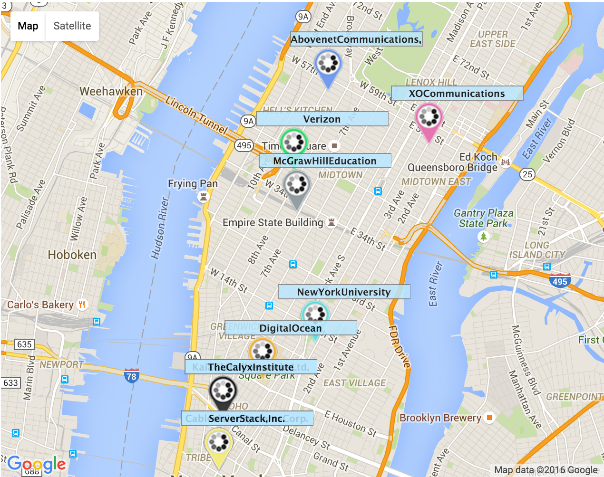
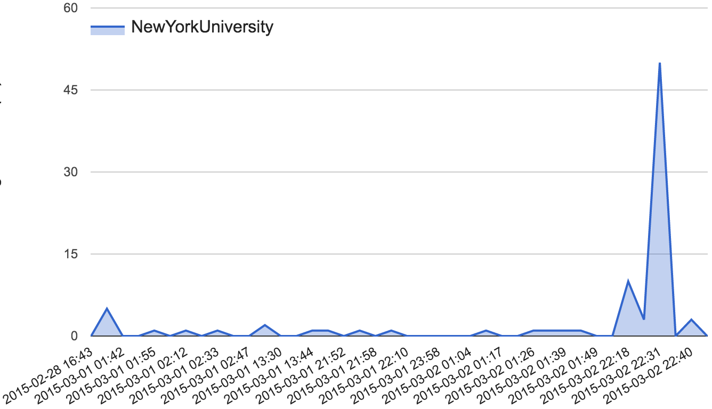
YouSlow monitoring site
https://dyswis.cs.columbia.edu/youslow/
HTTP latency during playback
Avg. HTTP latency (ms)
Date
Rebuffering ratio
Avg. rebuffering ratio (%)
Approximate location of events
Played bitrates and avg. HTTP latency
Rebuffering ratio
Date

Slide 14
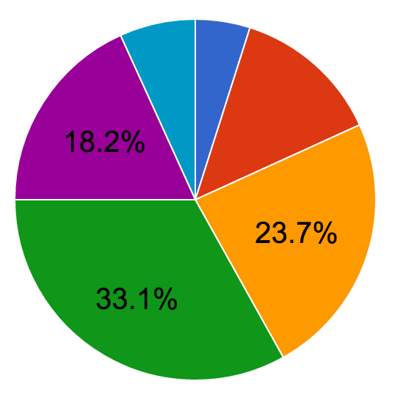
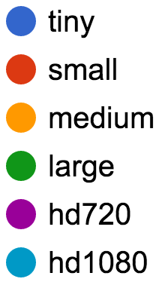
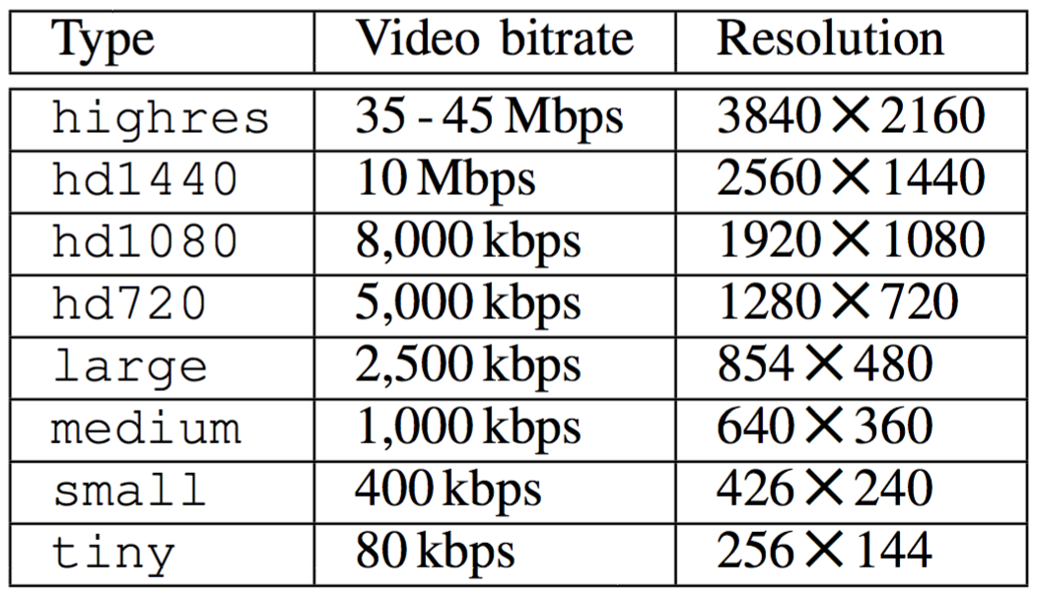
Distribution of YouTube played bitrates

Slide 15
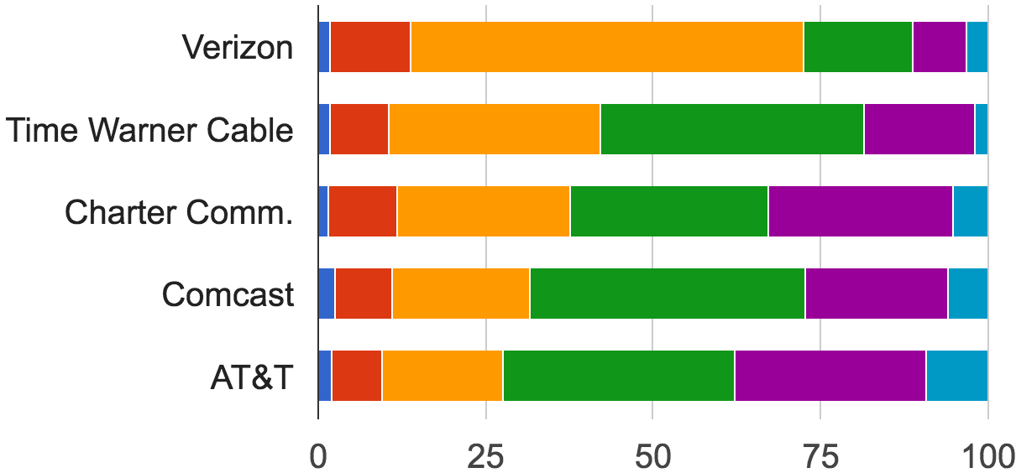
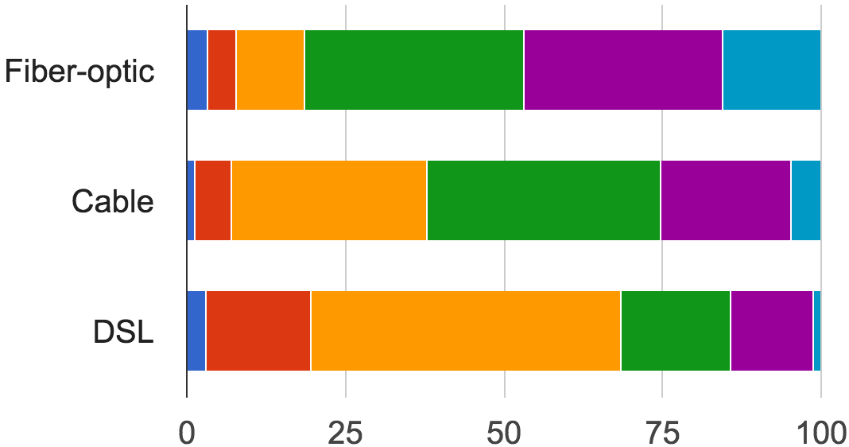
Comparison of YouTube played bitrates
U.S. ISPs
Different types of Internet connections

Slide 16
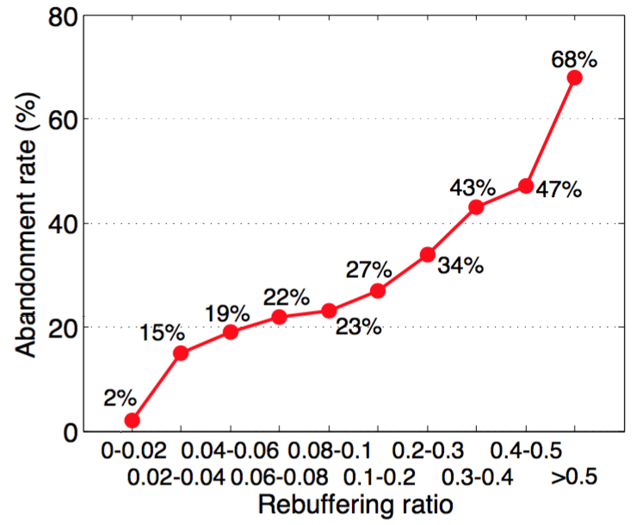
Ad-free
Non-initial buffered
Rebuffered
Rebuffering ratio on abandonment rate
$$Rebuffering ratio=\frac{Total rebuffering duration (sec)}{Total playback duration (sec)}$$
More viewers abandoned the videos as the rebuffering ratio increased

