Slide 1
Networks Beyond the Reach of Networks: What Roles Can 5G Play?
Henning Schulzrinne
Columbia University
October 23, 2018

Slide 2
Design principles & lessons
Keep applications independent of lower layers
  in particular, PHY
  = fundamental design principle of the Internet, even if 50 years old…
Allow island deployments that can merge to backbone when available
  may only be intermittent – but information needs may also be less urgent
Rely on commercial equipment where possible
  ruggedized, but same specs
  allows integration of non-traditional responders (Cajun Navy)
Simplify authorization
  mediated trust
Require no specialized resources
  no special spectrum licenses
  no carrier technicians or vehicles
  minimal training (IT technician level)

Slide 3
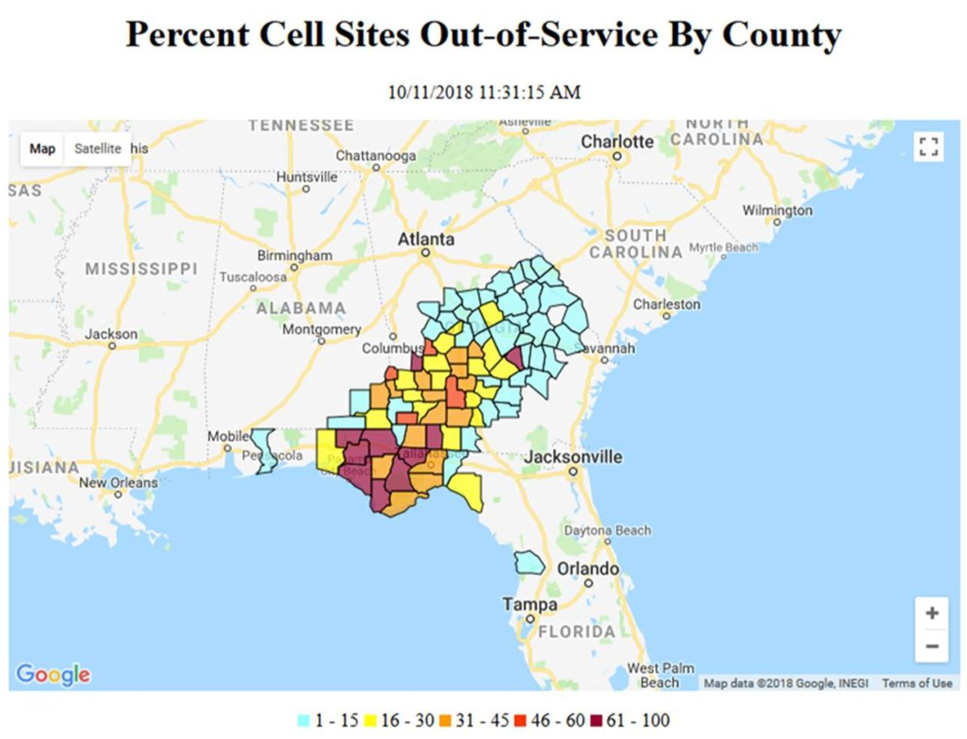
Cell networks may not be available
“She explained that in some cases even after service is restored, it quickly goes out again. New fiber cuts arise as recovery workers begin clearing roads and removing debris from residential properties, and as electric poles get replaced.
  "Our fiber crews are working around the clock to make repairs," Schultz said Monday. "While they are making good progress, we are still experiencing new fiber cuts as soon as repairs are made."
Notes:
https://www.cnet.com/news/fiber-outages-slow-cell-recovery-after-hurricane-michael/

Slide 4
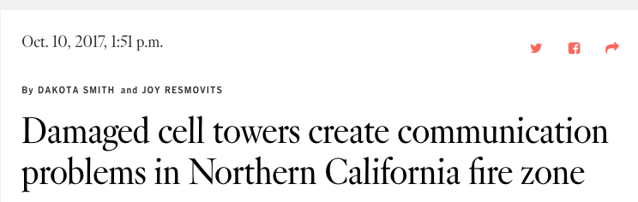
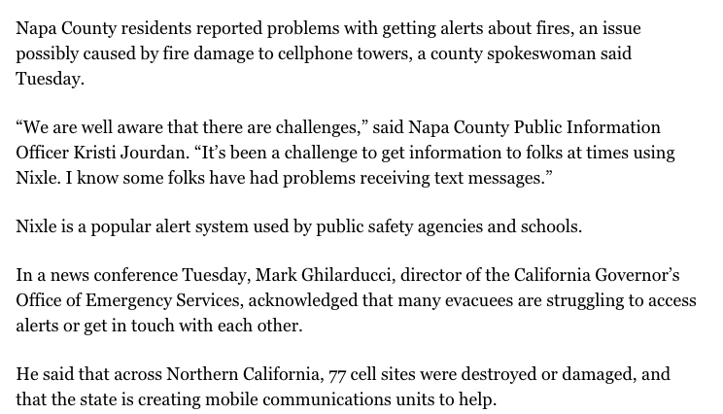
Fires, too

Slide 5
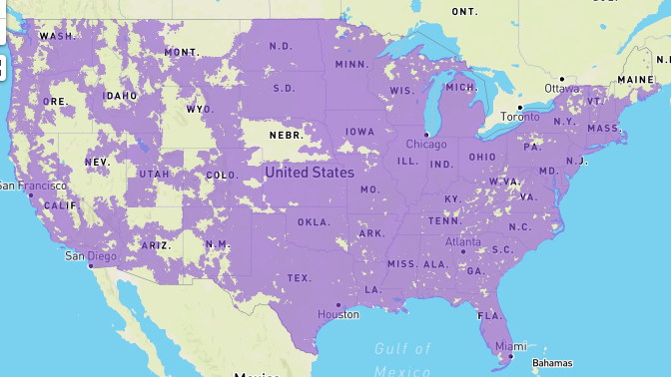
The inverse fire map
4G coverage
Notes:
https://www.whistleout.com/CellPhones/Guides/att-coverage-map

Slide 6
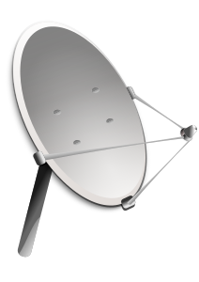


”Whatever it takes” communication
+
Notes:
FirstNet
satellite
Wi-Fi peer-to-peer
SMS
store-and-forward

Slide 7
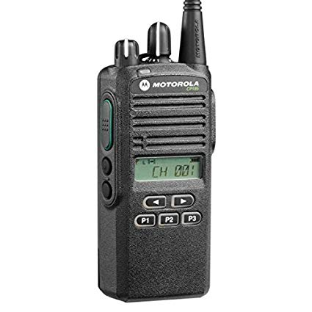
Progression
P2P voice
P2I voice (trunked)
P2I data
P2X voice + data + computation
multi-PHY
fog computing

Slide 8
Example: DARPA PHOENIX nodes
DECT
DARPA RADICS: support blackstart for electric utilities
802.11af
(TVWS)
high-bandwidth
VHF
mesh network (OLSR)
self-configuring – just turn on
network-technology agnostic (not just 4G)
local services (VoIP, messaging, edge cloud)
with diagnostics and traffic isolation
SDR: P.25
over VHF + Codec2 + data
Notes:
https://saankhyalabs.com/rural-broadband/meghdoot-base-station-slb802odu/

Slide 9
Internet Protocol radio communication
Distance | Technology | Bandwidth | Example radio
< 1 mi | 24 GHz | < 1 Gb/s | Ubiquiti AirFiber
< 10 mi | 802.11 5 GHz | < 300 Mb/s | Ubiquiti RP5AC
< 25 mi | 802.11af (TVWS) | < 24 Mb/s | Carlson Wireless
< 50 mi | VHF | 640 kb/s in 50 kHz (FD) 40-160 kb/s in 12.5 kHz | MiMOMax Tornado
< 1000 mi | HF | kilobits
tethered

Slide 10
Need local computation
Mobile devices don’t have the battery or continuity
Remote cloud is too unreliable
→ good application of fog computing
Applications:
  local VoIP and text service
  message store-and-forward
  IoT data gathering and aggregation
  local GIS system
  video processing
  higher-level data compression
  informational and transactional resources for public (e.g., check-in)

Slide 11



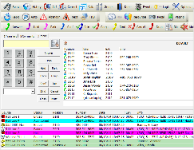
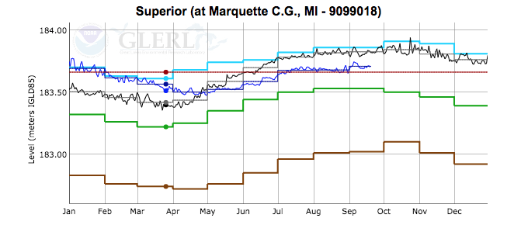
Integrating information flows
NLP
tailored sitreps
Notes:
input: social media, sensors, first responders, NG911
distill
automated reporting (NLP)

Slide 12
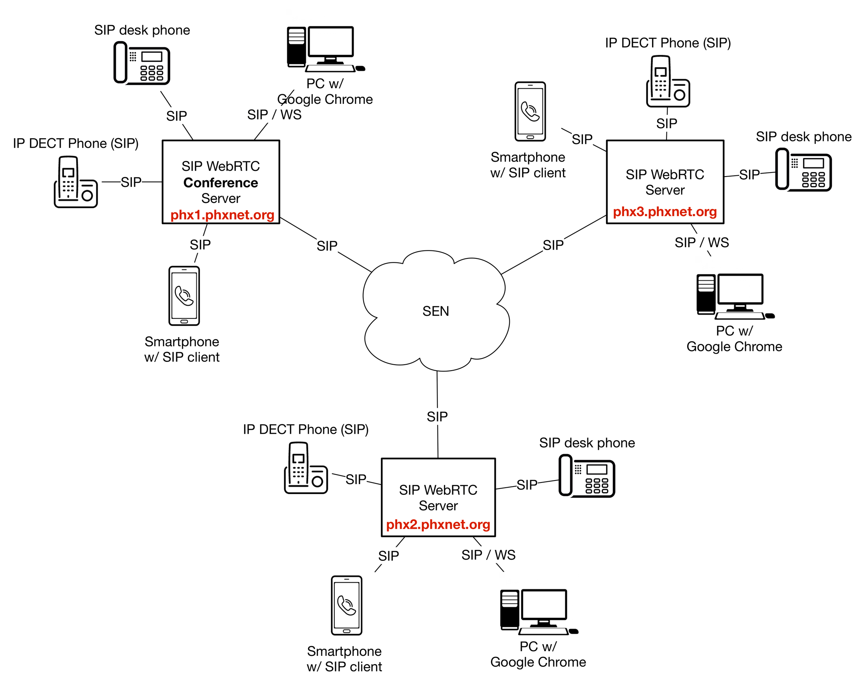
Example: distributed VoIP implementation
Every node can function by itself
Local capability, “global” dial plan

Slide 13
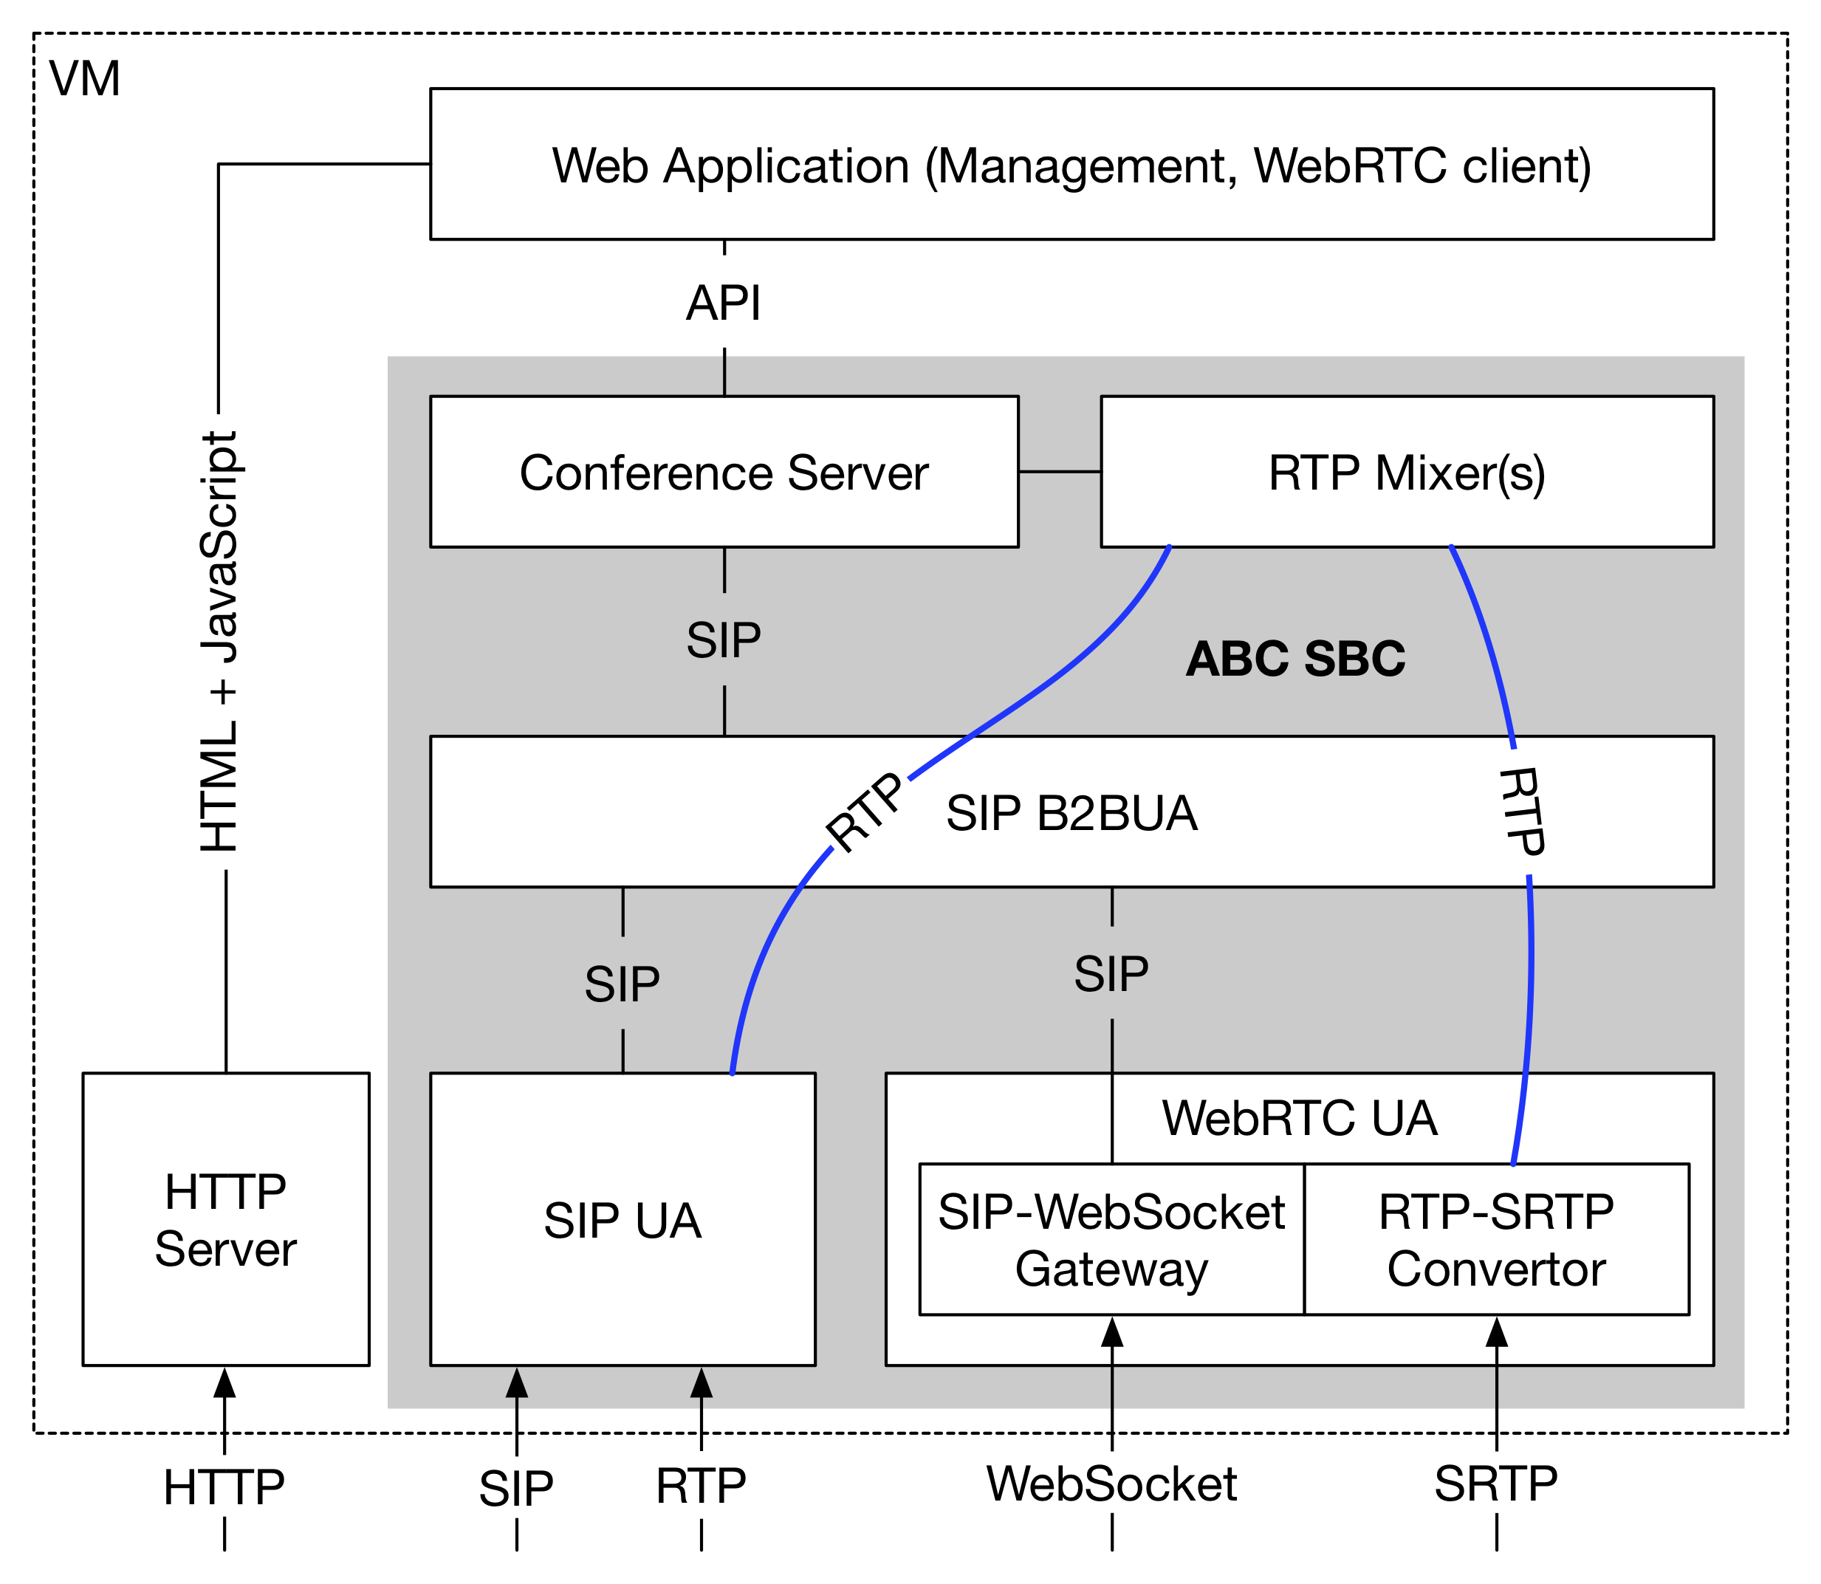
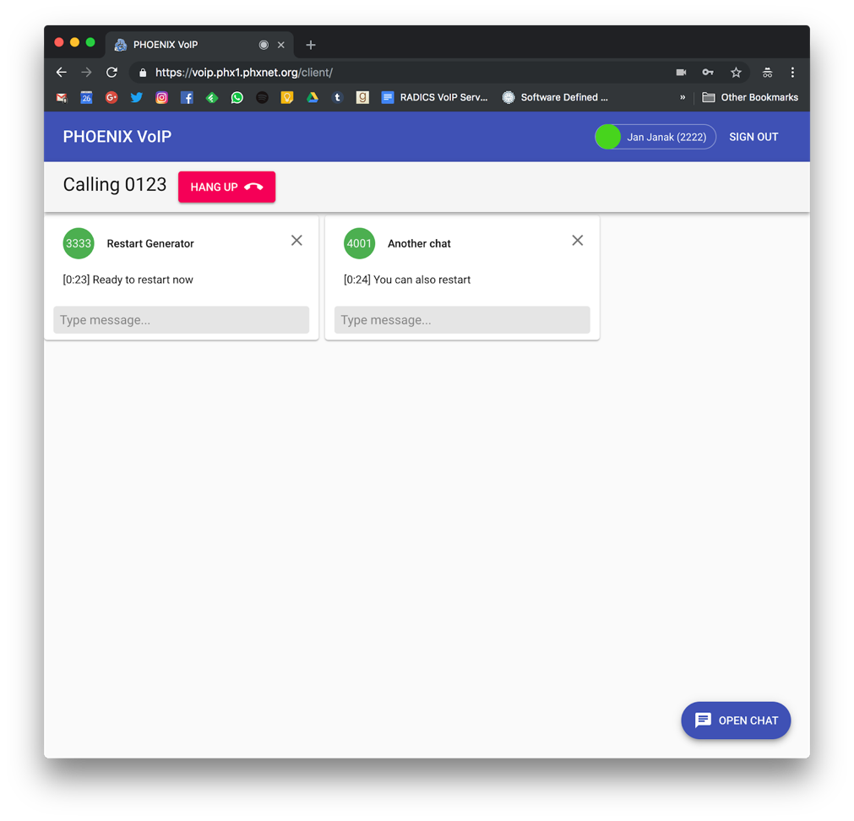
Node example – complete SIP VoIP
Android
WebRTC

Slide 14
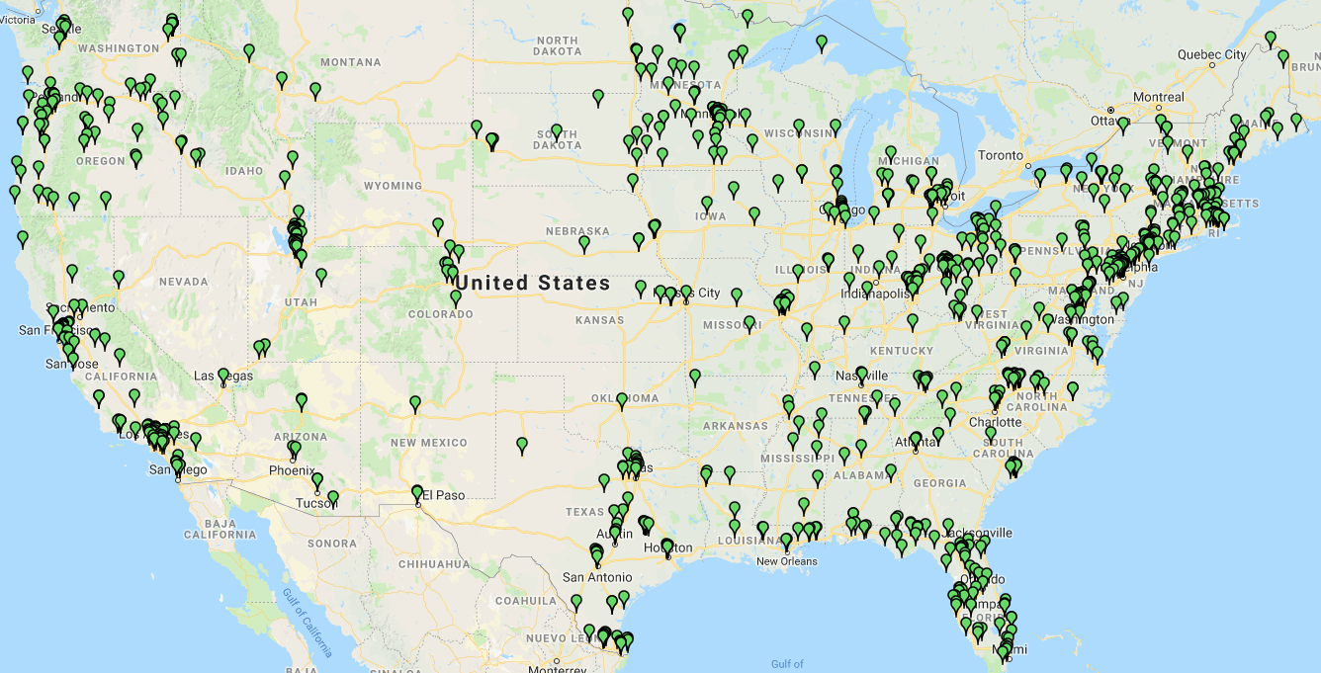
Federated identity: eduroam – US campuses

Slide 15
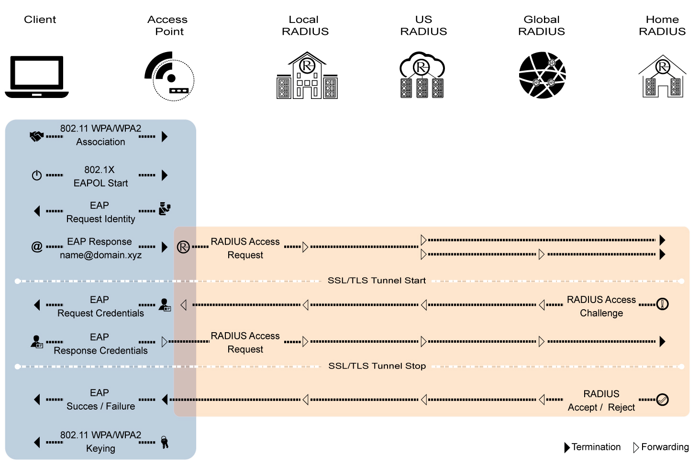
Federated identity: eduroam - mechanism

Slide 16
For public safety, plan for surprises
Generation | Expectation | Surprise | Cost per GB
0G (landline) | voice | fax & modem
1G | corporate limousine | eavesdropping
2G | better voice quality (“digital!”) | SMS | $1000
3G | WAP | web | $100
4G | IMS | YouTube, WhatsApp, notifications | $10
5G | IoT (low latency) | ? | $1?
underestimated cost and WiFi-equivalence as drivers
are the even generations the successful ones?

Slide 17
Conclusion
Lessons of 1G through 4G (+ the Internet): avoid coupling services and network
Consider hybrid networks as alternative
  allow for incremental service and technology upgrades
  helpful: open-source 4G & 5G implementations for local “cellular” service
Convincing use case for fog computing
  even if dubious elsewhere

