Slide 1
Network Neutrality is About Money, not Packets
(Price discrimination, not packet discrimination)
Henning Schulzrinne
IIT-RTC Chicago
October 2018
This material is based upon work supported by the National Science Foundation under Grant No. (CNS-1218977). Any opinions, findings, and conclusions or recommendations expressed in this material are those of the author(s) and do not necessarily reflect the views of the National Science Foundation.

Slide 2
A bit of history: Liberalization & CI
1956: Hush-A-Phone v. US (mechanical attachment)
1969: Carterfone (connect mobile radio to PSTN)
1970: Open Skies policy for satellites
1966: Computer I NOI: “data processing, computer information and message switching services”
1970: Computer I initial decision → data processing not subject to common carrier rules + “maximum separation” rule
1979: Second Computer Inquiry → rough division into transport and application
1985: Third Computer Inquiry → max. separation rule
1996: codified into 1996 Telecom Act
  renamed “basic service” → “telecommunication service”
  renamed “enhanced service” → “information service”

Slide 3
Not a new concern
Telecommunications in the United States has undergone a lengthy evolutionary process. The once limited communications market now offers many alternatives, in terms of carriers, services, and technologies. The change, while significant, is far from complete.
Throughout this dynamic period, the federal communications legislation—the Communications Act of 1934 (the "Communications Act" or the "Act")—barely has been changed. Numerous congressional attempts to adopt a new statute—or to update it—have failed for lack of support. Consequently, a complex mixture of federal and state actions— including regulation by administrative agencies, legislation, and court decisions—has been necessary to "stretch" the Act enough to accommodate new technologies and new regulatory objectives.
Some of the most difficult regulatory questions that the Federal Communications Commission (the "FCC" or the "Commission") must face are ones that might seem most basic. The FCC must define—and distinguish—"common carriers," "broadcasters," "cable operators," and "private radio" services. The Act offers little guidance, although this may be a reason for its durability and resilience. Consequently, the FCC has struggled to apply these old regulatory categories to new services or activities made possible by the merger of computer and communications systems and by advances in radio transmission technology.
From telecommunications to electronic services: a global spectrum of definitions, boundary lines, and structures 1985

Slide 4
Post-1996
2002: Cable Modem Order → one information service
  “like AOL” (IS) = DNS, email, …
  2005: NCTA vs. Brand X
Jun. 2003: Tim Wu “Network Neutrality, Broadband Discrimination”
Feb. 2004: FCC chairman Powell (R) speech
Aug. 2005: FCC policy statement
2005: DSL Reclassification Order → parity
April 2010: DC Circuit: Comcast v. FCC
Dec. 2010: Open Internet R&O
Jan. 2014: DC Circuit: Verizon v. FCC – upholds only transparency
Feb. 2015: Protecting and Promoting the Open Internet R&O
June 2016: US Telecom v. FCC – upholds 2015 order (2-1)
May 2017: en-banc hearing denied (2-1)
Dec. 2017: FCC Internet Freedom R&O – repeals 2015 order
Notes:
https://apps.fcc.gov/edocs_public/attachmatch/FCC-15-24A1.pdf
https://apps.fcc.gov/edocs_public/attachmatch/DOC-260435A1.pdf

Slide 5
US Internet access
cable modem
order
Brand X
OI 2010
Pew
Notes:
http://www.pewinternet.org/2013/08/26/home-broadband-2013/
http://www.pewinternet.org/three-technology-revolutions/

Slide 6
Background: telecommunications (47 USC 153)
… “telecommunications” means the transmission, between or among points specified by the user, of information of the user’s choosing, without change in the form or content of the information as sent and received.
… “telecommunications carrier” means any provider of telecommunications services, except that such term does not include aggregators of telecommunications services (as defined in section 226 of this title). A telecommunications carrier shall be treated as a common carrier under this chapter only to the extent that it is engaged in providing telecommunications services, except that the Commission shall determine whether the provision of fixed and mobile satellite service shall be treated as common carriage.
… “telecommunications service” means the offering of telecommunications for a fee directly to the public, or to such classes of users as to be effectively available directly to the public, regardless of the facilities used.

Slide 7
More definitions
Information service = users of telecommunication services
  “capability for generating, acquiring, storing, transforming, processing, retrieving, utilizing, or making available information via telecommunications, and includes electronic publishing, but does not include any use of any such capability for the management, control, or operation of a telecommunications system or the management of a telecommunications service.”
cf. Basic vs. enhanced service (CI)
  Basic telecommunications: "the offering of a pure transmission capability over a communications path that is virtually transparent in terms of its interaction with customer supplied information.”
  Enhanced: everything else
Adjunct services: directory services

Slide 8
Enhanced service
“'enhanced service' shall refer to services, offered over common carrier transmission facilities used in interstate communications, which employ computer processing applications that act on the format, content, protocol or similar aspects of the subscriber's transmitted information; provide the subscriber additional, different, or restructured information; or involve subscriber interaction with stored information.” 47 C.F.R. § 64.702(a).
Examples of enhanced services:
  Internet access service
  online service, computer bulletin boards
  video dialtone
  voice mail
  electronic publishing
  The mere fact that a network is packet-switched does not necessarily mean that it is an enhanced service.

Slide 9
Technical problems
Does not neatly map into engineering (protocol) interfaces
  Often assumed: Ethernet = “telecom”; IP = “information processing”, but no obvious difference
  What is “protocol processing”?
  Traditional telephone applications convert “protocols”, such as ISDN to T1 and formats, such as G.711 A-law to μ-law or G.711 (landline) to G.729 (mobile)
  Traditional telephony had filters, silence suppression and noise reduction signal processing
Does not capture control & management explicitly
  DNS, SS7, BGP
Upper-layer protocols do not generally transform, either
Caching services (CDN) vs. “transparent” proxy caches
Uncommon in other jurisdictions

Slide 10
Definition
Wu, 2003: “Internet that does not favor one application (say, the world wide web), over others (say, email)”
Two-sided platform view:
  providers: ”reasonable and non-discriminatory” access
  consumers: “all of the (legal) Internet”
Absolute equality of treatment (performance) unlikely
  TCP is latency-sensitive
  different applications react differently to impairments (packet loss, delay, reordering, …)
  may prohibit quality differentiation by providers
    ➔ user-chosen quality

Slide 11
What is network neutrality?
“The principle advocates no restrictions by Internet service providers and governments on content, sites, platforms, the kinds of equipment that may be attached, and the modes of communication.” (Wikipedia)
2005 FCC statement (based on 2004 Powell “Internet freedoms”):
  “access the lawful Internet content of their choice.
  run applications and use services of their choice, subject to the needs of law enforcement.
  connect their choice of legal devices that do not harm the network.
  competition among network providers, application and service providers, and content providers.”
= Any lawful content, any lawful application, any lawful device, any provider
Notes:
https://apps.fcc.gov/edocs_public/attachmatch/DOC-243556A1.pdf

Slide 12
Network transparency
RFC 1958: “Architectural Principles of the Internet”
However, in very general terms, the community believes that the goal is connectivity, the tool is the Internet Protocol, and the intelligence is end to end rather than hidden in the network.
RFC 2275: “Internet Transparency”
  NATs, firewalls, ALGs, relays, proxies, split DNS
RFC 3724: “The Rise of the Middle and the Future of End-to-End: Reflections on the Evolution of the Internet Architecture”
RFC 4924: “Reflections on Internet Transparency”
  A network that does not filter or transform the data that it carries may be said to be "transparent" or "oblivious" to the content of packets. Networks that provide oblivious transport enable the deployment of new services without requiring changes to the core. It is this flexibility that is perhaps both the Internet's most essential characteristic as well as one of the most important contributors to its success.

Slide 13
Network transparency and neutrality
neutral
transparent
QoS discrimination
pay for priority
block protocol features

Slide 14
Means, motive and opportunity
Political motivation
  suppress undesirable opinion
    e.g., union web site, abortion SMS
Economic advantage
  prevent competition in related services
    e.g., VoIP or over-the-top VoD
  leverage pricing power
    OTT content provider has to offer service to everyone
  market segmentation
    consumer vs. business customers
Non-tariff barriers
  e.g., special (undocumented) APIs
Notes:
http://en.wikipedia.org/wiki/Means,_motive,_and_opportunity

Slide 15
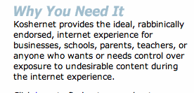
Are these neutrality issues?
Redirect DNS NXDOMAIN to ISP web site
Content translation
  e.g., reduce image resolution for cellular data
Blocking transport protocols other than UDP + TCP
Prohibit web servers for residential services
Spam filtering
“KosherNet”
Reset DSCP (ToS bits)
Not supporting IPv6
3GPP: only make non-BE available to carrier
“Metered” broadband (“usage-based pricing”)
Zero-rating of content

Slide 16
Optus (Australia) example

Slide 17

Two markets
shared coax
transit network
IXP
HFC
CDN
content
FTTH
edge-to-BIAS
BIAS-to-consumer

Slide 18
Two views
Open Internet advocates
Free market advocates
no prioritization
flat rates
all networks
no real problem
allow any business arrangement
“it’s my network”
use anti-monopoly laws if needed
FTC “unfair & deceptive”

Slide 19
Why?
Civic considerations
  freedom to read (passive)
  freedom to discuss & create (active)
Economic opportunity
  edge economy >> telecom economy
    Telecom revenue (US): $330B
    Content, etc. not that large, however
      Google: $8.44B
    others that depend on ability to provide services
  content, application, service providers
Technical motivation
  avoid network fragmentation
  reduce work-around complexity

Slide 20
Network neutrality & freedom of speech
Applies only to U.S. government, not private entities
  Example: soap box in city park vs. mall
  private vs. public universities
Freedom to speak + no forced speech
  demise of “fairness doctrine” (1949-1987; formally removed 2011)
1st amendment: Congress shall make no law abridging the freedom of speech

Slide 21
It used to be simple (ca. 1990)
MVPD
cable
(CATV)
satellite
(SAT)
ISP
ILEC
RLEC
CLEC
LEC

Slide 22
Vertical integration happened
content
video
distribution
advertising

Slide 23
Residential telecom is highly concentrated
Leichtman, 2Q18

Slide 24
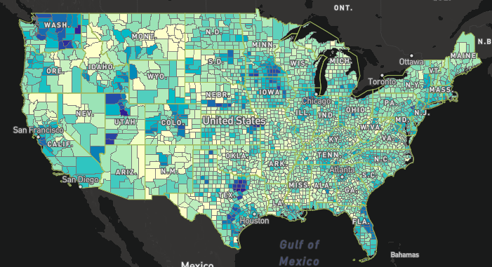
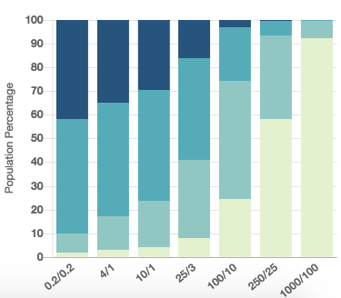
Number of 25/3 Mb/s providers
3+
0
2
1
blocks are considered served if one HH served

Slide 25
A simplified evolution of network neutrality
Early (2003-2009)
Intermediate (2010)
Advanced (2015-)
no blocking
attach non-harmful devices
competition
no blocking
no discrimination
transparency
privacy
interconnection
semi-voluntary?
Reversal (2017?)
zero rating & caps
anti-trust?
tethering
Authority unclear
Section 706
Title II
Information service?

Slide 26
How to be non-neutral
deep packet inspection
block Skype
user tracking
application
block transport protocol
block ports
insert RST
transport
block IP addresses
QoS discrimination
zero-rating
network
Not all practices are necessarily violations

Slide 27
Network neutrality and Title II
2015 order
no QoS
no metering
no zero-rating
§201
§202
§208
§222
tariffs
interlocking directorates
regulated interconnection
§214 discontinuance
no blocking
no paid prioritization
no unreasonable interference
transparency

Slide 28
Some high-profile cases
VPN blocking (Comcast, roughly 2001) - unconfirmed
WiFi blocking (AT&T AUP, 2002)
Madison River (2005)
  DSL provider blocked SIP ports
  fined $15,000 by FCC
  based on Section 201 “just and reasonable”
Comcast (late 2007)
  insert TCP RST into BitTorrent traffic
  later overturned on appeal in DC Circuit Court
RCN (2009): P2P
FaceTime on AT&T
Comcast vs. Level 3 (2010, in dispute) - interconnection
Comcast, Verizon, AT&T, … vs. Netflix termination (2013-2014)
Zero-rating (AT&T, T-Mo, VZ, Comcast)
Notes:
http://hraunfoss.fcc.gov/edocs_public/attachmatch/DA-05-543A1.pdf
http://www.zeropaid.com/news/88573/comcast-prevails-in-bittorrent-throttling-case/
http://www.practicallynetworked.com/news/comcast.htm
AT&T 2002 terms for DSL - https://www.wired.com/story/how-the-fccs-net-neutrality-plan-breaks-with-50-years-of-history/
Examples of prohibited programs and equipment include, but are not limited to, mail, ftp, http, file sharing, game, newsgroup, proxy, IRC servers, multi-user interactive forums and Wi-Fi devices
Theft of Service. Customer shall not connect the Service or any AT&T Broadband Equipment to more computers, either on or outside of the Premises, than are reflected in Customer’s account with AT&T Broadband. Customer acknowledges that any unauthorized receipt of the Service constitutes theft of service, which is a violation of federal law and can result in both civil and criminal penalties.

Slide 29
Open Internet R&O 2010 + DC Circuit
Transparency. Fixed and mobile broadband providers must disclose the network management practices, performance characteristics, and terms and conditions of their broadband services;
No blocking. Fixed broadband providers may not block lawful content, applications, services, or non-harmful devices; mobile broadband providers may not block lawful websites, or block applications that compete with their voice or video telephony services
No unreasonable discrimination. Fixed broadband providers may not unreasonably discriminate in transmitting lawful network traffic.
remanded
remanded

Slide 30
Verizon holding
Upheld Commission’s authority to promulgate Open Internet rules under section 706
Upheld transparency rule
Vacated and remanded blocking and discrimination rules as impermissible common carriage regulation of an information service

Slide 31
DC Circuit: discrimination rule
“Little hesitation” in concluding that nondiscrimination rule = common carriage regulation.
The rule requires broadband providers to offer service to all edge providers → “by its very terms compels . . . providers to hold themselves out ‘to serve the public indiscriminately,’” which is the essence of common carriage.
Commission never argued that the “no unreasonable discrimination” standard differed from the general nondiscrimination standard that applies to common carriers.

Slide 32
Excluded (2010 & 2015)
enterprise services
virtual private network services, hosting, or data storage services
premises operators
  coffee shops, hotels, Amtrak, airlines, …

Slide 33
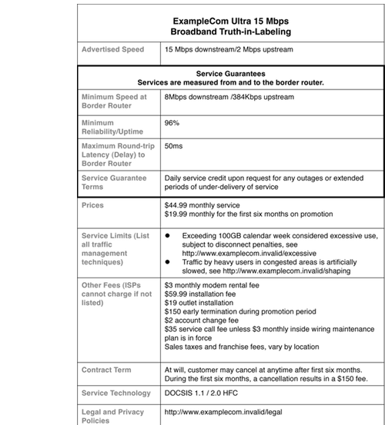
OI NPRM: transparency
Audience-specific disclosure
  consumer “nutrition label”
    include more than just intra-network performance
  edge providers (CDN, transit providers)
    performance
    peering policy?
Metrics
  network performance: averages, variability
  built-in measurements at finer geographic scale
  bandwidth caps (and tools)
  N-year cost
New America Foundation
example

Slide 34
2015 OI rules
telecommunication services – Title II
  defines PSTN as including data services
  includes mobile & fixed
Sections 201, 202 & 208 apply
but others forborne

Slide 35
2015 OI rules
No blocking
  “A person engaged in the provision of broadband Internet access service, …, shall not block lawful content, applications, services, or non-harmful devices, subject to reasonable network management.”
No throttling
  “... shall not impair or degrade lawful Internet traffic on the basis of Internet content, application, or service, or use of a non-harmful device, subject to reasonable network management.”
Paid prioritization
  “… shall not engage in paid prioritization.”
  “… not unreasonably interfere with or unreasonably disadvantage (i) end users’ ability to select, access, and use broadband Internet access service or the lawful Internet content, applications, services, or devices of their choice, or (ii) edge providers’ ability to make lawful content, applications, services, or devices available to end users.” (peering)
General conduct rule
Enhanced transparency

Slide 36
2015 Open Internet rules
Applied to both fixed and mobile wireless networks
Transparency → Measuring Broadband America reports
No blocking
No unreasonable discrimination (“reasonable network management” exception)
  historically, not contentious
Interconnection as ”area of observation”
General conduct rule

Slide 37
Other issues
Device attachment & software apps
  Can a provider prevent use of software, such as tethering or video apps?
  Alternate boot loader and OS versions?
Privacy
  ISP tracking of user activity: IP addresses visited
    direct usage (ad placement)
  Verizon “super cookie” & AT&T pay-for-privacy
Zero rating
  most controversial practice: consumer benefit vs. competition harm
  see Jan. 9, 2017 FCC WCB report (rescinded Feb. 3, 2017)
Notes:
https://transition.fcc.gov/Daily_Releases/Daily_Business/2017/db0111/DOC-342987A1.pdf

Slide 38
U.S. Telecom Association v. FCC, en-banc denied
(May 2017)
Kavanaugh: Dissenting from the denial of rehearing en banc (Brown, J.): Because the net neutrality rule reclassified broadband Internet access to subject it to common carrier regulation, it implicated a “major question” requiring clear statutory authority from Congress, which is absent because the net neutrality rule conflicts with the deregulatory structure of the Telecommunications Act of 1996. Dissenting from the denial of rehearing en banc (Kavanaugh, J.): FCC lacked authority to issue the net neutrality rule because agencies may not issue regulations with vast economic and political significance (i.e., major rules) without clear congressional authorization. The net neutrality rule was also invalid because it violated the First Amendment rights of Internet Service Providers (ISPs) to exercise editorial discretion and control over the content they carry.
Notes:
https://www.leagle.com/decision/infco20170501305
https://fas.org/sgp/crs/misc/R45269.pdf

Slide 39
WCB zero-rating report
Overall considerations
  Is the BIAS provider altering or influencing the unfettered flow of lawful Internet traffic between edge providers and end-users?
  Does the activity or practice in question have the effect (implicit or explicit) of favoring services provided by its affiliates, creating exclusionary relationships that benefit only selected edge providers, discriminating on the basis of content or other improper basis?
Non-discrimination
  Is zero-rating available, or available on materially favorable terms, only for a service directly affiliated with the BIAS provider?
  Does the zero-rating plan create exclusionary arrangements between the BIAS provider and unaffiliated content providers that raise reasonable competitive concerns from excluded parties?
  If a BIAS provider charges edge providers to be zero rated, are those charges imposed on affiliated and unaffiliated entities effectively on a non-discriminatory basis?

Slide 40
WCB zero-rating report
Data cap
  Is the associated data cap sufficiently high as to make all data effectively zero-rated for the overwhelming majority of customers, both on a static and forward-looking basis, such that consumers really are not facing a choice between zero-rated and non-zero-rated activity?
Choice and End User Control
  Do consumers and edge providers have the ability to easily opt into and out of the zero-rated plan if they prefer to remain with offers in line with those available at the time the plan was introduced, or to control other aspect of using the zero-rated service?
  Do consumers have easy alternatives for switching to other BIAS providers with different zero-rating practices?

Slide 41
Example zero-rating plans
T-Mobile BingeOn
  November 2015
  streaming video services that meet certain technical standards
  participating edge providers can offer to T-Mobile’s mobile broadband subscribers zero-rated video programming at 1.5 Mbps or 480p+/DVD quality
  no charge to providers
  no affiliated content
AT&T Data Perks
  reward for engaging in broadband activities that typically involve smaller amounts of data, such as purchasing products
AT&T Sponsored Data
  enables edge providers to supply streaming video programming and other content and edge services to AT&T’s mobile broadband consumers on a zero-rated basis
  zero-rate affiliated programming to its AT&T Mobility customers on its DIRECTV App and its DirecTV Now over-the-top video product
Verizon FreeBee Data 360
  edge providers to pay on a per-gigabyte-used basis
  zero-rate Go90
Comcast Xbox streaming

Slide 42
2017 OI rules
2010 transparency

Slide 43
2017 justifications
2015 OI caused decrease in investment
Internet service is technically an information service
  DNS and caching
FTC and anti-trust laws can deal with any anti-competitive behavior
Examples of anti-NN behavior aren’t bad

Slide 44
What’s next?
Rules published February 2018, effective April 2018
States and public interest organizations sue in DC Circuit
  Washington, Illinois, Kentucky, Pennsylvania, Delaware, Oregon, Vermont, the District of Columbia, and Massachusetts
Possible appeal to Supreme Court
Wildcard: 2018 Congressional election
  will likely determine any attempt at political solution

Slide 45
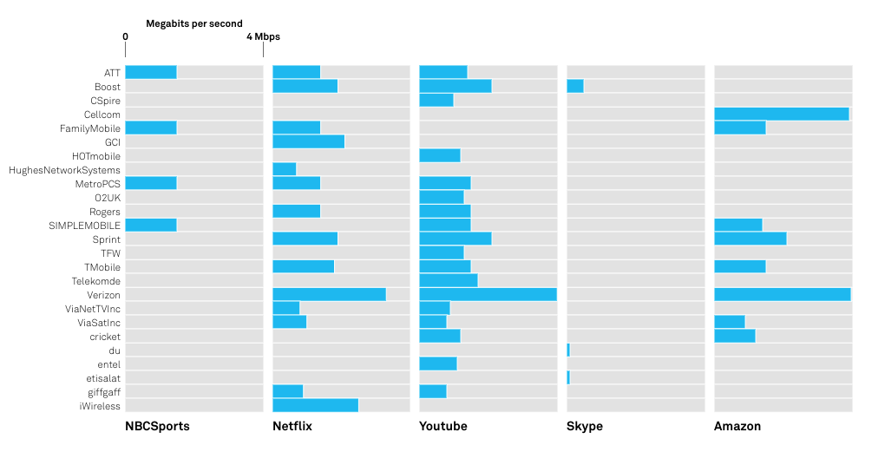
Video discrimination: Choffnes, 2018
Wehe tool: Many video providers limit video rates
Notes:
https://news.northeastern.edu/2018/09/10/new-research-shows-your-internet-provider-is-in-control/

Slide 46
California Internet Consumer Protection and Net Neutrality Act of 2018 [SB-822, shortened]
Blocking lawful content, applications, services, or nonharmful devices, subject to reasonable network management.
Impairing or degrading lawful Internet traffic on the basis of Internet content, application, or service, or use of a nonharmful device, subject to reasonable network management.
Requiring consideration, monetary or otherwise, from an edge provider …
Engaging in paid prioritization.
Engaging in zero-rating in exchange for consideration, monetary or otherwise, from a third party.
Zero-rating some Internet content … in a category of Internet content … but not the entire category.
Zero-rating Internet traffic in application-agnostic ways shall not be a violation provided that no consideration is provided by any third party in exchange.
Failing to publicly disclose accurate information regarding the network management practices, performance, and commercial terms of its broadband Internet access services sufficient for consumers to make informed choices regarding use of those services and for content, application, service, and device providers…
Notes:
https://leginfo.legislature.ca.gov/faces/billTextClient.xhtml?bill_id=201720180SB822

Slide 47
Questions beyond NN
What are the rights and obligations of
  broadband Internet access providers?
  content providers that want to interconnect?
  handset vendors and application writers?
  consumers?
  right-of-way owners (poles and ducts)?
What are the legal foundations?
Are there any economic restrictions?
  Telecom: “just & reasonable”
  or just anti—trust rules (largely, mergers & acquisition, collusion, …)
Who sets the rules?
  FTC – ”unfair or deceptive trade practices”
  FCC – sector-specific

Slide 48
Economic incentives for carriers
Reducing competition for vertically-integrated services
  make competitor less attractive (quality, price)
    e.g., only offer higher speed tiers for MVPD subscribers
  volume discrimination (zero-rating for own content or service)
  → Madison River VoIP, Comcast RST, Netflix interconnection
Two-sided market
  termination monopoly → no “fair” price
    cost for incremental quality or traffic can’t be determined objectively
    very little of the fixed network cost depends on volume
  overlaps with first concern
  third-party paid services
  → Netflix interconnection, ”intercarrier compensation”
Leveraging customer information

Slide 49
QoS
Well-known: no end-to-end (inter-provider) QoS
But local QoS → “specialized services”
  VoIP, MVPD video
Problem: for any reasonable service, most of the time, high-QoS ≡ basic-QoS
  → users will only upgrade rarely (see Paris Metro pricing)
No good charging mechanism:
  carrier-provided application: advantages provider
  negotiated individually: scaling problems for small providers or small ISPs
  paid by third party automatically: end-to-end signaling?
    block chain!
  subscriber paid by bucket: plausible
  zero cost: e.g., “get 2 Mb/s at low latency, up to 1 GB/month” → consumer choice

Slide 50
Principle 1: User choice
User choice as metric for reasonable carrier behavior
  in addition to network protection against attack or abuse
Encapsulate no blocking, no discrimination
Allows QoS differentiation
  users can designate traffic
  requires UNI signaling mechanism → SDN simplifies
  probably API rather than (say) RSVP
    easy except for differential charging

Slide 51
Principle 2: Virtual Structural Separation
Structural separation theoretically avoids vertical integration concerns
  traditionally, separate layer 3 and layer ½
  here, layer 3 vs. applications
But price setting is unsolved problem
  easier for QoS than base rate (smaller $!)
    margin squeeze problem
  use non-vertically-integrated provider as benchmark?

Slide 52
Principle 3: Transparency
Not just performance, but price
  see 2015 OI order
  ISPs are only large consumer expenditure that’s non-transparent
    and health care – but there is no Packet Insurance
    “taxes, fees, and surcharges not included”
    Try predicting second-year charge for residential ISP
Price discrimination by obfuscation

Slide 53
NN challenge: customer differentiation
Inconvenient for both sides of NN debate: business vs. residential users
  with fiber, speed, quality, facilities likely similar
Download speed increases reaching diminishing returns
Volume limitations are unpopular
  but may be sufficient to separate home ”edge computing” from residential use
Prediction: three tiers
  Variable-speed mobile for price-sensitive (small) households
  Near-flat fiber access with below-server cap
  Business volume metered (similar to cloud services)

Slide 54
Conclusion
NN is an economics (charging) problem, not a QoS or network management problem
  Price discrimination, not packet discrimination
Made much more difficult by vertical integration and lack of competition
  Including difficulty of using multiple services at once
Reach same conclusion as for voice telephony: flat rate, with $0 ICC

