Slide 1
NG911 is a start
Henning Schulzrinne
Columbia University

Slide 2
What has changed or will change?
Non-emergency and emergency calls separate → blending of 211, 311 and 911 services + alerting
911 as inbound public-to-PSAP only → (automated) personalized recommendations of actions
Generic flash flood alerts → “your evacuation pick-up is at 9:30 am”
Mostly audio (911, phone calls) → voice + text, social media, data, GIS, video
Largely single agency → multiple agencies (city, county, state, federal), mutual aid, citizen assistance (Cajun Navy), media
Field communication mostly LMR and voice → apps, IoT, UAVs, …
Procure software every 15+ years → on-going refinement and adaptation

Slide 3
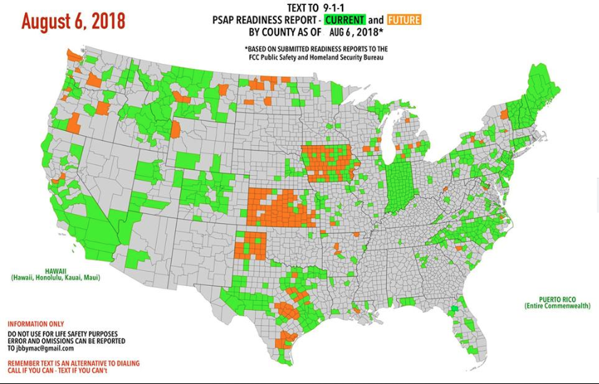
You first! No, you!
For text-to-911 + NG911, mutual dependency carriers + PSAPs
Text-to-911: obligation for carriers by June 2015

Slide 4
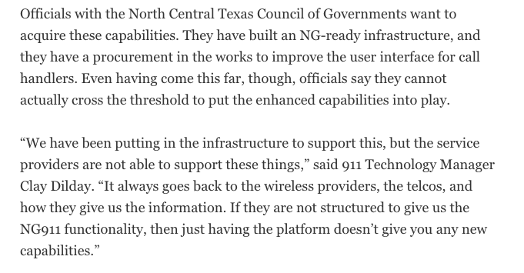
Carriers lag
June 28, 2017
Notes:
http://www.govtech.com/em/next-gen-911/PSAPs-Move-Ahead-with-Next-Generation-911-as-Carriers-Lag.html

Slide 5
Cost model
TAMU study 2017:
  ESInet (ESRP, ECRF, BCF, and LVF): $5.5B ($3.8B to $5.6B)
  PSAP cost: $1.7B (6500 PSAPs, 6 call taker stations each)
  interconnect: $13M
  security monitoring: $12M
NHTSA study Oct. 2018 (Table E5):
  $9.5B to $10.5B for statewide or multistate
  $12B for service solution
  huge costs for location delivery
Notes:
https://statescoop.com/federal-report-prices-national-next-generation-911-rollout

Slide 6



”Whatever it takes” communication
+
Notes:
FirstNet
satellite
Wi-Fi peer-to-peer
SMS
store-and-forward

Slide 7
Example: DARPA PHOENIX nodes
DECT
DARPA RADICS: support blackstart for electric utilities
802.11af
(TVWS)
high-bandwidth
VHF
mesh network
self-configuring – just turn on
network-technology agnostic (not just 4G)
local services (VoIP, messaging, edge cloud)
with diagnostics and traffic isolation
SDR: P.25
over VHF + Codec2 + data
Notes:
https://saankhyalabs.com/rural-broadband/meghdoot-base-station-slb802odu/

Slide 8
Internet Protocol radio communication
Distance | Technology | Bandwidth | Example radio
< 1 mi | 24 GHz | < 1 Gb/s | Ubiquiti AirFiber
< 10 mi | 802.11 5 GHz | < 300 Mb/s | Ubiquiti RP5AC
< 25 mi | 802.11af (TVWS) | < 24 Mb/s | Carlson Wireless
< 50 mi | VHF | 1 Mb/s in 50 kHz 64 kb/s in 12.5 kHz | SDR
< 1000 mi | HF | kilobits
tethered

Slide 9



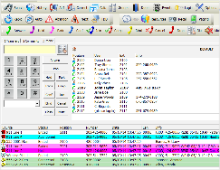
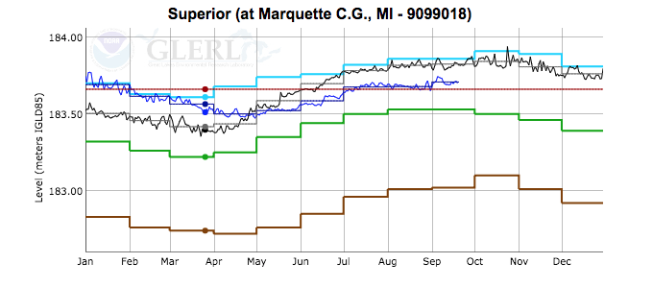
Integrating information flows
NLP
tailored sitreps
Notes:
input: social media, sensors, first responders, NG911
distill
automated reporting (NLP)

Slide 10
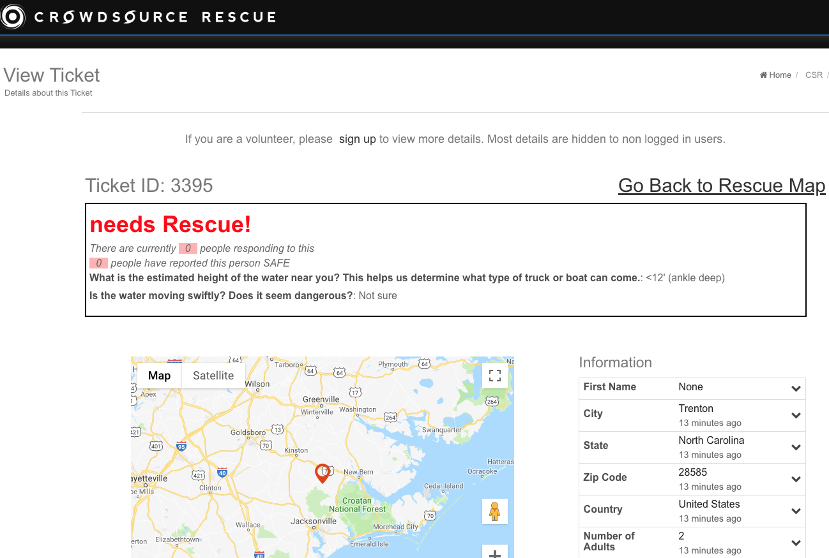
Illustration of need and possibilities, not necessarily perfect model.

Slide 11
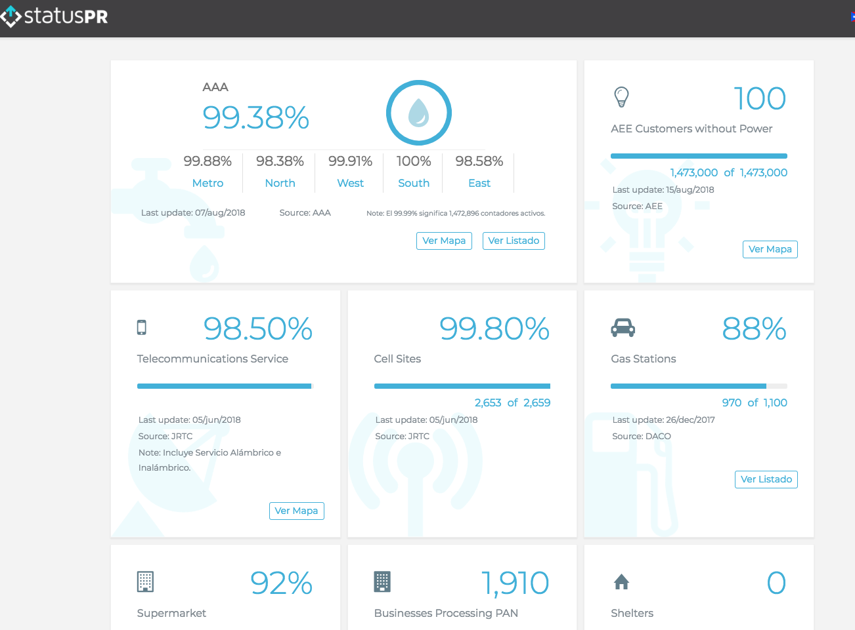
Example: status.pr

Slide 12
Microservices
Traditional: large, integrated (GIS) systems
  difficult to integrate new features
  mostly pre-web model (desktop PC as core user interface)
Complementary approach: “serverless” microservices
  commercial example: AWS lambda
  allow easier, quick additions of functionality
  external data sources & consumers
Research: domain-specific languages
  “Excel for first responders”
  e.g., event triggers, graphing, report generation, messaging

