Slide 1
Telecom policy: competition, spectrum, access and technology transitions
Henning Schulzrinne

Slide 2
Key challenges – (nearly) everywhere
Costs, competition and investment are poorly understood
Rural broadband is about finding the right levers, not 5G
Network neutrality is really about what rules apply to Internet services
Spectrum is no longer just book-keeping
Access for people with disabilities enables functionality for everybody
Emergency services (112 & 911) are mostly still stuck in pre-Internet

Slide 3
Network economics, competition & investment

Slide 4
The industry is complicated
MVPD (affects video rights & obligations)
cable
(CATV)
satellite
(SAT)
ILEC
RLEC
CLEC
LEC
owns
all entities can serve as a Broadband Internet Access Service (BIAS), commonly known as ISP
almost all ”TV” distributors are MVPDs, but not all MVPDs are ISPs (e.g., satellite)
AT&T, as an ILEC, owns a satellite MVPD (DirecTV)
Same company can be ILEC in one state & CLEC in another (rare)

Slide 5
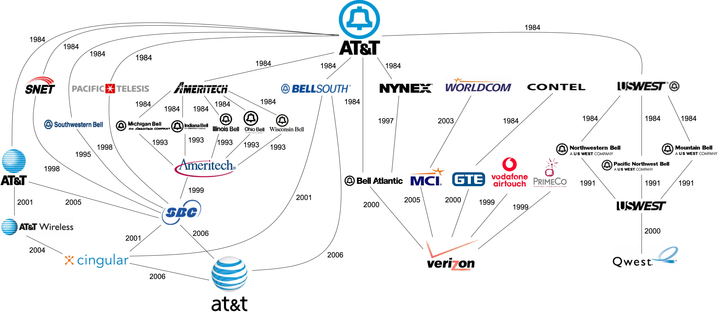
FreePress, 2008
Notes:
http://i.imgur.com/Tvh6teU.jpg
http://subjunctive.net/klog/2008/12/graphical_history_of/

Slide 6
Wireless revenue is falling
avg. about 2.1 GB/month
T-Mobile: 10 GB tethering
Notes:
https://451research.com/blog/1662-featured-data-1

Slide 7
Newspaper advertising
Twenty years ago classifieds provided more than a third of the revenue of The Washington Post. Craigslist has destroyed that business for the Post and every major paper in the country. (Brookings, 2014)
Notes:
http://www.businessinsider.com/chart-of-the-day-newspapers-classified-ads-revenue-2011-3

Slide 8
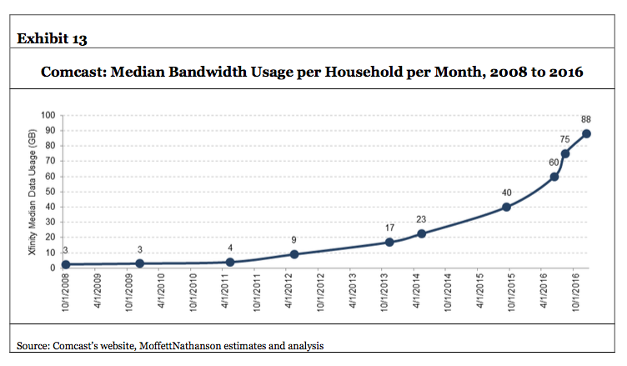
Problem likely capacity, not speed
June 2017: 100 GB
December 2017: 131 GB
Notes:
https://www.xfinity.com/support/internet/data-usage-average-network-usage/

Slide 9
Metrics: not Gb/s or b/s/Hz, but $/GB and $/year
Consumer market: $/GB delivered
  little willingness to pay for speed above 10 Mb/s for now
  unless $/GB → 0, 1 Gb/s download speed just threatens wallet
NB-IoT: $/device + $/year cost
  compete with $0 incremental cost BT/Zigbee/WiFi or LPWAN
  include amortized
  typically, << $1/month
  predictable coverage & international reach
  alternative for one-way: ATSC 3.0 (50+ miles reach, no incremental cost)

Slide 10

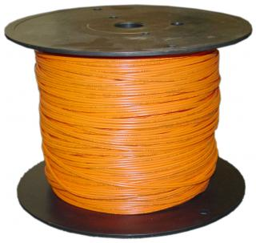
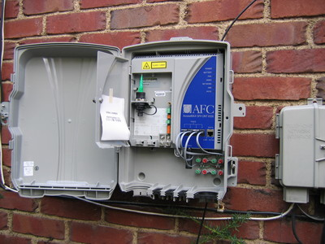
Network economics, (over)simplified
70%
30%
traditional: 12-15 staff/10k customers
Iliad, FR: 3-4 staff/10k
Notes:
opex ratios: Deloitte

Slide 11
Competition models: vertically integrated
content & applications
L3…L7
L2 (MAC)
L1 (PHY)
”L0” (infrastructure)
Notes:
http://www.oecd.org/sti/broadband/2-7.pdf loop unbundling

Slide 12
Sharing models: US
sharing (incumbent + new entrant) vs. neutral third party
+ WISP & satellite
DSL
(ILEC)
fiber
(ILEC, CATV, overbuilder)
HFC
PHY (LTE)
spectrum
ducts & poles
(electric utilities or ILEC)
towers

Slide 13
Sharing models: Canada, Europe, Australia
usually
unbundled
unbundling
varies
mostly not unbundled
DSL
fiber
HFC
PHY (LTE)
spectrum
ducts & poles
(electric utilities or ILEC)
towers
Notes:
http://dx.doi.org/10.1787/20716826
http://www.oecd.org/sti/broadband/2-7.pdf

Slide 14
Accidental broadband
94.2% of US
households have
phone service
G.992.2
ADSL
DSL patents
1988-1991
1993
1999
62.1 million US
households have
cable TV
“peak CATV”:
82% of HH
DOCSIS 3.1
(10G/1G)
DOCSIS 1.0
(40M/1M)
1995
1997
2008
2016
Notes:
file:///Users/hgs/Downloads/1997_Mar_Trends.pdf

Slide 15
Rural wireline ILECs lack resources
Wireline share of voice revenue:
2005: 79%
2015: 15%
Notes:
Deloitte

Slide 16
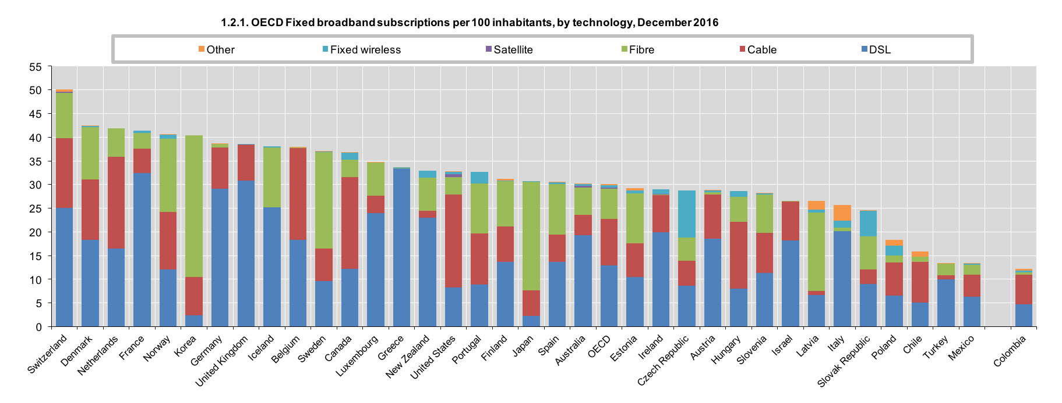
OECD overview

Slide 17
Trade-offs across the world?
If new deployment, predicted return on investment
  with unbundling: what is the wholesale price going to be?
  no magic algorithm --- margin squeeze
Allow infrastructure owner to provide services?
Impact on consumer surplus
US: pole attachment problems
  if incumbents are pole owners

Slide 18
Rural broadband

Slide 19
Broadband access by speed & geography
15% of US population

Slide 20
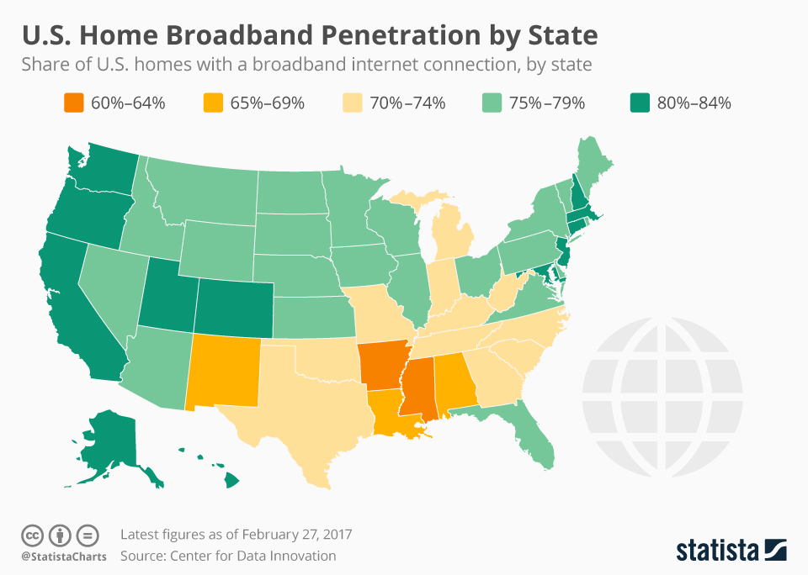

Slide 21
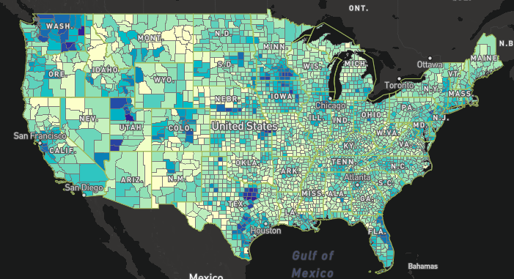
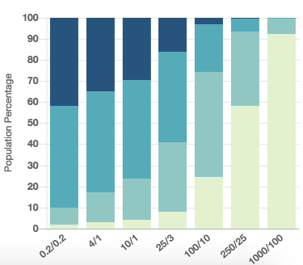
Number of 25/3 Mb/s providers
3+
0
2
1
blocks are considered served if one HH served

Slide 22
Lower population density, easier broadband
32.45/km²
2.91/km²
3.49/km²
Deloitte, 2017

Slide 23
Policy levers for rural broadband
Decrease cost of serving
  “dig once” – bury conduit or fiber during street (or other utility) repair & construction
  pole attachment: make-ready, rates, shot clocks, …
Provide funding
  US: Universal Service Fund
microtrenching

Slide 24
History: rural electrification
Early 1920s, between 2 and 3% of farms (likely less)
  1921: DC had 98.2%, MA 97.8%
“In 1935, only 10.9% of American farms (744,000) enjoyed central station power, compared with Germany and Japan at 90%, France between 90 and 95%, and New Zealand at 60%.”
“In 1940, just four and a half years after Roosevelt signed Executive Order No. 7037 (followed by 1936 ”Rural Electrification Act”), 25% of American farms had been electrified.”
1950: 90% had been electrified nationally
Today: 850 distribution coops serving 14 M homes
Notes:
http://remagazine.coop/flashbacks-rural-electrification-cartogram-numbers/

Slide 25
Rural electrification
“In 1935, Morris Llewellyn Cooke, a mechanical engineer … appointed by Roosevelt as the REA's first administrator, Cooke applied an engineer's approach to the problem, instituting what was known at the time as "scientific management"—essentially systems engineering. … By 1939 the cost of a mile of rural line had dropped from $2,000 to $600. Almost half of all farms were wired by 1942 and virtually all of them by the 1950s.”
Cost of aerial fiber installation: $14k/mile material, $39k/mile installation ^{(Singer, 2017)}
USDA loans at 2.81% for 30 years
$10,958 in 2017
Notes:
“Assessing the Impact of Removing Regulatory Barriers on Next Generation Wireless and Wireline Broadband Infrastructure Investment”, 2017
http://www.greatachievements.org/?id=2990 (rural electric)
https://fas.org/sgp/crs/misc/RL33816.pdf

Slide 26
Accidental broadband
94.2% of US
households have
phone service
G.992.2
ADSL
DSL patents
1988-1991
1993
1999
62.1 million US
households have
cable TV
“peak CATV”:
82% of HH
DOCSIS 3.1
(10G/1G)
DOCSIS 1.0
(40M/1M)
1995
1997
2008
2016
Notes:
file:///Users/hgs/Downloads/1997_Mar_Trends.pdf

Slide 27
Density determines network choices
cable
satellite
REC
DSL (common)
FTTH
WISP
HH/road mile
1454
1
7
10
20
50
100
1000
Alaska roadmiles
Notes:
Manhattan: 508 road miles - http://venus.fcny.org/cmgp/streets/pages/2001PDF/Report/DFMN.pdf ; Wikipedia: 738,644 households in Manhattan
Alaska: 15,178 miles; 741,894 population

Slide 28
Challenges for rural broadband
Who is going to build out?
  some incumbent local exchange carriers (ILECs) are not interested
  municipalities may be prohibited by state laws
    or hurdle is extremely high
  rural electric cooperatives – serve 14M homes in US (out of ~110M)
    average, 5.8 electric meters per mile
Who is going to pay for broadband?
  pay once or pay forever?
Are non-landline approaches scalable?
  TVWS
  satellite – NGS like OneWeb (600 satellites)
    currently, about 500k residential satellite subscribers

Slide 29
Reason for non-adoption
partially
technology
= economics
& policy

Slide 30
Internet usage by income
Computer and Internet Use in the United States: 2013
American Community Survey Reports

Slide 31
Open Internet (Network neutrality)

Slide 32
A simplified evolution
Early (2003-2009)
Intermediate (2010)
Advanced (2015-)
no blocking
attach non-harmful devices
competition
no blocking
no discrimination
transparency
privacy
interconnection
semi-voluntary?
Reversal (2017?)
zero rating & caps
anti-trust?
tethering
Authority unclear
Section 706
Title II
Information service?

Slide 33
How to be non-neutral
deep packet inspection
block Skype
user tracking
application
block transport protocol
block ports
insert RST
transport
block IP addresses
QoS discrimination
zero-rating
network
Not all practices are necessarily violations

Slide 34
Some high-profile cases
VPN blocking (Comcast, roughly 2001) - unconfirmed
WiFi blocking (AT&T AUP, 2002)
Madison River (2005)
  DSL provider blocked SIP ports
  fined $15,000 by FCC
  based on Section 201 “just and reasonable”
Comcast (late 2007)
  insert TCP RST into BitTorrent traffic
  later overturned on appeal in DC Circuit Court
RCN (2009): P2P
FaceTime on AT&T
Comcast vs. Level 3 (2010, in dispute) - interconnection
Comcast, Verizon, AT&T, … vs. Netflix (2013-2014)
Zero-rating (AT&T, T-Mo, VZ, Comcast)
Notes:
http://hraunfoss.fcc.gov/edocs_public/attachmatch/DA-05-543A1.pdf
http://www.zeropaid.com/news/88573/comcast-prevails-in-bittorrent-throttling-case/
http://www.practicallynetworked.com/news/comcast.htm
AT&T 2002 terms for DSL - https://www.wired.com/story/how-the-fccs-net-neutrality-plan-breaks-with-50-years-of-history/
Examples of prohibited programs and equipment include, but are not limited to, mail, ftp, http, file sharing, game, newsgroup, proxy, IRC servers, multi-user interactive forums and Wi-Fi devices
Theft of Service. Customer shall not connect the Service or any AT&T Broadband Equipment to more computers, either on or outside of the Premises, than are reflected in Customer’s account with AT&T Broadband. Customer acknowledges that any unauthorized receipt of the Service constitutes theft of service, which is a violation of federal law and can result in both civil and criminal penalties.

Slide 35
Network neutrality and Title II
2015 order
no QoS
no metering
no zero-rating
§201
§202
§208
§222
tariffs
interlocking directorates
regulated interconnection
§214 discontinuance
no blocking
no paid prioritization
no unreasonable interference
transparency

Slide 36
Questions beyond NN
What are the rights and obligations of
  broadband Internet access providers?
  content providers that want to interconnect?
  handset vendors and application writers?
  consumers?
  right-of-way owners (poles and ducts)?
What are the legal foundations?
Are there any economic restrictions?
  Telecom: “just & reasonable”
  or just anti—trust rules (largely, mergers & acquisition, collusion, …)
Who sets the rules?
  FTC – ”unfair or deceptive trade practices”
  FCC – sector-specific

Slide 37
2015 OI rules
telecommunication services – Title II
  defines PSTN as including data services
  includes mobile & fixed
Sections 201, 202 & 208 apply
but others forborne

Slide 38
2017 OI rules
2010 transparency

Slide 39
2017 justifications
2015 OI caused decrease in investment
Internet service is technically an information service
  DNS and caching
FTC and anti-trust laws can deal with any anti-competitive behavior
Examples of anti-NN behavior aren’t bad

Slide 40
What’s next?
Rules published February 2018, effective April 2018
States and public interest organizations sue in DC Circuit
  Washington, Illinois, Kentucky, Pennsylvania, Delaware, Oregon, Vermont, the District of Columbia, and Massachusetts
Possible appeal to Supreme Court
Wildcard: 2018 Congressional election
  will likely determine any attempt at political solution

Slide 41
Spectrum

Slide 42
Spectrum sharing
How much politeness & fairness is required?
→ LTE-U & LTE-LAA (license-assisted, listen-before-talk)
through
1990s
Wi-Fi
radio, TV,
early mobile
US: since 1994
Notes:
“Priority-Based Classification of Spectrum Access Models”, August 2013

Slide 43
Ideal spectrum
Unused or cheap
Available globally (→ important for consumer goods & market size)
  preferably under similar licensing conditions
No noisy or sensitive neighbors
Propagates indoors through walls and glass
Not affected by rain or leaves outdoors
Wide bands (≥ 5 MHz, preferably 20 MHz+)
Is paired (uplink & downlink)
Can be processed with cheap electronics (Si, not GaAs)
Allows small antennas🦄🦄

Slide 44
Spectrum management
Until the 2000s
“Modern”
Single purpose
Fixed technology (modulation)
Exclusive use
Narrow bands (except TV)
Assume single radio per device
Worry mostly about OOB to like
Spectral efficiency secondary
Single-country
Flexible use
Flexible technology
Shared, over/underlay
At least 5 MHz, preferably 100
Multiple (> 4) XTR/RCV
Receiver requirements?
Spectral efficiency matters
International coordination

Slide 45
Challenges for spectrum sharing
Unlicensed ~2000
Unlicensed now
Unlicensed emerging
indoor home
indoor enterprise
campus
--> natural separation
secondary public SSID
re-use HFC/FTTH backhaul
LTE-U, LAA
what are the “kindergarten” rules?
only power rules (no listen-before-talk (CS) required)
e.g., CableWiFi
One band, one channel

Slide 46
Spectrum co-existence
vs.
“high tower, high power”
(TV, cellular downlink, radar transmitter)
cellular uplink
radar receiver
GPS receiver
how do I quickly identify sources of interference?

Slide 47
Spectrum roles
400 – 800 MHz
1 – 3 GHz
3-6 GHz
> 10 GHz
base-level coverage
(particularly rural)
urban capacity
indoor & capacity
directional
capacity
Digital dividend
TV incentive auction
AWS-3
3.5 GHz
mmWave R&O

Slide 48
TV incentive auction
go off-air (6 MHz)
multiplex (share)
VHF
descending clock auction
→ reduce until clearing target met
TV station participated & got bid?
April 2017 ✅
initial
clearing goal
reverse
auction
(TV stations)
forward
auction
(carriers)
144 MHz
(May 2016)
forward bids
insufficient →
reduce clearing goal
repack
(39 months)
next step

Slide 49
Incentive auction facts

Slide 50
3.5 GHz band
FSS: C Band (3.625–4.200)

Slide 51
Universal access

Slide 52
Goal: functional equivalence
Title IV of Americans with Disabilities Act (ADA):
  The term "telecommunications relay services" means telephone transmission services that provide the ability for an individual who has a hearing impairment or speech impairment to engage in communication by wire or radio with a hearing individual in a manner that is functionally equivalent to the ability of an individual who does not have a hearing impairment or speech impairment to communicate using voice communication services by wire or radio. Such term includes services that enable two-way communication between an individual who uses a TDD or other nonvoice terminal device and an individual who does not use such a device.
47 USC 225

Slide 53
What can be done?
But what about YouTube?
Live events?
Enable access by people with disabilities → provide new capabilities for everyone

Slide 54
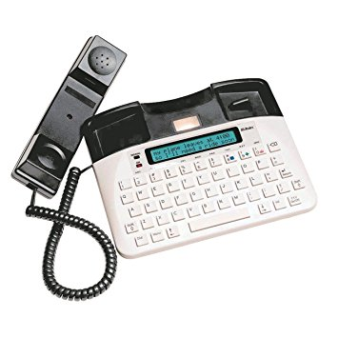


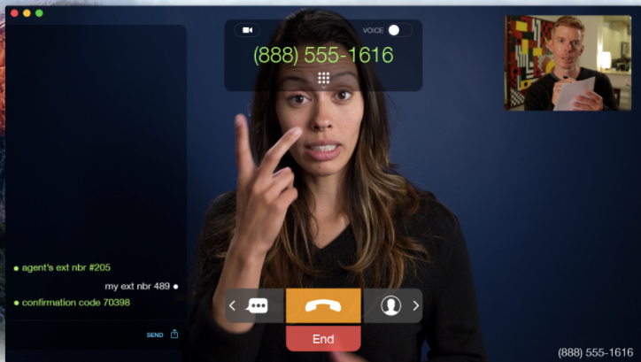
Relay services
text relay
(legacy, may
transition to RTT)
VRS
(ASL as first language;
mostly culturally Deaf)
IP-CTS
(Non-ASL;
mostly late-deafened)

Slide 55
Conclusions
Networks as infrastructure → technology, economics & policy
Think in decades, not conference cycles
Network performance is rarely the key problem
  except maybe at physical layer
Many of the problems are incentive problems
  we know how to solve them, but levers are missing
  or are politically not feasible

Slide 56
Emergency calling

Slide 57
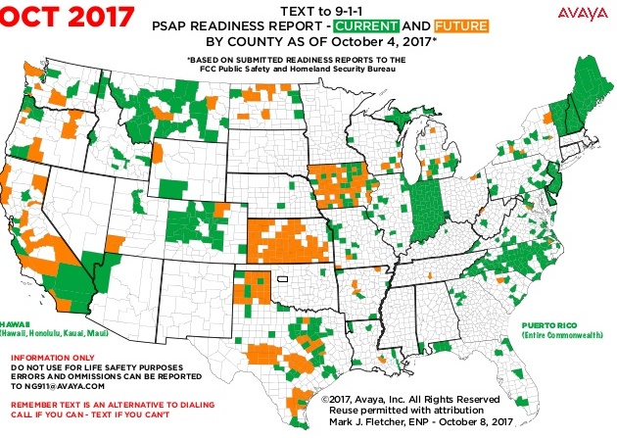
Text-to-911
obligation
for carriers
by June 2015

Slide 58
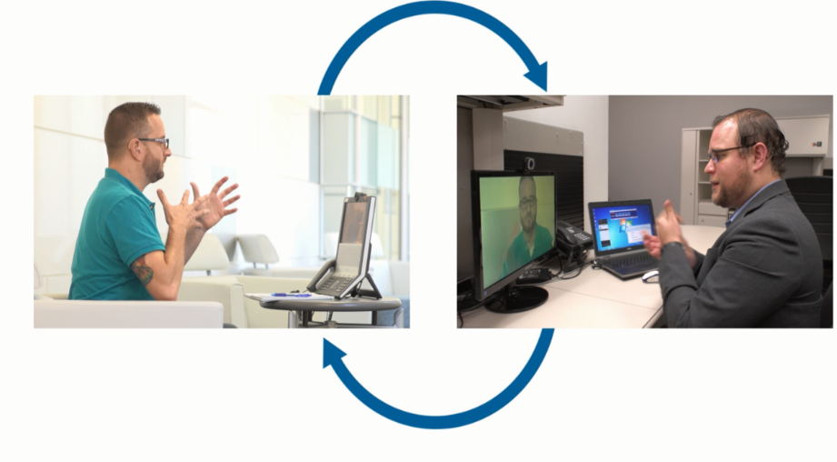
Direct video calling
old model: customer → video interpreter → government agency
new model: customer – (direct video calling) --- government agency
10% of VRS
minutes are
to small set of
destinations,
like SSA

Slide 59


VoIP emergency communications
phone & SMS-based (local)
emergency call
wireless emergency alerts
(WEA)
emergency alert
dispatch
90 characters
(360 in the future?)
AM/FM
TV
cable
civic coordination

Slide 60
What distinguishes 911?
5,784 PSAPs (in 3,135 U.S. counties)
  some very large (NYC, LA, Chicago), some tiny
  technical services by contractors and “system service providers”
240 million 9-1-1 calls per year: 70% cellular
Location delivery
  98.6% of population have some Phase II (July 2016) – outdoors!
  most carriers use hybrid location (GPS + network-based such U-TDOA)
Funded by variety of add-on 9-1-1 charges on phone bills, not taxes
  some diverted to other purposes
Limited regulatory authority for FCC
  Mostly, iVoIP and cellular providers, not PSAPs
  some oversight by state public utilities commission or state 911 office

Slide 61

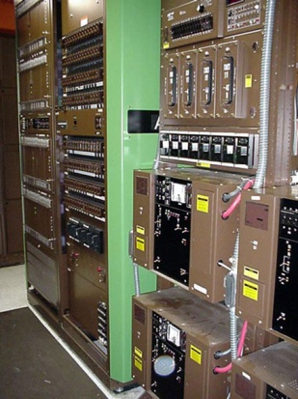
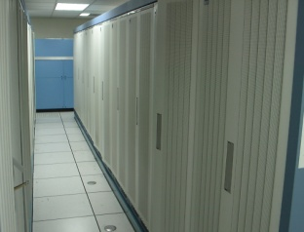
Wireless 911: Phase 2
MSC
pANI
(ESRD or ESRK)
y
N
e
t
r
s
i
r
l
i
t
Wireless Tower
LEC
selective router
PDE
MPC/SCP
E2
S
ALI
A-GPS, UTDOA, …
dynamic
updates
t
ESRK or ESRD →
coordinates
callback number
w
.
a
p
.
c
o
ESRK = unique for call
ESRD = unique for location

Slide 62

Switches are ageing
1979
Nortel DMS-100
http://www.phworld.org/switch/ntess.htm

Slide 63
March 8th AT&T Mobility VoLTE 911 Outage
March 8, 2017: Significant adverse impact on VoLTE 911 services
  Outage appeared to affect AT&T Mobility VoLTE 911 service for approximately 5 hours in the Southeast, Central and portions of the Northeast Region of the US, and eventually, a significant portion of VoLTE 911 calls in the remaining portion of the country.
  According to AT&T, on a normal day, it would expect its total VoLTE 911 call volume to be approximately 44,000 calls nationwide. During the event, approximately 12,600 unique callers were not able to reach 911 directly.
  Changes to AT&T’s network appeared to cause automated call routing for VoLTE 911 calls to fail.
  Small subset of calls were answered by a backup call center and routed to first responders. Volume of calls exceeded the call center’s capability to manually process them, resulting in a large number of calls being dropped.
  Some customers received fast busy signals when attempting to call 911. Others report that calls to 911 rang repeatedly without being answered.

