Slide 1
Flexible & resilient coordination for first responders
Henning Schulzrinne
Columbia University

Slide 2
What has changed or will change?
Non-emergency and emergency calls separate → blending of 211, 311 and 911 services + alerting
911 as inbound public-to-PSAP only → (automated) personalized recommendations of actions
Generic flash flood alerts → “your evacuation pick-up is at 9:30 am”
Mostly audio (911, phone calls) → voice + text, social media, data, GIS, video
Largely single agency → multiple agencies (city, county, state, federal), mutual aid, citizen assistance (Cajun Navy), media
Field communication mostly LMR and voice → apps, IoT, UAVs, …
Procure software every 15+ years → on-going refinement and adaptation

Slide 3
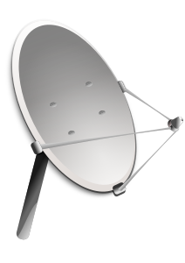


”Whatever it takes” communication
+
Notes:
FirstNet
satellite
Wi-Fi peer-to-peer
SMS
store-and-forward

Slide 4
Example: DARPA PHOENIX nodes
DECT
DARPA RADICS: support blackstart for electric utilities
802.11af
(TVWS)
high-bandwidth
VHF
mesh network
self-configuring – just turn on
network-technology agnostic (not just 4G)
local services (VoIP, messaging, edge cloud)
with diagnostics and traffic isolation
SDR: P.25
over VHF + Codec2 + data
Notes:
https://saankhyalabs.com/rural-broadband/meghdoot-base-station-slb802odu/

Slide 5
Internet Protocol radio communication
Distance | Technology | Bandwidth | Example radio
< 1 mi | 24 GHz | < 1 Gb/s | Ubiquiti AirFiber
< 10 mi | 802.11 5 GHz | < 300 Mb/s | Ubiquiti RP5AC
< 25 mi | 802.11af (TVWS) | < 24 Mb/s | Carlson Wireless
< 50 mi | VHF | 1 Mb/s in 50 kHz 64 kb/s in 12.5 kHz | SDR
< 1000 mi | HF | kilobits
tethered

Slide 6


Deployment:
Large node: rooftop deployments with number of antennas and edge cloud
Medium node: street-level devices dual use with wireless/wired backhaul

Slide 7



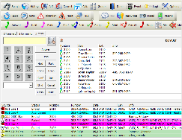
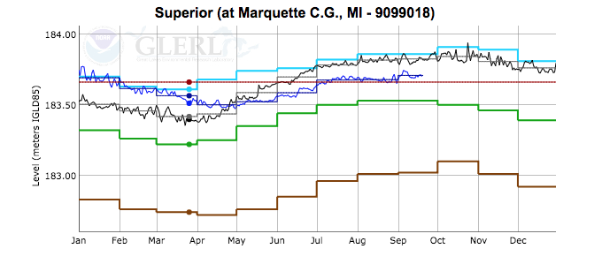
Integrating information flows
NLP
tailored sitreps
Notes:
input: social media, sensors, first responders, NG911
distill
automated reporting (NLP)

Slide 8
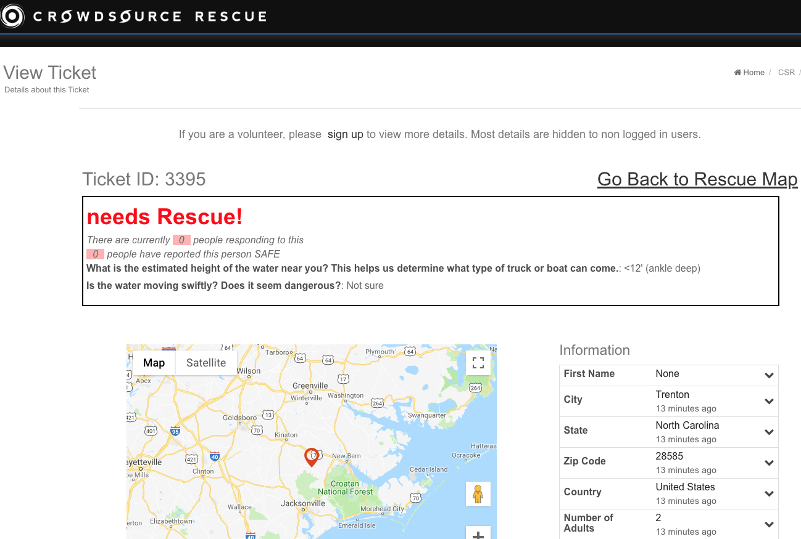
Illustration of need and possibilities, not necessarily perfect model.

Slide 9
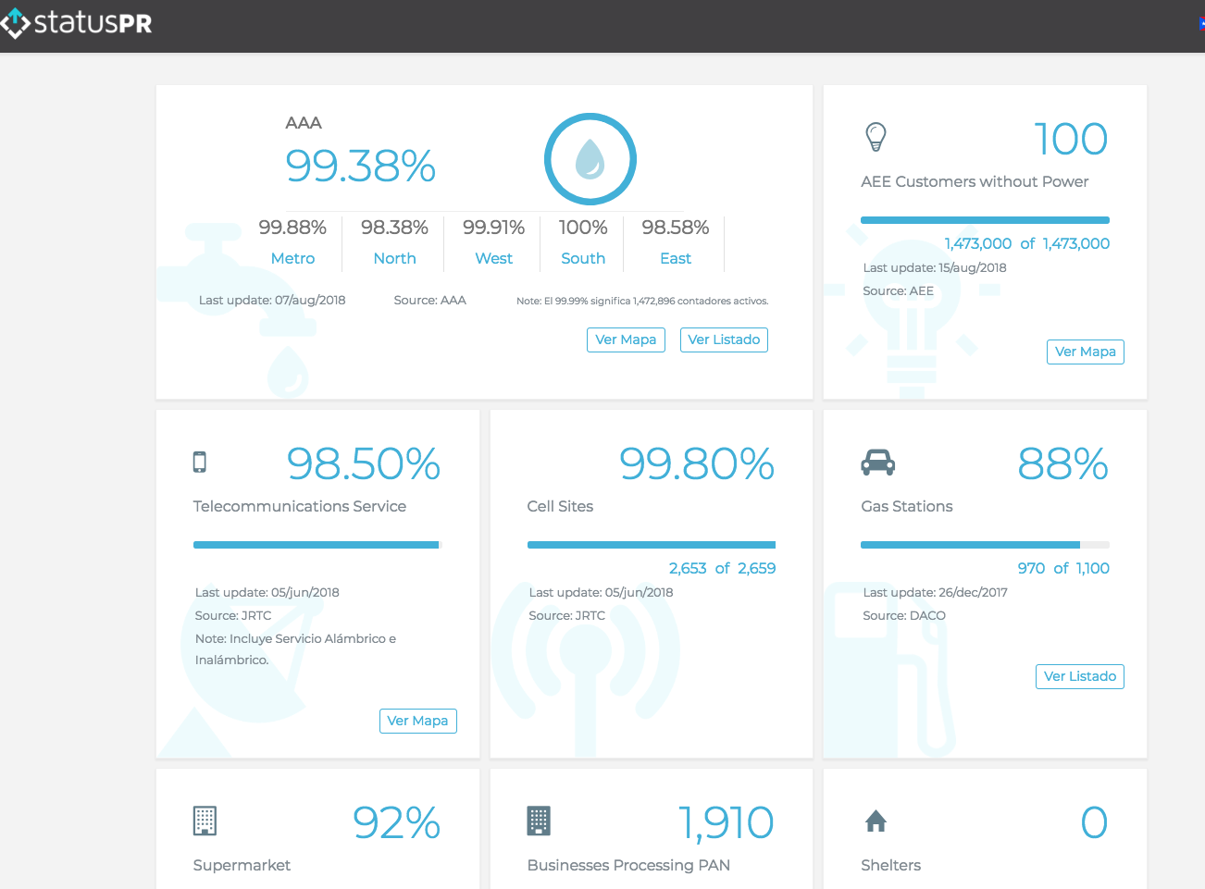
Example: status.pr

Slide 10
Microservices
Traditional: large, integrated (GIS) systems
  difficult to integrate new features
  mostly pre-web model (desktop PC as core user interface)
Complementary approach: “serverless” microservices
  commercial example: AWS lambda
  allow easier, quick additions of functionality
  external data sources & consumers
Research: domain-specific languages
  “Excel for first responders”
  e.g., event triggers, graphing, report generation, messaging

Slide 11
Conclusions
Not just changing technology, but changing environment
Single-stack technologies (FirstNet, LMR) → hybrid, flexible environments
From fixed functions with pre-defined reports + Microsoft Office → near real-time service creation as needed

