Slide 1
Reproducibility: A problem of economics, not science
Henning Schulzrinne
Columbia University

Slide 2
ACM recap
Replicability (Different team, same experimental setup)
The measurement can be obtained with stated precision by a different team using the same measurement procedure, the same measuring system, under the same operating conditions, in the same or a different location on multiple trials. For computational experiments, this means that an independent group can obtain the same result using the author’s own artifacts.
Reproducibility (Different team, different experimental setup)
The measurement can be obtained with stated precision by a different team, a different measuring system, in a different location on multiple trials. For computational experiments, this means that an independent group can obtain the same result using artifacts which they develop completely independently.
Notes:
https://www.acm.org/publications/policies/artifact-review-badging

Slide 3
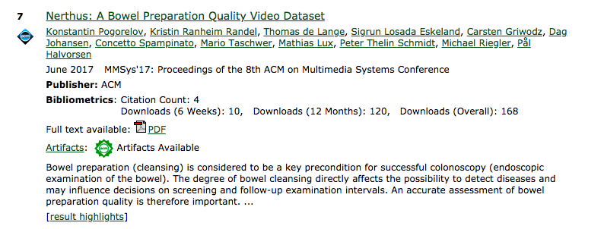
ACM artifacts available
591 total for ACM DL, 121 replicated, 12 SIGCOMM artifacts (0 reproduced)

Slide 4
The economics of replicability
Externalities: Lack of replicability pollutes the knowledge pool.
Opportunity costs: I could be doing something else.
Principal-agent problem: Funding agencies may want replication, but agents (researchers) may not.

Slide 5
Replicability crisis – lack of incentives
science: long-term results that lots of people care about + organized attempts at reproduction
networking: results with short shelf life
A tragedy of the (academic) commons: interpreting the replication crisis in psychology as a social dilemma for early-career researchers
Notes:
https://www.frontiersin.org/articles/10.3389/fpsyg.2015.01152/full

Slide 6
Decision tree for networking research replication
can I get funding?
if the result is “confirmed”?
can it get published?
does it count for the PhD student?
in a “good” conference?
is it likely to get cited?
Replicate!
Nope

Slide 7
Good news: we don’t have a p-hacking problem
because nobody provides even confidence intervals

Slide 8
What can be incentives?
Funding process
NSF data management plan + teeth (e.g.,, random checks or complaint process)
Incentivize replication – special grants for high-profile problems?
Review process
provide doesn’t-count space for detailed experiment descriptions
disallow data hiding for mostly research-competitive reasons
if the researchers got data under NDA, others should, too
“RAND” model – reasonable and non-discriminatory
enforce minimum statistical quality (CIs, p-values, …)
review checklist (“does the paper show statistical validity?”)
Community process
common test data sets (cf. vision, NLP, ML)
common test cases (beyond dumb-bell topology)
Extensibility >> reproducibility

