Slide 1
The economics of consumer networks
Henning Schulzrinne
Columbia University

Slide 2
Overview
Networking (as practiced) has not changed dramatically in past 20 years
Network engineering optimizes the less-important things
Network economics make change hard
Almost all the money is local

Slide 3
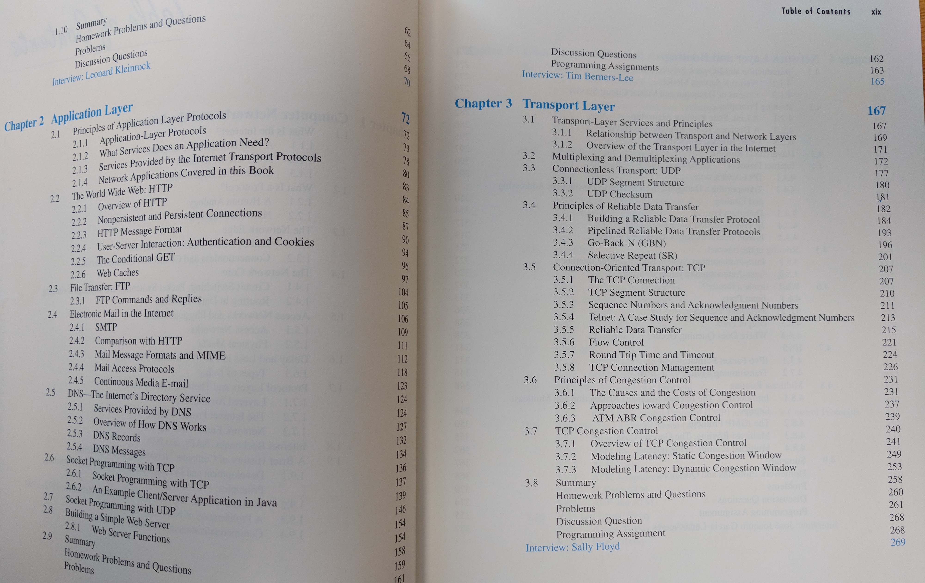
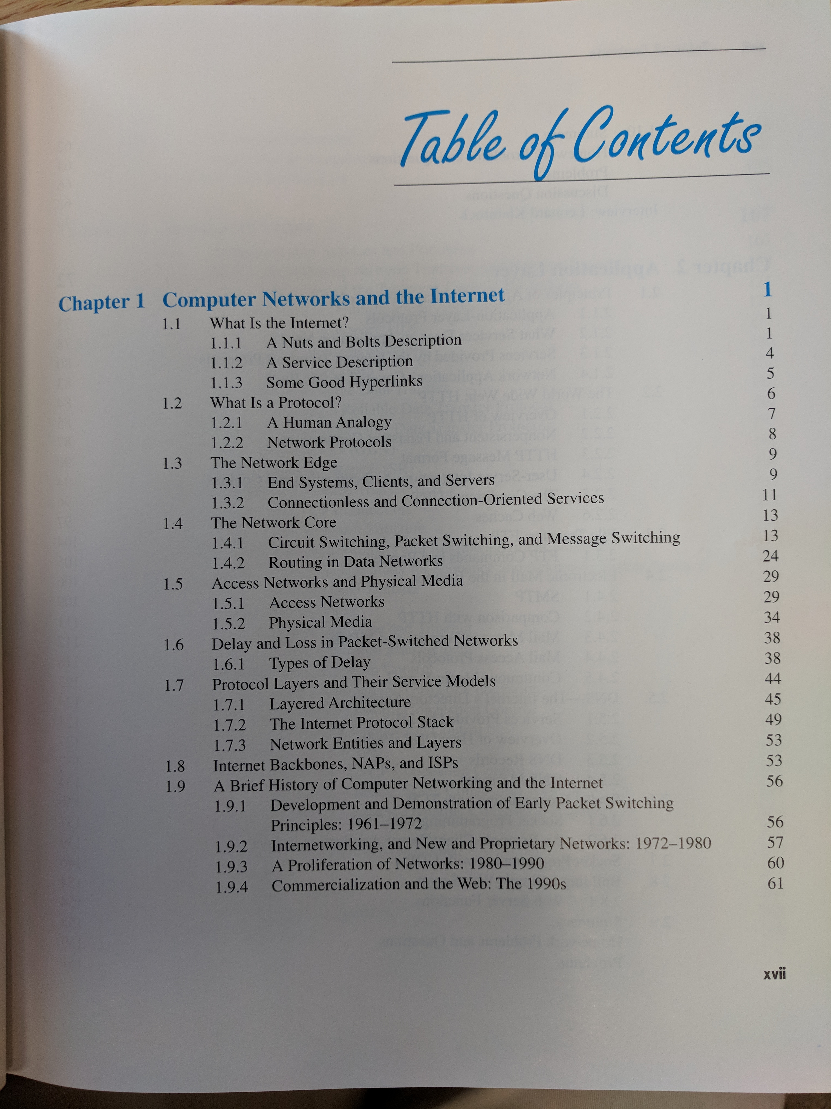

Slide 4
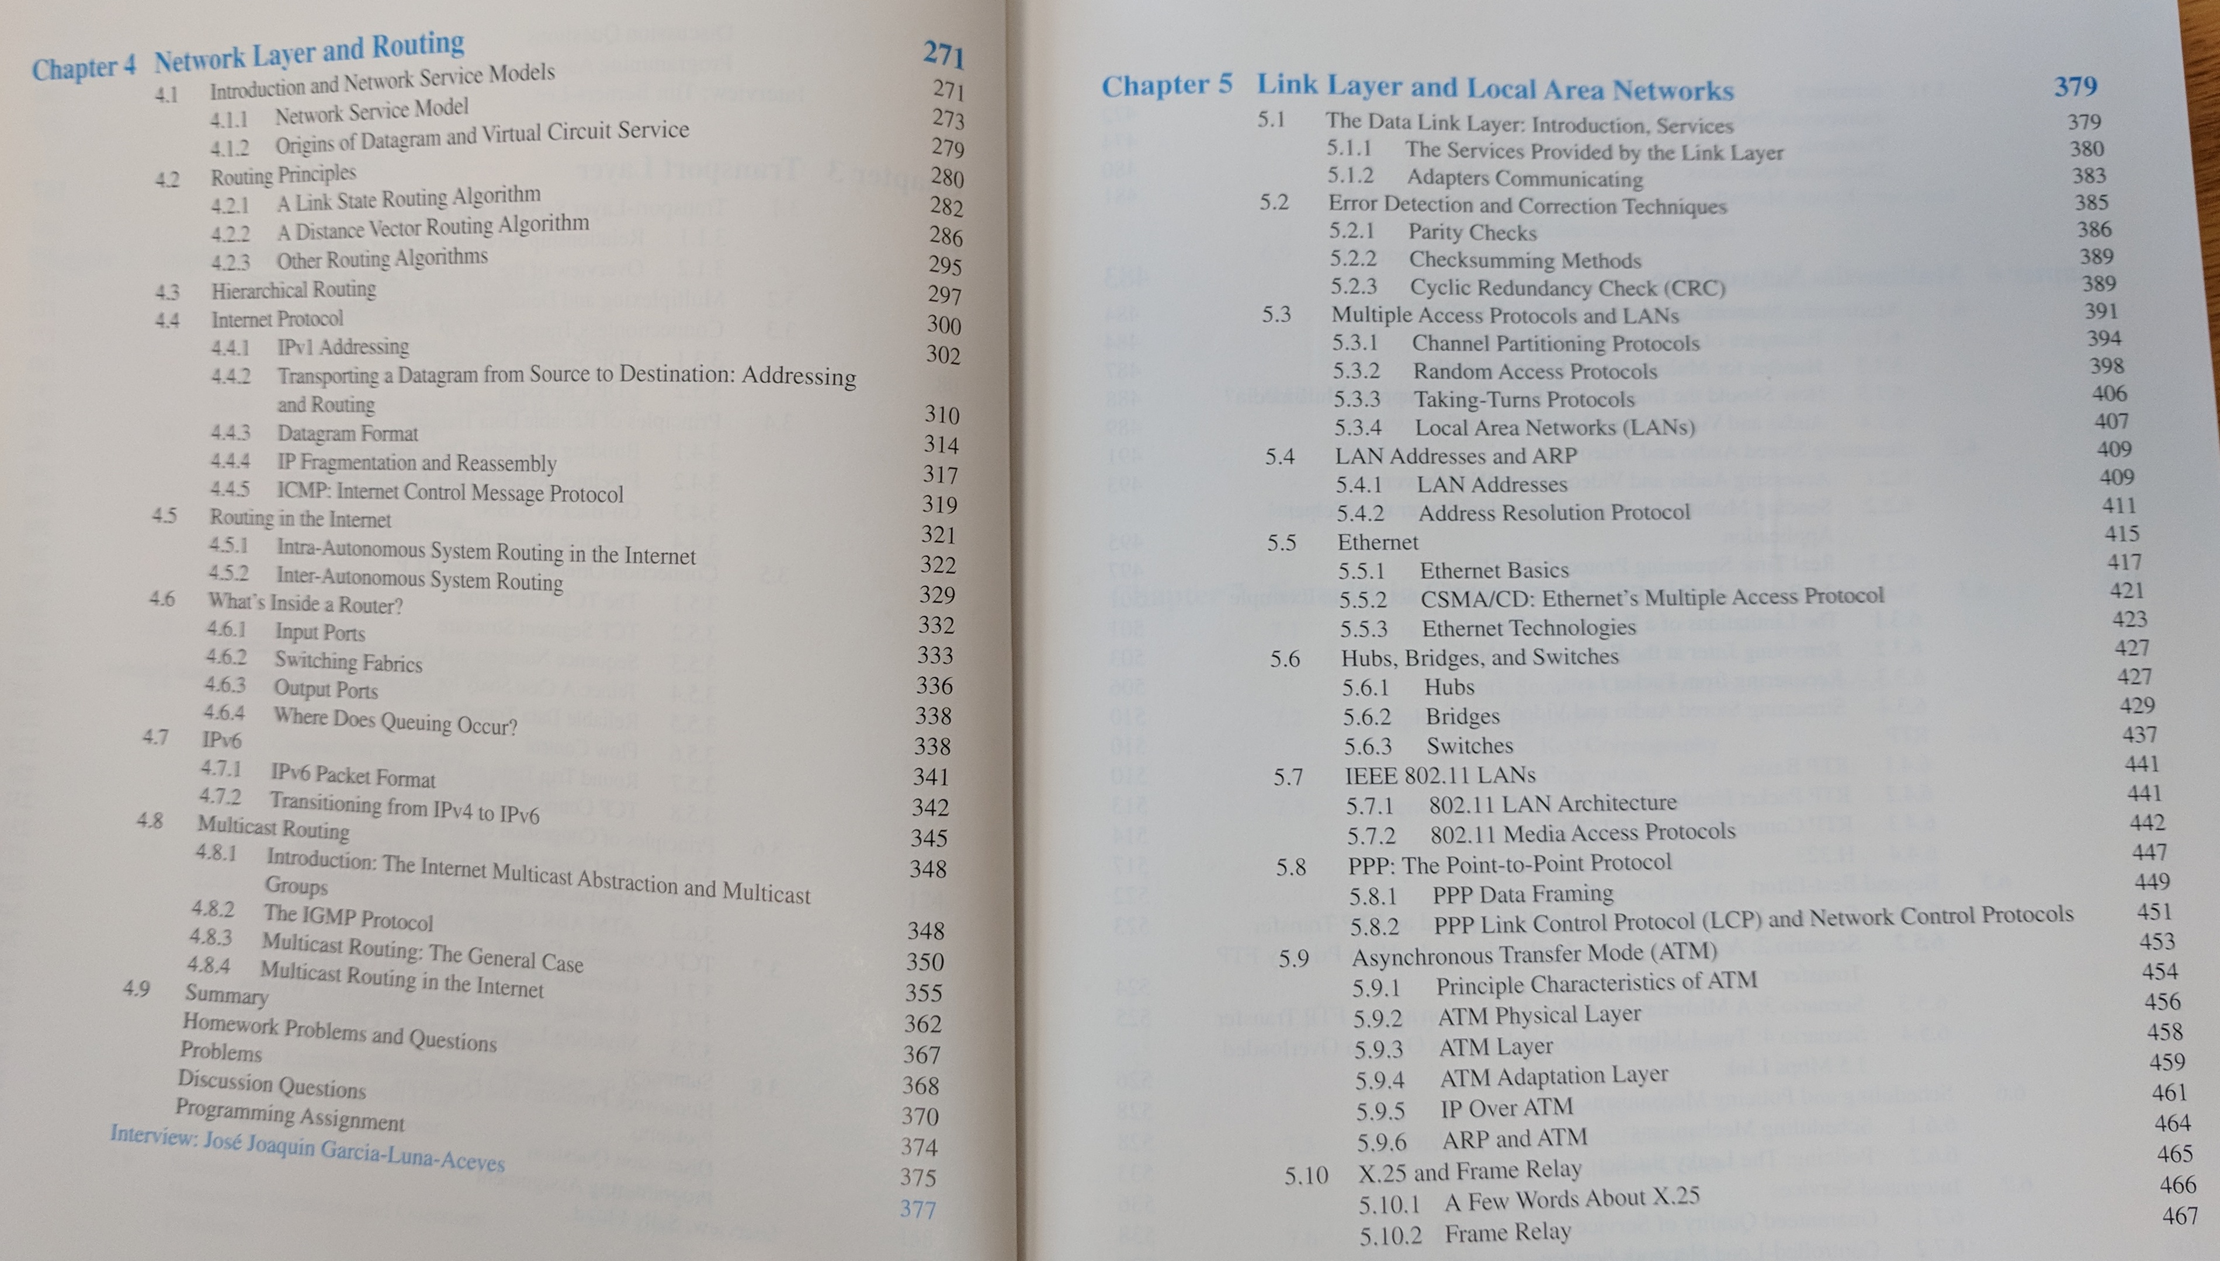

Slide 5
IETF25 (1992) looks familiar

Slide 6
Why so little change in the Internet?
 | Browser | Data center | Access networks | Internet
Major changes in last decade | WebRTC, HTML5, WebSocket, CSS3, … | SDN, heterogeneous computing, rack-scale, accelerators | 5G, DOCSIS 3.x | QUIC
Major players | 3 | 4 (or 7) | Major wireless Comcast | Hundreds to thousands
Backward compatible | Easy | Local | Separate frequencies | Minimum feature set
Incentive | Competition | Revenue | Spectral efficiency | Limited (OpEx?)

Slide 7
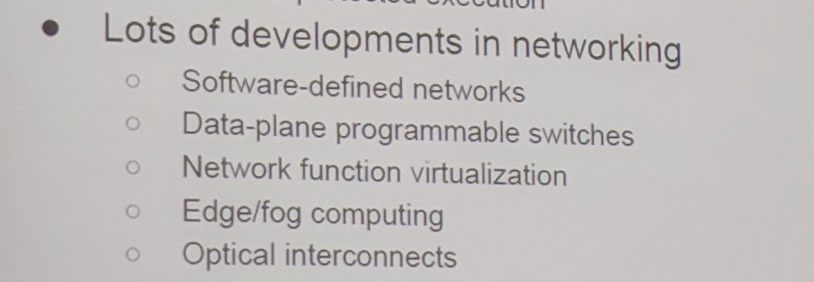
Random Dagstuhl slide
Implementations
Not protocols or algorithms
With exception of QUIC and maybe YANG, no major new protocols in last 10 years.

Slide 8

Networks never die, they just drop nodes
* 1982
➔ We’ll still have phone numbers and IPv4 addresses in 2047…

Slide 9
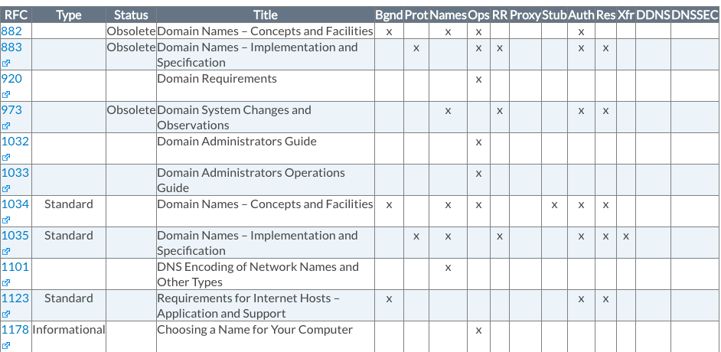
Simple core protocols have acquired technical debts
DNS:
~143 active RFCs
Notes:
http://www.bind9.net/rfc

Slide 10

The three tribes – but only two are growing
data center
enterprise
backbone
$52B big 4 cloud
$5.5B
consumer
access
Stronge, NANOG71
~$57B wireline
~$156B cellular
shift from backbone
to content providers
MoffettNathansan 2018
Notes:
MoffettNathansan, April 2018

Slide 11
The (US) industry is complicated
MVPD (affects video rights & obligations)
cable
(CATV)
satellite
(SAT)
ILEC
RLEC
CLEC
LEC
owns
all entities can serve as a Broadband Internet Access Service (BIAS), commonly known as ISP
almost all ”TV” distributors are MVPDs, but not all MVPDs are ISPs (e.g., satellite)
AT&T, as an ILEC, owns a satellite MVPD (DirecTV) and a content producer (Time Warner) and advertisement company (AppNexus)
Same company can be ILEC in one state & CLEC in another (rare)

Slide 12
Internet structure: network of networks
Tier 1 ISP
Tier 1 ISP
Google
No longer good
representation of
revenue structure
traditional money flow
IXP
IXP
IXP
Regional ISP
Regional ISP
large eyeball
ISPs may charge
long-haul and CDN
for access
access
ISP
access
ISP
access
ISP
access
ISP
access
ISP
access
ISP
access
ISP
access
ISP
at center: small # of well-connected large networks
  “tier-1” commercial ISPs (e.g., Level 3, Sprint, AT&T, NTT), national & international coverage
  content provider network (e.g., Google): private network that connects it data centers to Internet, often bypassing tier-1, regional ISPs

Slide 13
Networks are going private

Slide 14
Transit prices
http://drpeering.net/white-papers/Internet-Transit-Pricing-Historical-And-Projected.php

Slide 15
“We don’t want to be bit pipes”
France Telecom
Minitel era (~2000)
→ Avoid commoditization (competition on price only)
Two mechanisms: provide better services vs. withhold services (”APIs”) or price-differentiate
2008
WAP
IMS
Linear
video
Cloud
Content
Which prevents them from being good bit pipes
→ unusual, but inherent, conflict of interest between provider and customer
Notes:
https://mondaynote.com/verizon-no-we-cant-become-dumb-pipes-ddab2b41a2d8

Slide 16
The value of bits
Technologist: A bit is a bit is a bit
Economist: Some bits are more valuable than other bits
  e.g., $/bit(email) >> $/bit(video)
  no-QoS bits dominate in volume
Application | Volume | Cost per unit | Cost / MB | Cost / TB
Cable video | 660 GB |  | $0.06 | $60
Voice (13 kb/s GSM) | 97.5 kB/minute | 10c | $1.02 | $1M
Mobile data | 5 GB | $40 | $0.008 | $8,000
MMS (pictures) | < 300 KB, avg. 50 kB | 25c | $5.00 | $5M
SMS | 160 B | 10c | $625 | $625M
➔ Economic interests not aligned
Notes:
T-Mobile 2010
AT&T data
http://www.nowsms.com/discus/messages/12/8500.html

Slide 17
Metrics: not Gb/s or b/s/Hz, but $/GB and $/year
Consumer market: $/GB delivered
  little willingness to pay for speed above 10 Mb/s for now
  unless $/GB → 0, 1 Gb/s just threatens wallet
NB-IoT: $/device + $/year cost
  compete with $0 incremental cost BT/Zigbee/WiFi or LPWAN
  include amortized
  typically, << $1/month
  predictable coverage & international reach
  alternative for one-way: ATSC 3.0 (50+ miles reach, no incremental cost)

Slide 18

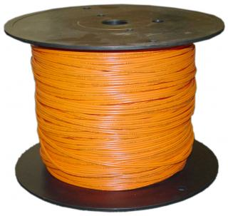
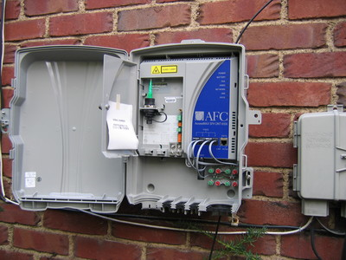
Network economics, (over)simplified
70%
30%
traditional: 12-15 staff/10k customers
Iliad, FR: 3-4 staff/10k
Notes:
opex ratios: Deloitte

Slide 19
Rural wireline ILECs lack resources
Wireline share of voice revenue:
2005: 79%
2015: 15%
Notes:
Deloitte

Slide 20
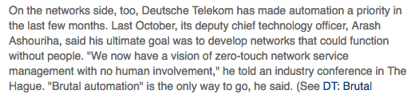
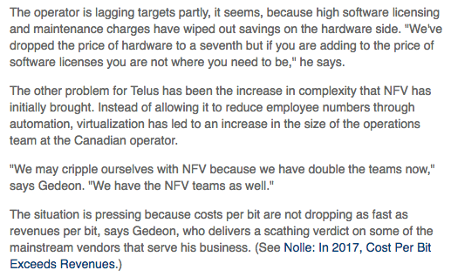
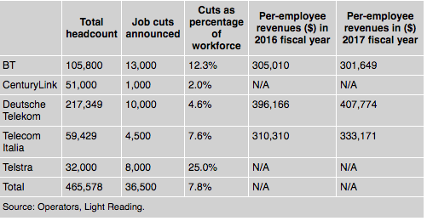
Automation & NFV
Notes:
http://www.lightreading.com/automation/dts-epic-undershoot-reflects-transformation-woes/d/d-id/743411?page_number=2
https://www.lightreading.com/carrier-sdn/nfv-(network-functions-virtualization)/telus-cto-nfv-burden-may-cripple-telcos/d/d-id/743076?
https://www.lightreading.com/business-employment/headcount/telco-job-prospects-go-from-bad-to-worse/d/d-id/744160?

Slide 21
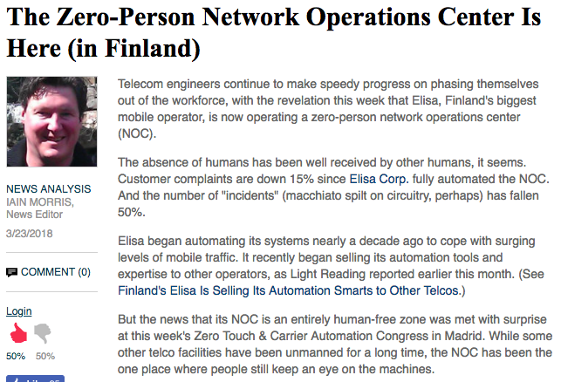
AT&T GNOC
Notes:
https://www.corp.att.com/njcbc/
https://www.lightreading.com/automation/the-zero-person-network-operations-center-is-here-(in-finland)/d/d-id/741695

Slide 22
DC interconnection is cheap

Slide 23
Network layer minimalism wins
Almost all attempts to add functionality to the network layer have been unsuccessful or multi-decade
IPv6 [19XX] → NAT, CGN (despite address exhaustion)
IP multicast → CDN
IP QoS

Slide 24
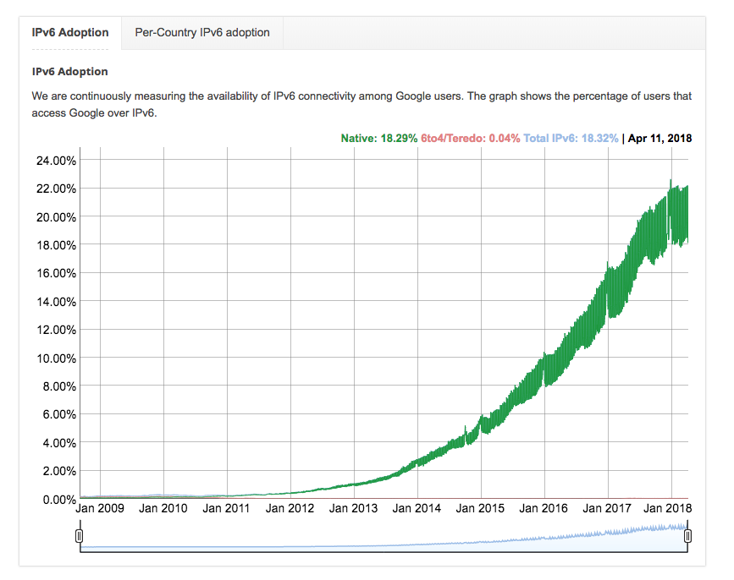
Google IPv6
RFC 2460: December 1998
Notes:
https://www.google.com/intl/en/ipv6/statistics.html

Slide 25
Accidental broadband
94.2% of US
households have
phone service
G.992.2
ADSL
DSL patents
1988-1991
1993
1999
62.1 million US
households have
cable TV
“peak CATV”:
82% of HH
DOCSIS 3.1
(10G/1G)
DOCSIS 1.0
(40M/1M)
1995
1997
2008
2016
Notes:
file:///Users/hgs/Downloads/1997_Mar_Trends.pdf

Slide 26
Broadband network cost - FTTP
Category | Details | Outside plant
FTTP in existing right-of-way | All underground, not including drops or electronics | $1,200…$1,300 per passing
 | 40% aerial, 60% underground, not including drops or electronics | $1,000…$1,100 per passing
FTTP drops | Range of distances and complexity | $300…$700 per connected home
Crown Fibre Holdings (Govt. of New Zealand); provided by CTC

Slide 27
Investment calculation
$50/month per subscriber → 15% for investment
  assume 10% for end user investment
$5 per month → $60/year → 16.6 years payback
Expected lifetime of fiber: 20 years
Carriers want ROIC of 10-12%
Verizon

Slide 28
Trade-offs across the world?
If new deployment, predicted return on investment
  with unbundling: what is the wholesale price going to be?
  no magic algorithm --- margin squeeze
Allow infrastructure owner to provide services?
Impact on consumer surplus
US: pole attachment problems
  if incumbents are pole owners

Slide 29
Conclusion
Except for large cable companies, challenging economics for ISPs
Especially for legacy landline telecoms
Introducing competitive fiber speeds is difficult everywhere
Emphasis on automation (+ staff cuts) and simplified service structure
  not new services, protocols, speeds
Research directions:
  fully autonomous, self-configuring networks

