Slide 1
Let’s shut down the Internet
Henning Schulzrinne

Slide 2
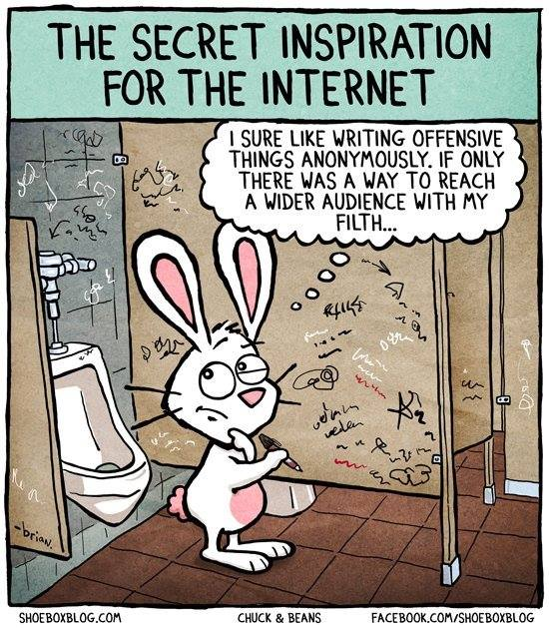

Slide 4
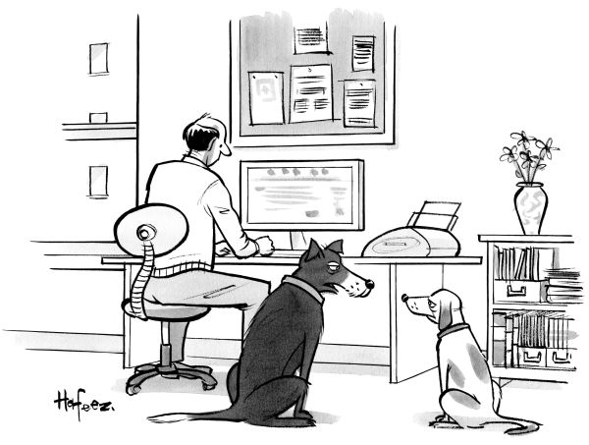
“Remember when, on the Internet, nobody knew who you were?”

Slide 5
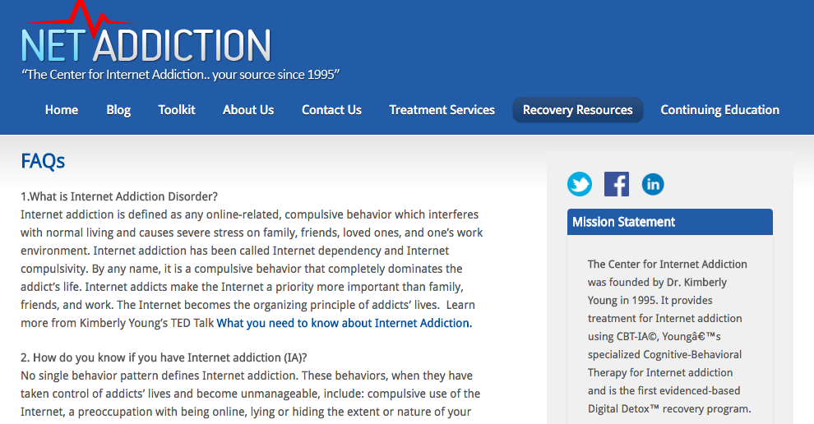

Slide 6
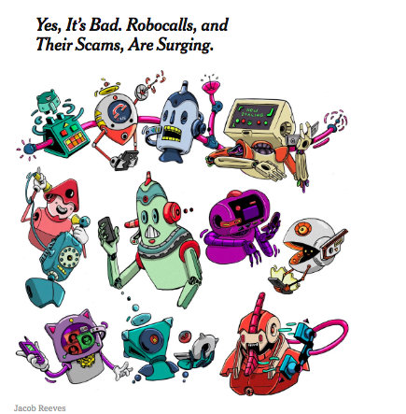

Slide 7
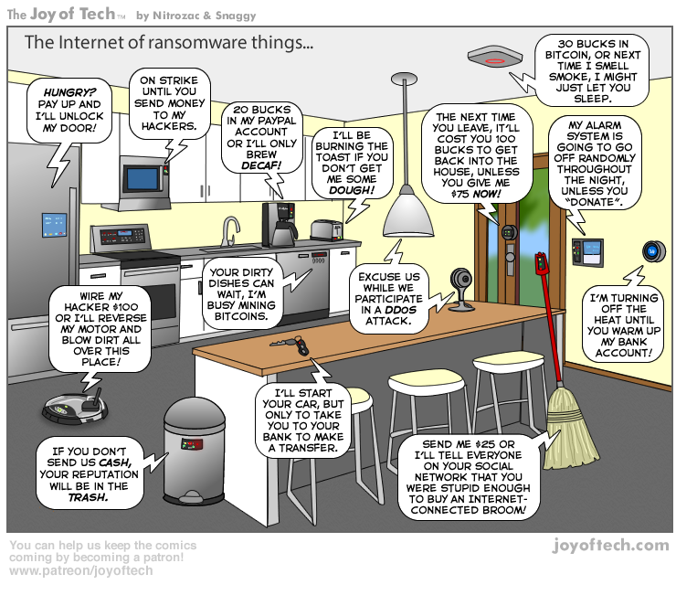

Slide 8
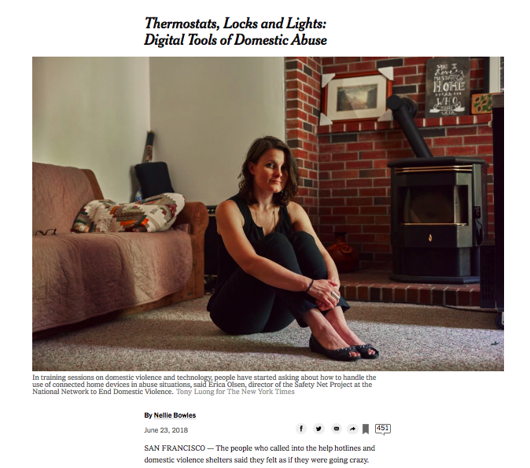

Slide 9
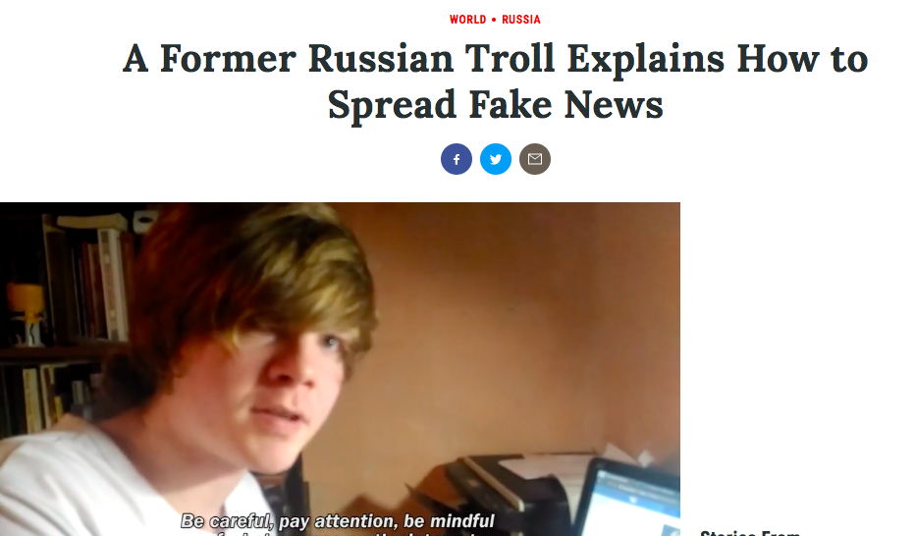

Slide 10
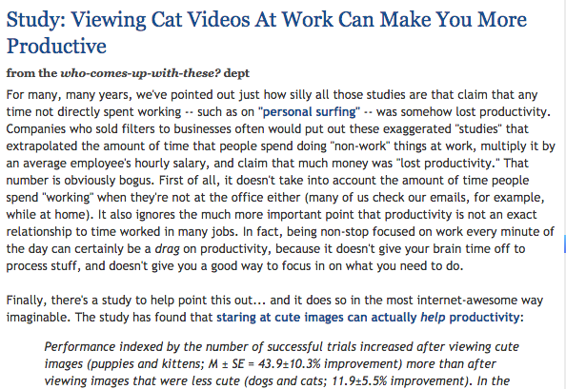

Slide 12
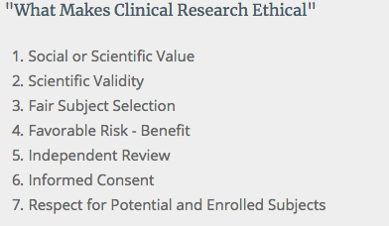

Slide 13
Content-Centric Networks
CON = Content-Only Networks

Slide 14
hyper-scalar
data center
hyper-scalar
data center

Slide 15
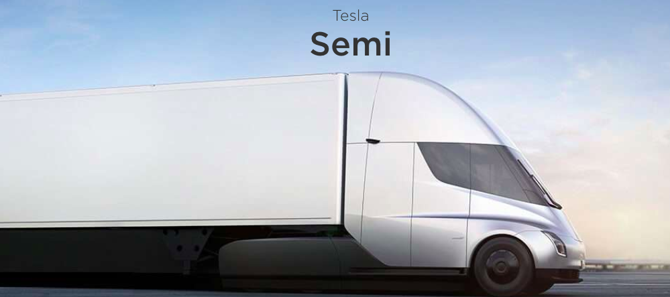
80 TB
cargo delivery network

