Slide 1
5G and IoT - Separating Hype from Promise
Henning Schulzrinne
Columbia University
typical keynote
closer to this one

Slide 2
5G and IoT – buzzword cousins
Looking back: IoT is old
Billions and billions of IoT devices justify 5G investment and hype
  rather than 5G as minor efficiency tune-up for 4G
There is no IoT network technology
Economics of

Slide 4
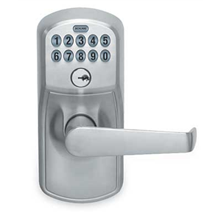
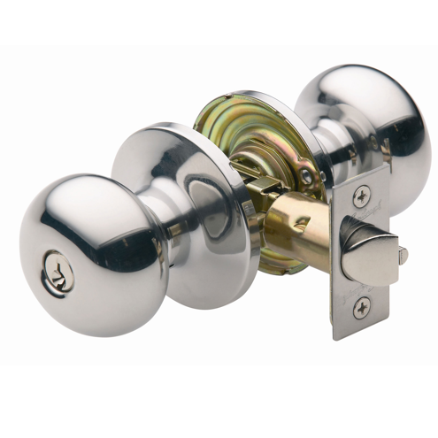
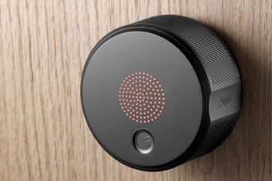
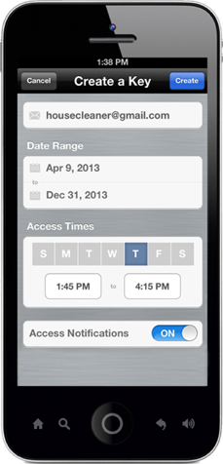
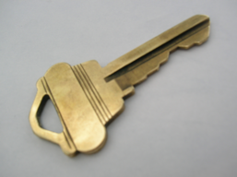
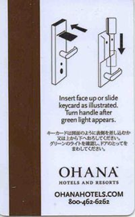
Natural evolution

Slide 5
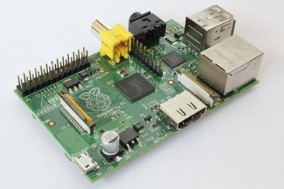
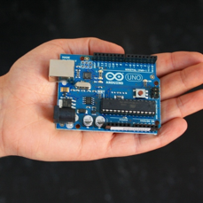
Key enablers
IoT
Cheap SOCs
Mature Internet protocols
Cellular connectivity
Unlicensed
Analytics
(“big data”)
Applications
Cloud-hosted applications & data

Slide 6
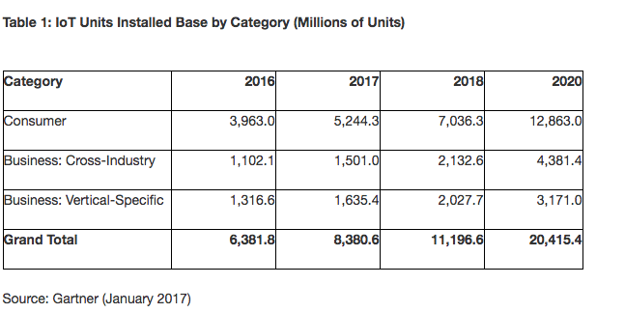
Billions and billions of devices
roughly 3 devices per human
https://www.gartner.com/newsroom/id/3598917
Notes:
https://spectrum.ieee.org/tech-talk/telecom/internet/popular-internet-of-things-forecast-of-50-billion-devices-by-2020-is-outdated

Slide 7

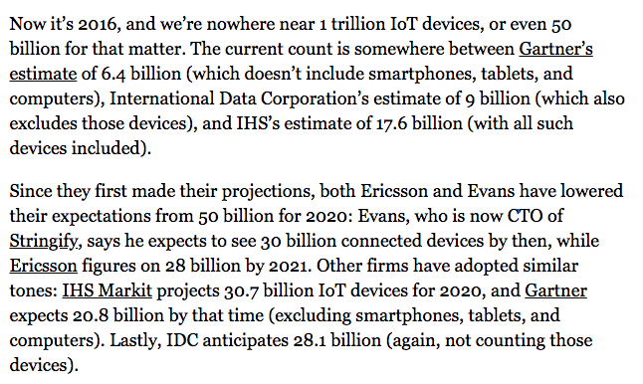

Pick your number
IEEE
Spectrum
8/2016
➔ the keynote estimator: the higher, the more likely to be cited in a keynote
Notes:
https://www.cisco.com/c/dam/en/us/products/collateral/se/internet-of-things/at-a-glance-c45-731471.pdf

Slide 8
IoT is not exactly new (1978)

Slide 9
IoT – an idea older than the web (1985)
Peter Lewis (panel discussion 1985)
From Chetan Sharma Consulting 2016

Slide 10
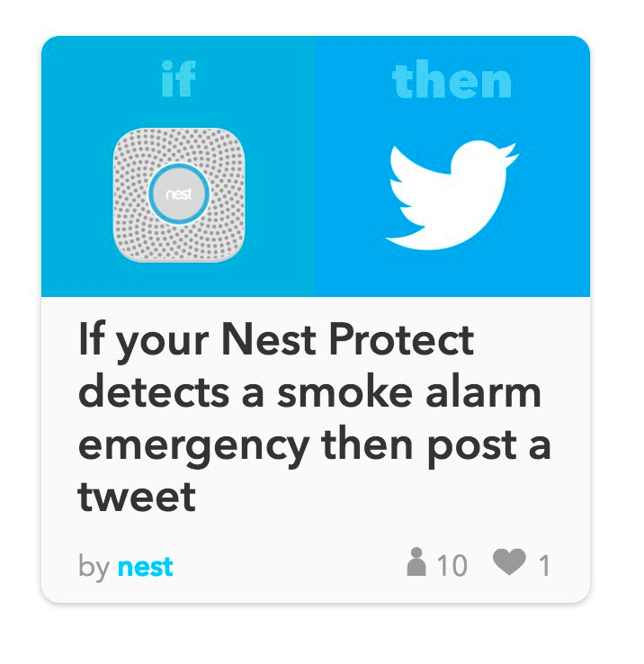
Kids, don’t do this at home
Notes:
https://twitter.com/internetofshit

Slide 11
https://twitter.com/internetofshit

Slide 12
Towel dispensers

Slide 13
The IoT killer app
http://www.traptec.eu/

Slide 14
But controlling light switches is still not the best use
Want to turn on the bedroom light? Sure, just pick up your smartphone, enter the unlock code, hit your home screen, find the Hue app, and flick the virtual switch. Suddenly, the smart home has turned a one-push task into a five-click endeavor, leaving Philips in the amusing position of launching a new product, Tap, to effectively replicate the wall switches we always had.
https://techcrunch.com/2014/12/04/the-problem-with-the-internet-of-things/

Slide 15
Where does IoT make sense?
Probably
  home security
  residential & commercial locks
  home medical (recording)
  housekeeping (restroom supplies)
  outdoor lighting
  parking meters
  vending machines
Not so much
  light switches
  most household appliances
  clothing
  smoke detectors?
not cost-effective, not just useless

Slide 16
Two kinds of IoT devices
< $20
> $50
BlueTooth, ZigBee, proprietary L2
connected only via gateway
fixed-function: sense or activate
single chip transceiver + MPU
only use L2 security
similar to peripherals
Wi-Fi, LTE-M, LoRa, SIGFOX
direct connection to Internet possible
SOC + network module
run (small) Linux stack
programmable
TLS and kin easy

Slide 17
Sensor networks may be (tiny) niche
Most IoT systems will be near power since they’ll interact with energy-based systems (lights, motors, vehicles)
Most IoT systems will not be running TinyOS (or similar)
Protocol processing overhead is unlikely to matter
Low message volume → cryptography overhead is unlikely to matter
  exceptions: light switches and similar 1-function I/O devices → BT/Zigbee fixed-function devices
$35.00
16-41x
A 900MHz quad-core ARM Cortex-A7
1 GB RAM
http://eschatologist.net/blog/?p=266

Slide 18
Quick 5G asides

Slide 19
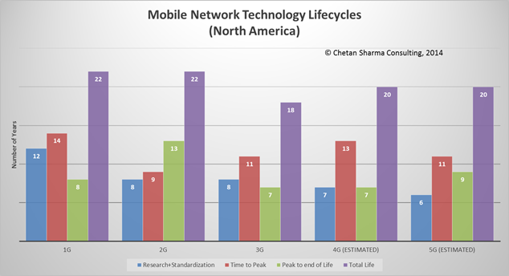
Design for 20 years

Slide 20
Generational surprises
Generation | Expectation | Surprise | Cost per GB
0G (landline) | voice | fax & modem
1G | corporate limousine | eavesdropping
2G | better voice quality (“digital!”) | SMS | $1000
3G | WAP | web | $100
4G | IMS | YouTube, WhatsApp, notifications | $10
5G | IoT (low latency) | ? | $1?
underestimated cost and fixed-equivalence as drivers
are the even generations the successful ones?

Slide 21
5G = 5 good reasons for hype
researchers
  research with real-world impact
  new opportunity for QoS research!
  compete with AI for attention
equipment manufacturers
  most of the 4G market has been saturated
  commodization of communications hardware
carriers
  need new quality differentiation instead of price-based commodity
  “4th Wave”
  motivate getting new spectrum
governments & regulators
  restore old industry dominance (Europe)
  Olympics
conference organizers & standardization bodies
  IEEE, ITU, … need excitement
does not
encourage
critical thinking…

Slide 22
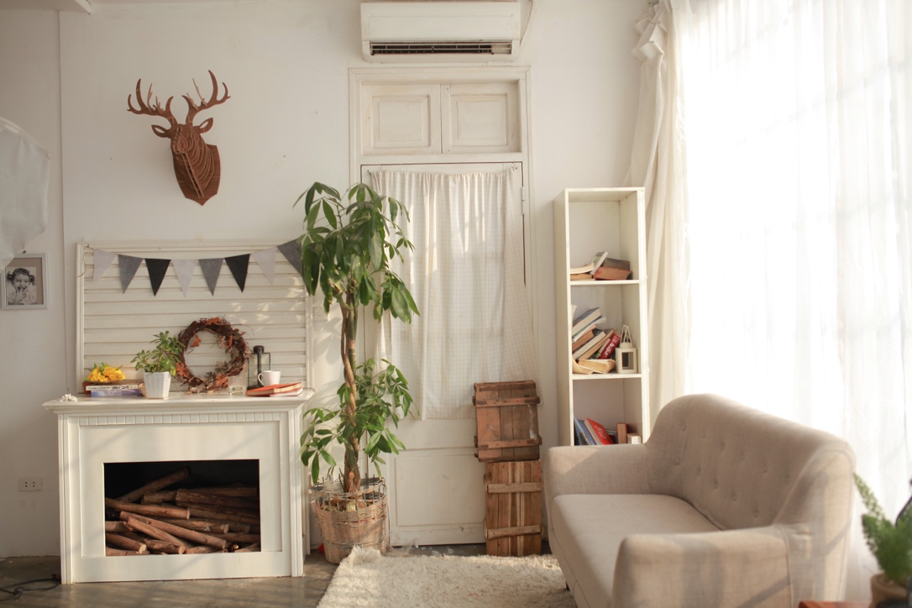
20 billion devices ≠ 20 billion device 5G connections
hybrid connectivity: cheap +
ubiquitous
cheap connectivity
managed connectivity

Slide 23
IoT requirements
Wide-area Wireless Communication Challenges for the Internet of Things
Harpreet S. Dhillon, Howard Huang, Harish Viswanathan

Slide 24
IoT is not a helpful term
The only common thread is what doesn’t matter: absence of a human
Otherwise, spans every dimension of networking
mobility
high-speed train
aeronautical
fixed infrastructure
message/week
bandwidth
4K video
minutes
or hours
latency
10 ms protective
relay
easy
hard
indoors or urban
geography
remote pipeline
cost constraints
$1/year
$5/device
1% of $1B bridge

Slide 25
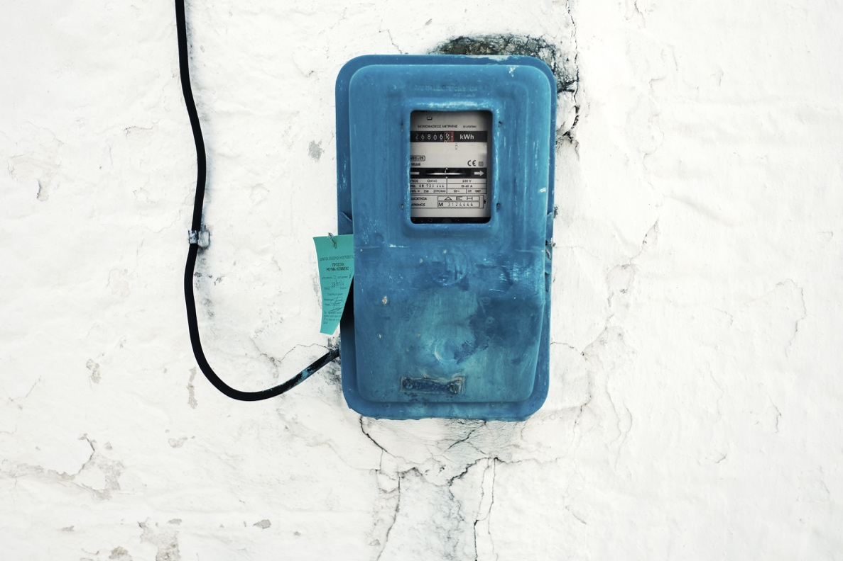
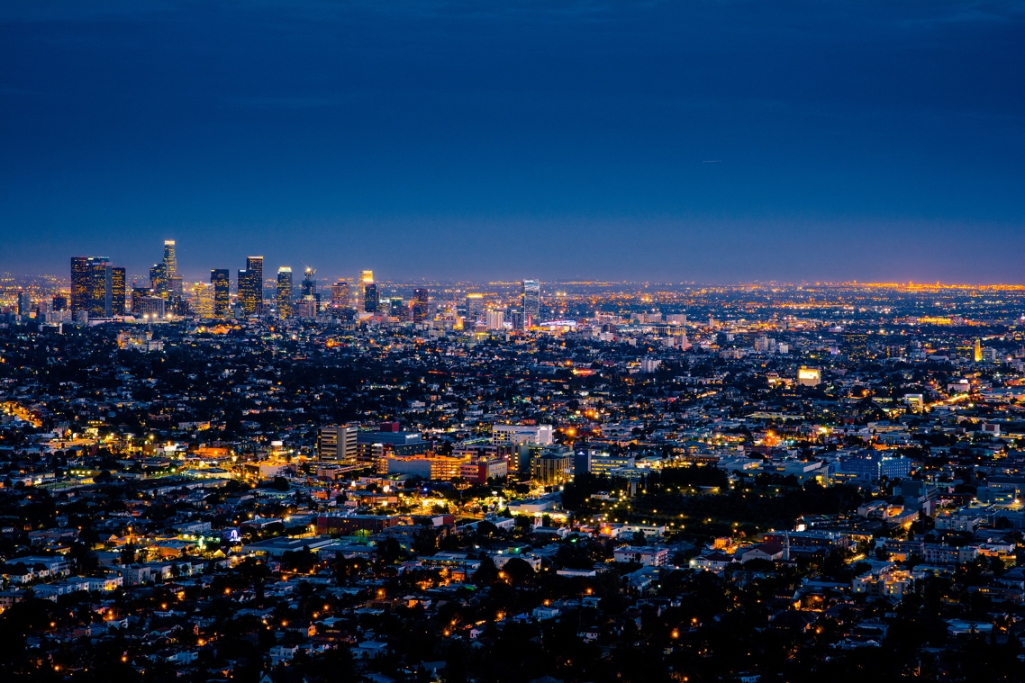
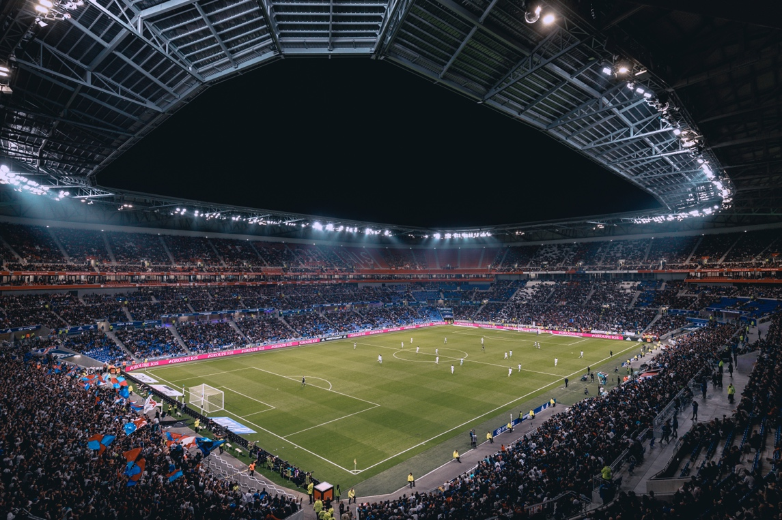
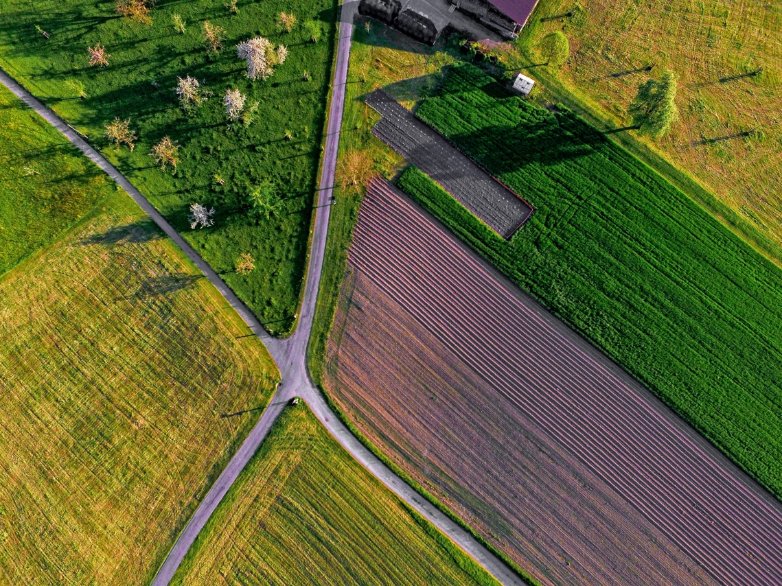
What are likely cellular IoT applications?
single provider
no reliance on local Wi-Fi
but: license-free and regional only
nodes / km²
security cameras
(high BW density)
100% coverage

Slide 26
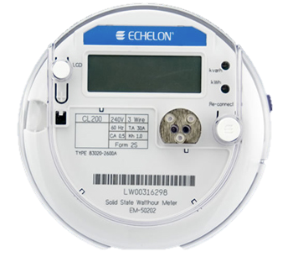
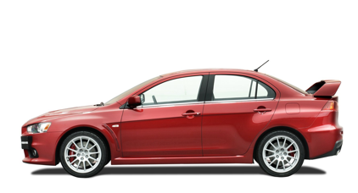
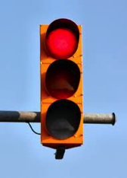
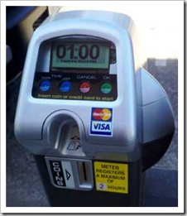
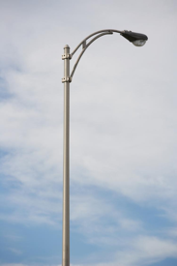
What is the scale of outdoor and distributed applications?
one per household or business (e.g., 136M housing units in US)
31,100 in US
but often connected to city fiber network
268.8M (US) cars, trucks, …
26.5M (44M) in US
$2B energy cost / year
Boston: 64k street lights
but: often connected to fiber (5G!)
5 million (US)
62,000 in NYC
Notes:
http://64.27.51.222/media/overview-of-the-us-parking-industry.aspx parking meters
https://www1.eere.energy.gov/buildings/publications/pdfs/ssl/nlc-streetlight2013_smalley.pdf

Slide 27
What kind of communication networks?
Dominant challenge | Example | solution
Low monthly cost | Residential | Wi-Fi
High bandwidth outdoors | Stadium (spectators, cameras) | 5G mmWave
High bandwidth indoors | University lecture hall | Wi-Fi
Outdoor, but regional | Public transit, metering, traffic signage | NB-IoT, LoRAWAN
Outdoor, on major roads | Connected vehicles | DSRC + LTE?
Outdoor (including marine), 100% coverage, small antenna | Agriculture sensors | Iridium NEXT?
Outdoor (including marine), 100% coverage, antenna size not limited | Agriculture machinery, construction, pipelines, shipping, logistics | LEO satellites?

Slide 28
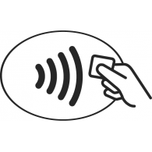


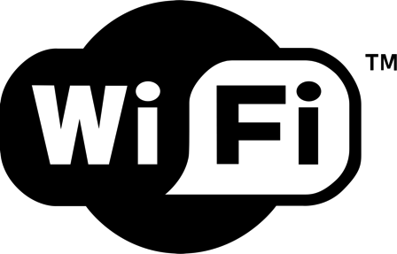
Niche networks
short range
low energy; mesh
ubiquity; low cost
speed; public APs

Slide 31
5G low latency
X
X
X
one-to-many!
X
V2I2V
LAN
EEW
(< 5 s)
protective
relay
tight control loop → near-100% availability in time & space

Slide 32
Challenge for non-carrier IoT networks
Need international and near-universal (road) coverage
  Sigfox: 7 million connections in 20 countries (2017)
    goal: $1/year connectivity
  compete with cellular aggregators
  need to be everywhere before customers interested anywhere
Challenging pricing model
  per month?
  per message (e.g., for lost items & problem reporting)?
Notes:
http://www.lightreading.com/iot/iot-strategies/sigfox-said-to-face-customer-backlash/d/d-id/724292?page_number=3

Slide 33
Example: gas meter using LoRAWAN
→ works well for IoT applications that are inherently regional
(utilities, public transit signage)

Slide 34
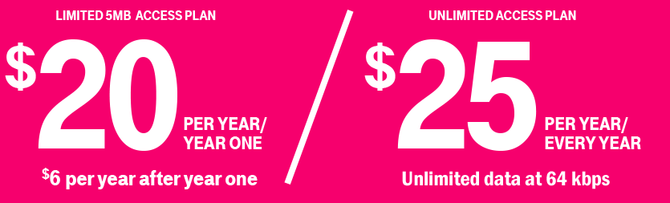
T-Mobile (US) example
NB-IoT
u-blox SARA-N410-02B (20k+ at $5 ea.)
Notes:
https://iot.t-mobile.com/pricing/#annual-plans

Slide 35
Short & long-range IoT networks
Notes:
Bernstein, Sept. 2017
Asian Semis & Semicap & APAC Telecom
The Long View: The Dawn of the IoT Era (Part 2): NB-IoT & Other Wide-area Technologies

Slide 37
Verizon telematics + IoT revenue
VZ: $31.8B revenue (Q118)

Slide 38
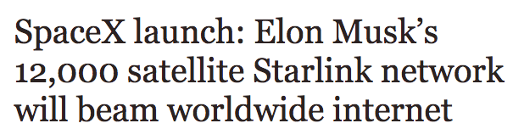
Alternative: satellite communication
NEXT
Iridium
two-way
GlobalStar
GPS fix every 10 minutes
LEO
Notes:
http://www.oneweb.world
https://www.iridiumnext.com/2016/09/22/new-platform-new-possibilities/

Slide 39

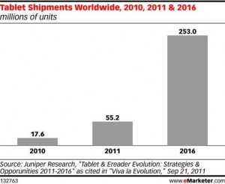

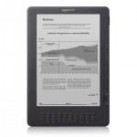
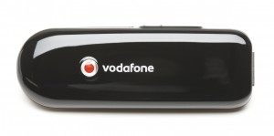
Phone numbers for machines?
< 2010
254 mio.
212 555 1212
500 123 4567
(and geographic numbers)
12% of adults
500 123 4567
533, 544
5 mio.
311,000
64 mio.
now: one 5XX code a year…
(8M numbers)
10 billion +1 #’s available
44.9 mio.
see Tom McGarry, Neustar
Notes:
http://blog.neustar.biz/neustar-insights/telephone-numbers-are-for-people-not-machines/
http://www.parking.org/media/overview-of-the-us-parking-industry.aspx
http://www.statisticbrain.com/e-reader-statistics/
http://www.ite.org/reportcard/TechnicalReport.pdf – 311k signals
www.aceee.org/files/proceedings/2012/data/papers/0193-000144.pdf – 44.9 M street lights

Slide 40
Fog & edge computing

Slide 41
(Dubious) economics of fog computing
hyperscale
cloud providers
free
known to OEM
”free”
privacy assurances
save access BW
low latency
save backhaul
low cost (scale, mux.)
well-known interfaces
Paas, SaaS, serverless, bare metal
limited
capacity
limited
capacity
limited capacity
business model?
heterogeneity
programming model?
> 20 ms latency
privacy concerns

Slide 42
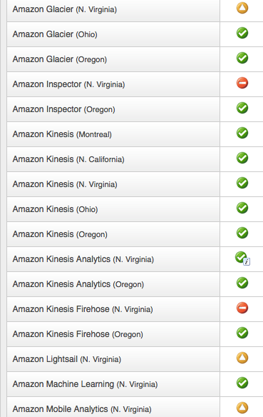
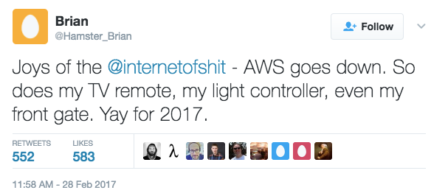


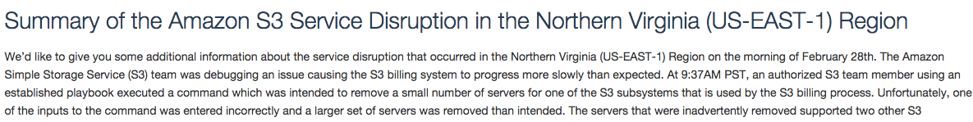
Don’t depend on one cloud

Slide 43
Protocols matter, but programmability matters more
Nobody wants to program raw protocols
Most significant network application creation advances:
  1983: socket API → abstract data stream or datagram
  1998: Java network API → mostly names, HTTP, threads
  1998: PHP → network input as script variables
  2005: Ruby on Rails → simplify common patterns
Many fine protocols and frameworks failed the programmer hate test
  e.g., JAIN for VoIP, SOAP for RPC
Most IoT programmers will not be computer scientists

Slide 44
Scaling IoT UP

Slide 45
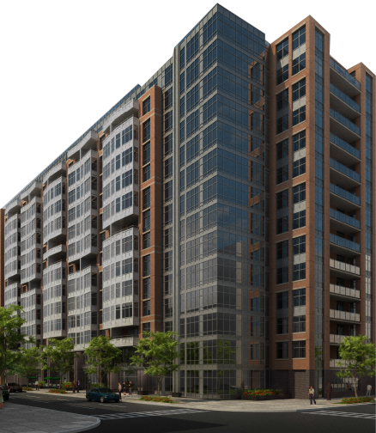
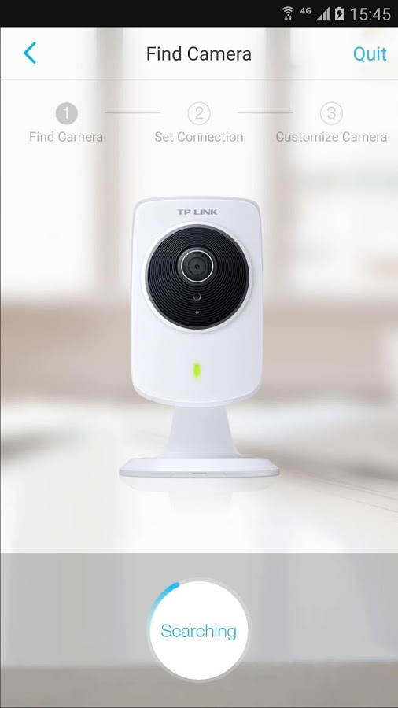
Scaling IoT up
one device
apartment building
(10² – 10⁴)
city+
(10⁶ – 10⁸)

Slide 46
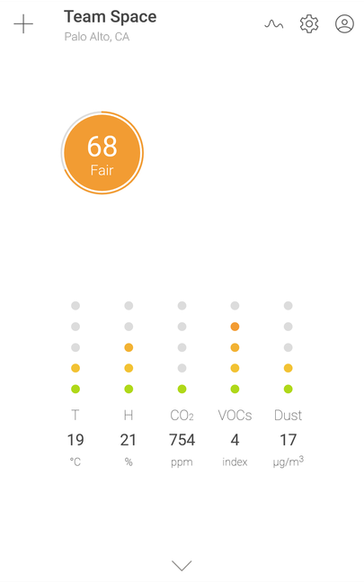
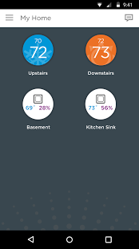
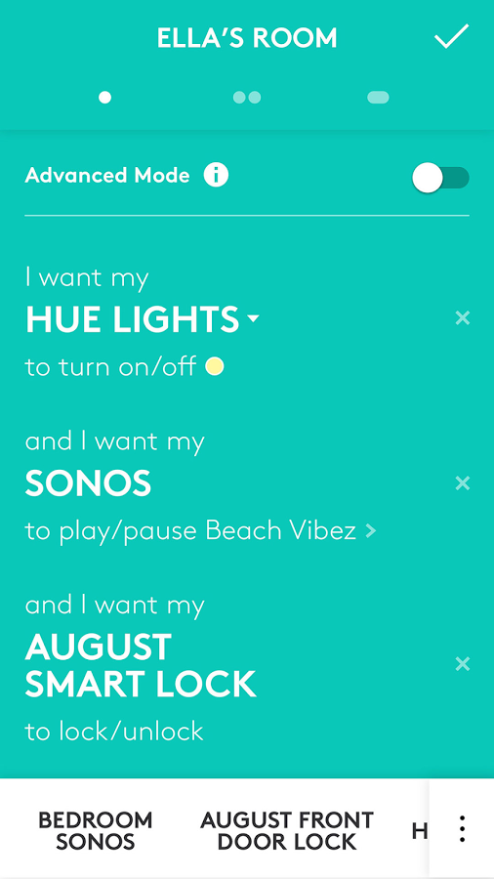
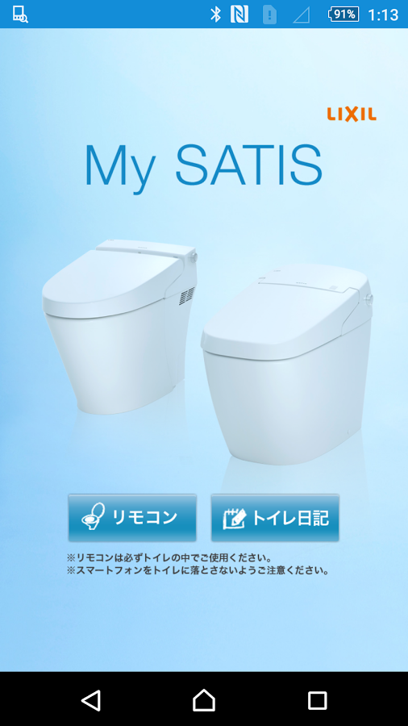
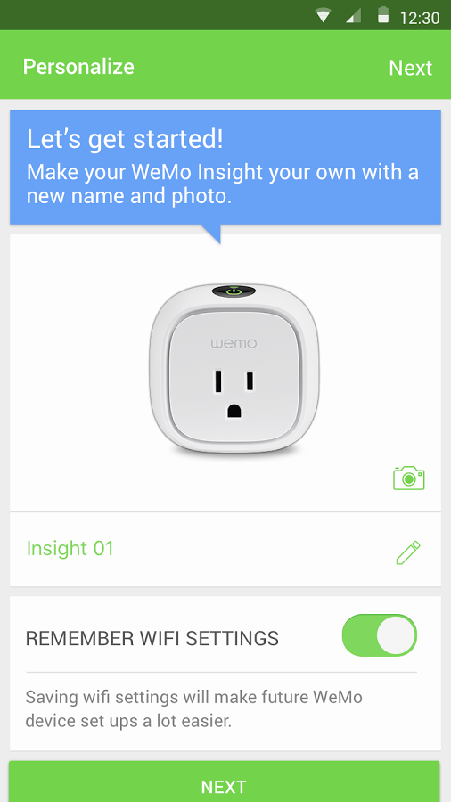
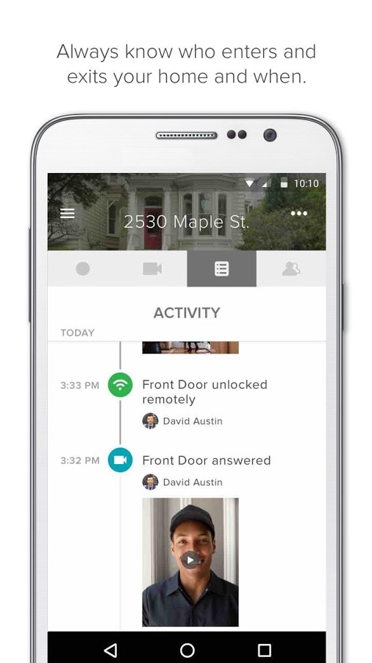
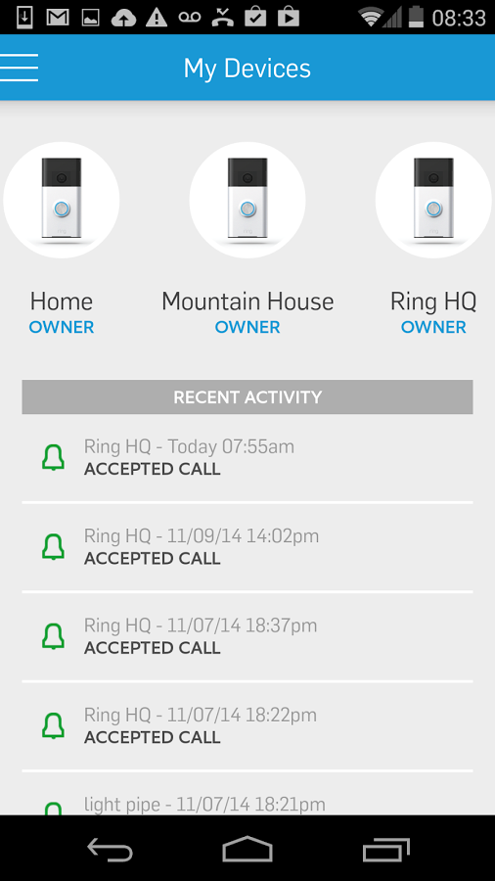
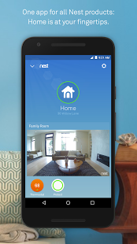
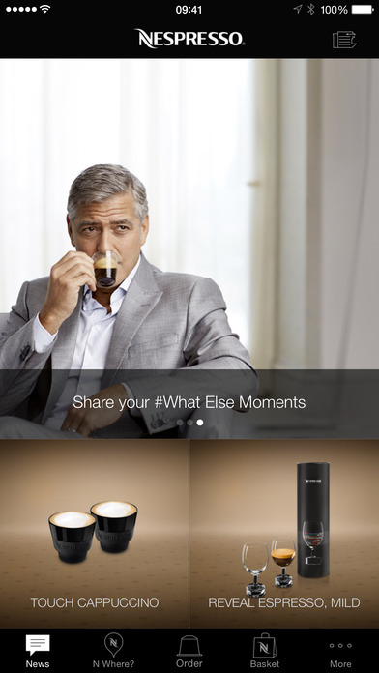
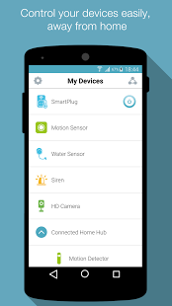
One Thing, one app
Awair
Honeywell
Logitech
SATIS
WeMo
Ring
August
Nest
D-link
Nespresso

Slide 47
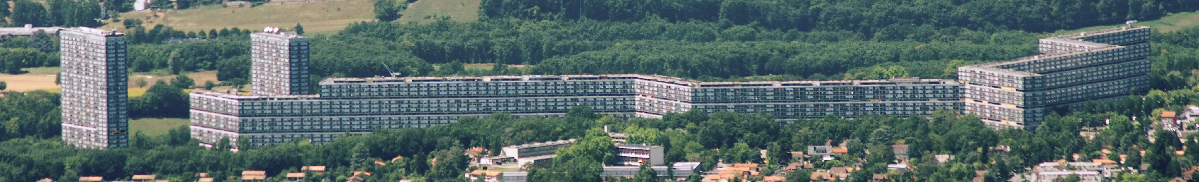
Does not scale well to real-world sizes
Le Lignon, Switzerland (0.7 mi long): 2,780 apartments
Camden NoMa (DC): 405 apartments

Slide 48
IoT = Internet at scale
Security at scale
  still largely “add password to configuration file”
  identify by IP address
Management at scale
  device-focused
  SNMP, at best
  CLI, at worst
  no performance diagnostics capabilities (“why is this so slow?”
Naming at scale
  identify by node name
Programming at scale
system
& rack
data center

Slide 49
Obligatory security considerations section

Slide 50
IoT security confluence
IoT insecurity
supply chain
long-lived device
one-time purchase
mostly hardware expertise
millions of them
no liability
assembly of software
no UI
no BCP38

Slide 51
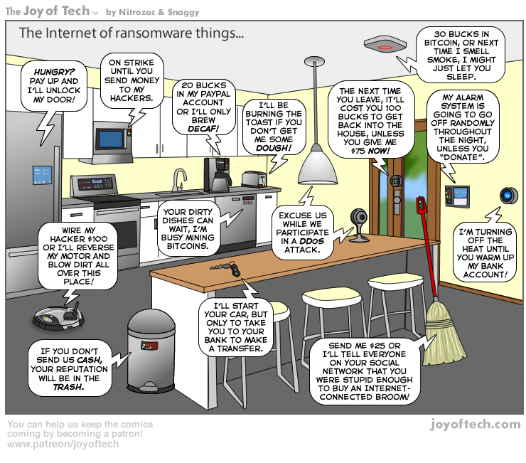

Slide 52
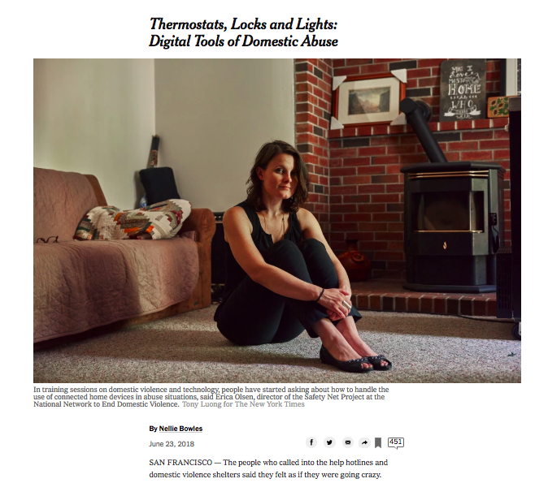

Slide 53
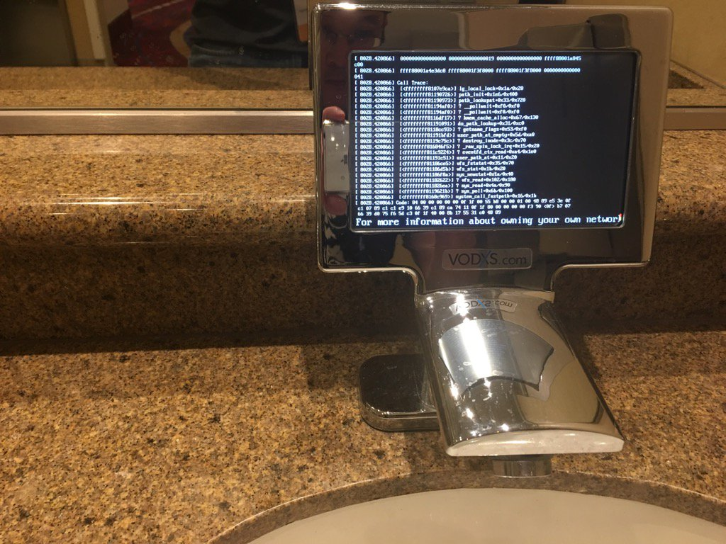
Smart faucet

Slide 54
DDOS via IoT
Krebs DDOS, 9/2016: 620 Gb/s, total of > 1.5 Tb/s
GRE, SYN, HTTP GET, POST
MiraiNet: “380k bots from telnet alone”
Enabled by UPnP → bypass NATs
xc3511 vizxv admin 888888 xmhdipc default 123456 54321 support
Notes:
https://www.incapsula.com/blog/malware-analysis-mirai-ddos-botnet.html

Slide 55
Mirai botnet
Chinese manufacturer, used by lots of OEMs
BusyBox Linux
Brute-force ssh and telnet
Web reset doesn’t change ssh or telnet

Slide 56
IoT DDOS economics
Schneier
Oct. 2016
Cohan
Apr. 2013
DDOS as externality
  device owners don’t care:
    barely slows down their Internet service
    device still functions normally
    don’t know victims, generally
  vendors don’t care (enough)
    not liable for damage (right now) – public nuisance?
    only marginally affects their business reputation
  ISP don’t care (much)
    individually, not much load – in lightly-loaded direction (outbound)
    hard to combat
    haven’t adopted BCP38 (egress address filtering)
Notes:
https://www.schneier.com/blog/archives/2016/10/security_econom_1.html

Slide 57
IoT lemons
“The Market for Lemons: Quality Uncertainty and the Market Mechanism” (Akerlof, 1970)
Information asymmetry
  purchaser cannot judge invisible qualities
  pays only average price
  → above-average-quality goods not marketed
“defect four or more times and the problem is still occurring, the car may be deemed to be a lemon” → get purchase price back
  more than four patches?

Slide 58
Fixes for externalities and lemons
Liability
  slow, one-by-one, uncertain standards of care
  what is “negligent”?
Certification
  voluntary or mandatory
Insurance liability
  homeowner’s insurance
Regulation
  adherence to minimum performance standards
Notes:
https://www.thedigitalstandard.org/

Slide 59
This is not that hard!
More research needed?
More action needed!
No factory-default passwords
  long-term, no human-setable passwords at all → client certs
No telnet, ssh, SNMP (typically)
Only configure from local subset
Automated, signed updates
Web interfaces use non-root accounts
Automated testing for XSS and SQL injection

Slide 60
Conclusions
Treat predictions of market size with extreme caution
  and IoT population ⋙ your favorite network technology share
  you will not get your appendix removed via 5G
Economics challenging for 5G IoT and edge computing
Key challenges:
  fragmentation of eco system (one app per device)
  security and lifecycle
  failure modes – fail safe?

Slide 61
5G visual clutter
Notes:
http://wirelessestimator.com/articles/2018/atts-small-cell-rats-nest-of-cables-is-needlessly-messy-says-former-fcc-senior-exec/
http://www.steelintheair.com/Blog/2017/04/top-10-things-the-wireless-industry-doesnt-tell-you-about-small-cells.html

