Slide 1
Audio
Henning Schulzrinne
Dept. of Computer Science
Columbia University
Fall 2018

Slide 2
Key objectives
How do humans generate and process sound?
How does digital sound work?
How fast do I have to sample audio?
How can we represent time domain signals in the frequency domain? Why?
How do audio codecs work?
How do we measure their quality?
What is the impact of networks (packet loss) on audio quality?

Slide 3
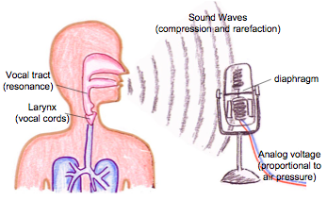
Human speech
Mark Handley

Slide 4
Human speech
voiced sounds: vocal cords vibrate (e.g.,A4 [above middle C] = 440 Hz
  vowels (a, e, i, o, u, …)
  determines pitch
unvoiced sounds:
  fricatives (f, s)
  plosives (p, d)
filtered by vocal tract
changes slowly (10 to 100 ms)
air volume → loudness (dB)

Slide 5
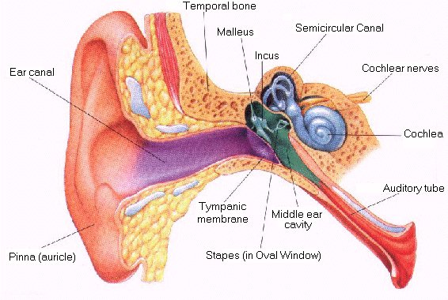
Human hearing
Notes:
http://www.infj.ulst.ac.uk/~pnic/HumanEar/Andy's%20Stuff/MScProject/workingcode_Local/EarChapter.html

Slide 6
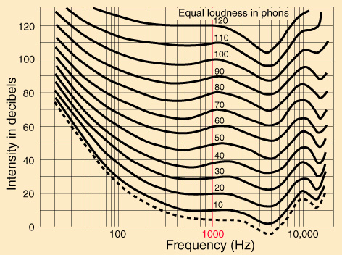
Human hearing

Slide 7
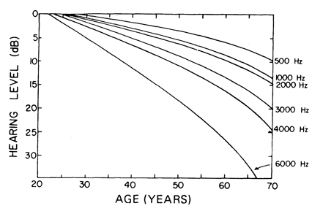
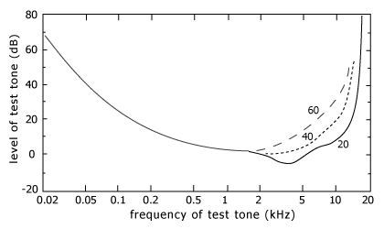
Human hearing & age

Slide 8
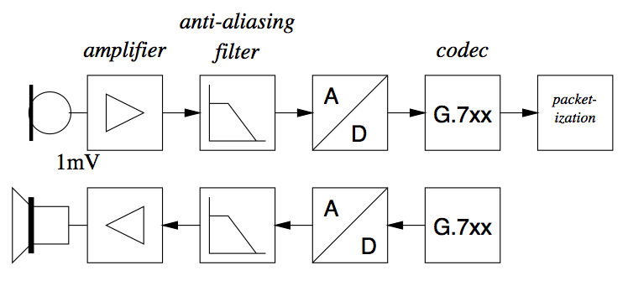
Digital sound

Slide 9
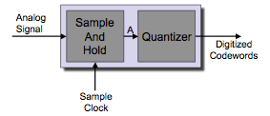
Analog-to-digital conversion
Sample value of digital signal at f_{s} (8 – 96 kHz)
Digitize into 2^{B} discrete values (8-24)
Mark Handley

Slide 10
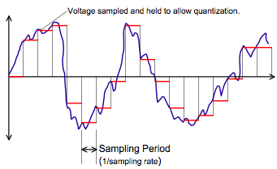
Sample & hold
quantization noise
Mark Handley

Slide 11
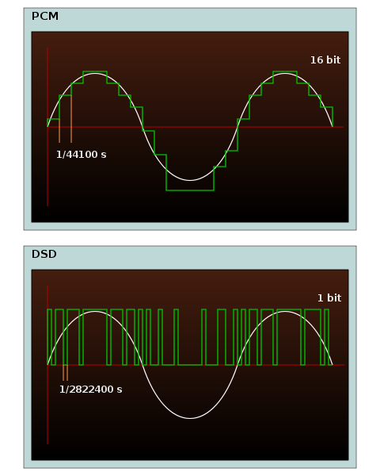
Direct-Stream Digital
Delta-Sigma
coding
Notes:
Wikipedia

Slide 12
How fast to sample?
Harry Nyquist (1928) & Claude Shannon (1949)
  no loss of information → sampling frequency ≥ 2 * maximum signal frequency
More recent: compressed sensing
  works for sparse signals in some space

Slide 13
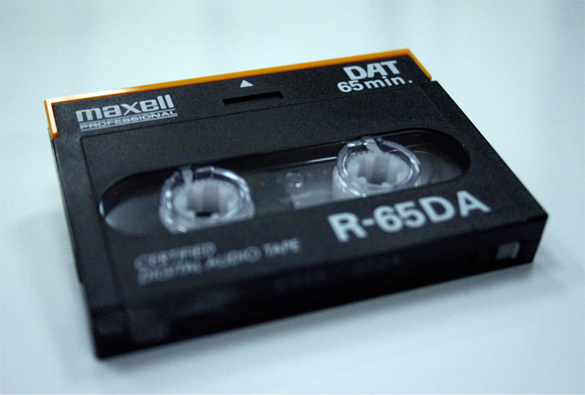
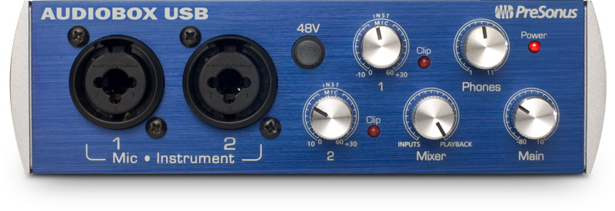
Audio coding
application | frequency | sampling | quantization
telephone | 300-3,400 Hz | 8 kHz | 12-13
wide-band | 50-7,000 Hz | 16 kHz | 14-15
high quality | 30-15,000 Hz | 32 kHz | 16
 | 20-20,000 Hz | 44.1 kHz | 16
 | 10-22,000 Hz | 48 kHz | ≤ 24
CD
DAT
24 bit, 44.1/48 kHz

Slide 14
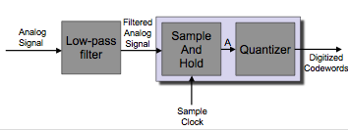
Complete A/D
Mark Handley

Slide 15
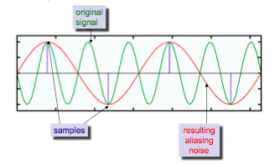
Aliasing distortion
Mark Handley
Mark Handley

Slide 16
Quantization
CDs: 16 bit → lots of bits
Professional audio: 24 bits (or more)
8-bit linear has poor quality (noise)
Ear has logarithmic sensitivity → “companding”
  used for Dolby tape decks
  quantization noise ~ signal level

Slide 17
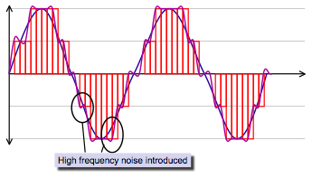
Quantization noise
Mark Handley

Slide 18
Transforms
Transform time domain into some other (“frequency”) domain
  using basis functions (sine & cosine, …)
→ simplify certain operations (convolution)
  and better represent channel (noise) or receiver (ear)
→ ~ cf. logarithm
periodic | continuous
 | discrete
finite duration | continuous
 | discrete

Slide 19
Fourier transform
Fourier transform: time series → series of frequencies
  complex frequencies: amplitude & phasess
Inverse Fourier transform: frequencies (amplitude & phase) → time series
Note: also works for other basis functions

Slide 20
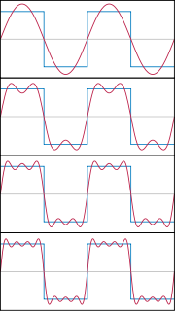
Fourier series
Express periodic function as sum of sines and cosines of different amplitudes
  iff band-limited, finite sum
Time domain → frequency domain
  no information loss
    and no compression
  but for periodic (or time limited) signals
http://www.westga.edu/~jhasbun/osp/Fourier.htm
Notes:
Figure: Wikipedia

Slide 21
Fourier series of a periodic function
continuous time,
discrete frequencies

Slide 22
Fourier transform
forward transform (time x, real frequency k)
inverse transform
continuous time,
continuous frequencies
Euler’s formula

Slide 23
Discrete Fourier transform
For sampled functions, continuous FT not very useful → DFT
complex numbers → complex coefficients

Slide 24

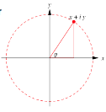
DFT example
Interpreting a DFT can be slightly difficult, because the DFT of real data includes complex numbers.
  The magnitude of the complex number for a DFT component is the power at that frequency.
  The phase θ of the waveform can be determined from the relative values of the real and imaginary coefficients.
  Also both positive and “negative” frequencies show up.
Mark Handley

Slide 25
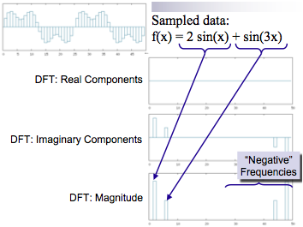
DFT example
Mark Handley

Slide 26
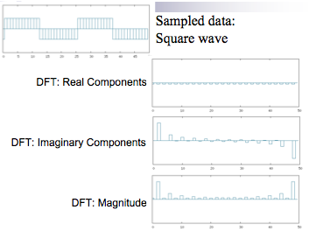
DFT example
Mark Handley

Slide 27
Fast Fourier Transform (FFT)
Discrete Fourier Transform would normally require O(n2) time to process for n samples:
Don’t usually calculate it this way in practice.
  Fast Fourier Transform takes O(n log(n)) time.
  Most common algorithm is the Cooley-Tukey Algorithm.

Slide 28
Fourier Cosine Transform
Split function into odd and even parts:
Re-express FT:
Only real numbers from an even function → DFT becomes DCT

Slide 29
DCT (for JPEG)
other versions exist (e.g., for MP3, with overlap)

Slide 30
Why do we use DCT for multimedia?
For audio:
  Human ear has different dynamic range for different frequencies.
  Transform to from time domain to frequency domain, and quantize different frequencies differently.
For images and video:
  Human eye is less sensitive to fine detail.
  Transform from spatial domain to frequency domain, and quantize high frequencies more coarsely (or not at all)
  Has the effect of slightly blurring the image - may not be perceptible if done right.
Mark Handley

Slide 31
Why use DCT/DFT?
Some tasks easier in frequency domain
  e.g., graphic equalizer, convolution
Human hearing is logarithmic in frequency (→ octaves)
Masking effects (see MP3)

Slide 32
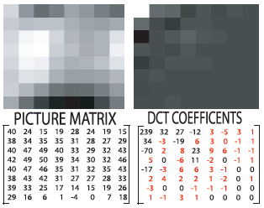
Example: DCT for image
Notes:
http://cnx.org/content/m13173/latest/

Slide 33
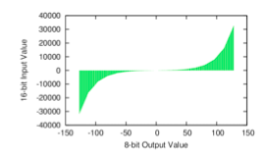
µ-law encoding
Mark Handley

Slide 34
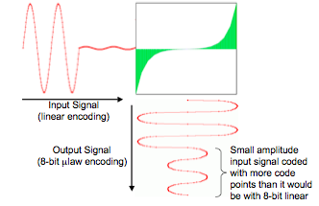
µ-law encoding
Mark Handley

Slide 35
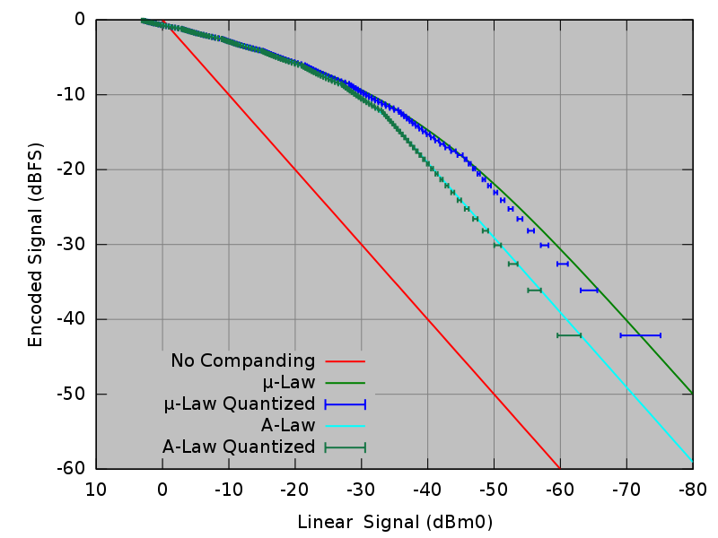
Companding
Wikipedia

Slide 36
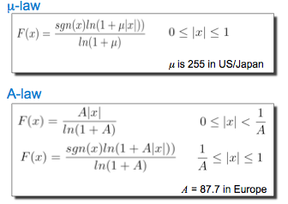
µ-law & A-law
Mark Handley

Slide 37
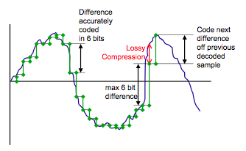
Differential codec

Slide 38
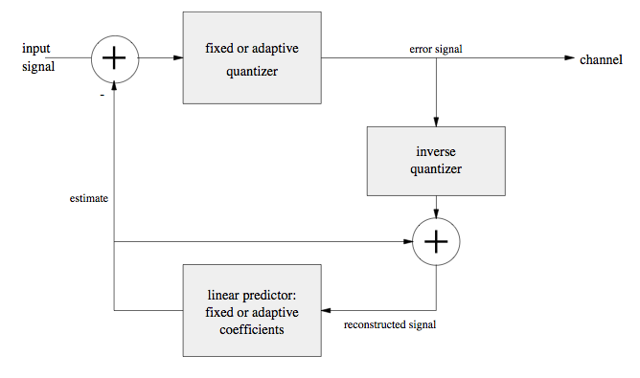
(Adaptive) Differential Pulse Code Modulation

Slide 39
ADPCM
Makes a simple prediction of the next sample, based on weighted previous n samples.
For G.721, previous 8 weighted samples are added to make the prediction.
Lossy coding of the difference between the actual sample and the prediction.
  Difference is quantized into 4 bits ⇒ 32Kb/s sent.
  Quantization levels are adaptive, based on the content of the audio.
  Receiver runs same prediction algorithm and adaptive quantization levels to reconstruct speech.

Slide 40
Model-based coding
PCM, DPCM and ADPCM directly code the received audio signal.
An alternative approach is to build a parameterized model of the sound source (i.e., human voice).
For each time slice (e.g., 20ms):
  Analyze the audio signal to determine how the signal was produced.
  Determine the model parameters that fit.
  Send the model parameters.
  At the receiver, synthesize the voice from the model and received parameters.

Slide 41
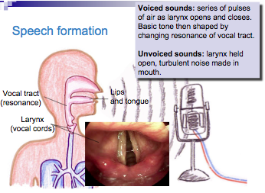
Speech formation

Slide 42
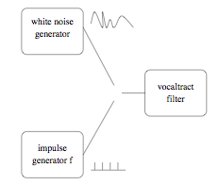
Linear predictive codec
Earliest low-rate codec (1960s)
LPC10 at 2.4 kb/s
  sampling rate 8 kHz
  frame length 180 samples (22.5 ms)
  linear predictive filter (10 coefficients = 42 bits)
  pitch and voicing (7 bits)
  gain information (5 bits)

Slide 43
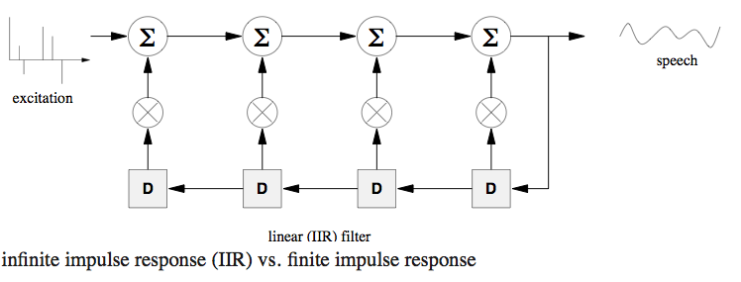
Linear predictive codec

Slide 44
Code Excited Linear Prediction (CELP)
Goal is to efficiently encode the residue signal, improving speech quality over LPC, but without increasing the bit rate too much.
CELP codecs use a codebook of typical residue values. (→ vector quantization)
Analyzer compares residue to codebook values.
  Chooses value which is closest.
  Sends that value.
  Receiver looks up the code in its codebook, retrieves the residue, and uses this to excite the LPC formant filter.

Slide 45
CELP (2)
Problem is that codebook would require different residue values for every possible voice pitch.
  Codebook search would be slow, and code would require a lot of bits to send.
    One solution is to have two codebooks.
    One fixed by codec designers, just large enough to represent one pitch period of residue.
    One dynamically filled in with copies of the previous residue delayed by various amounts (delay provides the pitch)
  CELP algorithm using these techniques can provide pretty good quality at 4.8Kb/s.

Slide 46
Enhanced LPC usage
GSM (Groupe Speciale Mobile)
  Residual Pulse Excited LPC
  13 kb/s
LD-CELP
  Low-delay Code-Excited Linear Prediction (G.728)
  16 kb/s
CS-ACELP
  Conjugate Structure Algebraic CELP (G.729)
  8 kb/s
MP-MLQ
  Multi-Pulse Maximum Likelihood Quantization (G.723.1)
  6.3 kb/s

Slide 47
Distortion metrics
error (noise) r(n) = x(n) – y(n)
variancesσx2,σy2,σr2
power for signal with pdf p(x) and range −V ...+V
SNR = 6.02N − 1.73 for uniform quantizer with N bits

Slide 48
Distortion measures
SNR not a good measure of perceptual quality
➠ segmental SNR: time-averaged blocks (say, 16 ms)
frequency weighting
subjective measures:
  A-B preference
  subjective SNR: comparison with additive noise
  MOS (mean opinion score of 1-5), DRT, DAM, . . .

Slide 49
Quality metrics
speech vs. music
communication vs. toll quality
score | MOS | DMOS | understanding
5 | excellent | inaudible | no effort
4 | good, toll quality | audible, not annoying | no appreciable effort
3 | fair | slightly annoying | moderate effort
2 | poor | annoying | considerable effort
1 | bad | very annoying | no meaning

Slide 50
Subjective quality metrics
Test phrases (ITU P.800)
  You will have to be very quiet.
  There was nothing to be seen.
  They worshipped wooden idols.
  I want a minute with the inspector.
  Did he need any money?
Diagnostic rhyme test (DRT)
  96 pairs like dune vs. tune
  90% right → toll quality

Slide 51
Objective quality metrics
approximate human perception of noise and other distortions
distortion due to encoding and packet loss (gaps, interpolation of decoder)
examples: PSQM (P.861), PESQ (P.862), MNB, EMBSD – compare reference signal to distorted signal
either generate MOS scores or distance metrics
much cheaper than subjective tests
only for telephone-quality audio so far

Slide 52
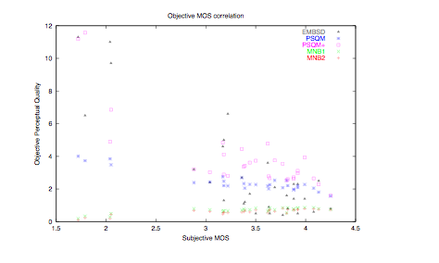
Objective vs. subjective quality

Slide 53
Common narrowband audio codecs
Codec | rate (kb/s) | delay (ms) | multi-rate | em-bedded | VBR | bit-robust/ PLC | remarks
iLBC | 15.2 13.3 | 20 30 |  |  |  | --/X | quality higher than G.729A no licensing
Speex | 2.15--24.6 | 30 | X | X | X | --/X | no licensing
AMR-NB | 4.75--12.2 | 20 | X |  |  | X/X | 3G wireless
G.729 | 8 | 15 |  |  |  | X/X | TDMA wireless
GSM-FR | 13 | 20 |  |  |  |  | GSM wireless (Cingular)
GSM-EFR | 12.2 | 20 |  |  |  | X/X | 2.5G
G.728 | 16 12.8 | 2.5 |  |  |  | X/X | H.320 (ISDN videconferencing)
G.723.1 | 5.3 6.3 | 37.537.5 |  |  |  | X/-- | H.323, videoconferences

Slide 54
Common wideband audio codecs
Codec | rate (kb/s) | delay (ms) | multi-rate | em-bedded | VBR | bit-robust/ PLC | remarks
Speex | 4—44.4 | 34 | X | X | X | --/X | no licensing
AMR-WB | 6.6—23.85 | 20 | X |  |  | X/X | 3G wireless
G.722 | 48, 56, 64 | 0.125 (1.5) |  |  |  | X/-- | 2 sub-bands now dated
http://www.voiceage.com/listeningroom.php

Slide 55
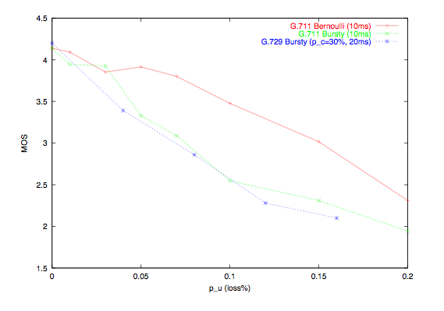
MOS vs. packet loss

Slide 56
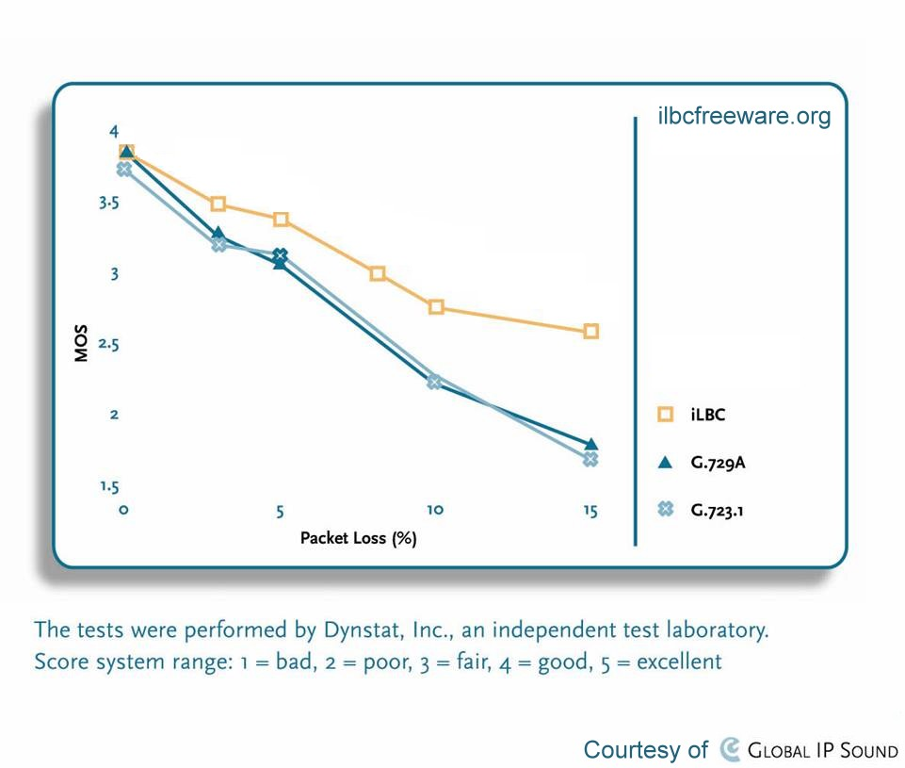
iLBC – MOS behavior with packet loss

Slide 57
Recent audio codecs
iLBC: optimized for high packet loss rates (frames encoded independently)
AMR-NB
  3G wireless codec
  4.75-12.2 kb/s
  20 ms coding delay

Slide 58
Opus audio codex (RFC 6716)
interactive speech & (stereo) music
6 kb/s … 510 kb/s (music)
frame size: 2.5 ms … 60 ms
Linear prediction + MDCT
SILK
  Developed by Skype
  Based on Linear Prediction
  Efficient for voice
  Up to 8 kHz audio bandwidth
CELT
  Developed by Xiph.Org
  Based on MDCT
  Good for universal audio/music
SILK decoder
Notes:
http://www.opus-codec.org/comparison/GoogleTest2.pdf

Slide 59
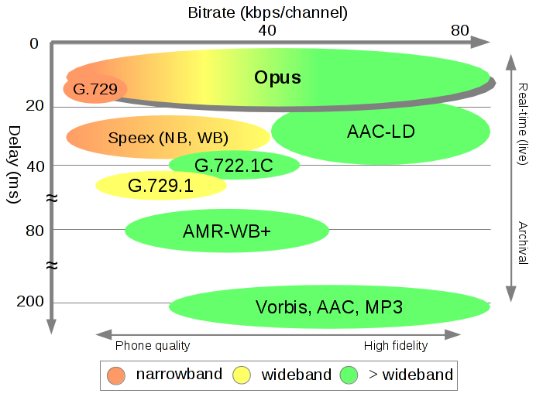
Comparison

Slide 60
Audio traffic models
talkspurt: typically, constant bit rate:
  one packet every 20. . . 100 ms ➠ mean: 1.67 s
silence period: usually none
  (maybe transmit background noise value) ➠ 1.34 s
➠ for telephone conversation, both roughly exponentially distributed
double talk for “hand-off”
may vary between conversations
  ➠ only in aggregate

Slide 61
Sound localization
Human ear uses 3 metrics for stereo localization:
  intensity
  time of arrival (TOA) – 7 µs
  direction filtering and spectral shaping by outer ear
For shorter wavelengths (4 – 20 kHz), head casts an acoustical shadow giving rise to a lower sound level at the ear farthest from the sound sources
At long wavelength (20 Hz - 1 KHz) the, head is very small compared to wavelengths
  In this case localization is based on perceived Interaural Time Differences (ITD)
UCSC CMPE250 Fall 2002

Slide 62
Audio samples
http://www.cs.columbia.edu/~hgs/audio/codecs.html
Opus: http://opus-codec.org/examples/
  both narrowband and wideband

