Slide 1
Internet access and backbone technology
Henning Schulzrinne
Columbia University
COMS 6181 – Fall 2018

Slide 2
Key objectives
Fundamental models for communication
How are bits switched?
How does a large router work internally?
What are the limits to communication capacity?
How do DSL and cable modems work?

Slide 3
Overview
Physical layer for CS majors
  modulation
  spectral efficiency
Residential last-mile technologies
  DSL
  Cable (DOCSIS)
  Residential fiber
Backbone networks
Wireless networks

Slide 4
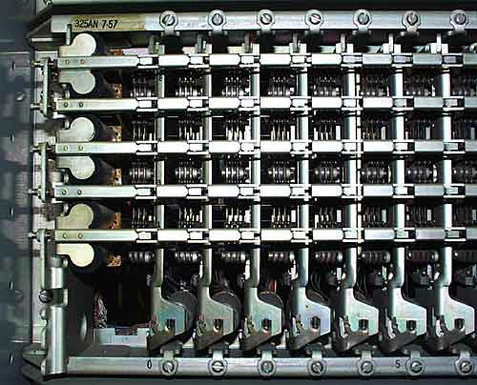
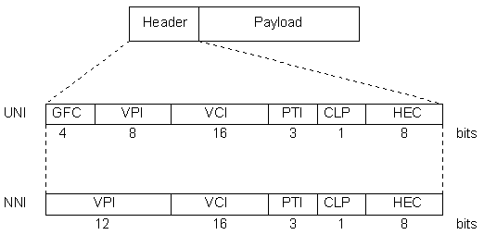
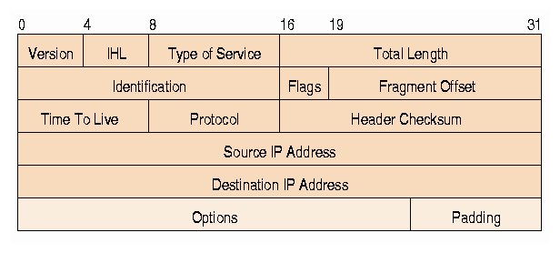
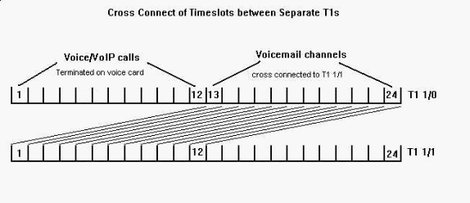
Circuits, VCs and packets
 | Circuits | virtual circuits | packets
Resources | copper circuit (space) time | switching capacity (maybe) | none (except with resource reservation)
Information unit | bit, byte | cell, frame | packet
Routing | switched (e.g., timeslot 15 to timeslot 13) | VC identifier (switch-local) | IP address (network-global)
Examples | phone, ISDN, X.21 | ATM, MPLS | IP, Ethernet
Notes:
http://people.seas.harvard.edu/~jones/cscie129/nu_lectures/lecture11/switching/xbar/xbar.html

Slide 5
Circuit switching: crossbar space switch
N x N array of crosspoints
Connect an input to an output by closing a crosspoint
Non-blocking: Any input can connect to idle output
Complexity: N² crosspoints
1
2
…
N
…
1
2
N –1
N
Notes:
http://www.cc.gatech.edu/classes/AY2005/cs4251_fall/
C. Dovrolis

Slide 6
CS: multistage space switch
Large switch built from multiple stages of small switches
n inputs to a first-stage switch share k paths through intermediate crossbar switches
Larger k (more intermediate switches) means more paths to output
In 1950s, Clos asked, “How many intermediate switches required to make switch non-blocking?
k intermediate
N/n first stage, each
with n inputs, k outputs
2(N/n)nk + k (N/n)² crosspoints
n×k
N/n × N/n
k×n
1
1
1
n×k
k×n
N
inputs
2
N/n × N/n
2
N
outputs
n×k
2
k×n
3
3
●
●
●
…
…
…
n×k
k×n
N/n
N/n × N/n
N/n
k
Notes:
http://www.cc.gatech.edu/classes/AY2005/cs4251_fall/

Slide 7
CS: Clos Non-Blocking Condition: k=2n-1
Request connection from last input to input switch j to last output in output switch m
Worst Case: All other inputs have seized top n-1 middle switches AND all other outputs have seized next n-1 middle switches
If k=2n-1, there is another path left to connect desired input to desired output
nxk
N/n x N/n
kxn
1
1
1
…
…
n-1
busy
N/n x N/n
Desired
output
Desired
input
nxk
n-1
kxn
j
m
N/n x N/n
n-1
busy
…
n+1
…
# internal links = 2x # external links
N/n x N/n
2n-2
nxk
kxn
N/n
Free path
N/n x N/n
Free path
2n-1
N/n
Notes:
http://www.cc.gatech.edu/classes/AY2005/cs4251_fall/

Slide 8
Backbone router
may have
buffers
cross-connect
(“backplane”)
Route processor
TCAM = ternary content addressable memory
Notes:
http://ipj.dreamhosters.com/wp-content/uploads/2014/12/ipj17.2.pdf

Slide 9
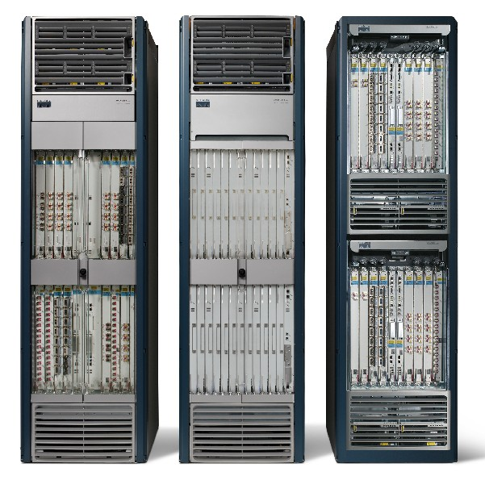
Example: Cisco CRS-1

Slide 10

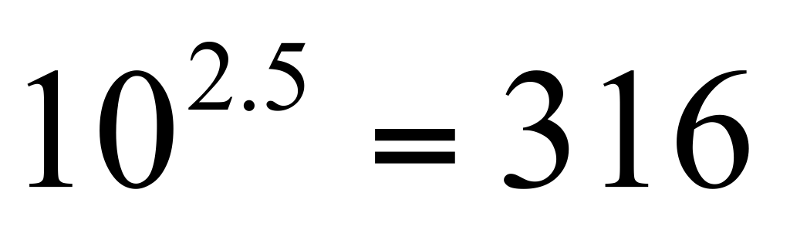
Physical media: capacity
Capacity has theoretical limit
  Shannon’s Law: capacity limit given by
  C = B log2 (1 + S/N) with spectral bandwidth B
  E.g., phone has B = 3000 Hz, S/N = 35 dB, C = 34.8 kb/s
dB =
  E.g., 25 dB =
Speed has physical limits: c in free space, 0.66 c in fiber

Slide 11
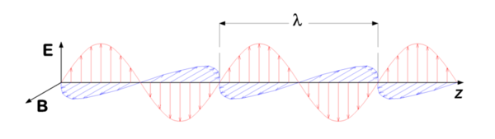
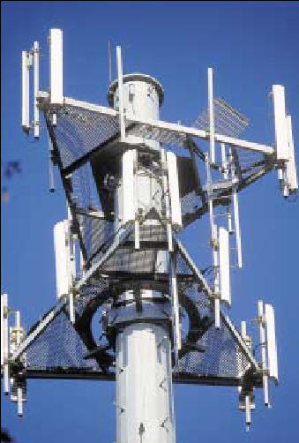
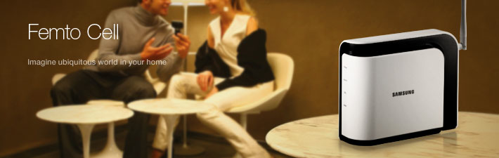
Bypassing Shannon
Multiple channels
  polarization
Spatial re-use
  directional antennas (120º “sectors”)
  smaller cell sizes
    macro, micro, femto, … cells
Notes:
LTE - Anritsu

Slide 12
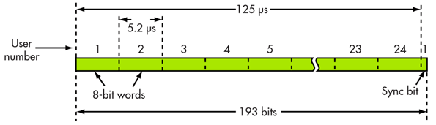
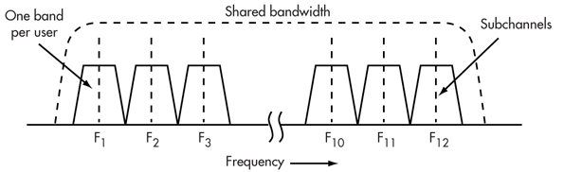
Modulation
T1 circuit (1.54 Mb/s – 24 voice ch.)
Time
  TDxxx
  typically, “time slots”
Frequency
  one signal → one frequency
  multiple frequencies → OFDM
    e.g., DSL, LTE, 802.11a/n, …
Phase (time-shift)
Notes:
http://electronicdesign.com/communications/fundamentals-communications-access-technologies-fdma-tdma-cdma-ofdma-and-sdma

Slide 13
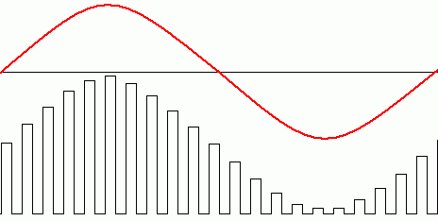
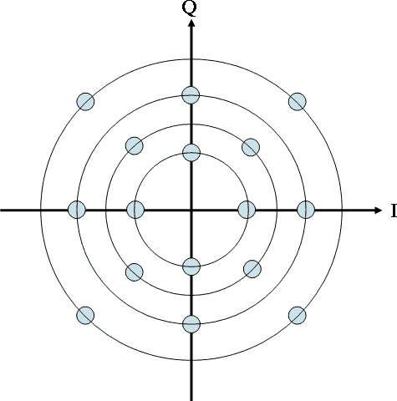
Mapping bits to symbol
symbol rate vs. bit rate
Amplitude
Phase (+ amplitude)

Slide 14
Spectral efficiency
Medium | Spectrum | Data rate | b/Hz
Modem (V.92) | 3,100 Hz | 56 kb/s | 18.1
2G cellular (GSM) | 0.2 MHz |  | 0.52
LTE | 20 MHz | 326 Mb/s | <16.3
ADSL downlink | 0.962 | 12 Mb/s | 12.5
WiFi 802.11 a/g | 20 MHz | < 54 Mb/s | < 2.7
WiFi 802.11 n | 20 MHz | < 144 Mb/s | < 7.2
Notes:
http://en.wikipedia.org/wiki/Spectral_efficiency

Slide 15
Broadband
What (is Broadband Internet Access)?
    FCC: was >200 kb/s or 4 Mb/s down & 1 Mb/s up
      now 25 Mb/s down/3 Mb/s up
    NTIA: >768 kb/s downstream/200 kb/s upstream
    YouTube recommendation: >500 kb/s
    Multimedia: >10 Mb/s downstream
      Unicast/broadcast
Where?
    Rural: Low density (<100 pop/km²)
      Minimize fixed infrastructure cost
    Urban: High density (>1000 pop/km²; >10,000 in cities)
      Maximize Mb/s/km²
Notes:
http://globalgeeknews.com/2010/07/23/fcc-changes-broadband-definition-to-4mbps-up-and-1mbps-down/

Slide 16
Cost for providing access
cost
across provider boundaries
possibly another step when crossing oceans
within campus/AS
(multiple L2s)
same L2 switch
(non-blocking)
distance
within home

Slide 17
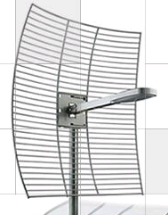
Broadband Access Technologies
FBWA or 4G
FTTHome
FTTCurb
BPL
DSL
4G
Fiber PON
HFC
Digital
Subscriber Line
Telco or ILEC
10s of Mbps
Entertainment, data, voice
Fiber -- Passive
Optical Network
Telco or ILEC
~75 Mb/s
Futureproof?
Fixed Broadband Wireless Access
Wireless ISP
WiMAX or LTE:
  -10s of Mbps
Satellite: few Mbps
4G/LTE
Cellular operators
5-10 Mbps (100 kph)
Hybrid Fiber Coax
CableCo (MSO)
Entertainment, data, voice
10s of Mbps
Broadband Power Line
PowerCo
Data, voice
~few Mbps
Paul Henry (AT&T), FCC 2009
Notes:
http://www.broadband.gov/ws_fixed_bb.html

Slide 18
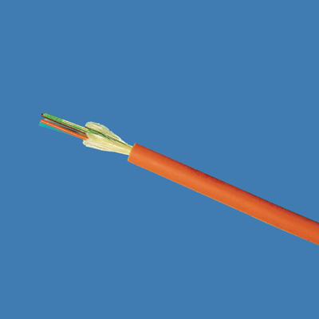
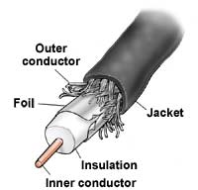
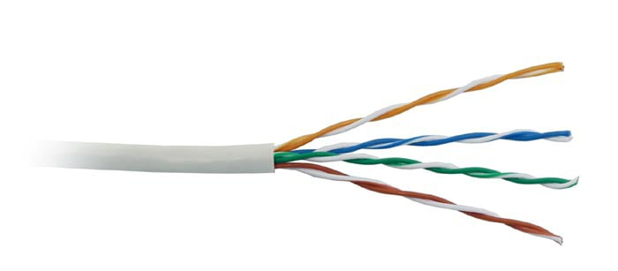
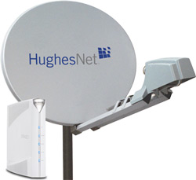

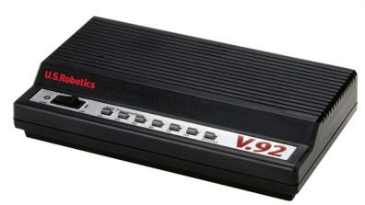
Available access speeds
100 Mb/s
marginal VOIP
20 Mb/s
10 Mb/s
5 Mb/s
1 Mb/s
avg. sustained
throughput
20%
80%
90%
97%
100%
of households (availability)

Slide 19
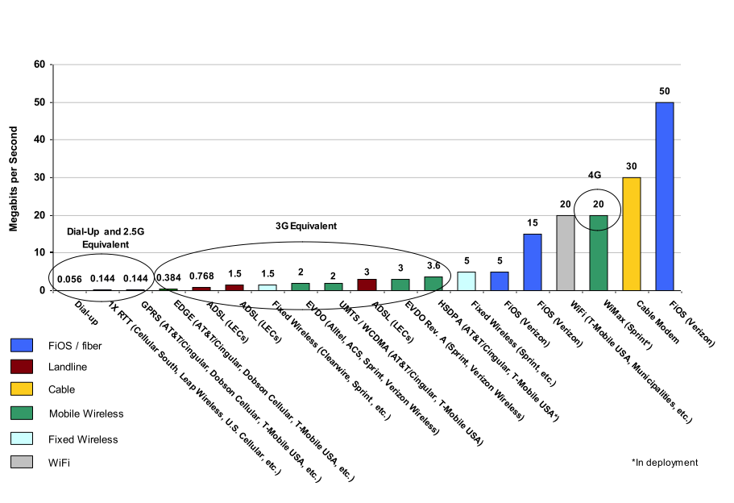
Maximum Theoretical Broadband Download Speeds
Multiple Sources: Webopedia, bandwidthplace.com, PC Magazine, service providers, ISPs, Phonescoop.com, etc.
Paul Garnett, CTIA, June 2007

Slide 20
Access costs
DSL VDSL: 100 Mb/s over short distances, ready to double with DSM
  Bonding also doubles speed.
  DSL repeaters very cheap way to bring “up to 6 meg” longer distances (~$200).
Cable 30M homes can now get 50 Mb/s down
  DOCSIS 3.0. 60% of U.S. in 2010-2011
  85+% in 2013-2014. Upstream 50 meg at Comcast starting in months.
  Specification designed to go to a shared gigabit. 95-99% reliable speed; balance still over 10 megabits. < $100/home, fast to deploy
David Burstein (DSL Prime) 2009
Notes:
http://www.broadband.gov/ws_fixed_bb.html

Slide 21
Access costs
Fiber → GPON 200 Mb/s both directions
  $200-400 for gear
  Verizon FiOS < $700/home passed -- dropping
  $20K/mile to run fiber
Wireless LTE/WiMAX
  4-10 Mb/s typical
  95% of U.S. population 2013 (McAdam, VZ)
  Shared 30-120 Mb/s, so heavy HD TV use a problem

Slide 22
Residential access: DSL
Uses single copper pair
  shared with analog or ISDN phone service
  but “bonding” proposed since most residences have 2 pairs
ADSL = asymmetric digital subscriber line
  “web browsing”
  but: sending photos, video conferencing
distance-limited
IDSL: ISDN encoding; 144 kb/s, but longer loops
ADSL: typically, < 20 Mb/s down, 2 Mb/s up
  G.lite: 1.5 Mb/s down, 384 kb/s up; no splitter
SDSL: symmetric 2.3 Mb/s
SHDSL: ITU rate-adaptive
VDSL: short distance to ONU
  up to 55 Mb/s

Slide 23
ADSL standards
Standard name | Common name | Downstream rate | Upstream rate
ITU G.992.1 | ADSL (G.DMT) | 8 Mbit/s | 1.0 Mbit/s
ITU G.992.2 | ADSL Lite (G.Lite) | 1.5 Mbit/s | 0.5 Mbit/s
ITU G.992.3/4 | ADSL2 | 12 Mbit/s | 1.0 Mbit/s
ITU G.992.3/4 Annex J | ADSL2 | 12 Mbit/s | 3.5 Mbit/s
ITU G.992.3/4 Annex L | RE-ADSL2 | 5 Mbit/s | 0.8 Mbit/s
ITU G.992.5 | ADSL2+ | 24 Mbit/s | 1.0 Mbit/s
ITU G.992.5 Annex L | RE-ADSL2+ | 24 Mbit/s | 1.0 Mbit/s
ITU G.992.5 Annex M | ADSL2+ | 28 Mbit/s | 3.5 Mbit/s
Michal, Angel, Igor
Notes:
Miturski Michal
Mirkovski Angel
Sacevski Igor

Slide 24
ADSL Range
Range for DSL without a repeater: 5.5 km
As distance decreases toward the telephone company office, the data rate increases
Data Rate | Wire gauge | Wire size | Distance
1.5 or 2 Mbps | 24 AWG | 0.5 mm | 5.5 km
1.5 or 2 Mbps | 26 AWG | 0.4 mm | 4.6 km
6.1 Mbps | 24 AWG | 0.5 mm | 3.7 km
1.5 or 2 Mbps | 26 AWG | 0.4 mm | 2.7 km

Slide 25
ADSL (ITU G.992.1)
ADSL spectral power repartition (PSTN)
Power
DATA
DATA
POTS
DATA
POTS
POTS
Upstream
Upstream
Upstream
Downstream
Downstream
Downstream
300 Hz
300 Hz
300 Hz
3,4 kHz
3,4 kHz
3,4 kHz
22 kHz
22 kHz
22 kHz
133kHz
133kHz
133kHz
203 kHz
203 kHz
203 kHz
1.1 MHz
1.1 MHz
1.1 MHz
Frequency
FDD: Frequency Division Duplexing
=>no interferences between Up and Down

Slide 26
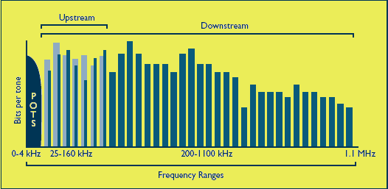
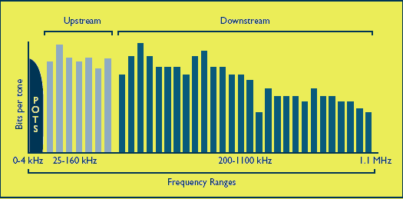
The DMT frequency bands
Frequency Division Multiplexing (FDM)
Echo Cancellation

Slide 27
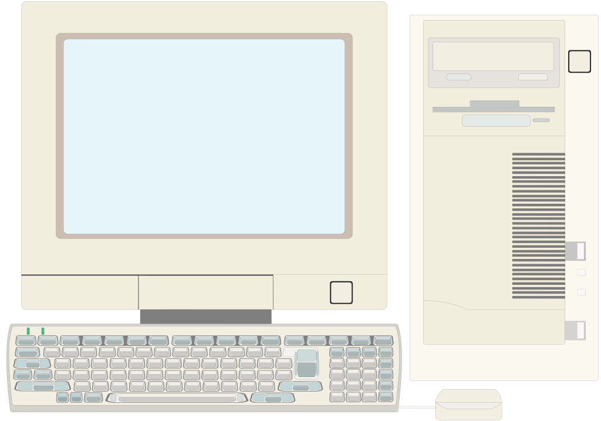
Functional scheme of a DSLAM
DSLAM: Digital Subscriber Line Access Multiplexer
POTS/ISDN
POTS/ISDN
ADSL
modem
POTS
ISDN
Split.
ADSL + POTS/ISDN
POTS
ISDN
Split.
LT
Copper access line
STM-1
NT
ATM network
ATM cells
DSLAM

Slide 28
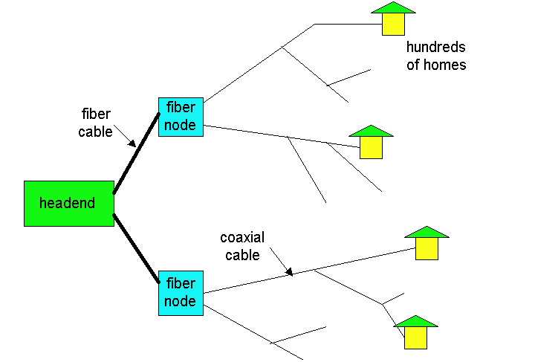
Residential access: cable modems
HFC: hybrid fiber coax
  asymmetric: up to 10 Mb/s upstream, 1 Mb/s downstream
network of cable and fiber attaches homes to ISP router
  shared access to router among home
  issues: congestion, dimensioning
deployment: available via cable companies
Kurose/Ross

Slide 29
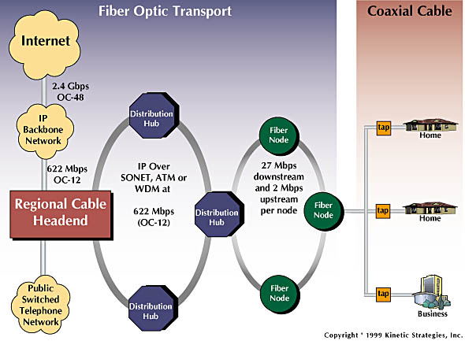
Residential access: cable modems
Diagram: http://www.cabledatacomnews.com/cmic/diagram.html

Slide 30

Cable network architecture
Typically 500 to 5,000 homes
cable headend
cable distribution
network (simplified)
home

Slide 31
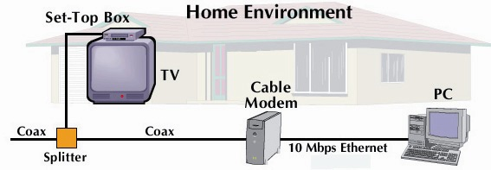
Cable network architecture
cable headend
cable distribution
network (simplified)
home

Slide 32
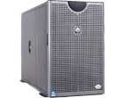
Cable network architecture
server(s)
cable headend
cable distribution
network
home

Slide 33
Cable network architecture
FDM:
C
O
N
T
R
O
L
V
I
D
E
O
V
I
D
E
O
V
I
D
E
O
V
I
D
E
O
V
I
D
E
O
V
I
D
E
O
D
A
T
A
D
A
T
A
1
2
3
4
5
6
7
8
9
Channels
cable headend
cable distribution
network
home

Slide 34
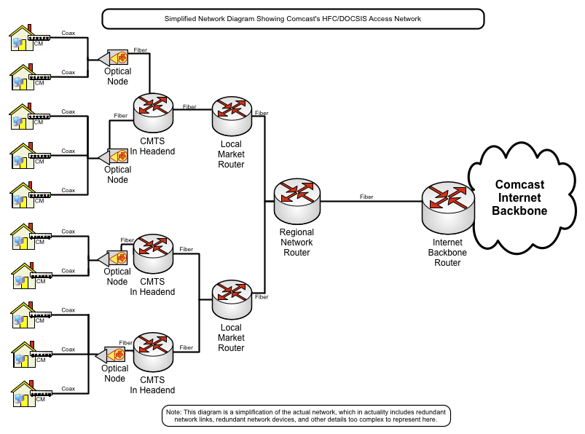
Simplified access network diagram
Jason Livingood (Comcast) FCC 2009
Notes:
34
http://www.broadband.gov/ws_fixed_bb.html

Slide 35
DOCSIS 3.0 Channel Bonding
DOCSIS 3.0 is the next generation of the DOCSIS standard
152 Mbps
Logical Channel Bonding Technology
38 Mbps
38 Mbps
38 Mbps
38 Mbps
6 MHz
6 MHz
6 MHz
6 MHz
DOCSIS 2.0 is limited to single channel’s capacity
DOCSIS 3.0 employs packet bonding across multiple channels
  Initially will bond 4 channels
  8 channel-capable silicon coming soon
  Upstream bonding in 2010
  Increased speeds 100Mbps+
Notes:
35

Slide 36
Network cost
Electronic and electro-optic costs are dropping rapidly
  GigE switch : 2001 - $15K 2003 - $1.2K 2009 - $600 (12 port)
  GigE transceivers 2001 - $750 2003 - $180
  CWDM transceivers $400-800 for 50-100km reach!
Direct fiber cost is relatively low
  $60/fiber-km in 80-fiber bundle
But – fiber installation cost is still tall pole
  Europe: >$20/m (or any populous wide-area)
  U.S.: >$10m (in simplest desert environment)
A. Whitney (2003, modified)
Notes:
http://fiberinfrastructure.blogspot.com/2008/11/construction-cost-estimates.html

Slide 37
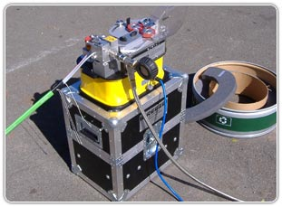
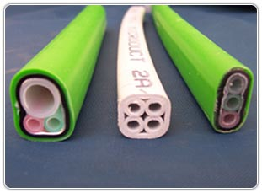
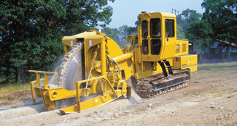
Fiber installation cost
Construction cost (Oct, 2008) estimate for Northern California for a 1" fiber optic cable where aerial infrastructure (poles) are already in place
Method | Cost
Aerial | $3.30/ft
Open trench | $10/ft
Rockwheel (24” depth) | $28/ft
Light underground (trench or bore) | $38.93/ft
Heavy underground (backhoe asphalt) | $72.93/ft
Notes:
http://fiberinfrastructure.blogspot.com/2008/11/construction-cost-estimates.html
http://www.liteaccess.com/

Slide 38
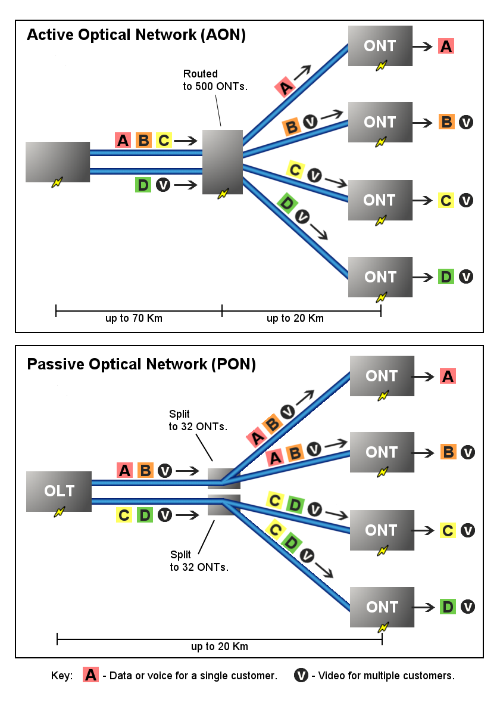
Passive Optical Networks
serves 16-128 premises
  20-32 split common
  1490 nm down, 1310 nm upstream
ITU-T G.984
  2.488 Gb/s down
  1.244 Gb/s upstream
  variable-length packets (GEM)
G.987 (10G-PON): 10 Gb/2.5 Gb/s
EPON: Ethernet frames

Slide 39

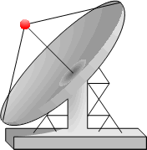

Example: FiOS TV architecture
Serving
Office
Fiber
Super
Headend
Hub
Office
Serving
Office
Fiber
Serving
Office
Splitter
Super
Headend
Broadcast Video
Voice, Data, IP TV
Voice, Data, IP TV
2 national super headends
9 video hub offices
292 video serving offices
J. Savage (Telecom ThinkTank), Nov. 2006
Notes:
Joseph Savage, Nov. 29, 2006
http://www.glgroup.com/glgi-presentations/iptv-11-29-06/Savage%20NYC%2011%2029%20seminar%20(3).ppt

Slide 40
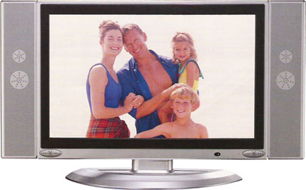

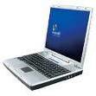
Verizon’s FTTP architecture
customer premise
OLT
Optical Line Terminal
Voice & Data Downstream 1490 nm
Voice, Data & Video 1490 nm, 1310 nm, 1550 nm
ONT
Optical Network Terminal
Optical Couplers (WDM)
Optical Splitter
Upstream 1310 nm
Video 1550 nm
1x32
CENTRAL OFFICE
EDFA
Erbium Doped Fiber Amplifier
Bandwidth & Services
Upstream
Downstream
1310 nm
1490 nm
1550 nm
Voice & Data at 155 to 622 Mbps
Voice, Data & VOD at 622 Mbps
Broadcast Video
54 MHz
864 MHz
Brian Whitton, Verizon
Analog TV
Digital TV and HDTV
Notes:
by Brian Whitton, Verizon Networks

Slide 41
Internet structure: network of networks
roughly hierarchical
at center: “tier-1” ISPs (e.g., UUNet, Level3, Sprint, AT&T), national/international coverage
  treat each other as equals
Tier-1 providers also interconnect at public network access points (NAPs)
Tier-1 providers interconnect (peer) privately
Tier 1 ISP
NAP
Tier 1 ISP
Tier 1 ISP
Kurose/Ross

Slide 42
More precisely…
Tier 1 = those ISPs that run no-default routing tables on their backbones
  operations in more than one country
  own and operate their own physical networks
  revenue-neutral peering agreements with other tier 1
  may only be tier-1 regionally
Tier-2 ISPs buy connectivity (upstream transit) from one or more Tier-1 ISPs

Slide 43
Tier-1 providers
Provider | AS | Degree
AOL | 1668 | 74
AT&T | 7018 | 1382
Level 3 (with Global Crossing) | 3356 / 3349 | 499
Verizon Business (was UUNET) | 701 | 1452
NTT Communications (was Verio) | 2914 | 254
Centurylink (was Qwest & Savvis) | 209 / 3561 | 828
Sprint | 1239 | 880
Telecom Italia Sparkle (Seabone) | 6762
TeliaSonera International Carrier | 1299
Deutsche Telekom AG (DTAG) | 3320 | 501
NTT Communications | 2914
other major
carriers:
Cogent
XO
AboveNet
Wikipedia

Slide 44
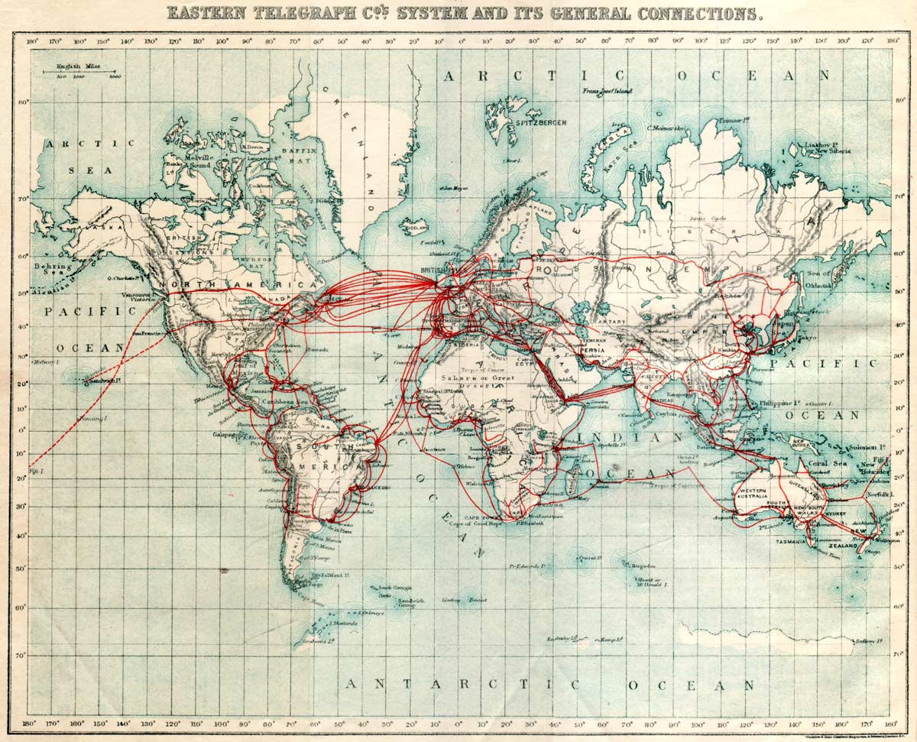
1901 “data” backbone

Slide 45
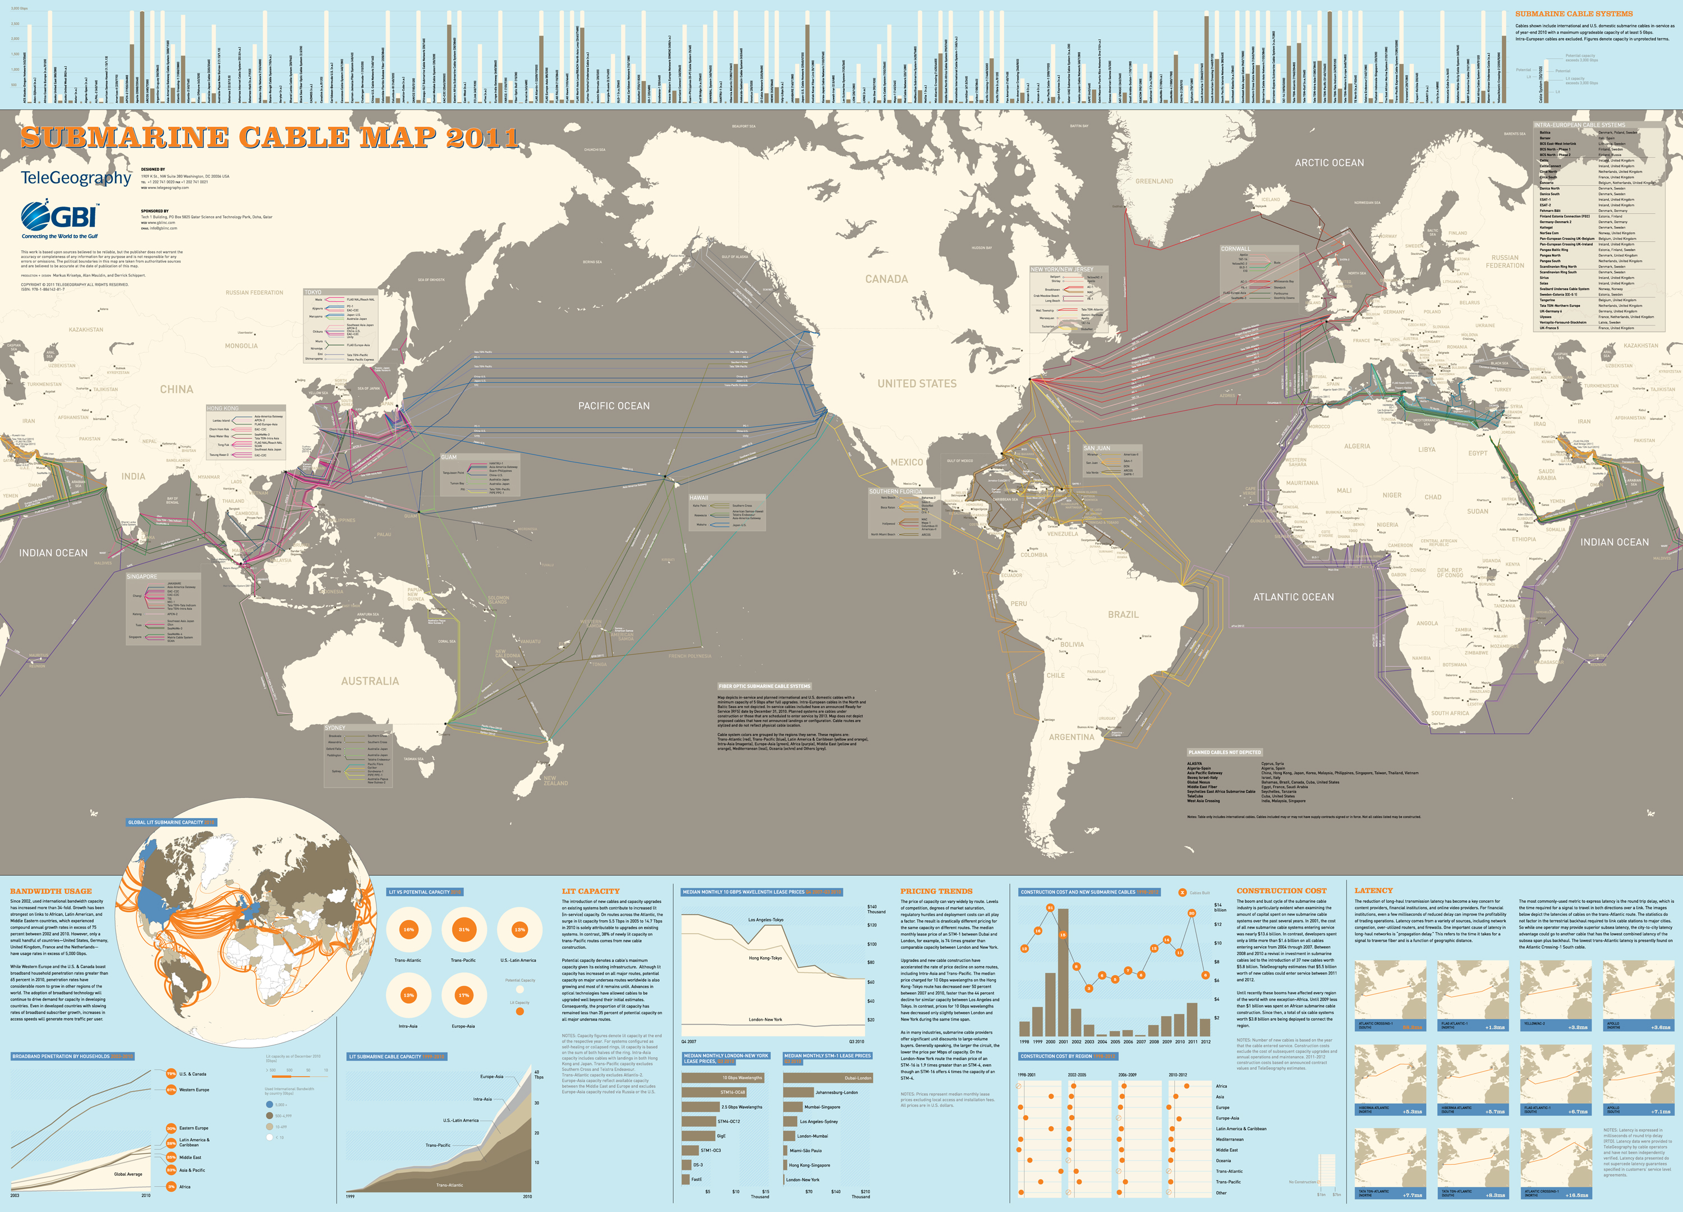
Submarine cable map
http://www.telegeography.com/
Notes:
http://www.telegeography.com/

Slide 46
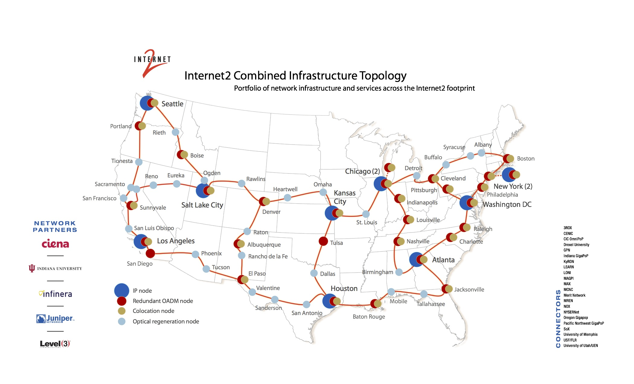
Backbone: Internet2 architecture

Slide 47
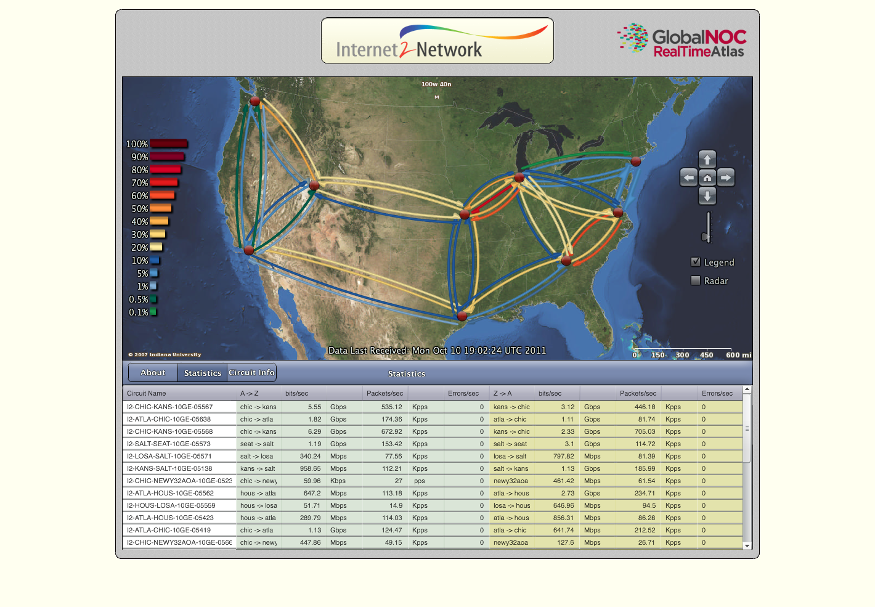
Internet2 loading
http://atlas.grnoc.iu.edu/I2.html

Slide 48
Internet topology
large ISP
EGP
large ISP
medium ISP
WISP
dedicated
access ISP
AS (Autonomous System) - a collection of routers under the same technical and
administrative domain.
EGP (External Gateway Protocol) - used between two AS’s to allow them to exchange routing information so that traffic can be forwarded across AS borders. Example: BGP
Nina Taft

Slide 49
Purpose: to share connectivity information
you can reach
net A via me
AS2
AS1
BGP
R2
R3
traffic to A
R1
A
table at R1:
dest next hop
A R2
border router
R
internal router
Nina Taft
Notes:
BGP is a protocol that happens between 2 nodes.
It uses TCP as its transport protocol. In other words, 2 routers establish a BGP session using TCP and then exchange BGP messages.
During session establishment routers identify themselves. Each neighbor can accept or reject the connection.

Slide 50
BGP sessions
One router can participate in many BGP sessions.
Initially … node advertises ALL routes it wants neighbor to know (could be >50K routes)
Ongoing … only inform neighbor of changes
AS1 (Level3)
BGP Sessions
AS3
(MIT)
AS2 (UDel)
Nina Taft

Slide 51
Routing protocols
I-BGP
IGP: Interior Gateway Protocol
Examples: IS-IS, OSPF
R3
R2
A
AS1
E-BGP
announce B
AS2
R1
AS3
R5
R4
R
border router
internal router
B
Nina Taft

Slide 52
Address arithmetic: address blocks
The <address/prefix> pair defines an address block:
Examples:
  128.15.0.0/16 => [ 128.15.0.0 - 128.15.255.255 ]
  188.24.0.0/13 => [ 188.24.0.0 - 188.31.255.255 ]
  consider 2nd octet in binary:
Address block sizes
  a /13 address block has 2³²⁻¹³ addresses (/16 has 2³²⁻¹⁶)
  a /13 address block is 8 times as big as a /16 address block
  because 2³²⁻¹³ = 2³²⁻¹⁶ * 2³
198.00011000.0.0
settable
13th bit
Nina Taft
Notes:
The 2nd example is the case that shows how it works on arbitrary bit boundaries.

Slide 53
CIDR: longest prefix match
Because prefixes of arbitrary length allowed, overlapping prefixes can exist.
Example:
router hears 124.39.0.0/16 from one neighbor
and 124.39.11.0/24 from another neighbor
Router forwards packet according to most specific forwarding information, called longest prefix match
  Packet with destination 124.39.11.32 will be forwarded using /24 entry.
  Packet w/destination 124.39.22.45 will be forwarded using /16 entry
Nina Taft

Slide 54
Four Basic Messages
Open:
Establishes BGP session (uses TCP port #179)
Notification:
Report unusual conditions
Update:
Inform neighbor of new routes that become active
Inform neighbor of old routes that become inactive
Keepalive:
Inform neighbor that connection is still viable

Slide 55
BGP attributes
ORIGIN:
  Who originated the announcement? Where was a prefix injected into BGP?
  IGP, EGP or Incomplete (often used for static routes)
AS-PATH:
  a list of AS’s through which the announcement for a prefix has passed
  each AS prepends its AS # to the AS-PATH attribute when forwarding an announcement
  pick shortest route
  useful to detect and prevent loops
Prefix | Next hop | AS Path
128.73.4.21/21 | 232.14.63.4 | 1239 701 3985 631

Slide 56
Wireless networks

Slide 57
Frequencies
Licensed vs. unlicensed
  Unlicensed = ISM (door openers to WiFi) + UNII
    902-928 MHz (26 MHz - UHF)
    2.450 – 2.5 GHz (50 MHz - 802.11b/g)
    5.125-5.25 (125 MHz), 5.25-5.35, 5.5250-5.8250, 5.650 – 5.925 GHz
  + whiteband
Roughly:
  lower frequency → longer range
  but smaller capacity (smaller bands)
  2.45 GHz: microwave oven (interference)
  2.5 GHz: foliage issues (beware pine needles!)
    light-light (~380-750 nm = 400-789 THz)
Same technology may be used in different frequency bands
  e.g., WiMAX: 700 MHz, 2.3, 2.4, 2.5, 5.8 GHz
Notes:
http://www.ntia.doc.gov/osmhome/allochrt.pdf

Slide 58
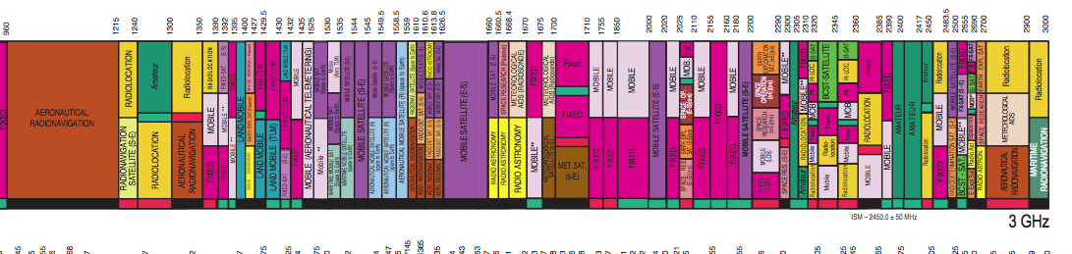
Radio spectrum 1-3 GHz
http://www.ntia.doc.gov/osmhome/allochrt.pdf

Slide 59
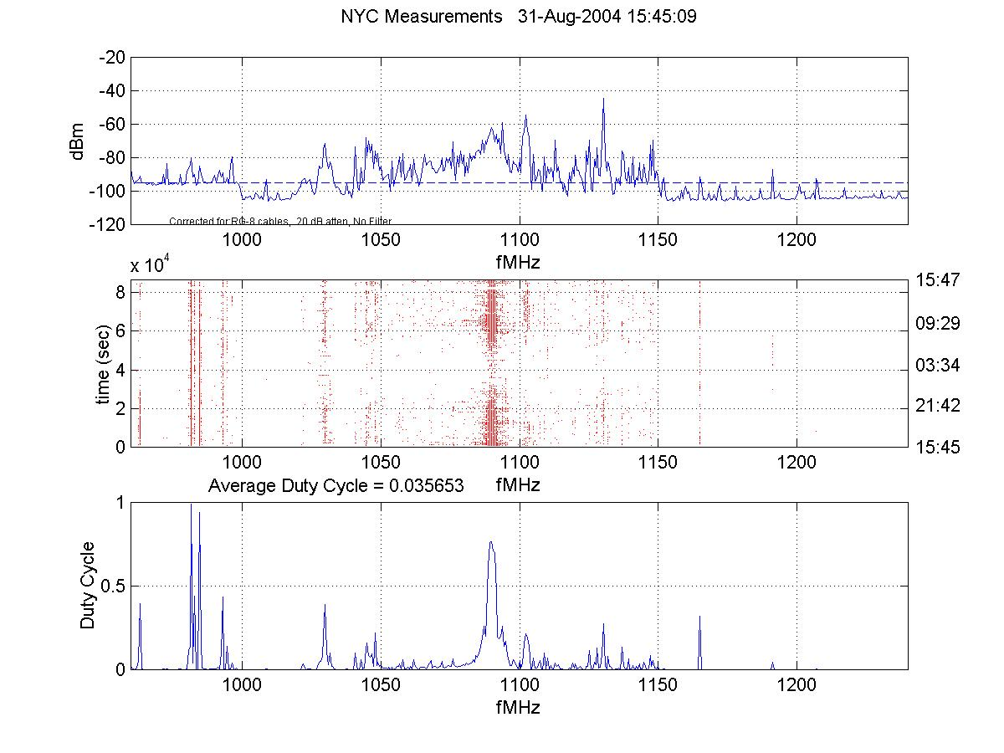
But often lightly used
http://www.sharedspectrum.com/measurements/
NYC, August 2004
Notes:
www.fcc.gov/sptf

Slide 60
The wireless “stack”
multiple access
L2
channel coding
protect against bit errors
modulation
(QAM, PSK)
L1
bits into frequency & phase
sub-channels
(OFDM)
large number of orthogonal channels
FDM

Slide 61
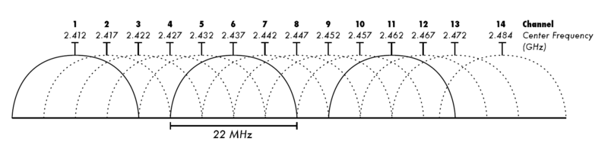
WiFi
802.11b: spread-spectrum
  83.5 MHz @ 2.4 GHz: CCK using QPSK
  1 Mb/s - 11 Mb/s nominal, 4.5 Mb/s typical
  11 channels, some countries 2, 4 or 14; 1-6-11 typical
802.11a: OFDM
  480 MHz in 24 (US) 20 MHz channels @ 5 GHz
  23 Mb/s typical, 54 Mb/s max.
802.11g
  2.4 GHz
  23 Mb/s typical, 54 Mb/s max.
802.11n: MIMO
  2.4 or 5 GHz
  74 Mb/s typical, 300 Mb/s max.
not in US

Slide 62
Cellular wireless technologies
Cell radius: hundreds of m to 35 km (GSM)
  power-controlled
  also: macro cell (tower), micro cell (below roof level), pico cell (indoor)
  900 or 1800 MHz
    US: 850, 1900 MHz
    Scandinavia: 400, 450 MHz (range!)
    GSM: 25 MHz uplink + downlink, 200 kHz channels
Generations:
  1G: analog
  2G:
    TDMA (time-division multiple access)
    CDMA (code-division multiple access)
    GSM (Global System for Mobile Communications)
    iDEN (Integrated Enhanced Digital Network) - Nextel

Slide 63
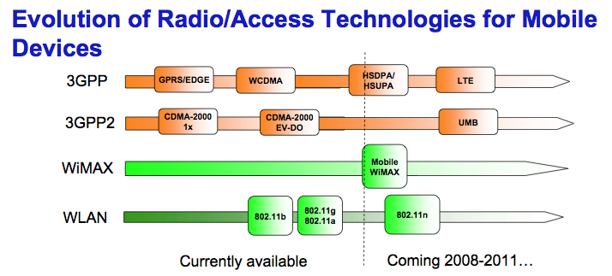
Wireless
Markus Isomäki (Nokia), 2008

Slide 64
2.5G & 3G wireless
CDMA
  CDMA 1X, 1XEV-DO
    400 kb/s to 2 Mb/s total
    Verizon, Sprint/Nextel
TDMA - GSM
  GPRS (General Packet Radio Services)
    up to 60 kb/s per subscriber
  EDGE (Enhanced Data rates for GSM Evolution)
    up to 150 kb/s per subscriber
    AT&T (iPhone), T-Mobile
  HSDPA (High-Speed Downlink Packet Access)
    1.8 to 14.4 Mb/s
    South Korea
  UMTS/WCDMA

Slide 65
Evolution of Wireless Technologies
CDMA
GSM
Other Technologies
Availability: | Now | Now through Mid-2007 |  | 2009
Benefits: | Higher speeds, lower costs, greater efficiencies
2G
3G
4G
1X RTT
EV-DO
Rev. 0
EV-DO
Rev. A
UMB
OFDM
MIMO
EDGE
HSDPA
HSPA+
LTE
WiMAX
(802.16e)
New Entrants
Paul Garnett, CTIA, June 2007

Slide 66
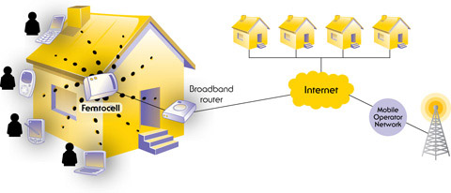
Wireless backhaul
= BS → backbone network
  one of the largest carrier OpEx components (30-40%)
Traditional: T1 (1.5 Mb/s) - $600/month
New solutions:
  microwave
    800 Mb/s to 3 Gb/s (future)
  CableCo fiber ($100/month/Mb/s)
  bonded DSL
  FiOS
  Femtocells – in subscriber home
Notes:
http://www.cellular-news.com/tags/backhaul/opex/
http://www.cellular-news.com/story/32737.php
http://www.intomobile.com/2009/09/21/att-3g-microcell-kills-dead-spots-in-charlotte.html
http://www.networkworld.com/news/2008/010808-femtocell.html

