Slide 1
Can Policies and Regulations Really Impact 5G Deployment?
Henning Schulzrinne
Columbia University

Slide 2
Themes
US-focused discussion, but problems are similar everywhere
Spectrum allocation
Small cell deployment
Impact on competition
5G and security

Slide 3
Spectrum

Slide 4
Who is in charge?
+ WRC designations
Notes:
Wells Fargo Wireless Spectrum Primer, 2017

Slide 5
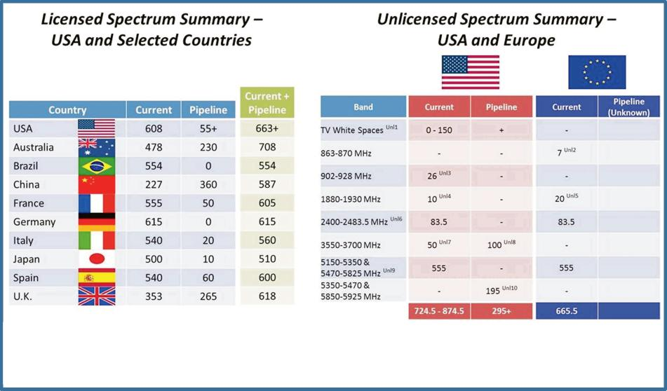
Feb. 2013
Notes:
http://hraunfoss.fcc.gov/edocs_public/attachmatch/DOC-318485A1.pdf

Slide 6
5.8 GHz band is complex
DFS
DFS
Notes:
https://www.connect802.com/802-11-channel-frequency-allocation

Slide 7
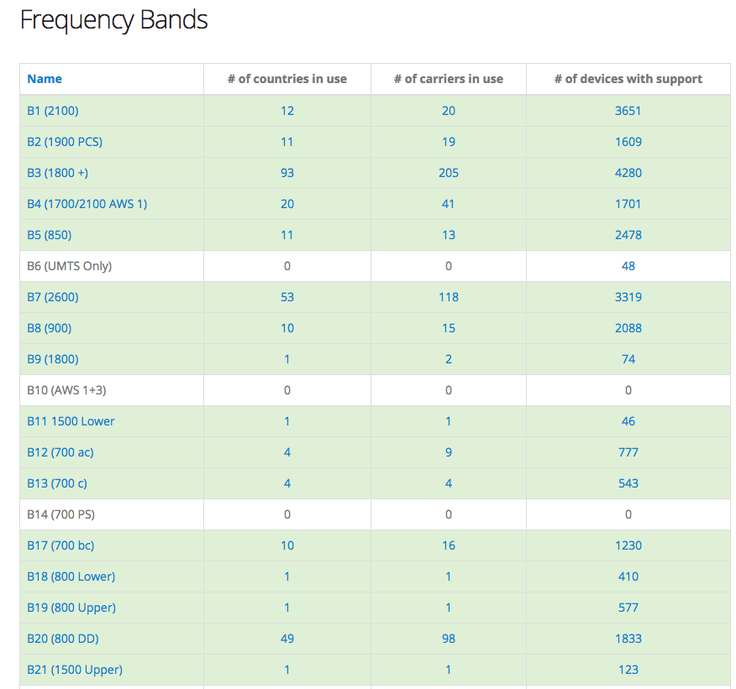
LTE band support varies
https://www.frequencycheck.com/interfaces/lte

Slide 8
Notes:
The Mobile Broadband Spectrum Challenge: International Comparisons
Wireless Telecommunications Bureau Office of Engineering & Technology
February 26, 2013

Slide 9
FCC license areas
3,007
734
491
176
“DMA”
TV
52
12

Slide 10




Why does it take so long?
Decide auction modes, regions, band plan, blocks, bidder preferences, …
auction
clearing
Who are we going to pick on?
ITU, 3GPP
coordination
(“this is my SAT band”)
build-out
end-user devices

Slide 11
It takes a long time to convert spectrum
Notes:
Wells-Fargo Research June 2017

Slide 12
3.5 GHz band
FSS: C Band (3.625–4.200)

Slide 13
3.5 GHz user classes
must not interfere
1
Federal users
Fixed satellite users (FCC)
census tract
≤ 70 MHz
3-year licenses
assigned via SAS
2
Priority licenses (PAL)
10 MHz channels in 3550-3650
3
General authorized use (GAL)
ESC (environmental sensing capability) allows commercial use in coastal and Great Lakes region

Slide 15
mmWave bands
Unlicensed:
64-71 GHz
70-80 GHz (new uses)
Satellite:
24.75-25.25 GHz (FSS earth)
40—42 GHz
48.2—50.2 GHz
Notes:
Wells Fargo Wireless Spectrum Primer, 2017

Slide 16
mmWave bands for mobile systems (non-satellite)
Band | Available | Currently used | Frequencies | Area, format | Blocks
12.2-12.7 GHz | 500 MHz | Licensed to DISH (2004 & 2012)
24 GHz (UMFUS) | 900 MHz | FiberTower, AT&T | 24.25–24.45, 24.75–25.25 GHz | PEA clock | 7 x 100 MHz (after 28 GHz)
28 GHz (LMDS) | 0.9 GHz | Verizon (via XO) | 27.5–28.35 GHz | County SMR | 2 x 425 MHz (Nov. 2018)
37 GHz | 1.6 GHz | Greenfield, federal use |  |  | 6 100 MHz
39 GHz | 1.4 GHz | FSS (unused), 14 blocks of 50+50; StraightPath (VZ)
57-71 GHz (V-band) | 14 GHz | unlicensed (WiGig)
71-76 + 81-86 GHz (E-band) | 10 GHz | light license
Notes:
https://docs.fcc.gov/public/attachments/DOC-347449A1.pdf

Slide 17
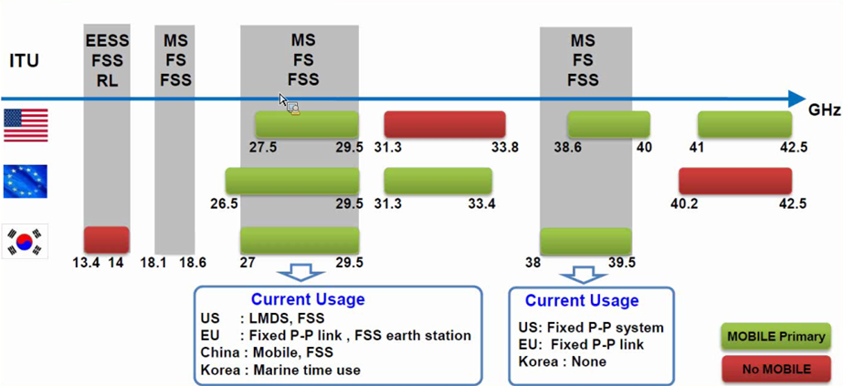
Source : Samsung Communications Research Team
30-40GHz mmW – Spectrum Overview
17
Note: The Commission’s Fixed Microwave (Part 101) and Satellite Communications (Part 25) service rules govern most of US Mobile allocations shown above

Slide 18
Small cell deployment

Slide 19
Two perspectives on small cells
Municipalities
enables smart city deployments
Carrier
5G deployment provides public benefit
needed for US competitiveness
cities and tribes just extorting money
fees should reflect cost of permitting
carriers are not charities
concerns about visual blight
what about digital inclusion?
not a major cost factor
Federal preemption, please!
it’s my city!

Slide 20
Reviews
The FCC (or states) don’t approve cell towers or small cells → largely, local issue
National Environmental Policy Act (“NEPA”)
National Historic Preservation Act (“NHPA”)
Tribal review, according to AT&T
  “last three years AT&T has spent $13 million in tribal fees”
  “CTIA and WIA have explained that tribal review takes, on average, about 110 days”

Slide 21
Broadband Deployment Advisory Committee (BDAC)
Established April 2017
  Model Code for Municipalities
  Model Code for States
  Competitive Access to Broadband Infrastructure
  Removing State and Local Regulatory Barriers
  Streamlining Federal Siting
Membership: 30 members, 3 of which represent municipalities
  rest carries, industry associations, conservative academics
Significant leadership and membership churn
  mayor of San Jose resigned
Goal: develop model agreement and guidelines for small-cell deployments
  non-binding, but related to pole attachment rules

Slide 22
Small cell deployments
“A wireless facility where each antenna, excluding associated equipment, comprises no more than three cubic feet in volume.” (AT&T)
“17% of AT&T costs to deploy each small cell node are directed to NEPA and NHPA compliance” (AT&T)
~ 3 ft³
Notes:
https://ecfsapi.fcc.gov/file/1022359695070/2018-02-23%20-%20ATT%20Ex%20Parte%20-%20WT%2017-79.pdf

Slide 23
AT&T examples of small cells

Slide 24
5G small cell – deployed reality
Notes:
http://wirelessestimator.com/articles/2018/atts-small-cell-rats-nest-of-cables-is-needlessly-messy-says-former-fcc-senior-exec/
http://www.steelintheair.com/Blog/2017/04/top-10-things-the-wireless-industry-doesnt-tell-you-about-small-cells.html

Slide 25
Example: San Jose (April 2018)
60 day processing
170 small cells
+
$1M fund
$850k prepay

Slide 26
Impact on Competition

Slide 27
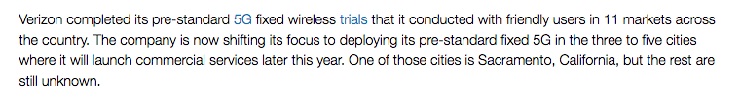
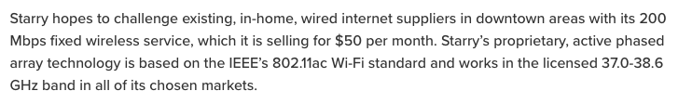
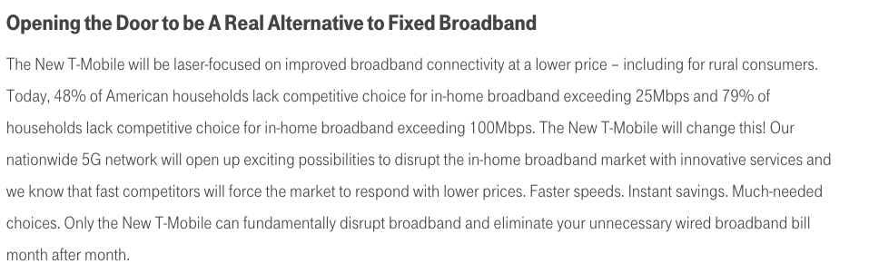
5G as hope for facilities-based competition
Notes:
https://newtmobile.com/sparking-the-5g-economy/

Slide 28
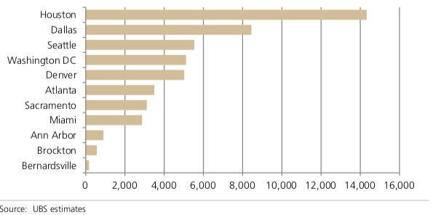
Financial model

Slide 29
Competition models, 2020+
4G/5G tethering
5G fixed
wireless
HFC (cable)
urban
FTTH (telco)
DSL
FTTH
(limited availability)
rural
fixed wireless
4G tethering
satellite
variable speed < 10 Mb/s
few GB/month
variable speed < 50 Mb/s
few tens GB/month
consistent speed ≧100 Mb/s
TB/month

Slide 30
FCC, 5G and security

Slide 31
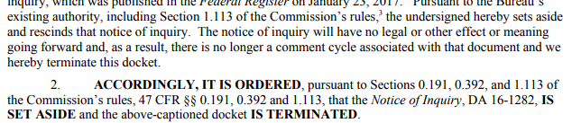
2017: 5G security NOI (Feb. 2017)

Slide 32
Conclusion
Spectrum policy gets messier
  most 5G action seems to be at 3.5 GHz, not mmW
  can we make mobile vs. satellite discussions more rational?
    little economic impact analysis
Towers: not in my backyard → small cells: not on my lamp post (without a fee)
  danger of carrier overreach
Impact of 5G on competition: HFC or another BPL?
Should there be other regulatory interventions
  security? interoperability (bands)? receiver requirements?

