Slide 1
5G and IoT – Cousins, not Siblings
This material is based upon work supported by the National Science Foundation under Grant No. 1702967. Any opinions, findings, and conclusions or recommendations expressed in this material are those of the author(s) and do not necessarily reflect the views of the National Science Foundation.
Henning Schulzrinne
Columbia University
typical keynote
closer to this one

Slide 2
5G and IoT – buzzword cousins
Looking back: IoT is old
Billions and billions of IoT devices justify 5G investment and hype
  rather than 5G as minor efficiency tune-up for 4G
There is no single IoT network technology
Economics of edge/fog/dew/… computing

Slide 3
Hype feedback loop
5G provides 1 ms latency!
5G
IoT
initial non-5G IoT networks: low complexity, very low speed
“IoT will drive 5G demand!”

Slide 5
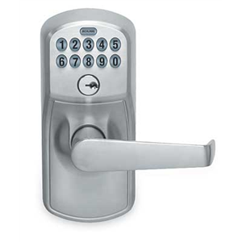

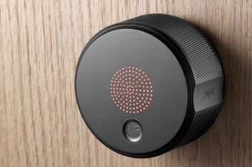
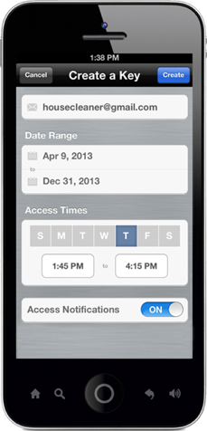
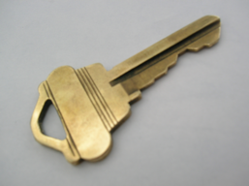

Natural evolution

Slide 6
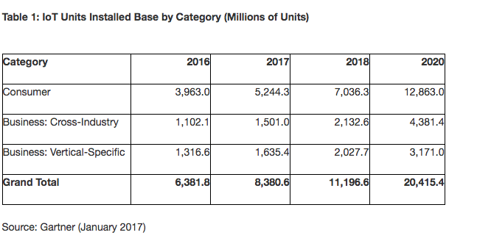
Billions and billions of devices
roughly 3 devices per human
https://www.gartner.com/newsroom/id/3598917
Notes:
https://spectrum.ieee.org/tech-talk/telecom/internet/popular-internet-of-things-forecast-of-50-billion-devices-by-2020-is-outdated

Slide 7

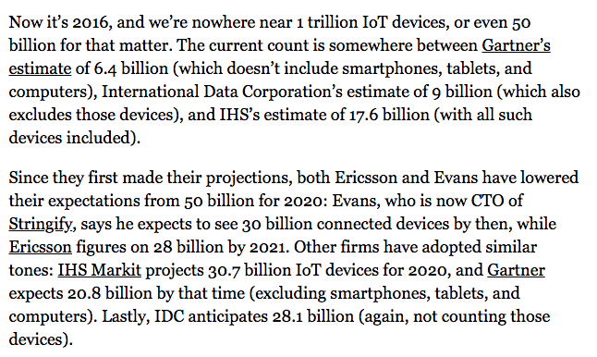

Pick your number
IEEE
Spectrum
8/2016
➔ the keynote estimator: the higher, the more likely to be cited in a keynote
Notes:
https://www.cisco.com/c/dam/en/us/products/collateral/se/internet-of-things/at-a-glance-c45-731471.pdf

Slide 8
IoT is not exactly new (1978)

Slide 9
IoT – an idea older than the web (1985)
Peter Lewis (panel discussion 1985)
From Chetan Sharma Consulting 2016

Slide 10
The IoT killer app
http://www.traptec.eu/

Slide 11
But controlling light switches is still not the best use
Want to turn on the bedroom light? Sure, just pick up your smartphone, enter the unlock code, hit your home screen, find the Hue app, and flick the virtual switch. Suddenly, the smart home has turned a one-push task into a five-click endeavor, leaving Philips in the amusing position of launching a new product, Tap, to effectively replicate the wall switches we always had.
https://techcrunch.com/2014/12/04/the-problem-with-the-internet-of-things/

Slide 12
Generational surprises
Generation | Expectation | Surprise | Cost per GB
0G (landline) | voice | fax & modem
1G | corporate limousine | eavesdropping
2G | better voice quality (“digital!”) | SMS | $1000
3G | WAP | web | $100
4G | IMS | YouTube, WhatsApp, notifications | $10
5G | IoT (low latency) | ? | $1?
underestimated cost and fixed-equivalence as drivers
are the even generations the successful ones?

Slide 13

20 billion devices ≠ 20 billion device 5G connections
hybrid connectivity: cheap +
ubiquitous
cheap connectivity
managed connectivity

Slide 14
IoT requirements
Wide-area Wireless Communication Challenges for the Internet of Things
Harpreet S. Dhillon, Howard Huang, Harish Viswanathan

Slide 15
IoT is not a helpful term
The only common thread is what doesn’t matter: absence of a human
Otherwise, spans every dimension of networking
mobility
high-speed train
aeronautical
fixed infrastructure
message/week
bandwidth
4K video
minutes
or hours
latency
10 ms protective
relay
easy
hard
indoors or urban
geography
remote pipeline
cost constraints
$1/year
$5/device
1% of $1B bridge

Slide 16
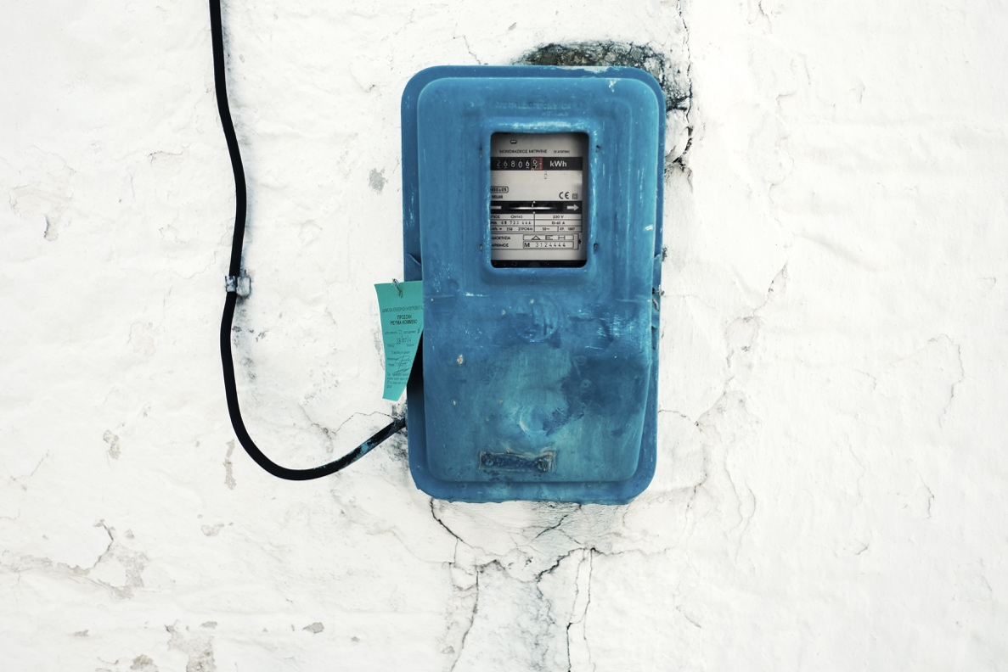

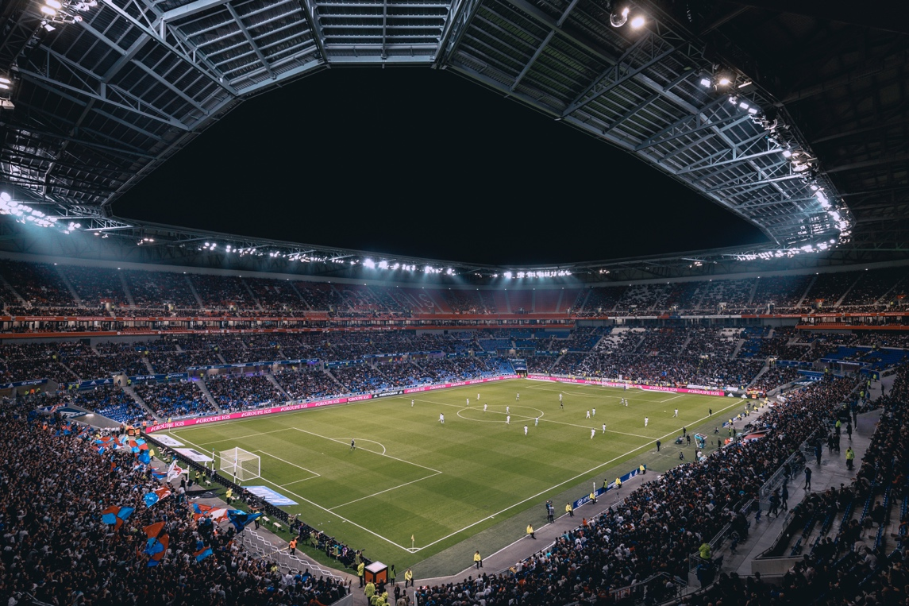
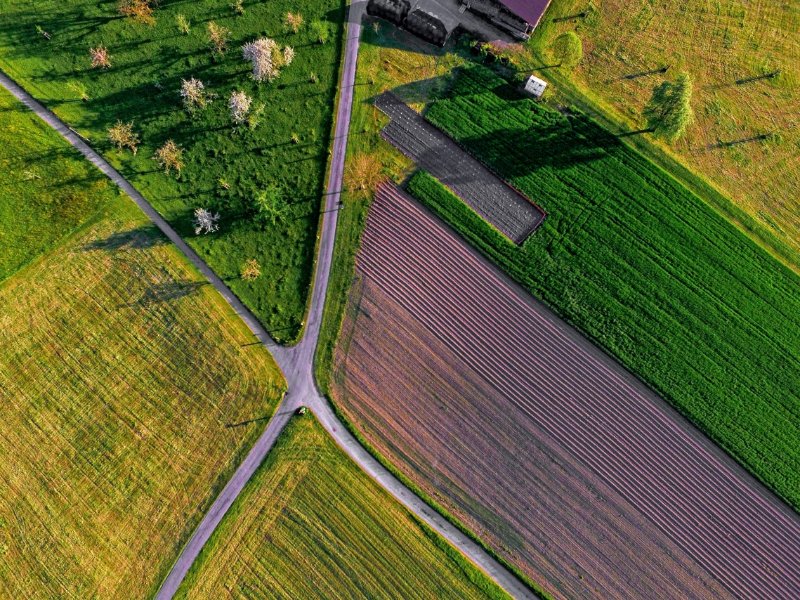
What are likely cellular IoT applications?
single provider
no reliance on local Wi-Fi
but: license-free and regional only
nodes / km²
security cameras
(high BW density)
100% coverage

Slide 17
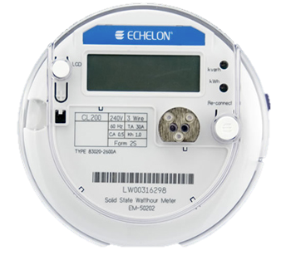
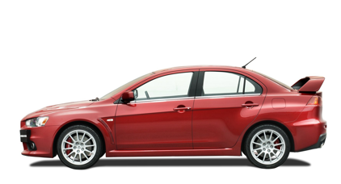

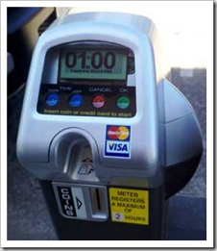
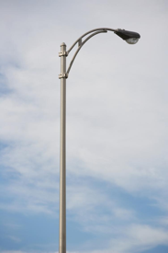
What is the scale of outdoor and distributed applications?
one per household or business (e.g., 136M housing units in US)
31,100 in US
but often connected to city fiber network
268.8M (US) cars, trucks, …
26.5M (44M) in US
$2B energy cost / year
Boston: 64k street lights
but: often connected to fiber (5G!)
5 million (US)
62,000 in NYC
Notes:
http://64.27.51.222/media/overview-of-the-us-parking-industry.aspx parking meters
https://www1.eere.energy.gov/buildings/publications/pdfs/ssl/nlc-streetlight2013_smalley.pdf

Slide 18
What kind of communication networks?
Dominant challenge | Example | solution
Low monthly cost | Residential | Wi-Fi
High bandwidth outdoors | Stadium (spectators, cameras) | 5G mmWave
High bandwidth indoors | University lecture hall | Wi-Fi
Outdoor, but regional | Public transit, metering, traffic signage | NB-IoT, LoRAWAN
Outdoor, on major roads | Connected vehicles | DSRC + LTE?
Outdoor (including marine), 100% coverage, small antenna | Agriculture sensors | Iridium NEXT?
Outdoor (including marine), 100% coverage, antenna size not limited | Agriculture machinery, construction, pipelines, shipping, logistics | LEO satellites?

Slide 20
5G low latency
X
X
X
one-to-many!
X
V2I2V
LAN
EEW
(< 5 s)
protective
relay
tight control loop → near-100% availability in time & space

Slide 21
Challenge for non-carrier IoT networks
Need international and near-universal (road) coverage
  Sigfox: 7 million connections in 20 countries (2017)
    goal: $1/year connectivity
  compete with cellular aggregators
  need to be everywhere before customers interested anywhere
Challenging pricing model
  per month?
  per message (e.g., for lost items & problem reporting)?
Notes:
http://www.lightreading.com/iot/iot-strategies/sigfox-said-to-face-customer-backlash/d/d-id/724292?page_number=3

Slide 22
Example: gas meter using LoRAWAN
→ works well for IoT applications that are inherently regional
(utilities, public transit signage)

Slide 23
Short & long-range IoT networks
Notes:
Bernstein, Sept. 2017
Asian Semis & Semicap & APAC Telecom
The Long View: The Dawn of the IoT Era (Part 2): NB-IoT & Other Wide-area Technologies

Slide 25
Verizon telematics + IoT revenue
VZ: $31.8B revenue (Q118)

Slide 26
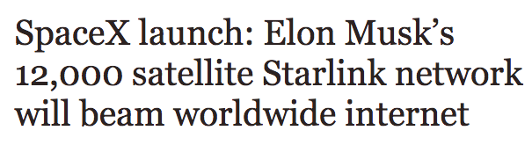
Alternative: satellite communication
NEXT
Iridium
two-way
GlobalStar
GPS fix every 10 minutes
LEO
Notes:
http://www.oneweb.world
https://www.iridiumnext.com/2016/09/22/new-platform-new-possibilities/

Slide 27
(Dubious) economics of fog computing
hyperscale
cloud providers
free
known to OEM
”free”
privacy assurances
save access BW
low latency
save backhaul
low cost (scale, mux.)
well-known interfaces
Paas, SaaS, serverless, bare metal
limited
capacity
limited
capacity
limited capacity
business model?
heterogeneity
programming model?
> 20 ms latency
privacy concerns

Slide 28
Protocols matter, but programmability matters more
Nobody wants to program raw protocols
Most significant network application creation advances:
  1983: socket API → abstract data stream or datagram
  1998: Java network API → mostly names, HTTP, threads
  1998: PHP → network input as script variables
  2005: Ruby on Rails → simplify common patterns
Many fine protocols and frameworks failed the programmer hate test
  e.g., JAIN for VoIP, SOAP for RPC
Most IoT programmers will not be computer scientists

Slide 29


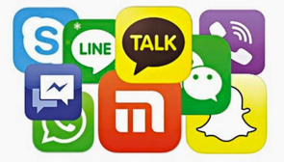

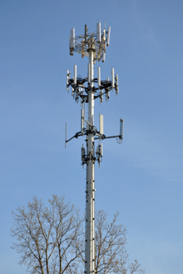
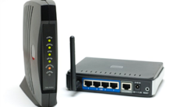
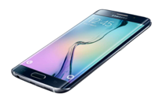

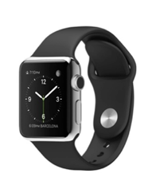
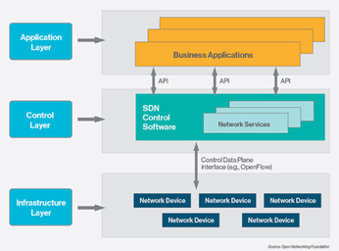


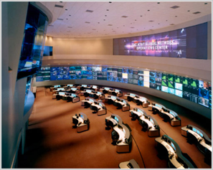


5G – what exactly is a carrier?
Spectrum DB
Spectrum DB
40k towers each (US)
Level3
Cogent
LTE-U
802.11n
LTE

Slide 30
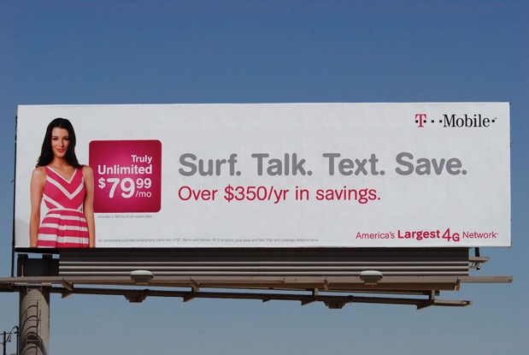
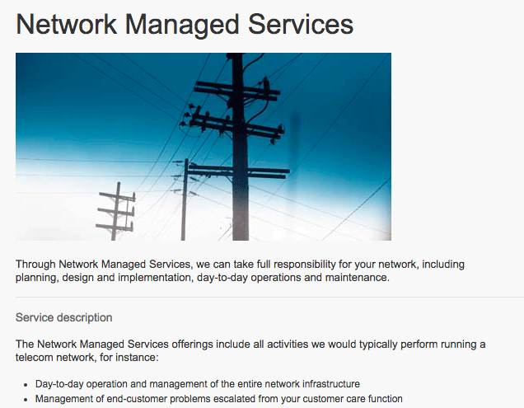
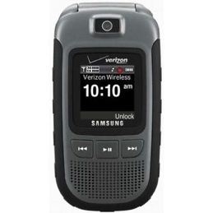
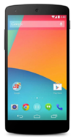
5G: Carriers as consumer brand
Outside
Inside

Slide 31
What are carriers good at?
Research?
Software development?
  Who is going to develop those 5G SDN applications?
OTT applications?
API-based services?
  Why did Twilio and Tropo offer voice service APIs and not the ILECs?

Slide 32
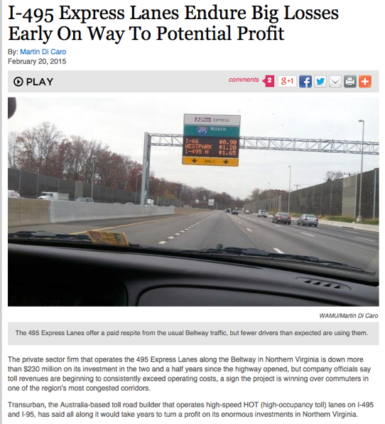
The law of new networks
“Any new network technology will be justified on (finally) providing QoS”
To succeed, they have to provide good-enough QoS for best effort
  at least with competition
The business model for QoS is difficult
  see bypass toll roads
QoS is usually not accessible to applications
  or not end-to-end

Slide 33
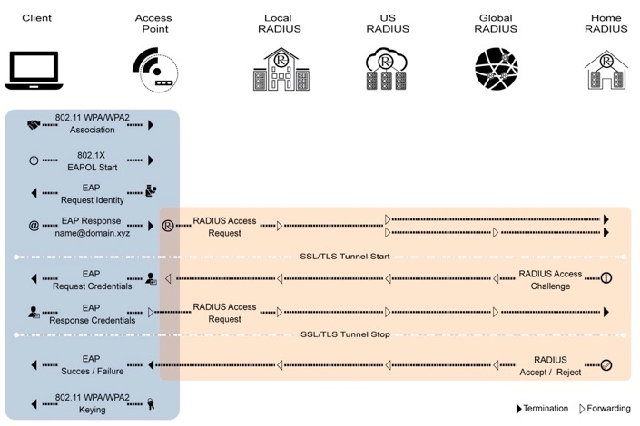

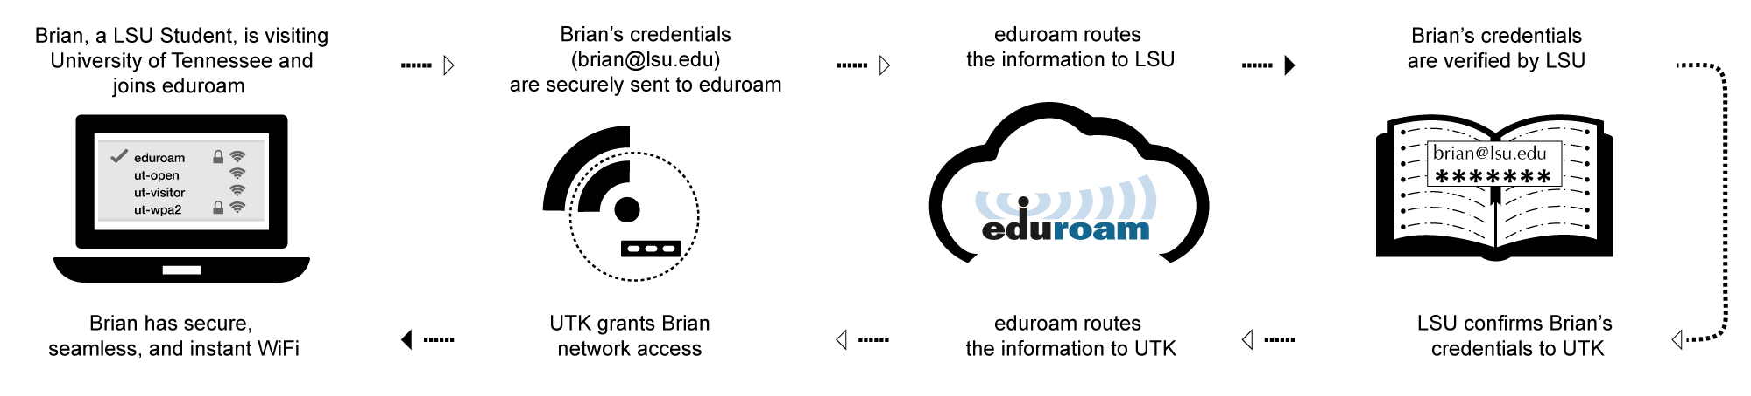
5G & IoT prototype: Eduroam

Slide 34
Conclusions
Treat predictions of market size with extreme caution
  and IoT population ⋙ your favorite network technology share
  you will not get your appendix removed via 5G
Economics challenging for 5G IoT and edge computing
Key challenges:
  fragmentation of eco system (one app per device)
  security and lifecycle
  failure modes – fail safe?

