Slide 1
The economics of networks: The challenges of rural networkification
Henning Schulzrinne

Slide 2
Why is this hard?
What is rural?
How far behind are rural areas?
We electrified rural America in the 1930s!
What are the options and trade-offs?
Adoption, not just construction

Slide 3
What is rural?
Census:
  Urban = Urbanized Areas (UAs) of 50,000 or more people
    OR Urban Clusters (UCs) of 2,500 to 50,000 people.
    core of population density of 1000 people/mi²
      all of NJ: 1210 / mi²
  Rural = everywhere else
OMB:
  Metropolitan Statistical Areas (MSAs): >= one urbanized area of >= 50,000 population, plus adjacent territory that has a high degree of social and economic integration with the core as measured by commuting ties.
  Micropolitan Statistical Areas: >= one urban cluster of at least 10,000 but less than 50,000 population, plus adjacent territory that has a high degree of social and economic integration.
USDA
  based on counties

Slide 4
Rural areas (USDA)
Notes:
https://www.ers.usda.gov/topics/rural-economy-population/rural-classifications/what-is-rural.aspx

Slide 5
Broadband access by speed & geography
15% of US population

Slide 6
Rural broadband US
Notes:
https://fivethirtyeight.com/features/the-worst-internet-in-america/

Slide 7
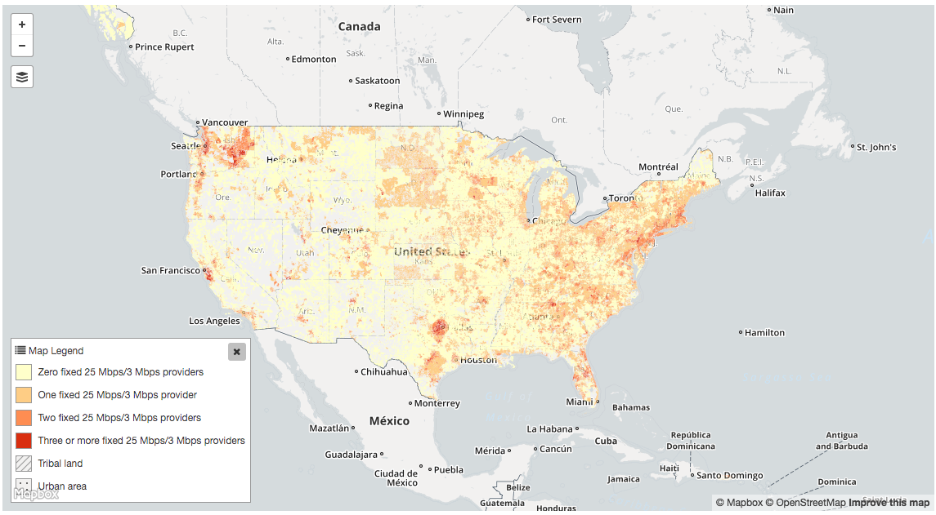
Number of 25/3 Mb/s providers

Slide 8
Aside: urban areas, too
Chicago metro area
Notes:
https://www.brookings.edu/research/signs-of-digital-distress-mapping-broadband-availability/

Slide 9
Rural electrification
Early 1920s, between 2 and 3% (likely less)
  1921: DC had 98.2%, MA 97.8%
“In 1935, only 10.9% of American farms (744,000) enjoyed central station power, compared with Germany and Japan at 90%, France between 90 and 95%, and New Zealand at 60%.”
“In 1940, just four and a half years after Roosevelt signed Executive Order No. 7037 (followed by 1936 ”Rural Electrification Act”), 25% of American farms had been electrified.”
1950: 90% had been electrified nationally
Today: 850 distribution coops serving 14 M homes
Notes:
http://remagazine.coop/flashbacks-rural-electrification-cartogram-numbers/

Slide 10
Rural electrification
“In 1935, Morris Llewellyn Cooke, a mechanical engineer who had devised efficient rural distribution systems for power companies in New York and Pennsylvania, had written a report that detailed a plan for electrifying the nation's rural regions. Appointed by Roosevelt as the REA's first administrator, Cooke applied an engineer's approach to the problem, instituting what was known at the time as "scientific management"—essentially systems engineering. Rural electrification became one of the most successful government programs ever enacted. Within 2 years it helped bring electricity to some 1.5 million farms through 350 rural cooperatives in 45 of the 48 states. By 1939 the cost of a mile of rural line had dropped from $2,000 to $600. Almost half of all farms were wired by 1942 and virtually all of them by the 1950s.”
Cost of aerial fiber installation: $14k/mile material, $39k/mile installation ^{(Singer, 2017)}
$10,958 in 2017
Notes:
“Assessing the Impact of Removing Regulatory Barriers on Next Generation Wireless and Wireline Broadband Infrastructure Investment”, 2017
http://www.greatachievements.org/?id=2990 (rural electric)

Slide 11
Accidental broadband
94.2% of US
households have
phone service
G.992.2
ADSL
DSL patents
1988-1991
1993
1999
62.1 million US
households have
cable TV
“peak CATV”:
82% of HH
DOCSIS 3.1
(10G/1G)
DOCSIS 1.0
(40M/1M)
1995
1997
2008
2016
Notes:
file:///Users/hgs/Downloads/1997_Mar_Trends.pdf

Slide 12
Trade-offs across the world?
If new deployment, predicted return on investment
  with unbundling: what is the wholesale price going to be?
  no magic algorithm --- margin squeeze
Allow infrastructure owner to provide services?
Impact on consumer surplus
US: pole attachment problems
  if incumbents are pole owners

Slide 13
Policy levers for rural broadband
Decrease cost of serving
  “dig once” – bury conduit or fiber during street (or other utility) repair & construction
  pole attachment: make-ready, rates, shot clocks, …
Provide funding
  US: Universal Service Fund
microtrenching

Slide 14
Challenges for rural broadband
Who is going to build out?
  some incumbent local exchange carriers (ILECs) are not interested
  municipalities may be prohibited by state laws
    or hurdle is extremely high
  rural electric cooperatives – serve 14M homes in US (out of ~110M)
    average, 5.8 electric meters per mile
Who is going to pay for broadband?
  government support: pay once (build out) or pay forever?
  pay for middle mile or last mile or subsidize use?
Are non-landline approaches scalable?
  TV whitespaces
  satellite – NGS like OneWeb (600 satellites)
    currently, about 500k residential satellite subscribers

Slide 15
Rural wireline ILECs lack resources
Wireline share of voice revenue:
2005: 79%
2015: 15%
Notes:
Deloitte

Slide 16

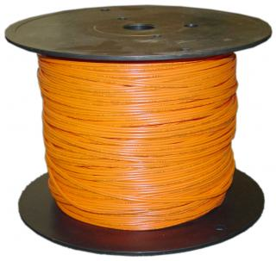
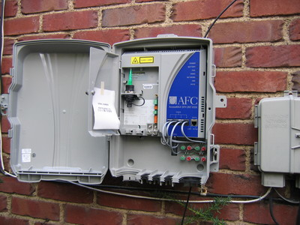
Network economics, (over)simplified
70%
30%
traditional: 12-15 staff/10k customers
Iliad, FR: 3-4 staff/10k
Notes:
opex ratios: Deloitte

Slide 17
Density determines network choices
cable
satellite
REC
DSL (common)
FTTH
WISP
HH/road mile
1454
1
7
10
20
50
100
1000
Alaska roadmiles
Notes:
Manhattan: 508 road miles - http://venus.fcny.org/cmgp/streets/pages/2001PDF/Report/DFMN.pdf ; Wikipedia: 738,644 households in Manhattan
Alaska: 15,178 miles; 741,894 population

Slide 18
Rural deployment options
Technology | Capacity in rural areas (typical) | Advantage | Disadvantage
DSL | < 5 Mb/s | mostly deployed | speed increase requires active components deep in network
4G LTE | ~ 5 Mb/s | existing deployment, MF II | limited capacity (current avg.: 2.1 GB/month)
5G (3.5 GHz, not mmWave) | depends on deployment model | saves fiber drop | spectrum OpEx
satellite (current geo) | 12 Mb/s nominal | no incremental deployment cost | expensive, capacity-limited, latency
HFC (“cable”) | 25-100 Mb/s | low upgrade cost to 1 Gb/s+ | 85% of households
FTTH & FTTC | 100 Mb/s – 1 Gb/s | 20 year life time passive outside plant | cost to deploy

Slide 19
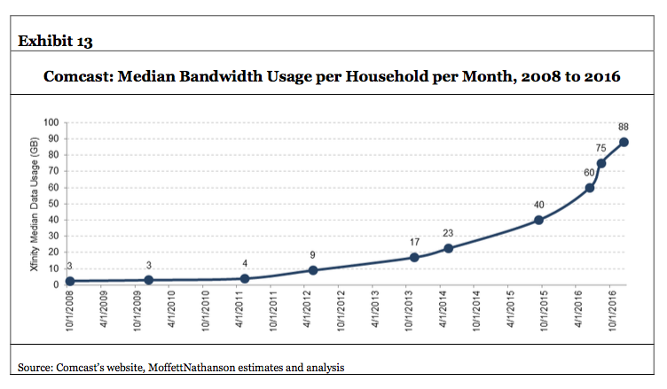
Problem likely capacity, not speed
June 2017: 100 GB

Slide 20
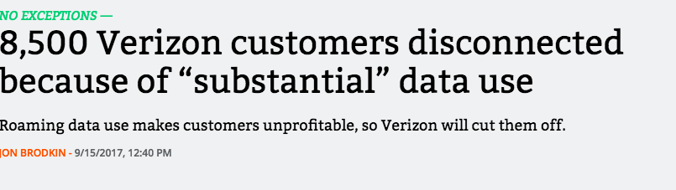
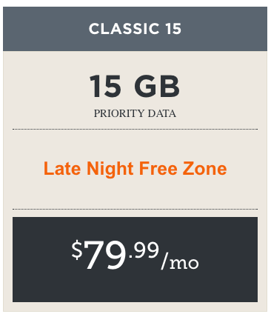
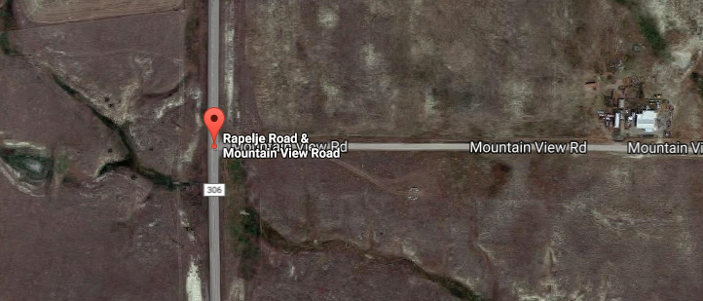
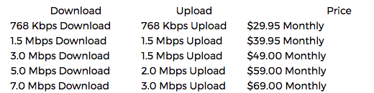
Rural options may be restricted
Big Timber, MT

Slide 21
Broadband adoption
Used to be simple binary: “are you on the Internet?”
Now:
  low-speed landline Internet
  mobile Internet
  high-speed Internet
What capabilities matter?
  Facebook and Whatsapp access?
  ability to fill out job form? → mobile apps
  content creation → tethering ok?

Slide 22
Reason for non-adoption
partially
technology
= economics
& policy

Slide 23
Conclusions
We managed to electrify rural farms in a decade, but have been working on broadband for two already
We have not made much progress in getting networks deployed cheaper and faster
  and operate them more efficiently
  consider these as broader-impact research opportunities…
Adoption is probably harder than for electricity
Many of the problems are incentive or non-incentive problems
  we know how to solve them, but levers are missing
  or are politically not feasible
  or some actors have an active interest in things not happening

Slide 24
Lower population density, easier broadband
32.45/km²
2.91/km²
3.49/km²
Deloitte, 2017

Slide 25
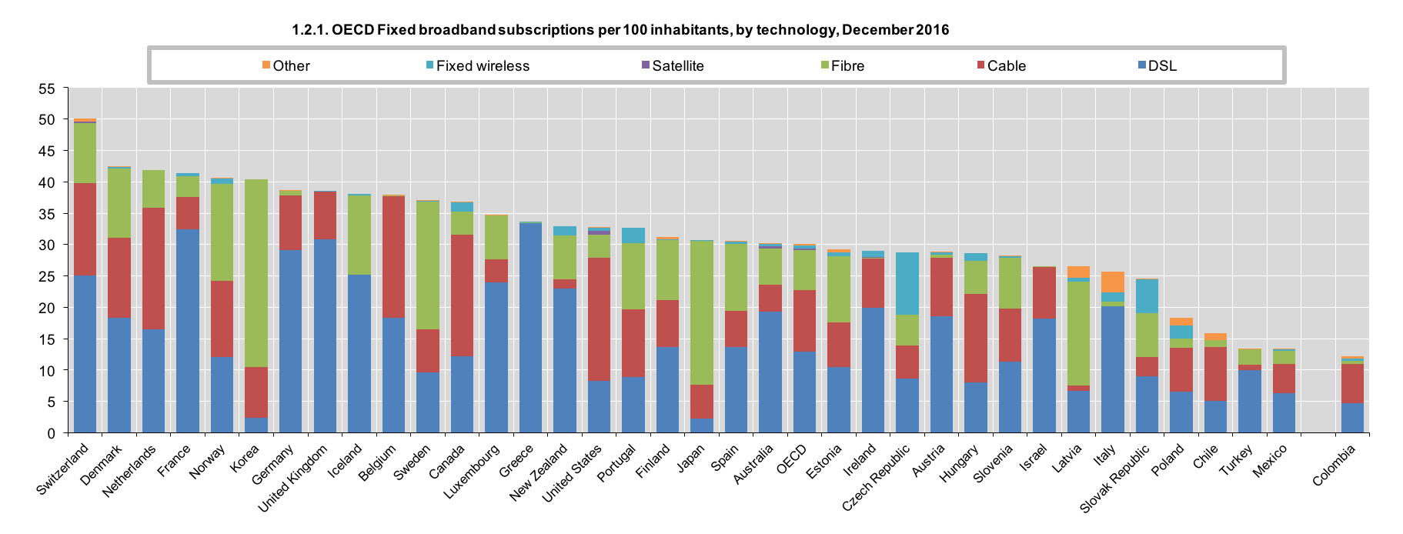
OECD overview

Slide 26
Metrics: not Gb/s or b/s/Hz, but $/GB and $/year
Consumer market: $/GB delivered
  little willingness to pay for speed above 10 Mb/s for now
  unless $/GB → 0, 1 Gb/s just threatens wallet
NB-IoT: $/device + $/year cost
  compete with $0 incremental cost BT/Zigbee/WiFi or LPWAN
  include amortized
  typically, << $1/month
  predictable coverage & international reach
  alternative for one-way: ATSC 3.0 (50+ miles reach, no incremental cost)

Slide 27
Sharing models: US
sharing (incumbent + new entrant) vs. neutral third party
+ WISP & satellite
DSL
(ILEC)
fiber
(ILEC, CATV, overbuilder)
HFC
PHY (LTE)
spectrum
ducts & poles
(electric utilities or ILEC)
towers

Slide 28
Sharing models: Canada, Europe, Australia
usually
unbundled
unbundling
varies
mostly not unbundled
DSL
fiber
HFC
PHY (LTE)
spectrum
ducts & poles
(electric utilities or ILEC)
towers
Notes:
http://dx.doi.org/10.1787/20716826
http://www.oecd.org/sti/broadband/2-7.pdf

Slide 29
Barriers to Internet adoption

Slide 30
Internet usage by income
Computer and Internet Use in the United States: 2013
American Community Survey Reports

