Slide 1
5G: Enabled by technology, with Public Policy Assist
Henning Schulzrinne
The views and opinions expressed in this presentation are those of the author and do not necessarily reflect the official policy or position of any agency of the U.S. government. Any resemblance to actual policies, living or dead, or actual events is purely coincidental.

Slide 2
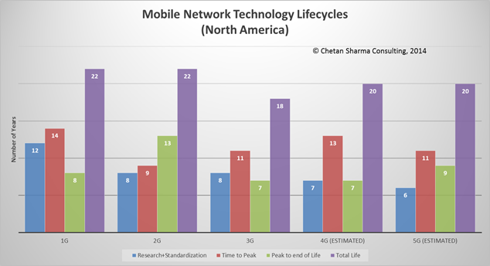
Design for 20 years

Slide 3
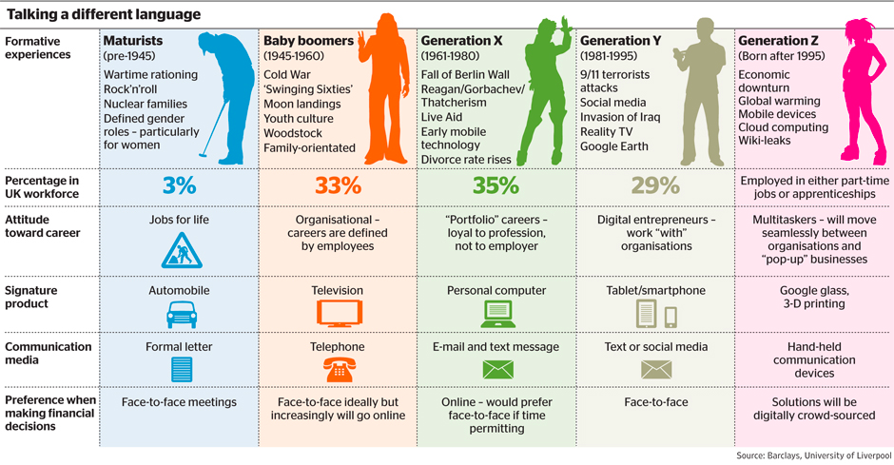
Generations are distinct
land
line
2G
3G
4G

Slide 4
Generations overlap
2G
3G
4G
4.5G
5G
Notes:
http://about.att.com/story/5g_evolution_to_over_20_metros_in_2017.html

Slide 5
Generational surprises
Generation | Expectation | Surprise
2G | better voice quality (“digital!”) | SMS
3G | WAP | web
4G | IMS | YouTube, WhatsApp, notifications
5G | IoT (low latency) | ?
underestimated cost and fixed-equivalence as drivers

Slide 6
Lessons, in brief
Experience | Lessons
VoLTE, IMS | avoid complexity avoid entanglement plan intercarrier interfaces
Wi-Fi | don’t trust the RAN/AP
disaggregation of functions | clear & simple interfaces don’t assume trust between elements
app stores | keep it application-neutral
FTTH, backhaul cost | re-use backhaul where you can find it

Slide 7
5G is a systems standard
2G → 3G → 4G → 5G ➔ increasing number of technology components
Technology component | Proposed application | Less exciting, but likely
mmWave | 10 Gb/s user rates | capacity in stadiums fixed wireless?
edge computing | IoT | video caching
M2M | billions & billions of devices! autonomous vehicles! | electric meters
1 ms latency | autonomous vehicles! | keep it application-neutral
slicing | QoS | test networks, VPNs

Slide 8
Changing spectrum environment
Except at highest frequencies, all new spectrum likely to be shared
  e.g., 3.5 GHz
  in time & space
→ need frequency-agile systems that can shift capacity to different bands, quickly
→ few common bands for consulting spectrum database
  now: scan, pray & wait
  5G: shared band → database

Slide 9
Spectrum sharing
How much politeness & fairness is required?
→ LTE-U & LTE-LAA (license-assisted, listen-before-talk)
Notes:
“Priority-Based Classification of Spectrum Access Models”, August 2013

Slide 10
Ideal spectrum
Unused or cheap
Available globally (→ important for consumer goods & market size)
  preferably under similar licensing conditions
No noisy or sensitive neighbors
Propagates indoors through walls and glass
Not affected by rain or leaves outdoors
Wide bands (≥ 5 MHz, preferably 20 MHz+)
Is paired (uplink & downlink)
Can be processed with cheap electronics (Si, not GaAs)
Allows small antennas🦄🦄

Slide 11
Spectrum management
Until the 2000s
“Modern”
Single purpose
Fixed technology (modulation)
Exclusive use
Narrow bands (except TV)
Assume single radio per device
Worry mostly about OOB to like
Spectral efficiency secondary
Single-country
Flexible use
Flexible technology
Shared, over/underlay
At least 5 MHz, preferably 100
Multiple (> 4) XTR/RCV
Receiver requirements?
Spectral efficiency matters
International coordination

Slide 12
Challenges for spectrum sharing
Unlicensed ~2000
Unlicensed now
Unlicensed emerging
indoor home
indoor enterprise
campus
--> natural separation
secondary public SSID
re-use HFC/FTTH backhaul
LTE-U, LAA
what are the “kindergarten” rules?
only power rules (no listen-before-talk (CS) required)
e.g., CableWiFi
One band, one channel

Slide 13
Spectrum co-existence
vs.
“high tower, high power”
(TV, cellular downlink, radar transmitter)
cellular uplink
radar receiver
GPS receiver

Slide 14
Spectrum roles
400 – 800 MHz
1 – 3 GHz
3-6 GHz
> 10 GHz
base-level coverage
(particularly rural)
urban capacity
indoor & capacity
directional
capacity
Digital dividend
TV incentive auction
AWS-3
3.5 GHz
mmWave R&O

Slide 15
The filter problem
guard band
(wasted)
filter
(input or output)
licensed band
user 1
licensed band
user 2
Power imbalance:
cell downlink: 100 W ERP
cell uplink: 0.05 – 2 W
Notes:
http://oem.bmj.com/content/61/9/769/T2.expansion.html

Slide 16
TV incentive auction
go off-air (6 MHz)
multiplex (share)
VHF
descending clock auction
→ reduce until clearing target met
TV station participated & got bid?
April 2017 ✅
initial
clearing goal
reverse
auction
(TV stations)
forward
auction
(carriers)
144 MHz
(May 2016)
forward bids
insufficient →
reduce clearing goal
repack
(39 months)
next step

Slide 17
600 MHz incentive auction
FirstNet
spectrum
5 MHz downlink blocks
5 MHz uplink blocks
radio astronomy, medical monitoring

Slide 18
Incentive auction facts

Slide 19
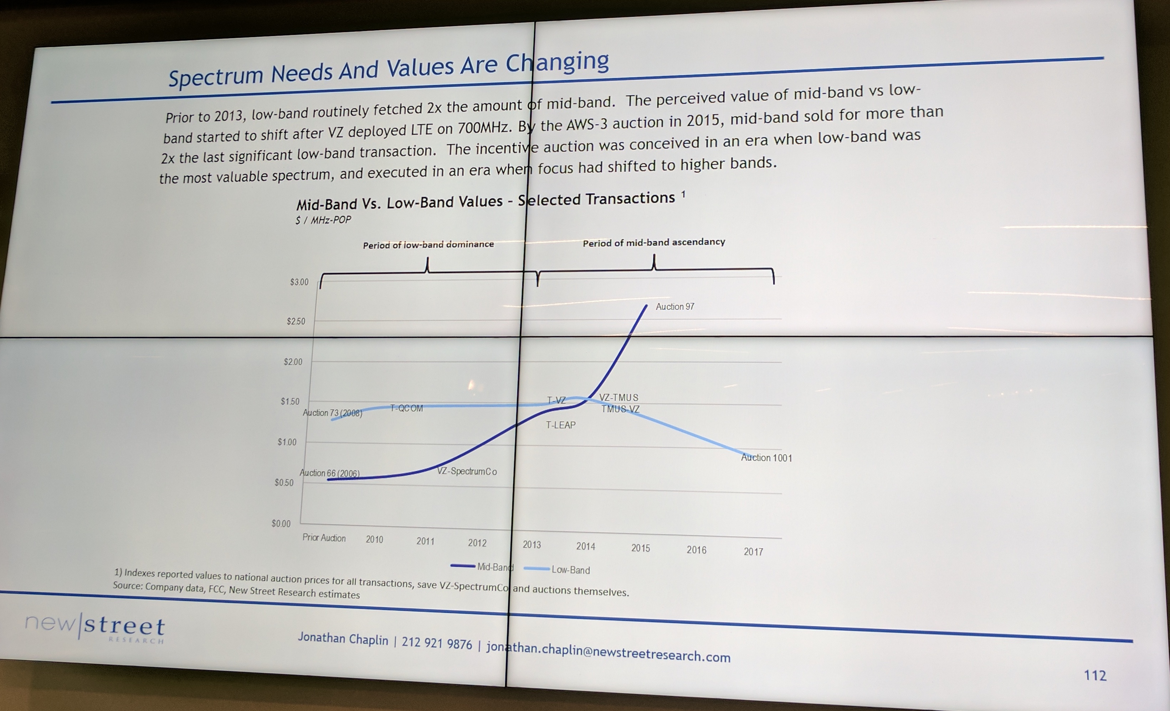
https://law.duke.edu/innovationpolicy/spectrum-incentive-auction/
Notes:
https://law.duke.edu/innovationpolicy/spectrum-incentive-auction/

Slide 20
Forward auction: T-Mobile & others
$8B
$6.2B
486 licenses
$1.7B
145M POPS
$1B
18 PEAs
(has 700 MHz spectrum)
FirstNet spectrum
Notes:
http://www.fiercewireless.com/wireless/mapping-t-mobile-dish-comcast-and-at-t-who-got-how-much-600-mhz-spectrum-and-where

Slide 21
TV white spaces (US)
First large-scale spectrum database
But limited use in the US
  number of channels
  power levels
  equipment
  available mostly in rural areas, not urban
  change after incentive auction
Leonia, NJ
Amherst, MA

Slide 22
3.5 GHz band
FSS: C Band (3.625–4.200)

Slide 24
3.5 GHz user classes
must not interfere
1
Federal users
Fixed satellite users (FCC)
census tract
≤ 70 MHz
3-year licenses
assigned via SAS
2
Priority licenses (PAL)
10 MHz channels in 3550-3650
3
General authorized use (GAL)
ESC (environmental sensing capability) allows commercial use in coastal and Great Lakes region

Slide 25
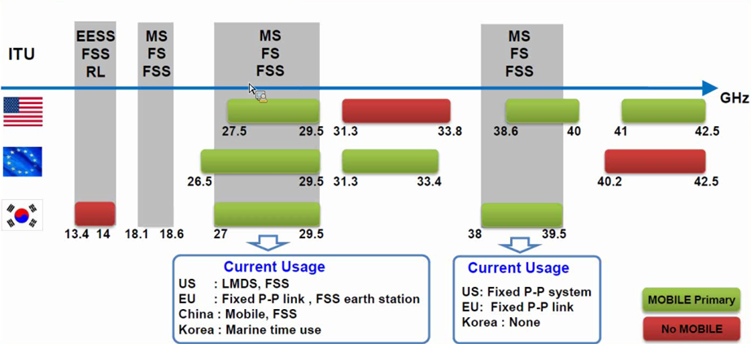
30-40 GHz mmW overview
Source : Samsung Communications Research Team
Note: The Commission’s Fixed Microwave (Part 101) and Satellite Communications (Part 25) service rules govern most of US mobile allocations shown above
25

Slide 26
MMW: Spectrum Frontiers R&O
Core Principles
  Identify substantial spectrum in MMW bands for new services
  Protect incumbent services against interference
  Flexible use: enable market to determine highest valued use
  Overlay auctions where no existing assignments
  Provide spectrum for both licensed and unlicensed use
R&O – 10.85 GHz added for mobile service (July 2016)
  Licensed bands (3.85 GHz): 27.5-28.35 GHz; 37-38.6 GHz; 38.6-40 GHz
  Unlicensed bands (7 GHz): 64-71 GHz
FNPRM – seeks comment on another 18 GHz & above 95 GHz
  24.25-24.45 GHz; 24.75-25.25 GHz; 31.8-33.4 GHz; 42-42.5 GHz; 47.2-50.2 GHz; 50.4-52.6 GHz; 71-76 GHz; 81-86 GHz; bands above 95 GHz
Licensing, operating and regulatory rules
  Part 30: Upper Microwave Flexible Use Service (UMFUS)
  Geographic area licensing, area size, band plan, license term

Slide 27
Conclusions
5G is no one thing
  and some of the “things” may be secondary
  but reducing the cost per
New spectrum is one key differentiator for 5G
New bands may take 10+ years: policy negotiation + clearing/sharing + deployment
Each band has unique challenges, but some tools emerging
  reverse auctions for clearing
  spectrum databases, enabled by multiple radios and GPS

