Slide 1
New Frontiers in Multimedia Communications
Henning Schulzrinne
columbia University

Slide 2
How can we push beyond 2001?
Phone numbers forever – or what should the communication identifier be?
Interoperable messaging – can we get back from the silo?
Interoperable real-time communication – VRS shows the way
What role can SIP play in the Internet of Things?
Mostly questions rather than answers

Slide 3
Open Internet vision
HTTP
closed source
open source

Slide 4
Protocol installation, ca. 2000

Slide 5
J. Rosenberg
IETF plenary 3/2011

Slide 6
2016 reality (1)
rapid app switching
seamless download
proprietary
HTTP(S)
HTTP GET/POST API
HTTP(S)
external
program
See (e.g.,) draft-tschofenig-post-standardization (2012)

Slide 7
2016 reality (2)
proprietary
HTTP(S)
SDP

Slide 8

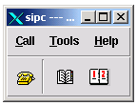
2001
sipc

Slide 9
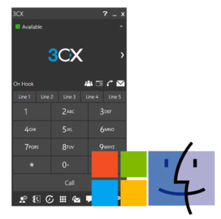
2016

Slide 10
But we leave users with two choices
OR
same service as in 1950!
same service as in 1985!

Slide 11
Interoperable identifiers
Henning Schulzrinne

Slide 12
Communication identifiers
Property | URL owned | URL provider | E.164 phone number | Service-specific
Example | alice@smith.name sip:alice@smith.name | alice@gmail.com sip:alice@ilec.com | +1 202 555 1010 | www.facebook.com/alice.example
Protocol-independent | no | no | yes | yes
Multimedia | yes | yes | maybe (VRS) | maybe
Portable | yes | no | somewhat | no
Groups | yes | yes | bridge number | not generally
Trademark issues | yes | unlikely | unlikely | possible
Privacy | Depends on name chosen (pseudonym) | Depends on naming scheme | mostly | Depends on provider “real name” policy
Notes:
http://findmyfacebookid.com

Slide 13

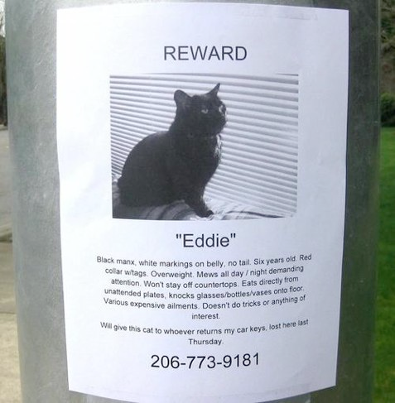
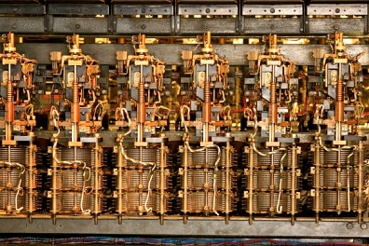
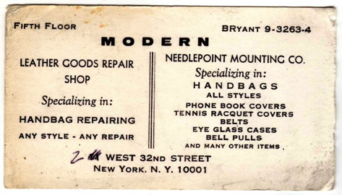
Phone number evolution

Slide 14
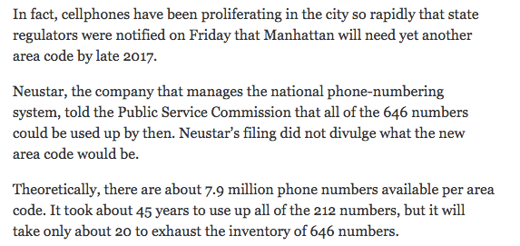
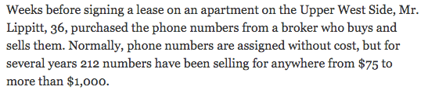
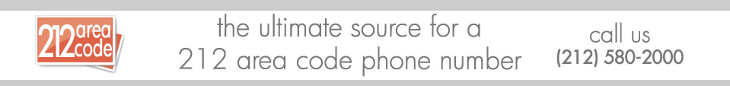
Phone numbers are valuable
NY Times, March 25, 2015
Notes:
http://www.nytimes.com/2015/03/25/nyregion/as-manhattan-area-codes-multiply-some-still-covet-a-212.html

Slide 15
Numbers vs. DNS & IP addresses
 | Phone # | DNS | IP address
Role | identifier + locator | identifier | locator (+ identifier)
Country-specific | mostly | optional | no
# of devices / name | 1 (except Google Voice) | any | 1 (interface)
# names /device | 1 for mobile | any | any
controlled by | carrier, but portability unclear (800#) and geo. limited | any entity, with trademark restrictions | any entity (ISP, organization)
who can obtain? | geographically-constrained, currently carrier only | varies (e.g., .edu & .mil, vs. .de) | enterprise, carrier
porting | complex, often manual; wireless-to-wireline may not work | about one hour (DNS cache) | if entity has been assigned PIAs
delegation | companies (number range) | anybody | subnets
identity information | carrier (OCN), billing name only → LERG, LIDB | WHOIS data (unverified) | RPKI, whois
Notes:
http://www.nanpa.com/reports/faq.html#g1

Slide 16
All problems in computer science can be solved by another level of indirection, except of course for the problem of too many indirections. (David Wheeler)

Slide 17
Humans vs. machines
 | Human-visible | Machine-usable
Scope | local (“Mom”) | global
Persistence | temporary (“dentist”, “babysitter”) | often long-lived
Length | short (4-10?) | embeddable (< 200?)
many identifiers serve as both – but UI can hide details

Slide 18
Communication modalities
Car
Insurance company
unpredictable
< 1/year
Professional
Colleagues & casual friends
Close family & friends
> 1/week
“I have a refrigerator magnet”
“I know her email, but need to call her”
“Alice and I always use Skype to chat.”
not all communication identifiers are persistent

Slide 19
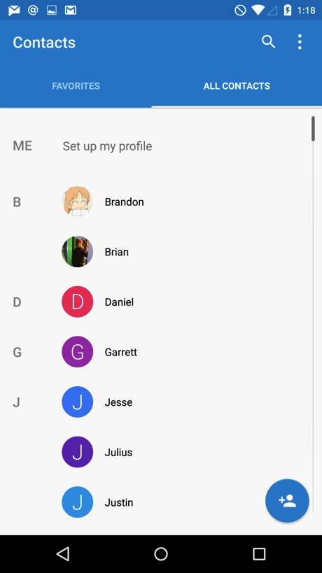
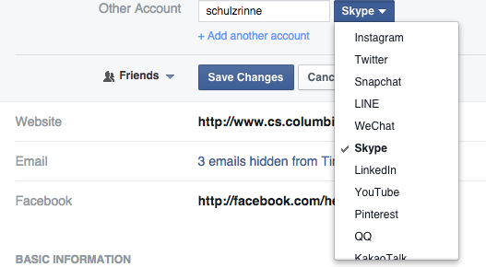

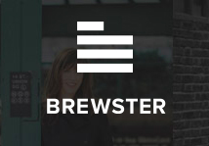

Identity options
Universal communication app
  Winner take all (WeChat…)
Directory intermediation?
  But no universal query protocol
  or update mechanism (tool publishes into address book)

Slide 20
Identifiers have social conventions
Identifier = access permission
  phone number, email address, …
Identifier = “pairing” permission
  Skype: ask for permission
Mutuality
  only mutual Twitter followers can direct message each other

Slide 21
Identifiers have social conventions
A WhatsApp identifier is the phone number, but the expectation is that it will be used for messaging only, not calls.
Pre-mobile days: friends only got your home number, colleagues only got your work number
  and friends or colleagues wouldn’t use the other
Asking a person you met in a bar for their phone number has deep social connotations
PO boxes and UPS “suites” provide semi-anonymity

Slide 22
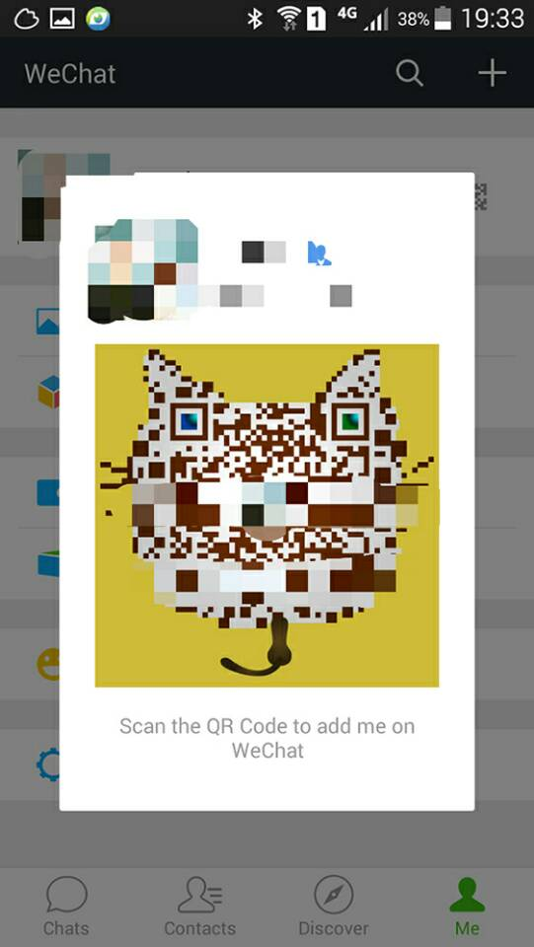
Example: WeChat QR code introduction & NFC
→ human readability doesn’t matter
Notes:
http://chinachannel.co/wechat-qr-codes-wechat-essential-tips/

Slide 23
Special-purpose identifiers
hgs+rfctopic@cs.columbia.edu identifiers spam scrape sources
“burner” phone numbers
one-time use email addresses
forward-only email (somebody@ieee.org, braggard@alum.mit.edu)

Slide 24
Impostors – fake identities

Slide 25
Security ≅ identity assertion
Need to be able to assert possession of identifiers
Kind of works for…
  phone/SMS: provide code
  email: clickable link
  domain name: modify DNS entry (for TLS certs)
  SIP URL: provide code?
But third parties can’t validate this automatically
  → need certs for these identifiers (see: STIR for phone numbers)

Slide 26
Identifiers in transition
Likely
  in some countries, single app (KakaoTalk in South Korea, LINE in Japan, ...)
  with phone number as back-up
Opportunities for new approaches to identification for real-time use
  secured → properties
  user friendly
  special use (e.g., one-time, traceable)

Slide 27
Interoperable team collaboration

Slide 28
Goals (often unstated)
Support unstructured collaboration in (small-ish) groups of people
Work teams (long-term or ad-hoc), projects (customer team + sales + engineering)
Standards bodies, university classes, community organizations
Often ad-hoc assembly of email, emailing documents, Google Drive/Dropbox, Doodle, … + dial-in conference calls
Groups created by cc lists (“chain” in FCC parlance...)
only
or
?

Slide 29
Three origins

Slide 30
From PBX…

Slide 31
to unified communications
call-focused
independent events
  user-managed history and state
weak team & project notion

Slide 32
From Outlook & webmail…
1996

Slide 33
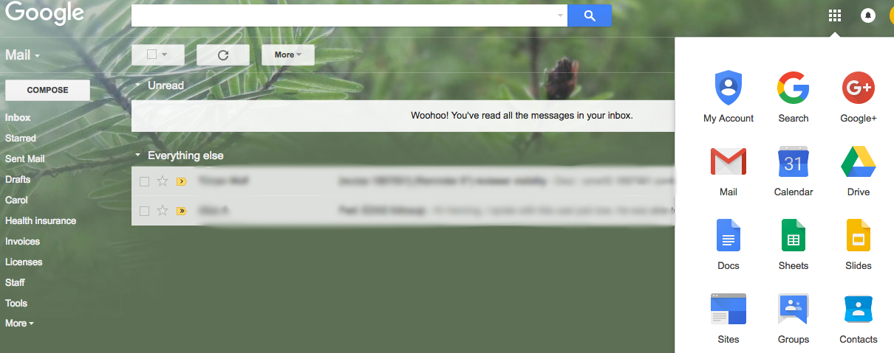
“Outlook on the web”
email-focused
email folders (~projects)
loose integration → flexible tools
internal ≈ external
weak or no team concept
weak real-time communication

Slide 34
From IRC…
1988

Slide 35
You will be assimilated
channels (teams, rooms, …)
timeline central
short, rapid messages
no file system integration
email as the enemy
must join to participate
  → winner take all
mainly text
video external (BlueJeans)
text + video conferencing

Slide 36
And everyone wants you in their garden

Slide 37
Bots

Slide 38
Can we dream (and build)?
Interoperable using existing open standards (mostly) → SIP, RTP or maybe HTTP layer?
  modularity could be improved
web client + standards-based clients
no new accounts necessary → use phone number or email address
internal users same as external
file system integration: Dropbox, Google Drive, OneDrive, photo albums, …
some people (still) like email → treat as first-class citizen
  including setting up real email groups (digest, …)
bots act like regular users (messaging)
support open calendaring

Slide 39

Federated model
group
manager
files
other domain,
similar setup
SIP, SMTP, HTTP, …
calendar
mail
lists
cloud-hosted or local

Slide 40
Interoperable video calls

Slide 41
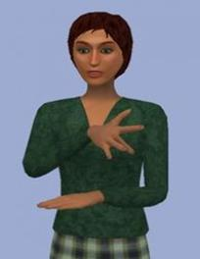
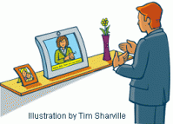
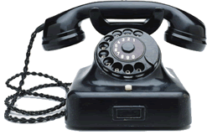
Video relay service (VRS)
Serves about 200k people who use sign language
Uses regular +1 NANP phone numbers – portable between providers
Probably largest interoperable, standards-based multimedia service
CAs
access platform
now: SIP, H.323
soon: SIP + legacy H.323

Slide 42
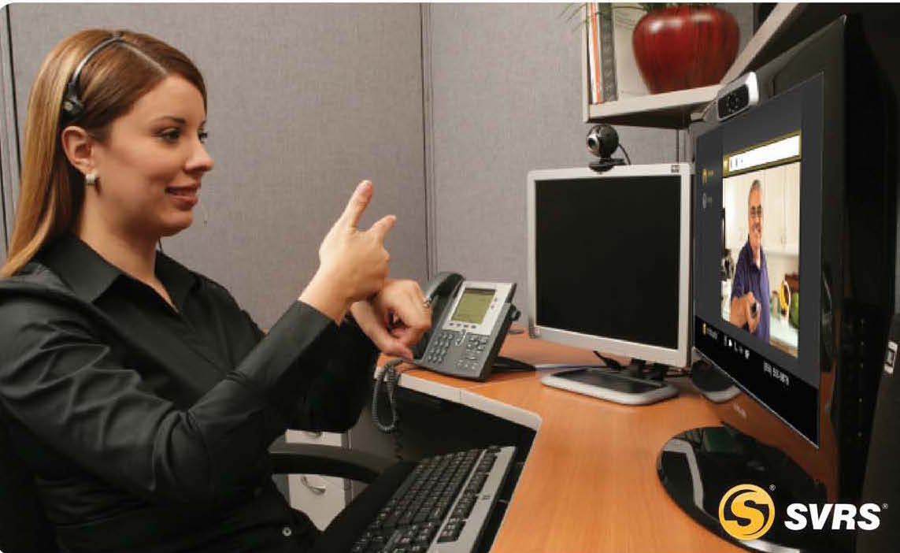


VRS architecture (SIP-based)
202 555 1111
SIPForum VRS spec
(near production)
provider A
provider B
+ location
ENUM
RUE spec
(in progress)
direct ASL calls
to gov’t, large companies
201 555 1234

Slide 43
Telecommunication relay program

Slide 44
ACE initiative

Slide 45
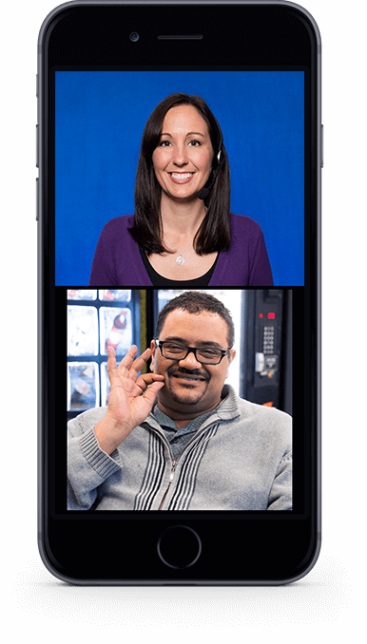
VRS client examples (not all SIP – yet)

Slide 47
Interoperable Internet of Things

Slide 48
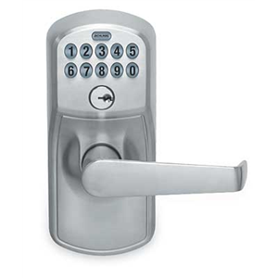
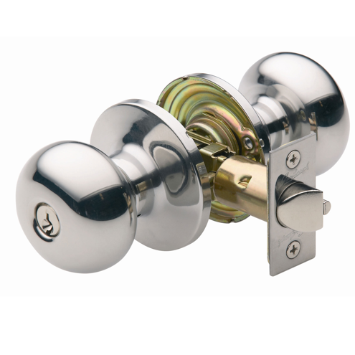
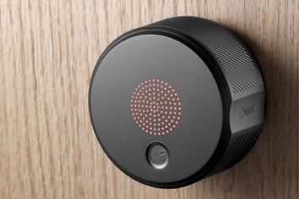
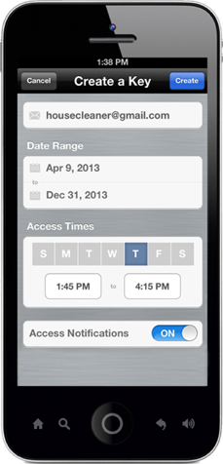
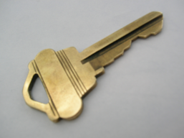
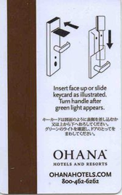
Natural evolution

Slide 49
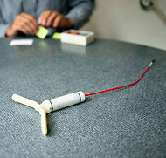
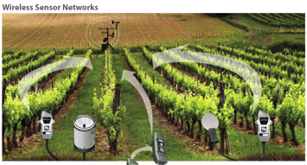
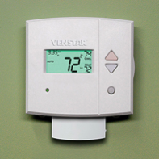
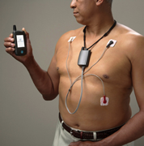
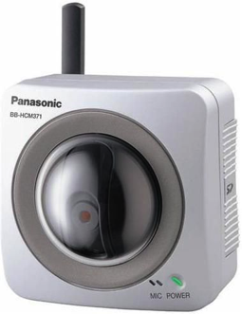
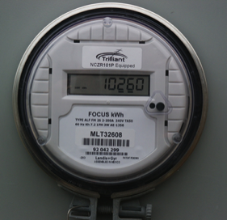
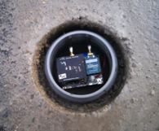

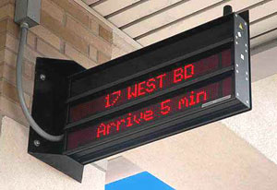
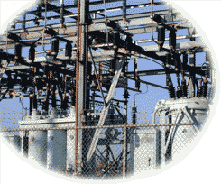
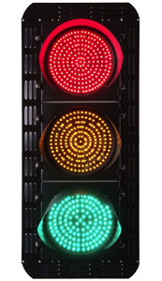
IoT varies in communication needs
sensors
← notifications
streaming →
CPS
1/hour
1/minute
1/second
10/second
actuators
Notes:
http://www.nytimes.com/2012/10/02/world/europe/device-sends-message-to-swiss-farmer-when-cow-is-in-heat.html?pagewanted=all

Slide 50
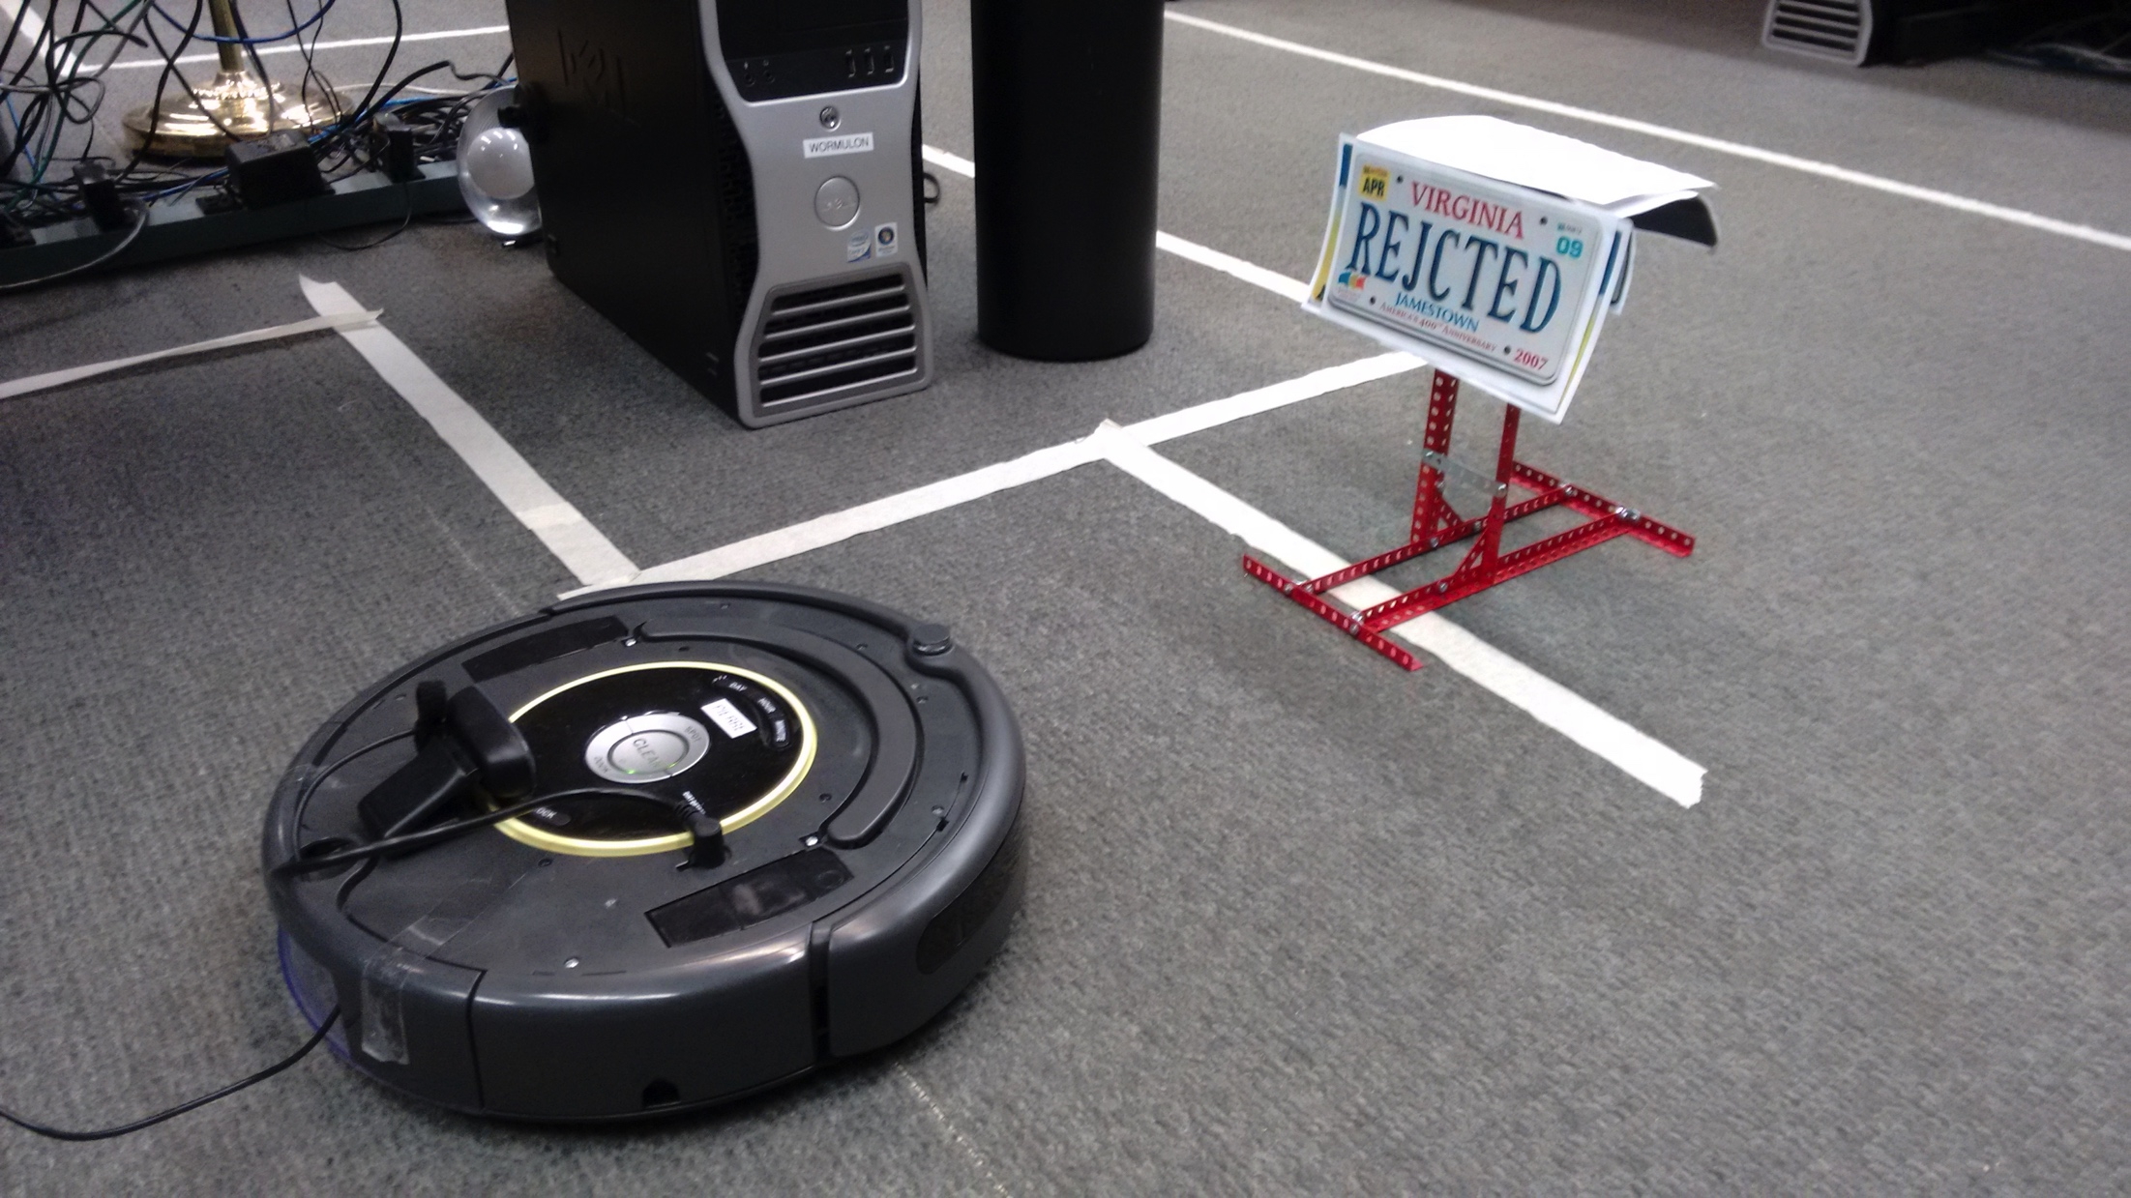
Internet of Things – 3 main modes
Send commands to abstract “things”
  with changing network attachment point
Get notifications when something interesting happens (“temperature too high”, “no more LeCroix water in vending machine”)
  how would MQTT compare?
Send streams of data
  obviously, video (and audio): security, mainly
  but also industrial sensors (process control)

Slide 51
How should we name things?
network interface
device
(independent of network)
device by function & location
EUI-64
domain name? → portability?
phone number?
“ceiling lamp in kitchen”
(used in programs)
IPv6

Slide 52



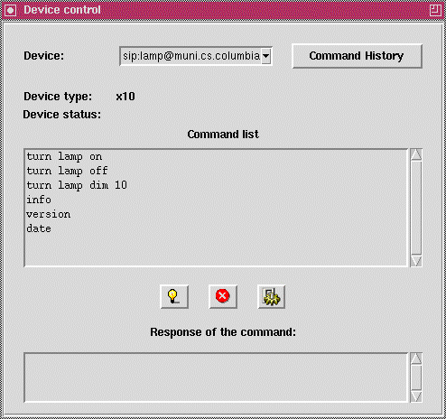
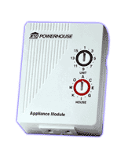
Device control
2001
Do sip:lamp@cs.columbia.edu SIP/2.0
…..
<Control>
<Action>turn lamp on</Action>
</Control>
serial port

Slide 53
Conclusion
Internet standards work best as building blocks
Potential for innovation on top: make standards invisible, but preserve openness
What is the role of identifiers?
Do we need secured identifiers → like web certs?

