Slide 1
NG911: Time to dispatch = 15 years and counting
Henning Schulzrinne
Columbia University & FCC (with usual disclaimers)

Slide 2
Quick history of 911 in the US
Phase II for cellular: handset or network location (carrier req.)
Presidential Commission recommends single number
proposal for national emergency number by NAFC
Phase I for cellular: deliver tower & sector to PSAP
first 9-1-1 call in Haleyville, AL
Carriers must support text-to-911
selective call routing trials
National 911 Act (Congress)
50/67%, 150m/80% (handset)
NEAD privacy & security plan
NENA NG911 i3 spec.
Text-to-911 bounce-back
50 m for 50% of calls
17% of US has 9-1-1
50 m for 40% of calls
50% of US has 9-1-1
Location test bed
barometric data PSAPs
70% 50m
1957
1967
1968
1970s
1976
1987
1998
1999
2001
2011
Jan
2013
June
2013
2015
Aug.
2016
Feb.
2017
Apr.
2017
Apr.
2018
Aug.
2018
Apr.
2020
Notes:
Sep 2010: https://apps.fcc.gov/edocs_public/attachmatch/FCC-10-176A1.pdf location accuracy
Dec 2012: https://www.fcc.gov/document/text-911-further-notice-proposed-rulemaking
May 2013: https://www.fcc.gov/document/text-911-bounce-back-message-order
Jan 2015: https://apps.fcc.gov/edocs_public/attachmatch/FCC-15-9A1.pdf
text-to-911: https://apps.fcc.gov/edocs_public/attachmatch/FCC-14-118A1.pdf (December 31, 2014)

Slide 3
What distinguishes US 911 from elsewhere?
5,894 PSAPs (in 3,135 U.S. counties)
  some very large (NYC, LA, Chicago), some tiny
  technical services provided by contractors and “system service providers”
240 million 9-1-1 calls per year
  70% cellular
Emphasis on location delivery
  98.6% of population have some Phase II (July 2016)
  most carriers use hybrid location (GPS + network-based such U-TDOA)
Funded by variety of add-on 9-1-1 charges on phone bills, not taxes
  some of these charges are diverted to other purposes
Limited regulatory authority for national regulator (FCC)
  Mostly, iVoIP and cellular providers, not PSAPs
  some oversight by state public utilities commission or state 911 office
Strong professional associations (APCO & NENA), with standard setting efforts and training

Slide 4
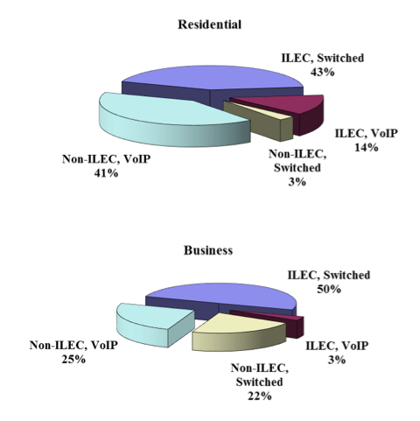
US landline phone service
FCC Voice Telephone Services: Status as of December 31, 2014
TEMU 2016

Slide 5
About half of households are wireless-only

Slide 6
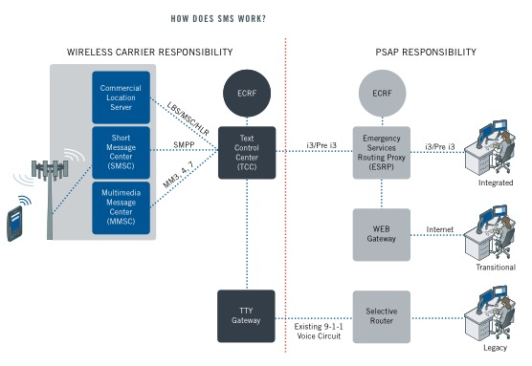
Text-to-911 architecture
Intrado, “Text-to-9-1-1 saves Lives”, 2013
TEMU 2016

Slide 7
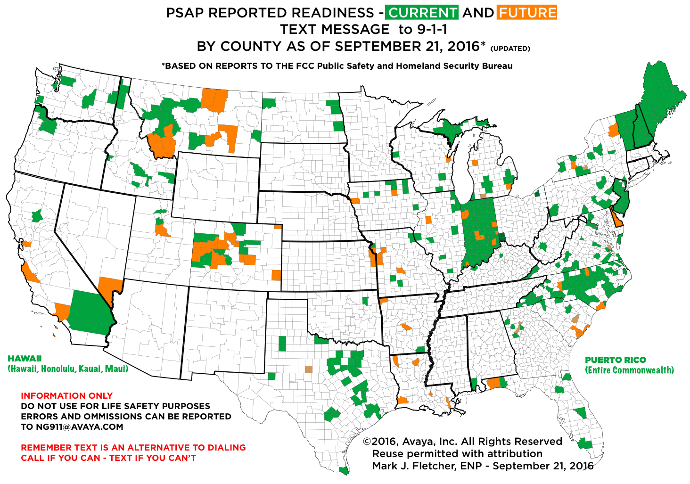

Slide 8
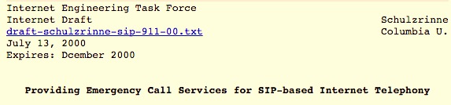
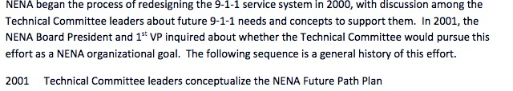
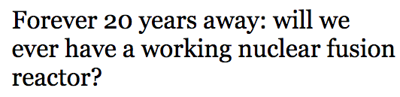
Insanity is … Doing something 6,200 times and expecting a speedy result.
(Einstein + Heisenberg)

Slide 9
US NG911 status
 | 2011 (27 responses) | 2013 (39 responses)
Statewide NG911 plan | 9 | 15
Concept of operations | 3 | 12
Request for proposals released |  | 13
Contracts |  | 13
Testing parts, functions and components at state level |  | 9
TEMU 2016

Slide 10
What are the causes?
Bottom up: small groups of PSAPs get together
  build (have built) their own ESInet
  Deploy their own ESRP, ECRF, LNG
  Each requires educating the late adopters, consultants, RFP, negotiation with carriers, coordinated funding, …
Engineered as one-offs
  Custom interconnect, equipment, configuration, …
600 selective routers
Capital investment
  But 911 entities typically cannot issue bonds
  No significant national funding sources
  Diversion of 911 fees collected by many U.S. states
Expertise uneven (GIS, IP networks, cybersecurity, …)
Carrier obligations – make PSAPs pay for legacy services

Slide 11

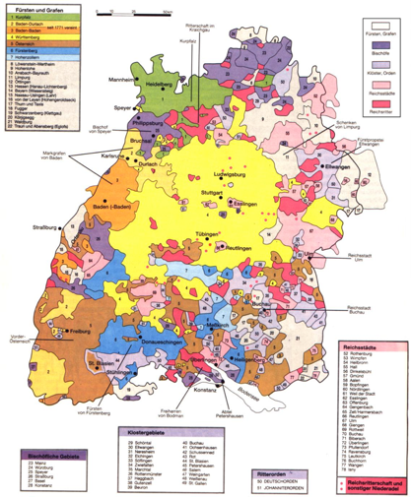
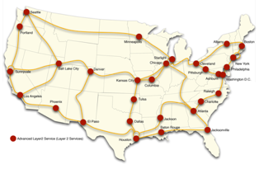
Alternative network models
Suomenlinna
Current deployment model
  network islands with SBC moats
  one county, one network, one server rack, one purpose, one decade
Similar to early academic Internet → Internet2
  initially custom, then re-use dark fiber
  membership model?

Slide 12







Alternative network models
national network(s)
LIS
LoST
VPNs
major network interconnect points:
SEA, LAX, SJC, DEN, CHI, BOS, DC, NYC

Slide 13
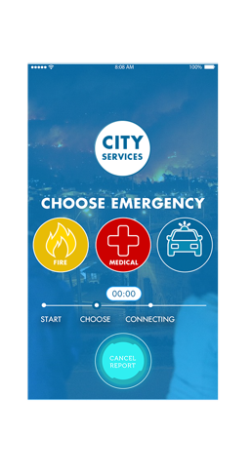
911 apps emerging
Offer advanced features
  Notify family & friends
  Share images
  Avoid delays in the carrier – PSAPs – system service provider dependency circle
Challenges
  Are 911 calls delivered to the right PSAP?
  911 features on handsets
  Funding model – consumer pays? PSAP pays?
  Privacy concerns
Notes:
https://www.apcointl.org/doc/advocacy/623-the-status-of-9-1-1-apps/file.html
http://appcomm.org/

Slide 14
Caller location
Builds on long history of FCC location accuracy requirements
  implicitly outdoor: 50m (67%)/150m (80%-90%) circles (1996), with geographic exclusions
dispatchable location or x/y within 50 m
  ~70% calls are wireless
  unknown % indoor
  residential indoor may allow GPS
z axis:
  3 years: uncompensated barometric
  6 years: 80% of top 25 CMAs
open issues:
  nomadic iVoIP
  separation of location & call delivery
  reliable location w/o power

Slide 15
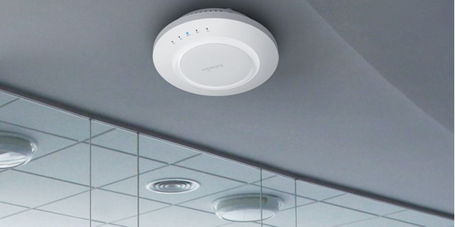



Indoor location
record common locations?
location = f(observed APs, barometer)
known location?
indoor or
outdoor?
“where are you?”
GPS or GNSS
commercial Wi-Fi database
crowdsourced database
NEAD
building/street
floor, apartment, office
WiFi AP
TEMU 2016

Slide 16
Indoor location challenges
 | Advantage | Challenges | Possible approaches
GNSS | near-universal in handsets no infrastructure | fails in dense urban canyons steel frame buildings | Long-term: L2C & L1C GPS
Wi-Fi | near-universal in handsets existing infrastructure | ground truth (room-level) moves | crowdsourcing
BlueTooth | universal in newer handsets | mapping beacons to location maintenance | crowdsourcing build into infrastructure
Barometric | cheap to add | limited handset availability indoor air pressure weather compensation mapping elevation to floor | building-level calibration combine with Wi-Fi
Accelerometer (dead reckoning) | near-universal in handsets no infrastructure | accuracy & mode detection mapping elevation to floor | use in hybrid systems

Slide 17
E911 location accuracy requirements (9/2010)
 | Handset-based |  | Network-based
 | 50 m/67% | 150m/80-90% | 100m/67% | 300m/90%
Year 1 – Jan. 2012 |  |  | 60% of counties covering 70% of pops
Year 2 – Jan. 2013 | 50 m/67% ea. county | 150m/80% ea. county
 | Carriers must provide confidence and uncertainty data on a per call basis upon PSAP request
Year 3 – Jan 2014 |  |  | 70% of counties covering 80% of pops (can use blended data) | 60% of counties with 70% pops (can use blended data)
Year 5 – Jan 2016 |  |  | 100% of counties (can use blended or handset data) | 70% of counties with 80% of pops (can use blended data)
Year 8 – Jan 2019 |  | 150m/90% ea. county |  | 85% of counties (can use blended or handset data)
Exclusions |  | May exclude 15% of counties w/forestation (no sunset) | May exclude counties where triangulation not feasible (< 3 sites) – sunsets after Year 8
47 CFR 20.18(h)
Notes:
https://www.law.cornell.edu/cfr/text/47/20.18

Slide 18
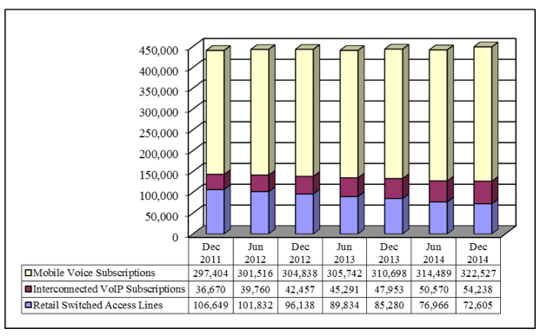
US voice telephony connections
FCC Voice Telephone Services: Status as of December 31, 2014
TEMU 2016
Notes:
https://apps.fcc.gov/edocs_public/attachmatch/DOC-338629A1.pdf

