Slide 1
A RiOT of opportunity: Integrating real-time data into the Internet of Things
Henning Schulzrinne
(+ Jan Janak & other CUCS IRT contributors)
RTC 2016

Slide 2
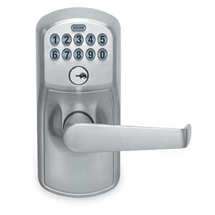
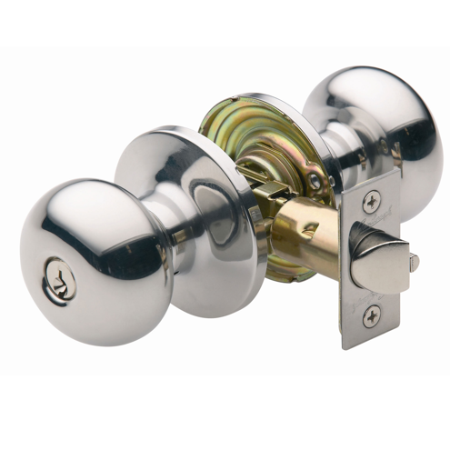
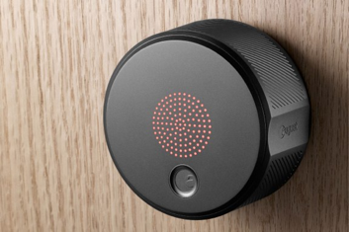
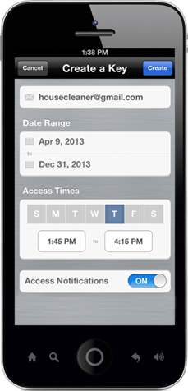
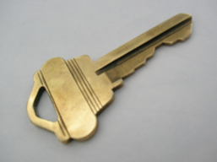
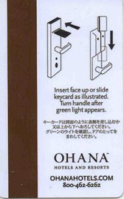
Natural evolution

Slide 4
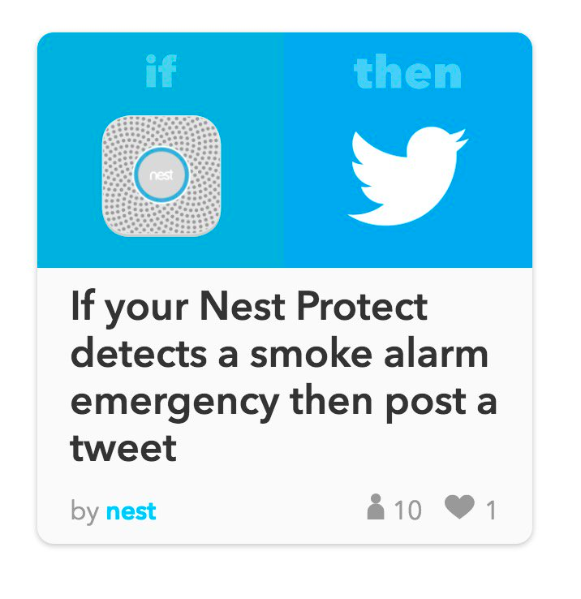
Kids, don’t do this at home
Notes:
https://twitter.com/internetofshit

Slide 5
https://twitter.com/internetofshit

Slide 6
Towel dispensers

Slide 7
The IoT killer app
http://www.traptec.eu/

Slide 8
Drones as part of the IoT
images
pollution
noise

Slide 9
link.nyc & smart trash cans
GPRS or CDMA
GPS location service

Slide 10
IoT is not exactly new

Slide 11
But controlling light switches is still not the best use
Want to turn on the bedroom light? Sure, just pick up your smartphone, enter the unlock code, hit your home screen, find the Hue app, and flick the virtual switch. Suddenly, the smart home has turned a one-push task into a five-click endeavor, leaving Philips in the amusing position of launching a new product, Tap, to effectively replicate the wall switches we always had.
https://techcrunch.com/2014/12/04/the-problem-with-the-internet-of-things/

Slide 12
Where does IoT make sense?
Probably
home security
residential & commercial locks
home medical (recording)
housekeeping (restroom supplies)
outdoor lighting
parking meters
vending machines
Not so much
light switches
most household appliances
clothing
smoke detectors?
not cost-effective, not just useless

Slide 13
Security

Slide 14
IoT security confluence
IoT insecurity
supply chain
long-lived device
one-time purchase
mostly hardware expertise
millions of them
no liability
assembly of software
no UI
no BCP38

Slide 15
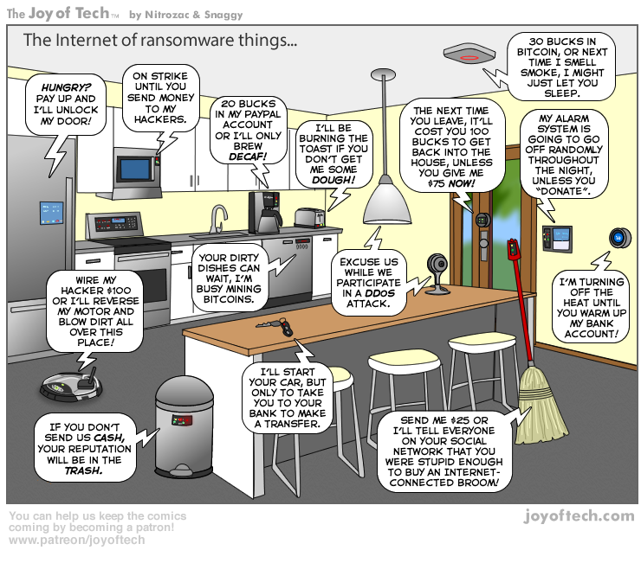

Slide 16
DDOS via IoT
Krebs DDOS, 9/2016: 620 Gb/s, total of > 1.5 Tb/s
GRE, SYN, HTTP GET, POST
MiraiNet: “380k bots from telnet alone”
Enabled by UPnP → bypass NATs
xc3511 vizxv admin 888888 xmhdipc default 123456 54321 support
Notes:
https://www.incapsula.com/blog/malware-analysis-mirai-ddos-botnet.html

Slide 17
Mirai botnet
Chinese manufacturer, used by lots of OEMs
BusyBox Linux
Brute-force ssh and telnet
Web reset doesn’t change ssh or telnet

Slide 18
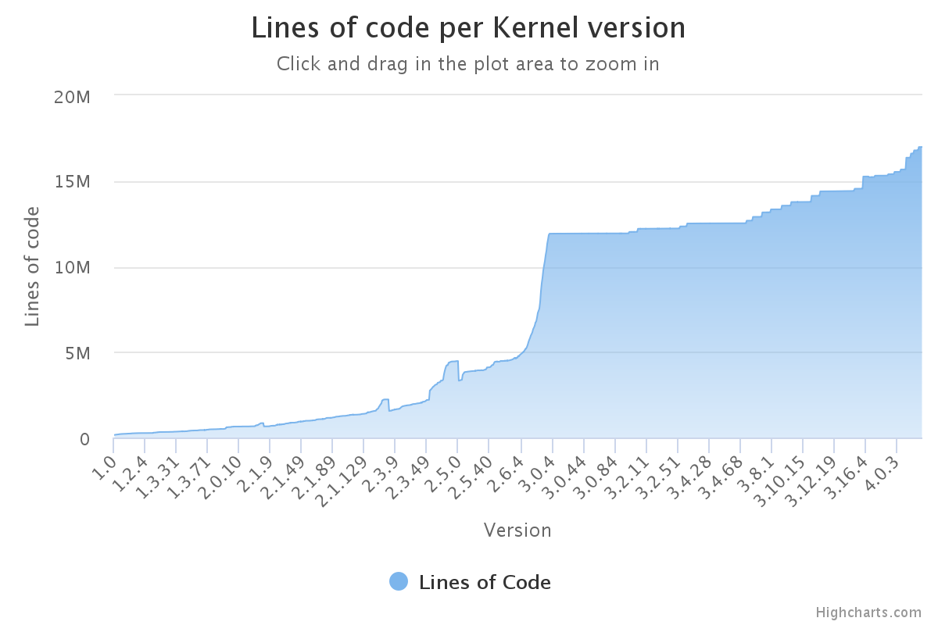
Linux kernel lines of code
BusyBox:
177,650 SLOC

Slide 19
You cannot hide
Hackers worldwide currently probe IoT devices for vulnerabilities after they have been connected to the internet for six minutes. Each hour these devices are tested for vulnerabilities - at least 800 times per hour - with an average of 400 login attempts occurring daily. On average, hackers try to access one IoT device every five minutes and a total of 66 per cent of their attempts end up being successful.
http://www.itproportal.com/news/the-average-iot-device-is-compromised-after-being-online-for-6-minutes/

Slide 20
IoT DDOS economics
Schneier
Oct. 2016
Cohan
Apr. 2013
DDOS as externality
device owners don’t care:
barely slows down their Internet service
device still functions normally
don’t know victims, generally
vendors don’t care (enough)
not liable for damage (right now) – public nuisance?
only marginally affects their business reputation
ISP don’t care (much)
individually, not much load – in lightly-loaded direction (outbound)
hard to combat
haven’t adopted BCP38 (egress address filtering)
Notes:
https://www.schneier.com/blog/archives/2016/10/security_econom_1.html

Slide 21
IoT lemons
“The Market for Lemons: Quality Uncertainty and the Market Mechanism” (Akerlof, 1970)
Information asymmetry
purchaser cannot judge invisible qualities
pays only average price
→ above-average-quality goods not marketed
“defect four or more times and the problem is still occurring, the car may be deemed to be a lemon” → get purchase price back
more than four patches?

Slide 22
Fixes for externalities and lemons
Liability
slow, one-by-one, uncertain standards of care
what is “negligent”?
Certification
voluntary or mandatory
Insurance liability
homeowner’s insurance
Regulation
adherence to minimum performance standards

Slide 23
This is not that hard!
No factory-default passwords
long-term, no human-setable passwords at all → client certs
No telnet, ssh, SNMP (typically)
Only configure from local subset
Automated, signed updates
Web interfaces use non-root accounts
Automated testing for XSS and SQL injection

Slide 24
IoT good-citizen rules
FCC TAC recommendations +
Implement current best practices
no plain-text data or commands
low-power CPUs are no excuse – long-payback or infrequent crypto operations
no default passwords
Do not assume that your (cellular) network is around in > 8 years
short-range unlicensed bands more likely a safe harbor
Update yourself securely
Don’t trust random APs → PassPoint, 802.1x?
matters mainly for DNS and denial-of-service
Go into fail-safe mode if no updates
Be nice to cellular network (signaling, white spaces, …)
and maybe “kill switch” if misbehaving (or stolen!)
Don’t ask for special spectrum
except maybe if you’re a health-and-safety device (but share nicely)
or maybe low-bandwidth narrowband spectrum
Notes:
http://www.sigfox.com/en/#!/technology

Slide 25
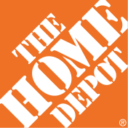
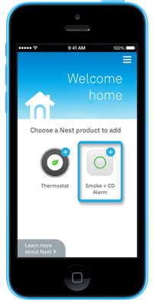
Challenge: enrollment
Commercial buildings → enroll 1,000s of devices at once
Home → enroll one device at a time
current model: one app per device (class)
re-do if Wi-Fi password changes
common options:
QR code
P2P Wi-Fi (Wi-Fi Direct)
possibilities
“hi, I’m a Philips light bulb – add me!” (PKI)

Slide 26
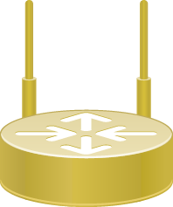
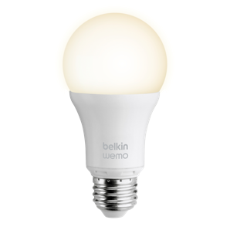
How should we secure things?
Old model
802.1x
WPA2
(P, E)
DIAMETER
“I want to join!”
New model
commissioner
device authorization
database
create entries

Slide 27
AllJoyn is doing something similar

Slide 28
Privacy

Slide 29
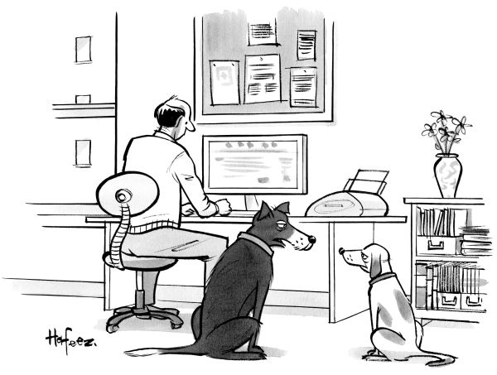
“Remember when, on the Internet, nobody knew who you were?”

Slide 30
Privacy fears deter usage
NTIA
May 2016
Major Concerns Related to Online Privacy and Security Risks, Percent of Households with Internet Users, 2015
Notes:
https://www.ntia.doc.gov/blog/2016/lack-trust-internet-privacy-and-security-may-deter-economic-and-other-online-activities

Slide 31
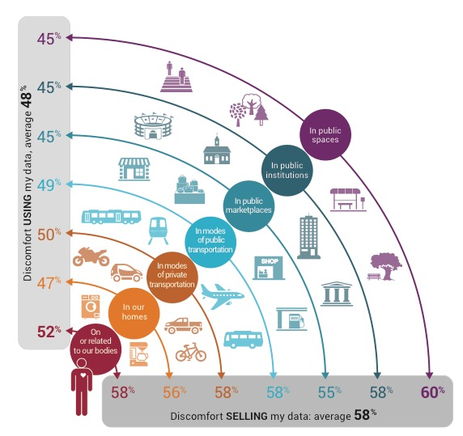
Roughly half of consumers uncomfortable
Altimeter Group
June 2015
Notes:
http://www.altimetergroup.com/pdf/reports/Consumer-Perceptions-Privacy-IoT-Altimeter-Group.pdf

Slide 32
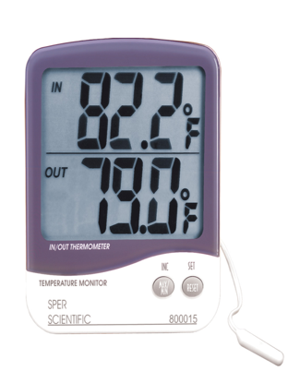
Local processing for efficiency privacy
node
publicly visible script
cloud storage and access
fuzz
anonymize
average
rate limit
observable storage
indoor
thermometer
fog computing model

Slide 33
Building large IoT systems

Slide 34
IoT = Internet at scale
Security at scale
still largely “add password to configuration file”
identify by IP address
Management at scale
device-focused
SNMP, at best
CLI, at worst
no performance diagnostics capabilities (“why is this so slow?”
Naming at scale
identify by node name
Programming at scale
system
& rack
data center

Slide 35
Lessons from early IoT (and cousins)
ATC
proprietary network architecture
"Ongoing problems continue to threaten NextGen's costs and timeline."
PTC
220 MHz dedicated network
"[NTSB] has advocated for some form of positive train control for more than 45 years."
ITS
5.9 GHz
allocated in 1999

Slide 36
Lesson: sensor networks may be (tiny) niche
Most IoT systems will be near power since they’ll interact with energy-based systems (lights, motors, vehicles)
Most IoT systems will not be running TinyOS (or similar)
Protocol processing overhead is unlikely to matter
Low message volume → cryptography overhead is unlikely to matter
$35.00
A 900MHz quad-core ARM Cortex-A7
1 GB RAM
http://eschatologist.net/blog/?p=266

Slide 37
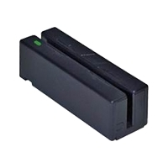
The age of application-specific {sensors, spectrum, OS, protocol …} is over
Computing system: dedicated function → OS
→ abstract into generic components
e.g., USB human interface device (HID)
What are the equivalent sensor and actuator classes?
Networks: generic app protocols
request/response → HTTP
event notification → SMTP, SIP, XMPP
Spectrum: from new application = new spectrum to generic data transport

Slide 38
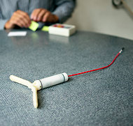
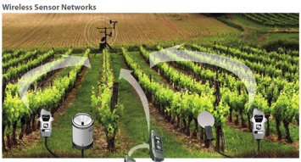
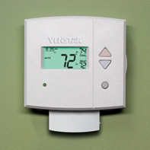
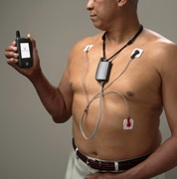
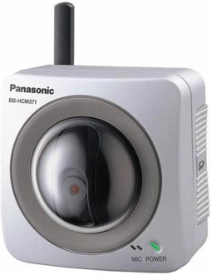
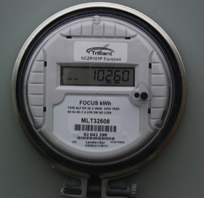
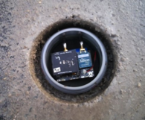
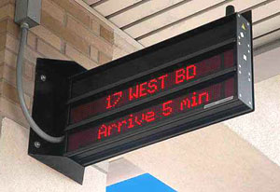
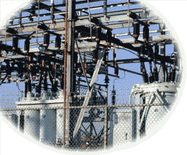
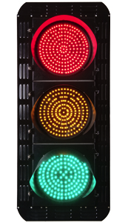
IoT varies in communication needs
sensors
CPS
1/hour
1/minute
1/second
10/second
actuators
IoT
Notes:
http://www.nytimes.com/2012/10/02/world/europe/device-sends-message-to-swiss-farmer-when-cow-is-in-heat.html?pagewanted=all

Slide 39
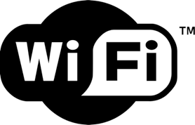
5G is not the only option
indoor
unmanaged
indoor
ext. managed
outdoor
urban
outdoor
rural
outdoor
remote

Slide 40
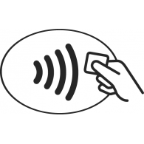
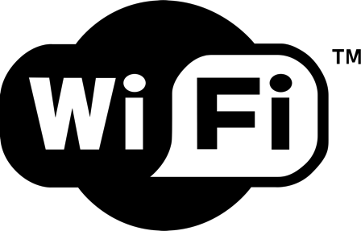
Niche networks
short range
low energy; mesh
ubiquity; low cost
speed; public APs

Slide 41
5G = low latency + mmW + …
one-to-many!
X
X
V2I2V
X
EEW
(< 5 s)

Slide 42
Protocols matter, but programmability matters more
Nobody wants to program raw protocols
Most significant network application creation advances:
1983: socket API → abstract data stream or datagram
1998: Java network API → mostly names, HTTP, threads
1998: PHP → network input as script variables
2005: Ruby on Rails → simplify common patterns
Many fine protocols and frameworks failed the programmer hate test
e.g., JAIN for VoIP, SOAP for RPC
Most IoT programmers will not be computer scientists

Slide 43
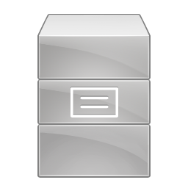
What is the best generic (simple) architecture?
cloud, fog, …
SQL (via HTTP RESTful API)
SENML?
Streaming (JSON web stream … RTP)
event notification
mediate access
user-delivered code

Slide 44
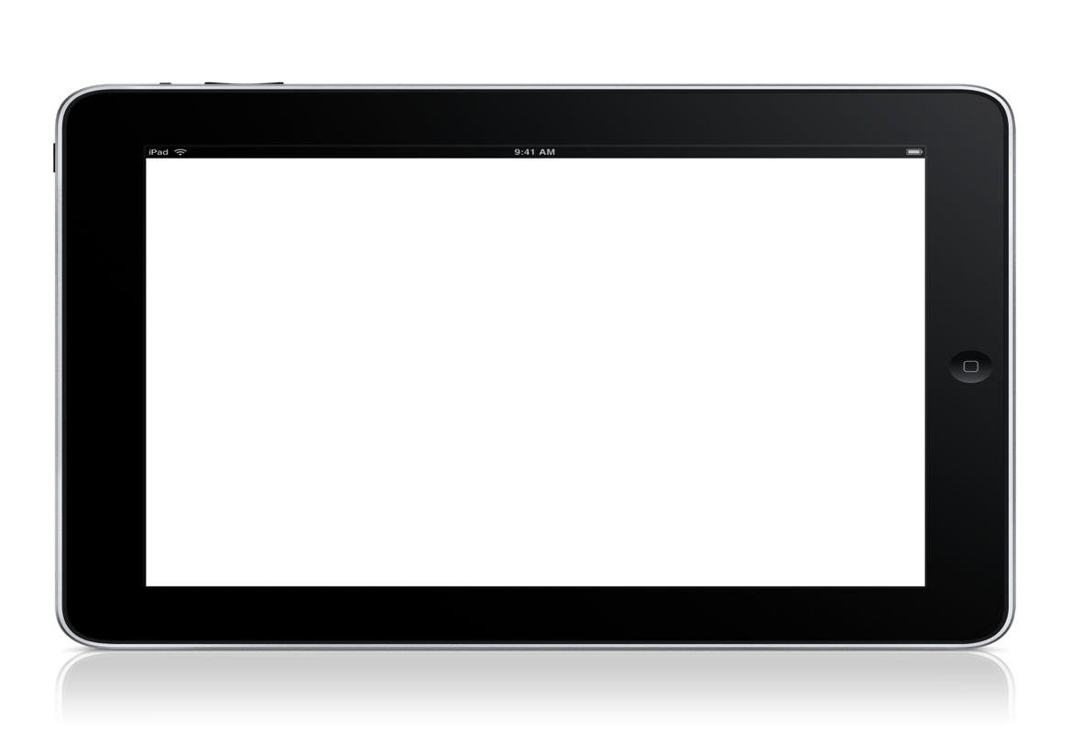
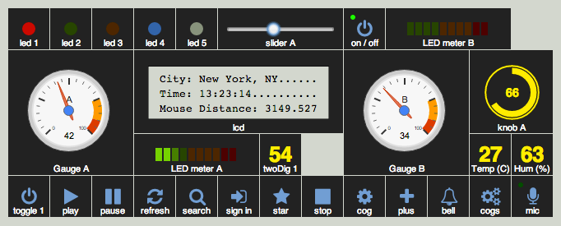
Challenge: integrate embedded, mobile & virtual
magnetometer
accelerometer
location
gyroscope

Slide 45
Some of IoT is streaming
update rate of 10 to 250 Hz

Slide 46
IoT communication modalities
SIP world
HTTP GET
COAP GET
MQTT?
MESSAGE?
get
HTTP POST
CoAP POST
MQTT?
DO?
MESSAGE?
set
subscribe
publish
HTTP long poll
CoAP observe
MQTT
SUBSCRIBE
PUBLISH
MSRP
WebRTC
INVITE + RTP
RTSP
stream

Slide 47
MQTT model
kitchen/+/temperature matches kitchen/foo/temperature but not kitchen/foo/bar/temperature

Slide 48
Example: AllJoyn bus
publish-subscribe model (implicit)
Wi-Fi
UDP multicast
BT SDP

Slide 49
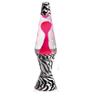
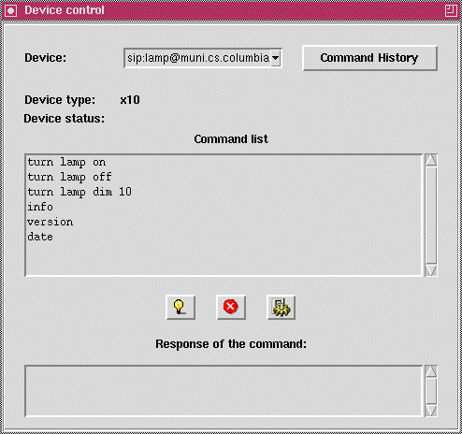
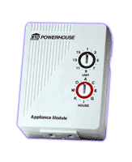
Device control
2001
Do sip:lamp@cs.columbia.edu SIP/2.0
…..
<Control>
<Action>turn lamp on</Action>
</Control>
serial port

Slide 50
We could do better
Somewhat unsatisfactory
AllJoyn model only for LAN operations
CoAP & HTTP better for get/set operations
MQTT simpler for publish/subscribe
SIP (or RTSP) better for media streaming
Lots of proprietary network protocols
BAC for building automation
Same device or source, multiple identifiers
HTTP URL or SIP URL or MQTT IP address/domain name
none are particularly useful or semantically meaningful
e.g., likely change if device is replaced

Slide 51
Lifecycle

Slide 52
Windows XP, Corolla & Revolv
13 years
available
12/2001
end of sales
6/2008
end support
4/2009
end install
10/2010
end ext. support 4/2014
1996 Corolla
- still can get parts
$2,359
founded 2012
acquired by Nest 2014
shut down May 2016
Notes:
http://windows.microsoft.com/en-us/windows/lifecycle

Slide 53
Design for 20 years

Slide 54
IoT needs a life cycle model
X
services
security support
safe mode
feature support
EoL?
local only
guardian
services
conservator
support
company hands over control
(bond or insurance model)

Slide 55
IoT needs an economic model
Do you own or rent a device?
and do you know what rights you have (transfer, sale, …)?
and for how long?
What is expected lifetime?
in what mode?
with what enhancements?
Who pays for computation and storage?
printer & ink? stove & electricity?
subscription model → doesn’t scale except with aggregator
advertising model → creepiness-factor, no direct interaction
third party model: health or fire insurance, research (“your data for science”), electric utility

Slide 56
Development lifecycle
Currently, hard to design large-scale reliable systems
failure modes, server load, control algorithms, …
See Jan Janak’s talk at 1.30 today
physics emulator
network
emulation
set network
parameters
y = f(x)
y = f(t)
5G
VM
Mininet
http://mininet.org/

Slide 57
Conclusion
IoT is finding lots of boring niches
But IoT security is exposing almost all the security deficiencies of the Internet eco system
“thoughts and prayers” approach
continuing to do the same thing for the next 5 years and hoping for better results is not a strategy
Start thinking beyond stove pipes of applications
→ engineering large scale systems

