Slide 1
Thinking beyond the network & Lessons from the not-so-past
Henning Schulzrinne
Columbia University

Slide 2
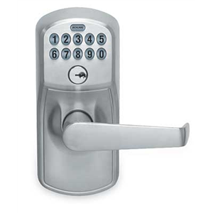
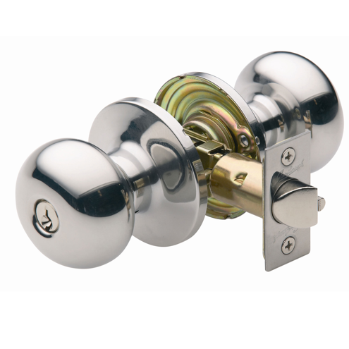
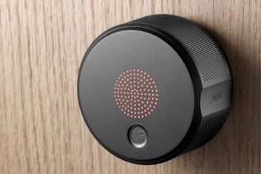
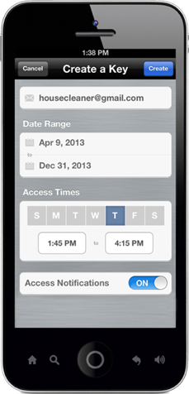
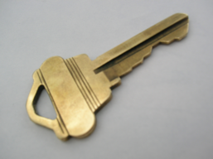
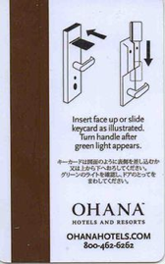
Natural evolution

Slide 3
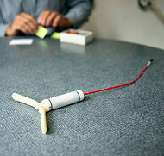
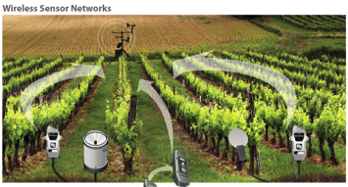
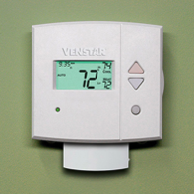
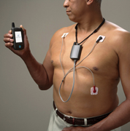
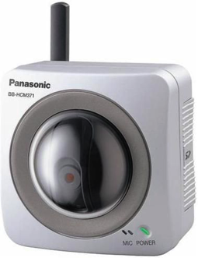
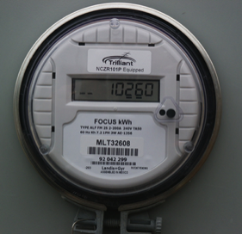
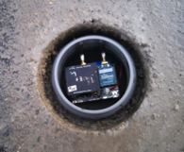

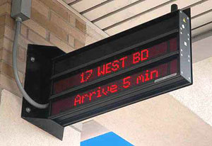
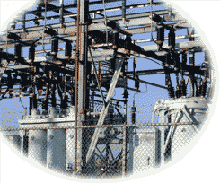
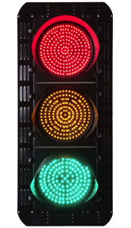
IoT varies in communication needs
sensors
CPS
1/hour
1/minute
1/second
10/second
actuators
IoT
Notes:
http://www.nytimes.com/2012/10/02/world/europe/device-sends-message-to-swiss-farmer-when-cow-is-in-heat.html?pagewanted=all

Slide 4
IoT: more than programmable light bulbs
public sensors & actuators
semi-private
private

Slide 5
Lessons on our way to wireless cities
We don’t predict applications well
Resource constraints are dollar constraints
  they mainly offer temptation to do QoS research (again)
Internet lesson #1: L3 is forever, but don’t get too attached to L1/L2
  Cross-layer optimization may make for better papers, but confuse developers
Security usability is more important than security sophistication
  Cliché: Internet not designed for security
  Network security is about naming

Slide 6
ATC
proprietary network architecture
"Ongoing problems continue to threaten NextGen's costs and timeline."
PTC
220 MHz dedicated network
"[NTSB] has advocated for some form of positive train control for more than 45 years."
ITS
5.9 GHz
allocated in 1999

Slide 7
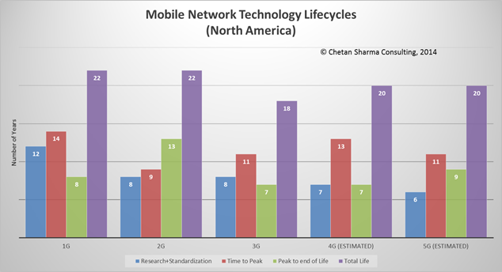
Design for 20 years

Slide 8
We need research for opex, not (just) capex
Company | Revenue | Capital expenditures | %
Comcast (US) [3Q14] | $11.04B | $1.644B | 14.9
Telekom (DE) [3Q14] | €15.6B | $2.58B | 16.5
Safaricom (KE) [H1FY15] | Ksh 79.34B | Ksh 12.37 | 15.5

Slide 9
Generational surprises in cellular networks
Generation | Expectation | Surprise
2G | better voice quality (“digital!”) | SMS
3G | WAP | web
4G | IMS | YouTube, WhatsApp, notifications
5G | IoT (low latency) | ?
underestimated cost and fixed-equivalence as drivers

Slide 10
Lessons, in brief
Experience | Lessons
VoLTE, IMS | avoid complexity avoid layer entanglement plan intercarrier interfaces
Wi-Fi | don’t trust the RAN/AP
disaggregation of functions | clear & simple interfaces don’t assume trust between elements
app stores | keep it application-neutral
FTTH, backhaul cost | re-use backhaul where you can find it
Premature optimization is the root of all evil (Knuth 1974)

Slide 11
Lesson: sensor networks may be (tiny) niche
Most IoT systems will be near power since they’ll interact with energy-based systems (lights, motors, vehicles)
Most IoT systems will not be running TinyOS (or similar)
Protocol processing overhead is unlikely to matter
Low message volume → cryptography overhead is unlikely to matter
$35.00
A 900MHz quad-core ARM Cortex-A7
1 GB RAM
http://eschatologist.net/blog/?p=266

Slide 12



What is the best generic (simple) architecture?
cloud, fog, …
SQL (via HTTP RESTful API)
SENML?
Streaming (JSON web stream … RTP)
event notification
mediate access
user-delivered code

Slide 13
How should we name things?
device
(independent of network)
network interface
device by function & location
EUI-64
IPv6
domain name? → portability?
phone number?
“ceiling lamp in kitchen”
(used in programs)

Slide 14

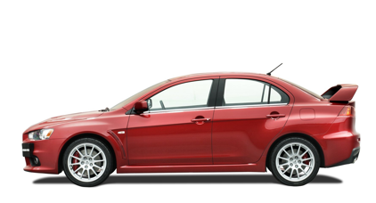
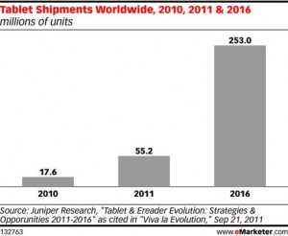


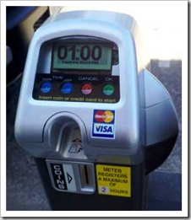
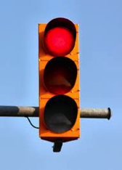
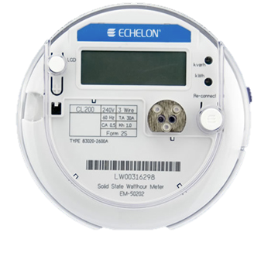
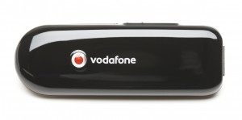
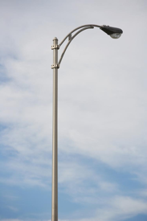
Phone numbers for machines?
< 2010
254 mio.
212 555 1212
500 123 4567
(and geographic numbers)
12% of adults
500 123 4567
533, 544
5 mio.
311,000
64 mio.
now: one 5XX code a year…
(8M numbers)
10 billion +1 #’s available
44.9 mio.
see Tom McGarry, Neustar
Notes:
http://blog.neustar.biz/neustar-insights/telephone-numbers-are-for-people-not-machines/
http://www.parking.org/media/overview-of-the-us-parking-industry.aspx
http://www.statisticbrain.com/e-reader-statistics/
http://www.ite.org/reportcard/TechnicalReport.pdf – 311k signals
www.aceee.org/files/proceedings/2012/data/papers/0193-000144.pdf – 44.9 M street lights

Slide 15
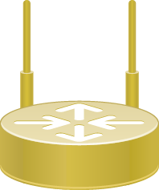
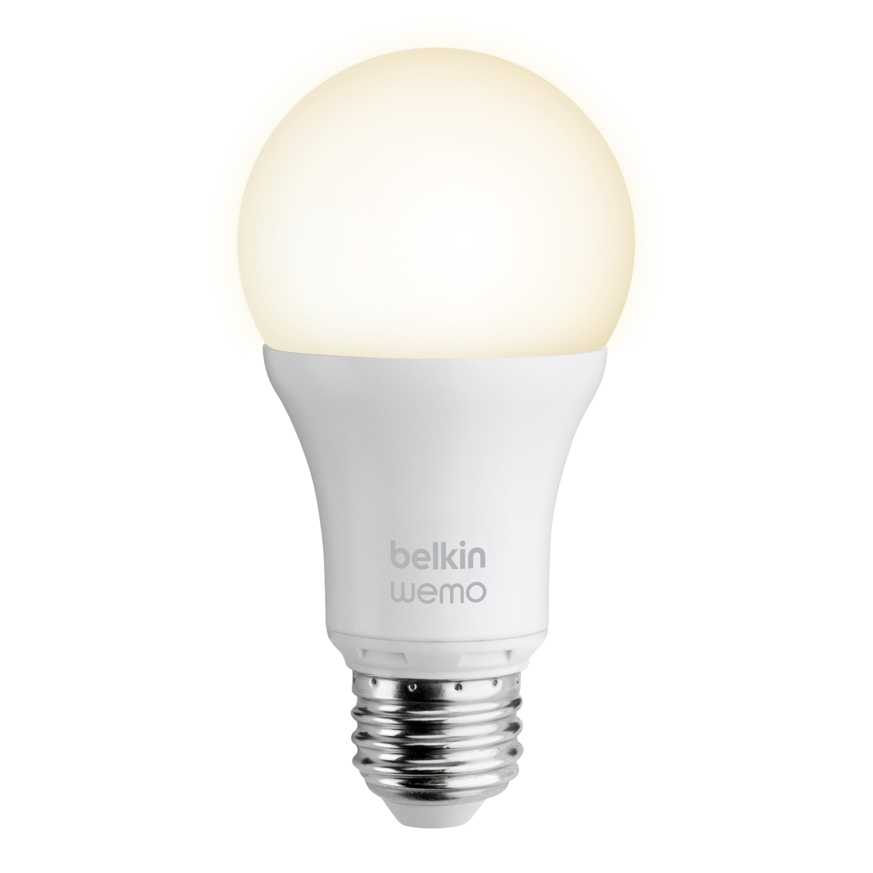

How should we secure things?
Old model
802.1x
WPA2
(P, E)
DIAMETER
New model
“I want to join!”
commissioner
device authorization
database
create entries

Slide 16

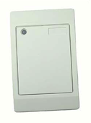






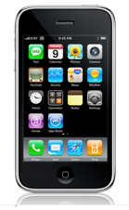


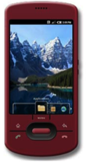


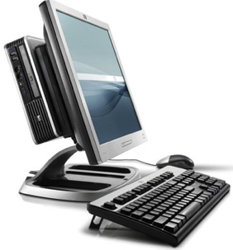
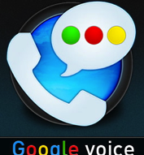



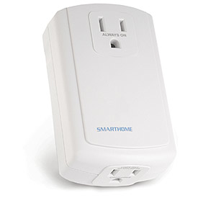
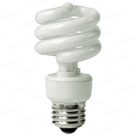
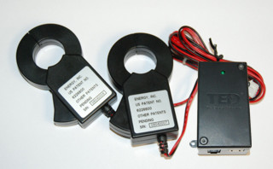
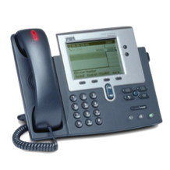
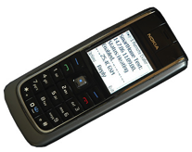
SECE (Sense Everything, Control Everything)
GW
next appt.
RFID
Alice → a@b.com,
+1 212 555 1234
geocoding
travel time
SUB/NOT
PIDF-LO, RPID,
others
SECE
PUBLISH
PIDF-LO
update SNs, , email…
GW
GW
call state
Call events, VM, SMS
monitor energy
usage
B2BUA
control appliances

Slide 17
Conclusion
Design for simplicity and generality, not performance
Design for surprises
Design for developers – what do they need and want?
Design for L2 evolution and co-existence

