Slide 1
The Internet is Insecure and Will Likely Remain So - What now?
Henning Schulzrinne
Columbia University
February 2015, updated June 2016

Slide 2
Overview
Security fallacies
  Stop blaming (and “educating”) users
  Reduce the value of targets
  Avoid “small mistake, huge cost”
  Secure key identifiers
  Make it hard to scale attacks
  Make it easy to detect loss
  Design fraud-resistant systems
  Worry about DOS attacks on humans
Robo-calling and caller ID spoofing

Slide 3
Security approach: blame the victim
Run 10 anti-virus systems!
Choose passwords you can’t remember!
Pay cash!
Don’t click on that link!
Choose another operating system!

Slide 4
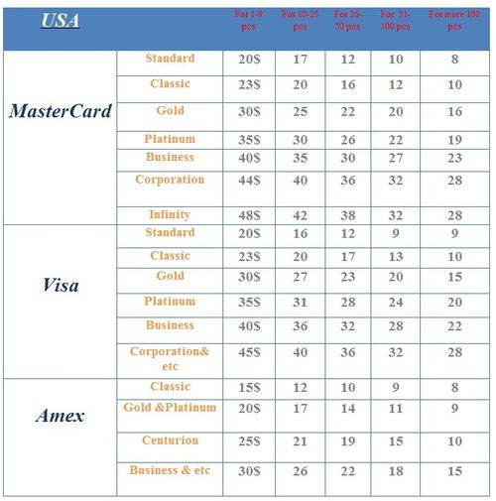
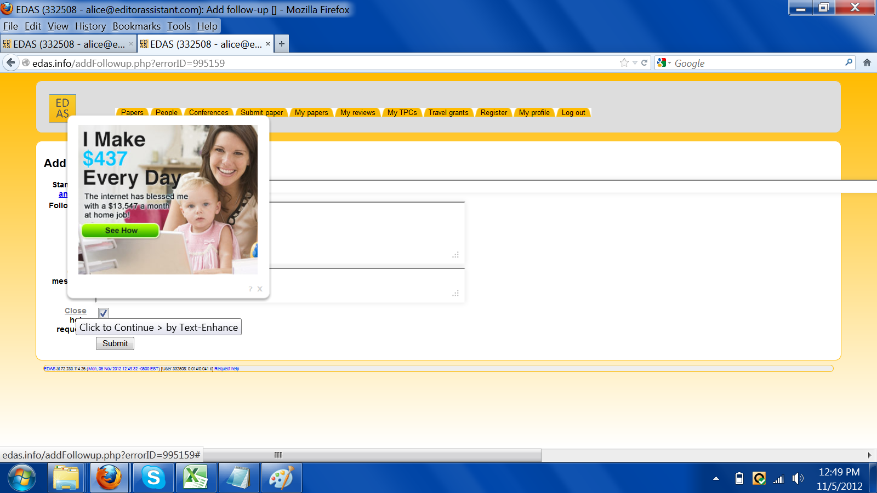
Nobody cares about you!
Unless you have access to high-value information
  sometimes for individualized identity theft
You are only valuable as
  a credit card number that can be resold in bulk ($2-$8)
  a machine usable for …
    DOS attacks
    email spam
      88% of spam sent by botnet
    a machine usable for advertising click fraud
      watch highlighted links!
      $0.002-0.003/click → $0.50-$2 CPM
  extortion (ransomware)
    $100-$500 (via BitCoin)
Notes:
http://blog.imperva.com/2011/10/current-value-of-credit-cards-on-the-black-market.html
http://iseclab.org/papers/cutwail-LEET11.pdf

Slide 5
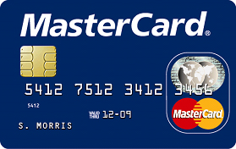
You are (mostly) on your own
Credit card
  liability limited to $50
  US: mag stripe vs. chip & PIN
Debit card
  two days → $50, otherwise $500
Checks
  no, your bank does not check your signature (or your address)
Consumer bank account → Regulation E
  no liability if reported within 60 days
Small business account
  No protection, no loss bound
  ACH fraud common

Slide 6
Example: FTC CTO identity theft
Walk into cell phone store & replace phones
  charged to existing phone number
  requires only crude fake ID
  now access to 2FA via SMS

Slide 7
Example: ZeroAccess
The ZeroAccess botnet infected 2.2 million home networks worldwide during Q3 [2012], making it the most active botnet for the year thus far, said a malware report from security analysis firm Kindsight. The Alcatel-Lucent subsidiary's Security Labs team found ZeroAccess infected one in 125 home networks during the quarter. “Cybercriminals are primarily using it to take over victim computers and conduct ad-click fraud,” Kindsight Security Labs security architect Kevin McNamee said Tuesday in a news release. “With ZeroAccess, they can mimic the human behavior of clicking online ads, resulting in millions of dollars of fraud.” The botnet may be costing advertisers $900,000 per day in ad-click fraud, Kindsight said. About 13 percent of home networks in North America were infected in Q3, with 6.5 percent of all home networks having high-level threats like bots and banking Trojans, Kindsight said (http://xrl.us/bnww7h).

Slide 8
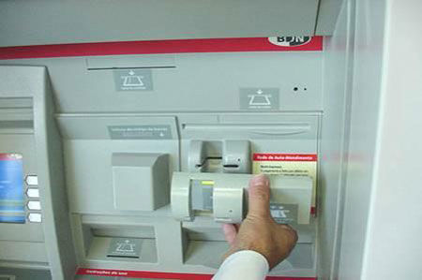
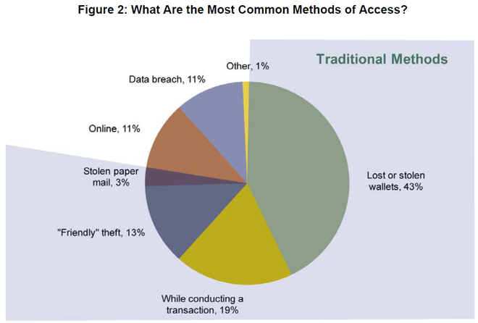
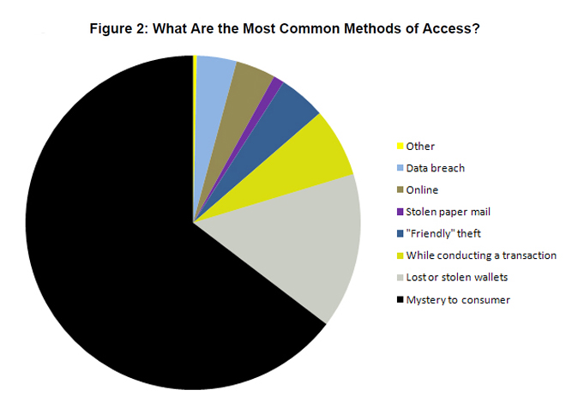
Identity theft is often analog
http://www.wired.com/threatlevel/2009/02/stolen-wallets/
Notes:
http://papers.ssrn.com/sol3/papers.cfm?abstract_id=969441#
http://geek.thinkunique.org/wp-content/uploads/2008/10/atm_skimmer2.jpg

Slide 9
Authentication

Slide 10
Traditional authentication
Authentication
Something you know
(password)
Something you have
(cell phone, fob)
Something you are
(biometrics)
Where you are
(light switch)

Slide 11
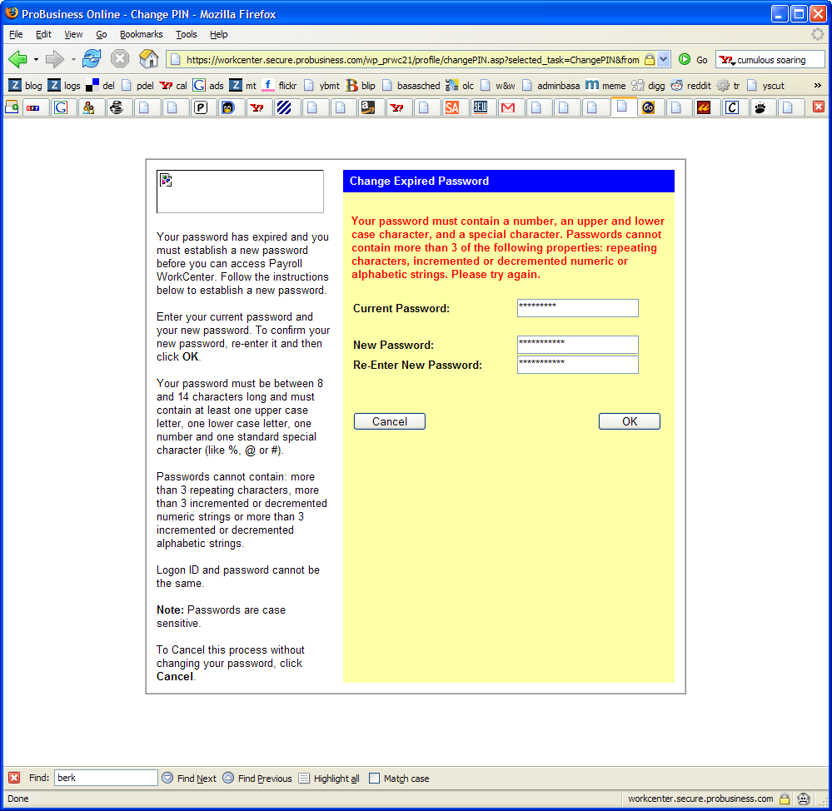
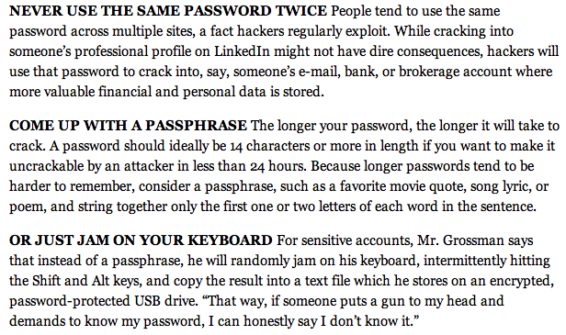
Password policies gone amuck
Contradictory policies
  Strong passwords don’t work everywhere
Password expiration
  and can’t use old one
Don’t re-use password across sites
NY Times, 11/07/2012
Notes:
http://jeremy.zawodny.com/i/password-insanity.png
http://www.nytimes.com/2012/11/08/technology/personaltech/how-to-devise-passwords-that-drive-hackers-away.html

Slide 12
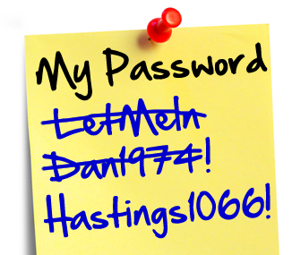
Password advice
Unless you’re the CIA director, writing down passwords is safe
  you’ll pick safer ones if you do
Stop blaming users → web sites need to tell us what they do
  bad: plain text, silly rules
  not much better: hashed
  good: salted hash, single sign-on
Impacts password recovery
  bad: your dog’s name
  not great: send password to email
  ok: time-limited reset link

Slide 13
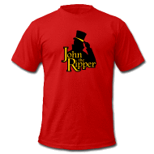
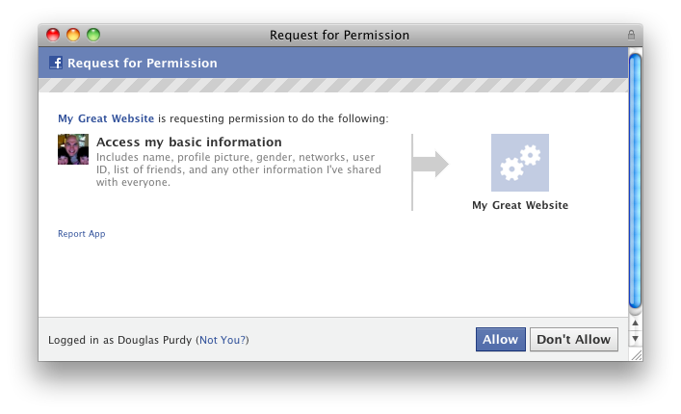

More password issues
With rainbow tables, only length matters
  12+ characters likely safe
  except for dictionary word combinations
  brute force via GPU: billions of guesses a second
Always next year: single sign on

Slide 14
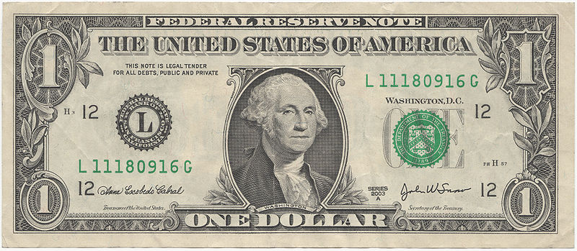
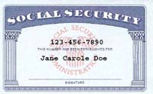
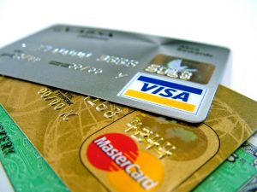
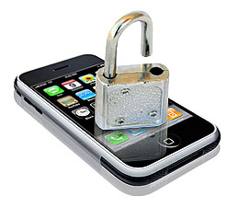
Reduce value of goods
Particularly single-factor goods
  if you can’t tell that they are gone

Slide 15
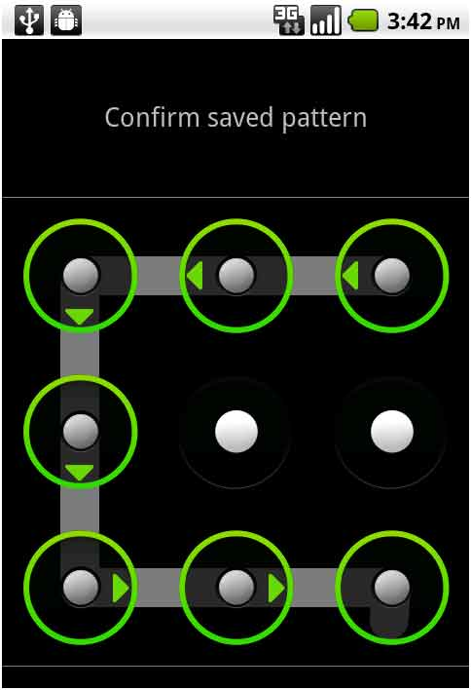
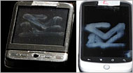
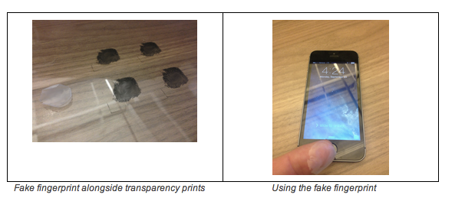
What about non-passwords?
Replacements have been suggested:
  Swipe pattern (Android)
  Voice pattern
  Fingerprints (TouchID)
  Keyboard typing or swiping
  Face recognition
Problems:
  not generalizable
    only works on some devices
  not precisely representable
    doomed if you have a cold or are in a noisy airport
    likely need password backup
  hard to have different ones → bad if clonable
Useful as supplement for high-value transactions
Notes:
http://www.smartplanet.com/blog/business-brains/goodbye-passwords-new-alternatives-emerge-but-passwords-persist/21304

Slide 16
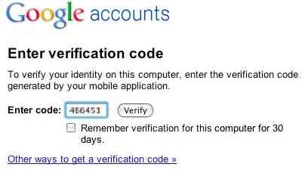
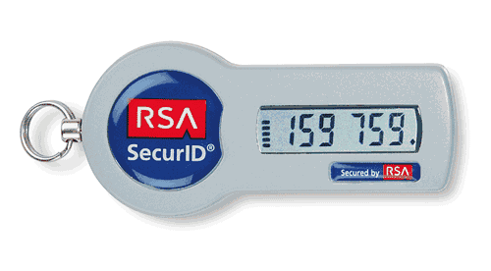
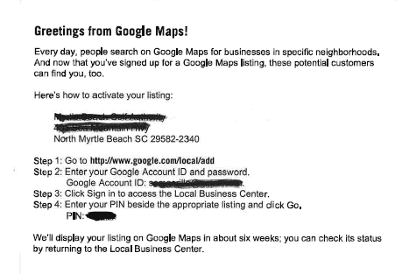
The convergence to “what you have”
Two-factor authentication
Advantages:
  easy to recognize when lost
  hard to scale theft (but: see RSA)
  separate data path
    voice path vs. data path
    postal mail
  related: host recognition (e.g., via cookies)

Slide 17
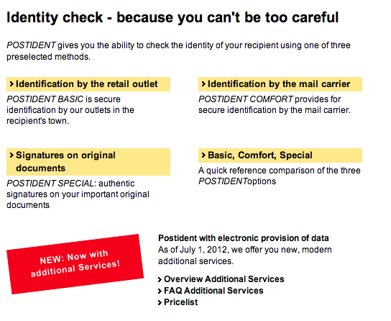
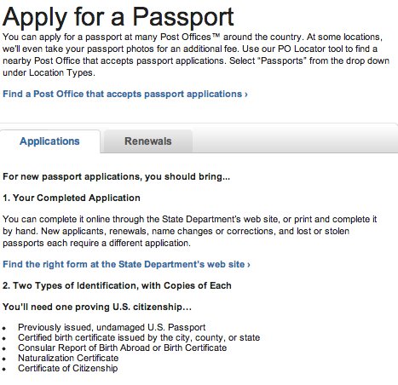

Provide physical validation services
Goals:
  make scaling hard for bad guy
  increase risk of arrest
  make geography matter
But generally not integrated with digital processes!
Notes:
http://www.deutschepost.de/dpag?xmlFile=1015469

Slide 18
Securing the Internet

Slide 19
We must make the Internet secure!
Internet layer
deployability
doesn’t know user & desired operation
changes with mobility
IP layer as introducer → by definition, parties may not know each other
Transport layer: TLS, DTLS
certificate validation often wrong
no client certificates (domain vs. user)
integrated transport & security layer?
Application layer
knows the what & who
→ secure infrastructure

Slide 20
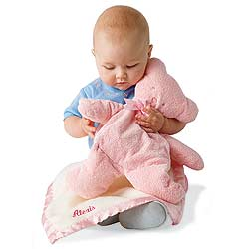
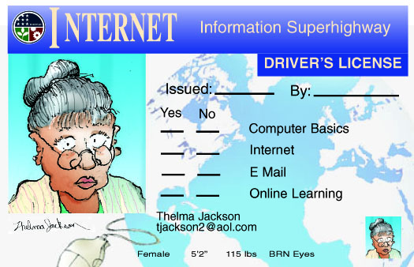
Securing the Internet – once and for all!
Dream of a security layer that lets everybody else do nothing
Suggested: “Internet passport”
  no more unauthenticated packets!
  what about compromised machines?
Possible:
  “don’t talk to me unless I talked to you”
  → permission-based sending
  most useful for small-group DOS attacks
    but most are now trickle attacks
  keep out packets at coarse level
    “not interested in packets from Elbonia”
      but easily spoofed

Slide 21
Cause of death for the next big thing
 | QoS | multi- cast | mobile IP | active networks | IPsec | IPv6
not manageable across competing domains |  |  |  | 
not configurable by normal users (or apps writers) |  |  |  |  | 
no business model for ISPs |  |  |  |  |  | 
no initial gain |  |  |  |  |  | 
80% solution in existing system |  |  |  |  |  |  (NAT)
increase system vulnerability |  |  |  | 

Slide 22
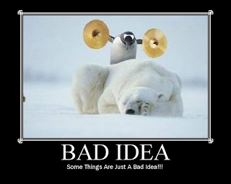
Secure key identifiers
Security by:
  return routability
  cryptographic proof of ownership
  keeping them secret (SSN)
Identifier | Proof of ownership | Spoofable | Critical for
IP address | RR, RPKI (?) | egress filtering (RFC 3013) | everything…
AS number | RPKI? | yes (BGP) | routing
domain name | TLS | TLS failures → DANE | web sites
email address | RR | mostly | password recovery
phone number | RR | caller-ID spoofing | 2-factor authentication
location | ? | yes | authentication

Slide 23
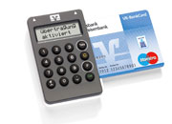
Avoid single-failure = catastrophic failure
Download the wrong application ➔ bank account gone
Attacker advantage: one flaw, hundreds of thousands of victims
→ Make it hard to scale attacks
  require access to physical world
  multiple paths that are unpredictable to far-away third party
  Honey pots (e.g., trap spam senders)
System design:
  separate systems for high-value transactions
    separate web browser
    separate VM
    single-purpose computer
    second independent path: SMS

Slide 24
Securing end systems

Slide 25
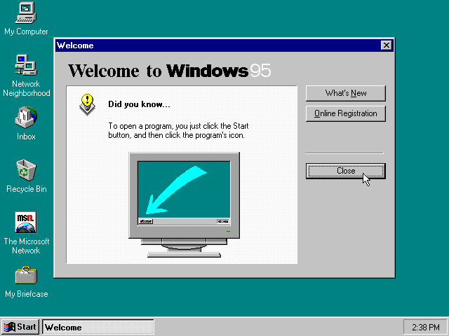
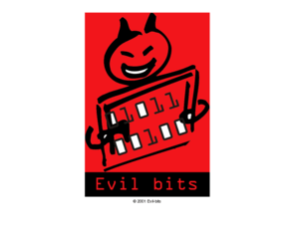
The old attack model
port 135
(DCE)
Internet
port 137, 139
(NetBIOS)
port 1433, 1434
(MS SQL)

Slide 26


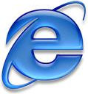

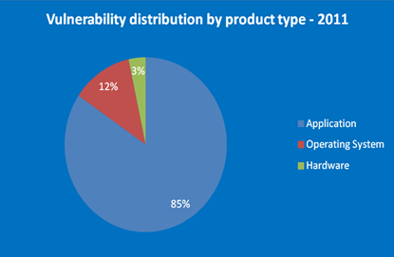
… and now
downloaded documents

Slide 27
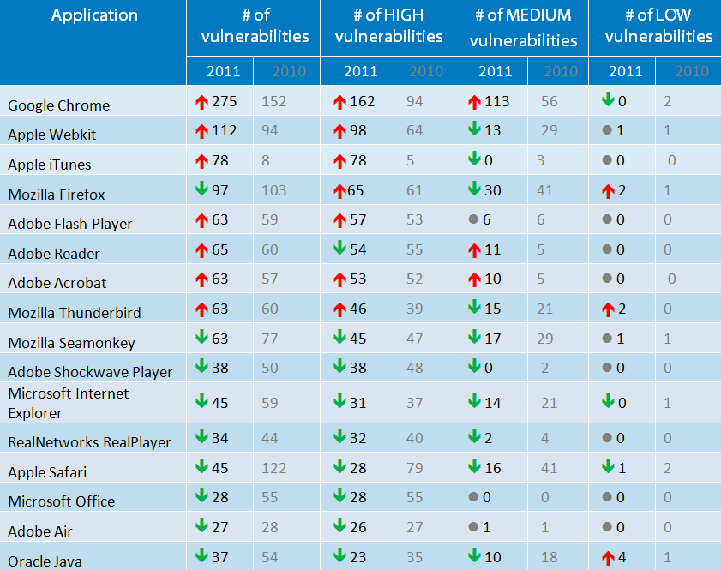
Vulnerabilities 2011
dubious metric?
Notes:
http://www.accuvant.com/sites/default/files/AccuvantBrowserSecCompar_FINAL.pdf

Slide 28
What can be done?
Harden key libraries
  protocols (HTTP, IMAP, SIP, …)
  file type parsing
  → fuzzing
Separate parsing & system access via pipe
  e.g., Google Chrome
Separate VM for enterprise applications
Restrict privileges
  Android: each app has separate user ID
  Permission restriction
    App store, rather than browser, for installing software
    No need to store files in system areas
    Limited system permissions
      harder with HTML5, WebRTC, SVG, …

Slide 29
All systems must update automatically
Manual updates → compromise (see Adobe Flash)
  Microsoft “patch Tuesdays”
“Evergreen browsers”: Firefox, Chrome
MacOS transitioning to automatic updates
yum on CentOS and RedHat EL
Google policy on responsible disclosure

Slide 30
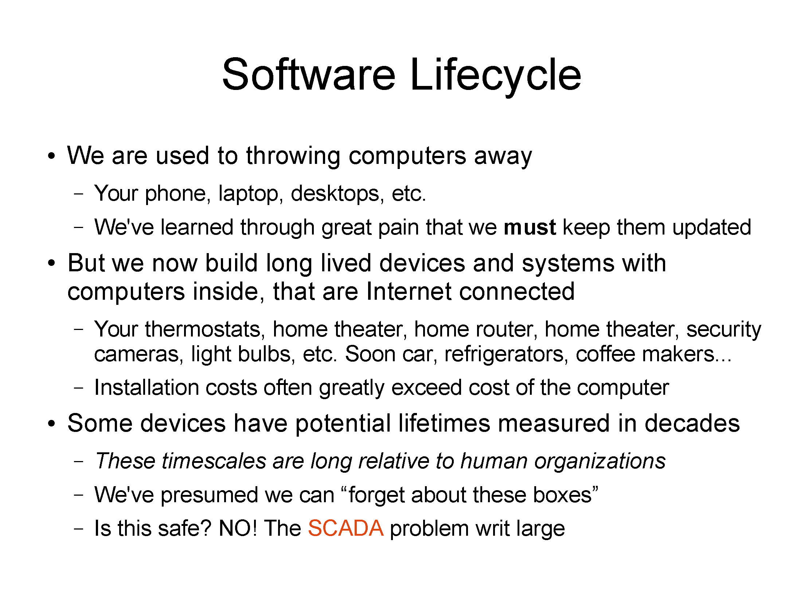
Jim Gettys (June 2014)

Slide 31
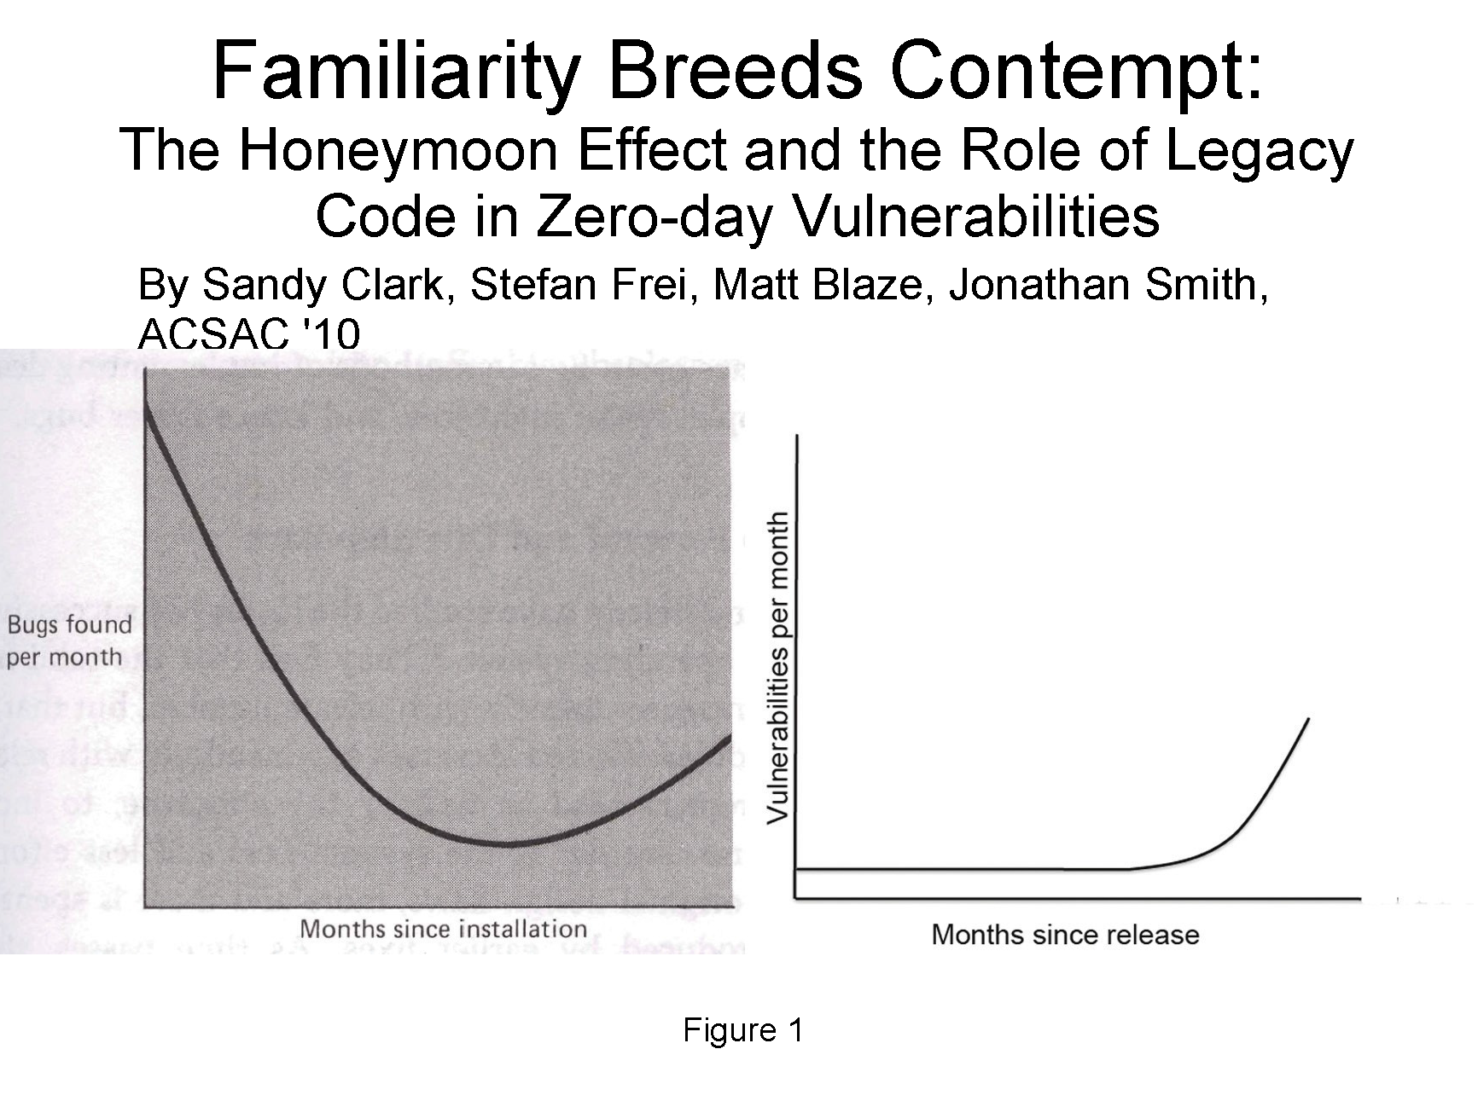
Jim Gettys (June 2014)

Slide 32
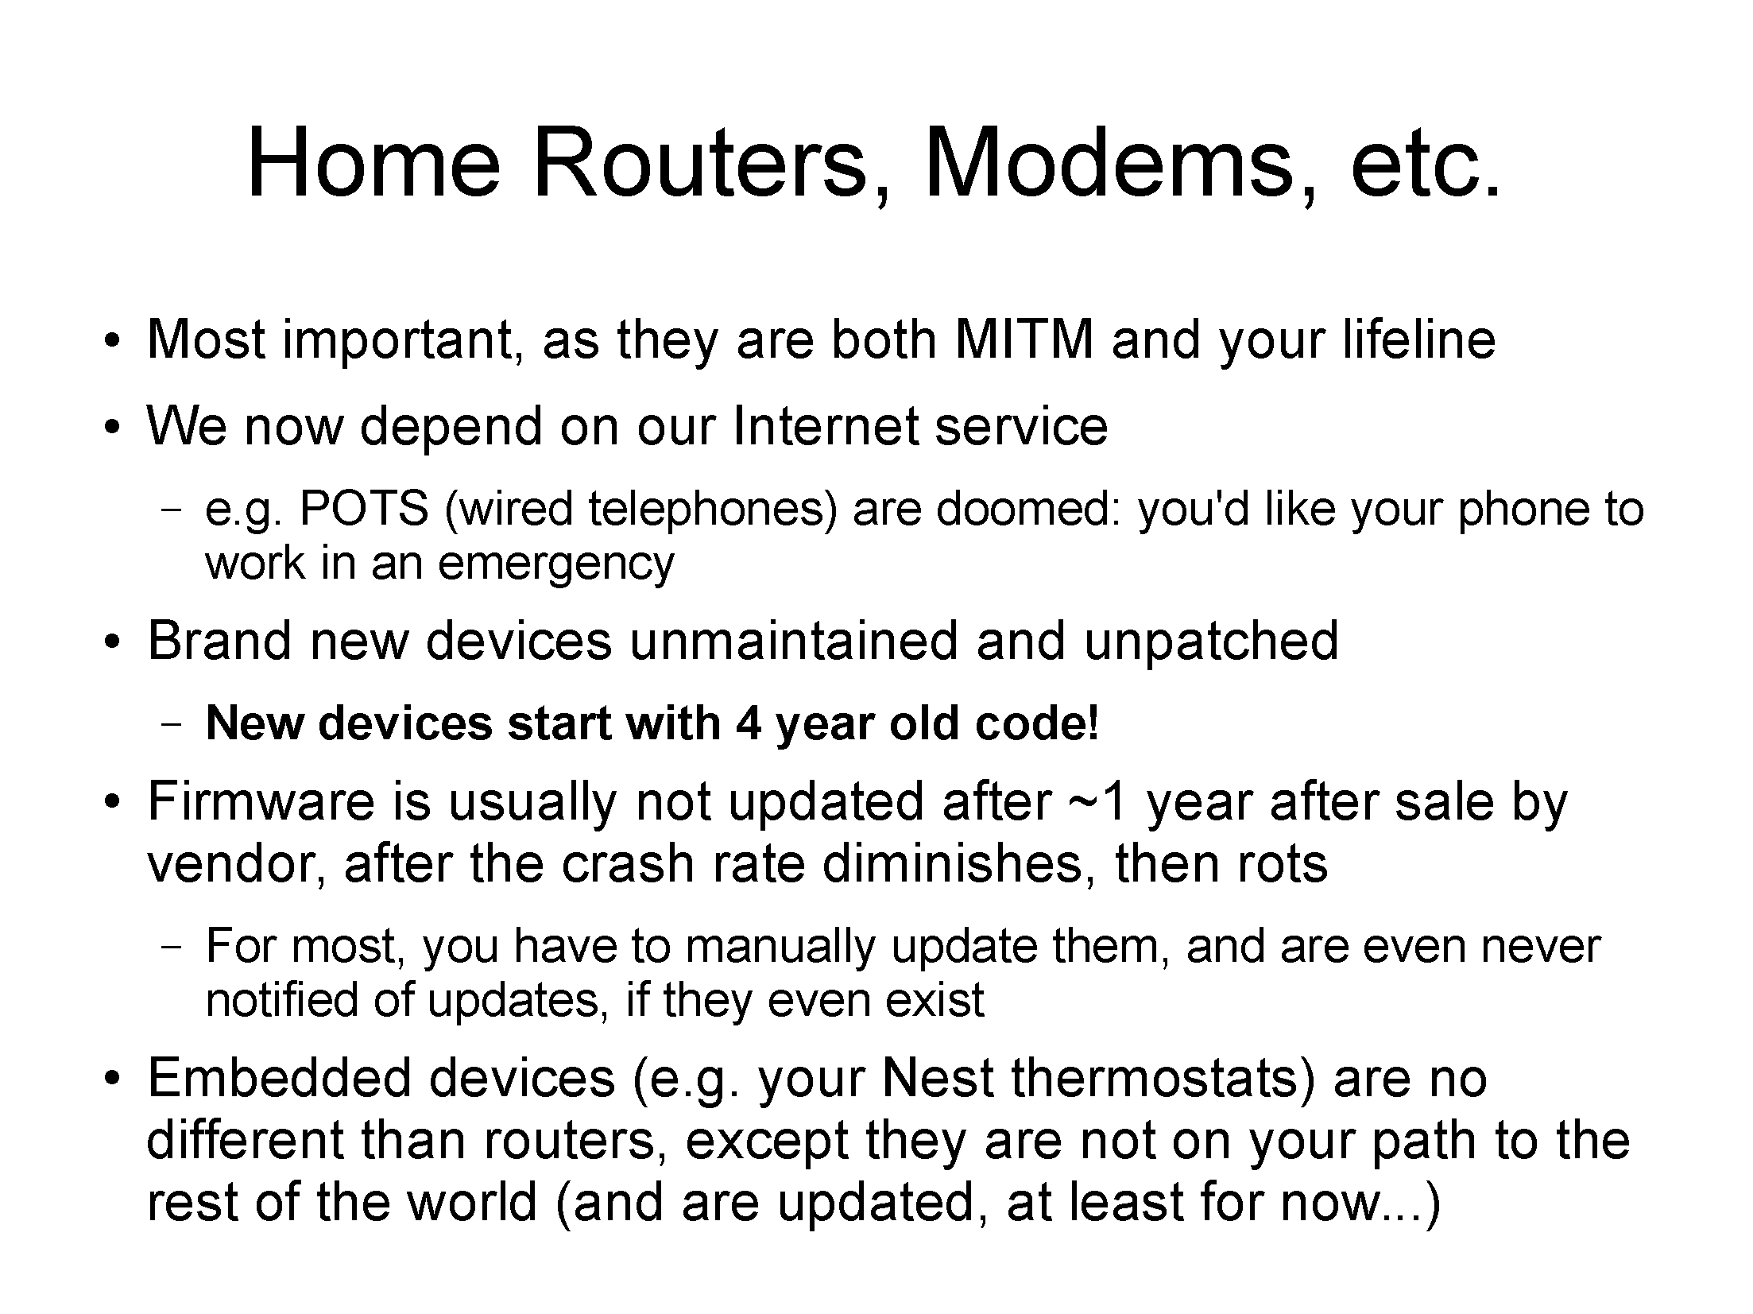
Jim Gettys (June 2014)

Slide 33
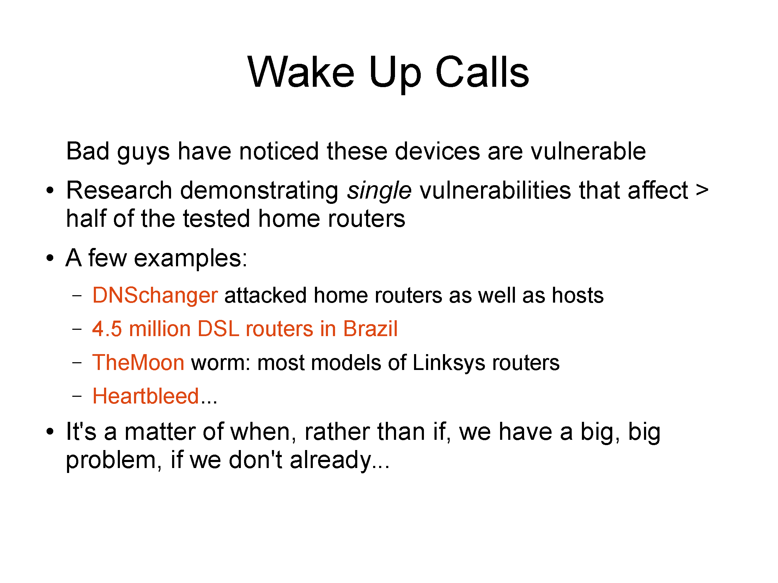
NTP reflection attack
Jim Gettys (June 2014)

Slide 34
Six dumbest ideas in cybersecurity (2005!)
Default permit
  firewall rules
  execution
Enumerating badness
  anti-virus, intrusion detection, deep packet inspection, …
Penetrate and patch
Hacking is cool
Educating users
  “you should expect to have to ‘patch’ your users every week”
Action is better than inaction
Remote computing freed criminals from the historic requirement of proximity to their crimes. Anonymity and freedom from personal victim confrontation increased the emotional ease of crime, i.e., the victim was only an inanimate computer, not a real person or enterprise. Timid people could become criminals. The proliferation of identical systems and means of use and the automation of business made possible and improved the economics of automating crimes and constructing powerful criminal tools and scripts with great leverage.
Notes:
http://www.ranum.com/security/computer_security/editorials/dumb/index.html

Slide 35
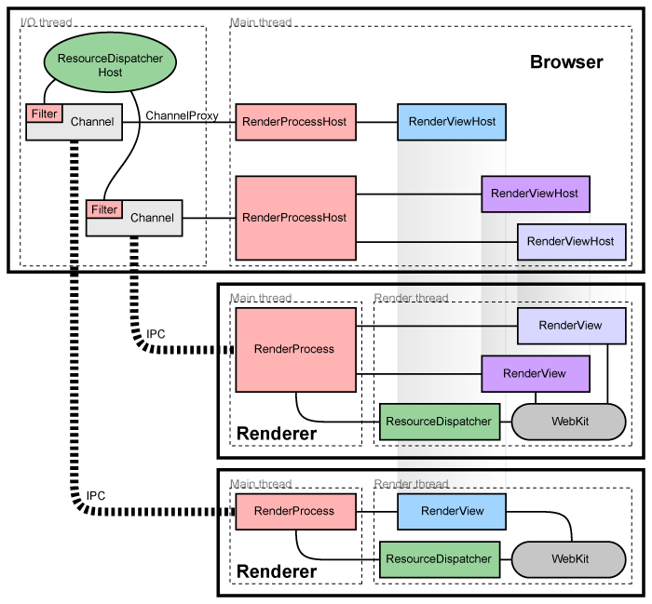
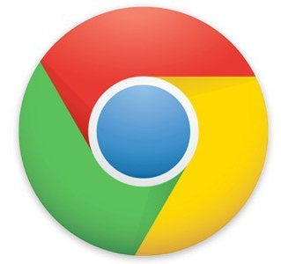
Design pattern: process separation

Slide 36
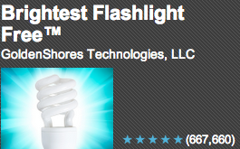
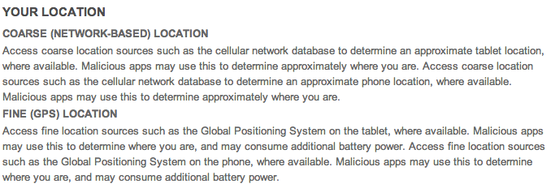
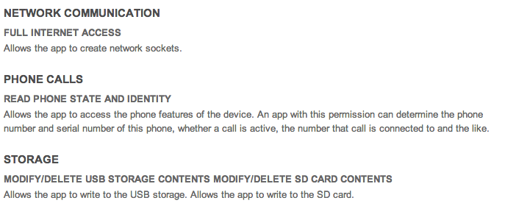
App permissions are not sufficient

Slide 37
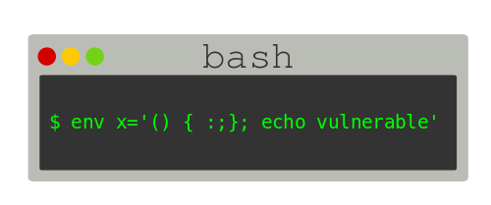

ShellShock for light switches
IoT risks: privacy, DDOS, extortion (ransomware for your freezer), …
Securely field updateable or no connection to Internet
  still vulnerable if malware on home network
Lifetime of devices > lifetime of company
Insurance model:
  source code escrow + maintenance for N years
UL listing

Slide 38
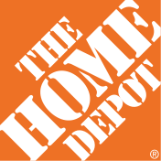
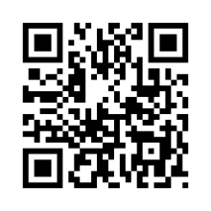
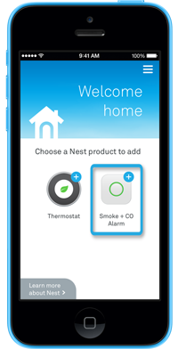
Challenge: enrollment
Commercial buildings → enroll 1,000s of devices at once
Home → enroll one device at a time
  current model: one app per device (class)
  re-do if Wi-Fi password changes
  common options:
    QR code
    P2P Wi-Fi (Wi-Fi Direct)
  possibilities
    “hi, I’m a Philips light bulb – add me!” (PKI)

Slide 39
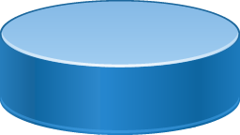
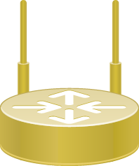
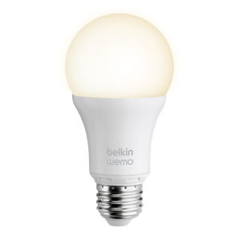
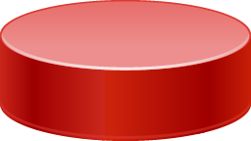
How should we secure things?
Old model
802.1x
WPA2
(P, E)
DIAMETER
New model
“I want to join!”
commissioner
device authorization
database
create entries

Slide 40
Privacy

Slide 41
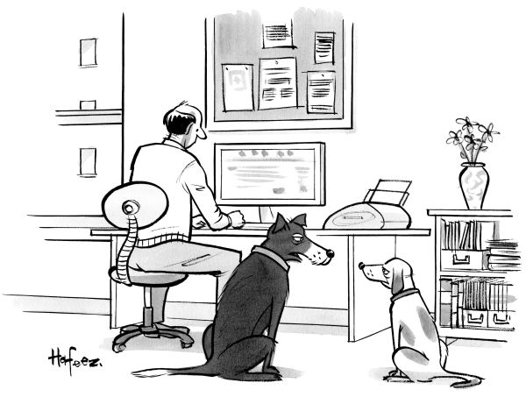
“Remember when, on the Internet, nobody knew who you were?”

Slide 42

Privacy threats
fear of exploration
embarrassment
family secrets
“we regret to inform you”
pre-existing condition
vacation burglary
stalking

Slide 43
Privacy fears deter usage
NTIA
May 2016
Major Concerns Related to Online Privacy and Security Risks,
Percent of Households with Internet Users, 2015
Notes:
https://www.ntia.doc.gov/blog/2016/lack-trust-internet-privacy-and-security-may-deter-economic-and-other-online-activities

Slide 44

Roughly half of consumers uncomfortable
Altimeter Group
June 2015
Notes:
http://www.altimetergroup.com/pdf/reports/Consumer-Perceptions-Privacy-IoT-Altimeter-Group.pdf

Slide 45




Privacy
Difficulty of defining privacy
  specific threats (“harm”) vs. just fear of threat
  current vs. future (e.g., job search, insurance)
    algorithmic scoring of consumers
Emphasis on data gathering unhelpful
  → same information can be used for low-risk and high-risk activities
IETF GEOPRIV approach:
  how long is data stored?
  is it shared with third parties?
    (but what are third parties?)
Notes:
http://www.ftc.gov/os/2013/02/130201mobileprivacyreport.pdf

Slide 46
IoT: more than programmable light bulbs
public sensors & actuators
semi-private
private

Slide 47

Privacy – other approaches
Hiding & obfuscation
  e.g., pretend that location is unavailable
  fuzz location
Restrict sensitive information to approved purposes
  expose location to well-known ad network, not unknown
Third-party privacy evaluation
FTC Section 5 enforcement (“unfair or deceptive practices”)

Slide 48
Privacy
“flow of information in accordance with social norms, as governed by context” (Nissenbaum, 2009)
→ confidentiality + fair use
classical responses:
  C-PET (confidentiality-oriented Privacy Enhancing Technologies) [JP Hubaux/A Juels, 2016]
    encryption, proxies, cookie blocking, identifier randomization, …
  laws and regulations
    EU: general data protection rules (access, deletion, retention, …)
    US: sector-specific laws (health, education, finance) + notice-and-consent
but increasingly hard to maintain
  consensual sharing
  second-hand data leakage (e.g., picture tagging)
  leaks & malware
  lack of plausible alternatives (e.g., search or BIAS)
  combinations of semi-public data sources
JP Hubaux & A Juels, CACM 6/2016

Slide 49

Local processing for efficiency privacy
node
publicly visible script
cloud storage and access
fuzz
anonymize
average
rate limit
observable storage
indoor
thermometer
fog computing model

Slide 50
Infrastructure security

Slide 51
Improving network infrastructure security
FCC + industry for six months → three critical threats to the Internet:
  Domain Name System security
  Routing security
  Botnets
Specific voluntary recommendations approved by CSRIC in March 2011 to advance deployment of DNSSEC, BGPSEC, and a domestic ISP Code of Conduct to fight botnets.
Nine of the largest ISPs, representing nearly 90% of the domestic user base, publicly announced their intent to deploy the recommendations.
Next step: measure deployment & impact → Measuring Broadband America
  not much as of 2016
51

Slide 52

Anti-botnet ecosystem

Slide 53
Security beyond viruses and Phishing: Fraud & Human DOS attacks

Slide 54






Fraud in TRS (text relay service)
+1 201 555 1234

Slide 55


DOS attacks on humans: 9-1-1

Slide 56
Conclusion
Internet security is a systems problem, not (primarily) a crypto or protocol problem
Treat security as system failures → redundancy, time-to-repair
Don’t wait for the Internet to be secure
Global optimization:
  change processes
  encourage transparency and informed consumer choice
  economics: externalities – make cause of problem bear the cost

Slide 57
Robocalls & Caller-ID spoofing

Slide 58
The Telemarketing Sales Rule: Three Protections
Do not call (national)
no sales calls to users on do-not-call list
Do not call (entity-specific)
businesses and for‐profit fundraisers can’t make sales or solicitation calls to consumers who have previously requested not to receive calls from that company.
Robocalls
businesses can’t make sales calls to consumers
prohibited even if the consumer’s phone number is not on the Do Not Call Registry
except written permission
does not include politicians
FTC (Will Maxson, 2012)

Slide 59
What calls are not covered?
Most business to businesses telemarketing
Debt collection calls
Customer service or customer satisfaction calls
Market research/survey calls (only if no sales pitch)
Polling/political calls (get out the vote, contribution requests)
Calls made by companies subject to special federal /state regulation (banks, phone companies, insurance companies)
Robocalls delivering a healthcare message made by or for a covered entity, as defined by the HIPAA Privacy Rule
FTC (Will Maxson, 2012)

Slide 60

How do robocalls work?
FTC 2012

Slide 61

The geography of robo-calling
FTC 2012

Slide 62

Robocall eco system
FTC 2012

Slide 63

What you can do when robo-called

Slide 64
The enablers
Robocalling
Cheap VoIP
Number spoofing
Cheap labor

Slide 65




Law enforcement vs. robocallers
Agile numbering
Automated customer acquisition
Transnational
One faxed subpoena at a time
Manual trace-back
Largely domestic

Slide 66




What has changed?
one assigned
number
customer
local exchange carrier
can’t tell end user from provider → can use any number

Slide 67

Caller ID spoofing
Caller ID Act of 2009: Prohibit any person or entity for transmitting misleading or inaccurate caller ID information with the intent to defraud, cause harm, or wrongfully obtain anything of value.

Slide 68
Caller ID spoofing
enhances theft and sale customer information through pretexting
harass and intimidate (bomb threats, disconnecting services)
enables identity theft and theft of services
compromises and can give access to voice mail boxes
can result in free calls over toll free dial-around services
facilitates identification of the name (CNAM) for unlisted numbers
activate stolen credit cards
causes incorrect billing because the jurisdiction is incorrect
impairs assistance to law enforcement in criminal and anti-terrorist investigations
A. Panagia, AT&T

Slide 69



VoIP spoofing
A. Panagia, AT&T
PSTN
VoIP Application
Switch
A
Switch
B
STP
IP
CNAM
SPOOFER
SPOOFEE

Slide 70
Why not use email spam filtering techniques?
 | Email | Phone calls
Name space | infinite | relatively small
Content inspection | common | not possible
Addresses | IP address – non-spoofable for TCP Email address – easily spoofable | Phone number -- spoofable
Delivery | filtered by provider: block lists (e.g., Spamhaus) SPF, DKIM | interconnection and delivery obligations
Delivery trace | Received-by headers | Via headers – only for end-to-end VoIP calls
Limited-use address | easy (e.g., web mail) | not feasible
Consent-based | CAPTCHA systems (not common) | likely too annoying
see also RFC 5039

Slide 71






Future, part 1: trustable phone numbers
previous contact

Slide 72


IP-based PSTN: build in security!
Via: SIP/2.0/TLS client.biloxi.example.com:5061;branch=z9hG4bKnashds7
;received=192.0.2.201
trace call route
VoIP provider A
VoIP provider B
§
§
§
automatically route subpoena

Slide 73





Caller identification
known caller
previous calls
sent her emails
what’s your SSN?
name unimportant
bank ✔
credit card office ✔
can you recommend student X?
name unimportant
IEEE ✔
known university ✔

Slide 74
Attribute validation
For unknown callers, care about attributes, not name
SIP address-of-record (AOR) → attributes
  employment (bank, registered 501c3)
  membership (professional)
  age (e.g., for mail order of restricted items)
  geographic location
Privacy
  → selective disclosure
  no need to disclose identity

Slide 75




Attribute Validation Service
Attribute Validation Server (AVS): Issuer
e.g., members.ieee.org
Attribute Reference ID
(ARID)
e.g.,
https://members.ieee.org/arid/4163
c78e9b8d1ad58eb3f4b5344a4c0d5a
35a023
{Alice’s username, credentials, user ID, role}
3. Establishes the validity of the
ARID with access code and retrieves selected attributes e.g., Alice’s role
1. Requests an ARID,
selecting attributes to disclose
HTTP over TLS
SIP over TLS
2. Makes a call with the ARID and part of access code
Caller: Principal
Alice
Student member in ieee.org
tel:+12345678
Callee: Relying Party
Bob
Accepts calls from members in ieee.org;
does not know Alice’s phone number
sips:bob@example.com
75

