Slide 1
Internet Technology, Economics and Policy
Henning Schulzrinne
http://www.cs.columbia.edu/~hgs/teaching/itep/

Slide 2
Class overview

Slide 3
Big questions
How does the Internet work, technically?
How come your Internet bill is so high (or low)?
What’s hard about extending the Internet to rural areas?
Is the Internet local, national or international?
What does it mean for the Internet to be “open” or “neutral”?
How can we make the Internet useful for public safety, people with disabilities?
Why do carriers pay billions of dollars for spectrum?
What makes “cyber security” hard?
What is privacy?

Slide 4
What should you be able to do after taking the class?
Elevator pitch
  “What is spectrum and why is it hard to find” – in 2 minutes
In-depth survey
  “The economics of Internet adoption in rural and urban areas”
Research
  Know sources and approaches
    engineering models vs. economic models vs. legal analysis
  Appreciate need to consider
    technical feasibility
    economic factors
    policy enablers and constraints

Slide 5
Materials
No formal text book, but draws from
  “Telecommunications Law & Policy” (S. Benjamin, Shelanski, Speta, Weiser), 2012.
  “The Master Switch” (T. Wu).
  “Computer Networking: A Top-Down Approach” (J. Kurose, K. Ross), 6th edition, Addison-Wesley, 2013.
Other materials:
  Technical papers (IEEE, ACM, tech reports, …)
  White papers
  Industry analysis reports
  Regulatory filings (FCC, Ofcom, BEREC, …)
  Laws & regulations

Slide 6
Why do we care?

Slide 7
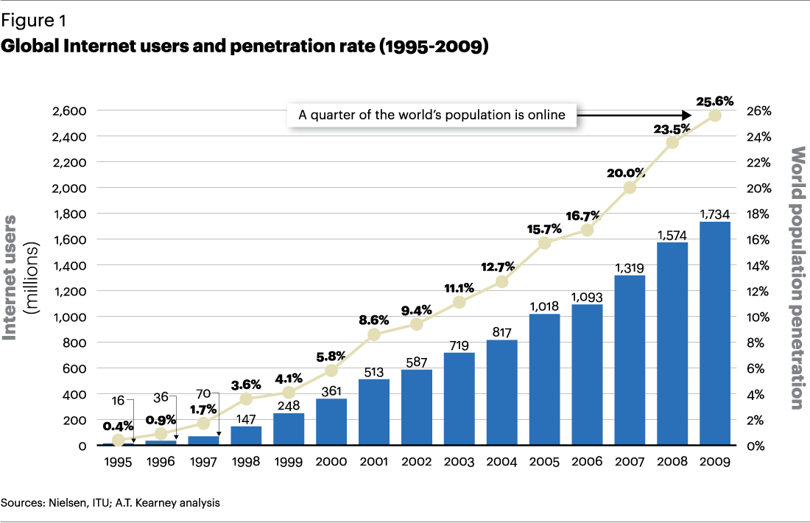
Internet growth – classical view

Slide 8
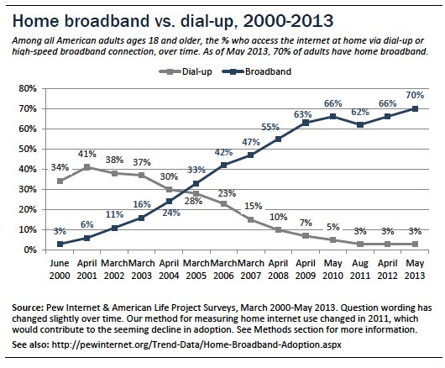
US Internet use
Pew
Notes:
http://www.pewinternet.org/2013/08/26/home-broadband-2013/

Slide 9
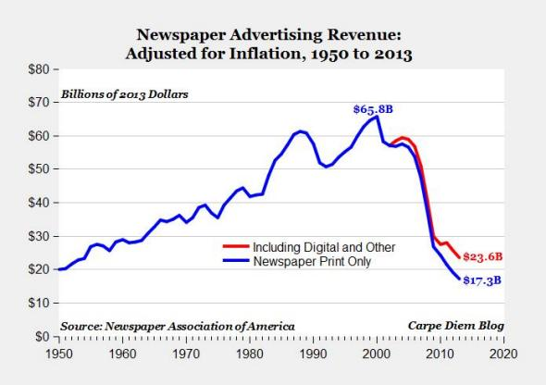
But not all are happy about this…

Slide 10

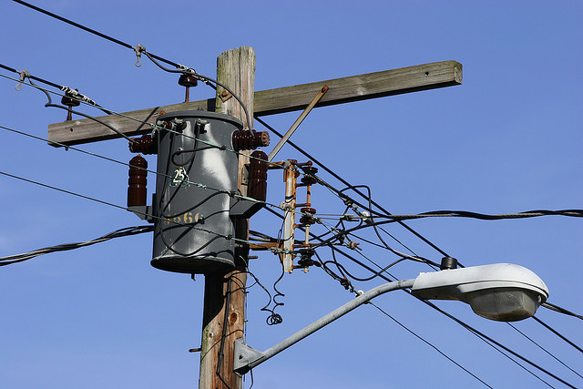









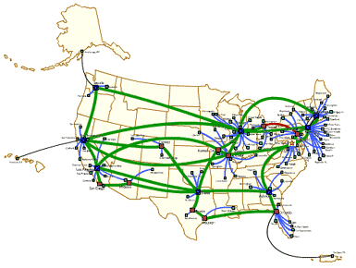
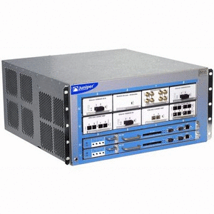
Basic Internet money routing
ISP
Internet
consumer spending
($11.2T)
content & service aggregators
OTT
(over-the-top)
Notes:
http://www.tradingeconomics.com/united-states/consumer-spending

Slide 11
OTT, VOD, SVOD, …
OTT = delivery of services (interactive voice, entertainment video) over the Internet without subscribing to traditional cable or telephone service
  Video: Netflix, Hulu, HBO Go, YouTube, Vimeo, Go90
  Voice: Skype, Vonage, FaceTime, …
OVD = online video distribution (linear, scheduled [not VOD])
SVOD = streaming/subscription video on demand
AVOD = ad-supported video-on-demand
TVOD = transactional; “pay TV”
MVPD = multi-channel video programming distributor
  typically, linear = “live TV”
TV Everywhere = cable service over IP (same bundle)
Notes:
http://digiday.com/platforms/what-is-over-the-top-ott/
http://www.lightreading.com/video/ott/to-be-or-not-to-be-an-mvpd/d/d-id/714880

Slide 12
OTT, SVOD, …
Service | Linear vs. on-demand | bundle or individual | payment | example
OVD | both | any | any
MVPD | linear (may offer VOD) | bundles | monthly | cable TV, satellite
TV Everywhere | linear | subset of TV bundle | monthly | Comcast, TWC
SVOD | on demand | bundle | monthly | Netlfix, HBO Go, Hulu Plus
TVOD |  | movie | movie | Amazon Instant Video
AVOD |  | short form content, movie | ad-supported | YouTube, Vimeo, Hulu

Slide 13
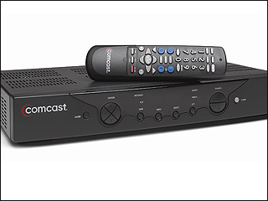






Basic video money routing
MSO/MVPD
retransmission consent fees
cable
consumer spending
($11.2T 2Q15)
cable channels
reverse compensation

Slide 14
More industry revenues
Company or sector | US domestic revenue, 2014
Netflix (US) | $3.4B
Cisco (Americas) | $27.8B
US cable TV | $56B
US film | $31B (2013)
US music | $10B (2013)
US Games (software) | $20.5B
US Wireless telecom | $205B
Google (worldwide) | $66B (56% international)
Notes:
http://files.shareholder.com/downloads/NFLX/716284934x0x826035/b69e6840-a84e-425e-9ea3-a0ff4c507e58/SEC-NFLX-1065280-15-6.pdf
http://clients1.ibisworld.com/reports/us/bed/default.aspx?bedid=4625
http://www.statista.com/statistics/293486/revenue-of-cable-networks-in-the-us/
http://selectusa.commerce.gov/industry-snapshots/media-entertainment-industry-united-states.html
http://www.techtimes.com/articles/9270/20140627/america-china-japan-video-games-revenue.htm
http://www.statista.com/statistics/293490/revenue-of-wireless-telecommunication-carriers-in-the-us/
https://investor.google.com/earnings/2014/Q4_google_earnings.html
https://apps.fcc.gov/edocs_public/attachmatch/FCC-15-41A1.pdf

Slide 15
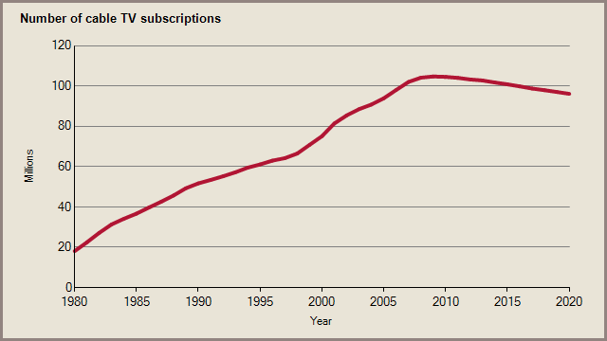
Cable TV subscriptions

Slide 16
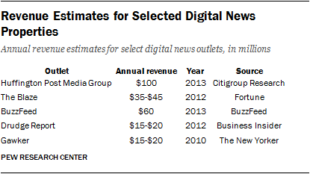
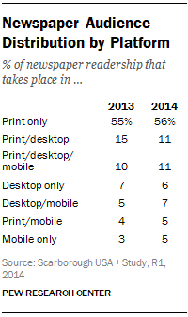
News revenue
2012: $38.6B for 1,400 US dailies
  2/3 ($25.2B) from advertising
  ¼ ($10.4B) digital & print circulation
  rest: events, commercial printing, e-commerce, …
12 cable news channels, 3 broadcast networks news, 800 news-producing local TV stations
  $16.4B revenue
  total of about 2,200 TV stations
  3 news networks: $691M average
Non-commercial sector: $1.9B
  includes 1,000 local public radio stations
Notes:
http://www.journalism.org/2015/04/29/newspapers-fact-sheet/
http://www.journalism.org/2014/03/26/industry-breakdown-newspapers-still-largest-revenue-segment/

Slide 17
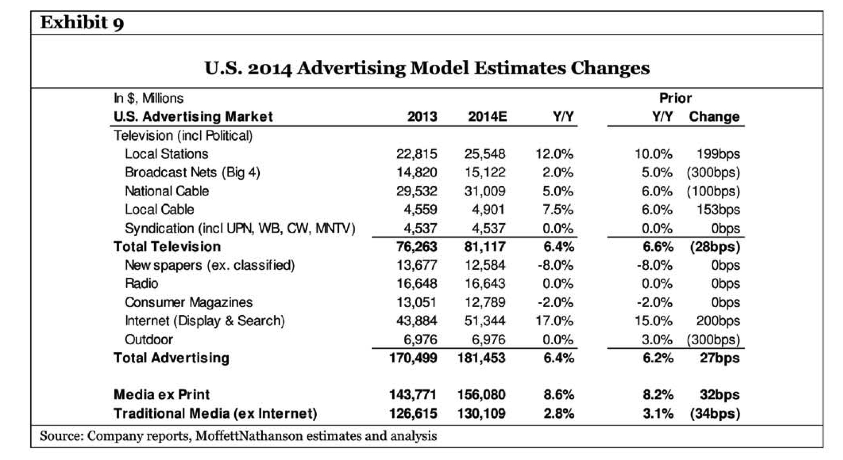
2014 U.S. Advertising

Slide 18
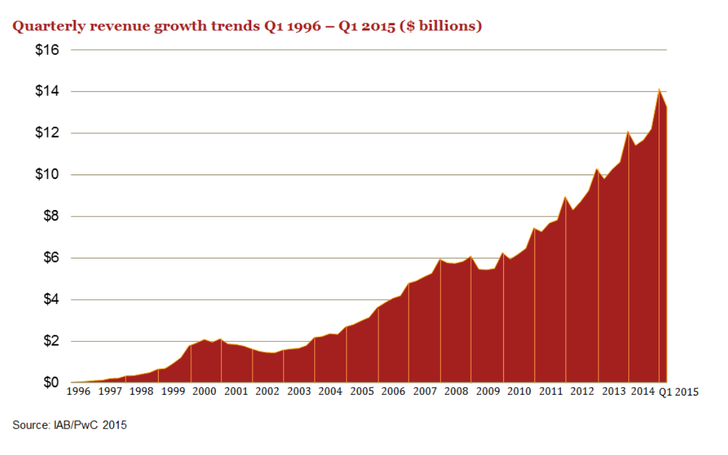
Digital advertising revenue
Notes:
http://www.iab.net/about_the_iab/recent_press_releases/press_release_archive/press_release/pr-061115

Slide 19
Who is advertising?
Notes:
http://www.iab.net/media/file/PwC_IAB_Webinar_Presentation_FY2014_PWC.pdf

Slide 20


What kind of advertising?
Display ads
  brand awareness, mostly
  fixed cost or bidding for pages
  pop-ups, inline, interstitial (before & after)
Search ads
  bidding for key words
Location-based (push) advertising
Email-based
Sponsored content
Video ads
  Pre-roll & insert
Classifieds (e.g., Craigslist)

Slide 21
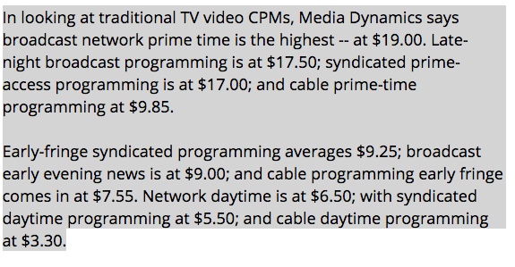
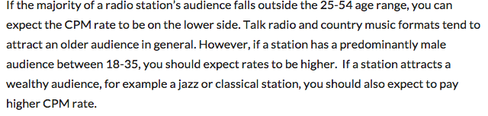
Advertising reach
Classical
  TV, radio: rating points – 1% of TV households (116.3 M in 2014)
    particular A18-49 (adults 18 to 49)
    Live, Live+SD, Live+7
  Newspaper: circulation
Digital
  CPM: thousand impressions
    $2.80 display ads; $5 email; $3 video
  CPC: thousand clicks
    → CTR: click-through rate (relevance for mobile?)
  Google AdSense: 68% to publisher, 32% to Google
TV CPM
Radio CPM: ~$20
Notes:
http://www.statista.com/statistics/243789/number-of-tv-households-in-the-us/
http://www.allbusiness.com/web-advertising-and-cpm-a-quick-guide-for-small-businesses-2646-1.html
http://monetizepros.com/display-advertising/average-cpm-rates/
http://webgilde.com/en/how-much-does-adsense-pay/
http://fitsmallbusiness.com/radio-advertising-costs/

Slide 22
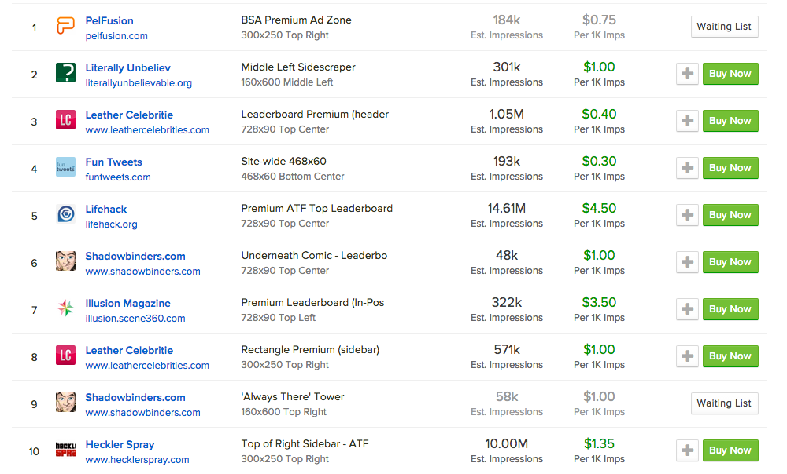
How much can you make on web ads?
https://buysellads.com/buy/leaderboard/id/17/soldout/1/ch/47

Slide 23

Web and mobile advertising
Not just CPM – multiple ads per page
  “$48/1000 visits”
  $0.25-$3 for generic sites
  $1-$10 for content rich sites
  $10 for product-related sites
Ad tracking
  cross-site cookies – embedded frames or images
    or track by IP address, browser characteristics, etc.
  effectiveness?
Impact of ad blocking?
  IOS9
Notes:
http://webgilde.com/en/how-much-does-adsense-pay/
https://www.eff.org/privacybadger

Slide 24
Example trackers (New York Times)

Slide 25
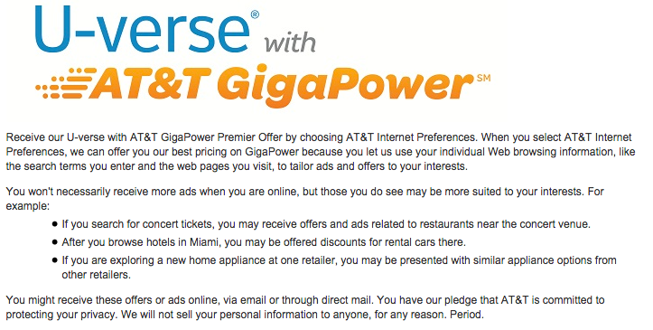
Tracking users and households
Cookies (“same origin policy”)
IP address
Browser characteristics
  e.g., user agent, links visited
“Super cookies”
ISP-based tracking

Slide 26
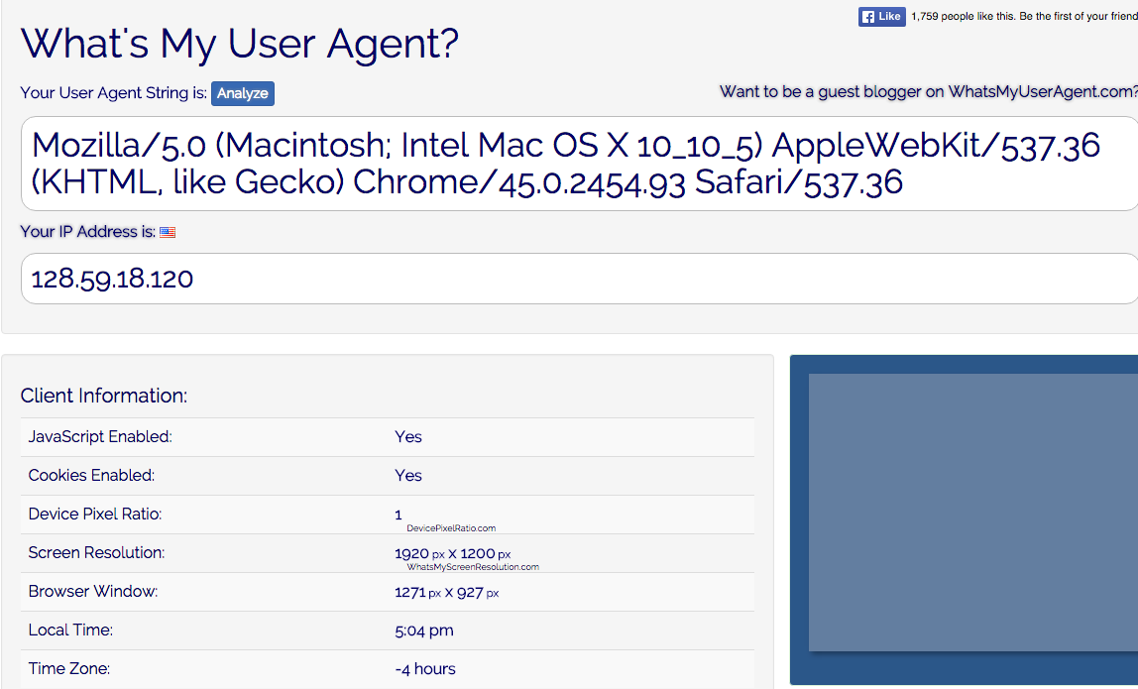
Browser strings
Notes:
http://whatsmyuseragent.com/

Slide 27
What kind of advertising?
Real-time brokered: $2B
Notes:
http://www.iab.net/media/file/PwC_IAB_Webinar_Presentation_FY2014_PWC.pdf

Slide 28
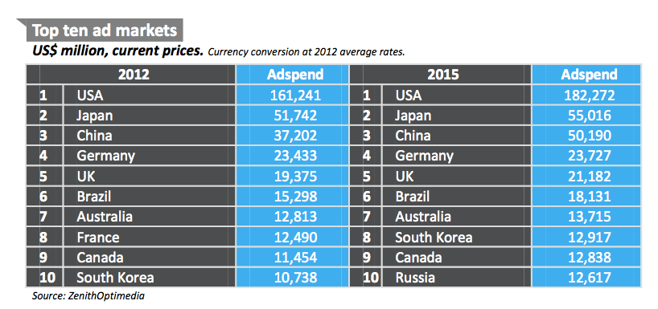
US dominates marketing

Slide 29
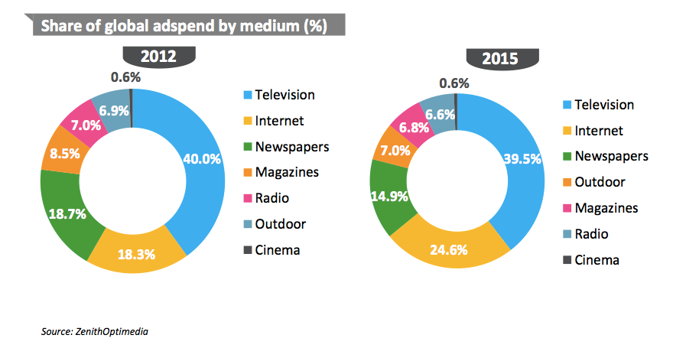
Global ad spending by medium

Slide 30

Converging communities
since 1900: separate networks, companies, professions
machine → machine
machine → human
human → human
1960s
1896
1915
1876
data
broadcast
(radio, TV)
voice
(telephone)
IM
generality
data integrity
access control
low cost
scalability
copyright prot. (DRM)
ease of use
universality
reliability
privacy
Internet

Slide 31
Lifecycle of technologies
traditional technology propagation:
military
corporate
consumer
opex/capex doesn’t matter;
expert support
capex/opex sensitive, but amortized;
expert support
capex sensitive;
amateur
Can it be done?
Can I afford it?
Can my mother use it?

Slide 32
Internet and networks timeline
university
prototypes
production use
in research
commercial
early residential
broadband
home
Internet
everywhere
theory
1960
1970
1980
1990
2000
2010
port
speeds
100 kb/s
1 Mb/s
10 Mb/s
100 Mb/s
1 Gb/s
DNS
RIP
UDP
TCP
SMTP
SNMP
finger
ATM
BGP, OSPF
Mbone
IPsec
HTTP
HTML
RTP
Internet
protocols
XML
OWL
SIP
Jabber
email
ftp
queuing
architecture
routing
cong. control
DQDB, ATM
QoS
VoD
p2p
ad-hoc
sensor

Slide 33
What has changed?
1980s/1990s | 2000s+
Rapid technology evolution in network core | Relatively stable core technology
Internet exceptionalism (no distance! no borders!) | National laws & customs
Internet utopianism | “Big Switch”, harms & limitations
Performance! | Reliability?
Cost-insensitive (and “free” phone access) | Deployment cost barriers
Separated from commercial media (newspaper, magazines, radio, TV) | Affects all media
Self-revealed data (email, BBS) | Intimate data (information access, behavioral)
Little economic impact | One of the largest US exports

Slide 34
What’s different?
What | Utilities (gas, water, electricity) | Internet | Consumer electronics
Geographic scope | regional | local, national, international | mostly international
Economics | enabler | entry, competition, enabler | Trade, patents
Impact on culture | minimal | foundational | rarely (Walkman, iPhone)
Impact on domestic politics | in LDCs | jobs, education, health, transportation, copyright, income inequality | health & education (smartphones)
Impact on international politics | water rights? | trade, espionage, propaganda, cyberattacks, copyright, … | trade

