Slide 1
Network technology review
Henning Schulzrinne
material drawn from various online sources, reports & author

Slide 2



Slide 3
Dividing the problem

Slide 4


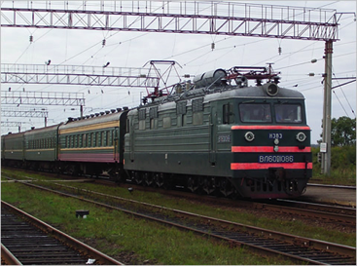
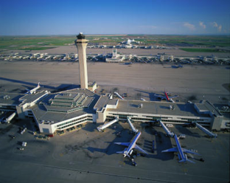
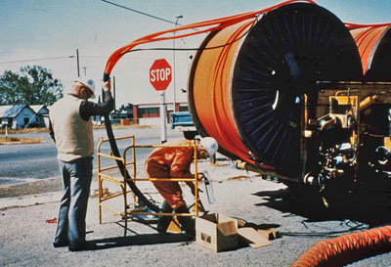
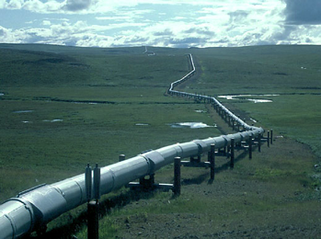
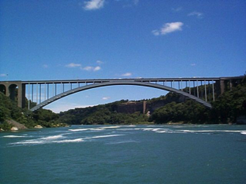
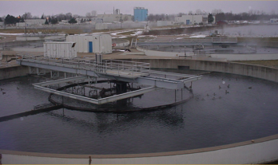
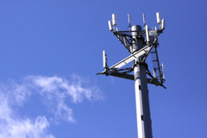
The great infrastructure
Technical structures that support a society → “civil infrastructure”
  Large
  Constructed over generations
  Not often replaced as a whole system
  Continual refurbishment of components
  Interdependent components with well-defined interfaces
  High initial cost
water
energy
transportation
communication

Slide 5
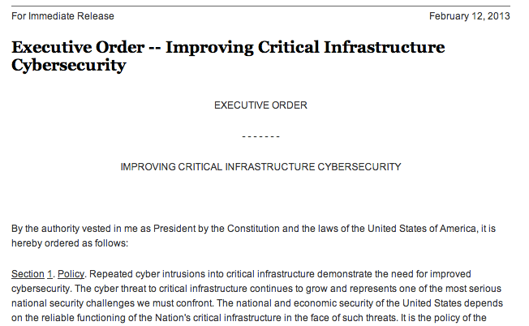
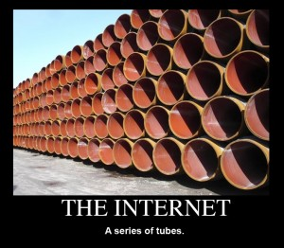
The Internet as core civil infrastructure

Slide 6
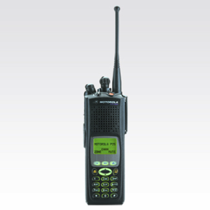

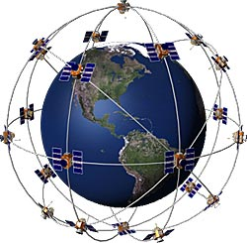


Broadband, Internet, communications
LMR
dial-up
Broadband (Internet)

Slide 7
Interdependencies with other lifelines
outside plant
Trans
recovery coordination
control
Water
CO & DC
flooding
shared
RoW
Telecom
shared
poles
towers & antennas
fuel
parts
Power
Pipelines

Slide 8













Who runs communication systems and networks?
incumbent local exchange carriers
(“ILEC”)
competitive local exchange carriers
(“CLEC”)
cable companies
(“MVPD”)
cellular providers (3-4)
~12
rural local exchange carriers
(“RLEC”)
wholesaler providers
(“carriers’ carrier”)
satellite providers
~1,000
communities (“muni networks”)
radio & TV stations
(1,784 TV, 15,470 radio)
private land mobile radio (public safety, transit, taxis, …)
~2
# with ~90% marketshare

Slide 9
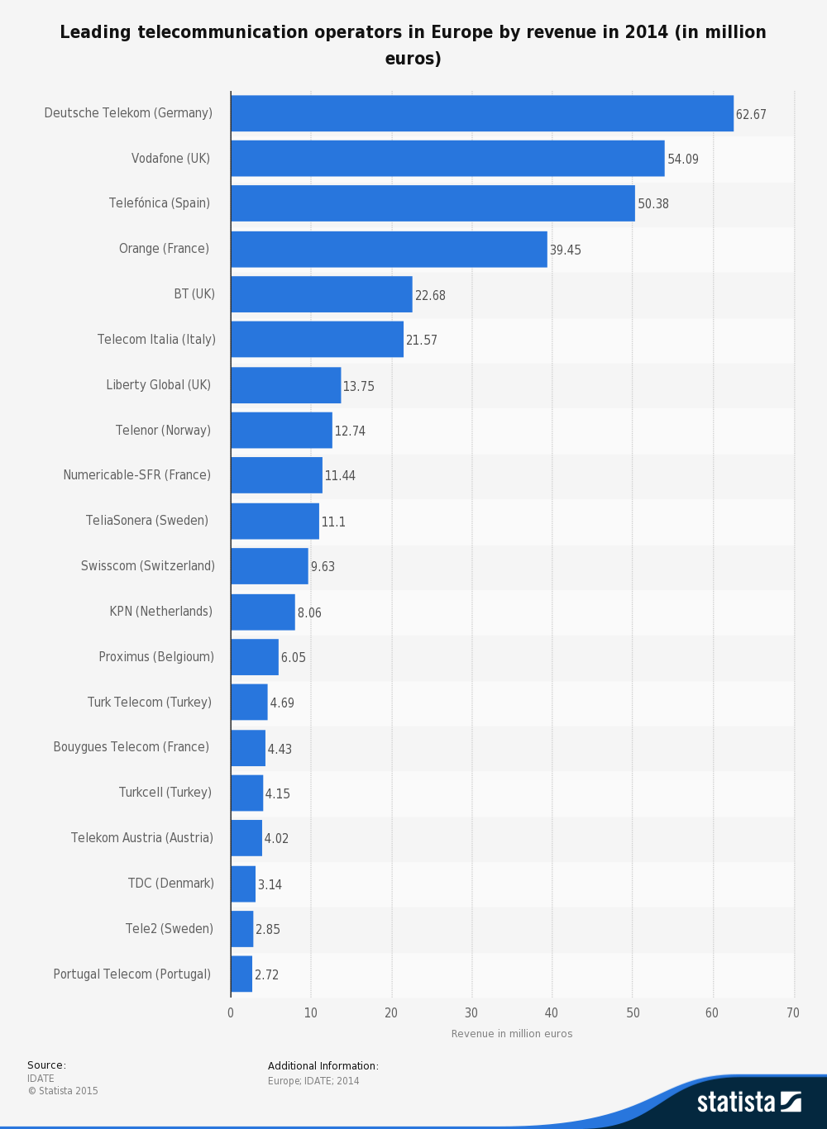
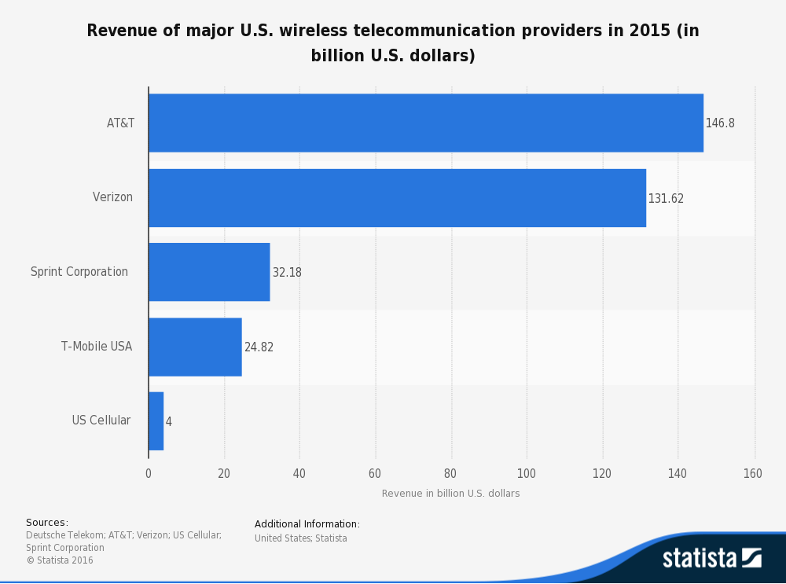
European and US telecom operators

Slide 10
Gerard de Graaf
European Commission
Where does Europe stand compared
to the rest of the world ? 3
3. A global transformation to a digital economy, fierce competition :

Slide 11
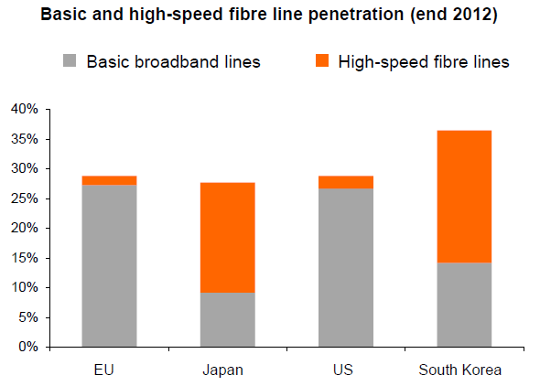
Gerard de Graaf
European Commission
Where does Europe stand compared
to the rest of the world ? 1
A global transformation to a digital economy, fierce competition :
- fixed access to the internet
European Commission, OECD

Slide 12
What do communications networks do that’s different?
Any-to-any: multiparty, coordination & cooperation, conflict
  less of a concern in (say) civil engineering
Economics: network effect, scale effects
Challenges:
  geographic distribution
  long-lived
  different industries participating

Slide 13
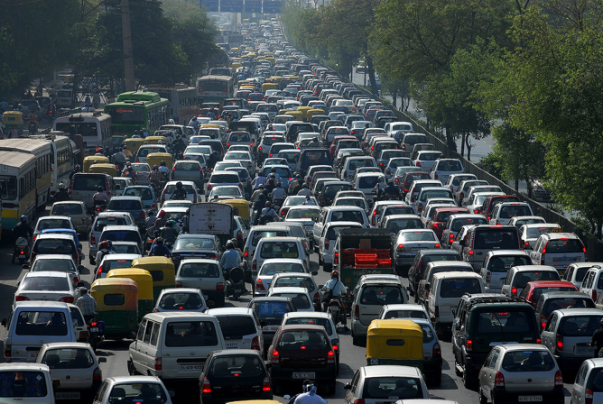
What problems do networks solve?
Diversity in technologies
  wired vs. terrestrial wireless vs. satellite
  trade-off capacity vs. cost vs. distance
Variation in load
  intermittent demand → shared networks
  cannot design capacity for top 5 minutes of load
“Noise”
  electric noise
  radio interference
Human adversaries
  denial-of-service attacks
  information theft
  impersonation

Slide 14
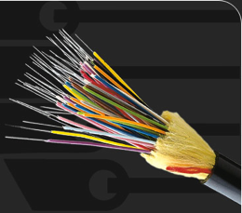
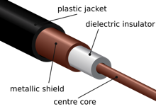
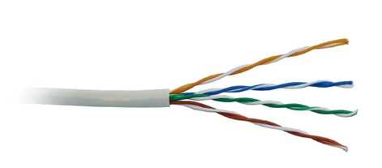
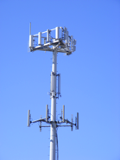
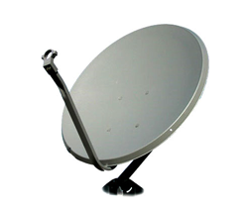
Network trade-offs
cost per user
* incremental cost assuming legacy networks;
“green field” cost is roughly the same
capacity per user

Slide 15
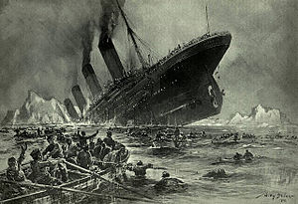


A bit of (US) history
1895-1901: G. Marconi demonstrates wireless communications
1912: Titanic
Radio Act of 1912
  all radio stations licensed
  monitor distress channel (500 kHz)
Radio Act of 1927
  deal with AM (“medium wave”) chaos → licensing “in the public interest”

Slide 16
Communications as a regulated industry
free-market economies, subject to government regulation
  “why” (and objections) later
telephony: federally regulated since 1910
broadcasting: 1927
telecommunications: 1934
  but dates back to Interstate Commerce Act of 1887 (railroads)
  cousins: railroads, electricity, air service, …
  specialized administrative agency for sector-specific regulation
    vs. general regulation (environmental, safety, employment, contracts, consumer protection, …)
Notes:
Benjamin

Slide 17
The Internet as core civil infrastructure
Involved in all information exchange
  (in a few years)
Crucial to
  commerce
  governance
  coordination
  inter-personal communication
Assumed to just be there
  “plumbing”, “pipes”, …

Slide 18

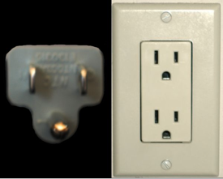
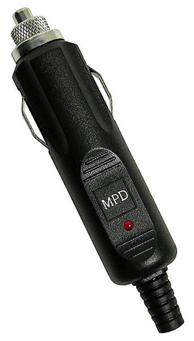
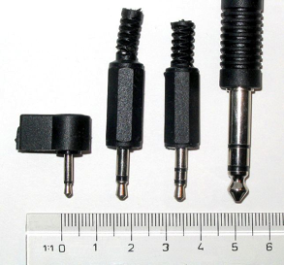

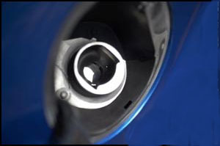
Technology comes & goes, interfaces are forever
1993
1904
1908
1947
1956
1878
1982
1970s
fuel nozzle
1885?
1974
1992
Notes:
http://www.cpcstech.com/usoc-universal-service-ordering-code-information.htm

Slide 19
The two-layer model
content
apps & software
services
copyright
data privacy
data theft
disability access
IP
patents
resource scarcity
investment
technology innovation
“Lower layers”
infrastructure
“the network”
disruption
location privacy
universal service

Slide 20
Layering
secure, reliable, world-wide
email
functionality
L7
generality
PHY (L1)
any digital
communications
unreliable bits
over one link

Slide 21

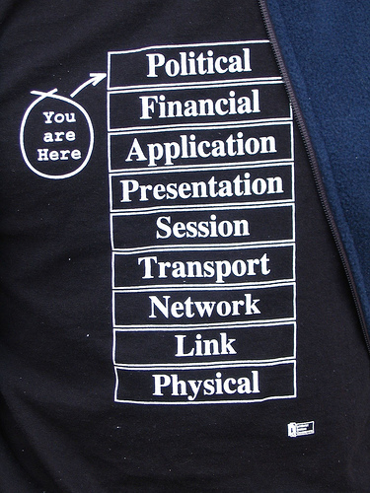
The real model

Slide 22

The Internet Protocol Hourglass
email WWW phone...
SMTP HTTP RTP...
TCP UDP…
IP
ethernet PPP…
CSMA async sonet...
copper fiber radio...
small number of long-term stable interfaces
S. Deering

Slide 23
Why four (core) layers?
Layer | Colloquial name | Function
1 | PHY | photons & electrons → bits
2 | MAC | bits → packets on one technology
3 | L3 | packets end-to-end, on heterogeneous technologies, to interface
4 | L4 | unreliable → reliable host/interface → application
(5) | Presentation, data | application data structure encoding
7 | Application | Application behavior (email, web)

Slide 24
History of the Internet: serialization
TLV
CBOR
ad-hoc
binary
ASN.1
RFC822
XML
JSON
HTTP/2.0

Slide 25
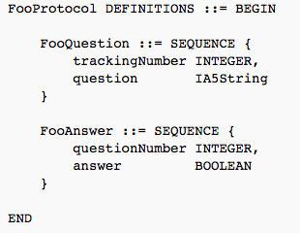

Serialization: ASN.1
serialization = convert data structure into
(linear) byte stream
like C, without pointers…
30 13 02 01 05 16 0e 41 6e 79 62 6f 64 79 20 74 68 65 72 65 3f

Slide 26
Serialization: RFC 822
Delivered-To: hgs10@lionmailmx.cc.columbia.edu
Received: by 10.140.158.132 with SMTP id e126csp131562qhe;
Thu, 28 Aug 2014 14:01:48 -0700 (PDT)
Return-Path: etickets@amtrak.com
Return-Path: etickets@amtrak.com
Received: from unknown (HELO etvswas01p) ([10.14.128.202])
by phlsmtprelay01.amtrak.com with ESMTP; 28 Aug 2014 16:55:42 -0400
Date: Thu, 28 Aug 2014 17:01:30 -0400 (EDT)
From: etickets@amtrak.com
To: HGS@cs.columbia.edu, HENNING.SCHULZRINNE@FCC.GOV
Message-ID: <633700356.JavaMail.TDDServerProd@amtrak.com>
Subject: Amtrak: eTicket and Receipt for Your 09/10/2014 Trip
MIME-Version: 1.0
Content-Type: multipart/mixed;
boundary="----=_Part.1409259690306”
MIME-Version: 1.0
Content-Type: multipart/mixed;

Slide 27
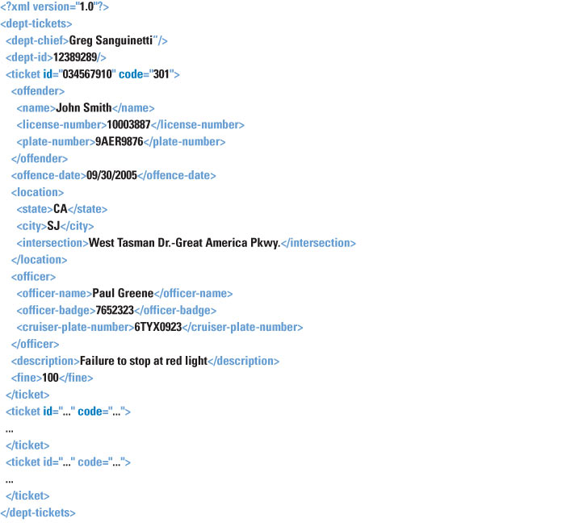
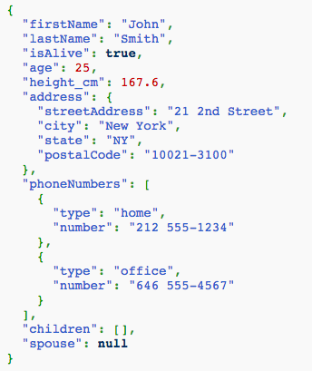
Serialization: converting data structures into a byte stream
XML
JSON

Slide 28
What makes a good serialization?
 | Binary | ASN.1 | RFC822 | TLV | XML | JSON | CBOR
Schema | informal | ✅ | ABNF | informal | XSD | in progress | ?
Compact | ✅ | ? | ❌ | ✅ | ❌ | 😐 | ✅
Secure | ✅? | ? | ❌(BO) | ✅ | ? | ✅ | ?
Fast (parsing) | ✅ | ❌ | ✅ | ✅ | ❌ | 😐 | ✅
Extensible | ❌ | ✅ | ✅ | ✅ | ✅ | ✅ | ✅
Self-describing | ❌ | ✅ (not ERs) | ✅ | ❌ | ✅ | ✅ | ❌
Security: loops (recursion), buffer overflows (length & pointers)

Slide 29

The problems with layering
Doesn’t capture whole story
  control protocols
Information hiding
  inefficiency: more than needed
Information and implementation leakage
Ossification
Duplication
  “If you want it done right, you have to do it yourself”
Notes:
Charles-Guillaume Étienne

Slide 30
Internet architecture

Slide 31


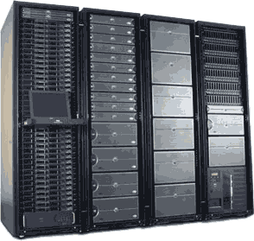
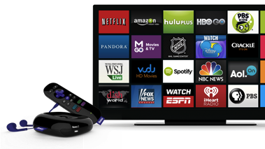
Internet traffic flows today
CDN
content
access network
(data center provider)
backbone (transit)
eyeball ISP
Google
Facebook
YouTube
Yahoo
Live
Baidu
Comcast
comm.
CDN
Level3
Cogent
Akamai
content CDN
video
conferencing
Netflix
server farm
31

Slide 32
Network types
Access
  “last mile”
Regional or metro
  “metro fiber”, “metro Ethernet”
Wholesale
  connect points-of-presence across
  may also provide access to commercial buildings & data centers
Trans-oceanic
  often, owned separately (consortium), but integrated into wholesale networks

Slide 33
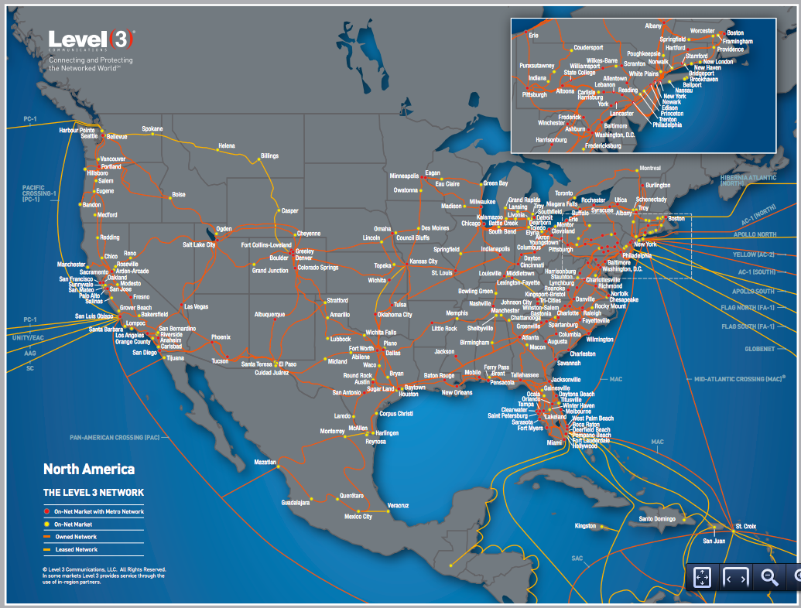
A backbone network

Slide 34
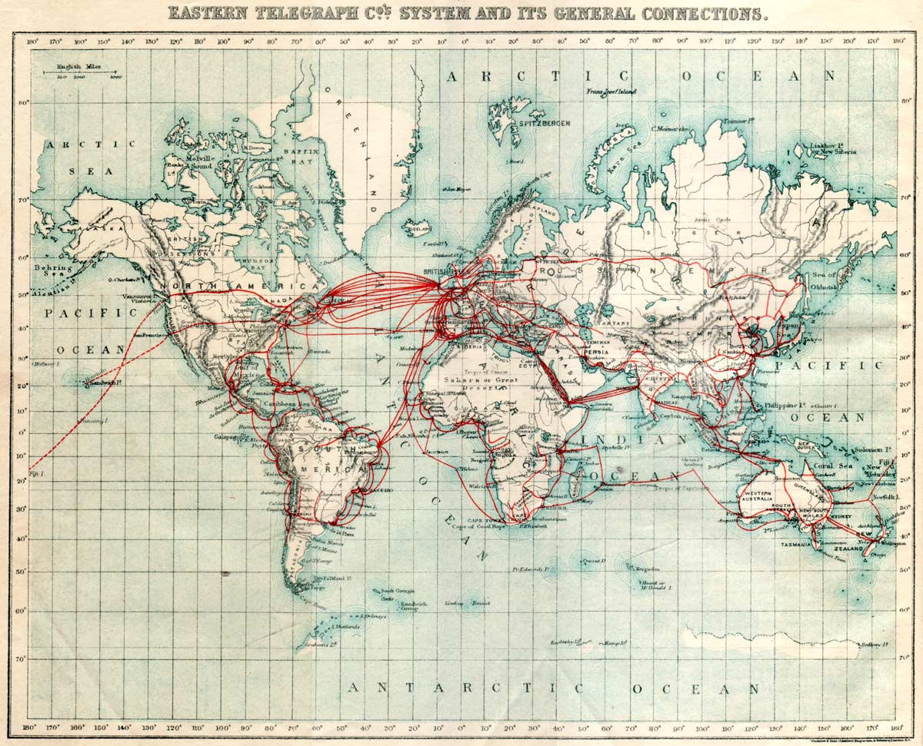
1901 “data” backbone

Slide 35
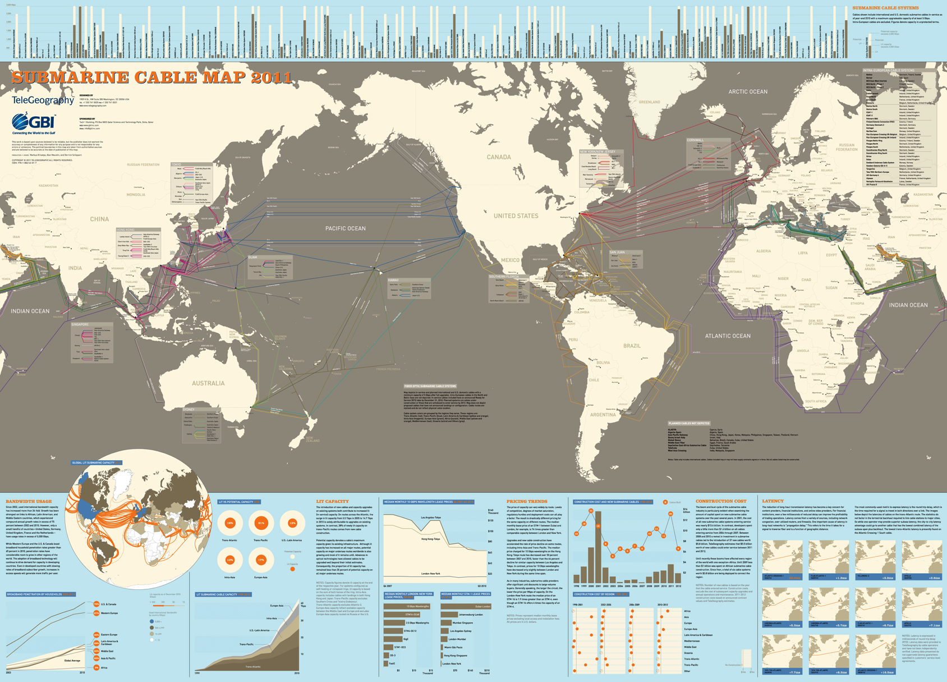
Submarine cable map
http://www.telegeography.com/
Notes:
http://www.telegeography.com/

Slide 36
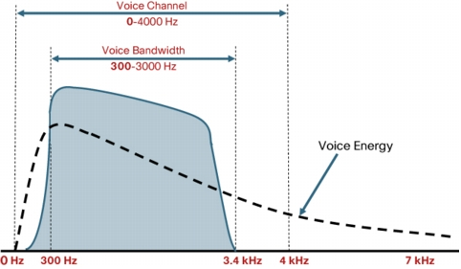
It’s all spectrum - phone
Notes:
http://www.voipsupply.com/images/voice_freq_range.jpg

Slide 37
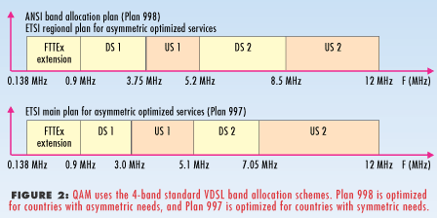
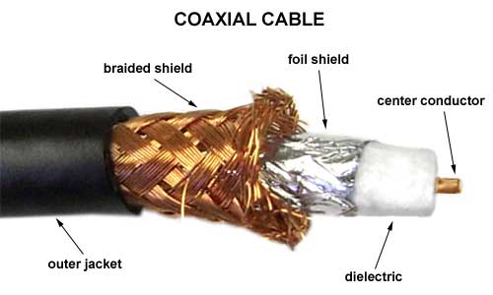
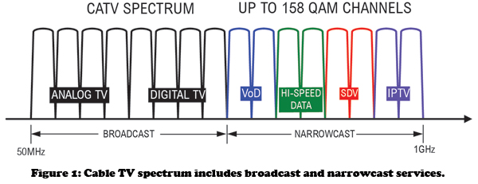
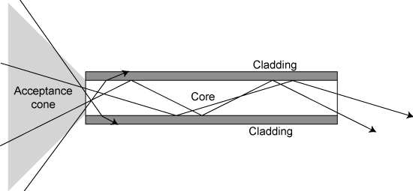
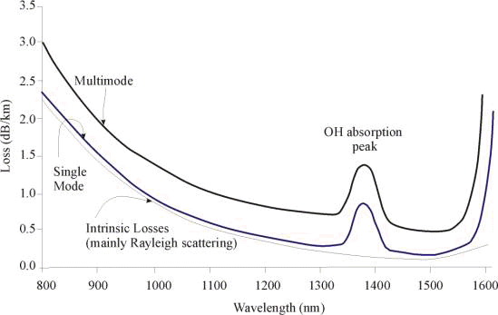
It’s all spectrum - wires
4 kHz
copper
10 MHz
1 GHz
200 - 347 THz

Slide 38
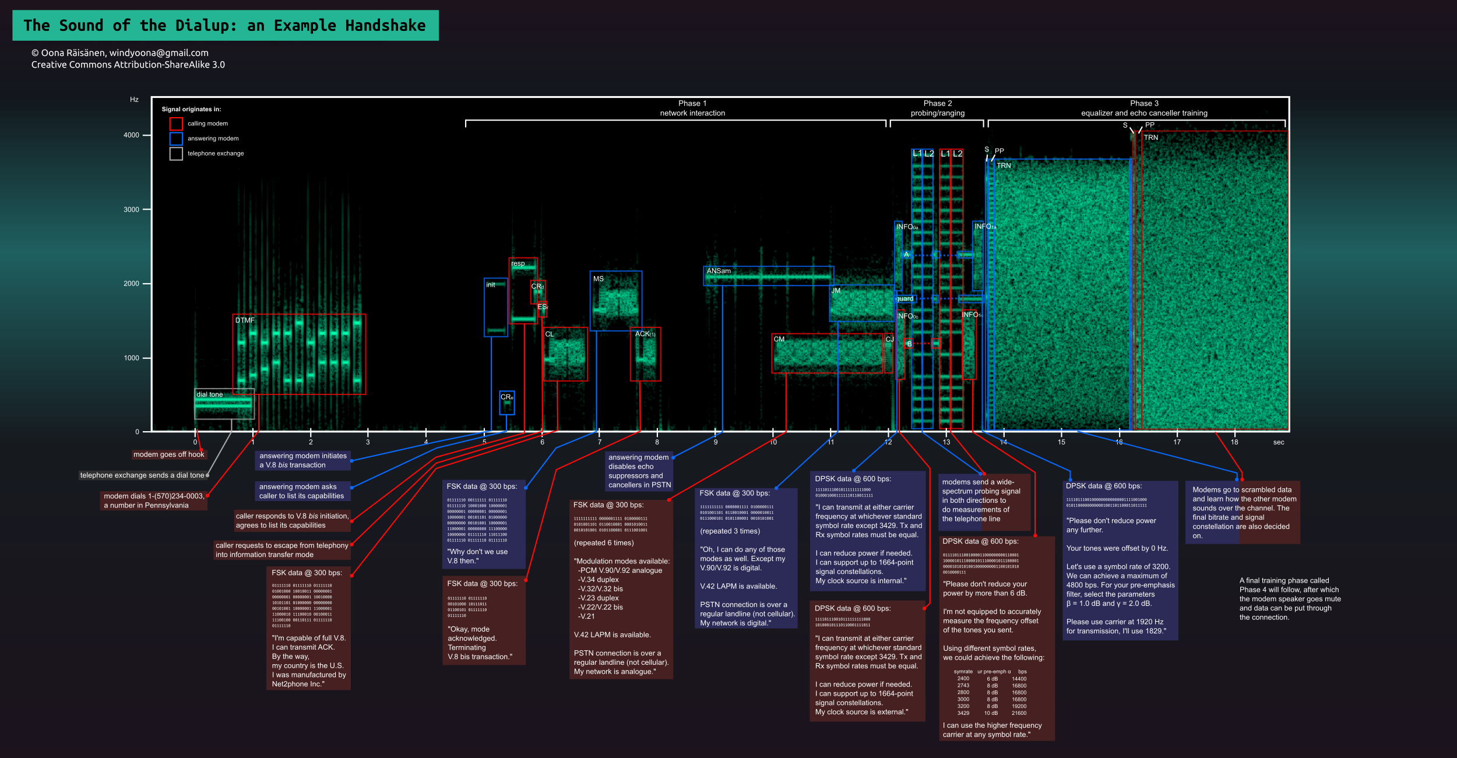
It’s all spectrum - modem
Notes:
http://hackadaycom.files.wordpress.com/2013/01/dial-up-handshake-infographic.png

Slide 39

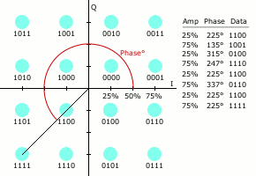
Fundamental limit to channel capacity
channel capacity
(bits/second)
bandwidth
(Hz)
signal-to-noise ratio
(typically, dB)
Shannon-Hartley limit

Slide 40
Shannon examples
SNR (dB) = 10 log₁₀ (S/N)
Telephone modem: SNR = 20 dB (1:100); frequency 4 kHz → 4,000 log₂ (101) = 26.63 kb/s
Noise can be larger than signal!
  → negative SNR
Less noise → higher signal power
Only true for simple channel models
  “additive Gaussian white noise” (AWGN)
Spectral efficiency: bits per second per Hz
  often, around 1-2 b/s/Hz, but can be much higher

Slide 41
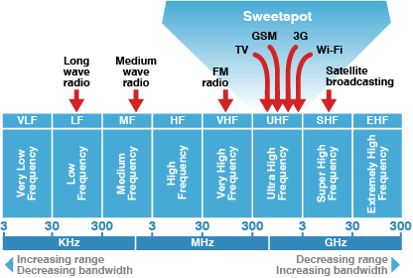
It’s all spectrum - radio
FM radio: 100 kHz
AM radio: 9 or 10 kHz
typical cell channel:
5-20 MHz
TV: 5 or 6 MHz

Slide 42
How is spectrum allocated?
AWS3 (2014): $2.65 MHz-Pop
ITU

Slide 43
Spectrum sharing
How much politeness & fairness is required?
→ LTE-U & LTE-LAA (license-assisted, listen-before-talk)
Notes:
“Priority-Based Classification of Spectrum Access Models”, August 2013

Slide 44
The value of spectrum
Spectrum auction prices vary dramatically:
  Germany June 2015: 0.23€ MHz per unit of population (pop)
    700, 900, 1500, 1800 MHz bands
  US February 2015: 2.71 US$/MHz/pop
    65 MHz:
      50 MHz paired in 1755-1780 & 2155-2180 MHz
      15 MHz unpaired in 1695-1710 MHz
Depends on
  timing – other auctions past and future
  competition (foreclosure, entry)
  encumbrances
  alternatives – densification
  availability in devices (bands)
Notes:
http://telecoms.com/opinion/the-german-spectrum-auction-failure-to-negotiate/

Slide 45
The economic value of spectrum
Valuing the use of spectrum in the EU, GSMA, June 2013

Slide 46
Auctions have limitations
One-time estimate of value
  most spectrum is licensed indefinitely (US) or long-term (EU)
  technology may change value – up or down
    e.g., small cells, MIMO
  new neighbors may change value
  typical spectrum value:
May encourage speculation
  build-out requirements help (and common), but can be 3-10 years
Relies on small (3-4) number of carriers
  only subscription model
  how do you aggregate the value of 5.8 GHz spectrum?
Likely necessary where spectrum requires nationwide multi-$B investment

Slide 47
Alternative models
Sharing by usage
  indoor vs. outdoor
  satellite vs. terrestrial (directional antennas!)
  multiple bands → rendezvous band → spectrum database
Unlicensed initially only home and enterprise
  and limited rural wireless ISPs (WISPs)
But CableWiFi and FON show other models
  cheap infrastructure
  existing high-capacity fiber/coax deployment (backhaul)
  emphasis on nomadic, not mobile, use
  emphasis on data, not voice → tolerate quality variability
  easily shareable among providers (just authentication)
→ neutral spectrum provider
  cf. shared infrastructure models (Europe)

Slide 48
Spectrum Databases
A wide range of solutions may be involved to enable dynamic spectrum sharing and should be considered in Spectrum DataBase (SDB) frameworks .
Unlicensed
Limits in Power Adequate
Local Sensing
Strong, detectable
signals
(e.g. DFS)
Sensing Networks
More Complex Detection, and better siting
Time Specific Exclusion
Database Driven
(e.g. SAS)
Fixed Exclusion
If Undetectable, or constantly on
Fixed Rules in Devices
Adjustable Rules in Database System
FCC TAC 2014

Slide 49




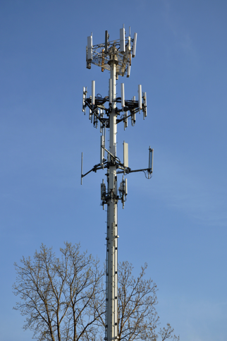
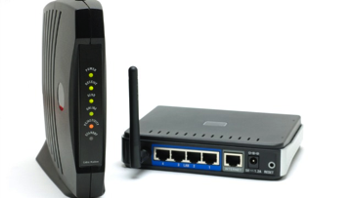
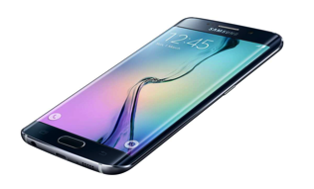

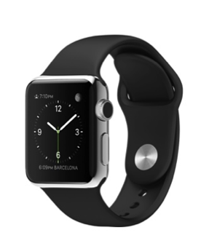
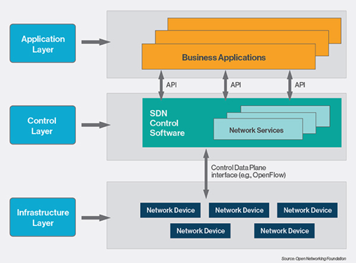


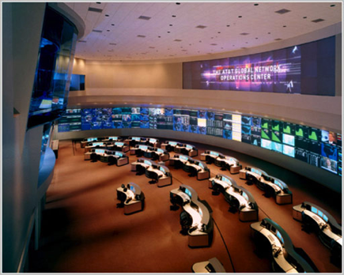


5G – what exactly is a carrier?
Spectrum DB
Spectrum DB
40k towers each (US)
Level3
Cogent
LTE-U
802.11n
LTE

Slide 51
Commercial wireless spectrum (US)

Slide 52
Spectrum for mobile services - EU

Slide 53
But devices don’t support all spectrum

Slide 54
LTE FDD bands
Notes:
http://www.radio-electronics.com/info/cellulartelecomms/lte-long-term-evolution/lte-frequency-spectrum.php

Slide 55
LTE TDD
Notes:
http://www.radio-electronics.com/info/cellulartelecomms/lte-long-term-evolution/lte-frequency-spectrum.php

Slide 56
Example: Verizon (US)
covers 308 M pop
roughly 112 M users
Notes:
http://www.fiercewireless.com/special-reports/2015-how-much-lte-spectrum-do-verizon-att-t-mobile-and-sprint-have-and-wher

Slide 57
Unlicensed & lightly-licensed bands (US)
UHF (476-700 MHz) – incentive auctions (licensed) + some unlicensed + TV white spaces
2.4 GHz (73 MHz) – 802.11b/g
3.550 GHz (150 MHz) – shared, database
3.6 GHz (100 MHz) – for backhaul & WISPs
4.9 GHz (50 MHz) – public safety
5.8 GHz (400 MHz) – 802.11 a/n

Slide 58
5.8 GHz Wi-Fi bands
Notes:
http://www.radio-electronics.com/info/wireless/wi-fi/80211-channels-number-frequencies-bandwidth.php

Slide 59
Existing spectrum
All spectrum below 6 GHz:
  allocated long ago
  holders have
    important public functions
    money (& lawyers)
    guns
    time (→ committees)
    Congress
    and combinations
  need to be bought out even if they didn’t buy the spectrum (e.g., TV)

Slide 60
Ideal spectrum
Unused or cheap
Available globally (→ important for consumer goods & market size)
  preferably under similar licensing conditions
No noisy or sensitive neighbors
Propagates indoors through walls and glass
Not affected by rain or leaves outdoors
Wide bands (≥ 5 MHz, preferably 20 MHz+)
Is paired (uplink & downlink)
Can be processed with cheap electronics (Si, not GaAs)
Allows small antennas🦄🦄

Slide 61
Spectrum roles
400 – 800 MHz
1 – 3 GHz
3-6 GHz
> 10 GHz
base-level coverage
urban capacity
indoor & capacity
directional
capacity
Digital dividend
TV incentive auction
AWS-3
3.5 GHz
mmWave NPRM

Slide 62
Spectrum band trade-offs
Band | Antenna | Capacity (typical channel width) | In-building penetration | Rural
LF (below 400 MHz) | e.g., FM: 80 cm | 5-100 kHz per band | very good | very good
Low (400 MHz – 1 GHz) | small (1/4 λ = 7.5 cm) | 5-10 MHz | good | good
Mid-band (1 – 2.5 GHz) | small | 5-20 MHz | ok | ok
High-band (> 2.5 GHz) | small | 5-100 MHz | poor | poor
“1900 MHz takes somewhere between 2 to 4 times as many sites as 850 MHz”

Slide 63
Attenuation by freqency

Slide 64
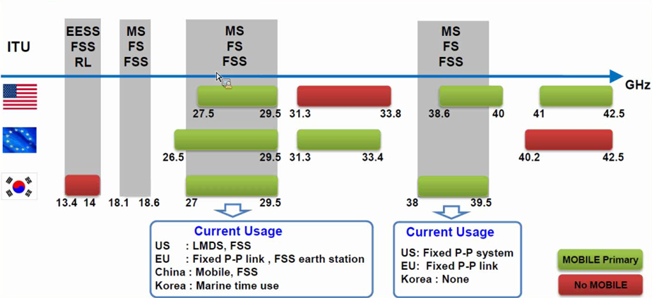
30-40GHz mmW – Spectrum Overview
Source : Samsung Communications Research Team
Note: The Commission’s Fixed Microwave (Part 101) and Satellite Communications (Part 25) service rules govern most of US Mobile allocations shown above
64

Slide 65
vs.
“high tower, high power”
(TV, cellular downlink, radar transmitter)
cellular uplink
radar receiver
GPS receiver

Slide 66
The filter problem
guard band
(wasted)
filter
(input or output)
licensed band
user 1
licensed band
user 2
Power imbalance:
cell downlink: 100 W ERP
cell uplink: 0.05 – 2 W
Notes:
http://oem.bmj.com/content/61/9/769/T2.expansion.html

Slide 67
TV white spaces (US)
First large-scale spectrum database
But limited use in the US
  number of channels
  power levels
  equipment
  available mostly in rural areas, not urban
Leonia, NJ
Amherst, MA

Slide 68
Incentive auction
go off-air (6 MHz)
multiplex
VHF
descending clock auction
→ reduce until clearing target met
TV station participated & got bid?
initial
clearing goal
reverse
auction
(TV stations)
forward
auction
(carriers)
144 MHz
(May 2016)
forward bids
insufficient →
reduce clearing goal
repack
(39 months)

Slide 69
600 MHz incentive auction
FirstNet
spectrum
5 MHz downlink blocks
5 MHz uplink blocks
radio astronomy, medical monitoring
JP Morgan: $1.34/MHz/Pop

Slide 70

3.5 GHz band
FSS: C Band (3.625–4.200)

Slide 71

Federal Exclusion Zones

Slide 72
User classes
must not interfere
1
Federal users
Fixed satellite users (FCC)
census tract
<= 70 MHz
3-year licenses
assigned via SAS
2
Priority licenses (PAL)
10 MHz channels in 3550-3650
3
General authorized use (GAL)

Slide 73
3.5 GHz
ESC: environmental sensing capability
allow commercial use in coastal and Great Lakes region
ESC senses radar signal → SAS → GAL devices cease operation or move to another channel

Slide 74
TX Power Limits
Device | Geographic Area | Maximum Conducted Output Power (dBm/10 megahertz)** | Maximum EIRP (dBm/10 megahertz) | Maximum Conducted PSD (dBm/MHz)
End User Device | All | n/a | 23 | n/a
Category A CBSD | All | 24 | 30 | 14
Category B CBSD* | Non-Rural | 24 | 40 | 14
Category B CBSD* | Rural | 30 | 47 | 20

Slide 75
Long-range networks
5G IOT → predictable geographic coverage, not (just) capacity
Wide-area Wireless Communication Challenges for the Internet of Things
Harpreet S. Dhillon, Howard sHuang, Harish Viswanathan

Slide 76
Challenges for spectrum sharing
Enforcement!
  incumbents need to trust new entrants not to misbehave
    or to be swiftly extricated from the band
  as old as radio station identification (“You are listening to WNYC”)
  can’t rely on FCC field engineers with SUVs
→ band user identification
  unalterable by (modestly sophisticated) user
  traceable to real ”servable” identity

Slide 77
Challenges for spectrum sharing
Unlicensed ~2000
Unlicensed now
Unlicensed emerging
indoor home
indoor enterprise
campus
--> natural separation
secondary public SSID
re-use HFC/FTTH backhaul
LTE-U, LAA
what are the “kindergarten” rules?
only power rules (no listen-before-talk (CS) required)

Slide 78
Spectrum outlook
Move from purpose-specific to generic spectrum
Spectrum rules tend to evolve (slowly)
  e.g., sharing conservative → liberal
Consider setting expectations for receivers (“no right to complain”)
  currently, implicit by original occupancy
Simple spectrum database models
  but increasingly dynamic data in space & time (e.g., mobile primary users)
  start with either licensed or generic “rendezvous” channel
  ask database for channels available across many bands (e.g., IETF PAWS)
Need for more constrained unlicensed bands?
  long range, low duty cycle networks – rendezvous, low-bandwidth IoT

Slide 79
All networks are similar
packets
time-division multiplexing
packets
modulation
frequency division
medium = spectrum

Slide 80










Reference architecture
Other
Communications
Networks
Internet
Peering
OTT
Interconnected Networks
Users
ISP
Comm Complex
Video Complex
Access Network
Regional Broadband
Network
Transport Core
Service Core
Interconnected Networks
Local Video
Feeds
Video Feeds
and 3rd Party
CDNs
Other Cores
Within the
Network
L3 Router
SBC and
L3 Router
Set top box
command&control
Video
Cache

Slide 81

Local loop

Slide 82
Physical architecture
Feeder Cables
  Carries traffic serving multiple endpoints form an “office” to a neighborhood
  (local convergence point, LCP, or serving area interface, SAI)
Distribution Cables
  Carry traffic for one or more households from LCP to the curb (network access point)
Drop Cables (above ground) or service wire (underground)
  Carry traffic from curb to dwelling unit
Depending upon the architecture
  Cables may be fiber, twisted pair or coax
  Local convergence point and/or network access point could host a patch panel, a DSLAM, an optical splitter, an Ethernet switch, or a fiber/coax interface.

Slide 83


Broadband access
-48v

Slide 84
Co-VSDL
FTTC
Rendon Schneir, J., & Xiong, Y. A cost study of fixed broadband access networks for rural areas. Telecommunications Policy (2016), http://dx.doi.org/10.1016/j.telpol.2016.04.002i
FTTRN
FTTdp
Street
FTTdp
Building
FTTH

Slide 85
Bandwidths possible
distance = copper
Rendon Schneir, J., & Xiong, Y. A cost study of fixed broadband access networks for rural areas. Telecommunications Policy (2016), http://dx.doi.org/10.1016/j.telpol.2016.04.002i

Slide 86

Logical architecture
Access network extends from Residential Gateway (RG) to Broadband Network Gateway (BNG)
Flow management between AN and RG depends upon the architecture
Flow management in the Ethernet Aggregation Network similar across architectures but may differ from how flows are managed between the AN and the RG
In Metro Network flows are typically distinguished by layer 3 QoS tags and/or separate VPNs
http://www.broadband-forum.org/technical/download/TR-101_Issue-2.pdf

Slide 87

xDSL logical architecture
http://www.broadband-forum.org/technical/download/TR-101_Issue-2.pdf

Slide 88
ADSL (ITU G.992.1)
ADSL spectral power repartition (PSTN)
Power
DATA
DATA
POTS
DATA
POTS
POTS
Upstream
Upstream
Upstream
Downstream
Downstream
Downstream
300 Hz
300 Hz
300 Hz
3,4 kHz
3,4 kHz
3.4 kHz
22 kHz
22 kHz
22 kHz
133kHz
133kHz
203 kHz
203 kHz
203 kHz
1.1 MHz
1.1 MHz
1.1 MHz
Frequency
FDD: Frequency Division Duplexing
➔ no interference between up and down

Slide 89




Access: cable network
cable headend
…
cable
modem
splitter
CMTS
cable modem
termination system
data, TV transmitted at different
frequencies over shared cable
distribution network
ISP
HFC: hybrid fiber coax
  asymmetric: up to 30Mbps downstream transmission rate, 2 Mbps upstream transmission rate
network of cable, fiber attaches homes to ISP router
  homes share access network to cable headend
  unlike DSL, which has dedicated access to central office

Slide 90

Simplified access network diagram
Jason Livingood (Comcast) FCC 2009
Notes:
90
http://www.broadband.gov/ws_fixed_bb.html

Slide 91
DOCSIS 3.0 channel bonding
152 Mbps
Logical Channel Bonding Technology
38 Mbps
38 Mbps
38 Mbps
38 Mbps
6 MHz
6 MHz
6 MHz
6 MHz
DOCSIS 2.0 is limited to single channel’s capacity
DOCSIS 3.0 employs packet bonding across multiple channels
  Initially will bond 4 channels
  8 channel-capable silicon coming soon
  Upstream bonding in 2010
  Increased speeds 100Mbps+
Notes:
91

Slide 92



Verizon’s FTTP architecture
customer premise
OLT
Optical Line Terminal
Voice & Data Downstream 1490 nm
Voice, Data & Video 1490 nm, 1310 nm, 1550 nm
ONT
Optical Network Terminal
Optical Couplers (WDM)
Optical Splitter
Upstream 1310 nm
Video 1550 nm
1x32
CENTRAL OFFICE
EDFA
Erbium Doped Fiber Amplifier
Bandwidth & Services
Upstream
Downstream
1310 nm
1490 nm
1550 nm
Voice & Data at 155 to 622 Mbps
Voice, Data & VOD at 622 Mbps
Broadcast Video
54 MHz
864 MHz
Brian Whitton, Verizon
Analog TV
Digital TV and HDTV
Notes:
by Brian Whitton, Verizon Networks

Slide 93

Communication satellites
Communication satellites, some properties, including: altitude above earth, round-trip delay time, number of satellites for global coverage.

Slide 94

Geostationary satellites (1)
The principal satellite bands

Slide 95

Geostationary satellites (2)
“bent pipe”
VSATs using a hub.

Slide 96
HTS launches per year
Dedicated HTS | Hybrid Payload HTS
Thaicom 4 | Anik F2
WildBlue 1 | AMC-15
Spaceway 3 | AMC-16
Ka-Sat | Ciel-2
ViaSat-1 | Hylas 1
Jupiter-1 | Arabsat 5C
Inmarsat 5F2 | YahSat 1B
Inmarsat 5F1 | Hylas 2
Inmarsat 5F3 | Hispasat AG1
NBN Co 1A | Express AM5
GSAT-11 | Astra 2F
NBN Co 1B | Express AM6
 | Amazonas 3
 | Astra 2E
 | Thor 7
 | Astra 2G
 | Jabiru-1
David Hartshorn, 2014

Slide 97


Low-Earth orbit satellites
The Iridium satellites form six necklaces
around the earth.

Slide 98

Exede beam map
http://www.wildbluetools.com/content/dealer/email/Beam_map-high-mid-low.html

Slide 99
Satellite
Advantages
Disadvantages
Near-universal geographic availability
  low incremental cost
    satellite terminal + installation
Resilient after natural disasters
  often used as backup
Latency
  MBA 2014: RTT 671 ms
Temporary disruptions
  sun alignment
  rain fade
Capacity
  Viasat-1: 140 Gb/s (for 300,000 customers)
  usually, usage-capped

Slide 100

Example: Exede satellite plans

Slide 101
The cost of networks

Slide 102



Broadband cost
30%
70%

Slide 103
Rural broadband geo types
OECD: < 150 inhabitants/km²
EC rural broadband: < 100 / km²
EC combined: 50% of the population lives in rural grid cells. Rural grid cells exist outside urban clusters, whereas urban clusters are “clusters of contiguous grid cells of 1 km2 with a density of at least 300 inhabitants per km2 and a minimum population of 5000 [2014]
Finland: 18/km²
Tampere: 430/km²

Slide 104
CAPEX and OPEX
CAPEX
  the cost of digging
  deployment of ducts
  the rollout of fiber (installation, fiber)
  manholes
OPEX
  7.5% for active elements
  1% for passive elements
  €0.8, €0.3, €1.1 and €0.8/month for the in-building, drop, distribution and feeder segments, respectively
Lifetimes

Slide 105
CAPEX
per-home passed

Slide 106
Investment per home connected

Slide 107





Fiber deployment
wastewater pipe
(3-5 km/week)

Slide 108
Broadband network cost - FTTP
Category | Details | Outside plant
FTTP in existing right-of-way | All underground, not including drops or electronics | $1,200…$1,300 per passing
 | 40% aerial, 60% underground, not including drops or electronics | $1,000…$1,100 per passing
FTTP drops | Range of distances and complexity | $300…$700 per connected home
Crown Fibre Holdings (Govt. of New Zealand); provided by CTC

Slide 109

Broadband network cost – Fiber middle mile
Category | Details | Outside plant | Source
aerial, new attachment | Northeastern city municipal utility; 96% aerial, 4% underground; 87.6 miles | $30,000/mile | Public utility (actual cost)
aerial overlash | Major metropolitan area (U.S. east coast) | $15,000/mile
buried | Mixed suburban/urban locations and pot/bore construction | $89,000/mile | Washington, D.C.-area BTOP project (actual cost)
Data provided by CTC

Slide 110
Middle mile cost example
CTC, 2009 (“Brief Engineering Assessment: Efficiencies available through simultaneous construction and co-location of communications conduit and fiber”)

Slide 111
More fiber observations
Fiber middle-mile cost: $50-70k/mile
Fiber cost: 144 strands = $10k/mile, 48 strands = $4.7k/mile
Common characteristics:
  avoid active elements in network → power, maintenance → PON
  recently: avoid anything except fiber (including splitters)
    cf. wireless last mile approach
  fiber home run, even if PON (Google Fiber, Stockholm)
Fiber cost higher for buried, but cheaper if conduit or aerial
Recent FTTH:
  avoid indoor installation (cf. Verizon FiOS)
  one box in home (ONT + 802.11ac), not ONT + MoCa STB

Slide 112
FTTH estimates
Bell Alliant in Western Canada has now passed over half a million homes with fiber home, the largest deployment in North America after Verizon. Their latest financial report showed capex of less than $500 per home passed.
Verizon reported costs fell below $700/home passed several years ago and headed to $600. Add the cost of actually installing a large fraction of those homes, and your cost per home passed by the network comes closer to $1,000.
Installing each home at Verizon added $500-600. Digging lawns and drilling holes into the homes is labor intensive.
Includes equipment whose price is rapidly dropping. Early Verizon gear cost $300-400/home, but today they are probably paying half that.
  Very large fiber builds in China are paying less than $100/home.

Slide 113

FTTx cost vs. DSL
Alcatel-Lucent, 2013

Slide 114
Capital investment
Company | Revenue | Capital expenditures | %
Comcast (US) [3Q14] | $11.04B | $1.644B | 14.9
Telekom (DE) [3Q14] | €15.6B | $2.58B | 16.5
Safaricom (KE) [H1FY15] | Ksh 79.34B | Ksh 12.37 | 15.5

Slide 115
Engineering and business opportunities
Capital investment surprisingly small
Academic and industry research focuses on 15%, rather than 85%
Three likely models in different countries:
  public conduits (& fiber) + private Internet access
    community & electric utilities
  structurally-separated into transmission, interconnection & connect
  vertically integrated (monopoly & duopoly) provider

Slide 116
Network competition models
single provider
(any technology)
cable
copper, fiber
IP
“bit stream”
MAC
(Ethernet)
shared copper, fiber
PHY
poles & conduits
regulated: pricing? behavior?
how many entrants? where?
margin squeeze

Slide 117
Broadband competition challenges

Slide 118

US cellular market

Slide 119
The difficulty of competition
Static vs. dynamic (new entrants)
  existing, converging infrastructures
    coax cable + copper + wireless
Difficulties for new entrants (“overbuilder”)
  capital investment vs. amortized network
  legal barriers
  customer acquisition (“sticky” customers)
  incumbent pricing
Notes:
https://aws.amazon.com/blogs/aws/aws-importexport-snowball-transfer-1-petabyte-per-week-using-amazon-owned-storage-appliances/

Slide 120

Google Fiber

Slide 121
Network costs
yes, but mostly
electronics
middle mile
last mile
backbone
CDN
largely unaffected
by video
ISP-owned
vs. leased!
DSL | no
HFC | homes/service node
fiber | no
cellular | densification
lack of IXPs in LDCs!

Slide 122




Bandwidth costs
Amazon EC2
  $50 - $120/TB out, $0/TB in
CDN (Internet radio)
  $600/TB (2007)
  $7-20/TB (Q1 2014 – CDNpricing.com)
NetFlix (7 GB DVD)
  postage $0.70 round-trip → $100/TB
FedEx – 2 lb disk
  5 business days: $6.55
  Standard overnight: $43.68
  Barracuda disk: $91 - $116/TB
DVD-R (7 GB)
  $0.25/disk → $35/TB
Notes:
FedEx and EC2 prices as of 09/15/09
CDN: http://www.mindbranch.com/listing/product/R678-29.html
http://www.cdnpricing.com/

Slide 123
Transit prices
http://drpeering.net/white-papers/Internet-Transit-Pricing-Historical-And-Projected.php

Slide 124
cost recovery

Slide 125

Consumer expenditures
“Americans spent $116 more a year on telephone services in 2011 than they did in 2007, according to the Labor Department, even as total household expenditures increased by just $67.
Meanwhile, spending on food away from home fell by $48, apparel spending declined by $141, and entertainment spending dropped by $126. The figures aren't adjusted for inflation.” (WSJ 2012)
Notes:
Morgan Stanley, Macro Meets Micro: A Five- Year View of the Telecom Services Industry, July 2014.
http://online.wsj.com/articles/SB10000872396390444083304578018731890309450
http://www.bls.gov/opub/btn/archive/consumer-spending-in-2010-pdf.pdf

Slide 126
Mobile ARPU – US vs. EU

Slide 127
The value of bits
Technologist: A bit is a bit is a bit
Economist: Some bits are more valuable than other bits
  e.g., $(email) >> $(video)
Application | Volume | Cost per unit | Cost / MB | Cost / TB
Voice (13 kb/s GSM) | 97.5 kB/minute | 10c | $1.02 | $1M
Mobile data | 5 GB | $40 | $0.008 | $8,000
MMS (pictures) | < 300 KB, avg. 50 kB | 25c | $5.00 | $5M
SMS | 160 B | 10c | $625 | $625M
Notes:
T-Mobile 2010
AT&T data
http://www.nowsms.com/discus/messages/12/8500.html

Slide 128
The challenges of service differentiation
Method | Used by | Advantage | Drawbacks | Customer dislike estimate
Speed tiers | C, DSL | Differentiates basic usage modes | Less effective above 10 Mb/s | 😦
Usage-based charging (caps, metered) | M, (C, DSL), LD | heavy vs. light users encourages Wi-Fi use | complaints about meter accuracy adaptive applications (4G bill shock) pay for ads hard to predict | 😦😦😦
Application-based charging | M | Easier to predict Business model | Affects content competition barriers to entry | 😦😦😦
Differentiated privacy | AT&T, NetZero | Full functionality | Low-income users may not be attractive to advertisers | 😦 or 😦😦😦

Slide 129
The challenges of service differentiation
Method | Used by | Advantage | Drawbacks | Customer dislike estimate
Priority | ? | Better experience for VoIP | Other experience must be bad → economy class in airline | ?
Time-of-day | LD, Sat | Approximates congestion Easy to understand | Not optimally efficient Possible bill shock | 😦😦
Congestion-based | ? | Encourages time shifting | Limited shift Unpredictability | 😦😦😦😦
The words you won't say on your deathbed are, "If only I had spent more time watching the bandwidth meter (or phone bill)."

Slide 130
Cable TV vs. Internet
Bundle of all possible channels
  → “skinny bundles” (few channels)
Lots of advocates of “fairness” for metering
Very few advocate scaling the monthly TV fee (Europe) or the cable TV fee by hours watched
  eminently feasible with STBs
  content tiers but not viewing tiers
“but cost of cable TV does not depend on viewers”
not really: content cost to MVPD is based on popularity

