Slide 1
Telecom Law 101
Drawn from Jay M. Feinman, “Law 101”, 2nd edition, 2006 and other sources

Slide 2
Law 101
Law is not in the law books
  there is more than one
Law is not an algorithm
  even if it reads like flow control statements
  and could use coverage analysis
  but sometimes pseudo-code
Law is not secret
Law is political conflict
People make the law

Slide 3
Legal thinking vs. computational thinking
Laws are generally (intentionally) vague
  consistency, fairness, predictability
  “driving faster than the speed limit is a crime”
Exceptions
  ambulance
  rush child to hospital
  “just a little bit”

Slide 4
The kinds of law
Constitutional law (1787)
  relationship between
    president and Congress
    federal government and states
  bill of rights (1791) + 17 amendments
  short compared to other constitutions
Criminal law
  “Homicide means conduct which causes the death of a person or an unborn child with which a female has been pregnant for more than twenty-four weeks under circumstances constituting murder, manslaughter in the first degree, manslaughter in the second degree, criminally negligent homicide, abortion in the first degree or self-abortion in the first degree.” (NYS S125.00)
  "Person," when referring to the victim of a homicide, means a human being who has been born and is alive.
Civil law
  contract, uniform commercial code, labor laws, …
Administrative law
  e.g., how can regulations be made and enforced

Slide 5
The US (and similar) hierarchy of laws
Constitution
Commerce clause
Law
Telecom Act 1934 & 1996
47 CFR
Narrative
reasonable network management
Article I, Section 8: To regulate Commerce with foreign Nations, and among the several States, and with the Indian Tribes (1787)
SEC. 706. ADVANCED TELECOMMUNICATIONS INCENTIVES. (a) IN GENERAL- The Commission … shall encourage the deployment on a reasonable and timely basis of advanced telecommunications capability to all Americans (including, in particular, elementary and secondary schools and classrooms) by utilizing, in a manner consistent with the public interest, convenience, and necessity, …, or other regulating methods that remove barriers to infrastructure investment.

Slide 6
First amendment
“Congress shall make no law … abridging the freedom of speech, or of the press”
Goals of Framers unclear:
  prevent government from direct prohibition of expressing opinions (but punish afterwards)?
  criticize without sanction?
World War I cases
“market place of ideas” (Abrams vs. US 1919)
  vs. dignity of individuals
political speech vs. commercial speech
  racial epithets, “fire” in crowded theater, publishing celebrity photos, burning draft cards (non-verbal!), …?
  false advertising?
  regulatory disclosure? (forced speech)

Slide 7
First amendment
No prior restraint
  Pentagon papers case
  except for “must inevitably, directly, immediately” peril (e.g., troop movements in war)
  exceptions: obscenity, commercial advertising
Not content-based
  “because of its message, its ideas, its subject matter, or its content”
  vs. time, place and manner
  compelling interest, least restrictive, neither too vague nor overly broad
  see Texas v. Johnson (1989) – flag burning
    heckler’s veto
  includes hate speech (R.A.V. v. City of St. Paul 1992) vs. Virginia v. Black (2003) - intimidation

Slide 8
Fourth amendment – search & seizure
“The right of the people to be secure in their persons, houses, papers, and effects, against unreasonable searches and seizures, shall not be violated, and no warrants shall issue, but upon probable cause, supported by oath or affirmation, and particularly describing the place to be searched, and the persons or things to be seized.”
Expectation of privacy
  garbage (abandoned property)? email?
Challenges
  old model: suspicion (how?) → search warrant → search
  new criminal model: first activity
  old model: crime → prosecute → punish
    what about planned crimes? (see Minority Report…)
Notes:
http://www.law.cornell.edu/wex/fourth_amendment

Slide 9
Electronic communication
Distinguish:
  What can a carrier do with your private information?
    → CPNI
  What can your employer get access to?
  What can other businesses do with private information?
  What can third parties do?
    → wire tapping
    Is listening to Wi-Fi beacons wiretapping? (→ Google case)
  When and how can the government get this information?
    For criminal vs. civil enforcement?
Different kinds of information
  mostly, for commercial privacy
  health (HIPAA), student records (FERPA), financial data, …
  international complications (e.g., European rules, “safe harbor”)

Slide 10
Example: Wire tapping
At common law, “eavesdroppers, or such as listen under walls or windows, or the eaves of a house, to hearken after discourse, and thereupon to frame slanderous and mischievous tales, are a common nuisance and presentable at the court-leet; or are indictable at the sessions, and punishable by fine and finding of sureties for [their] good behavior,” 4 BLACKSTONE,COMMENTARIES ON THE LAWS OF ENGLAND, 169 (1769).
Notes:
http://www.cybertelecom.org/security/ecpacontent.htm
http://www.epic.org/privacy/wiretap/98-326.pdf

Slide 11
Internet law issues
Legal interactions constrained by
  locality → global reach
    usually, clear what jurisdiction applies to interaction
    sales taxes, pornography, copyright, right-to-be-forgotten, European consumer protection laws, data privacy
  scale
    often, one-on-one interactions
    copying mix tapes
  physicality
    includes visibility of actions
    determine age of customer, property vs. copyright, first-sale doctrine, sexting
  hurdles of distance
    access to paper records (pseudo-privacy)
  difficulties of law enforcement
    robocalling, fraud, ransomware, doxing (cyber-bullying)

Slide 12
Behavioral constraints
Law
  threat of punishment
  → problems of enforcement & democratic legitimacy
Social norms
  dress codes, tax compliance, customs
  “regulation by raised eyebrow”
  → problems of scale
Markets
  by price, availability
  → problems of justice
Architecture
  physical layout, city architecture (NY Parkways)
  “code”, protocols
  → problems of participation and malleability
https://cyber.law.harvard.edu/works/lessig/finalhls.pdf

Slide 13
Two models of Internet
Internet “space” as unchangeable
  “state of nature”
  “Internet interprets censorship as damage and routes around it” (Gilmore, 1993)
  beyond the ability of nation states to influence
Internet space as realm of law
  lots of local interactions: access, commerce, people, …
  international law: Law of the Seas (“platform owner”)

Slide 14
Communications act

Slide 15
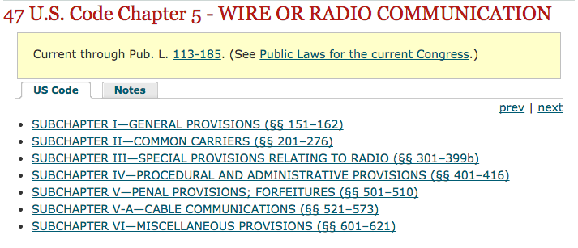
Communications Act

Slide 16
47 U.S. Code § 151 - Purposes of chapter; Federal Communications Commission created
For the purpose of regulating interstate and foreign commerce in communication by wire and radio so as to make available, so far as possible, to all the people of the United States, without discrimination on the basis of race, color, religion, national origin, or sex, a rapid, efficient, Nation-wide, and world-wide wire and radio communication service with adequate facilities at reasonable charges, for the purpose of the national defense, for the purpose of promoting safety of life and property through the use of wire and radio communications, and for the purpose of securing a more effective execution of this policy by centralizing authority heretofore granted by law to several agencies and by granting additional authority with respect to interstate and foreign commerce in wire and radio communication, there is created a commission to be known as the “Federal Communications Commission”, which shall be constituted as hereinafter provided, and which shall execute and enforce the provisions of this chapter.

Slide 17
How do competitors create their networks?
build own → cable, CLECs
build some, rent some from ILEC (e.g., CLEC switch and ILEC loops (UNE-L)
  components are unbundled network elements
  needs colocation
rent all (“UNE-P”)
resale
FCBA 2002

Slide 18
Universal service – explicit and implicit subsidies
Explicit = cash transfers to support service
Implicit = built into rates by regulation
  lower residential and rural rates
  higher long-distance rates
  higher urban rates through geographic rate averaging between urban and rural areas
  higher business line rates
  higher custom calling rates (e.g., call waiting, voice mail)
  intercarrier compensation (ICC)
+ Carrier of Last Resort (COLR) in local areas

Slide 19
Universal service – recurring issues
Who receives and for what?
  must be eligible telecommunications carrier (ETC)
Who contributes (pays)?
Relationship of universal service, local competition and access reform
→ transition from voice support to broadband
  broadband: currently 4 (down)/1 (up) Mb/s
  proposed: 10/1 Mb/s

Slide 20
Universal service
Connect America Fund (formally known as High-Cost Support) for rural areas
Lifeline (for low-income consumers), including initiatives to expand phone service for residents of Tribal lands
Schools and Libraries (E-rate)
Rural Health Care

Slide 21
Your phone/Internet bill
911 fee (by county)
subsidy (high-cost, low-income, e-Rate)
Verizon long distance
funds the FCC
state video franchise (NJ)

Slide 22
Title II, Section 201 (47 USC 201)
§201 (a): “It shall be the duty of every common carrier engaged in interstate or foreign communication by wire or radio to furnish such communication service upon reasonable request therefor;”
  “to establish physical connections with other carriers”,
(b) “All charges, practices, classifications, and regulations for and in connection with such communication service, shall be just and reasonable, and any such charge, practice, classification, or regulation that is unjust or unreasonable is hereby declared to be unlawful”

Slide 23
Title II Section 222 (Privacy)
(a) IN GENERAL.--Every telecommunications carrier has a duty to protect the confidentiality of proprietary information of, and relating to, other telecommunication carriers, equipment manufacturers, and customers, including telecommunication carriers reselling telecommunications services provided by a telecommunications carrier.
(b) CONFIDENTIALITY OF CARRIER INFORMATION.--A telecommunications carrier that receives or obtains proprietary information from another carrier for purposes of providing any telecommunications service shall use such information only for such purpose, and shall not use such information for its own marketing efforts.
PRIVACY REQUIREMENTS FOR TELECOMMUNICATIONS CARRIERS.--Except as required by law or with the approval of the customer, a telecommunications carrier that receives or obtains customer proprietary network information by virtue of its provision of a telecommunications service shall only use, disclose, or permit access to individually identifiable customer proprietary network information in its provision of (A) the telecommunications service from which such information is derived, or (B) services necessary to, or used in, the provision of such telecommunications service, including the publishing of directories.

Slide 24
Title II Section 251
(a) GENERAL DUTY OF TELECOMMUNICATIONS CARRIERS.—Each telecommunications carrier has the duty--
  (1) to interconnect directly or indirectly with the facilities and equipment of other telecommunications carriers; and
  (2) not to install network features, functions, or capabilities that do not comply with the guidelines and standards established pursuant to section 255 or 256.

Slide 25
Example of rule – 47 CFR 20.18
§ 20.18 911 Service.
(a) Scope of section. The following requirements are only applicable to CMRS providers, excluding mobile satellite service (MSS) operators, to the extent that they:
  (1) Offer real-time, two way switched voice service that is interconnected with the public switched network; and
  (2) Utilize an in-network switching facility that enables the provider to reuse frequencies and accomplish seamless hand-offs of subscriber calls. These requirements are applicable to entities that offer voice service to consumers by purchasing airtime or capacity at wholesale rates from CMRS licensees.
(b) Basic 911 Service. CMRS providers subject to this section must transmit all wireless 911 calls without respect to their call validation process to a Public Safety Answering Point, or, where no Public Safety Answering Point has been designated, to a designated statewide default answering point or appropriate local emergency authority pursuant to § 64.3001 of this chapter, provided that “all wireless 911 calls” is defined as “any call initiated by a wireless user dialing 911 on a phone using a compliant radio frequency protocol of the serving carrier.”

Slide 26
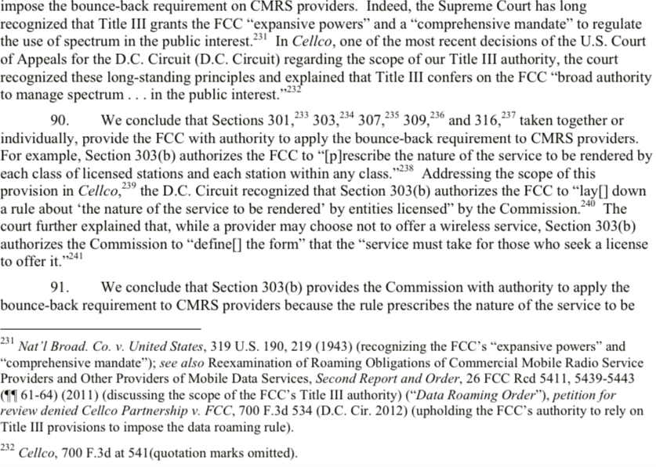
Authority example
FCC 13-64 (“Bounce-back Order”)

Slide 27
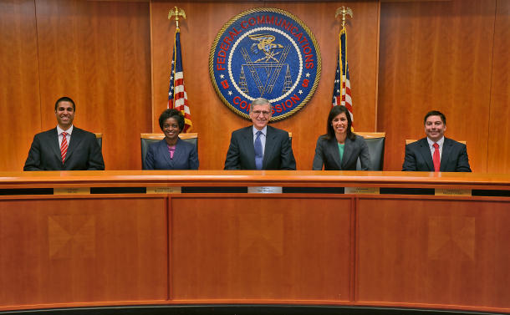
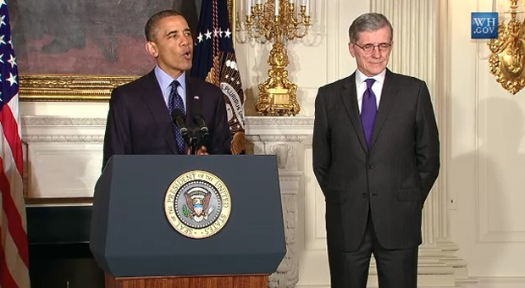
FCC
Chairman (D) – Tom Wheeler
4 Commissioners (2 D, 2 R)
Consumer and Governmental Affairs
Enforcement
International
Media
Public Safety & Homeland Security
Wireless Telecommunications
Wireline Competition
President nominates
Senate confirms
Independent federal agency
About 1,700 employees

Slide 28
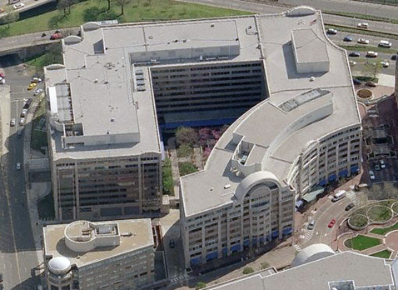
FCC HQ building

Slide 29
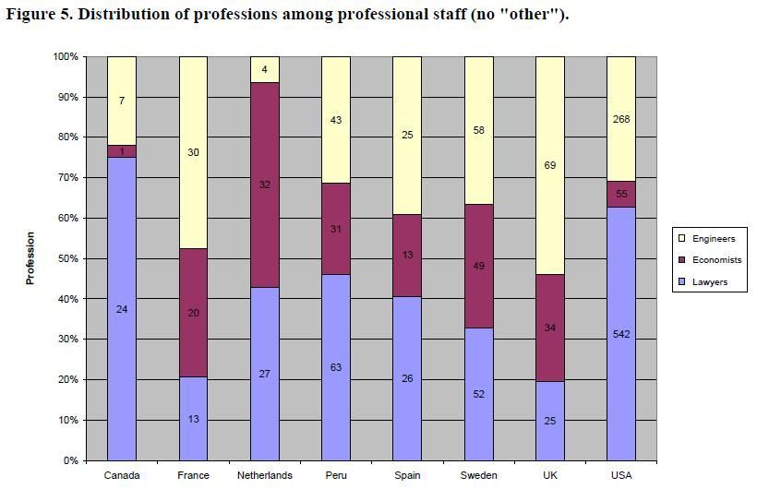
Staffing at National Regulatory Agencies

Slide 30
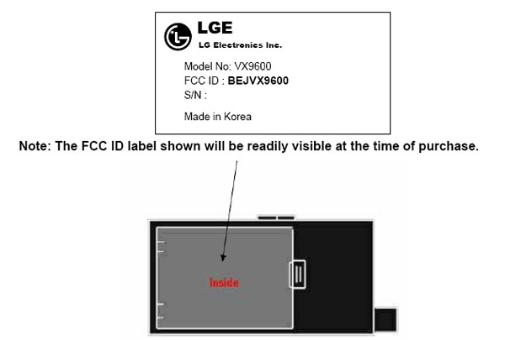
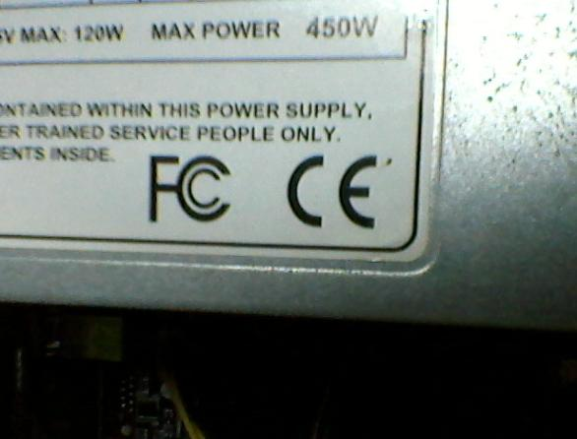
FCC device approval

Slide 31
Process
NOI
NPRM
R&O
Notice of Inquiry
Notice of Proposed Rule Making
Report & Order
comments & ex parte

Slide 33
Freedom of Information Act (FOIA)
No state secrets act in United States
Agency records are publicly available unless specific exemptions apply
  national defense
  law enforcement
  personal privacy
  pre-decisional agency deliberations
  trade secrets
  commercial and financial information → protective orders
    e.g., merger review

Slide 34
Open records law example - Finland
In Finland, the Laki yleisten asiakirjain julkisuudesta 9.2.1951/83 (Act on the Openness of Public Documents of 1951) established the openness of all records and documents in the possession of officials of the state, municipalities, and registered religious communities. Exceptions to the basic principle could only be made by law, or by an executive order for specific enumerated reasons such as national security. The openness of unsigned draft documents was not mandated, but up to the consideration of the public official. This weakness of the law was removed when the law was revised in the 1990s. The revised law, the Laki viranomaisten toiminnan julkisuudesta 21.5.1999/621 (Act on the Openness of Government Activities of 1999), called in short "Publicity Act" (Finnish: Julkisuuslaki) also extended the principle of openness to corporations that perform legally mandated public duties, such as pension funds and public utilities, and to computer documents.
Wikipedia

Slide 35
General trade-offs
Most open records laws exempt personal information, national intelligence data, exams (Finland!), …
But what about internal deliberations of political and regulatory bodies?
  Internal staff email
  Meeting notes
Consider trade-offs

Slide 36
eu telecom regulation

Slide 37
European regulatory model (2002)
SMP: significant market power

Slide 38
Europe 2020 Digital Agenda
Achieving the digital single market
  music downloads, online payments
Enhancing interoperability & standards
  IT devices, applications, data repositories and services interact seamlessly anywhere
Strengthening online trust & security
Promoting fast and ultra-fast Internet access for all
Investing in research & innovation
Promoting digital literacy, skills & inclusion
  e-accessibility
ICT-enabled benefits for EU society
  climate change
  managing aging populations
  digitization of content (Europeana)
Notes:
https://ec.europa.eu/digital-single-market/digital-agenda-europe

Slide 39
Digital Agenda for Europe 2020

Slide 40
European regulatory model
proposes
approves
European Commission Directorate General for Communications Networks, Content & Technology (DG CONNECT)
NRAs
(National Regulatory Authorities)
instructs

Slide 41
Definition: Electronic communication networks
EU's law on electronic communications networks and services (Directive 2002/21/EC)
Electronic communication networks cover most transmission networks - whether the signals are conveyed by wire, radio, optical or other electromagnetic means.
  satellite networks,
  fixed and mobile terrestrial networks,
  electricity cable systems to the extent that they are used for transmitting signals, and
  cable television networks, irrespective of the type of information conveyed.

Slide 42
Directive 2002/21/EC of the European Parliament: Electronic Communications Network
= transmission systems and, where applicable, switching or routing equipment and other resources which permit the conveyance of signals by wire, by radio, by optical or by other electromagnetic means, including satellite networks, fixed (circuit- and packet-switched, including Internet) and mobile terrestrial networks, electricity cable systems, to the extent that they are used for the purpose of transmitting signals, networks used for radio and television broadcasting, and cable television networks, irrespective of the type of information conveyed
~ US telecommunication network

Slide 43
Electronic communications services
According to EU law (Directive 2002/21/EC), electronic communications services are services provided by means of electronic signals over, for example, telecommunications or broadcasting networks.
Excludes:
  services controlling editorial content and
  information society services which do not involve the transmission of signals.
Somewhat similar to US telecommunication (and information) services, but EU version explicitly includes Internet

Slide 44
Market definition & SMP analysis

Slide 45
2002/21/EC: Electronic communications services
= a service normally provided for remuneration which consists wholly or mainly in the conveyance of signals on electronic communications networks, including telecommunications services and transmission services in networks used for broadcasting, but exclude services providing, or exercising editorial control over, content transmitted using electronic communications networks and services.

Slide 46
Regulatory framework
the assignment of radio frequencies and numbering resources
the strategic planning, coordination and harmonization of radio spectrum in the European Union
rights of way for the roll-out of networks and associated facilities
the sharing of network elements and associated facilities
the security and integrity of networks and services
standardization designed to promote the harmonized provision of electronic communications networks and services and associated facilities and services
the interoperability of digital television
control over powerful companies on the market and the procedure for the consistent application of solutions
procedures for defining and analyzing relevant markets, which take into account the Commission's Recommendation and Guidelines in this field
the settlement of disputes between undertakings providing electronic communications networks or services, including the Regulation on cross-border disputes
Notes:
http://eur-lex.europa.eu/legal-content/EN/TXT/?uri=uriserv:l24216a

Slide 47
BEREC
develop and disseminate among NRAs regulatory best practices, such as common approaches, methodologies or guidelines on the implementation of the EU regulatory framework;
on request, provide assistance to NRAs on regulatory issues;
deliver opinions on the draft decisions, recommendations and guidelines of the Commission as specified in the regulatory framework;
issue reports and provide advice, upon a reasoned request of the Commission or on its own initiative, and deliver opinions to the European Parliament and the Council, when needed, on any matter within its competence;
on request, assist the European Parliament, the Council, the Commission and the NRAs in relations, discussions and exchanges of views with third parties; and assist the Commission and NRAs in the dissemination of regulatory best practices to third parties
berec.europa.eu

Slide 48
BEREC example: Net Neutrality

Slide 49
Some National Regulatory Authorities
Austria
Finland
Germany
France
United
Kingdom
Notes:
https://ec.europa.eu/digital-single-market/en/national-regulatory-authorities

Slide 50
National Regulatory Authorities
independence: the NRAs must be legally separate from and independent of all organizations providing electronic communications networks, equipment or services;
right of appeal: effective national mechanisms must enable any user or supplier of electronic communications networks or services who is affected by the decision of a NRA to appeal to an independent body;
impartiality and transparency: the NRAs must exercise their power in an impartial and transparent manner, and must also put in place mechanisms for consulting interested parties when they are considering taking steps which may impact heavily on the market.
Notes:
http://eur-lex.europa.eu/legal-content/EN/TXT/?uri=uriserv:l24216a

Slide 51
National Regulatory Authorities
to promote competition in the provision of electronic communications networks and services. They also ensure that users derive maximum benefit from this competition in terms of choice, price and quality;
to contribute to the development of the internal market for electronic communications, in cooperation with the European Commission and BEREC;
to promote the interests of European citizens
  have access to a universal service;
  protection for consumers in their dealings with suppliers
  protection of personal data and privacy;
  transparency of tariffs;
  needs of specific social groups, in particular disabled users;
  security of communications networks.

Slide 52
Regulatory conflicts
Implementation of the EU regulatory framework for electronic communications - 2014

Slide 54
Notes:
http://www.doiserbia.nb.rs/img/doi/0013-3264/2010/0013-32641085107T.pdf
DOI 10.2298/EKA1085107T
http://ec.europa.eu/digital-agenda/en/news/draft-revised-recommendation-relevant-markets

Slide 55
EU market definition 2014
Market 1 | Wholesale call termination on individual public telephone networks provided at a fixed location
Market 2 | Wholesale voice call termination on individual mobile networks
Market 3 | a) Wholesale local access provided at a fixed location b) Wholesale central access provided at a fixed location for mass- market products
Market 4 | Wholesale high-quality access provided at a fixed location
Draft revised Recommendation on relevant markets, Jan. 2014
Notes:
http://ec.europa.eu/digital-agenda/en/news/draft-revised-recommendation-relevant-markets
http://ec.europa.eu/digital-agenda/en/news/future-electronic-communications-markets-subject-ex-ante-regulation

Slide 56
EU monopoly test
Hypothetical monopoly test
  What would happen if company increases price by small amount (5-10%)?
  Everything else stays the same
  Competitive market: loss of sales → loss of profit
  Monopoly market: increased profit (no alternatives)
    assumes pricing was for competitive market
Likelihood of market entry within a reasonable time
What about transnational markets?
  Most large EU telecoms are trans-national
Tintor, et al., 2010
Notes:
Vladica Tintor, Milan Janković, Vlade Milićević
ECONOMIC ANNALS, Volume LV, No. 185 / April − June 2010
THE LEGAL AND ECONOMIC FRAMEWORK OF EU TELECOM MARKET REGULATION

Slide 57
EU significant market power tests
Usually, > 40% market share
Market share
Overall size of an undertaking
Control of infrastructure not easily duplicated
Technological advantages and superiority
Absence of or low countervailing buying power
Easy or privileged access to capital markets/financial resources,
Product/services diversification (e.g., bundled products or services)
Economies of scale
Economies of scope
Vertical integration
A highly developed distribution and sales network
Absence of potential competition
Barriers to expansion
Tintor, et al., 2010
Notes:
Vladica Tintor, Milan Janković, Vlade Milićević
ECONOMIC ANNALS, Volume LV, No. 185 / April − June 2010
THE LEGAL AND ECONOMIC FRAMEWORK OF EU TELECOM MARKET REGULATION

Slide 58
Measures imposed on SMP operators
Wholesale
  Transparency: reference interconnection offers (RIO) and reference unbundling offers (RUO)
  Non-discrimination: same access to infrastructure as for SMP subsidiaries
  Accounting separation: avoid cross-subsidy
  Access obligations: network, colocation, power, …
  Price control: avoid exceedingly low or high prices
Retail
  Carrier preselection (for fixed: local, long-distance, international)
  Price control: last resort
  Leased lines: minimum quantity
Tintor, et al., 2010
Notes:
Vladica Tintor, Milan Janković, Vlade Milićević
ECONOMIC ANNALS, Volume LV, No. 185 / April − June 2010
THE LEGAL AND ECONOMIC FRAMEWORK OF EU TELECOM MARKET REGULATION

Slide 59
Regulatory models

Slide 60
Telecom regulation - general
Ex ante: “imposing obligations on all undertakings occupying a dominant position with the aim of preventing potential abuse of such a position” (economic version)
  anticipate or deal with lack of competition
  may prevent new consumer-friendly business models or reduce investment incentive
  “regulatory arbitrage”
Ex post: “collecting evidence in the case of an abuse of a dominant market position, as well as the adoption of adequate penalty measures.”
  “lighter touch” – wait for bad outcomes
  may also discourage bad behavior of similarly situated actors
  damage may be irreversible (e.g., disappearance of competitor, health)

Slide 61
Policy models
Regulated price Benchmark Procedural safeguards Case-by-case Antitrust
Regulator determines pricing level, model, or methodology | Regulator establishes safe harbor based on external data | Regulator establishes external process for redress | Regulator establishes qualitative criteria for adjudicating disputes | Regulator defers to courts or enforcement agencies
Rate of return; price caps; TELRIC | Program access (rates outside integrated footprint); railroads (rates from competitive routes); transfer pricing valuation for IRS | Commercial arbitration remedy (MVPD access to Fox’s Regional Sports Networks in NewsCorp-DirecTV merger); rules vs. blocking (ATT-SBC, VZ-MCI conditions) | Data roaming (“commercially reasonable” criteria) | AT&T breakup
Drawbacks well understood | Benchmark selection critical | Can protect vs. anti-competitive foreclosure, if not monopoly pricing | Criteria subject to interpretation; costly and slow remedy | Trinko precedent (2003) can deprive complainant of judicial remedy
Sharon Gillett

Slide 62
Regulatory models
“European”
“US”
Worry about under-enforcement
  e.g., irreversible concentration
Market baskets
Worry about over-enforcement
Regulated segments + forbearance
  Title I: information services
  Title II: telecommunication
  Title III: mobile
  Title VI: cable TV

Slide 63
Societal “Goods” – Whose Responsibility?
What Users, Governments Want
Regulatory Challenges (U.S.)
Competition whenever possible
Network access for all
Choice of what to do over network
Control over use of own data
Emergency communications
Protection vs. malware
Clarity around data jurisdiction
Lawful intercept
Precedents work against competitive/tech neutrality
Statutory goals outdated or inconsistent with grant of authority
App providers outside US
Coordination with complex industry
Public sector funding realities

Slide 64

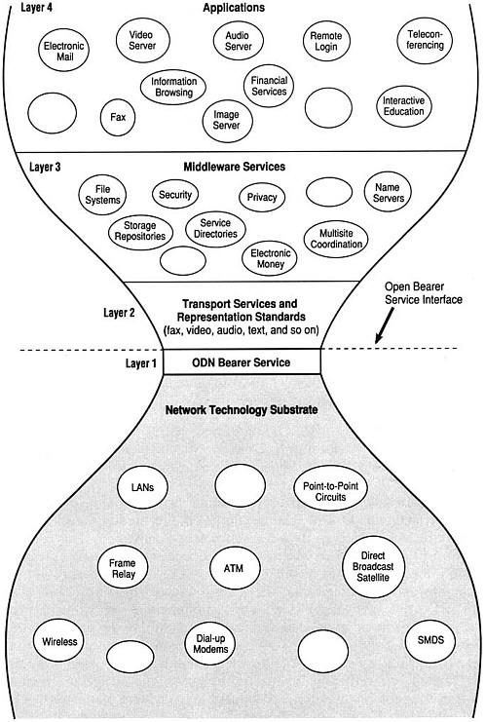
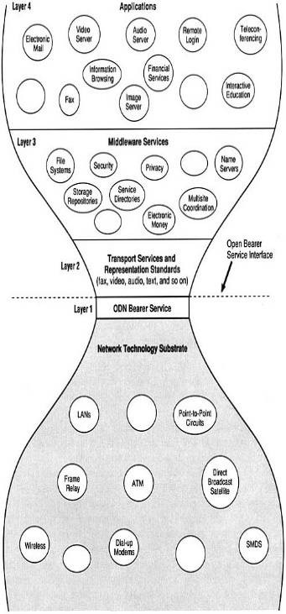
Did the Internet change industry structure?
1934
1994*
2014
Phone
service
Broadcast
TV
Services
Services
CDN
CDN
Long-haul
Long-haul
6 MHz spectrum
PSTN
Last-mile
Last-mile
*Realizing the Information Future: The Internet and Beyond. Computer Science and Telecommunications Board, National Research Council, 1994, p. 53
Sharon Gillett

Slide 65
Predicting
Policy mainly concerned about mass deployment (and legacy), not science experiments
  IPv6 was standardized in 1996, with earlier efforts starting in 1992, but did not achieve even modestly wide deployment until 2010
  first smartphone shown in 1994, 13 years before the iPhone launch
Technology in wide use in 2020 likely in lab & standardization in 2014

Slide 66
The dependency cycle
Technology (access, backbone)
speed scaling vs. new modalities
Consumer behavior
Industry structure
regulatory structure

Slide 67
Technology environment 2020
By 2020, the classical notion of Moore’s law of increasing transistor counts, particularly for the same power budget, will have largely run its course and mobile devices will remain constrained by battery technology.
Higher access speeds will largely depend on dense availability of fiber infrastructure, possibly leveraging infrastructure provided by non-traditional providers.
  Doubling spectrum → one year of bandwidth growth
  Wi-Fi overlay

Slide 68
Industry structure
ADSL increasingly non-competitive performance
Non-wireless carriers face stark choices:
  become AOL for not-quite-broadband
    where cable is not available
    and cheaper than LTE
  invest heavily into fiber and compete with HFC
  subsist on USF support
  become a datacenter & business services company

Slide 69
Next-generation Internet
Unlikely to see alternative models (beyond IPv6) by 2020
All alternatives struggle with the “why bother?” problem
  10x cheaper? 10x better?
  example: content-based networks
History of application & transport-layer solutions to network-layer problems
  security
  multicast
  mobility?
  caching → CDN

Slide 70
Financial constraints
Constraining constant are consumer financial resources:
  As fixed and mobile communication expenses are now the largest “utility” expense for many households and as the income of at least 90% of households is unlikely to increase much in real terms by 2020, the ability to free up additional financial resources for Internet and mobile by dropping landlines is also likely to diminish.
  The average US electric utility bill is $107.28 (2012).

Slide 71
Technology-induced policy challenges
Universal service obligations & COLR → other service obligations
  With emergency (text or voice) apps, the notion that the voice provider needs to be involved in the provision of 911 service will not be as clear-cut.
  Should consumers be able to choose a 911 access provider separate from their voice provider?
  Is the model of a monthly per-device or per-line fee for 911 sustainable and fair?

Slide 72
Regulatory models
So far, Internet regulation had advantage of largely leveraging existing last 1/4-mile infrastructure
Models:
  degrees of structural separation
    unbundling, explicit split, …
  rely on multiple parallel infrastructures
    emergence of next technology
    competitive on speed & cost/GB
    low-end competition easier

Slide 73
Cybersecurity
Traditionally, breaches mostly affected the careless or unlucky victim
but lack of diligence (and BCP 38 compliance) may cause entities to impose externalities on other parts of the Internet community by facilitating distributed denial-of-service attacks or route hijacking.
  software vendors, BCP 38, credit cards
Cyber insurance: fire insurance → city fire codes

Slide 74
Telecommunication access

Slide 75
Access for people with disabilities
Accessibility for
  devices (buttons, screen readers), software and web sites (screen readers, navigation)
Hearing aid compatibility for cell phones
Relay services
  text relay (TTY), video relay, …
Closed captioning
  1993 – most broadcast TV is close-captioned
  2006 – most video programming is to be close-captioned

Slide 76
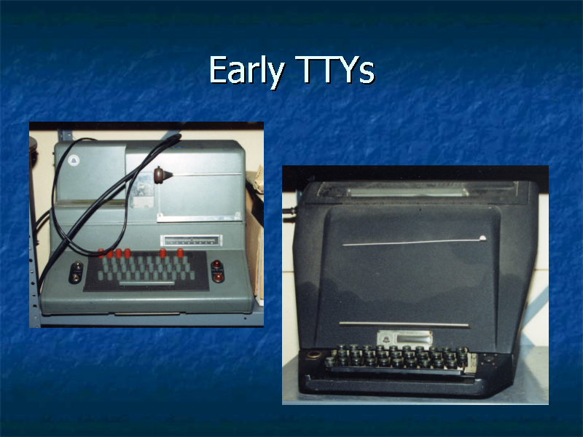

Slide 77
ASL & VRS
Sorensen

Slide 78
Improved US relay services
Video Relay (2000) – first E.164 IP-based multimedia system
  initially H.323, transitioning to SIP
Speech-to-Speech (2000)
Spanish Relay (2000)
Internet Relay (2001)
Access to audiotext (IVR) systems
Captioned Telephone (2003)
VRS interoperability (2015, 2016)
Automated speech transcription (2017?)
Direct communication to call centers (2017?)

Slide 79
