Slide 1
Intro to economics
very cursory & suitable only for networks
Henning Schulzrinne
(with material by G. Mankiw, Jerry Brocks, John B. Taylor and others)

Slide 2
Disclaimers
Focus on issues relevant to communication markets
  not: unemployment, inflation, balance of trade, income inequality, … (mostly, macro economics)
  not: reading a balance sheet
Very introductory (& simplified)
Try to point out limitations & assumptions
  “real world” has non-rational humans & companies, fraud, …

Slide 3
Concepts
Rational behavior
Opportunity costs
Elasticity of demand
Consumer surplus
Price setting
Less-than-perfect competition

Slide 4
Basic economic principles
People face trade-offs → opportunity costs
  time, money, reputation, health, …
  efficiency: most value from available resources
  equity, fairness: fair distribution of benefits
Cost = what you give up to get good or service
  Opportunity cost is what you give up to obtain item.
Rational people think at the margins
  Marginal changes are small, incremental adjustments to an existing plan of action.
  “sunk cost” fallacy
  People make decisions by comparing costs & benefits at the margin.
N. Gregory Mankiw

Slide 5
#4: People respond to incentives
Marginal changes in costs or benefits motivate people to respond.
The decision to choose one alternative over another occurs when that alternative’s marginal benefits exceed its marginal costs!
N. Gregory Mankiw

Slide 6
#5: Trade Can Make Everyone Better Off.
People gain from their ability to trade with one another.
Competition results in gains from trading.
Trade allows people to specialize in what they do best.
  “comparative advantage”
N. Gregory Mankiw

Slide 7
#6: Markets Are Usually a Good Way to Organize Economic Activity
A market economy is an economy that allocates resources through the decentralized decisions of many firms and households as they interact in markets for goods and services.
  Households decide what to buy and who to work for
  Firms decide who to hire and what to produce
N. Gregory Mankiw

Slide 8
#7: Governments Can Sometimes Improve Market Outcomes
Market failure occurs when the market fails to allocate resources efficiently.
When the market fails (breaks down) government can intervene to promote efficiency and equity.
Market failure may be caused by
  an externality, which is the impact of one person or firm’s actions on the well-being of a bystander.
  market power, which is the ability of a single person or firm to unduly influence market prices.
    acquired or government-granted monopolies
      patents, trademarks, concessions, right-of-ways, franchises, …
N. Gregory Mankiw

Slide 9
Rivalry
 | Excludable | Non-excludable
Rivalrous | Private goods (food, clothing, cars, personal electronics) | Common goods (fish stocks, timber, coal, roads)
Non-rivalrous | Club goods (cinemas, private parks, satellite TV) | Public goods (OTA TV, air, national defense)
Wikipedia

Slide 10
Externalities
Negative impact on others
  pollution, congestion (networks, land, …), …
  cost transfer (e.g., health care)
  privacy
Lack of positive outcomes
  under-investment in public goods: research, education, infrastructure, access for people with disabilities
  lack of innovation (e.g., trade secrets) or cultural production
  lack of resiliency (natural & man-made disasters)
Introducing
  regulation: “don’t cause it” → EPA fuel economy
    but some externality-causing behaviors have positive effects
      at least perceived by somebody (e.g., smoking)
  taxation: “pay for it” → gas guzzler tax, cigarette taxes

Slide 11
Economic models
Simplified real world
  similar to scientific models and engineering models
    e.g., ignore friction or quantum effects; simplify shapes
Typical assumptions (not all of them):
  rational behavior on relevant time scales (→ manager behavior)
  no externalities
  perfect information
  competition (see later)
Model output
  what is optimized – consumer benefit? total benefit?
  how large are the effects – often, examples are artificial and may exaggerate the effects
    → econometrics
Example: Open Internet modeling

Slide 12
The Circular-Flow Diagram
The circular-flow diagram is a visual model of the economy that shows how dollars flow through markets among households and firms.
N. Gregory Mankiw
Notes:
6

Slide 13
Our first model: the circular-flow diagram
Factors of Production
  inputs used to produce goods and services
  land, labor, and capital
  but also public goods: knowledge, infrastructure, …
N. Gregory Mankiw
Notes:
7

Slide 14

Figure 1 The Circular Flow
MARKETS
Revenue
FOR
Spending
GOODS AND SERVICES
Goods
Firms sell
Goods and
and services
Households buy
services
sold
bought
FIRMS
HOUSEHOLDS
Produce and sell
Buy and consume
goods and services
goods and services
Hire and use factors
Own and sell factors
of production
of production
Factors of
MARKETS
Labor, land,
production
FOR
and capital
FACTORS OF PRODUCTION
Wages, rent,
Households sell
Income
and profit
Firms buy
= Flow of inputs
and outputs
= Flow of dollars
Copyright © 2004 South-Western

Slide 15
Requirements for efficient transactions
Adequate information (location of buyers and sellers, product quality)
Enforcement of contracts
Protection of property rights
Limited externalities
Limits on market power or other limitations on fair bargaining
Jerry Brock

Slide 16
Perfect competition
The more competition there is, the more likely are firms to be efficient and prices to be low.
Perfect competition is the most competitive market imaginable in which everybody is a price taker. Firms earn only normal profits, the bare minimum profit necessary to keep them in business. If firms earn more than this (excess profits) other firms will enter the market and drive the price level down until there are only normal profits to be made.
  Perfect competition is rare and may not even exist. It is so competitive that any individual buyer or seller has a negligible impact on the market price. Products are homogeneous. Information is perfect. Everybody is a price taker. Output will be maximized and price minimized.
  Most markets exhibit some form of imperfect or monopolistic competition. There are fewer firms than in a perfectly competitive market and each can to some degree create barriers to entry. Thus firms can earn some excess profits without a new entrant being able to compete to bring prices down.
http://www.economist.com/economics-a-to-z/

Slide 17
(Near) perfect competition?
Food trucks
Chinese & Italian restaurants
Stock and commodities (gold, pork bellies) markets
Tutoring
Selling real estate
Low-wage employment
Musicians (?)

Slide 18
Consumer surplus
= The difference between what a consumer would be willing to pay for a good or service and what that consumer actually has to pay. Added to PRODUCER SURPLUS, it provides a measure of the total economic benefit of a sale.
Economist

Slide 19
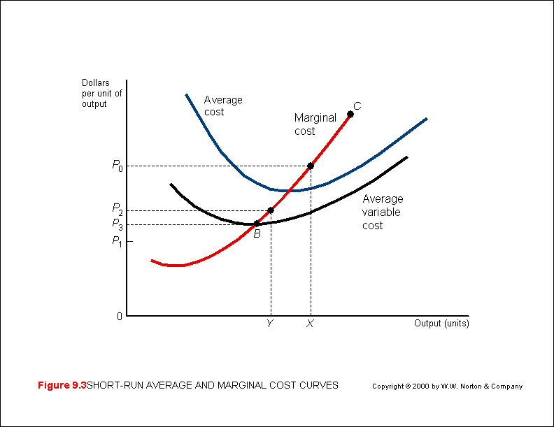
Classic cost, production curve

Slide 20
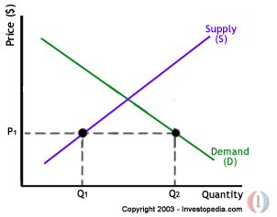
Basic demand-supply diagram

Slide 21
Competitive equilibrium
Firms expand if price is above marginal cost
Firms contract if price is below marginal cost
Equilibrium is where marginal cost (MC) crosses the demand curve
P = MC is socially efficient in the sense of “allocative efficiency”
Jerry Brock

Slide 22
Equilibrium with economies of scale
Marginal cost is below average cost
Marginal cost pricing will not cover all of costs
Non-regulated firms often use discriminatory pricing (information goods)
Regulated firms must have some prices above marginal cost for viability
Jerry Brock

Slide 23
Equilibrium with economies of scope
Prices designed to recover the incremental cost of each product will not recover the entire cost of the firm
In an unregulated market, revenue from each product would be between the incremental cost and the stand-alone cost
If revenue is less than the incremental cost, we say that product is cross-subsidized by another product
Jerry Brock

Slide 24
The elasticity of demand
Price elasticity of demand is a measure of how much the quantity demanded of a good responds to a change in the price of that good.
Price elasticity of demand is the percentage change in quantity demanded given a percent change in the price.
Mankiw

Slide 25
The price elasticity of demand and Its determinants
Availability of close substitutes
Necessities versus luxuries
Definition of the market
Time horizon

Slide 26
The price elasticity of demand and its determinants
Demand tends to be more elastic:
  the larger the number of close substitutes.
  if the good is a luxury.
  the more narrowly defined the market.
  the longer the time period.
Mankiw

Slide 27
Computing the Price Elasticity of Demand
The price elasticity of demand is computed as the percentage change in the quantity demanded divided by the percentage change in price.
Mankiw

Slide 28
Computing the price elasticity of demand
Price
$5
4
Demand
0
50
100
Quantity
Demand is price elastic
Mankiw

Slide 29
Demand curves
We can think of people as arrayed along the demand curve according to the maximum that they would pay for the good rather than do without.
The maximum that an individual will pay is determined by that person’s preferences for this good compared to other goods, by the prices of other goods, and by the individual’s income.
The difference between the demand curve and the price paid is the individual’s “consumer surplus”.

Slide 30
Network effects
A network effect exists when an increase in the size of the network increases the value to subscribers of the network
Network effects are sometimes called economies of scale on the demand side
Network effects give an advantage to the largest firm in the industry, even without economies of scale in the supply of the product

Slide 31
Economies of scope
Economies of scope exist when it is cheaper to produce two products together than to produce them separately
When economies of scope exist, the sum of the stand-alone cost is greater than the total cost and the sum of the incremental cost is less than the total cost
Example: car radio controversy
  “vertical integration” in media companies

Slide 32
Monopoly
Most markets exhibit some form of imperfect or monopolistic competition. There are fewer firms than in a perfectly competitive market and each can to some degree create barriers to entry. Thus, firms can earn some excess profits without a new entrant being able to compete to bring prices down.
The least competitive market is a monopoly, dominated by a single firm that can earn substantial excess profits by controlling either the amount of output (supply) in the market or the price (but not both). In this sense it is a price setter.
When there are few firms in a market (oligopoly) they have the opportunity to behave as a monopolist through some form of collusion (see cartel). A market dominated by a single firm does not necessarily have monopoly power if it is a contestable market.
  In such a market, a single firm can dominate only if it produces as efficiently as possible and does not earn excess profits. If it becomes inefficient or earns excess profits, another more efficient or less profitable firm will enter the market and dominate it instead.
http://www.economist.com/economics-a-to-z/

Slide 33
Monopsony
A market similar to a monopoly except that a large buyer not seller controls a large proportion of the market and drives the prices down. Sometimes referred to as the buyer's monopoly. (investopedia)
  Less common, but Amazon has been accused of that by book publishers.
  Cable companies buying content rights?

Slide 34
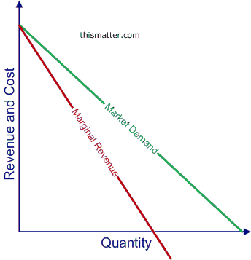
Monopolist: marginal revenue
1st item: $100
2nd item: $90 ➔ $180
→ MR = $80
monopolist sets price (or, less likely, output + auction
or restricted market)
Notes:
http://thismatter.com/economics/pure-monopoly-demand-revenue-costs-profits.htm

Slide 35
The General Rationale for Government Intervention: Deadweight Loss from Monopoly
$100
$50
Taylor

Slide 36
Two forms of government intervention
Taylor
Antitrust policy
  sometimes called competition policy
Price and entry regulation of firms
  sometimes called economic regulation
  distinct from social regulation

Slide 37
Herfindahl-Hirschman Index HHI or the “Herf”
Taylor
Definition: sum of squared market shares
  example: a 3 firm industry (30,30,40) has HHI
    = (30)² + (30)² + (40)²
    = 900 + 900 + 1600 = 3400
Example: challenge if HHI > 1800 and merger would increase HHI by 50 or more
  could two of the three firms merge? (60)² + (40)² =3600+1600=5200 NO WAY!!!

Slide 38
Telecom mergers

Slide 39
Price Discrimination (1)
Price discrimination requires some market power, the ability to distinguish the components of the market that value the product at higher or lower rates, and the ability to limit resale from customers who pay a lower price to those who pay a higher price.
Perfect price discrimination allows a monopolist to extract all of the consumer surplus from the market by charging each customer the maximum amount that customer would pay rather than do without the product, but perfect price discrimination is rarely possible.

Slide 40
Price Discrimination (2)
Practical price discrimination generally involves distinguishing two or more market segments and setting different prices for those market segments.
Profit maximizing price discrimination requires setting separate monopoly prices (MR = MC) in each segment. If the elasticity of demand is the same in both segments, no price discrimination is possible because both monopoly price computations yield the same result.
Price discrimination is more feasible in services or goods with licensing agreements than in manufactured goods because it is hard to prevent resale with manufactured goods.

Slide 41
There are three ways to regulate the price of a natural monopoly.
But first make sure it is a natural monopoly
Borderline cases like cable TV?
  How many over the air channels are there?
  What about satellite dishes?
  What about the electricity lines?
Open Internet and merger debates – who is competing?
  Satellite: ubiquitous, but latency
  Cellular: nearly ubiquitous (95% claimed), but usage metering and variability

Slide 42
Cost Concepts
Average cost (ATC) – total cost divided by the number of units produced
Marginal cost (MC) – the cost of producing one additional unit
Incremental cost – the cost of producing an additional quantity of output in the units that an efficient manager would choose – a practical approximation to marginal cost

Slide 43
Cost Concepts - continued
Historical cost – the cost as recorded by an accounting system based on past expenditures
Forward looking cost – the projected cost of production based on expected future expenditures

Slide 44
(1) Marginal cost pricing
Sounds pretty good, P = MC would mean efficiency and no deadweight loss
But the firm will earn negative economic profits; who would bother to produce?

Slide 45
(2) Average cost pricing
This sounds better:
  profits are not negative, rather they are zero
  and P is not nearly as high as PM though P is greater than MC
But ATC (average total cost) pricing can create bad incentives (corporate jets again, bad management)
  → “rate of return” carriers
  “A rate-of-return (ROR) carrier is one that is allowed to set rates on its various products and services so that it earns no more than the rate-of-return authorized by the FCC. FCC rules define the rate base (specified plant items) upon which a carrier is allowed to earn a return.” (USAC)
Taylor
Notes:
https://apps.fcc.gov/edocs_public/attachmatch/DA-13-1656A1.pdf

Slide 46
Wrap-Up and Compare
P = P_{M} P = MC P = ATC
Taylor

Slide 47
Regulation addresses market failures
Prevent or restrain monopolies
  anti-trust: prevent horizontal & vertical monopolies
  price setting or capping (“price cap regulation”)
Mandate behavior in exchange for license/franchise or industry
  PEG channels
  Accessibility (“hearing aid compatibility”)
Taxes to fund public goods
  emergency calling
  disability access (e.g., relay services)
  universal service by geography and income
    Internet access for students & libraries (“e-rate”)

Slide 48
Incentive Regulation
Set regulated price several years in advance
  for example, ATC plus an inflation factor
Firm gets to keep extra profits (or suffer extra loss) without the regulator immediately changing the regulated price
Thus firm has incentive to keep its costs down
Taylor

Slide 49
Regulatory summary
Useful for capital intensive infrastructure industry with stable technology
Allows long term investment with low cost of capital because of limited risk
Provides stable prices and services to consumers
Discourages change, including technological progress

Slide 50
Asymmetric information

Slide 51
Introduction
Basic economic analysis assumes that all parties have the relevant information, with little attention to precisely what information is required and how it is acquired.
With competition, prices themselves convey a great deal of information and reduce the need for detailed understanding of private information.
With small numbers of agents bargaining, information issues become much more significant than under competition with large numbers of agents.
Brock

Slide 52
Definitions (1)
Asymmetric information – one party to the bargain has relevant information unknown to the other party
  regulated firm and regulatory agency, employee and employer
Moral hazard – one party may undertake actions adverse to the other party that cannot be completely monitored
  homeowner’s private fire prevention efforts and insurance company
  employee’s intensity of effort and employer
  health insurance
Brock

Slide 53
Adverse selection & mechanism design
Adverse selection – an outcome that results from information asymmetry that would not have occurred if the uninformed party had access to the information possessed by the informed party (purchase of a bad used car from an owner that knew it was bad)
Mechanism design – a method of designing contracts or regulatory structures to create private incentives to reveal truthful information (incentive compatible regulation such as price caps, a menu of options designed to reveal information, Vickrey auction)
Brock

Slide 54
Lemons Model
Suppose buyers know that 50% of used cars are “lemons” worth $1000 and 50% are good cars worth $2000, but cannot distinguish between the good and bad cars.
If neither buyers nor sellers can distinguish car types, the equilibrium price would be the expected value of $1500.
If only sellers can distinguish, the equilibrium is to sell only bad cars at $1000.
Asymetric information combined with moral hazard creates adverse selection and eliminates the market for good used cars.
Brock

Slide 55
Signaling Models (1)
The lemons problem cannot be overcome by simply asking the buyer because the buyer may falsely assert that the car is good.
The lemons problem can be overcome by investing in signals that are correlated with the unknown quality characteristic (advertising, brand reputation).
In general, signals require the use of resources that would not be required to convey the information if all persons told the truth.
Brock

Slide 56
Signaling Models (2)
Michael Spence originally developed signaling models in the context of education.
Assume ability, not education, is the characteristic valued by employers.
Assume high ability individuals find it easier to acquire educational credentials than low-ability individuals.
Employers will pay according to education and individuals will rationally invest in education because of the correlation between education and the unknown but valued characteristic of ability.
Brock

