Slide 1
Trends in Communications – or Thinking Beyond Voice
Henning Schulzrinne
FCC/Columbia University
September 2016

Slide 2
Overview
Moving beyond voice in emergency communications
  what is changing?
  what does this mean for supporting communications in ”challenging” environments?
Emergency communications
  the challenges of getting 911 out of the analog age

Slide 3
Today if I want to phone someone just to chat, I first have to consider whether the call will be viewed as intrusive. My method is to ask myself, “Have I ever seen this person in the nude?”
With business calls, prevailing etiquette isn’t all that different. If you know somebody pretty well in the business sense (the threshold here being not “have I seen this person naked?” but “have I ever seen this person across a lunch table?”) you may phone with some confidence that the party will pick up. If not, you’ll have to leave a message and enter a ghastly limbo that requires a formal appointment.

Slide 4
About half of households are wireless-only

Slide 5
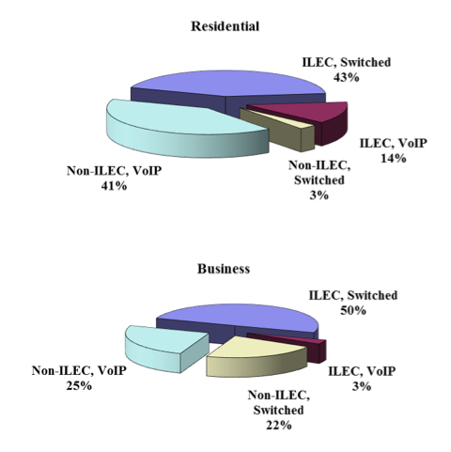
US landline phone service
FCC Voice Telephone Services: Status as of December 31, 2014

Slide 6
How can we push beyond 2001?
Phone numbers forever – or what should the communication identifier be?
Interoperable messaging – can we get back from the silo?
Interoperable real-time communication – VRS shows the way
What role can SIP play in the Internet of Things?
Mostly questions rather than answers

Slide 7
Open Internet vision
HTTP
closed source
open source

Slide 8
Protocol installation, ca. 2000

Slide 9
J. Rosenberg
IETF plenary 3/2011

Slide 10
2016 reality (1)
rapid app switching
seamless download
proprietary
HTTP(S)
HTTP GET/POST API
HTTP(S)
external
program
See (e.g.,) draft-tschofenig-post-standardization (2012)

Slide 11
2016 reality (2)
proprietary
HTTP(S)
SDP

Slide 12

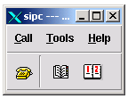
2001
sipc

Slide 13
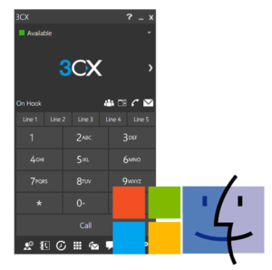
2016

Slide 14
But we leave users with two choices
OR
same service as in 1950!
same service as in 1985!

Slide 15
Interoperable identifiers

Slide 16
Communication identifiers
Property | URL owned | URL provider | E.164 phone number | Service-specific
Example | alice@smith.name sip:alice@smith.name | alice@gmail.com sip:alice@ilec.com | +1 202 555 1010 | www.facebook.com/alice.example
Protocol-independent | no | no | yes | yes
Multimedia | yes | yes | maybe (VRS) | maybe
Portable | yes | no | somewhat | no
Groups | yes | yes | bridge number | not generally
Trademark issues | yes | unlikely | unlikely | possible
Privacy | Depends on name chosen (pseudonym) | Depends on naming scheme | mostly | Depends on provider “real name” policy
Notes:
http://findmyfacebookid.com

Slide 17

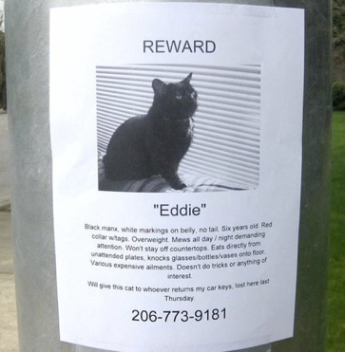

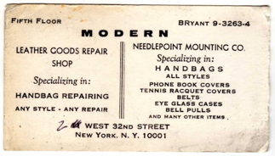
Phone number evolution

Slide 18
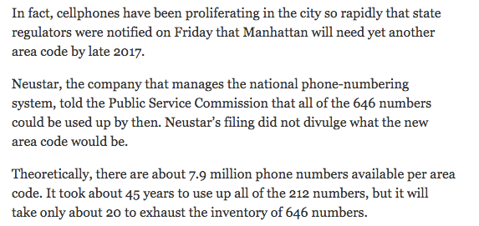
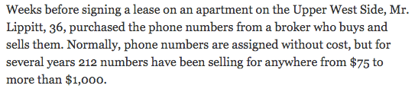

Phone numbers are valuable
NY Times, March 25, 2015
Notes:
http://www.nytimes.com/2015/03/25/nyregion/as-manhattan-area-codes-multiply-some-still-covet-a-212.html

Slide 19
All problems in computer science can be solved by another level of indirection, except of course for the problem of too many indirections. (David Wheeler)

Slide 20
Humans vs. machines
 | Human-visible | Machine-usable
Scope | local (“Mom”) | global
Persistence | temporary (“dentist”, “babysitter”) | often long-lived
Length | short (4-10?) | embeddable (< 200?)
many identifiers serve as both – but UI can hide details

Slide 21
Communication modalities
Car
Insurance company
unpredictable
< 1/year
Professional
Colleagues & casual friends
Close family & friends
> 1/week
“I have a refrigerator magnet”
“I know her email, but need to call her”
“Alice and I always use Skype to chat.”
not all communication identifiers are persistent

Slide 22
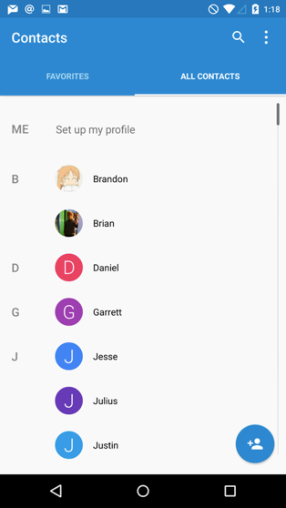
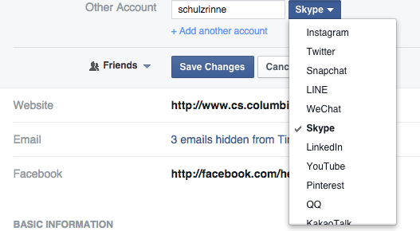

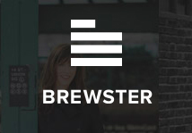

Identity options
Universal communication app
  Winner take all (WeChat…)
Directory intermediation?
  But no universal query protocol
  or update mechanism (tool publishes into address book)

Slide 23
Identifiers have social conventions
Identifier = access permission
  phone number, email address, …
Identifier = “pairing” permission
  Skype: ask for permission
Mutuality
  only mutual Twitter followers can direct message each other

Slide 24
Identifiers have social conventions
A WhatsApp identifier is the phone number, but the expectation is that it will be used for messaging only, not calls.
Pre-mobile days: friends only got your home number, colleagues only got your work number
  and friends or colleagues wouldn’t use the other
Asking a person you met in a bar for their phone number has deep social connotations
PO boxes and UPS “suites” provide semi-anonymity

Slide 25
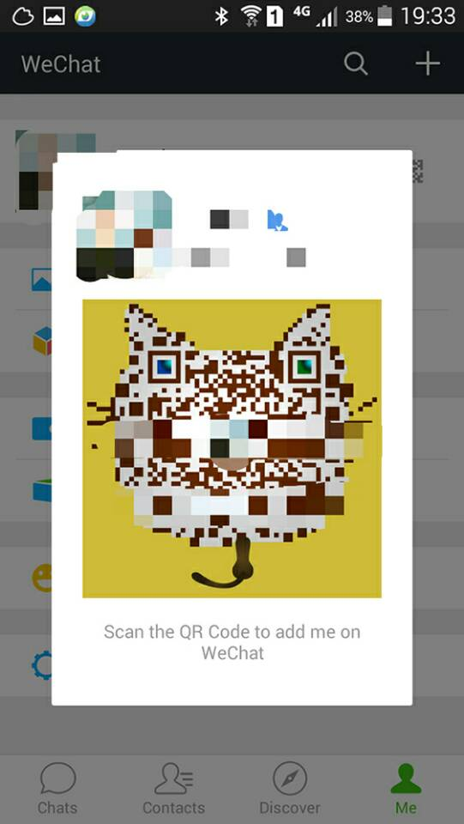
Example: WeChat QR code introduction & NFC
→ human readability doesn’t matter
Notes:
http://chinachannel.co/wechat-qr-codes-wechat-essential-tips/

Slide 26
Special-purpose identifiers
hgs+rfctopic@cs.columbia.edu identifiers spam scrape sources
“burner” phone numbers
one-time use email addresses
forward-only email (somebody@ieee.org, braggard@alum.mit.edu)

Slide 27
Impostors – fake identities

Slide 28
Security ≅ identity assertion
Need to be able to assert possession of identifiers
Kind of works for…
  phone/SMS: provide code
  email: clickable link
  domain name: modify DNS entry (for TLS certs)
  SIP URL: provide code?
But third parties can’t validate this automatically
  → need certs for these identifiers (see: STIR for phone numbers)

Slide 29
Identifiers in transition
Likely
  in some countries, single app (KakaoTalk in South Korea, LINE in Japan, ...)
  with phone number as back-up
Opportunities for new approaches to identification for real-time use
  secured → properties
  user friendly
  special use (e.g., one-time, traceable)

Slide 30
Interoperable team collaboration

Slide 31
Goals (often unstated)
Support unstructured collaboration in (small-ish) groups of people
Work teams (long-term or ad-hoc), projects (customer team + sales + engineering)
Standards bodies, university classes, community organizations
Often ad-hoc assembly of email, emailing documents, Google Drive/Dropbox, Doodle, … + dial-in conference calls
Groups created by cc lists (“chain” in FCC parlance...)
only
or
?

Slide 32
Three origins

Slide 33
From PBX…

Slide 34
to unified communications
call-focused
independent events
  user-managed history and state
weak team & project notion

Slide 35
From Outlook & webmail…
1996

Slide 36
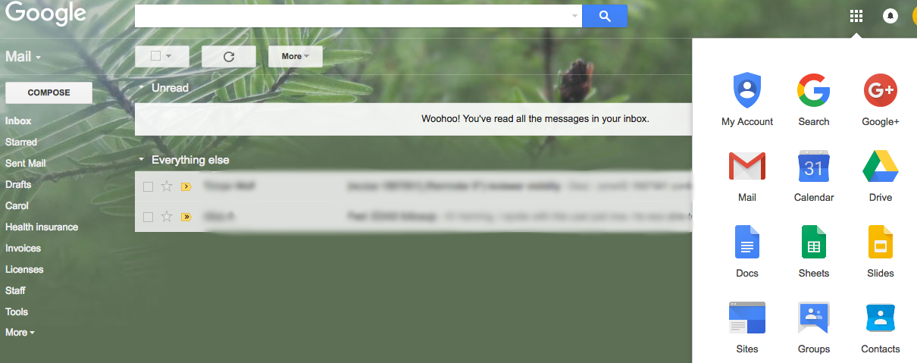
“Outlook on the web”
email-focused
email folders (~projects)
loose integration → flexible tools
internal ≈ external
weak or no team concept
weak real-time communication

Slide 37
From IRC…
1988

Slide 38
You will be assimilated
channels (teams, rooms, …)
timeline central
short, rapid messages
no file system integration
email as the enemy
must join to participate
  → winner take all
mainly text
video external (BlueJeans)
text + video conferencing

Slide 39
And everyone wants you in their garden

Slide 40
Bots

Slide 41
Can we dream (and build)?
Interoperable using existing open standards (mostly) → SIP, RTP or maybe HTTP layer?
  modularity could be improved
web client + standards-based clients
no new accounts necessary → use phone number or email address
internal users same as external
file system integration: Dropbox, Google Drive, OneDrive, photo albums, …
some people (still) like email → treat as first-class citizen
  including setting up real email groups (digest, …)
bots act like regular users (messaging)
support open calendaring

Slide 42

Federated model
group
manager
files
other domain,
similar setup
SIP, SMTP, HTTP, …
calendar
mail
lists
cloud-hosted or local

Slide 43
Interoperable video calls

Slide 44


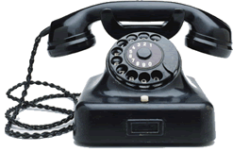
Video relay service (VRS)
Serves about 200k people who use sign language
Uses regular +1 NANP phone numbers – portable between providers
Probably largest interoperable, standards-based multimedia service
CAs
access platform
now: SIP, H.323
soon: SIP + legacy H.323

Slide 45
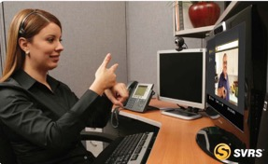


VRS architecture (SIP-based)
202 555 1111
SIPForum VRS spec
(near production)
provider A
provider B
+ location
ENUM
RUE spec
(in progress)
direct ASL calls
to gov’t, large companies
201 555 1234

Slide 46
Telecommunication relay program

Slide 47
ACE initiative

Slide 48
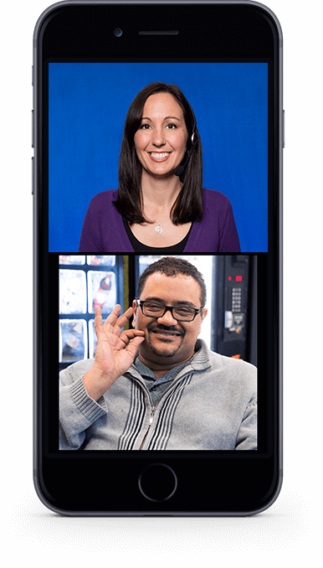
VRS client examples (not all SIP – yet)

Slide 50
What is changing in emergency telecom (requirements)?

Slide 51
Networks
1950-2000
HF (SHARES)
PSTN
2020+
point-to-point optical
commercial Internet & Wi-Fi
mesh networks
broadband satellite

Slide 52
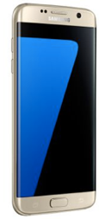
Network functions
1950-2000
2010+

Slide 53
New network sharing models

Slide 54
New communication-impacting emergencies
1950-2010
nuclear attack
2001+
terrorism
cyber attack
hurricanes
earthquakes
large-scale natural disasters

Slide 55
Emergency coordination
1950-2010
fax?
voice
2010+
text (chat, IM)
data access
GIS apps
voice (+ video)
multipoint

Slide 56
Communication needs
1930-2010
email
voice
2010+
email
voice
emergency GIS
electric utility
SCADA
M2M
H2GH
H2H

Slide 57
Emergency alerting
1930-2010
EAS
sirens
2010+
EAS
WEA
Facebook Check-in
Earthquake Early Warning
alert elevators,
not just humans
citizen-to-citizen
authority-to-citizen

Slide 58
Resource constraints
1930-2000
access line
long-distance trunks
Now
spectrum
Wi-Fi access
data center capacity
spectrum
service capacity
(conference calls!)

Slide 59
Where is the intelligence?
1930-2000
SS7 databases
Now
routers
edge middleboxes
handset OS
switches
apps

Slide 60
Network resilience concerns

Slide 61
SIGCOMM 2015

Slide 62
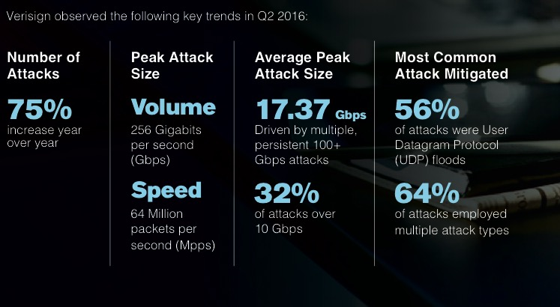
"Someone Is Learning How to Take Down the Internet” (Schneier, 9/2016)
DDOS + routing
“One week, the attack would start at a particular level of attack and slowly ramp up before stopping. The next week, it would start at that higher point and continue. And so on, along those lines, as if the attacker were looking for the exact point of failure.”
“testing the ability to manipulate Internet addresses and routes, seeing how long it takes the defenders to respond”
Verisign Q2 2016

Slide 63
Distributed networks, but key elements
HLR
DIAMETER
IMS
DNS resolvers
various APIs
American Prospect, Dec. 2001

Slide 64
Are 911 outages becoming more frequent?
Notes:
http://www.ems1.com/communications-dispatch/articles/127624048-Colo-dispatch-centers-file-complaints-over-911-outages/

Slide 65
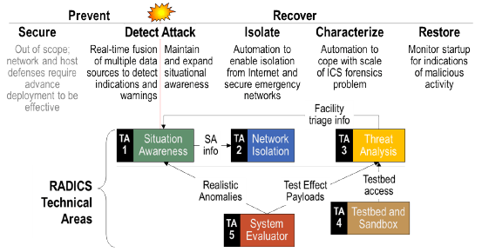
DARPA RADICS: Protecting Nation’s Grid from Cyber Attack

Slide 66
Part 4 (outage reporting)
Update metric from DS-3 to OC-3
911 outage metric
Report on TPS enrollees
FNPRM
  broadband network disruptions
    outage of 1 Gbps for 30 minutes or more (22,500 Gb/s user minutes)
  interconnected VoIP: degradations
  call failures in RAN
  airports
  consider information sharing with state and local authorities
July 2016: R&O on submarine cable outages

Slide 67
FCC WEA activities
15-91 (Nov. 2015)

Slide 68
Summary
Voice is becoming a niche technology
  even for emergency coordination: GIS, conference bridges, IoT, …
Outages and resiliency were about lines and switches
Much more diverse environment → more components need to work
  → larger geographic dependencies
  there are no more “local” calls or local Internet connectivity

