Slide 1
Insanity is - Or how can we finally make progress on securing our computing infrastructure?
Henning Schulzrinne
Columbia University
March 2015

Slide 2
Overview
Security fallacies
  Stop blaming (and “educating”) users
  Reduce the value of targets
  Avoid “small mistake, huge cost”
  Secure key identifiers
  Make it hard to scale attacks
  Make it easy to detect loss
  Design fraud-resistant systems
  Worry about DOS attacks on humans
Robo-calling and caller ID spoofing
Professional responsibility to not just patch things

Slide 3
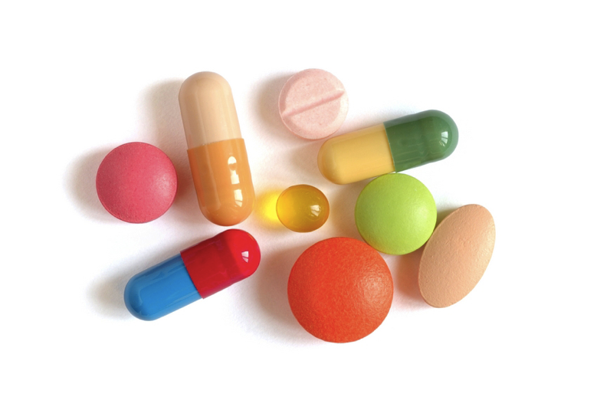
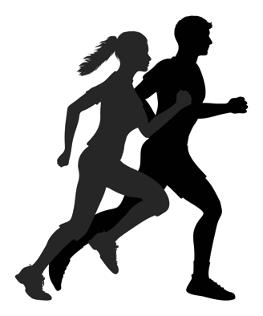
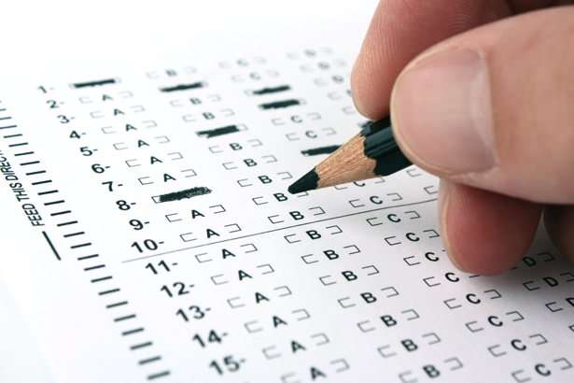

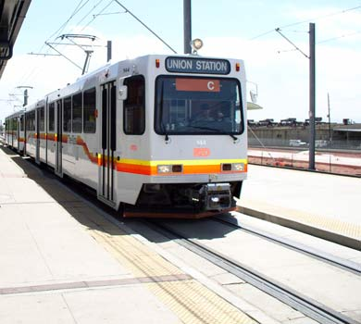
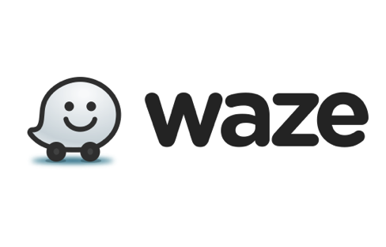
Pattern of failure

Slide 4

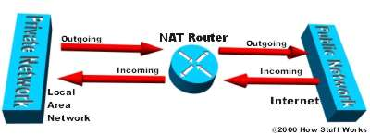

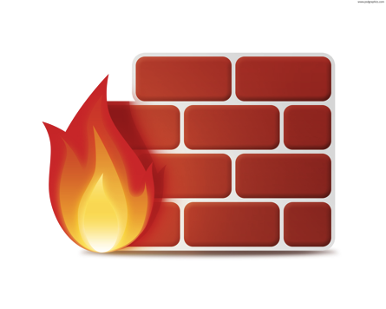
Pattern of failure
ICE
STUN
TURN
secure
OS & applications

Slide 5

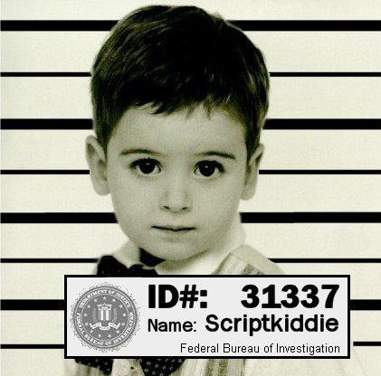
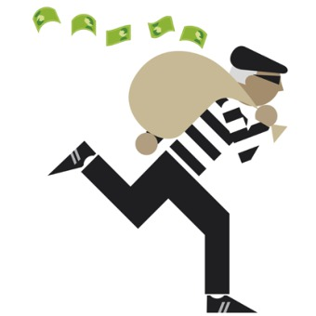
What are you worried about?
Goal | click fraud, DDOS | empty bank account
What doesn’t help | Encrypt all protocols | firewall | Updates (zero-days)
What might | Update software; firewall | Defense in depth | Encrypt all protocols

Slide 6
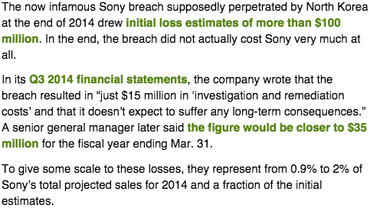
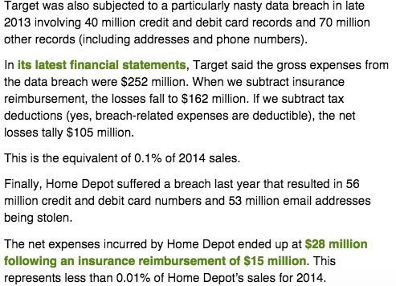
Limited incentive for companies
doesn’t account
for costs to customers
and credit card companies

Slide 7
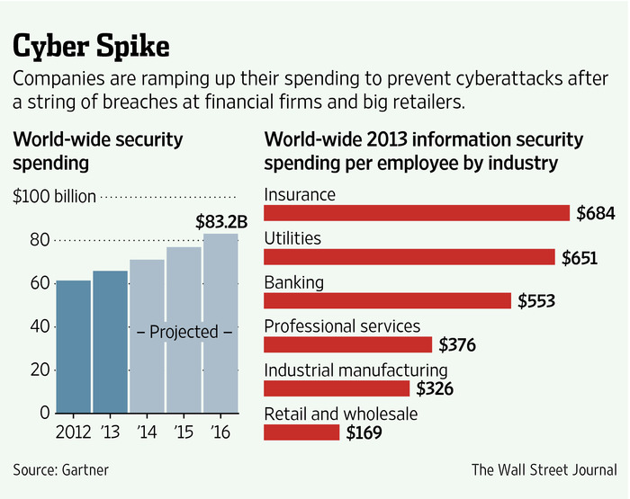
Tragedy of the Commons, again
Notes:
http://www.wsj.com/articles/financial-firms-bolster-cybersecurity-budgets-1416182536

Slide 8
Six dumbest ideas in security
(Ranum 2005)
Default permit
  firewall rules
  code execution
Enumerating badness
  track goodness instead
Penetrate and patch
  Java, Adobe Flash
  ←→ Qmail, PostFix compartmentalization
Hacking is cool
  → good engineering is cool
Educating users
Action is better than inaction
Notes:
http://www.ranum.com/security/computer_security/editorials/dumb/index.html

Slide 9
Six other dumb ideas
(US) credit cards
Social security numbers – public key cryptography, redefined
Checks
Linux ssh security defaults
  allow root login; no 2-factor built-in; no automated context login
Allowing user applications to write any file
  → ransomware
No type checking for external input data for web languages
  we won’t even talk about PHP register_globals

Slide 10
Security approach: blame the victim
Run 10 anti-virus systems!
Choose passwords you can’t remember!
Pay cash!
Don’t click on that link!
Choose another operating system!

Slide 11
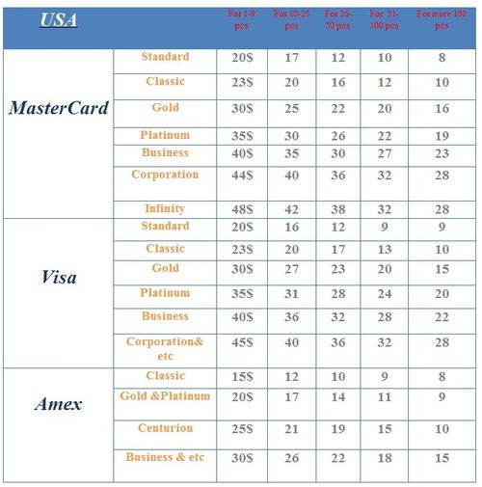
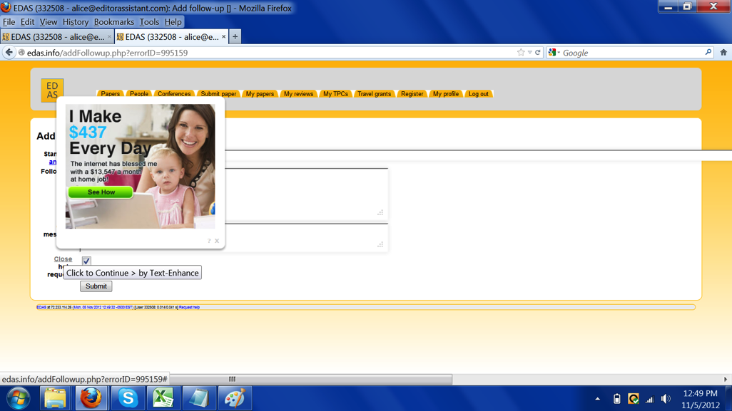
Nobody cares about you!
Unless you have access to high-value information
  sometimes for individualized identity theft
You are only valuable as
  a credit card number that can be resold in bulk ($2-$8)
  a machine usable for …
    DOS attacks
    email spam
      88% of spam sent by botnet
    a machine usable for advertising click fraud
      watch highlighted links!
      $0.002-0.003/click → $0.50-$2 CPM
Notes:
http://blog.imperva.com/2011/10/current-value-of-credit-cards-on-the-black-market.html
http://iseclab.org/papers/cutwail-LEET11.pdf

Slide 12
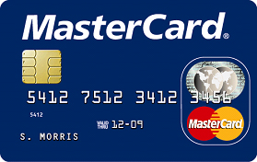
You are (mostly) on your own
Credit card
  liability limited to $50
  US: mag stripe vs. chip & PIN
Debit card
  two days → $50, otherwise $500
Checks
  no, your bank does not check your signature (or your address)
Consumer bank account → Regulation E
  no liability if reported within 60 days
Small business account
  No protection, no loss bound
  ACH fraud common

Slide 13
Authentication

Slide 14
Traditional authentication
Authentication
Something you know
(password)
Something you have
(cell phone, fob)
Something you are
(biometrics)
Where you are
(light switch)

Slide 15
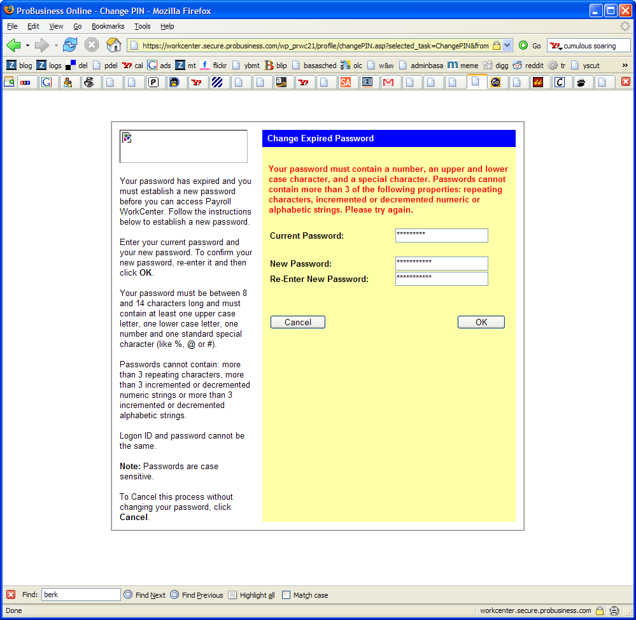
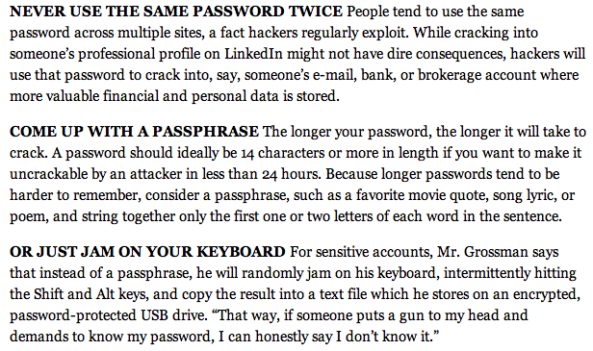
Password policies gone amuck
Contradictory policies
  Strong passwords don’t work everywhere
Password expiration
  and can’t use old one
Don’t re-use password across sites
NY Times, 11/07/2012
Notes:
http://jeremy.zawodny.com/i/password-insanity.png
http://www.nytimes.com/2012/11/08/technology/personaltech/how-to-devise-passwords-that-drive-hackers-away.html

Slide 16
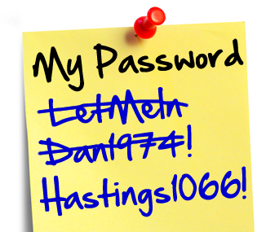
Password advice
Unless you’re the CIA director, writing down passwords is safe
  you’ll pick safer ones if you do
Stop blaming users → web sites need to tell us what they do
  bad: plain text, silly rules
  not much better: hashed
  good: salted hash, single sign-on
Impacts password recovery
  bad: your dog’s name
  not great: send password to email
  ok: time-limited reset link

Slide 17
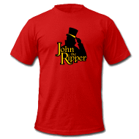
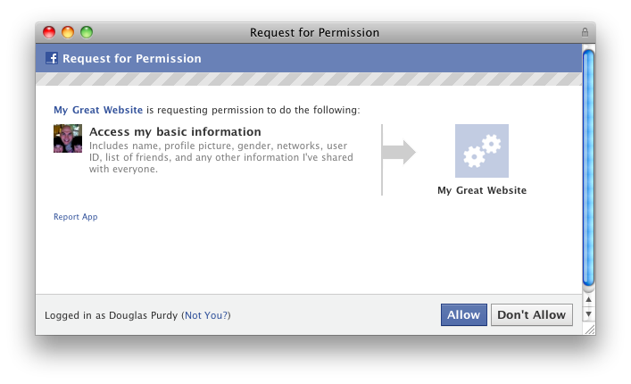

More password issues
With rainbow tables, only length matters
  12+ characters likely safe
  except for dictionary word combinations
  brute force via GPU: billions of guesses a second
Always next year: single sign on

Slide 18
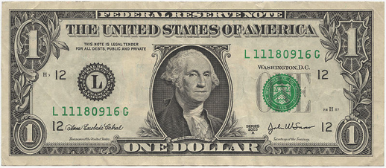
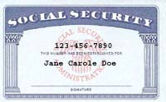
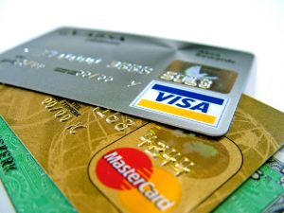
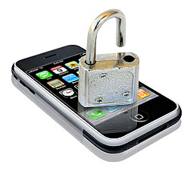
Reduce value of goods
Particularly single-factor goods
  if you can’t tell that they are gone

Slide 19
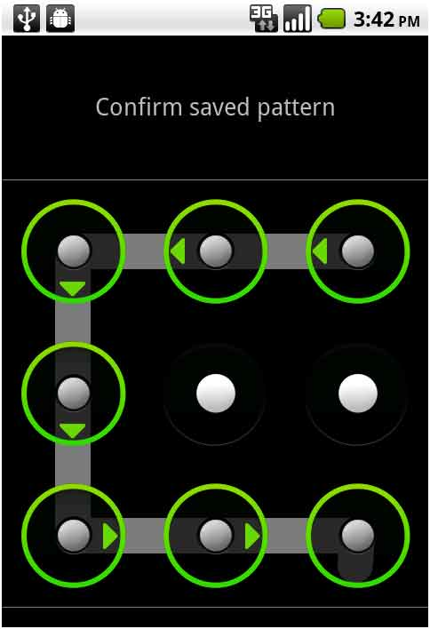
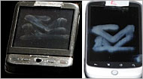
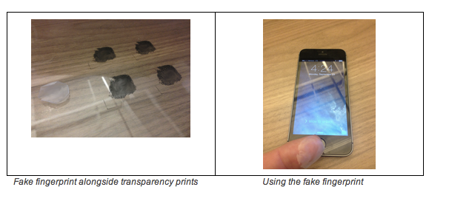
What about non-passwords?
Replacements have been suggested:
  Swipe pattern (Android)
  Voice pattern
  Fingerprints (TouchID)
  Keyboard typing or swiping
  Face recognition
Problems:
  not generalizable
    only works on some devices
  not precisely representable
    doomed if you have a cold or are in a noisy airport
    likely need password backup
  hard to have different ones → bad if clonable
Useful as supplement for high-value transactions
Notes:
http://www.smartplanet.com/blog/business-brains/goodbye-passwords-new-alternatives-emerge-but-passwords-persist/21304

Slide 20
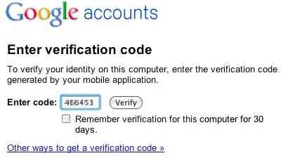
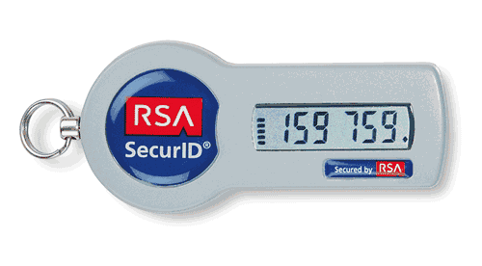
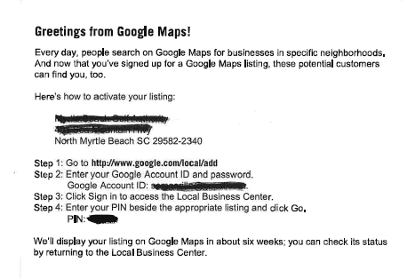
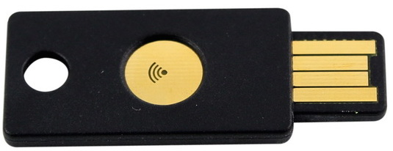
The convergence to “what you have”
Two-factor authentication
Advantages:
  easy to recognize when lost
  hard to scale theft (but: see RSA)
  separate data path
    voice path vs. data path
    postal mail
  related: host recognition (e.g., via cookies)

Slide 21
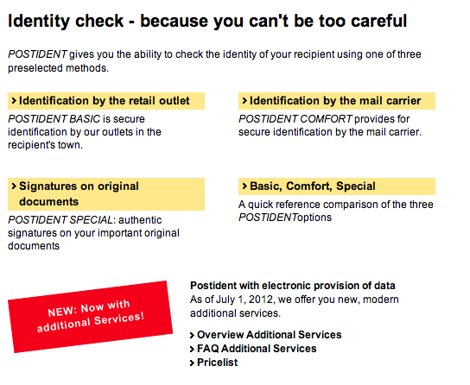
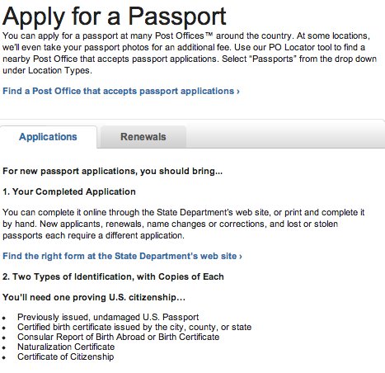

Provide physical validation services
Goals:
  make scaling hard for bad guy
  increase risk of arrest
  make geography matter
But generally not integrated with digital processes!
Notes:
http://www.deutschepost.de/dpag?xmlFile=1015469

Slide 22
Securing the Internet

Slide 23
We must make the Internet secure!
Internet layer
deployability
doesn’t know user & desired operation
changes with mobility
IP layer as introducer → by definition, parties may not know each other
Transport layer: TLS, DTLS
certificate validation often wrong
no client certificates (domain vs. user)
integrated transport & security layer?
Application layer
knows the what & who
→ secure infrastructure

Slide 24
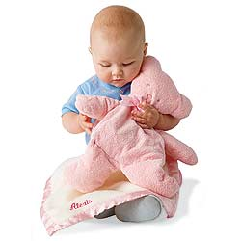
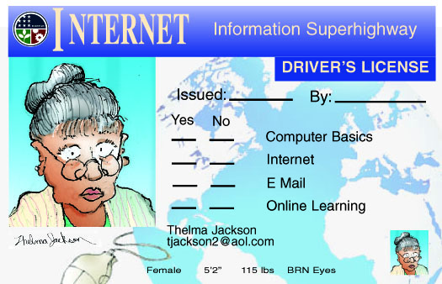
Securing the Internet – once and for all!
Dream of a security layer that lets everybody else do nothing
Suggested: “Internet passport”
  no more unauthenticated packets!
  what about compromised machines?
Possible:
  “don’t talk to me unless I talked to you”
  → permission-based sending
  most useful for small-group DOS attacks
    but most are now trickle attacks
  keep out packets at coarse level
    “not interested in packets from Elbonia”
      but easily spoofed

Slide 25
Cause of death for the next big thing
 | QoS | multi- cast | mobile IP | active networks | IPsec | IPv6
not manageable across competing domains |  |  |  | 
not configurable by normal users (or apps writers) |  |  |  |  | 
no business model for ISPs |  |  |  |  |  | 
no initial gain |  |  |  |  |  | 
80% solution in existing system |  |  |  |  |  |  (NAT)
increase system vulnerability |  |  |  | 

Slide 26
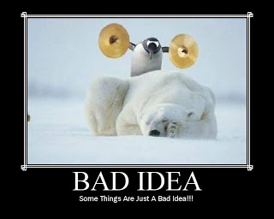
Secure key identifiers
Security by:
  return routability
  cryptographic proof of ownership
  keeping them secret (SSN)
Identifier | Proof of ownership | Spoofable | Critical for
IP address | RR, RPKI (?) | egress filtering (RFC 3013) | everything…
AS number | RPKI? | yes (BGP) | routing
domain name | TLS | TLS failures → DANE | web sites
email address | RR | mostly | password recovery
phone number | RR | caller-ID spoofing | 2-factor authentication
location | ? | yes | authentication

Slide 27
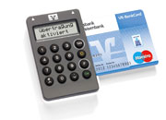
Avoid single-failure = catastrophic failure
Download the wrong application ➔ bank account gone
Attacker advantage: one flaw, hundreds of thousands of victims
→ Make it hard to scale attacks
  require access to physical world
  multiple paths that are unpredictable to far-away third party
  Honey pots (e.g., trap spam senders)
System design:
  separate systems for high-value transactions
    separate web browser
    separate VM
    single-purpose computer
    second independent path: SMS

Slide 28
Securing end systems

Slide 29
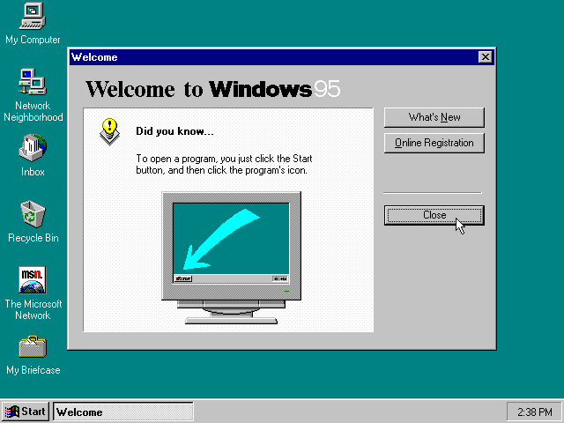
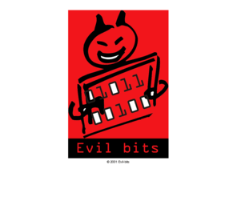
The old attack model
port 135
(DCE)
Internet
port 137, 139
(NetBIOS)
port 1433, 1434
(MS SQL)

Slide 30


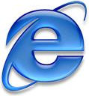

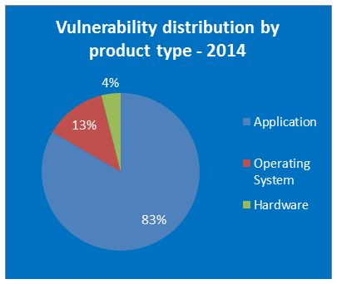
… and now
downloaded documents
Notes:
http://www.gfi.com/blog/most-vulnerable-operating-systems-and-applications-in-2014/

Slide 31
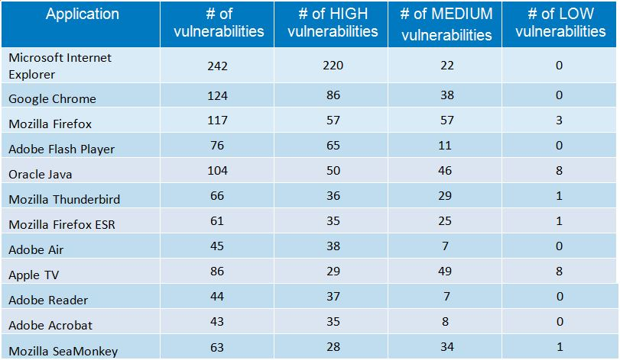
Vulnerabilities 2014
dubious metric?
Notes:
http://www.accuvant.com/sites/default/files/AccuvantBrowserSecCompar_FINAL.pdf
http://www.gfi.com/blog/most-vulnerable-operating-systems-and-applications-in-2014/

Slide 32
What can be done?
Harden key libraries
  protocols (HTTP, SMTP, IMAP, SIP, …)
  file type parsing
  → fuzzing
Separate parsing & system access via pipe
  e.g., Google Chrome
Separate VMs for enterprise applications (e.g., Docker)
  allow separate IP address → filtering
Self-learning security systems
  MySQL: “I always get database queries from 128.59.16.10”

Slide 33

What can be done?
Restrict privileges
  Android: each app has separate user ID
  Permission restriction
    App store, rather than browser, for installing software
    No need to store files in system areas
    Limited system permissions
      harder with HTML5, WebRTC, SVG, …
Separate trusted hardware
  not programmable
  for high-value interactions
  based on physical proximity

Slide 34
All systems must update automatically
Manual updates → compromise (see Adobe Flash)
  Microsoft “patch Tuesdays”
“Evergreen browsers”: Firefox, Chrome
MacOS transitioning to automatic updates
yum on CentOS and RedHat EL
Google policy on responsible disclosure

Slide 35
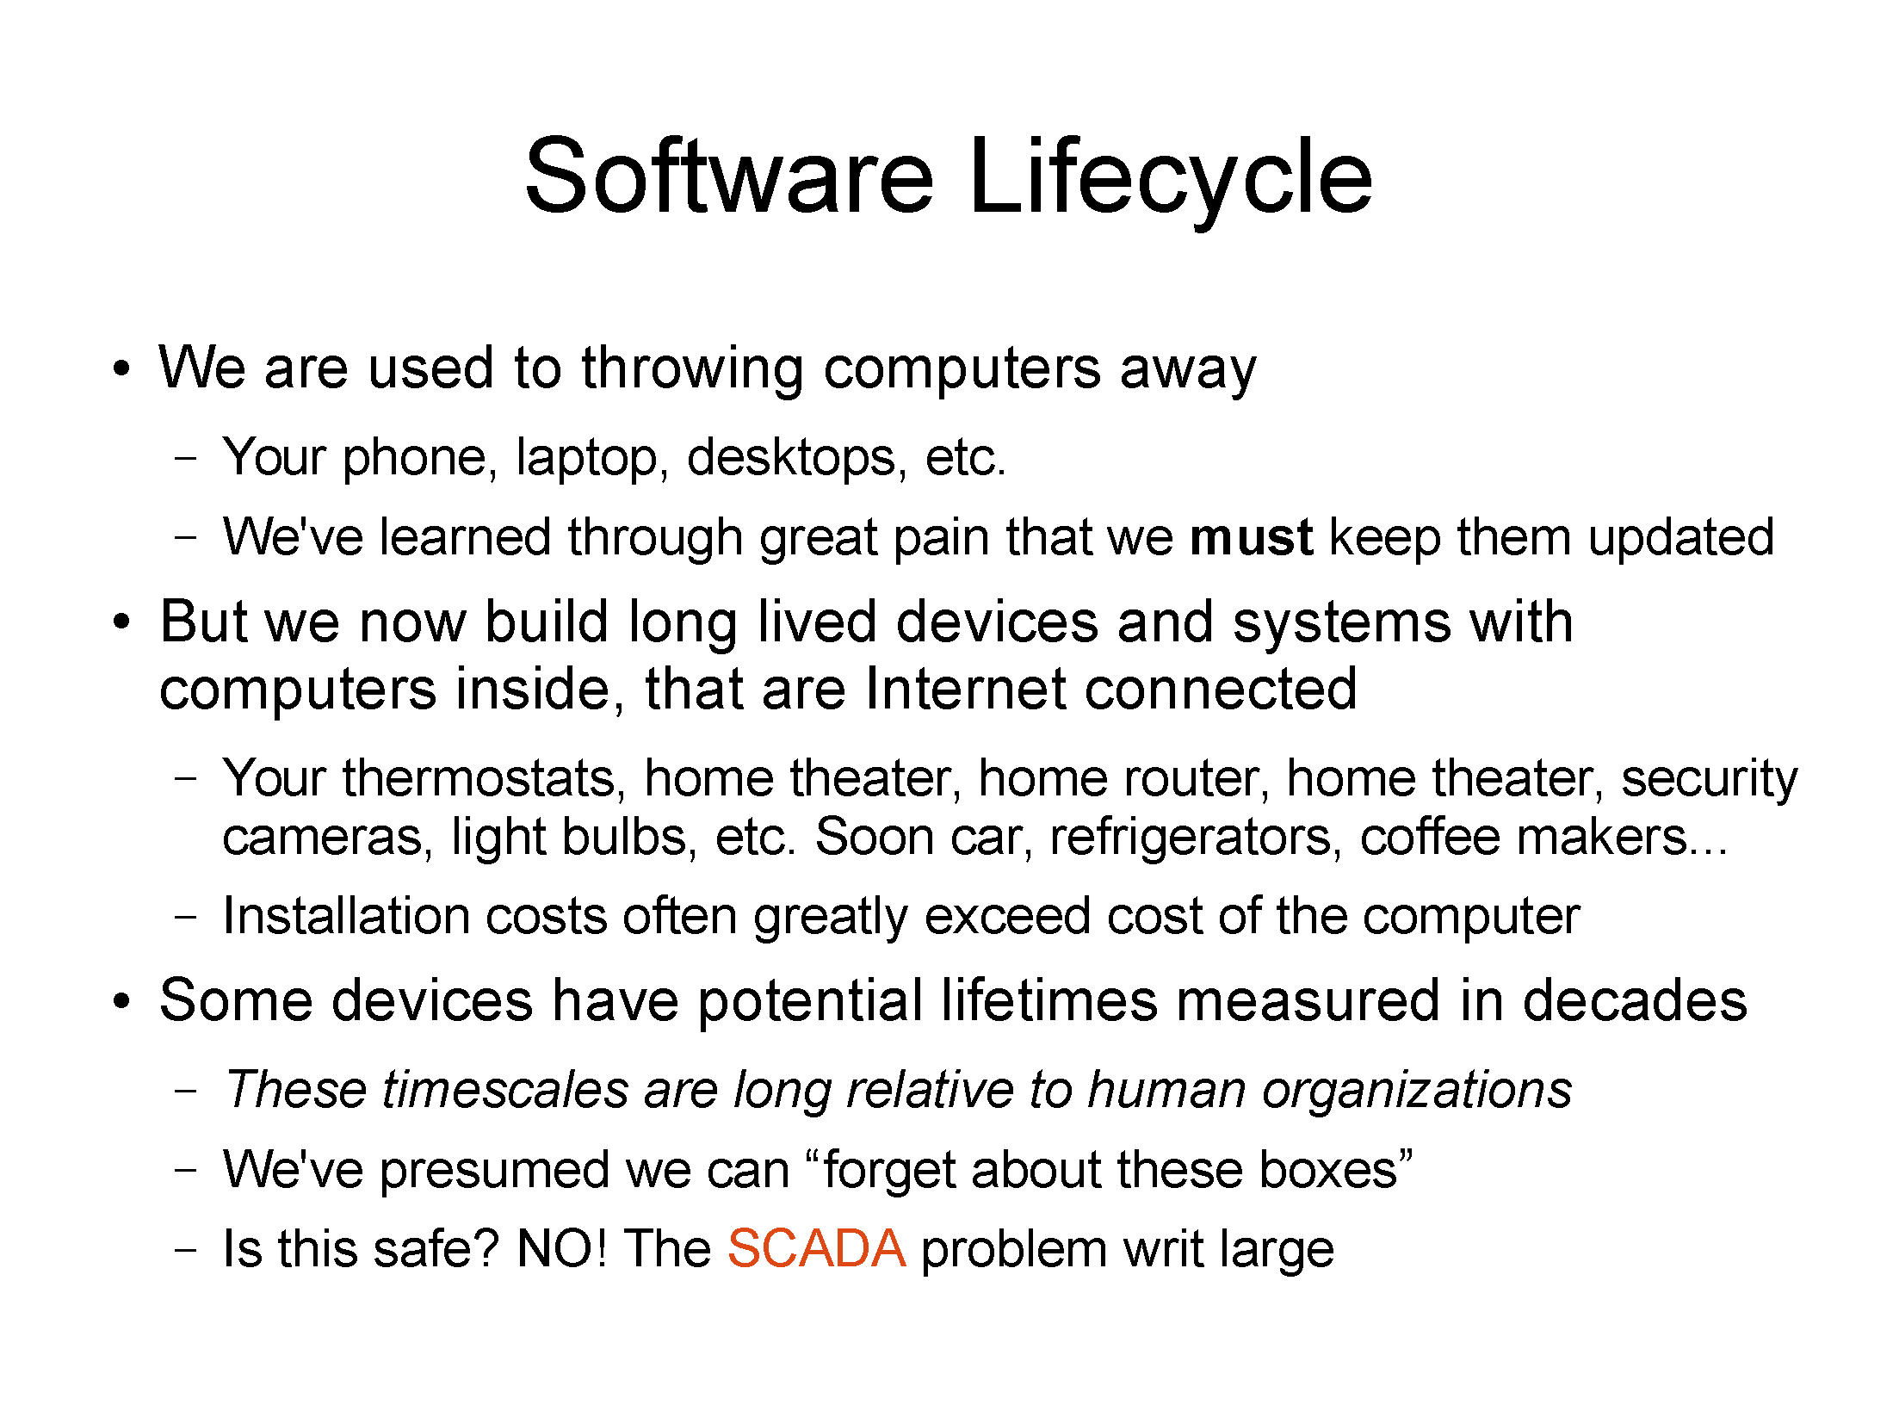
Jim Gettys (June 2014)

Slide 36
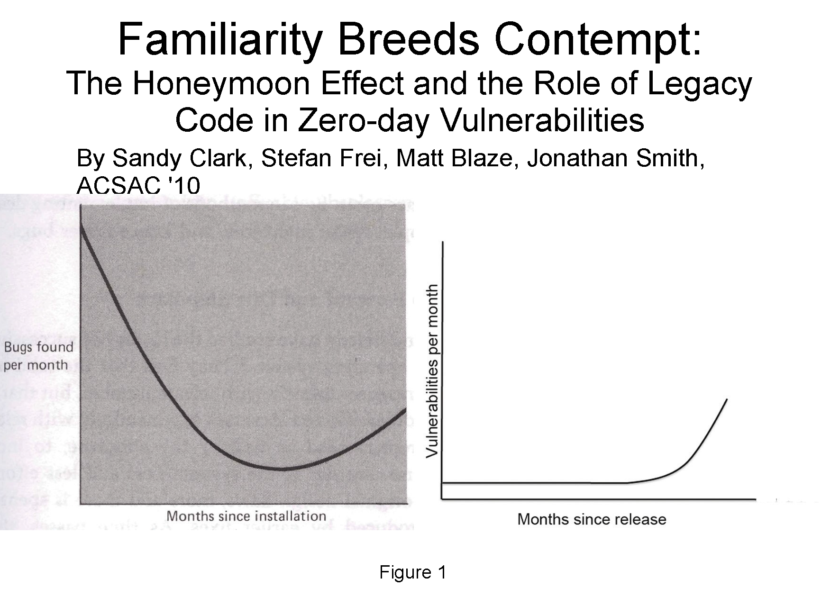
Jim Gettys (June 2014)

Slide 37
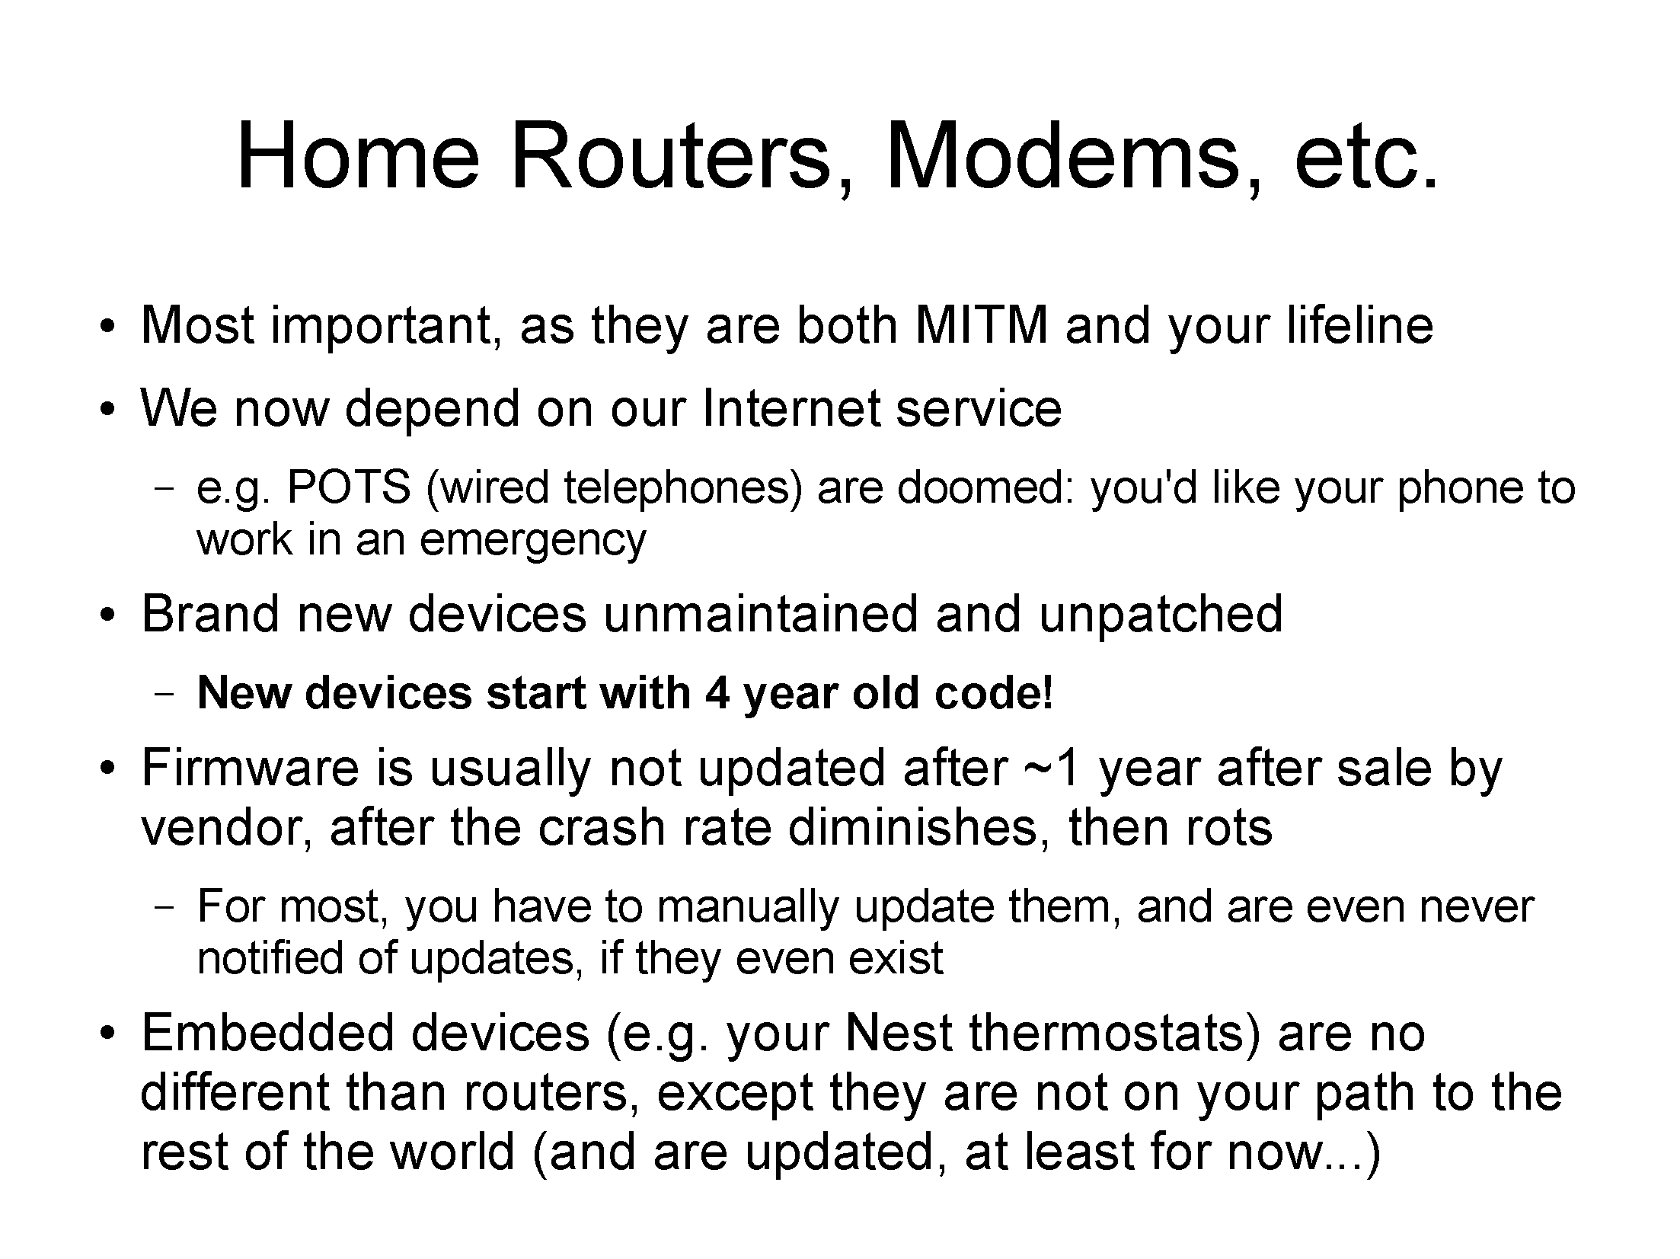
Jim Gettys (June 2014)

Slide 38
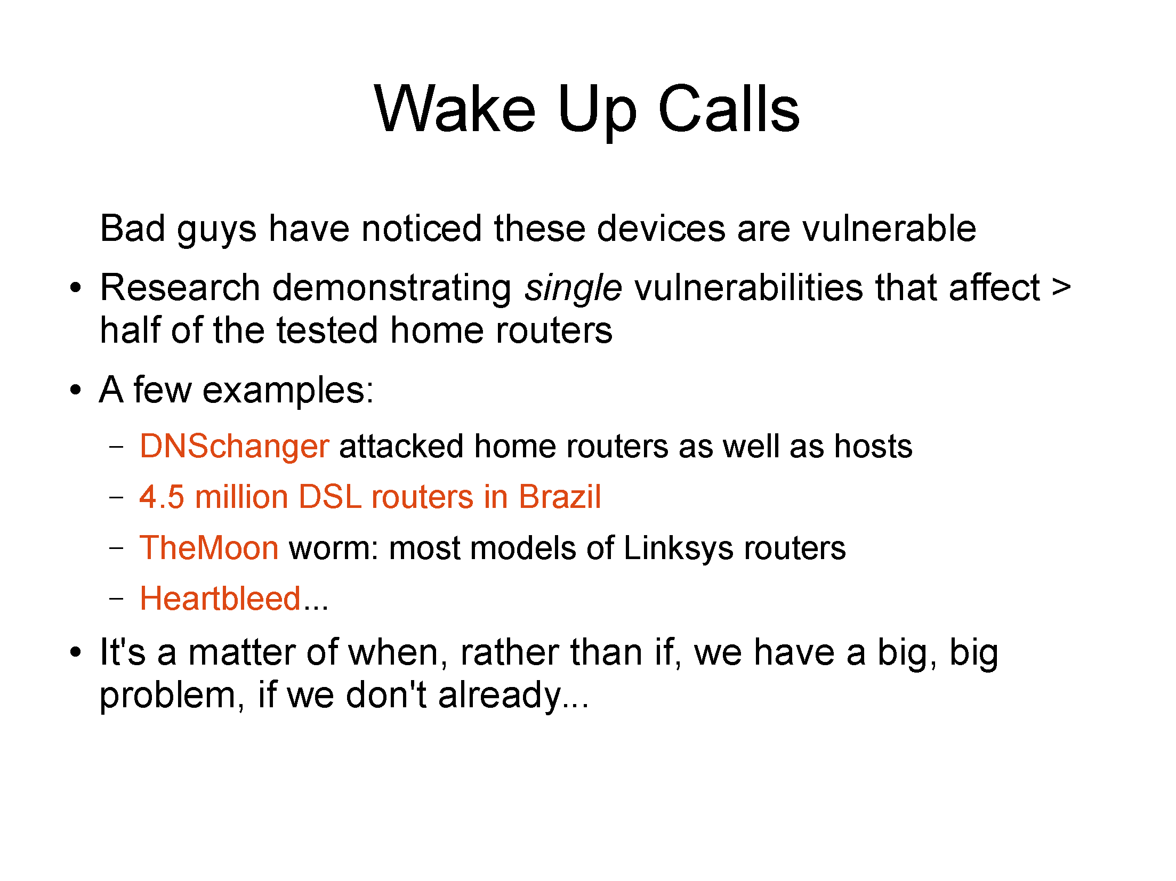
NTP reflection attack
Jim Gettys (June 2014)

Slide 39
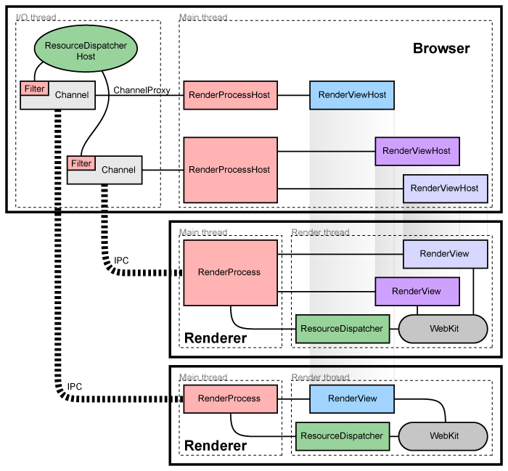
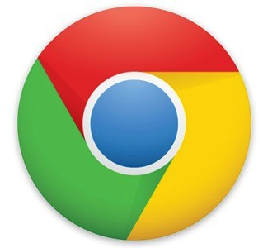
Design pattern: process separation

Slide 40
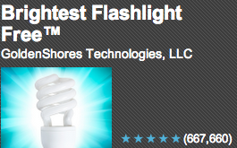
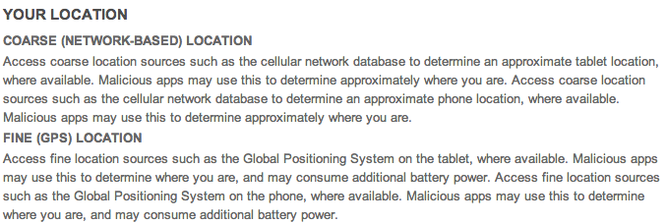

App permissions are not sufficient

Slide 41

Privacy threats
fear of exploration
embarrassment
family secrets
“we regret to inform you”
pre-existing condition
vacation burglary
stalking

Slide 42




Privacy
Difficulty of defining privacy
  specific threats vs. just fear of threat
  current vs. future (e.g., job search)
Emphasis on data gathering unhelpful
  → same information can be used for low-risk and high-risk activities
IETF GEOPRIV approach:
  how long is data stored?
  is it shared with third parties?
    (but what are third parties?)
Notes:
http://www.ftc.gov/os/2013/02/130201mobileprivacyreport.pdf

Slide 43

Privacy – other approaches
Hiding & obfuscation
  e.g., pretend that location is unavailable
  fuzz location
Restrict sensitive information to approved purposes
  expose location to well-known ad network, not unknown
Third-party privacy evaluation
FTC Section 5 enforcement (“unfair or deceptive practices”)

Slide 44
Improving network infrastructure security
FCC + industry for six months → three critical threats to the Internet:
  Domain Name System security
  Routing security
  Botnets
Specific voluntary recommendations approved by CSRIC in March 2011 to advance deployment of DNSSEC, BGPSEC, and a domestic ISP Code of Conduct to fight botnets.
Nine of the largest ISPs, representing nearly 90% of the domestic user base, publicly announced their intent to deploy the recommendations.
Next step: measure deployment & impact → Measuring Broadband America
44

Slide 45




What can be done?
?
insecure device
secure device

Slide 46
Security beyond viruses and Phishing: Fraud & Human DOS attacks

Slide 47






Fraud in TRS (text relay service)
+1 201 555 1234

Slide 48


DOS attacks on humans: 9-1-1

Slide 49
Conclusion
Internet security is a systems problem, not (primarily) a crypto or protocol problem
Treat security as system failures → redundancy, time-to-repair
Don’t wait for the Internet to be secure
Global optimization:
  change processes
  encourage transparency and informed consumer choice
  economics: externalities – make cause of problem bear the cost

Slide 50
Robocalls & Caller-ID spoofing

Slide 51
The Telemarketing Sales Rule: Three Protections
Do not call (national)
no sales calls to users on do-not-call list
Do not call (entity-specific)
businesses and for‐profit fundraisers can’t make sales or solicitation calls to consumers who have previously requested not to receive calls from that company.
Robocalls
businesses can’t make sales calls to consumers
prohibited even if the consumer’s phone number is not on the Do Not Call Registry
except written permission
does not include politicians
FTC (Will Maxson, 2012)

Slide 52
What calls are not covered?
Most business to businesses telemarketing
Debt collection calls
Customer service or customer satisfaction calls
Market research/survey calls (only if no sales pitch)
Polling/political calls (get out the vote, contribution requests)
Calls made by companies subject to special federal /state regulation (banks, phone companies, insurance companies)
Robocalls delivering a healthcare message made by or for a covered entity, as defined by the HIPAA Privacy Rule
FTC (Will Maxson, 2012)

Slide 53

How do robocalls work?
FTC 2012

Slide 54

The geography of robo-calling
FTC 2012

Slide 55

Robocall eco system
FTC 2012

Slide 56

What you can do when robo-called

Slide 57
The enablers
Robocalling
Cheap VoIP
Number spoofing
Cheap labor

Slide 58




Law enforcement vs. robocallers
Agile numbering
Automated customer acquisition
Transnational
One faxed subpoena at a time
Manual trace-back
Largely domestic

Slide 59




What has changed?
one assigned
number
customer
local exchange carrier
can’t tell end user from provider → can use any number

Slide 60

Caller ID spoofing
Caller ID Act of 2009: Prohibit any person or entity for transmitting misleading or inaccurate caller ID information with the intent to defraud, cause harm, or wrongfully obtain anything of value.

Slide 61
Caller ID spoofing
enhances theft and sale customer information through pretexting
harass and intimidate (bomb threats, disconnecting services)
enables identity theft and theft of services
compromises and can give access to voice mail boxes
can result in free calls over toll free dial-around services
facilitates identification of the name (CNAM) for unlisted numbers
activate stolen credit cards
causes incorrect billing because the jurisdiction is incorrect
impairs assistance to law enforcement in criminal and anti-terrorist investigations
A. Panagia, AT&T

Slide 62



VoIP spoofing
A. Panagia, AT&T
PSTN
VoIP Application
Switch
A
Switch
B
STP
IP
CNAM
SPOOFER
SPOOFEE

Slide 63
Why not use email spam filtering techniques?
 | Email | Phone calls
Name space | infinite | relatively small
Content inspection | common | not possible
Addresses | IP address – non-spoofable for TCP Email address – easily spoofable | Phone number -- spoofable
Delivery | filtered by provider: block lists (e.g., Spamhaus) SPF, DKIM | interconnection and delivery obligations
Delivery trace | Received-by headers | Via headers – only for end-to-end VoIP calls
Limited-use address | easy (e.g., web mail) | not feasible
Consent-based | CAPTCHA systems (not common) | likely too annoying
see also RFC 5039

Slide 64






Future, part 1: trustable phone numbers
previous contact

Slide 65


IP-based PSTN: build in security!
Via: SIP/2.0/TLS client.biloxi.example.com:5061;branch=z9hG4bKnashds7
;received=192.0.2.201
trace call route
VoIP provider A
VoIP provider B
§
§
§
automatically route subpoena

Slide 66






Caller identification
known caller
previous calls
sent her emails
what’s your SSN?
name unimportant
bank ✔
credit card office ✔
can you recommend student X?
name unimportant
IEEE ✔
known university ✔

Slide 67
Attribute validation
For unknown callers, care about attributes, not name
SIP address-of-record (AOR) → attributes
  employment (bank, registered 501c3)
  membership (professional)
  age (e.g., for mail order of restricted items)
  geographic location
Privacy
  → selective disclosure
  no need to disclose identity

Slide 68




Attribute Validation Service
Attribute Validation Server (AVS): Issuer
e.g., members.ieee.org
Attribute Reference ID
(ARID)
e.g.,
https://members.ieee.org/arid/4163
c78e9b8d1ad58eb3f4b5344a4c0d5a
35a023
{Alice’s username, credentials, user ID, role}
3. Establishes the validity of the
ARID with access code and retrieves selected attributes e.g., Alice’s role
1. Requests an ARID,
selecting attributes to disclose
HTTP over TLS
SIP over TLS
2. Makes a call with the ARID and part of access code
Caller: Principal
Alice
Student member in ieee.org
tel:+12345678
Callee: Relying Party
Bob
Accepts calls from members in ieee.org;
does not know Alice’s phone number
sips:bob@example.com
68

