Slide 1
5G: What can we learn from the previous four generations?
Henning Schulzrinne
Columbia University

Slide 2
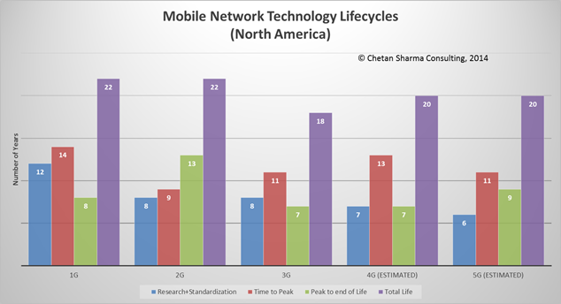
Design for 20 years

Slide 3
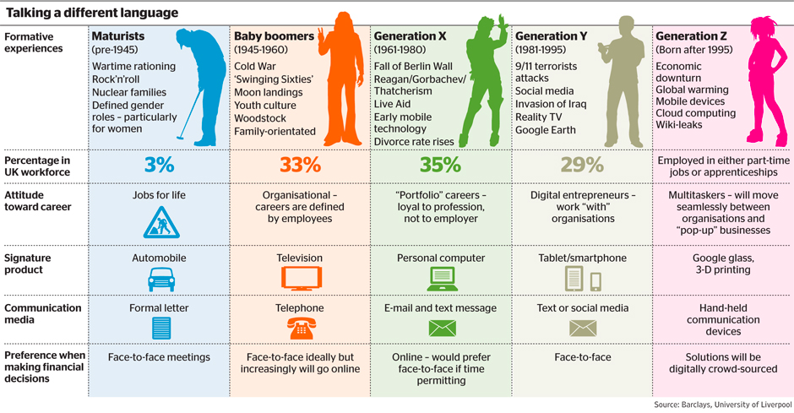
Generations are distinct
land
line
2G
3G
4G

Slide 4
Generations overlap
2G
3G
4G
5G

Slide 5
Generational surprises
Generation | Expectation | Surprise
2G | better voice quality (“digital!”) | SMS
3G | WAP | web
4G | IMS | YouTube, WhatsApp, notifications
5G | IoT (low latency) | ?
underestimated cost and fixed-equivalence as drivers

Slide 6
Lessons, in brief
Experience | Lessons
VoLTE, IMS | avoid complexity avoid entanglement plan intercarrier interfaces
Wi-Fi | don’t trust the RAN/AP
disaggregation of functions | clear & simple interfaces don’t assume trust between elements
app stores | keep it application-neutral
FTTH, backhaul cost | re-use backhaul where you can find it

Slide 7
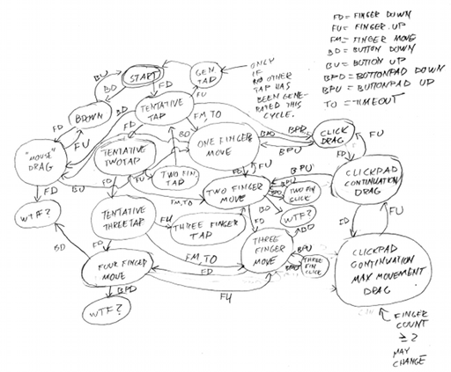
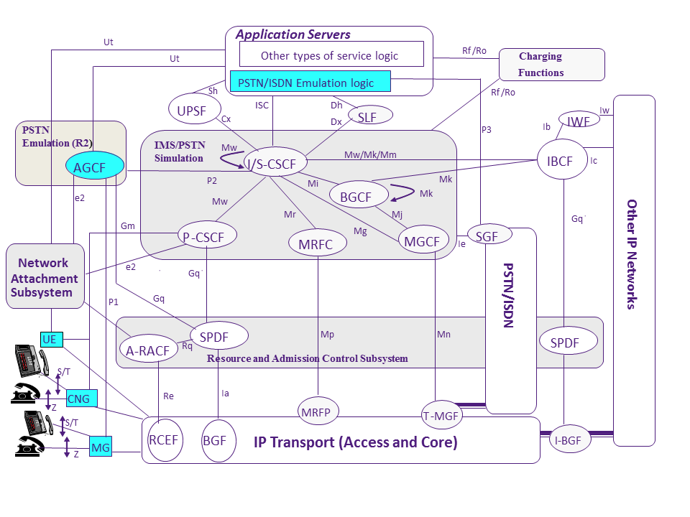
Complexity kills
IMS
Notes:
http://voices.canonical.com/jussi.pakkanen/files/2012/01/synaptics-statemachine.png
http://upload.wikimedia.org/wikipedia/en/9/9c/TISPAN_IMS_Reference_Architecture.png

Slide 8
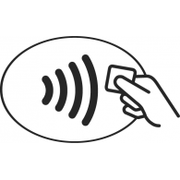



Niche networks
short range
low energy; mesh
ubiquity; low cost
speed; public APs

Slide 9
Long-range networks
Wide-area Wireless Communication Challenges for the Internet of Things
Harpreet S. Dhillon, Howard sHuang, Harish Viswanathan

Slide 10
SIGFOX, Ingenu and LoRa

Slide 11
New cellular domains
Fixed wireless → compete with DSL and maybe cable
  > 10 Mb/s bandwidth
  probably more rural than urban → ample spectrum available
  Comcast median usage:
    August 2013: 16 GB
    mid-2015: 40 GB ➔ roughly 50% YoY growth
    → 2020 usage of 300 GB
  typical cost: cellular $10/GB → $400 today, $3,000 in 2020
    median wireline: $55 month for unlimited
    ➔ cost problem (differentiate fixed from mobile)
IoT and other embedded applications
  many (most?) IoT applications are not mobile
  but are very cost-sensitive

Slide 12
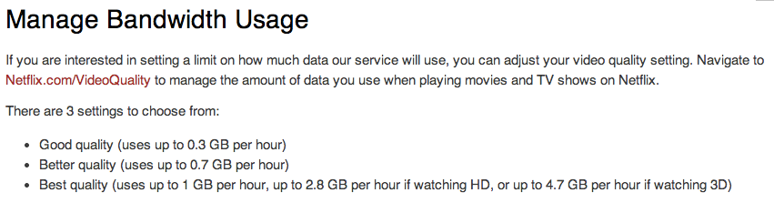
What happens if this moves to IP?
Thus, for 146 hours/month of HD → 410 GB/month
(does not count separate viewing among household members)

Slide 13

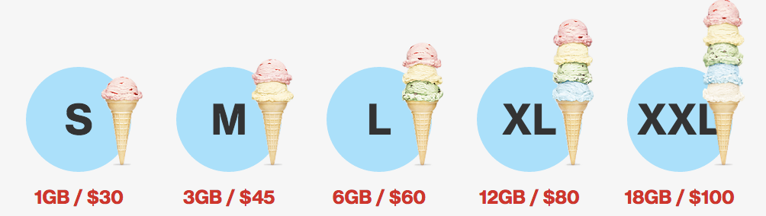
Example wireless plan

Slide 14
IoT requirements
Wide-area Wireless Communication Challenges for the Internet of Things
Harpreet S. Dhillon, Howard sHuang, Harish Viswanathan

Slide 15
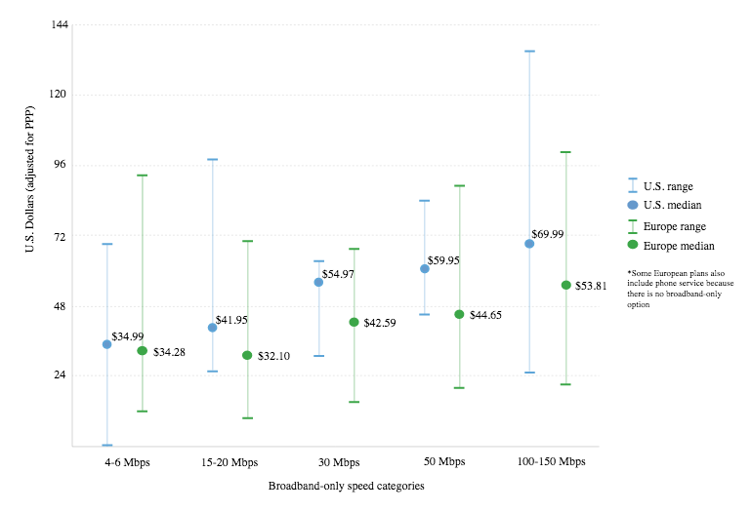
Broadband pricing
https://www.newamerica.org/oti/the-cost-of-connectivity-2014/

Slide 16
Attenuation by frequency

Slide 17
Propagation issues
Rural (low density) → coverage limited
  √ tower height (ft) ≈ coverage range (miles)
  e.g., 400 ft (120 m) tower → 20 miles
  but 4-5 miles more typical
  GSM: timing advance → 35 km
Urban outdoors
  cell spacing: 100 ft
  capacity-limited
  power-limited (5-20 W base station, 2 W mobile) → 5-8 miles
Urban indoors
  radio propagation

Slide 18
28 GHz attenuation & reflection
multipath reflections
highly directional antennas
Rappaport, 2013

Slide 19
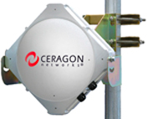
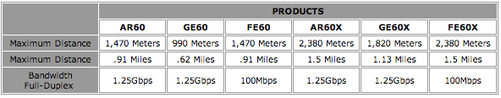
10 GHz+
Unlicensed

Slide 20
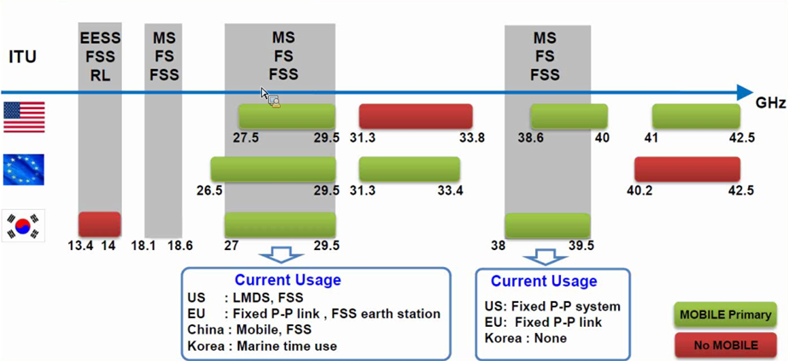
30-40GHz mmW – Spectrum Overview
Source : Samsung Communications Research Team
Note: The Commission’s Fixed Microwave (Part 101) and Satellite Communications (Part 25) service rules govern most of US Mobile allocations shown above
20

Slide 21
Changing spectrum environment
Except at highest frequencies, all new spectrum likely to be shared
  e.g., 3.5 GHz
  in time & space
→ need frequency-agile systems that can shift capacity to different bands, quickly

Slide 22
Example: 3.5 GHz (April 2015)
150 MHz at 3.550 GHz
incumbents: DoD radars + fixed satellite service (FSS) receive-only
exclusion zones: 60% pop. unsuitable for macrocell
access: incumbent, priority (PAL), general authorized
  Incumbent: authorized federal & grandfathered Fixed Satellite Service
  PAL: 3 years non-renewable, 10 MHz channel, census tract
  hospitals, utilities, state/local gov’t
see also TVWS, MBAN

Slide 23
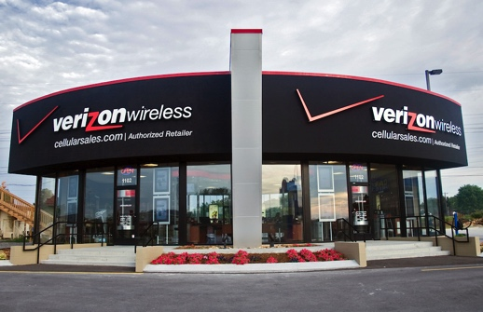

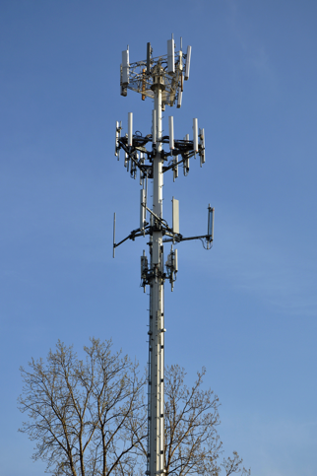
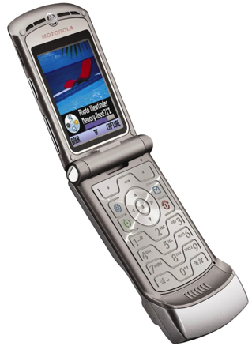
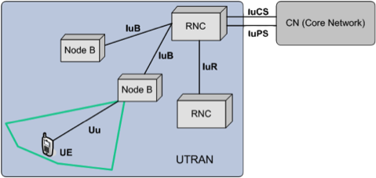
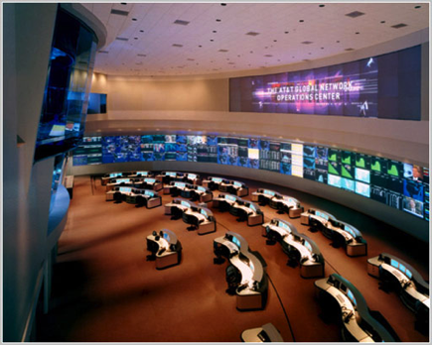
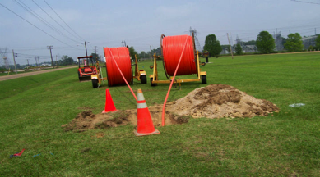
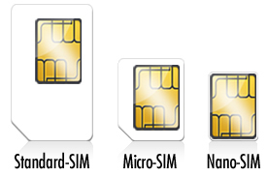
Networks 1G through 4Gish
national carrier
one subscriber,
one phone,
one provider

Slide 24
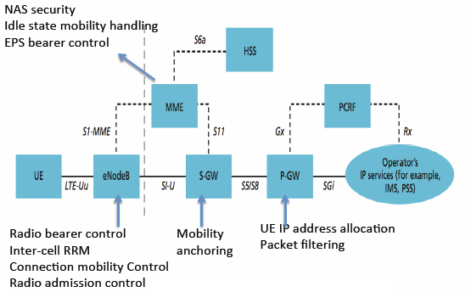
LTE – one carrier, plus roaming

Slide 25




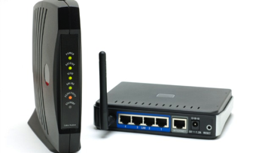
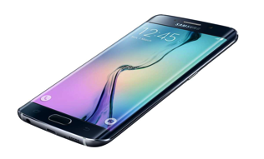

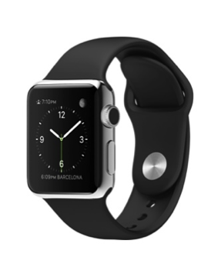
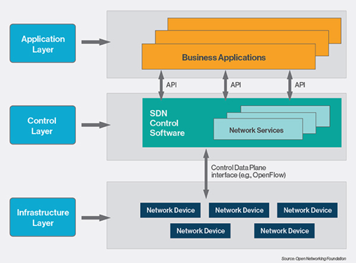




5G – what exactly is a carrier?
Spectrum DB
Spectrum DB
40k towers each (US)
Level3
Cogent
LTE-U
802.11n
LTE

Slide 26
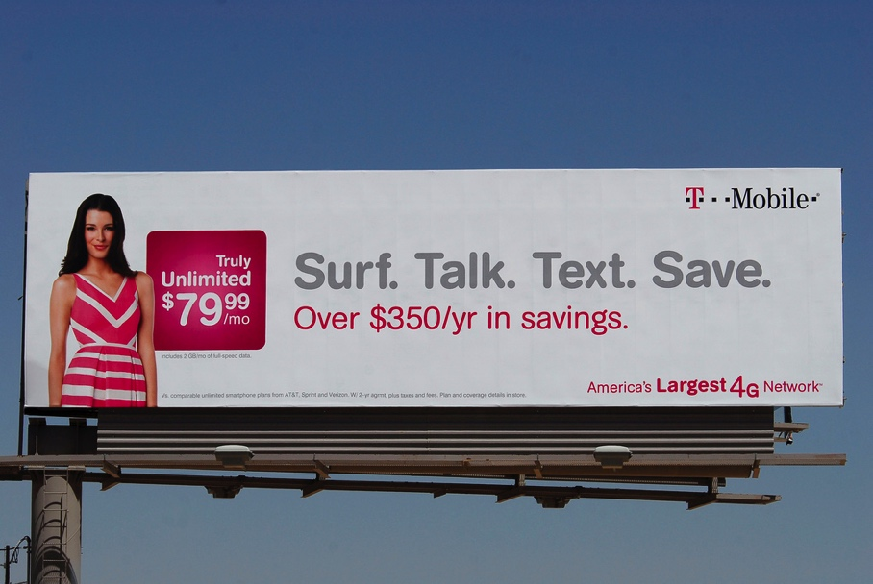
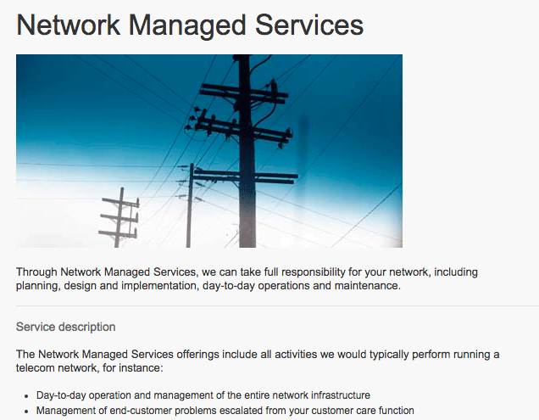
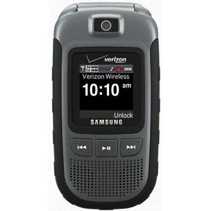
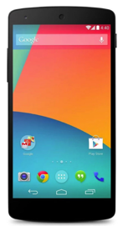
5G: Carriers as consumer brand
Outside
Inside

Slide 27
Cell towers
Tower owner | Number of towers
Crown Castle | 39,739
American Tower | 40,000 (with VZW)
SBA Communications | 15,151
United Cellular Co. | 4,802
Verizon Wireless | 1,400
T-Mobile Towers | 1,003
Time Warner | 950
Mediacom Communications | 750
Charter Communications | 650
Diamond Communications | 637
Trillion Partners | 635
cost/tower: $150k
total US: 205k
Notes:
http://www.statisticbrain.com/cell-phone-tower-statistics/
http://ir.sbasite.com/releasedetail.cfm?ReleaseID=908348

Slide 28
What are carriers good at?
Research?
Software development?
  Who is going to develop those 5G SDN applications?
OTT applications?
API-based services?
  Why did Twilio and Tropo offer voice service APIs and not the ILECs?

Slide 29

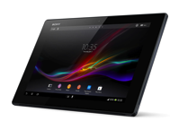
What’s the simplest network?
AAA
HLR
(?)
network characteristics (QoS)
IP address
AAA (incl. payment)
discovery
registrar
IPv6 access
(any network)
DHCP
network
resources
one subscriber, multiple devices, multiple providers

Slide 30


Where do we need mobility?
likely to have access provider diversity
  what is expected lifetime of IP address?
PMIP and MIP complex
  need to re-create application-layer security at L3
not really needed for HTTP video
  use mTCP?
  or HTTP restart?
maybe not even for real-time media
  registrar for new-call reachability
  application layer (SIP) mobility for mid-call hand-off?
or tunnels, tunnels everywhere?

Slide 31
Make the network location-aware
2G/3G/4G are location-ignorant: “I only know your cell sector”
All mobile devices will be location-aware to the ~5 m
Some know where they will likely be in the near future
  public transit
  road navigation systems
  ➔ predict access and hand-off
All devices will have multiple radios
  use macro cell network to query for local access

Slide 32
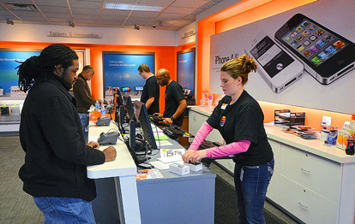
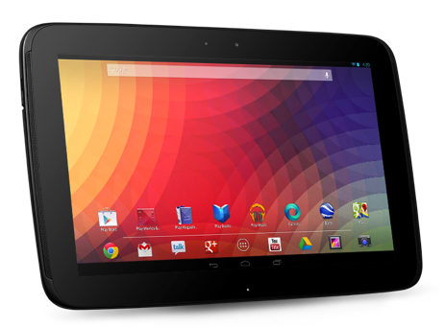
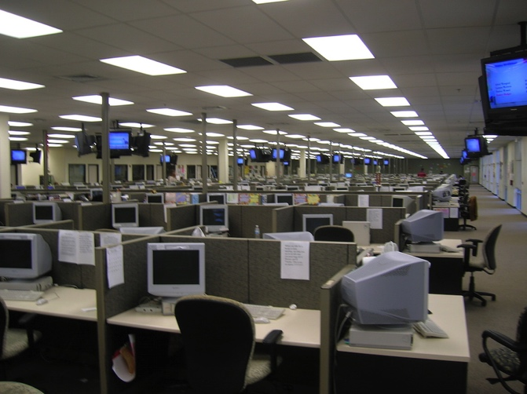
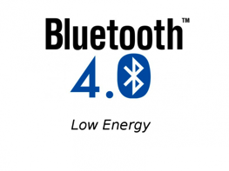

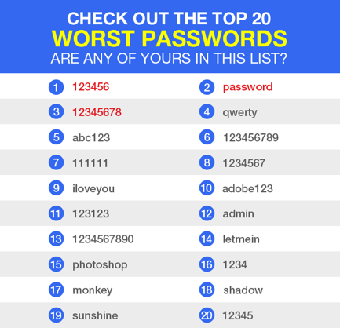
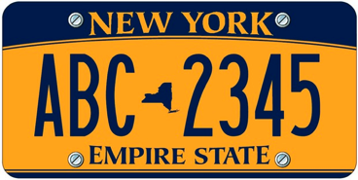
Simplify enrollment
enable access

Slide 33
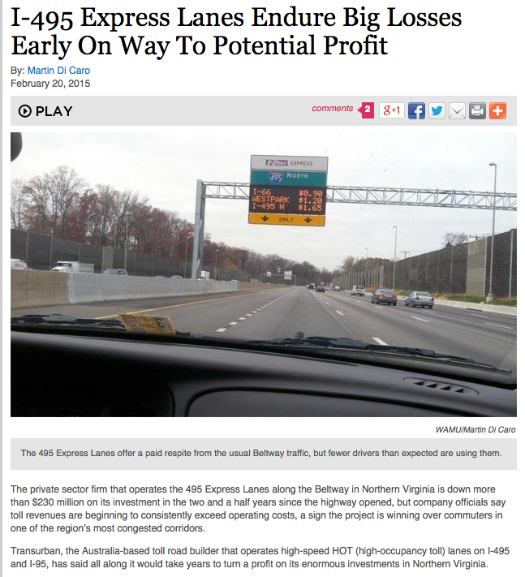
The law of new networks
“Any new network technology will be justified on (finally) providing QoS”
To succeed, they have to provide good-enough QoS for best effort
  at least with competition
The business model for QoS is difficult
  see bypass toll roads
QoS is usually not accessible to applications
  or not end-to-end

Slide 34
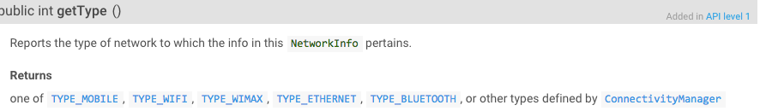
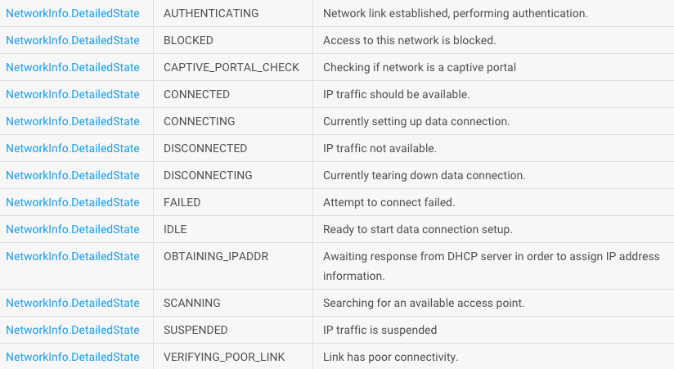
Providing a network API
Currently, applications can detect Wi-Fi vs. cellular
What is the correct API for discovering network properties?
  available options (“BE”, “LBE”, “low latency”)
  not RSVP flow specs…
cost?
($ or count for bucket?)
predicted performance?

Slide 35
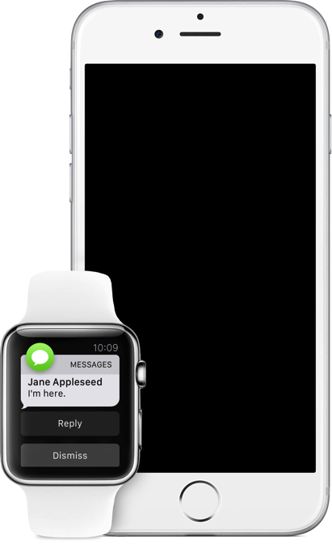

Mobile = events, not (just) video
Focus on bandwidth, but wearables and
Polling (outbound) and events (inbound)
  sleeping apps
Current models difficult for developers

Slide 36
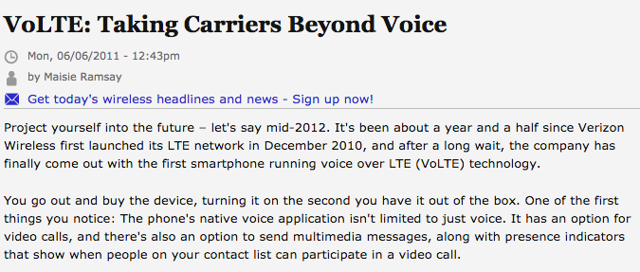
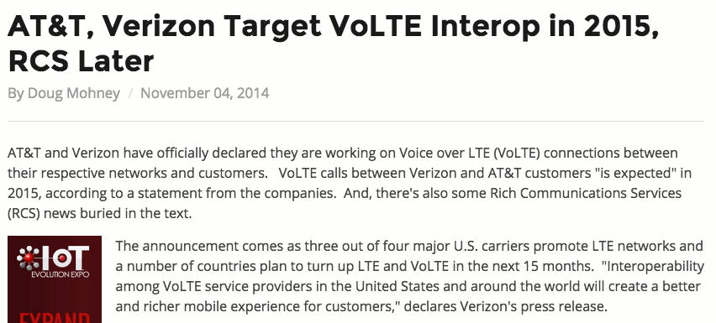
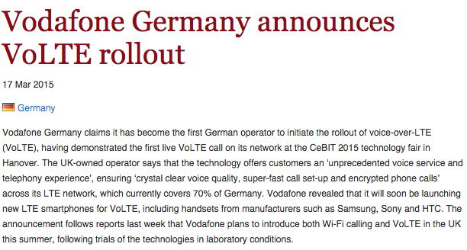
IMS /VoLTE
IMS = It Mostly Speaks
VoLTE = Voice-Only Later than Expected

Slide 37
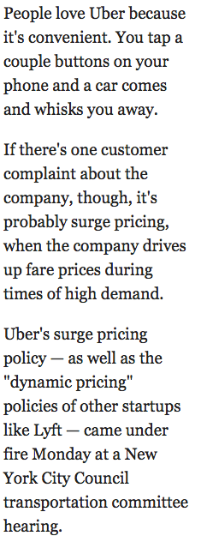
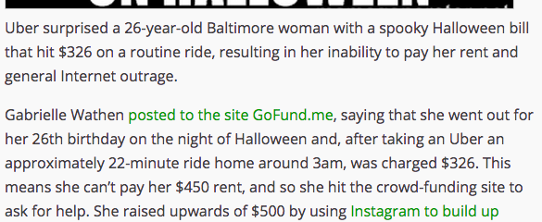


Surge pricing – non-telecom
BI, 1/13/2015
Notes:
Techcrunch

Slide 38
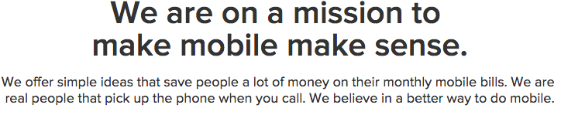
Aggressive competitors compete on simplicity

Slide 39
Capital investment
Company | Revenue | Capital expenditures | %
Comcast (US) [3Q14] | $11.04B | $1.644B | 14.9
Telekom (DE) [3Q14] | €15.6B | $2.58B | 16.5
Safaricom (KE) [H1FY15] | Ksh 79.34B | Ksh 12.37 | 15.5

Slide 40
The value of bits
Technologist: A bit is a bit is a bit
Economist: Some bits are more valuable than other bits
  e.g., $/bit(email) >> $/bit(video)
  no-QoS bits dominate in volume
Application | Volume | Cost per unit | Cost / MB | Cost / TB
Cable video | 660 GB |  | $0.06 | $60
Voice (13 kb/s GSM) | 97.5 kB/minute | 10c | $1.02 | $1M
Mobile data | 5 GB | $40 | $0.008 | $8,000
MMS (pictures) | < 300 KB, avg. 50 kB | 25c | $5.00 | $5M
SMS | 160 B | 10c | $625 | $625M
Notes:
T-Mobile 2010
AT&T data
http://www.nowsms.com/discus/messages/12/8500.html

Slide 41
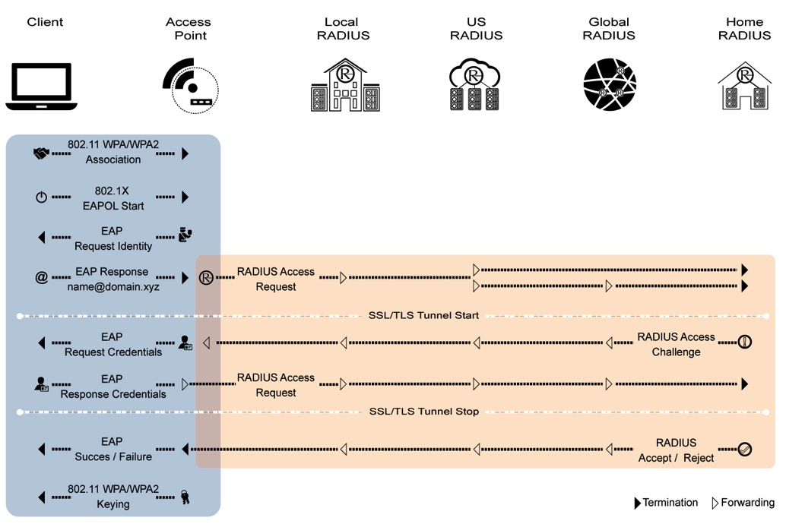

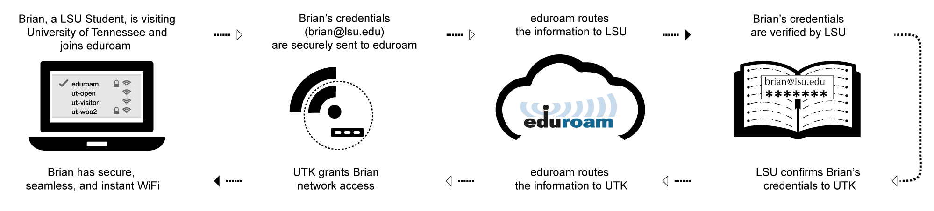
5G prototype: Eduroam

Slide 42

Growing-up lessons
Complexity kills
Play fair
CapEx is once, OpEx is forever
Know where you are
Share everything
Don’t trust strangers

Slide 43
Backup

Slide 44
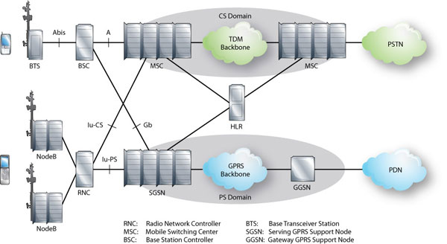
LTE architecture
Notes:
http://alcatel-lucent.com/enrich/v1i12007/article_c4a4.html

Slide 45
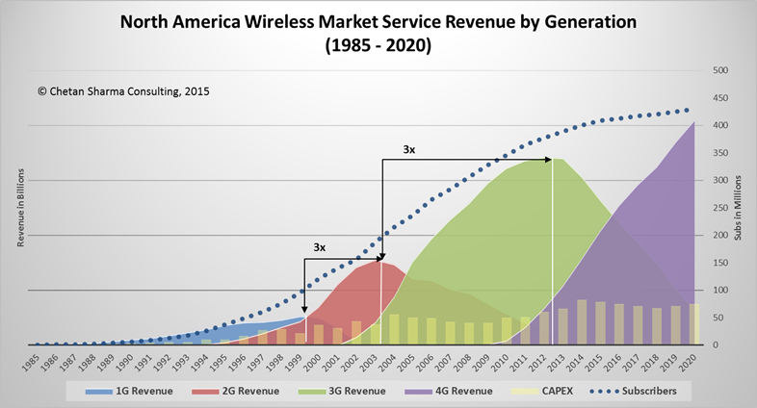
Wireless market evolution

