Slide 1
IP Transition: Why aren’t we there yet?
Henning Schulzrinne
Columbia University & FCC

Slide 2
Important issues I’ll skip
How do we ensure competition among voice services in a world of triple-play bundling?
How do we ensure competition for access circuits?
Who is responsible for backup power?

Slide 3
But we’ll talk about
Architecture transitions
Legacy services
Phone numbers and communication identifiers
Robocalls
NG911
Functionally-equivalent communication

Slide 4
Technology Transitions
TDM voice
VoIP
(incl. VoLTE)
application
transport
network
TDM circuits & analog
IP packets
fiber
coax
wireless
copper twisted-pair
(and combinations)
physical
layer
copper twisted-pair

Slide 5
The three transitions
From |  | to | motivation | issues
Copper | → | fiber | capacity maintenance cost | competition (“unbundled network elements”)
Wired | → | wireless | mobility cost in rural areas | capacity quality
Circuits | → | packets (IP) | flexibility cost per bit | line power
VoIP, VoLTE

Slide 6
Dividing the problem space
Tech transition
intra network
universal reach
power
inter network
interconnection
reliability
consumer protection
911
numbering

Slide 7
What has changed?
 | 1990s | 2015 | 2020?
New services | caller ID, voice mail | ? | programmable
media | voice (+ fax) | voice + SMS | voice, video, text, real-time text?
voice quality | 4 kHz | cellular | VoLTE, HD voice?
robocalls | local newspaper | “IRS”, “Microsoft” | none
programmability | VSC | web page | APIs?
911 | phase I | phase II | NG911?

Slide 8




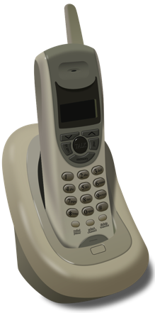



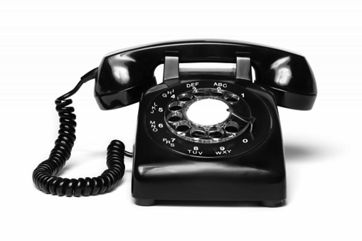




Stack transitions
economic bundle
copper
loops
UNE
copper
HFC
fiber
4G
4G/5G
HFC
fiber
technical bundle
1880s - 1996
1996-2000
2000-2015+
2015+

Slide 9
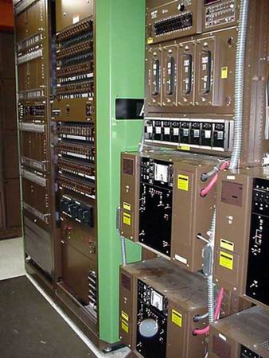
Switches are ageing
1979
Nortel DMS-100
http://www.phworld.org/switch/ntess.htm

Slide 10
How do we transition legacy services?
Service | Copper → fiber & (maybe) 4G | → 3G wireless
Low-speed modem services: credit card terminals, gas meters, TTYs | transparent or converter | problematic
High-speed modems: fax | mostly | fail
Line-powered devices (elevator phones)? | fail | fail
Galvanic services | unavailable | unavailable
Timing (FAA) | NTP? | unavailable

Slide 11
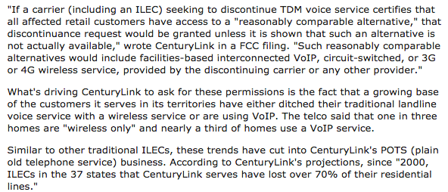
Could carrier voice fade?
FierceTelecom 06/23/2015

Slide 12
Identifiers

Slide 13
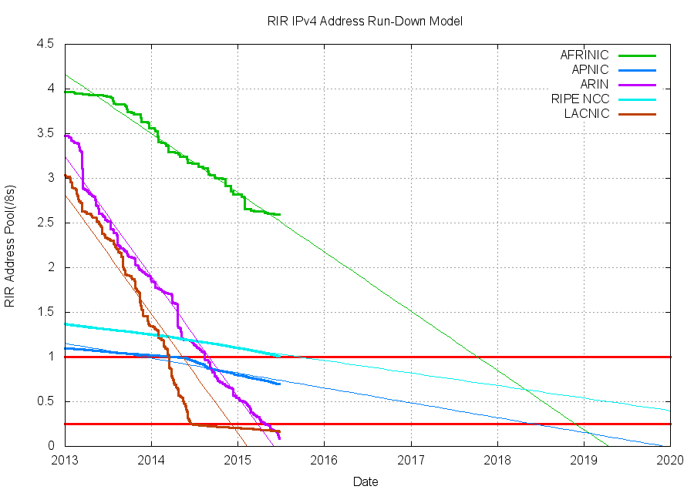

Identifiers are boring & critical
Identifiers define reachability, mobility and (sometimes) security
Identifiers are long-term architectural constants
  social security numbers
  MAC addresses
  IPv4 and IPv6 addresses
  phone numbers

Slide 14
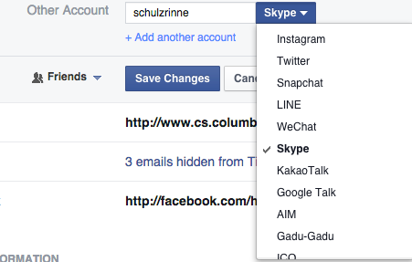



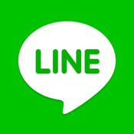

Tower of Babble
specialization of communication tools

Slide 15

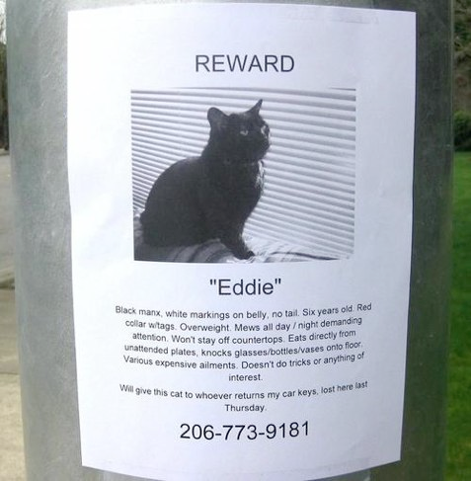
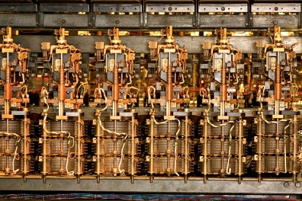
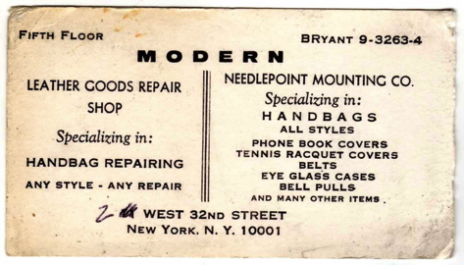
Phone number evolution

Slide 16
Communication identifiers
Property | URL owned | URL provider | E.164 phone numbers | Service-specific
Example | alice@smith.name sip:alice@smith.name | alice@gmail.com sip:alice@ilec.com | +1 202 555 1010 | www.facebook.com/alice.example
Protocol-independent | no | no | yes | yes
Multimedia | yes | yes | maybe (VRS) | maybe
Portable | yes | no | somewhat | no
Groups | yes | yes | bridge number | not generally
Trademark issues | yes | unlikely | unlikely | possible
I18N | technically, yes; humanly, no |  | yes | ?
Privacy | Depends on name chosen (pseudonym) | Depends on naming scheme | mostly | Depends on provider “real name” policy
Notes:
http://findmyfacebookid.com

Slide 17

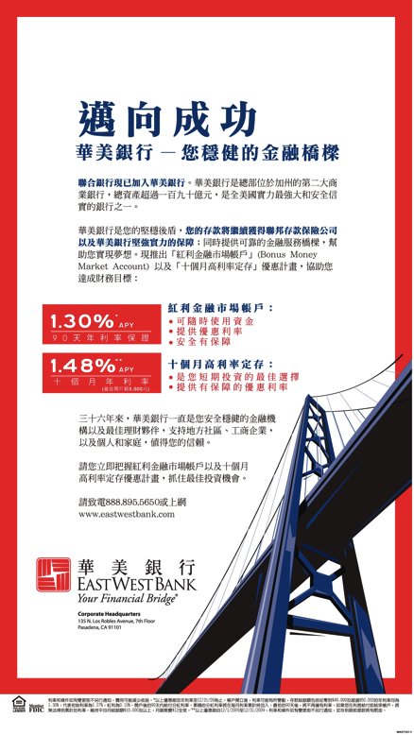
Communication identifiers
Need identifier that
  can work on different media
  can be conveyed orally
    try spelling email address…
  can work internationally
  is portable across organization
  does not reveal too much
  provides rough hint of geography & time zone
→
  I18N → number
  portable → no provider domain
  portable, privacy → no personal name
  geography → country-level assignment
Alternative:
  all app-world
  cryptographic identifier (public key) in address book

Slide 18

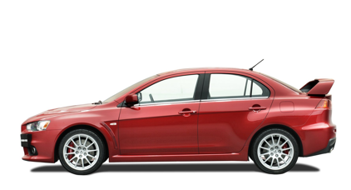

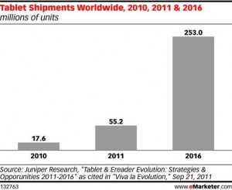
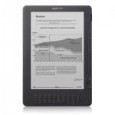
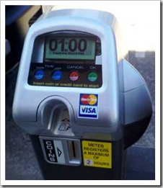
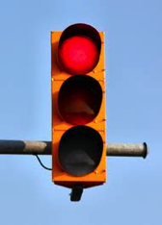
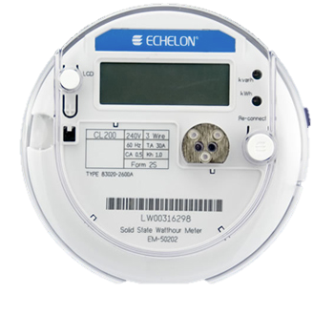
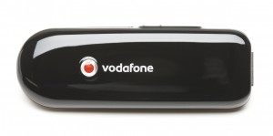
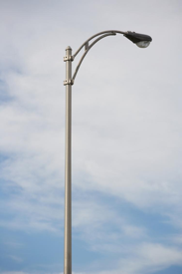
Phone numbers for machines?
254 mio.
212 555 1212
< 2010
500 123 4567
(and geographic numbers)
12% of adults
500 123 4567
533, 544
5 mio.
311,000
64 mio.
now: one 5XX code a year…
(8M numbers)
10 billion +1 #’s available
44.9 mio.
Notes:
http://blog.neustar.biz/neustar-insights/telephone-numbers-are-for-people-not-machines/
http://www.parking.org/media/overview-of-the-us-parking-industry.aspx
http://www.statisticbrain.com/e-reader-statistics/
http://www.ite.org/reportcard/TechnicalReport.pdf – 311k signals
www.aceee.org/files/proceedings/2012/data/papers/0193-000144.pdf – 44.9 M street lights

Slide 19
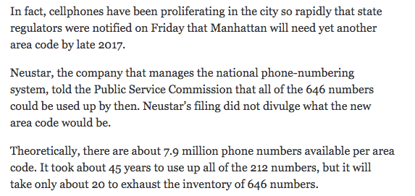
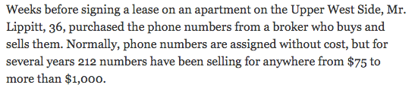
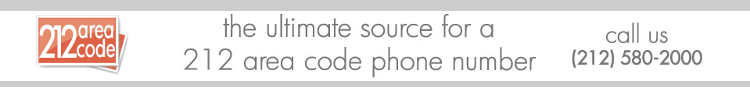
Phone numbers are valuable
NY Times, March 25, 2015
Notes:
http://www.nytimes.com/2015/03/25/nyregion/as-manhattan-area-codes-multiply-some-still-covet-a-212.html

Slide 20



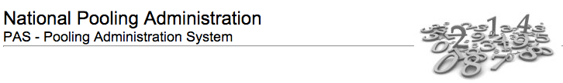

Number administration is baroque
NANC
advises
FoN
LNPA
NOWG
NAPM

Slide 21
Reconsider assumptions?
NANPA, LNP, LERG, RespOrg, … separation?
  NANP Administration System (NAS)
  Pooling Administration System (PAS)
  Number Portability Administration Center (NPAC)
  ➔ Number Administration Database?
numerous separate databases with often unclear data flows and opaque business models (e.g., CNAM, BIRRDS, LERG)
cross-modality portability is limited in arcane ways (rate center)
  porting from wireless to wireline may not work

Slide 22
Dialing plans can be confusing
NANPA report 2014

Slide 23
Sample policy variables
Who can get what kind of numbers?
  carriers and iVoIP providers
  organizational end users (companies)
  individuals
What rights do number holders have?
  Can they sell the number?
  Pass it on to others?
In what units?
  1, 100, 1000?
Are numbers restricted (in use or portability)?
  by geography (NPA? LATA? rate center?)
  by service (mobile, SMS, “freephone”)?
Who pays for what?
  manage scarcity by administrative rules or economic incentives
  one-time or periodic renewal (800#, 10c/month)
What attributes are associated with a number?
  Who can read & write those attributes?
Notes:
https://secure.sms800.com/ResoPDF/PublicDocuments/SMS800FunctionsTariff.pdf
$ 0.0948 per month and number

Slide 24
Additional numbering uses?
Numbers as long-term secure personal identifiers
  instead or along with email addresses
  with proof-of-possession validation
  already in almost all databases (bank, medical, IRS, …)
TCPA (“robocalling”)
  is this number a cell phone or a landline?
Validated or asserted attributes
  “extended validation”
  e.g., geographic location, registered name, licenses

Slide 25
Big picture
query
and push
ENUM
“MODB(s)”
212 555 1234 → {x,y,z}
SP
ENUM
SP
add, modify,
delete
TCAP
SP
registrars
(authorized)
history
ELEP
(law enforcement)
standardized & proprietary APIs

Slide 26
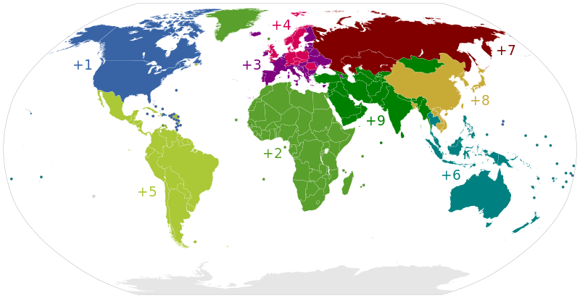
Country dialing codes

Slide 27
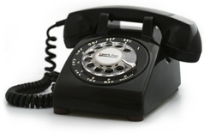
Architecture 1: tree
registry
registrar
# assignee

Slide 28
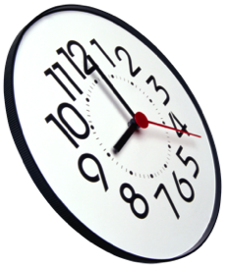
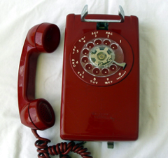
Architecture 2: mesh + tree
global
time
registry
assumed to be cooperative
example: TV whitespace DB, LoST (NG911)
registry
registry
registrar
registry
# assignee
everybody has same information
same state within N (7?) seconds
revived nodes can catch up

Slide 29
Number meta-data (examples)
Data element | Comments
E.164 number | key
OCN | several for different media & geographic scope?
URL | routing URL
Expiration date | if records expire
Type of number | mobile, landline (TCPA), prison, hotel
Media | voice, video (ASL!), text
Rough location | e.g., ZIP+4 (for 311)
Public key | for STIR
whois record | similar to domain name?
Log entries (who, what, when) | need to be visible?
?
most optional
Notes:
http://apps.fcc.gov/ecfs/document/view?id=7022117659

Slide 30
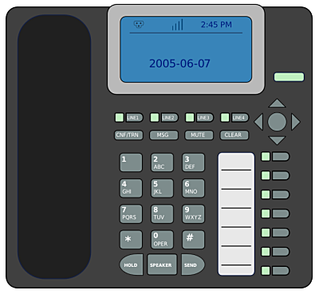
Porting: end user initiated
registry
NNSP (N)
“change 212 555 1234
OCN to N”
ONSP
notification:
212 555 1234
wants to change OCN to N”

Slide 31
IETF MODERN
“Birds of a Feather” meeting held at Dallas IETF 92 meeting
General interest in exploring protocol space
Also: ATIS document on protocol testbed

Slide 32
IETF MODERN charter
The MODERN working group will define a set of Internet-based mechanisms for the purposes of managing and resolving telephone numbers (TNs) in an IP environment. … The traditional model of a TN having an association to a single service provider and a single application is breaking down. … its use as an identifier for an individual or an organization will remain for some time. Devices, applications, and network tools increasingly need to manage TNs, including requesting and acquiring TN delegations from authorities. A sample of problems with existing mechanisms include:
lack of flexibility (for example, it can be difficult to add fields without a very elaborate and lengthy process typically spanning years)
lack of distribution (for example, it is hard or impossible to have more than one administrator for each database)
complexity (leading … to … rural call completion problems …)
difficulty of adopting more modern allocation (e.g., "blocks" of 1) and porting mechanisms

Slide 33
IETF MODERN charter
The work of this group will focus on TNs, as defined in RFC3966, and blocks of TNs, that are used to initiate communication with another user of a service. … There is an expectation that aspects of the architecture and protocols defined by the working group will be reusable for other user-focused identifiers. …. Solutions and mechanisms created by the working group will be flexible enough to accommodate different policies, e.g., by different regulatory agencies.
An architecture overview, including high level requirements and security/privacy considerations
A description of the enrollment processes for existing and new TNs including any modifications to metadata related to those TNs
A description of protocol mechanisms for accessing contact information associated with enrollments
A description of mechanisms for resolving information related to TNs

Slide 34
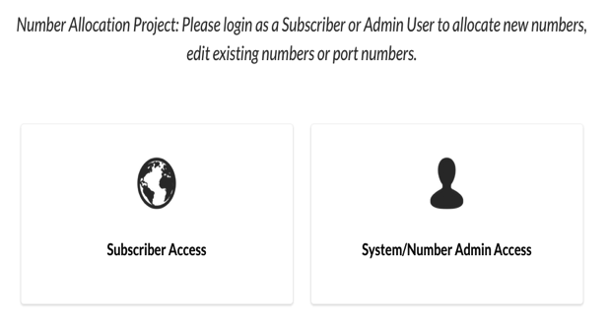
Pre-MODERN prototype
Student semester prototype (Akhilesh Mantripragada & Abhyuday Polineni, Columbia Computer Science)
Try it yourself: north.e164.space
Fully distributed cloud-based system (currently, 3 servers)
Ensures that only one entity can access a number at one time
  resolves simultaneous access by majority vote
No single point of failure
PIN-based porting model
  consumer gets or sets PIN via web page
  provides PIN to gaining carrier

Slide 35
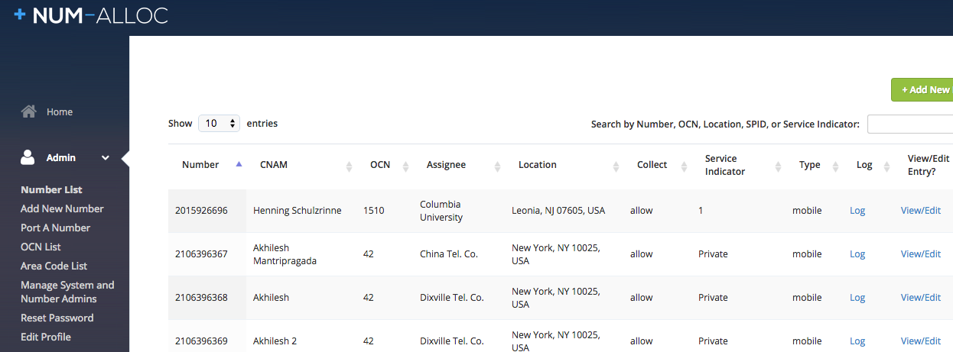
Prototype

Slide 36
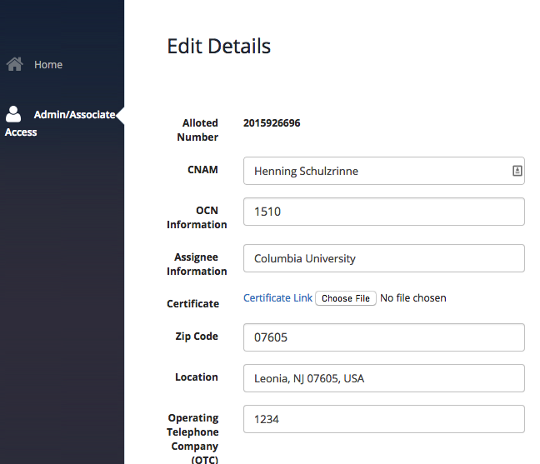
Prototype

Slide 37
Reducing Public Nuisance #1

Slide 38
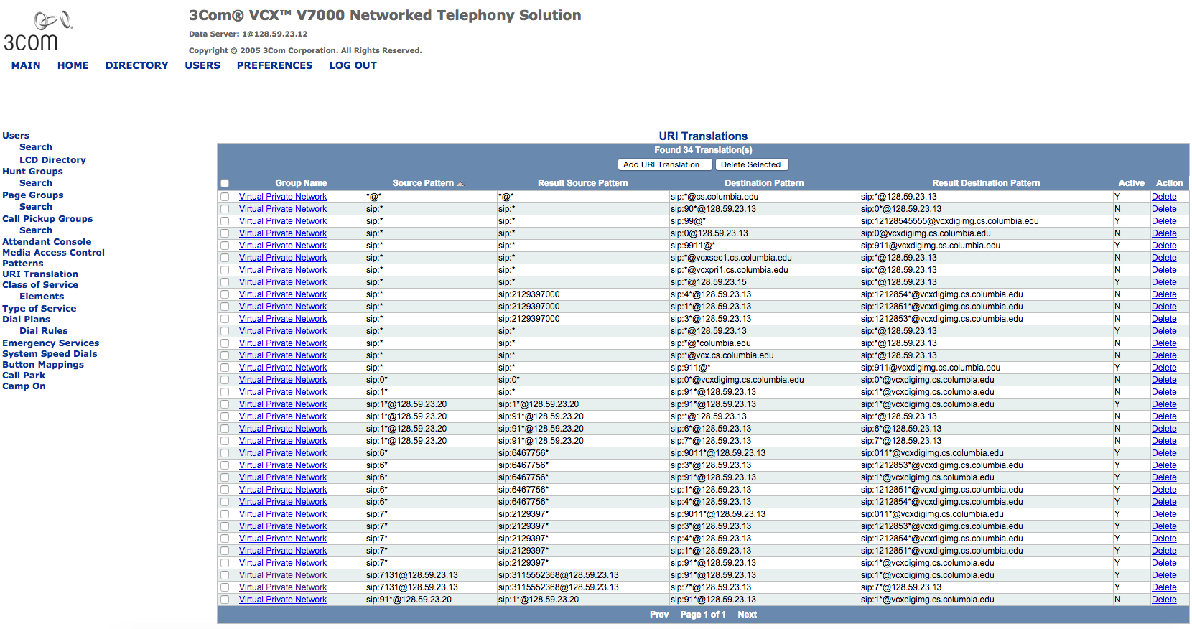


Slide 39
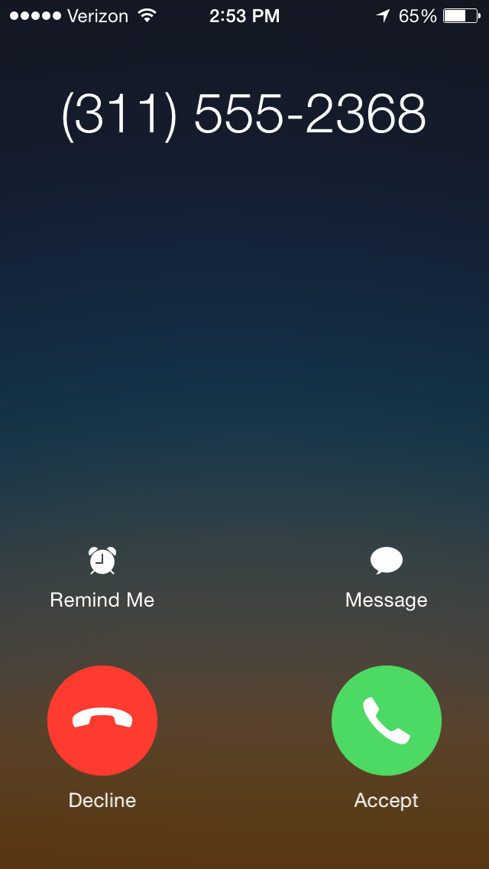
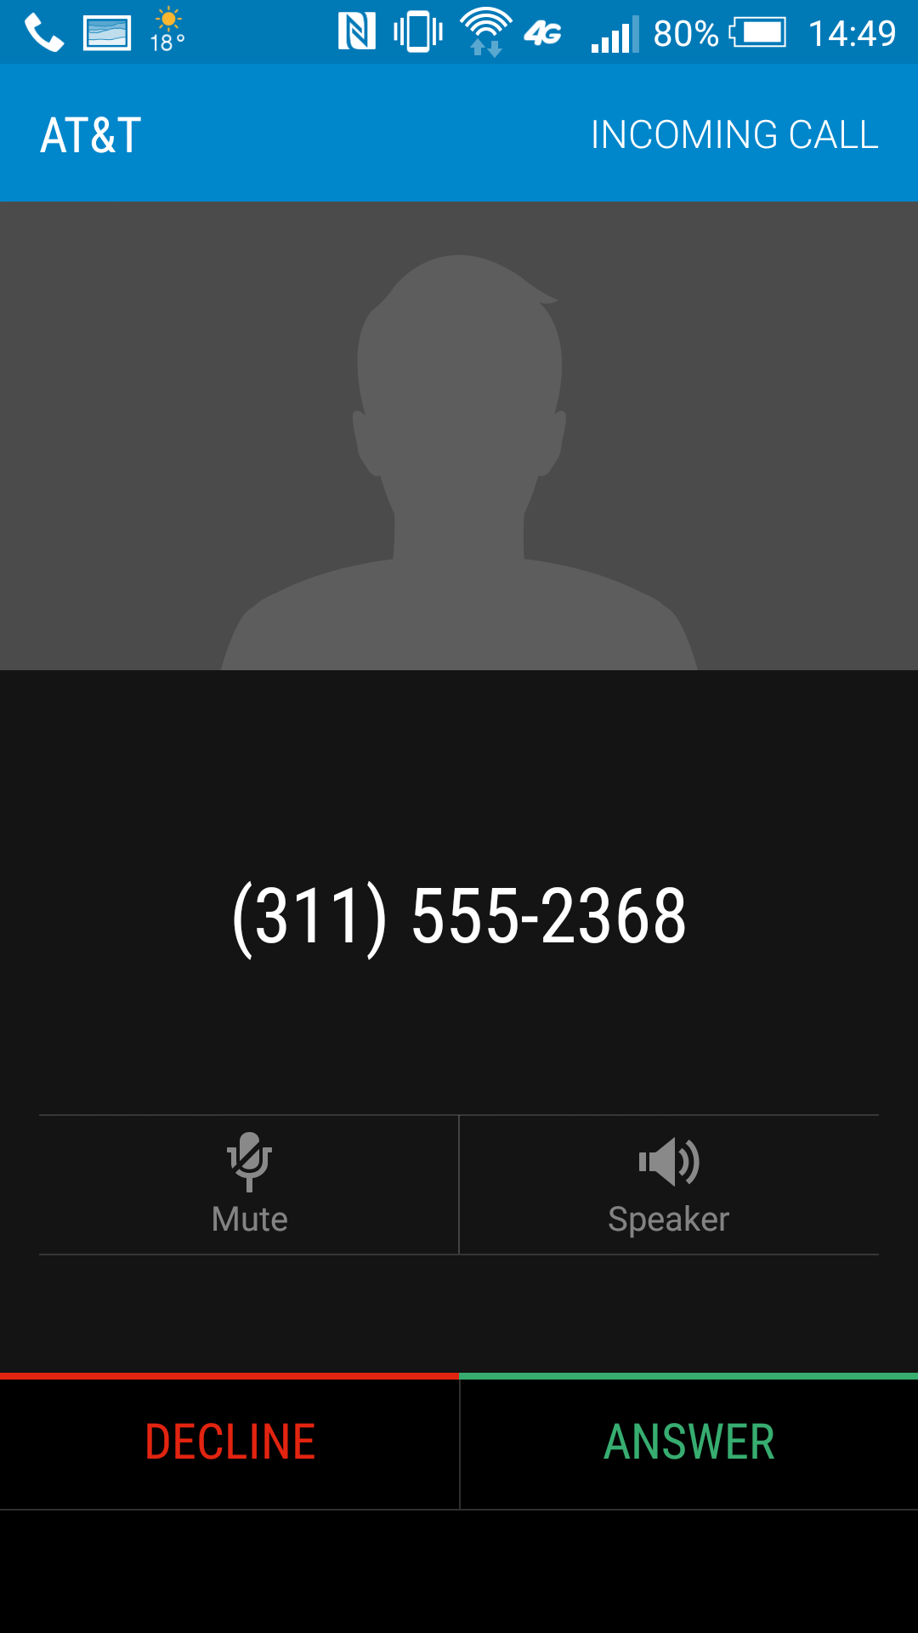

Slide 40

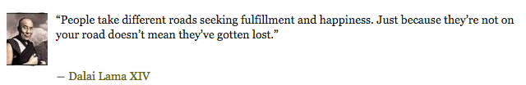
Robocalls: 7 Roads to Happiness
Prevent caller ID spoofing
  STIR
Clean up CNAM
  identify data sources
  more information
Allow consumer-driven filtering
  unwanted vs. illegal calls
Ensure interconnection works
  signature must survive interconnection
  SIP display name must survive
APIs for third-party filtering
Apps for smartphones
Do Not Originate as a short-term measure

Slide 41
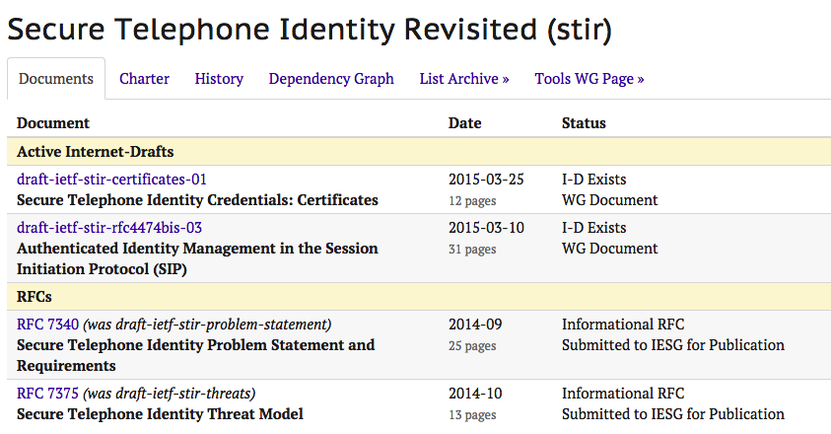
STIR (number signing) status

Slide 42
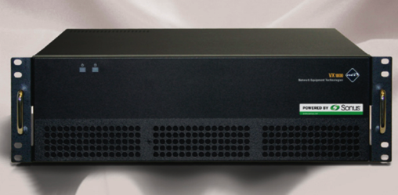

Do Not Originate (DNO)
Premise: almost all illegal robo-calls originate on VoIP
Thus, gateways as filter for numbers that shouldn’t be there (e.g., IRS or banks)
SS7
VoIP
“legacy” carriers that don’t interconnect via VoIP
“Do not originate” list
of numbers
(e.g., PSAP DNC list)

Slide 43
DNO: How do numbers get onto the list?
911 DNC list
Financial institutions
Government agencies
NANPA: unassigned numbers
TDM carrier numbers
Facilities-based VoIP (with own gateways)
OTT VoIP (except for contracted GWs)

Slide 44


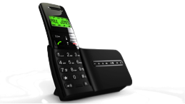



Automated call blocking
for vulnerable populations, allow only:
address book entries
government agencies
medical providers
emergency alerts
multiple 3rd party
providers
in black list?
in white list?
N
maintain
lists
Y
Y
N
designated trusted
third party
report
illegal robocalls

Slide 45
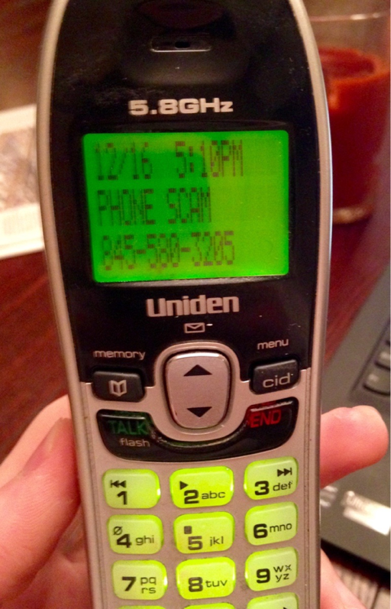
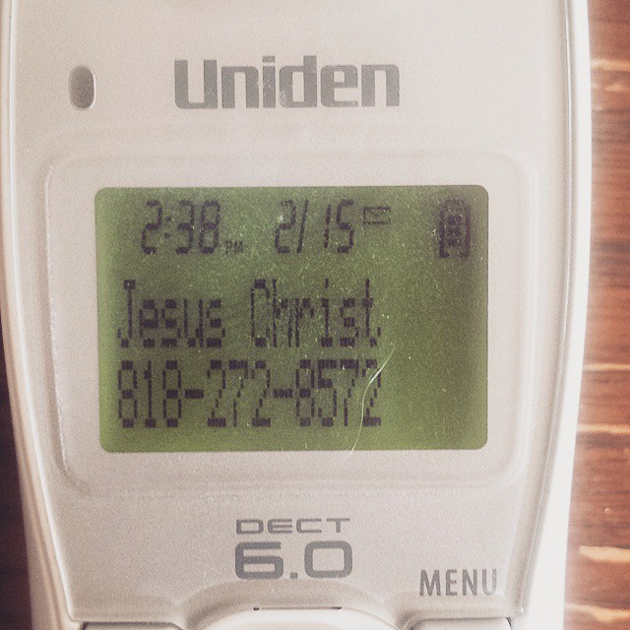
Caller name (CNAM) improvements
15 character limit
  mostly due to legacy displays and Bell 202 1200 baud modems?
  signaling allows larger data elements
Disallows
  full names → awkward abbreviations
  more information – caller name and affiliation (“John Doe, Acme Corp., Chicago”)
  no credentials (license, registration)
Architecture issues
  multiple providers → difficult to correct errors or prevent impersonation
  CNAM dip fees → kickback schemes that enable robocalling
  unclear provenance of information

Slide 46
911 in an all-IP world

Slide 47
911 deployment challenges
Three movies, same plot:
  Phase II location (cellular)
  Text-to-911
  NG911
Reasons for delay include:
  bottom-up deployment → consultant employment guarantee
  local control → local technology assets
  no regional, state or national funding mechanisms
  often, no state leadership
  slowest PSAP determines speed
  limited technical expertise at grass roots level
  uncooperative carriers (“Selective routers forever!”)
  unclear responsibility boundaries between carriers and PSAPs/ESInets

Slide 48
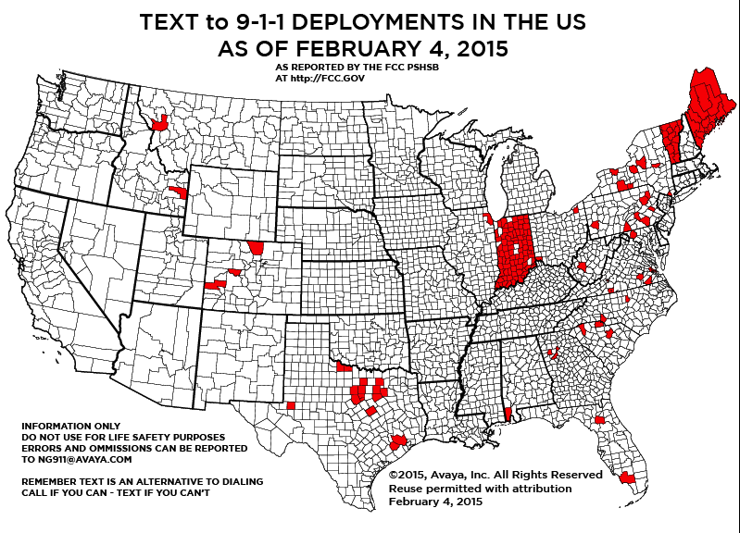
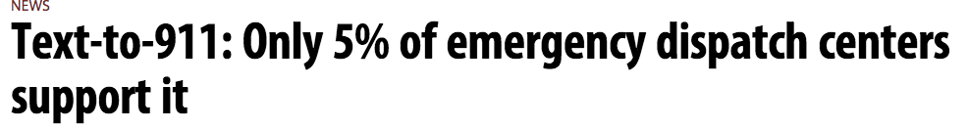
Text-to-911
M. Fletcher, Avaya

Slide 49
Caller location
Builds on long history of FCC location accuracy requirements
  implicitly outdoor: 50m (67%)/150m (80%-90%) circles (1996), with geographic exclusions
dispatchable location or x/y within 50 m
  ~70% calls are wireless
  unknown % indoor
  residential indoor may allow GPS
z axis:
  3 years: uncompensated barometric
  6 years: 80% of top 25 CMAs
open issues:
  nomadic iVoIP
  separation of location & call delivery

Slide 50

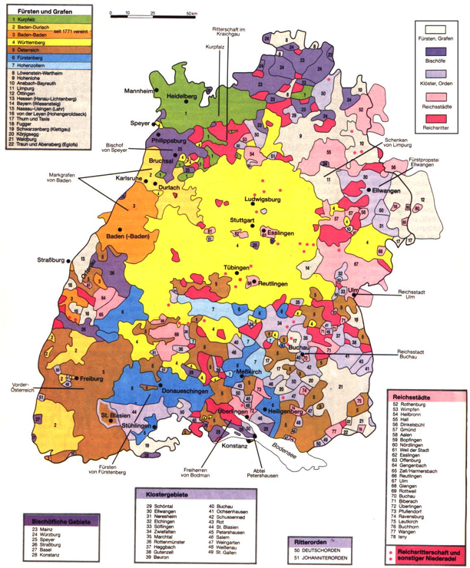
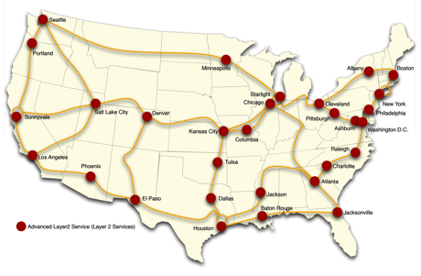
Alternative 911 network models
Current deployment model
  network islands (ESInets) with SBC moats
  one county, one network, one server rack, one purpose, one decade
Similar to early academic Internet → Internet2
  initially custom, then re-use dark fiber
  membership model?
Suomenlinna

Slide 51







Alternative network models
national network(s)
LIS
LoST
VPNs
major network interconnect points:
SEA, LAX, SJC, DEN, CHI, BOS, DC, NYC

Slide 52
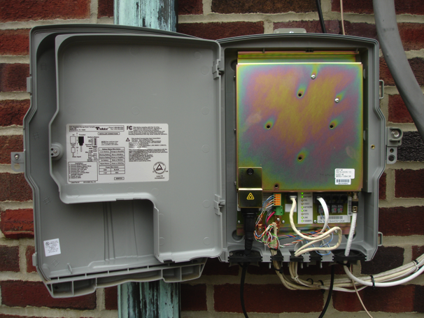
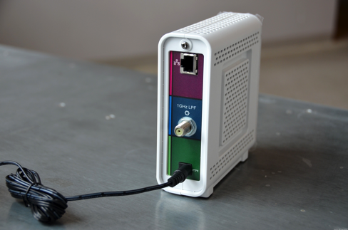

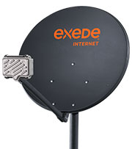
Alternative network models
old model: one 99.999% network
new model: 7 99% networks → 99.99999999999999% (in theory…)
4x

Slide 53
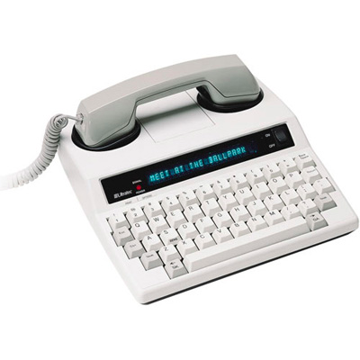
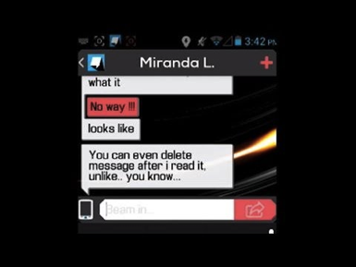
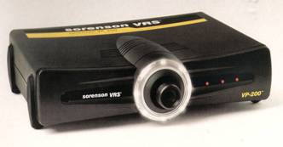



Functionally-equivalent communication
direct video communication
automated
speech-to-text
human-assisted
ASR

Slide 54
Conclusion
Hard parts of the IP transition:
  require intra/inter-industry coordination
  limited incentive to change (for some)
  limited willingness to invest
  waning skill sets
  all blame, no credit
If you don’t just want to be a bit pipe, create valuable services
  user controllable
  not just a nuisance (“I don’t pick up my phone any more”)

Slide 55
Backup

Slide 56

LERG
Operating Company Numbers, Company Names, Routing Contacts
Country Code Assignments
NPA Information (i.e., Area Codes)
LATA Codes By Region
Destination Codes (i.e., NPA NXX and Thousands-Blocks) (details on over 750,000 assignments)
Oddball NXXs (e.g. 911, 976)
Switching Entity Record detail (e.g. Equipment Type, V&H Coordinates)
Rate Center details (e.g. V&H Coordinates) and Localities (including county and postal codes)
Switch Homing Arrangements (tandem and other switch-to-switch interconnections)
Operator Access Tandem Codes (ATCs)
Location Routing Numbers (LRNs)
Notes:
http://www.trainfo.com/products_services/tra/catalog_details.html

Slide 57

Number porting models: token
registry
Transfer:
  registrar 1 → registrar 2
Porting:
  provider 1 → provider 2 (in EPP, that’s an <update>)
Token model (“AuthInfo” in EPP)
  current registrar provides secret token to assignee
    or assignee inserts random token via registrar
  assignee provides token to gaining registrar/carrier
  Oauth bearer token (RFC 6750)?
example.com
pw123
<transfer>
pw123
losing registrar
gaining registrar
pw123
Notes:
http://hraunfoss.fcc.gov/edocs_public/attachmatch/FCC-10-85A1.pdf (2010)

Slide 58
Porting: confirmation-based
registry
❶ “transfer
212 555 1234 to me”
❷ notification
❸ response
(agree, contest?)
NNSP
(N)
ONSP
(O)

Slide 59
Key management options
Number validation
Public key only (e.g., DNS)
public
private
X.509 cert
single certifier (per CC)
multiple certifiers per CC
single cert store (hierarchy)
any cert anywhere
separate delivery (URL)
single “CDN”
number-based access (no URL)
almost all of these could interoperate in single system

Slide 60
Certificate models
Integrated with number assignment
  assignment of number includes certificate: “public key X is authorized to use number N”
  issued by number assignment authority (e.g., NPAC), possibly with delegation chain
    allocation entity → carrier (→ end user)
separate proof of ownership
  similar to web domain validation
  e.g., similar to Google voice validation by automated call back
    “Enter the number you heard in web form”
  Automate by SIP OPTIONS message response?

Slide 61
Residential access
Notes:
http://apps.fcc.gov/ecfs/document/view?id=60001090571

Slide 62


International routing
+1
+49
+223
+998
about 230 cc’s
URL
service provider
entry points rarely change → static table

Slide 63
State transitions
Spare
Working
Expired
Transitional
(cannot be re-assigned)
Reserved
(cannot be allocated)
800#: Spare, Reserved, Working, Transitional, Disconnect
domain names: expired, redemption grace period (RGP), pending delete
Notes:
http://www.fatcow.com/knowledgebase/read_article.bml?kbid=297

Slide 64


Complexity kills
IMS
Notes:
http://voices.canonical.com/jussi.pakkanen/files/2012/01/synaptics-statemachine.png
http://upload.wikimedia.org/wikipedia/en/9/9c/TISPAN_IMS_Reference_Architecture.png

Slide 65
How to ensure correctness
Distribution of changes → gossiping
  see LoST
Allocation of new numbers & changes → avoid collisions
  block chain model
  Paxos, Raft and variants
    Alice: “may I allocate number/number block X”?
    Other nodes: “please go ahead, Alice” → quorum
    Alice: “please change property Y of X to V”
    Other nodes: “done”
Recovery
  new or revived replicas can catch up to changes
    transaction log
    relatively easy with timestamps (“tell me about changes after T”)

Slide 66
Robocall prohibitions
 | Wireline residential | Wireline business | Wireless (mobile)
not on DNC | pre-recorded TM | no restriction | pre-recorded non-emergency auto-dialed non-emergency
on DNC | any TM | any TM | any TM pre-recorded non-emergency auto-dialed non-emergency

Slide 67
How to prevent…
Content | Method | Wireline residential | Wireline business | Wireless (mobile)
Telemarketing | Manual | DNC | DNC | DNC
 | Auto-dialed | DNC | DNC | ❌
 | Pre-recorded | ❌ | DNC | ❌
Informational (including political, charity, polling) | Manual | can’t prevent | can’t prevent | can’t prevent
 | Auto-dialed or pre-recorded | opt-out | opt-out | ❌
Emergency | Any | permissible | permissible | permissible
Note: DNC does not cover calls from companies with which the customer has an existing
business relationship.

Slide 68

Validation: assignment with delegation
Reseller
Carrier
web
service
web
service
private key
{1544, PuK_{1,} gov}
{1544, PuK_{1,} gov}
{1544, PuK_{1,} gov}
public key
PuK₁
Reseller authenticates
Customer using normal auth (cert, HTTP Basic, API key, …)
same for carrier
Customer generates key pair, doesn’t share private key with anyone
registry
Number | PuK | Prop
202 418 1544 | PuK₁ | .gov
212 939 7042 | PuK₂ | .edu
similar for certificate → CSR

Slide 69
Improving caller name reliability
Textual caller ID used more than number by recipients
Generation of caller name varies:
  Various CNAM/LIDB databases: CPN → name
  Some from caller carrier, some third-party (reduce dip fees)
  Can be generated by third party
Change with VoIP: end-to-end delivery
  basic name, with attribution (“based on business record”, “self-asserted”)
  additional information (“FDIC-registered”, “accredited health care facility”, “registered charity”

Slide 70
Generational surprises
Generation | Expectation | Surprise
2G | better voice quality (“digital!”) | SMS
3G | WAP | web
4G | IMS | YouTube, WhatsApp
5G | IoT (low latency) | ?
underestimated cost and fixed-equivalence as drivers

Slide 71



IMS /VoLTE
IMS = It Mostly Speaks
VoLTE = Voice-Only Later than Expected

